Slide 1
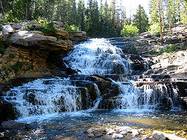
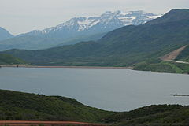
Comparison of Streamflow and Precipitation in the Provo River Watershed
CEE 6440
By: Steven McKee

Slide 2
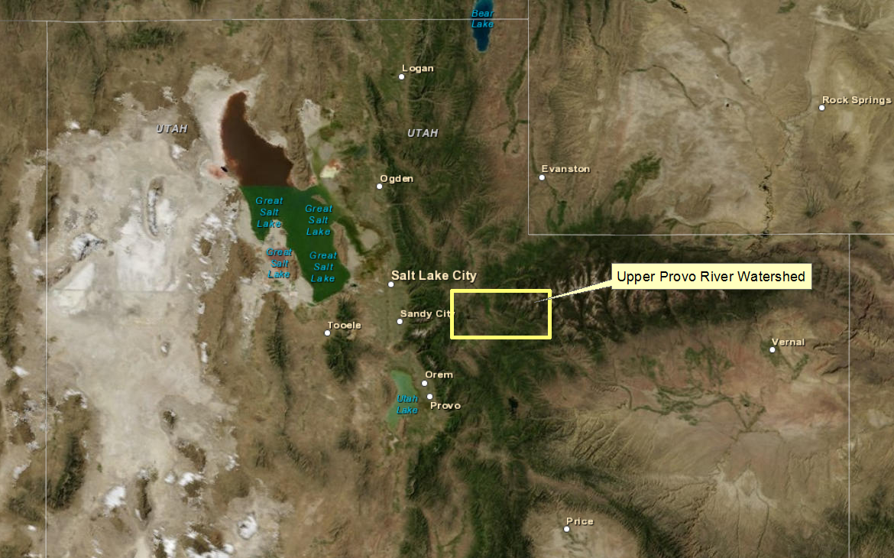
Objective and Location
To determine the regional runoff ratios by comparing precipitation and streamflow.

Slide 3
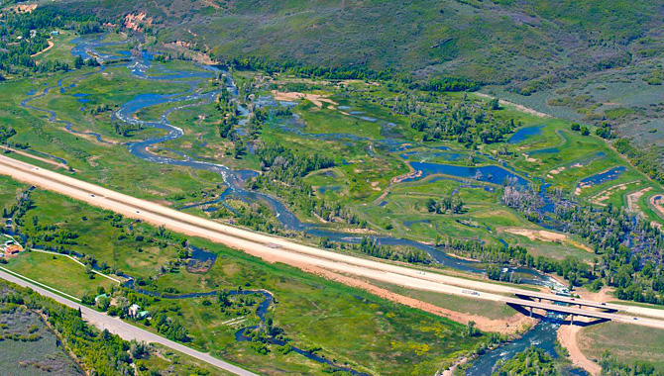
Analysis Steps
Streamgage and Streamflow Data
Watershed Delineation
Precipitation Data
Jordanelle Reservoir Data
Runoff Ratios

Slide 4
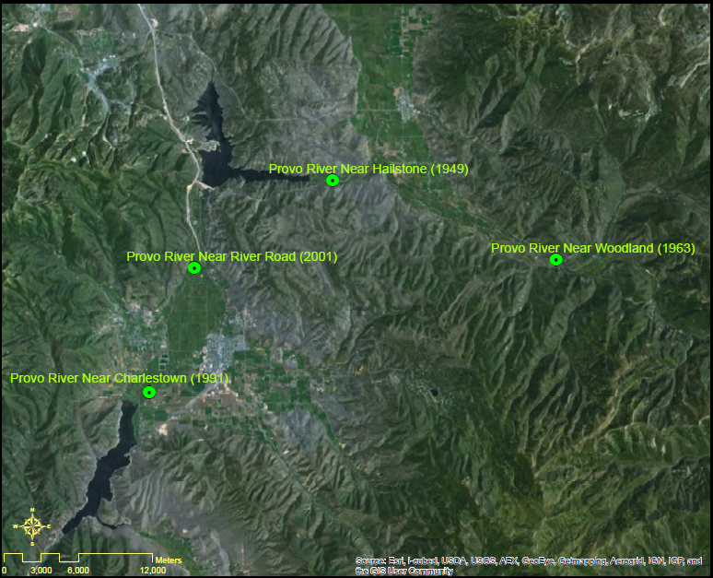
Streamgages

Slide 5
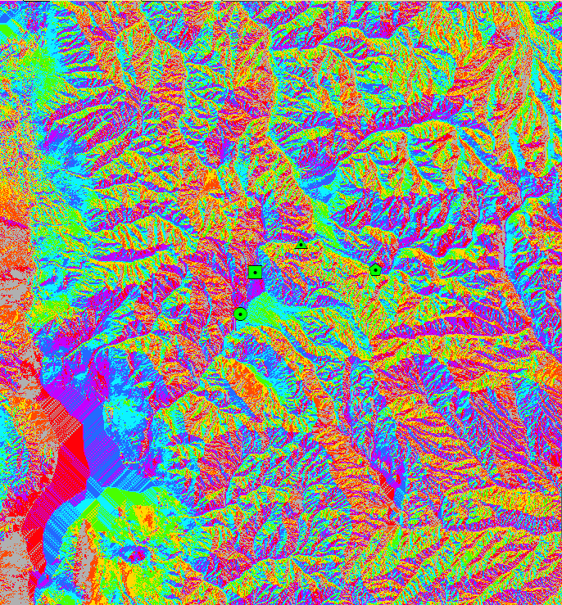
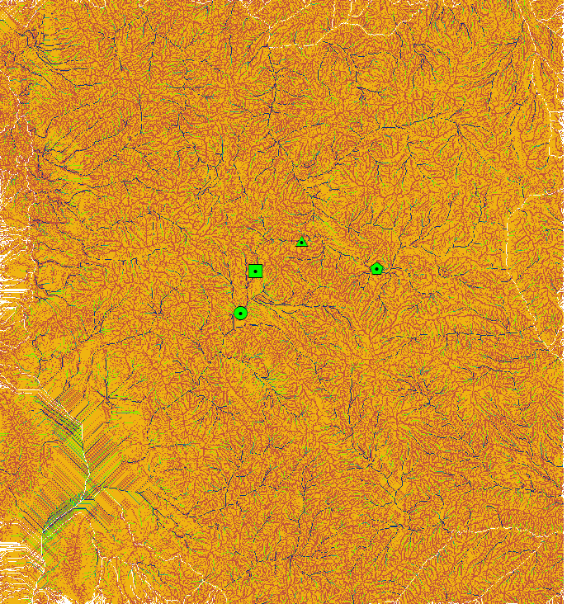
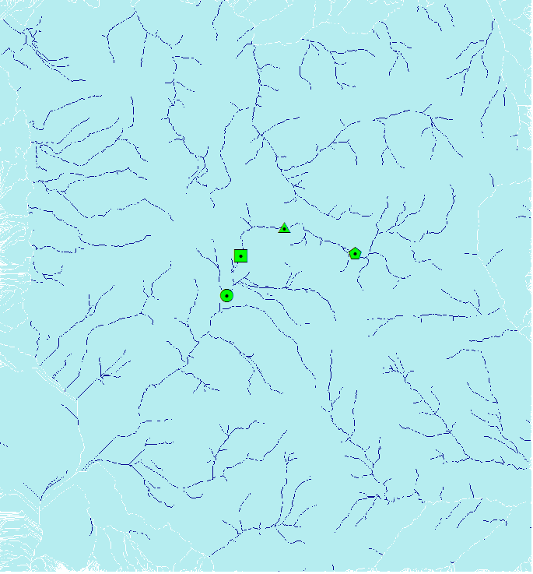
Watershed Delineation with TauDEM Tools

Slide 6
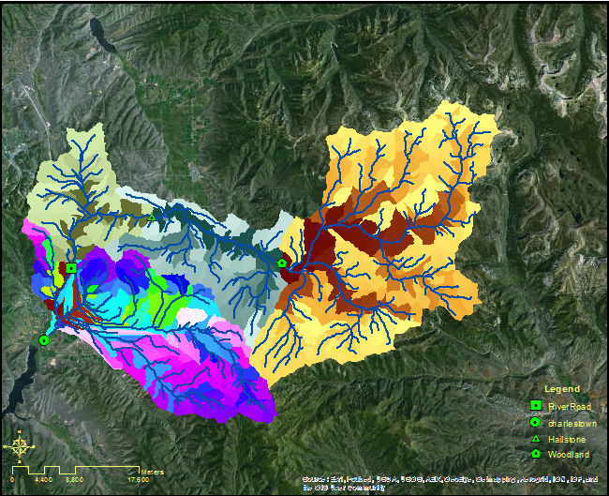
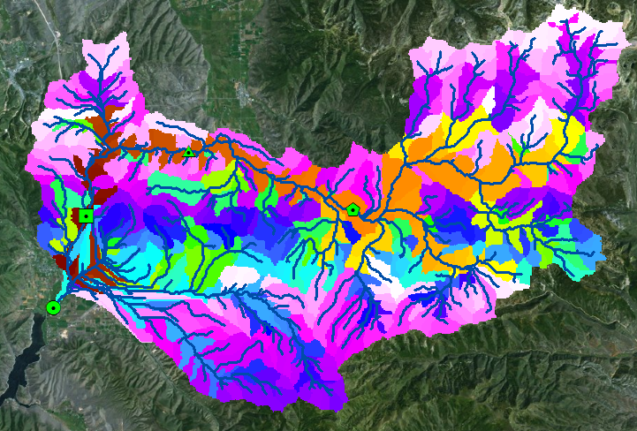
Watershed Delineation with TauDEM Tools

Slide 7
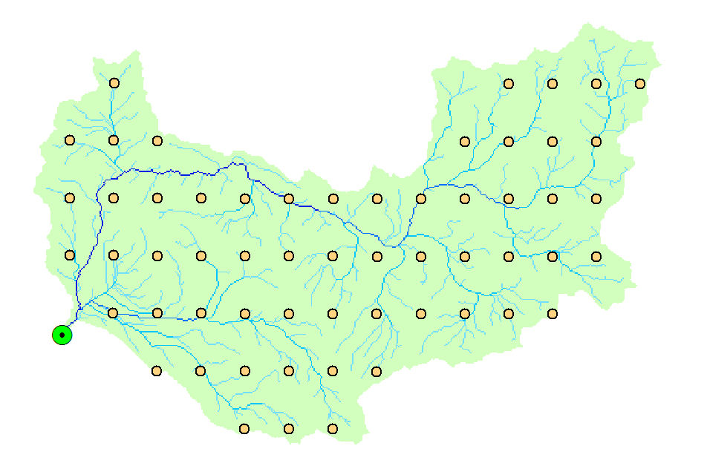
Precipitation Data
ArcMap and R used to extract PRISM Data (Oregon State University).

Slide 8
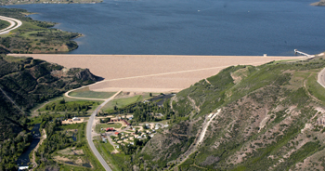
Runoff Ratio Calculations
r = q/P
Where r= runoff ratio (dimensionless)
q= Q/A, where Q=average streamflow in cubic feet/year and area in cubic feet.
P=Average precipitation in feet/year.
Streamflow Upstream and Downstream of Reservoir

Slide 9
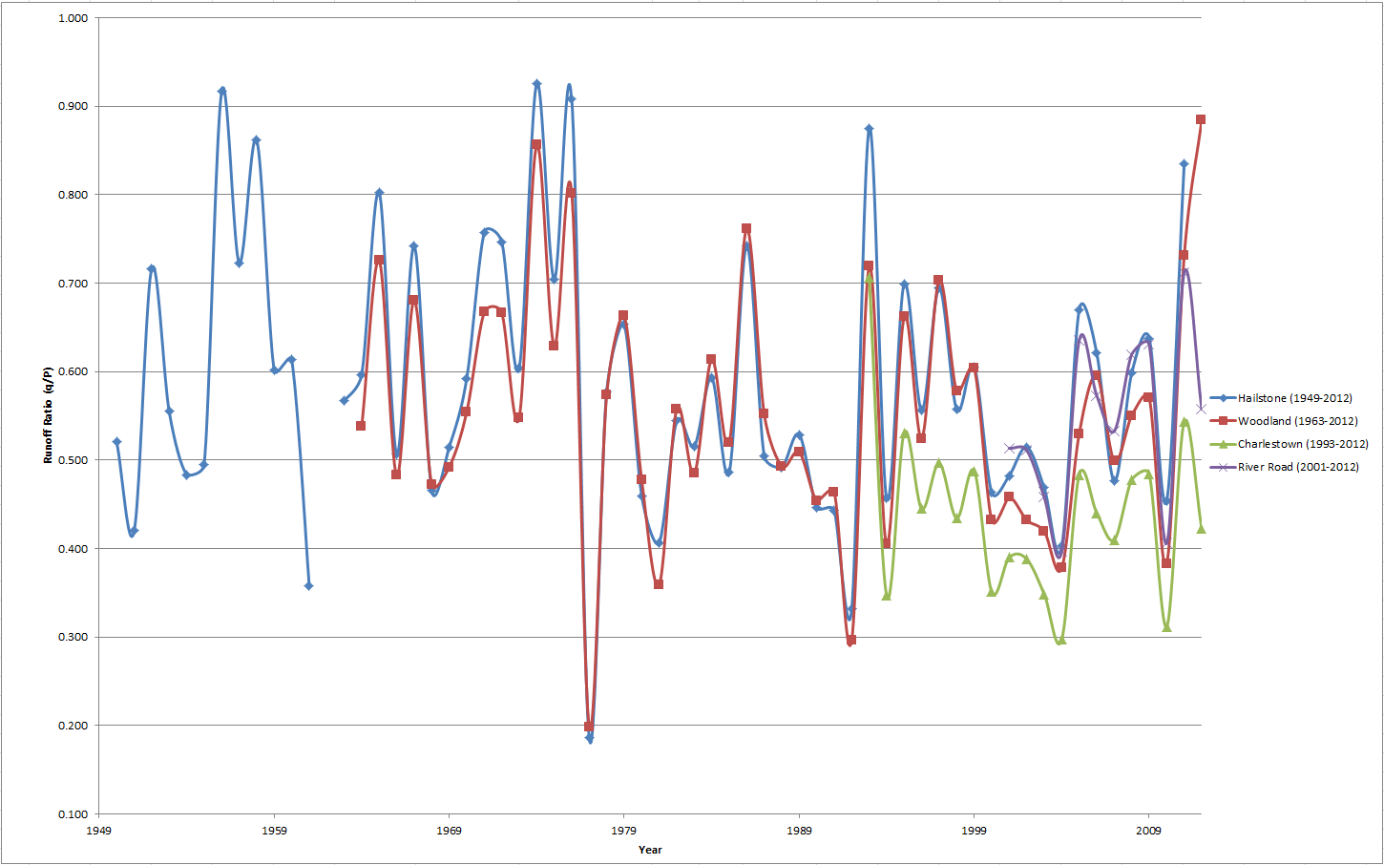
Runoff Ratio Comparison

Slide 10
Conclusions
Runoff ratios vary from year to year.
Runoff ratios relatively uniform from one gage to another.
Uncertainty in Analysis
Time periods with only one gage.
Charlestown streamflow assumption.

Slide 11
Sources
Bureau of Reclamation (2012). “Jordanelle Reservoir.”<http://www.usbr.gov/projects/Facility.jsp?fac_Name=Jordanelle%20Dam> (November 26, 2012).
Bureau of Reclamation (2012a). “Jordanelle Reservoir.” <http://www.usbr.gov/projects/Facility.jsp?fac_Name=Jordanelle%20Dam> (26 November 2012).
Bureau of Reclamation (2012b). “Jordanelle Reservoir Inflow/Outflow.” <http://www.usbr.gov/uc/crsp/GetSiteInfo> (November 21, 2012).
Oregon State University (2012). “PRISM Products Matrix.” <http://www.prism.oregonstate.edu/products/matrix.phtml> (13 November 2012).
USGS (2012a). “National Water Information System.” USGS surface water statistics.
<http://waterdata.usgs.gov/ut/nwis/current/?type=flow> (1 November 2012).
USGS (2012b). “National Map Viewer.” 10 and 30 m Digital Elevation Models (DEM).
<http://viewer.nationalmap.gov/viewer/> (15 November 2012).
Utah Lake Commission (2012). “Delta Upgrades equal Healthier lake and more fun time.” Image. <http://utahlake.gov/delta- upgrades-equal-healthier-lake-and-more-fun-time/> (November 26, 2012).
Utah State University Hydrology Research Group (2010). “Terrain Analysis Using Digital Elevation Models (TAUDEM).” <http://www.prism.oregonstate.edu/products/matrix.phtml> (5 November 2012).
Wikipedia (2012). “Jordanelle Reservoir .” Image.<http://en.wikipedia.org/wiki/Jordanelle_Reservoir> (November 25, 2012).

Slide 12
Questions

