Slide 1
Hyrum Reservoir and how it applies to Flood Control by Nathan Wright
Objective: Develop a ratio of snow water equivalent to stream flows and characterize Hyrum Reservoir as a Flood Control Device.
Watershed Delineation
Stream Flow
Snow Pack
Snow to Stream Flow ratio
Hyrum Reservoir and Flood Control

Slide 2
Location Map

Slide 3
Tools Used to Delineate Watershed
Pit fill
Flow Direction
Flow Accumulation
Watershed
Raster Calculator
Stream Link
Stream to Feature
Raster to Polygon
Stream Order

Slide 4
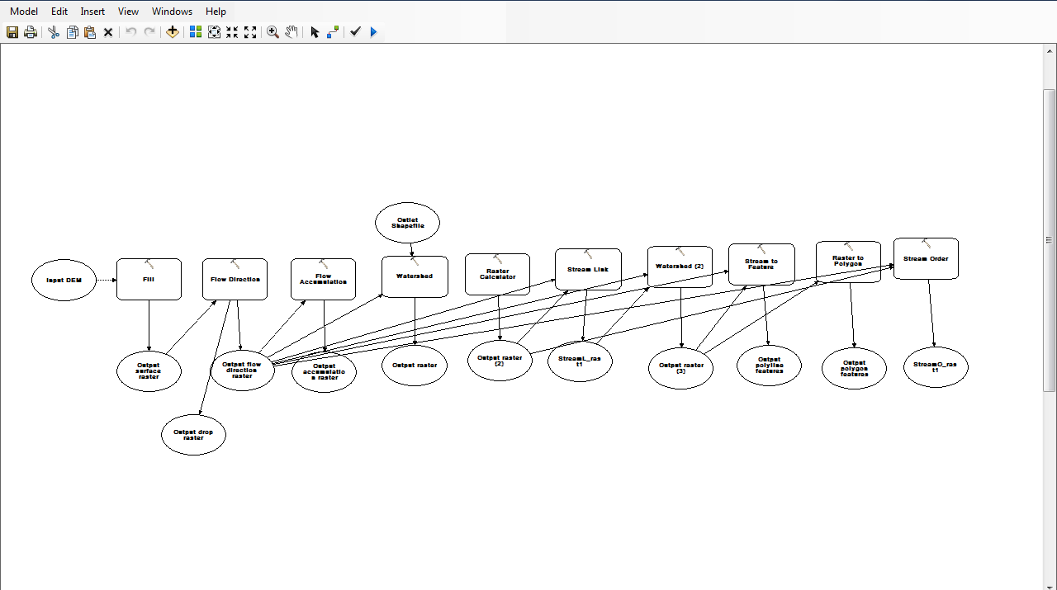

Slide 5
Stream flow Data
LITTLE BEAR RIVER AT PARADISE, UT

Slide 6
Stream flow Data

Slide 7
SWE vs. Elevation using Linear Regression
Raster Calculator to calculate SWE over watershed

Slide 8
Stream Flow vs. SWE
Compare Snowmelt Runoff Ratio at 3 different year:
Least Runoff Year
Mean Runoff Year
Max Runoff Year

Slide 9
Reservoir Routing
h
If h > Design Elevation, then release is maximum
If h ≤ Design Elevation, then release minimum downstream flow
If h < Dead Zone, then no release

Slide 10
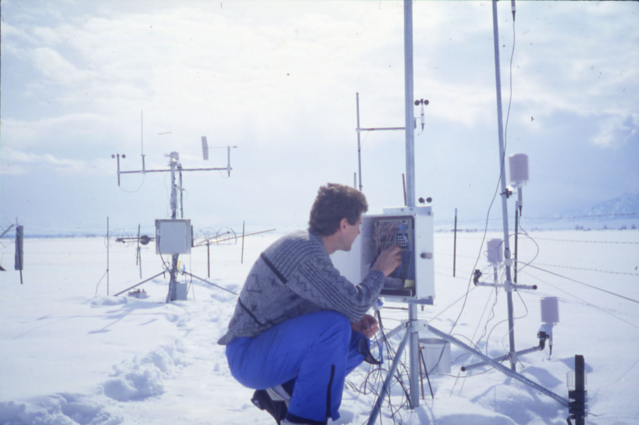
Questions?

