Slide 1
Optimal representation of Chlorophyll &Nitrogen content using high resolution imagery
Manal ELarab
GIS in Water Resources Term Project 2012

Slide 2
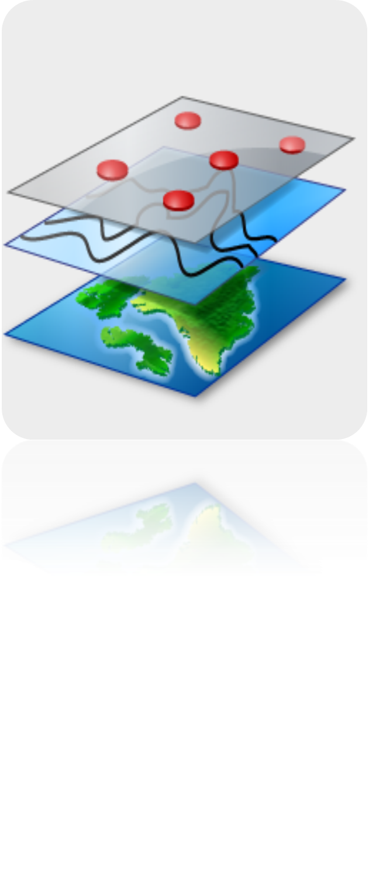
Outline
1. Study Area, data Collection
2. Objective & Motivation
  Time Series Interpolation
  Vegetative Indices Maps
  Linear Regression Analysis
  Chlorophyll Map
3. Conclusion

Slide 3
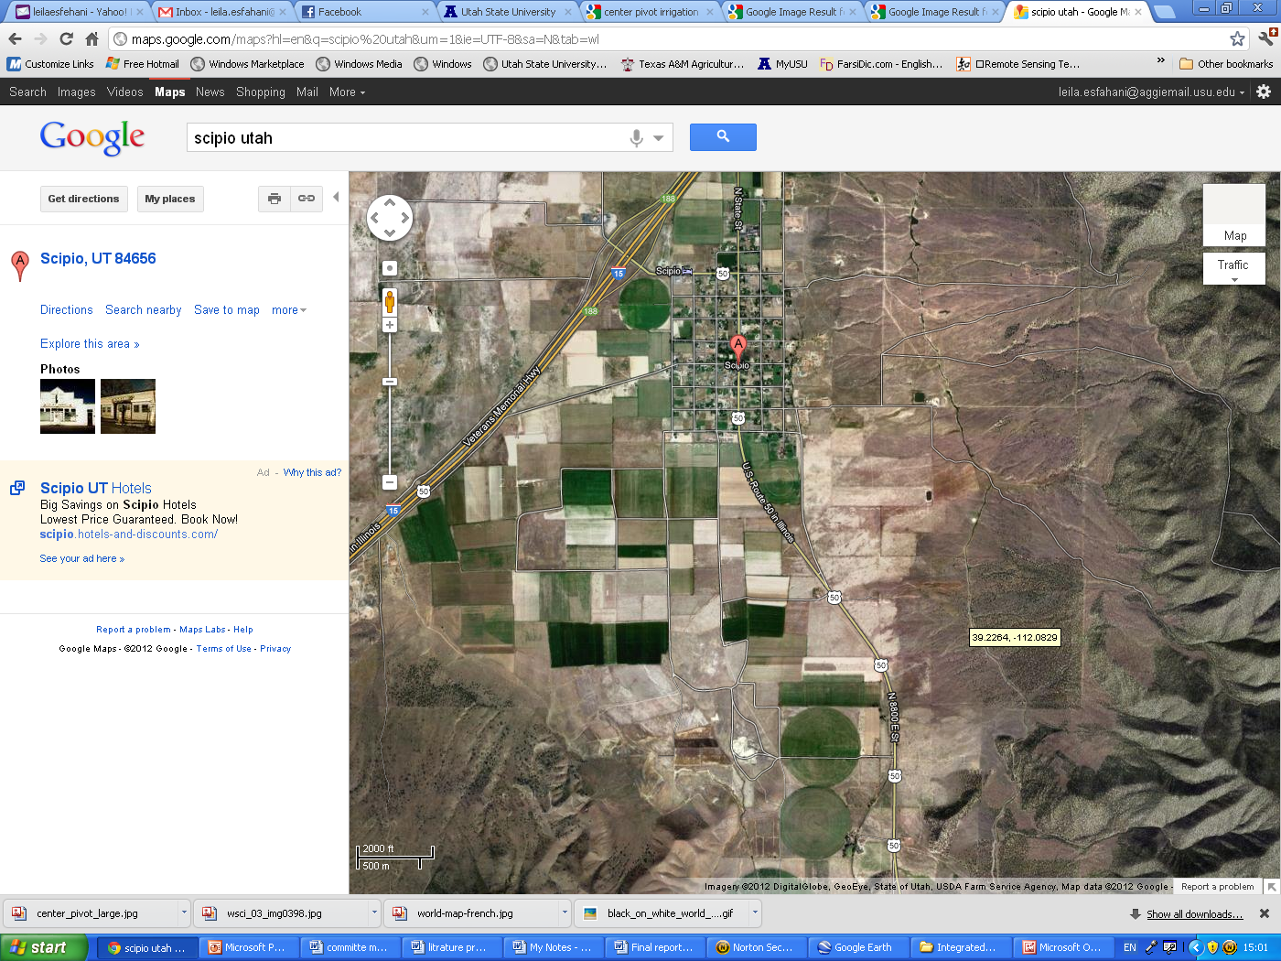
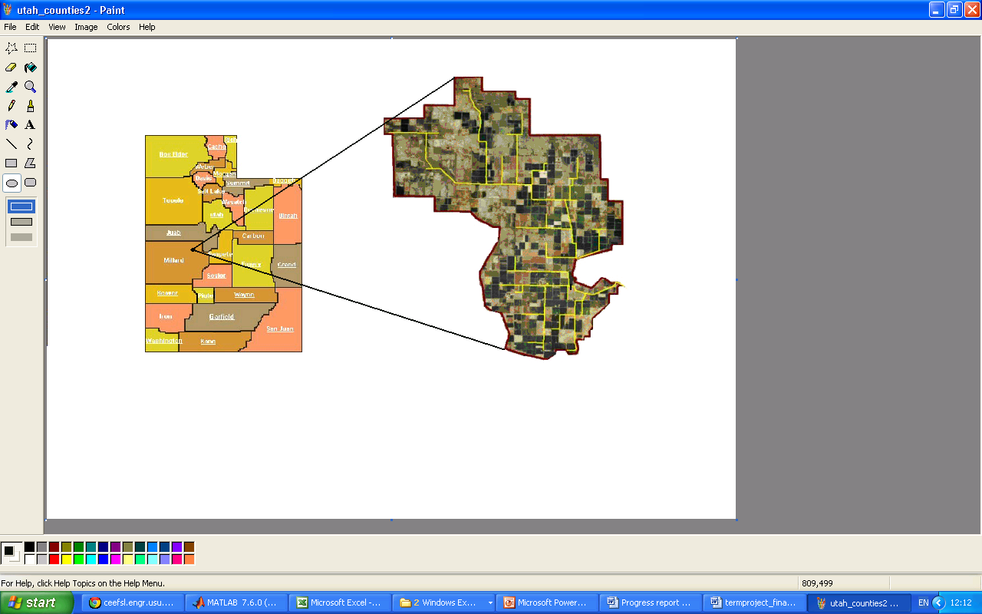
1. Study Area: Scipio
Millard County - Utah
HUC 16030005 (Lower Sevier)

Slide 4
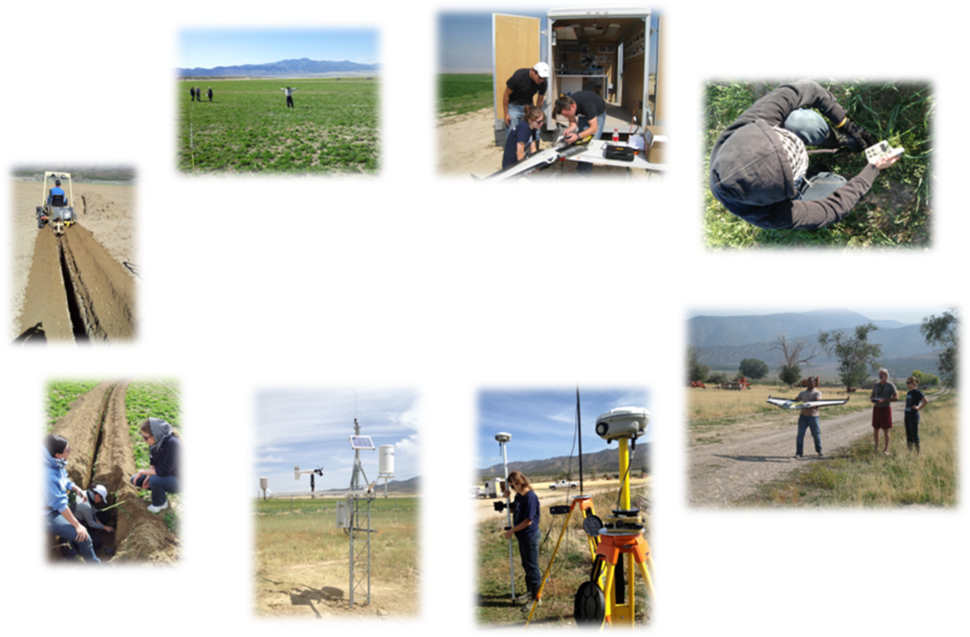
1. Data Collection

Slide 5
1. Data :
Soil & plant samples tested for Nitrogen
Chlorophyll reading
Decagon Sensors:
  Temperature
  Electrical conductivity
  Soil moisture at one and two feet
An RBG, NIR, Thermal image with resolution of 13cm*13cm

Slide 6
2. Objective
Visualize the data sets (T,EC,SM) and interpolate the rest of the field
Use the high resolution image to generate chlorophyll and soil Nitrogen maps
To investigate and develop precision agriculture techniques
Motivation

Slide 7
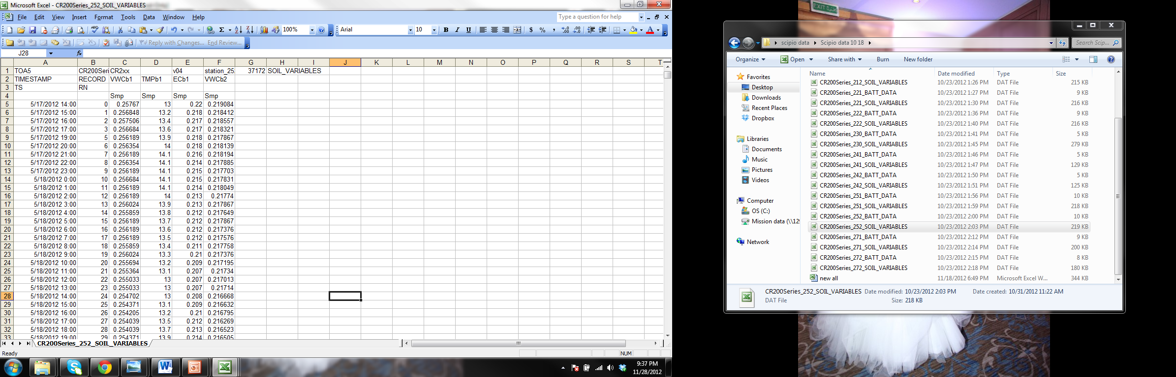
a. Time Series Interpolation
Data retrieved

Slide 8
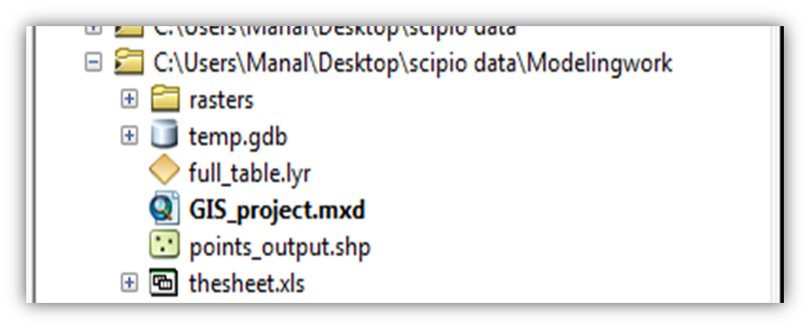
a. Time Series Interpolation
Created Geodatabase with feature classes
Added the excel table
Created a shape file that includes the location of samples and sensors
Joined the shape file and the excel table by creating a new field called “ID”
The new table is time enabled

Slide 9
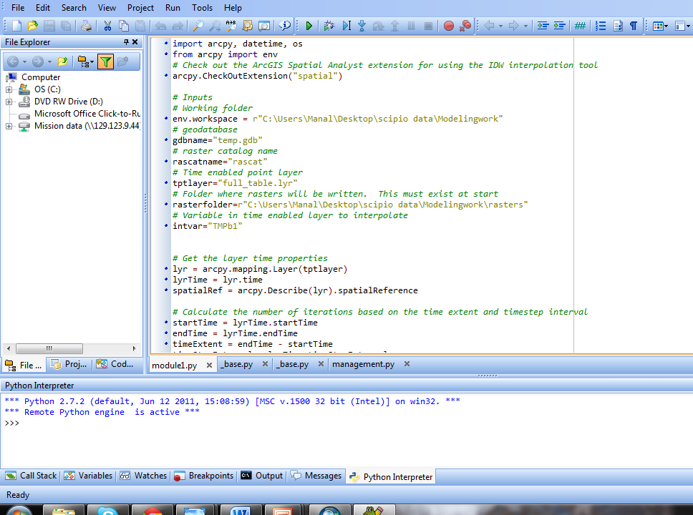
Time Series Interpolation
Ran the python script:

Slide 10
Iterate over time steps
Formulate the time query and increment
the time by the timeStepInterval
Create an in-memory feature layer
Create an interpolated raster surface
interpolation:
Do inverse distance weighted interpolation

Slide 11
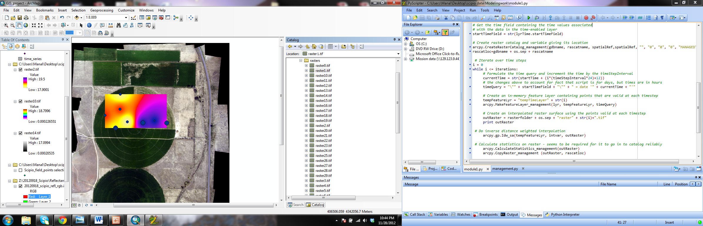

Slide 12
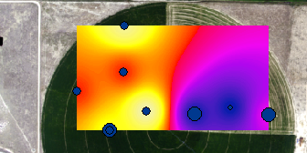
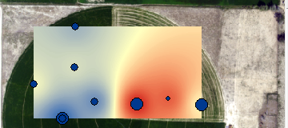
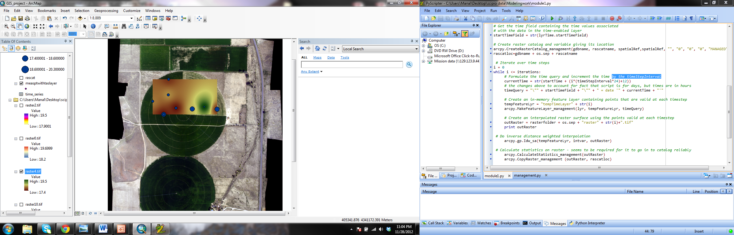
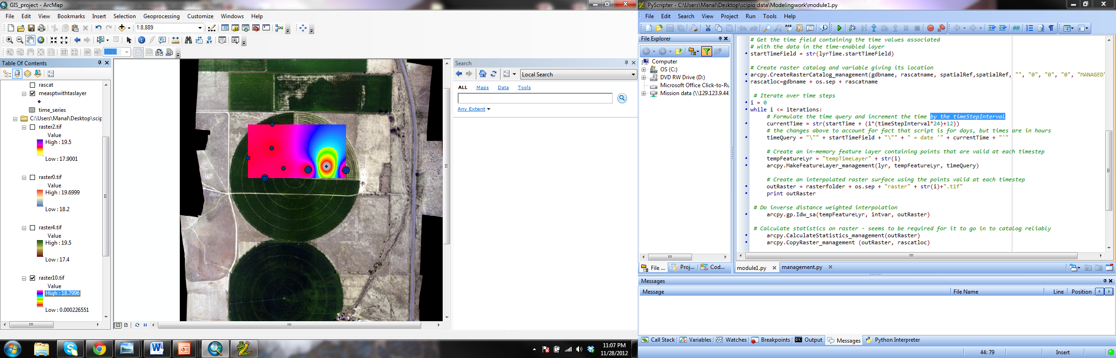
a. Time Series Interpolation
IDW interpolation of SM @ 2 feet
IDW interpolation of temperature
IDW interpolation of SM @ 1 foot
IDW interpolation of EC

Slide 13
b. Vegetative Indices Maps
The image is made up of 4 bands : RGB and NIR
Vegetative Indices: are combination of surface reflactance at two or more wavelengths designed to highlight a particular property of vegetation
Ex: NDVI, GNDVI, OSAVI, MCARI,……

Slide 14
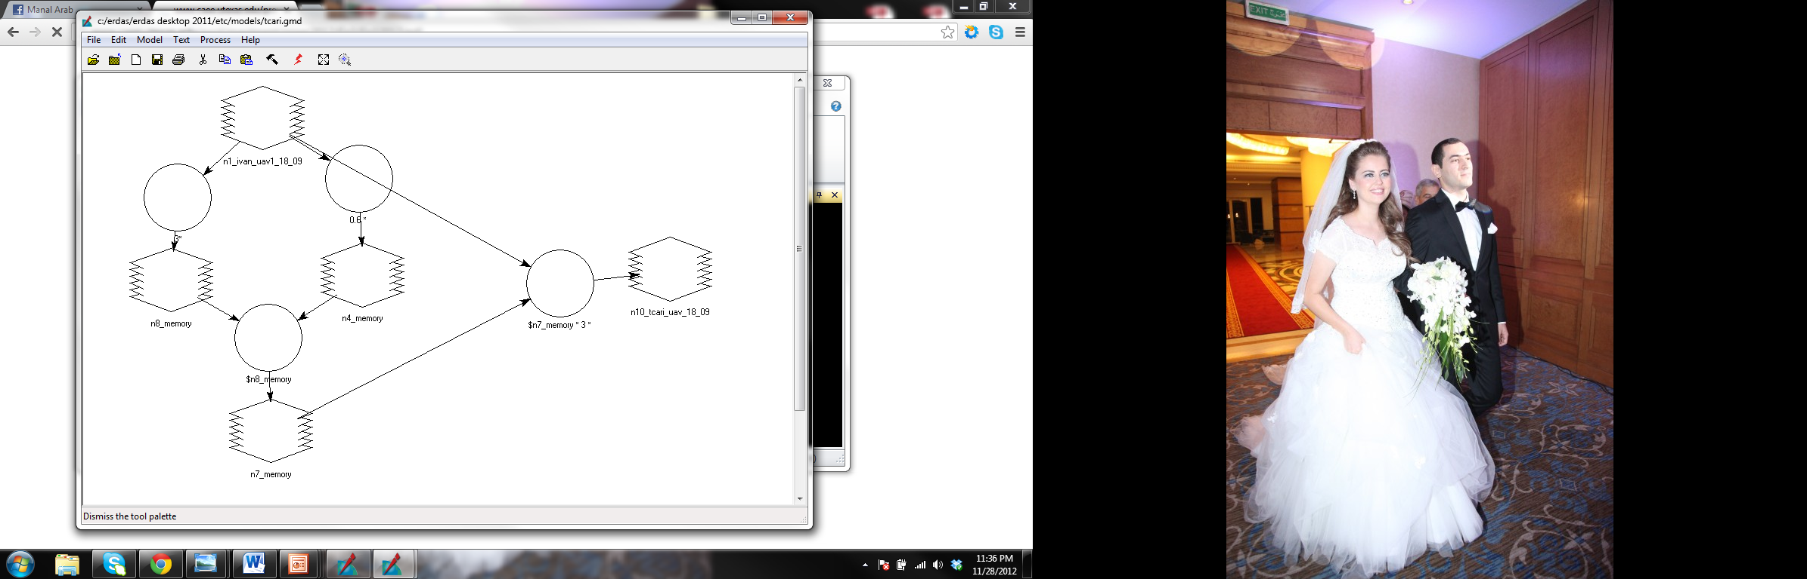

b. Vegetative Indices Maps

Slide 15
  c. Linear Regression Analysis
Multi linear regression in Excel (LINEST function)

Slide 16
  c. Linear Regression Analysis
Multi linear regression:
With an R of 0.825 we managed to correlate the Chlorophyll content in the plants to the different vegetative indices in the following relation
Chlo.Conc(Umole/m2)= (22.21*TCARI/OSAVI)+(-41.07 *MCARI/OSAVI)+(566.54 *NDVI)+(-29.34*MSR) +(56.90*GNDVI)+……

Slide 17
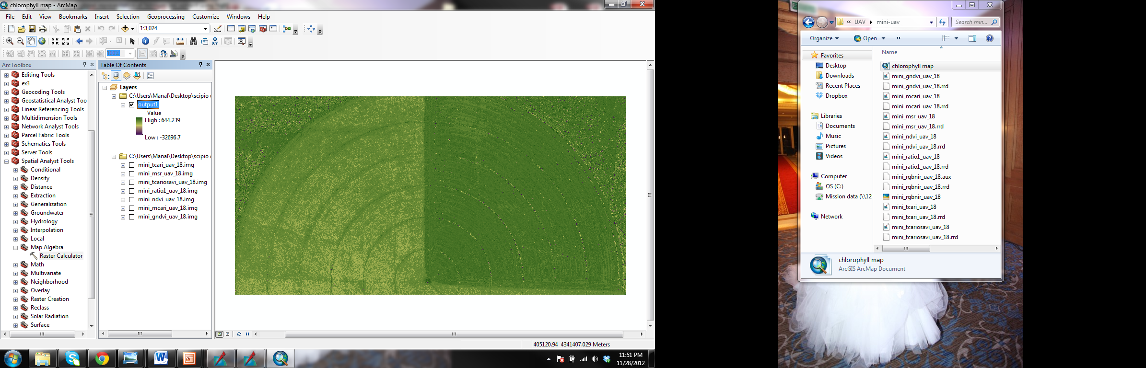
d. Generate chlorophyll maps

Slide 18
3. Conclusion
GIS showed to posses tools that can help in Visualization & interpolation of time series data
GIS tools related to image processing, Model makers, raster calculators etc…resulted in achieving a high resolution Chlorophyll map
GIS is a tool to be used in precision agriculture

Slide 19
Thank you

