Slide 1
underseepage analysis in levees using GIS
Lourdes Polanco
November 27th, 2012
CEE 6440

Slide 2
Objectives
To present an informative map showing vulnerable leveed areas along the Natomas basin based on underseepage analysis
Show possible flooded depths of the area if the levee were to fail
Pilot analysis

Slide 3
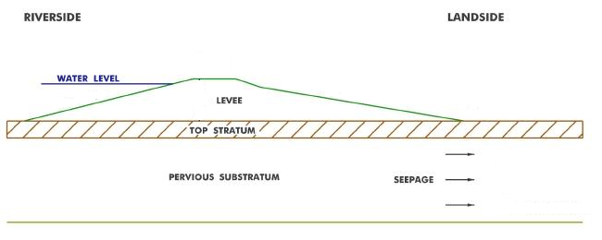
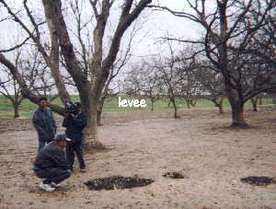
What are levees?
Levees are embankments designed to prevent the flooding of a river into an adjacent landward floodplain.
What is
underseepage?
From stanford.edu
From mvm.usace.army.mil
Seepage is the flow of water through soils.
3 of 19
California, Arboga, after the 1997 flood
Notes:
Seepage is the flow of water through soils.
The water may seep out gently
The water can erode the soil forcing it to erupt on the landside as “sand boils”.

Slide 4
Location of research
Levees

Slide 5
Why is it important?
DESCRIPTION
Open Water
Developed, Open Space
Developed, Low Intensity
Developed, Medium Intensity
Developed, High Intensity
Barren Land (Rock/Sand/Clay)
Shrub/Scrub
Grassland/Herbaceous
Pasture/Hay
Cultivated Crops
Woody Wetlands
Emergent Herbaceous Wetlands

Slide 6
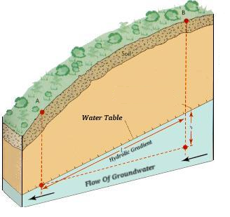
Deterministic Factor of Safety
Most common method used by engineers to assess underseepage.
Generally, for levee underseepage a F.S. > 3.0 is acceptable.
i_{c} is the gradient needed to initiate erosion
i_{e} is the gradient calculated with FEM analysis
Computation
usually between 0.8 and 1.0
i_{e} calculated by finite element analysis, provided in Corps report
From earthsci.org
Notes:
The critical gradient (ic) is generally taken to be a function of the saturated buoyant unit weight of the soil (γb) and the unit weight of the water,
The critical gradient (ic) is the gradient needed to initiate erosion in the soil and usually varies from about 0.80 to 1.0 (Mansur, Postol, and Salley, 2000), depending on the unit weight of the soil. The exit gradient (ie) is the gradient at the point of erosion calculated with Finite Element Analysis and it is a function of the subsurface geometry and the permeability of the subsurface soils.

Slide 7
SSURGO Data
Sutter county
Sacramento county
7 of 19

Slide 8
US Army Corps of Engineers Sacramento District data

Slide 9
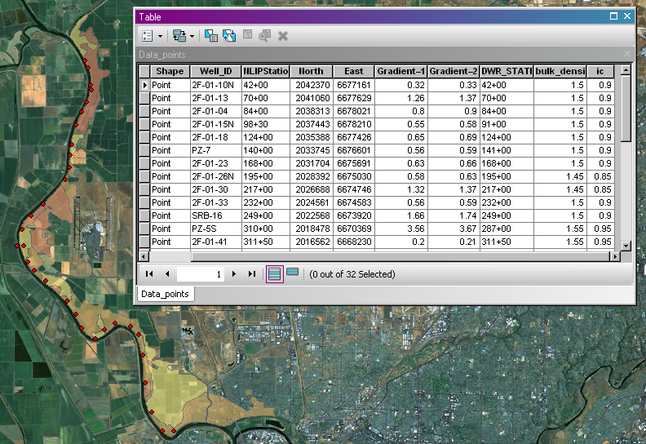
Data points
NAD_1983_HARN_StatePlane_California_II_FIPS_0402
Lambert_Conformal_Conic

Slide 10
IDW Interpolation of gradients
200 yr – flood hydraulic gradients
100 yr – flood hydraulic gradients
Critical gradients

Slide 11
F.S. raster calculation
200 yr – flood F.S.
100 yr – flood F.S.

Slide 12
Extract by mask

Slide 13
Vulnerable areas
100 yr – flood
200 yr – flood
Overlap

Slide 14
Comparison
100 yr – flood
SPLINE
100 yr – flood
IDW
Overlap

Slide 15
DEM
Mosaic to new Raster

Slide 16
Flooded depths
< 4.0 m
< 4.5 m
< 5.0 m
< 5.5 m
< 6.0 m
< 4.0 m
< 4.5 m
< 5.0 m
< 5.5 m
< 6.0 m
< 4.0 m
< 4.5 m
< 5.0 m
< 5.5 m
< 6.0 m
< 4.0 m
< 4.5 m
< 5.0 m
< 5.5 m
< 6.0 m

Slide 17
Limitations of analysis
Interpolation of gradients is not accurate but informative
Surface soils were used instead of stratigraphy soils
Conclusions
Design against underseepage feasible for 100yr-flood based on comparison
GIS is a great tool to make an informative map and compile data

Slide 18
Future work
Use piezometric heads
Use soils beneath the levees
Divide levee system into levee reaches
Compute probability of initiation of erosion
Extent analysis to Pocket area and other surrounding levees

Slide 19
THANK YOU! QUESTIONS?

