Slide 1
Logan City GIS Master PLAN
Colton Smith
CEE 6640
Fall 2012

Slide 2
Objective
Obtain data for Logan City
Create a data driven pages mapbook of the canals, trails, streets, businesses, and parks

Slide 3
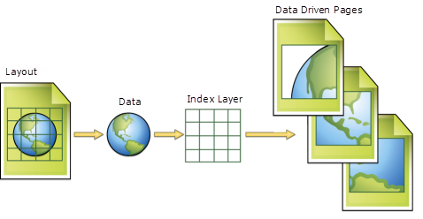
What is a Data Driven Pages Mapbook?
A collection of pages that are exported together which contain maps, text, and tabular data

Slide 4
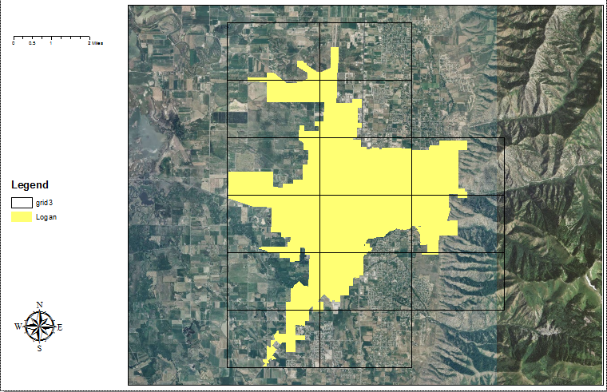
Steps in Creating Mapbook
Create grids using Grid Index Feature tool over the Logan City boundaries shape file
Use Data Driven Pages tool to create mapbook pages

Slide 5
Benefits of a Mapbook
Breaks up map and data into smaller sections

Slide 6
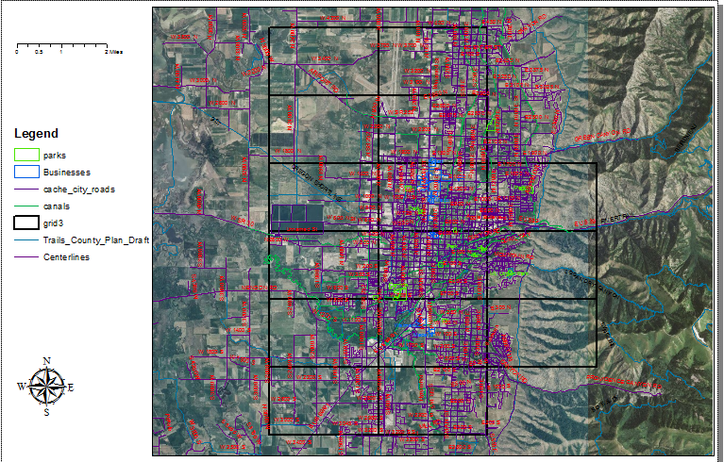

Slide 7
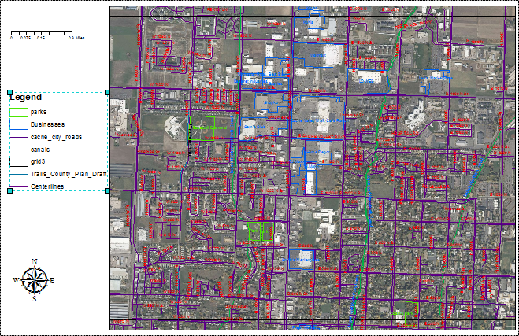

Slide 8
Trails
mapbook for logan river trial
Page of mapbook of logan city of logan river trial

Slide 9
Canals
Mapbook for Logan Northern canal
Page in mapbook of logan City of logan northern canal

Slide 10
Parks

Slide 11
Who Does it Benefit?
Those visiting and current residents

Slide 12
Questions ?

