Slide 1
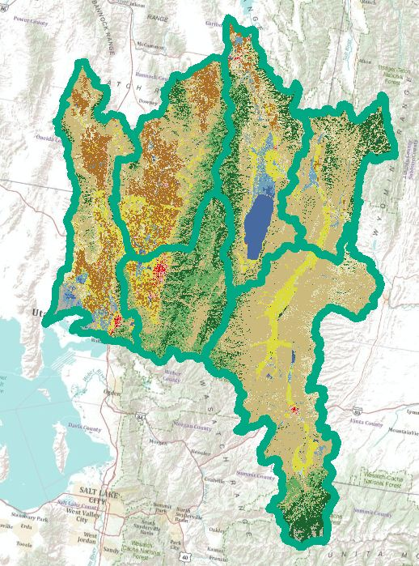
Ratio of Water used by Agriculture to Discharge into the Great Salt Lake in the Bear River Basin
Presented by: Timothy Shaffer

Slide 2
Introduction
Desired to know if the proportion of water used by irrigation in the Bear River Basin is a significant amount
Develop a basemap to determine the proportion (ratio)

Slide 3
Data Retrieval
NHDPlus
USGS
NLCD Landcover for 2006

Slide 4
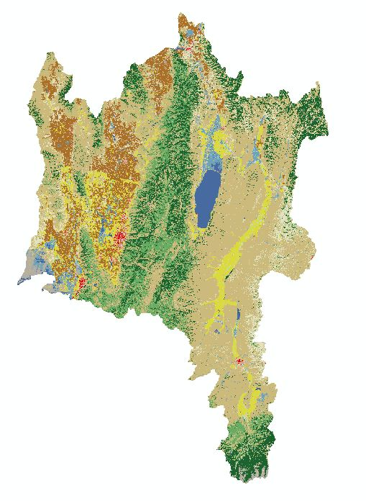
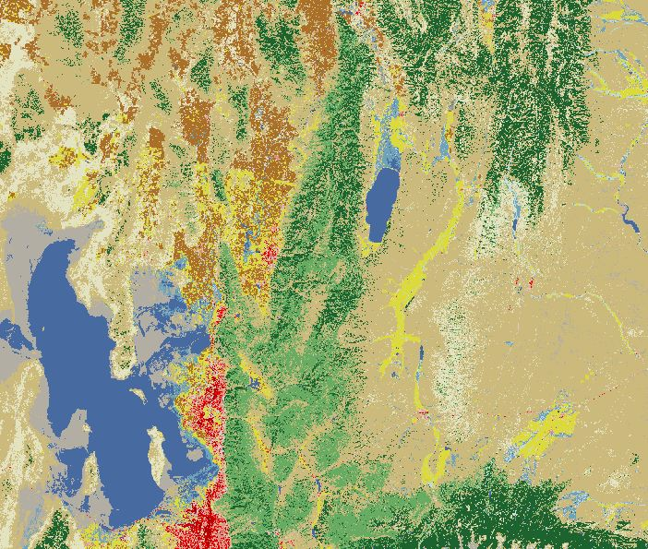
Data Retrieval
Landcover Data and isolate the data for the region

Slide 5
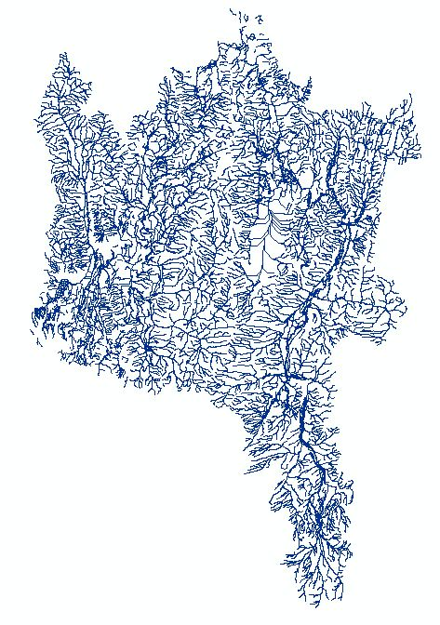
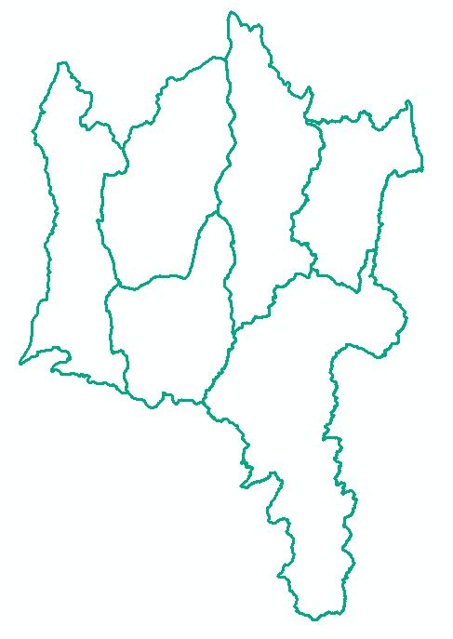
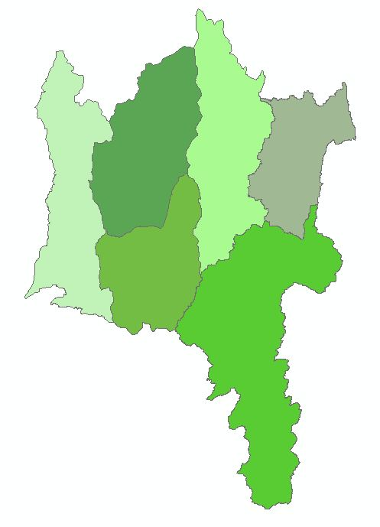
Basemap Development
Conversion of Flowline, Basin, and Watershed layers

Slide 6
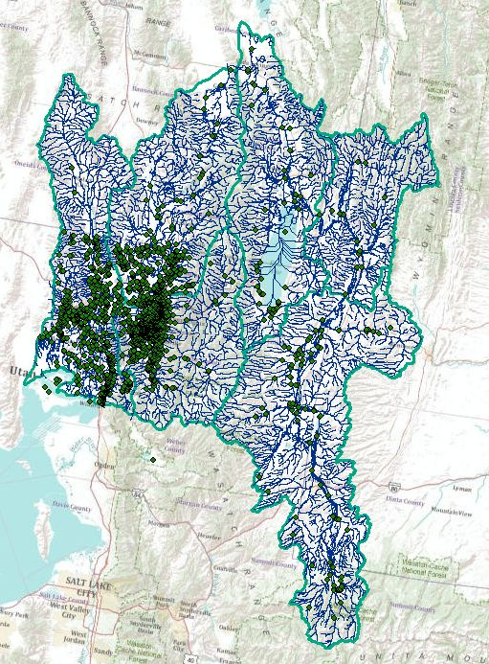
Analysis
USGS Stream Gages input onto map
1,892 Total Gage Stations
Notes:
Recently found out these are the wrong outlet gage stations.

Slide 7
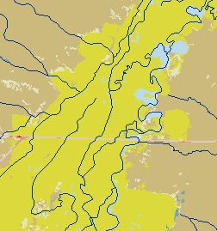
Analysis
Irrigated lands remain close to the river
Yellow is Irrigated land
Blue lines are the river

Slide 8
What’s Next
Determine the gages needed for the analysis
Input the flow accumulation and direction layers
Use the flow attribute table to determine amount of flow in the streams
Determine the Ratio of Agricultural Water use to discharge of the Bear River into the Great Salt Lake

Slide 9
Questions????
Special thanks to Dr. Tarboton

