Slide 1
Stormwater Management Along The Hyde Park Irrigation Canal
Why?
O & M Costs
How?
Using ArcGIS and EPA SWMM

Slide 2
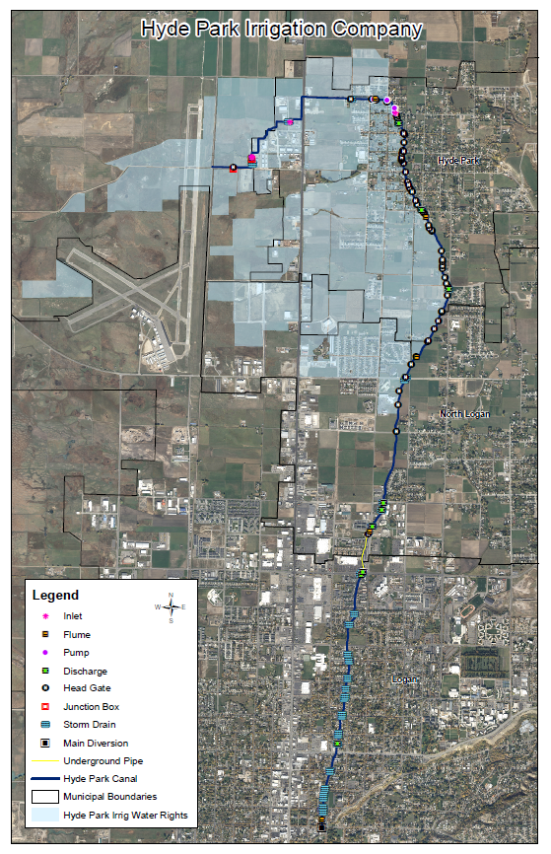

Slide 3
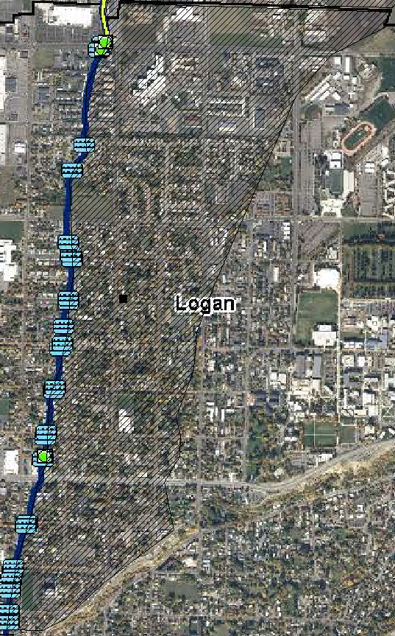
EPA SWMM
Event used to simulate runoff
100 year, 24-hour duration, SCS II curve

Slide 4
What is left?
ArcGIS
Total Area of watershed
Slope of Watershed
Determine pervious to impervious percentages for each city watershed
EPA SWMM
What parameters to input
Run simulation and analyze runoff data

Slide 5
References
Logan City, (2010). <http://loganutah.org/Public%20Works/Engineering/pdf/StormWaterDesignCriteria2010.pdf>.
Storm Water Management Model, (2011). EPA. <http://www.epa.gov/nrmrl/wswrd/wq/models/swmm>.
SWMM Manual, (2010). EPA, <http://www.epa.gov/nrmrl/wswrd/wq/models/swmm/epaswmm5_user_manual.pdf>.

