Slide 1
Trial and Error: Water Distribution Pipeline in Tuni Grande, Peru
Scout Mendenhall

Slide 2
Tuni Grande, Peru
Engineers Without Borders project
The Chijnaya Foundation
Southern Peru, district of Pucara
Small farming community, ~300 people

Slide 3
Tuni Grande, Peru
3000 L storage tank
90+ connections
Inefficient distribution system
Uneven water supply

Slide 4
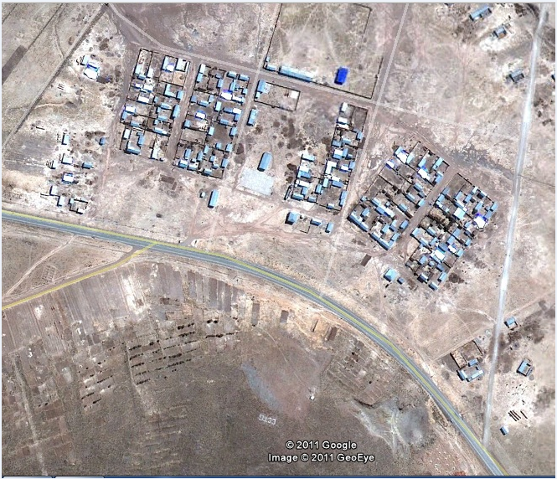
Need: Map of Distribution System

Slide 5
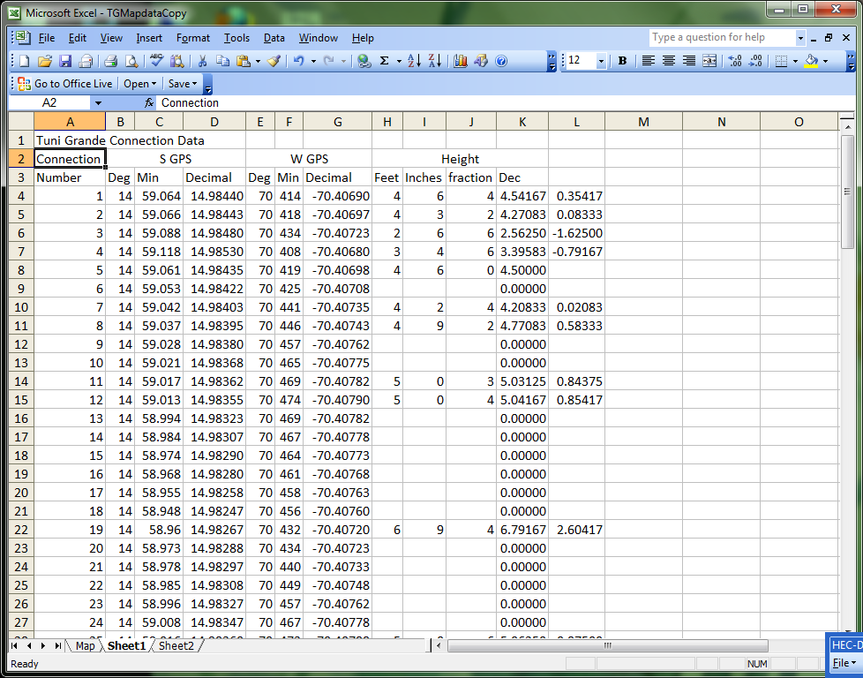
Data
Team traveled to Peru, August 2010
Collected GPS coordinates
Used laser level to determine elevation differences
Data points in Excel

Slide 6
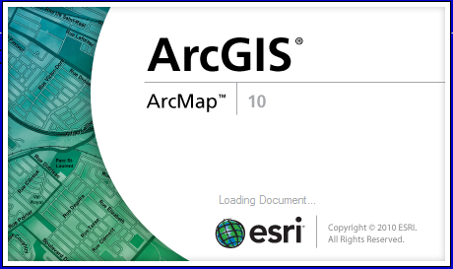
Solution: ArcGIS?
Slope
Distance
Network Analysis

Slide 7
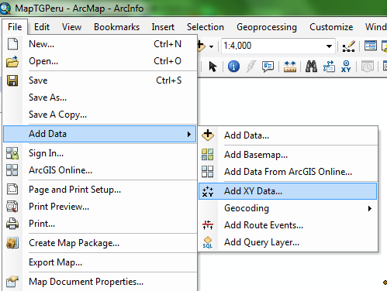
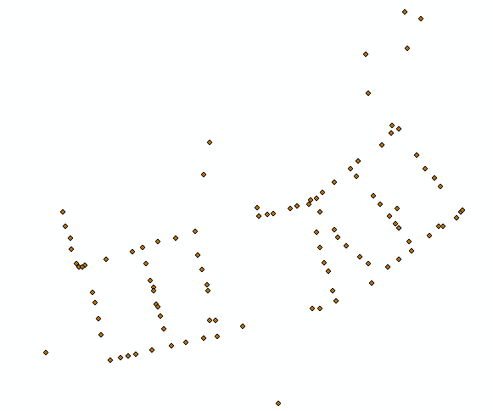
Importing Data into ArcGIS

Slide 8
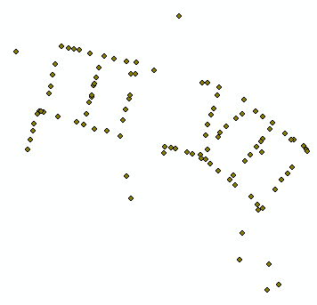
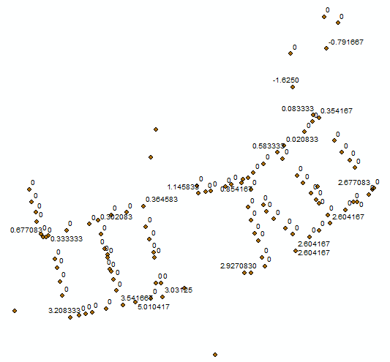
Importing into ArcGIS
GPS Coordinates written as positive latitude, negative longitude
Should be negative latitude and longitude

Slide 9
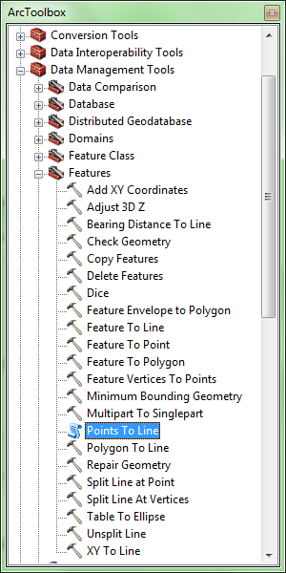
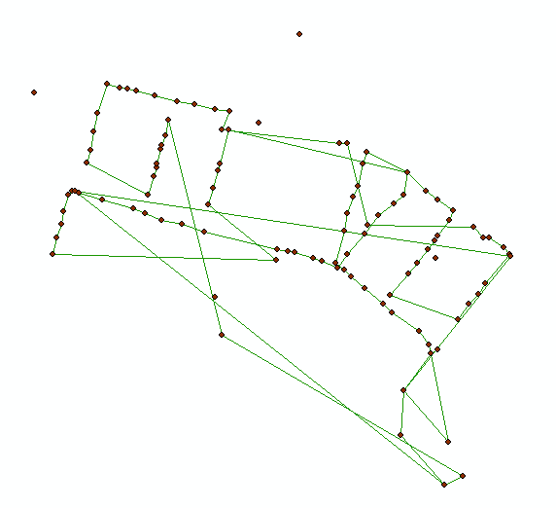
Creating a Pipeline

Slide 10
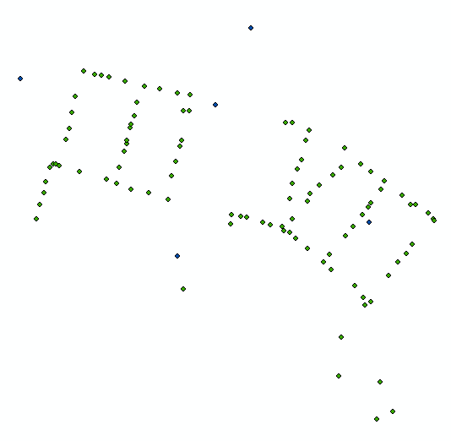
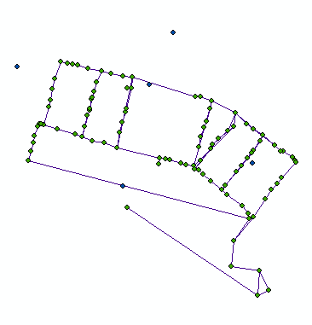
Creating a Pipeline (2)

Slide 11
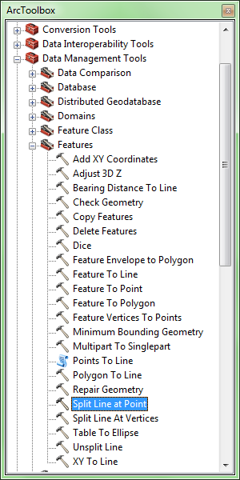
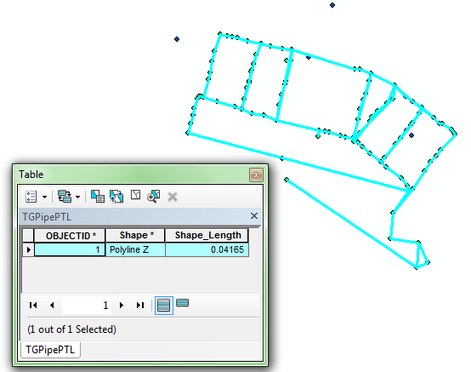
Creating a Pipeline (3)

Slide 12
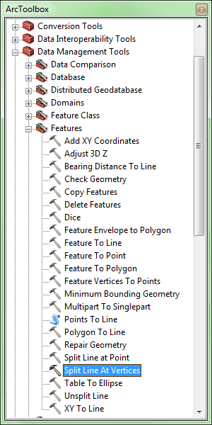
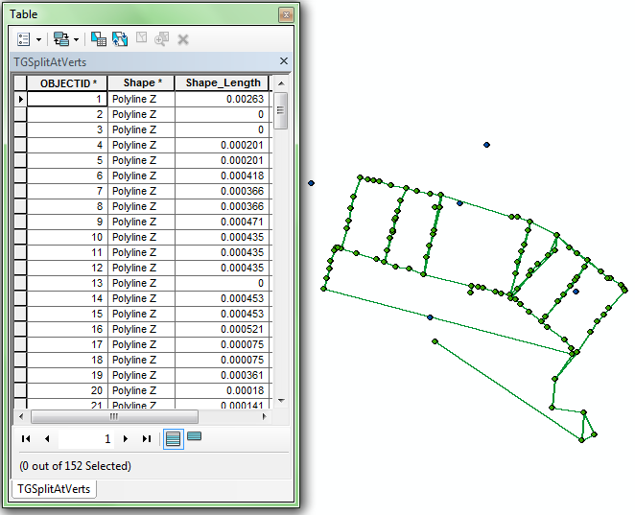
Creating a Pipeline (for real this time)

Slide 13
Comparing Measurements
Line Segment | Curved Earth Distance (m) | ArcGIS Split Line (?) | ArcGIS Measure Tool (m)
Well to Storage Tank | 285.9653 | 0.00263 | 285.4536
Length of Culvert | 21.78751 | 0.000201 | 21.76825
Curved Earth Distance = R cos⁻¹[sinɸ_{a}sinɸ_{b}+cosɸ_{a}cosɸ_{b}cos(λ_{a}-λ_{b})]

Slide 14
Conclusions
Data collection better left to the data-set pros
Requires “doctoring the data” prior to importing xy data
Difficult to manipulate data within ArcGIS
ArcGIS was not the best solution

Slide 15
Continuing Work
Determine distances between remaining data points
Explore digital elevation data (NASA)
Add contours
Add pop-up pictures to map

Slide 16
Questions?

