Slide 1
Effect of Soil Depth on Soil Moisture in the Variable Infiltration Capacity (VIC) model
John A Koudelka
Tuesday November 29, 2011
CEE 6440 – GIS in Water Resources

Slide 2
Background
Variable Infiltration Capacity Model
Water and energy balance
Semi-distributed macroscale hydrologic model developed to be incorporated into Global Climate Models (GCMs)
Climate change
Water resources management (reservoir operations)
Land-atmosphere interactions
Representation of vegetation heterogeneity, multiple soil layers with variable infiltration, and non-linear base flow.

Slide 3
VIC Components
Land Cover and Soil
Snow
Meteorology
Frozen Soil
Flow Routing

Slide 4
Soil Moisture
Assumes fixed soil depths
Gao et al., 2010

Slide 5
Soil Moisture Equations
Soil moisture for the top two layers
Mahrt and Pan, 1984
Diffusion between layers:
Mahrt and Pan, 1984
Direct runoff:
Mahrt and Pan, 1984
Bare soil evaporation:
Franchini and Pacciani, 1991
Zhao et al., 1980

Slide 6
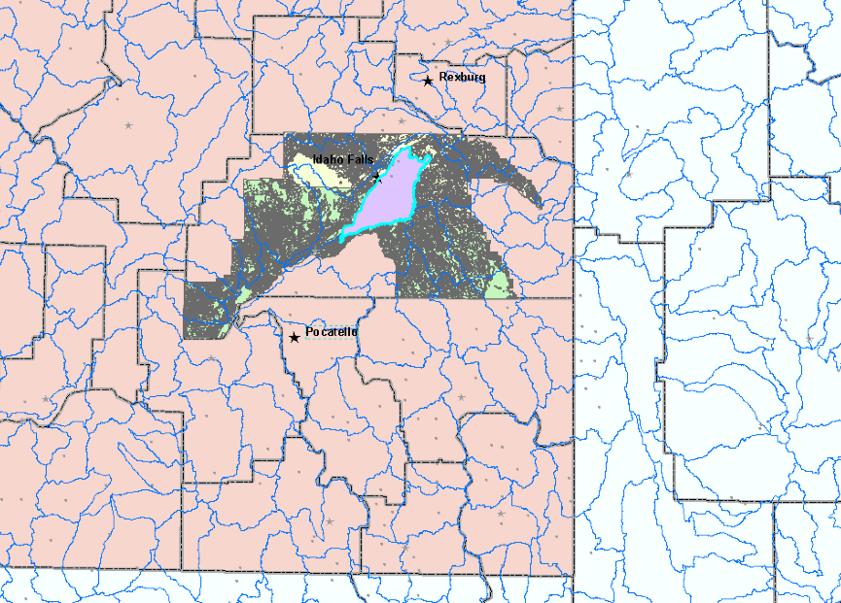
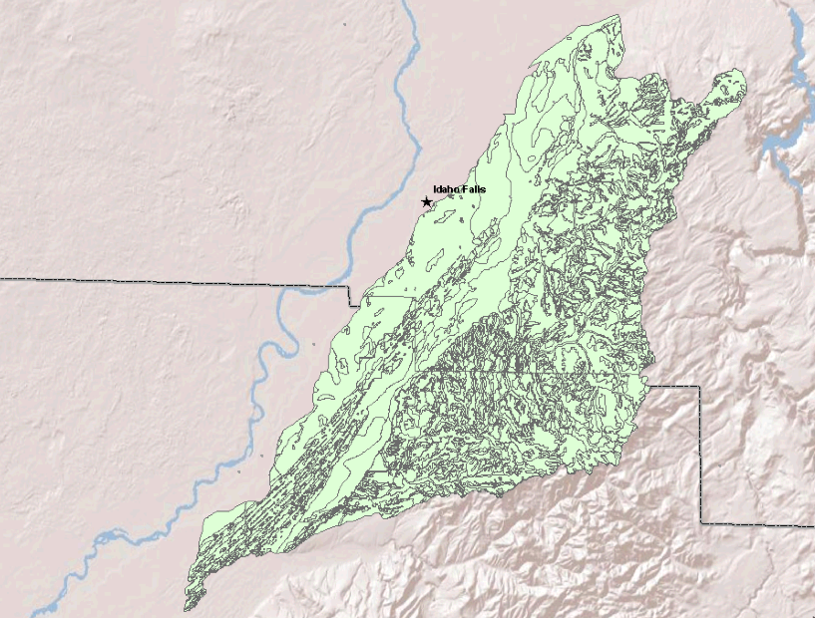
Data Preparation
Study Area
1704020705

Slide 7
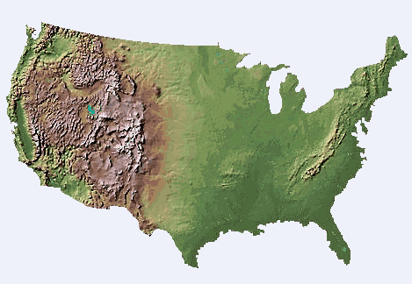
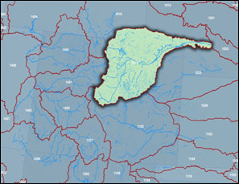
Data Sources
Datasets
NHD
SSURGO
NED
National Land Cover Dataset
PRISM

Slide 8
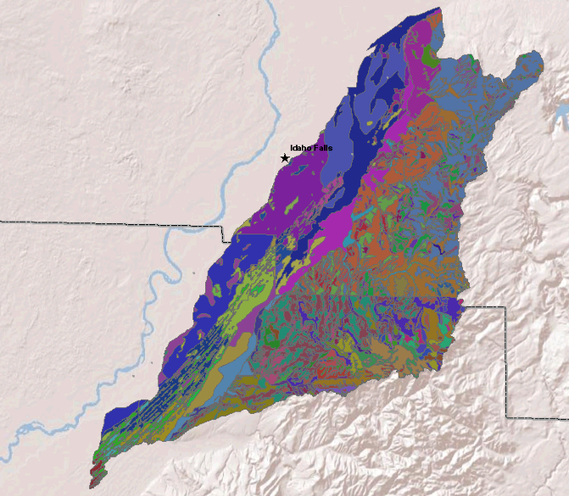
Data Preparation
Soil Depth assumed at fixed levels
SSURGO (STATSGO2) – for soil depth of each layer

Slide 9
Results
Soil | L1 (inches) | L2 (inches)
Ammon | 5 | 15
Aquic Cryoborolis | 7 | 53
Typic Cryaquolls | 7 | 53
Araveton | 7 | 12
Badgerton variant | 13 | 20
Bannock | 2 | 7
Bock | 4 | 10
Dranyon | 2 | 6
Harston | 10 | 20
Heiseton | 8 | 14
Hobacker | 4 | 16
Judkins | 2 | 4
Lanark | 5 | 10

Slide 10
References
Franchini, M., and M. Pacciani (1991), Comparative-analysis of several conceptual rainfall runoff models, Journal of Hydrology, 122(1-4), 161-219.
Gao, H., Q. Tang, X. Shi, C. Zhu, T. J. Bohn, F. Su, J. Sheffield, M. Pan, D. P. Lettenmaier, and E. F. Wood, 2010: Water Budget Record from Variable Infiltration Capacity (VIC) Model. In Algorithm Theoretical Basis Document for Terrestrial Water Cycle Data Records (in review).
Liang, X., et al. (1996), Surface soil moisture parameterization of the VIC-2L model: Evaluation and modification, Global Planet Change, 13(1-4), 195-206.
Mahrt, L., and H. Pan (1984), A 2-Layer Model of Soil Hydrology, Bound-Lay Meteorol, 29(1), 1-20.

Slide 11
Questions?

