Slide 1
Analysis of the South Fork Walla Walla River, Oregon
Juvenile bull trout distribution and density in relation to channel characteristics.
Hannah Moore

Slide 2
Project Background
Ten year project through Phaedra Budy (USU Associate Professor) and Tracy Bowerman (USU Graduate Research Assistant)
Funding provided from USGS, US Fish and Wildlife Service, and Utah Cooperative Fish and Wildlife Research Unit.
.

Slide 3
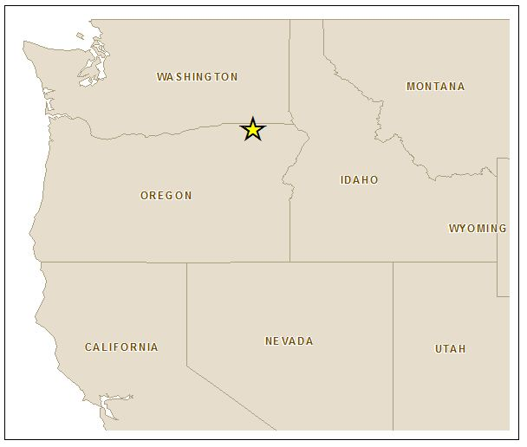
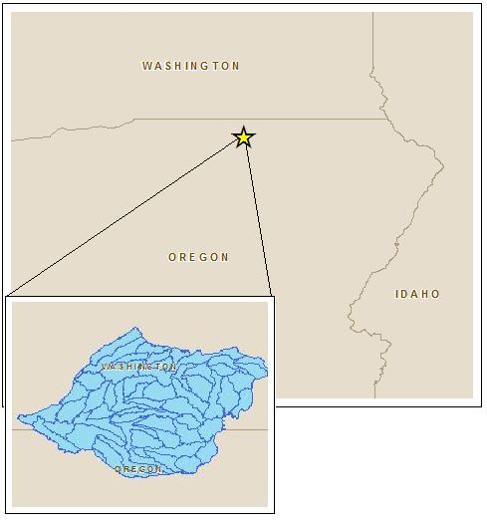
Study Area

Slide 4
Two Main Land Use Types
Evergreen Forest
Shrub Scrub
This system is fairly pristine, with no negative inputs from the upper watersheds.
Two Obstructions downstream of the South Fork
Little Walla Walla Diversion Dam – Has a fish ladder.
Nursery Bridge – Fish can move through.

Slide 5
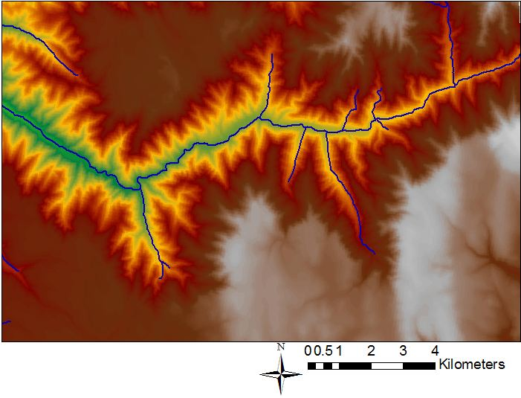

Slide 7
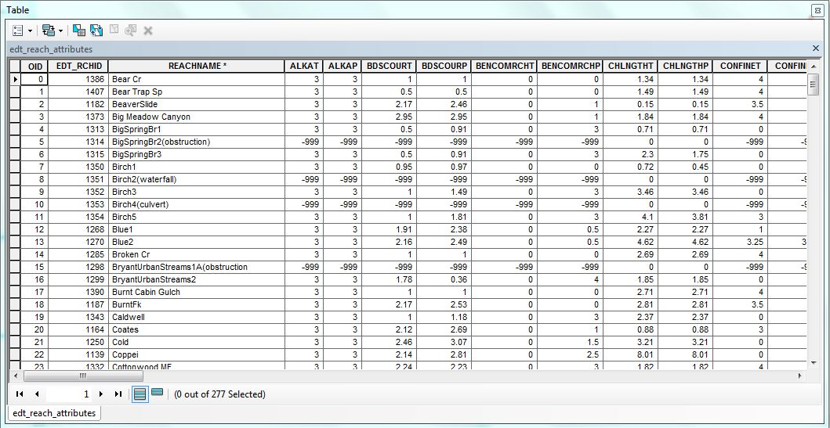
Attribute Tables
This initial table has all the information for each reach in the entire watershed (277 reaches).

Slide 8
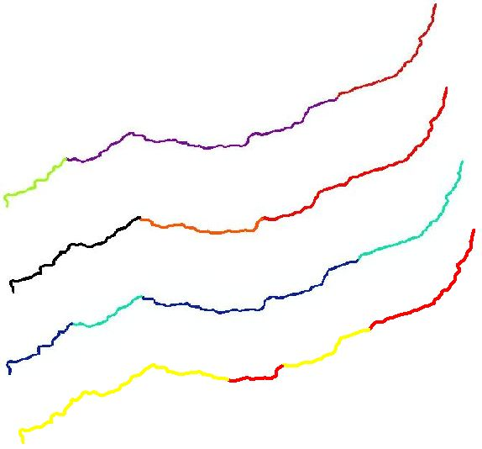
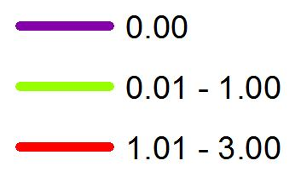
Confinement
Spawning Density
Width (ft.)
Gradient (%)

Slide 9
This line occurs at Skiphorton Creek, Reach 78. This is also the shift from warmer to colder temperatures upstream.

Slide 10
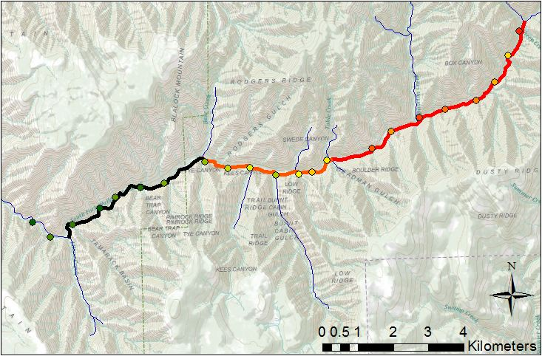
Ten Year Average Density of Juveniles

Slide 12
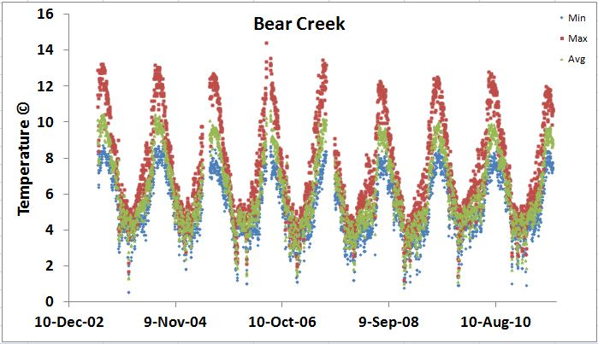
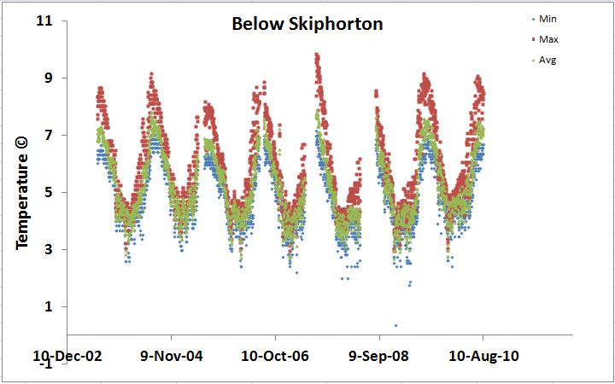
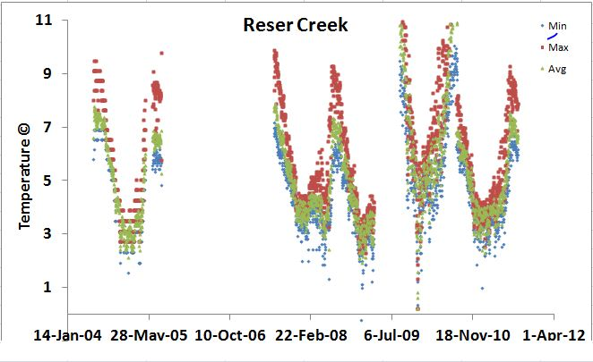
Temperatures at Four Stations

Slide 14
Conclusions
Juveniles (<170mm) do not move much from original spawning grounds (high spawning density = high juvenile density).
Juveniles prefer colder temperatures <5⁰ Celsius
Narrower, confined channels with a steeper gradient show higher juvenile density

Slide 15
Future Work
A random forest model is being generated to relate Juvenile Density to channel width, gradient, confinement, and temperature.
High frequency temperature data for the past ten years will also be extrapolated to determine the effects of Summer high and winter low temperatures.

