Slide 1
Identifying spatial and temporal extent of critical condition for water wells in Salt lake valley
Utah State University
GIS in Water Resources Term Project
Ali Forghani
Nov 2011

Slide 2
Introduction:
Water Resources:
- Surface water
- Groundwater
In this project:
Groundwater conditions in Salt lake valley (HUC8=16020204) have been studied
- Considering groundwater elevation

Slide 3
Objectives:
1- Obtaining interpolated surface of groundwater elevation in the study area
2- Specifying the critical areas
3- Specifying the regions possibly affected by artificial recharge system
4-Obtaining interpolated surface of depth of unsaturated zone
5- specifying the regions with high pumpage cost

Slide 4
Note:
1- lacking a complete data for extraction wells
2- lacking the monthly data for observation wells esp. after year 2000

Slide 5
Needed data:
1- Digital Elevation model (DEM)
2- groundwater elevation data
- USGS:“water level below land surface” (Depth of groundwater)

Slide 6
-Not existing stations in northwest of the region
-defining 4 new stations near surface waters (depth=0)

Slide 7
Objective 1: interpolated groundwater elevation
2 procedures:
1- determining groundwater elevation in each observation well and then interpolating
2- interpolating depth of water table and then subtracting it from DEM
The results of procedure 2 was more reliable.

Slide 8
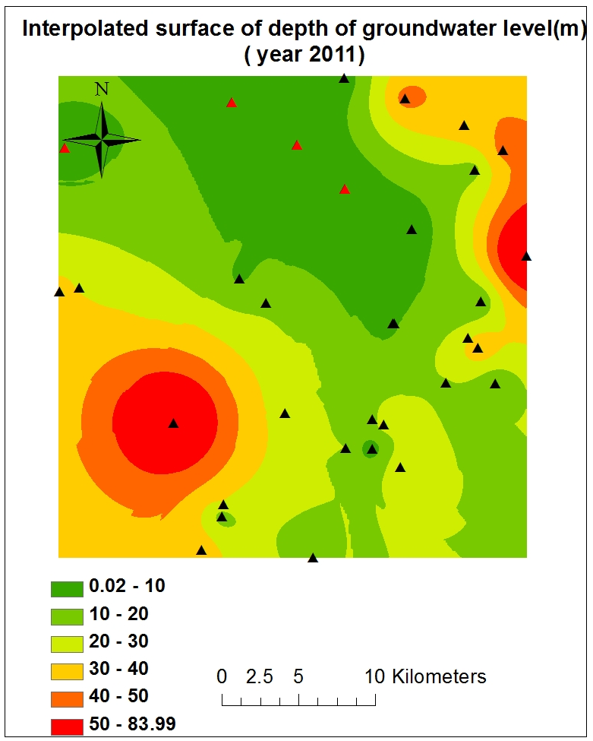
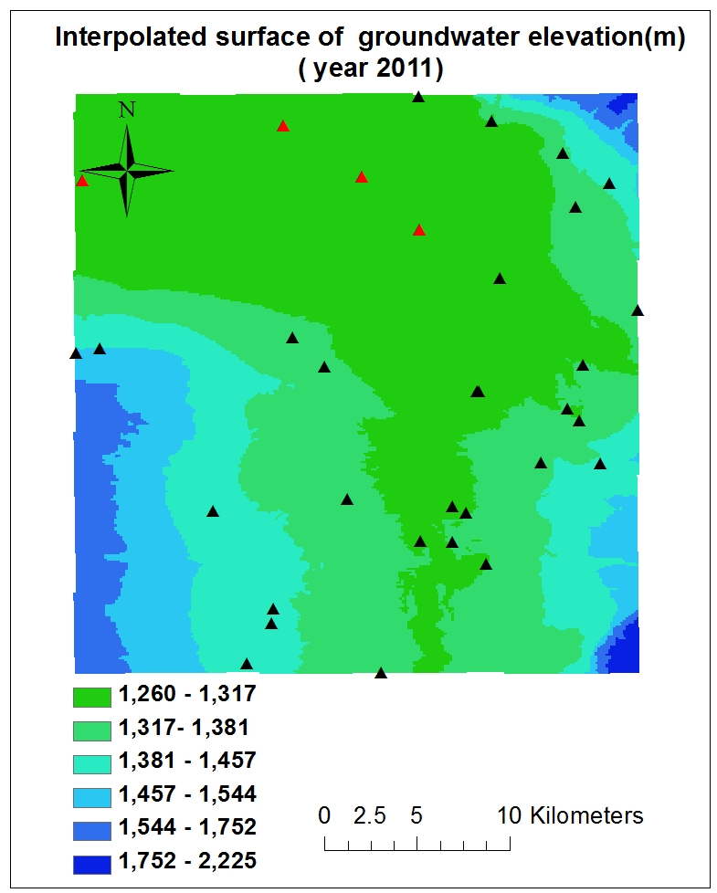

Slide 9
Objective 2: Specifying the critical areas
Critical area: the area with decrease in water table more than critical value
Obtaining the map of groundwater elevation differences in desired time periods
Definitions:
Yearly critical value:1m
10 years period critical value:4m

Slide 10
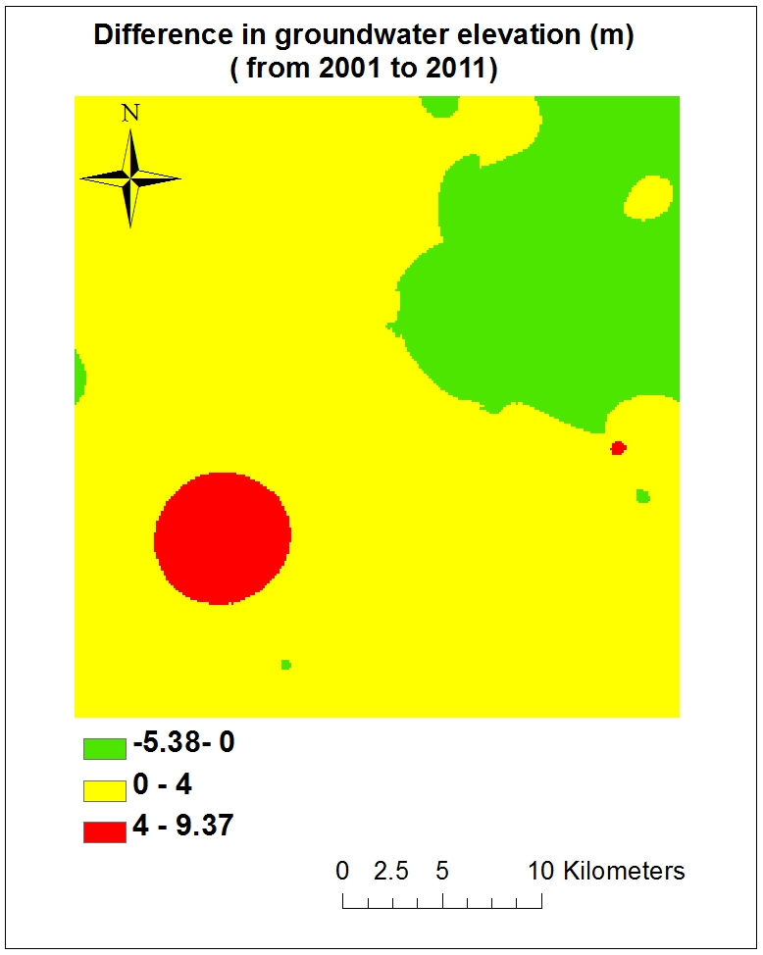
Critical area: (10 years period)
(Critical value:4m)
Red regions (3.8%)

Slide 11
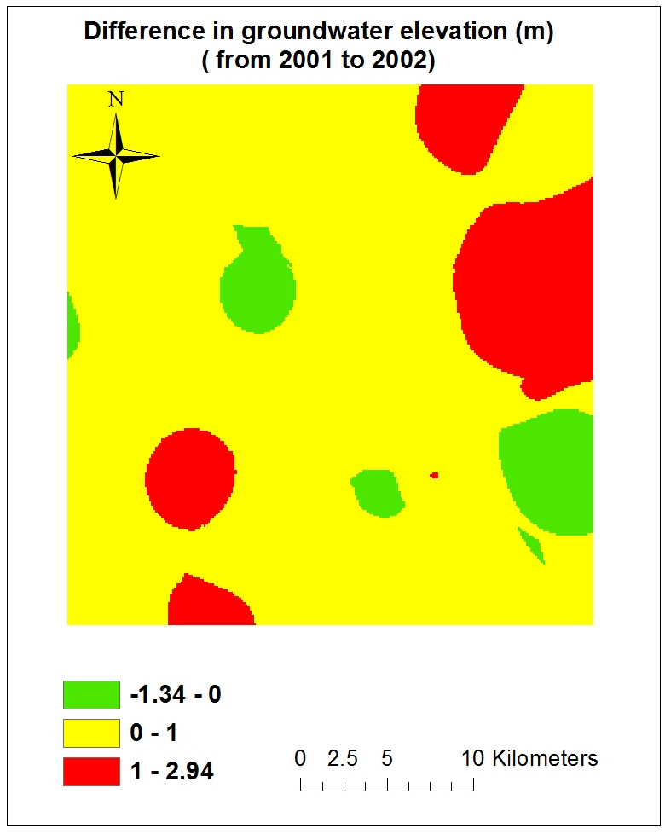
Critical area: (1 year period)
(Critical value:1m)
Red regions (14%)

Slide 12
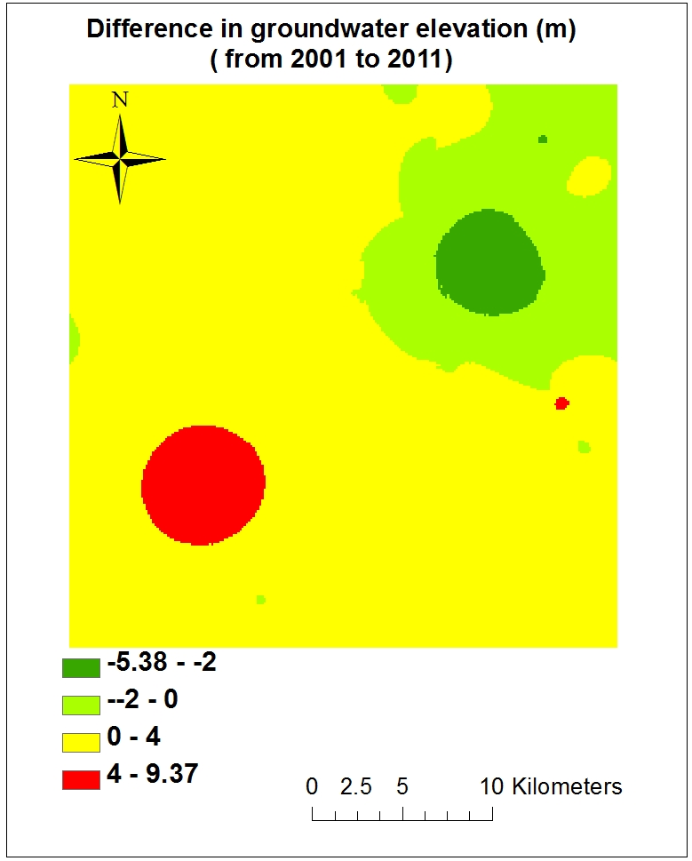
Objective 3:
The regions with highest increase (possibly affected by artificial recharge)
Dark green region

Slide 13
Objective 4: interpolated surface of unsaturated depth

Slide 14
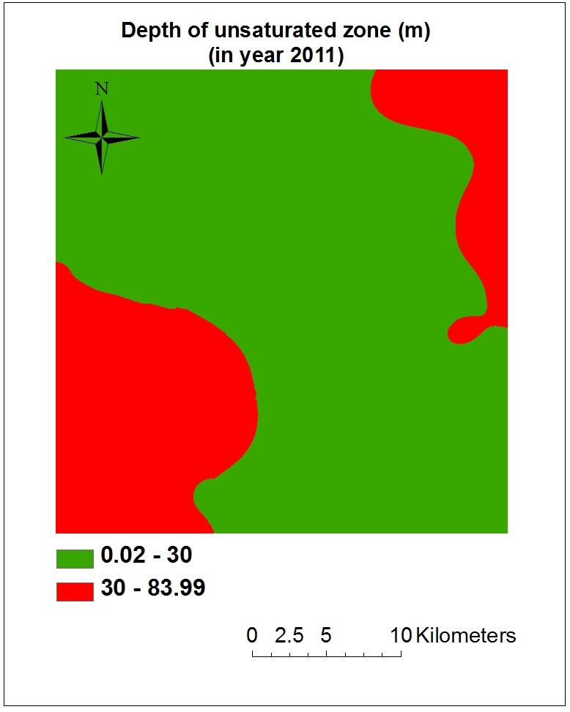
Objective 5: Regions with high pumpage cost (in which depth of unsaturated zone is high)
Definition:
high depth: depth more than 30m

Slide 15
Suggestion for further studies
Obtaining the complete data for extraction wells in the region
Using different interpolation methods and comparing results

Slide 16
Thanks for your attention
Any Questions???

