Slide 1
Examining Patterns and Trends in Streamflow variables used in Stream Ecology across the US
GIS in Water Resources
CEE 6440
Term Project
Sulochan Dhungel

Slide 2
What Streamflow variables are important to Stream Ecosystem ?
Base Flow Index
Coefficient of Variation of Daily Flows
Mean Daily Discharge
Zero Flow Days
Daily flow with a 1.67 year recurrence interval (Q1.67)
Flood Duration
Colwell’s Index of Predictability
Colwell’s Index of Constancy
Colwell’s Index of Contingency
Average 7 day minimum streamflow
Average 7 day maximum streamflow
Flow Reversals per year
Average 25% timing of flow
Average 50% timing of flow
Average 75% timing of flow
Time of Peak in first harmonic
Time of Peak
Notes:
Poff 1996, Poff et al 1997, Puckridge et al. 1998
There are 5 critical components of streamflow regime that are important to stream biota:
Magnitude
Frequency
Duration
Timing
Rate of change
(A method for Assessing Hydrologic Alteration within Ecosystems) Brian D. Richter 1996

Slide 3
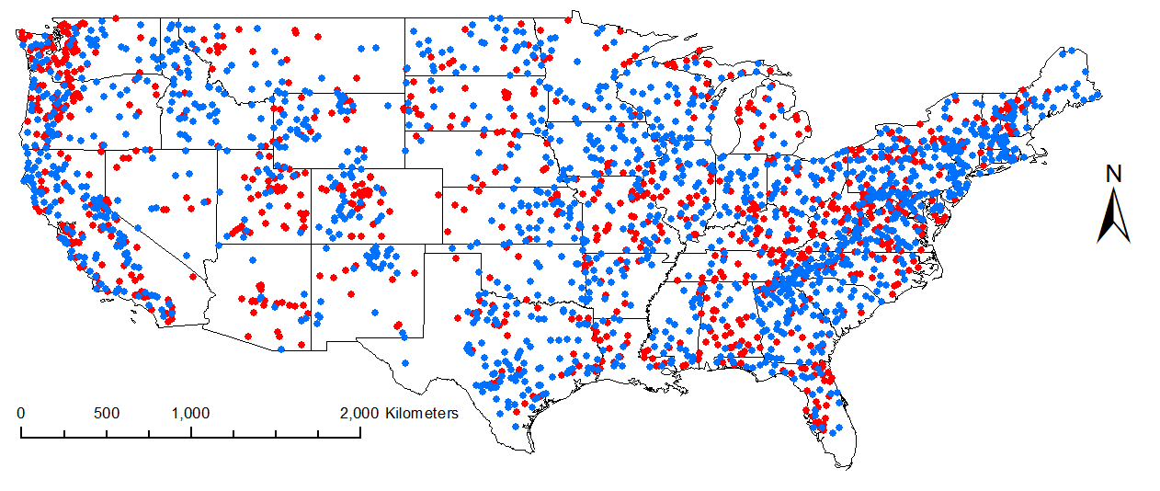
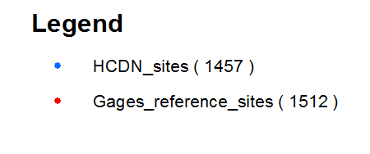
Location of 2419 Stations
Notes:
1457 HCDN sites (Green )
1512 Gages Reference Sites
550 Common sites between the two
GAGES – Geospatial Attributes of Gages for Evaluating Streamflow
There are 6875 sites in this dataset which lists 1512 of its sites as reference quality sites not affected by humans. There is 1457 HCDN sites which are also a set of relatively undisturbed sites developed for the purpose of studying the variation in surface water condition throughout the US.
I downloaded the streamflow data for these stations from USGS using R.
The period of record was between 20 and 58 years.
I used the queries in GIS attribute table for selecting the stations.

Slide 4
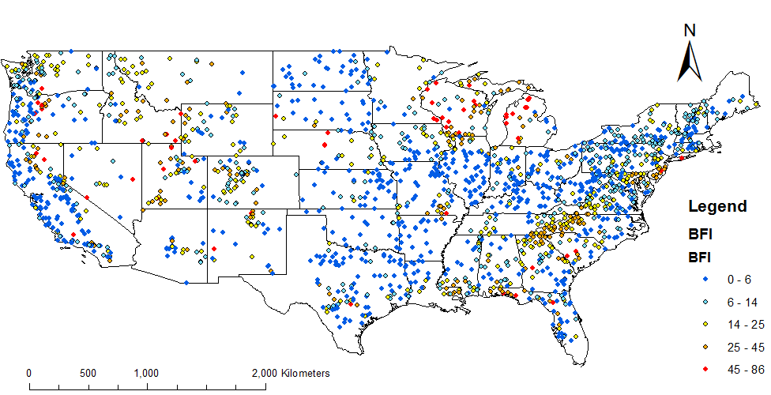
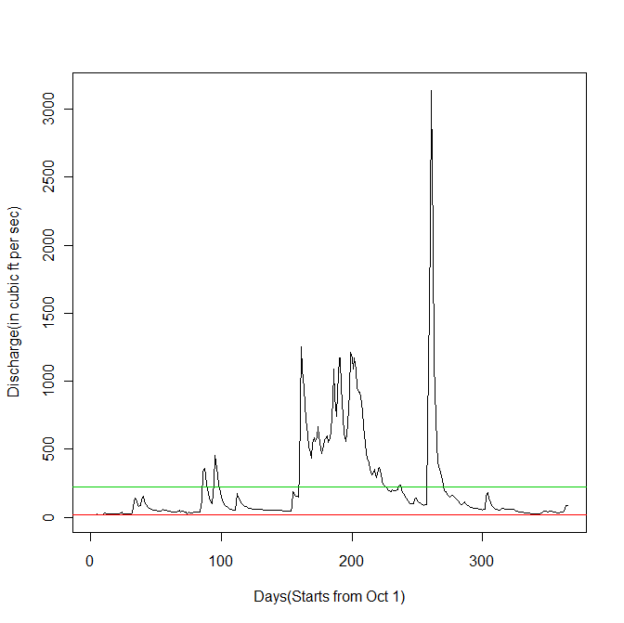
Base Flow Index
BFI for a year
$$= \frac{Minimum discharge}{Average Daily Discharge} x 100\%$$
Notes:
BFI indexes flow stability and susceptibility to drying.
Index Value of near 1 (or 100%) indicates flow remains fairly constant over the year.
Index value of near 0 (or 0%) indicates an intermittent stream.
Range - No of stations
0-6 809
6-14 434
14-25 318
25-45 198
45-86 59

Slide 5
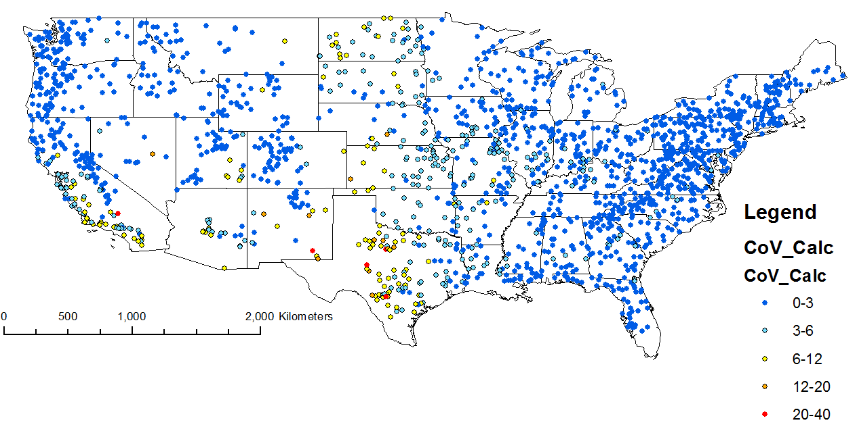
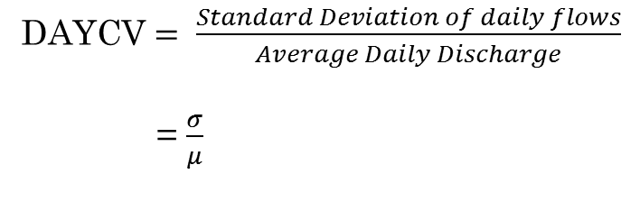
Coefficient of Variation of Daily Flows
DAYCV $= \frac{Standard Deviation of daily flows}{Average Daily Discharge}$
= $\frac{σ}{μ}$
Notes:
Coefficient of Variation of Daily Flows (DAYCV) describes flow variability without considering the temporal (relating to time) sequence of flow variation.
Horwitz(1978) explained that streams which had lower variability showed increase in diversity of species. Floods and Droughts are the catastrophic events hypothesized to affect diversity patterns in streams. Since river volume will affect river warming, cooling, turbidity in the water, volume of food available from scouring or silting, etc discharge variations are relevant to major aspects of stream biology.
Range – Number of stations
0-3 1394
3-6 292
6-12 112
12-20 13
20-40 5

Slide 6
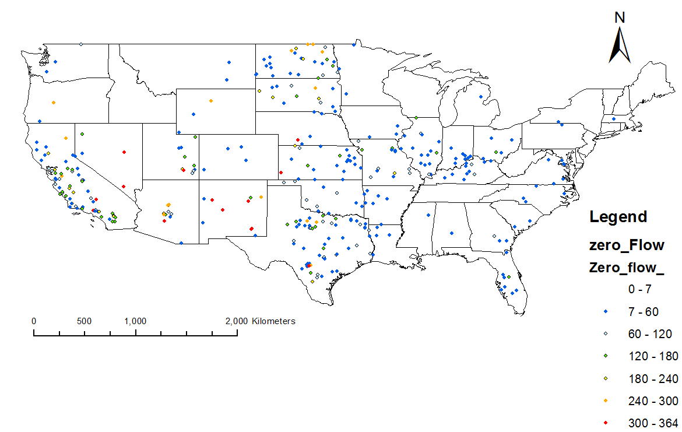
Zero Flow Days
Notes:
There are 346 stations for which the no of zero flow days per year is above 7.
We can see that Central and South-Western part have a high number of zero flow days per year – 89 sites (above 120 days).

Slide 7
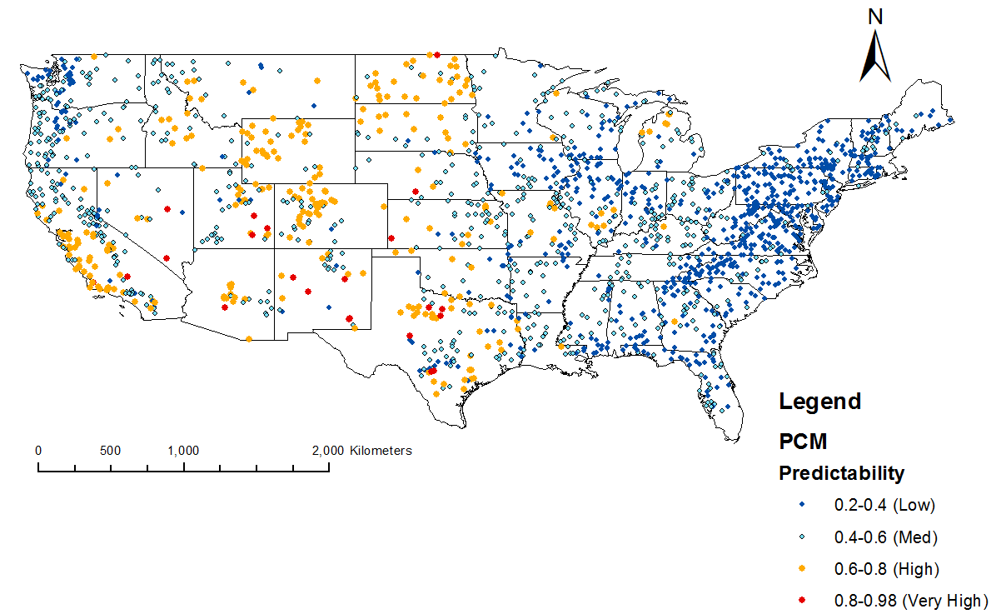
Predictability
Notes:
Predictability measures how predictable a stream is.
Its value ranges from 0 to 1.
The stream with predictability=1 is perfectly predictable.
The areas with high predictability (greater than 0.8) mostly coincides with the stations which have very high zero flow days. It makes sense as most of the streams with high zero flow days have highly predictable discharge at different times of the year.
Most of the Eastern US has a relatively lower predictability than the western parts.

Slide 8
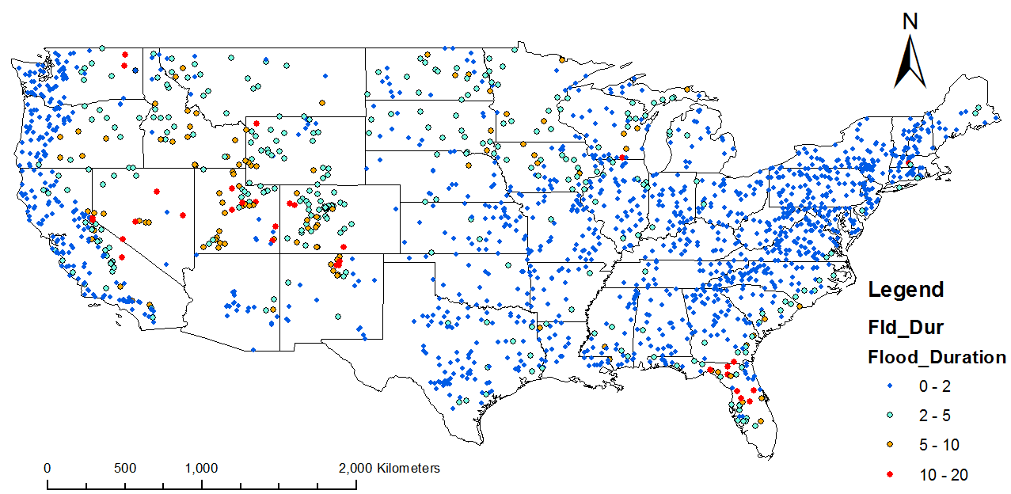
Flood Durations
Flood Duration?
No. of Days when Q equals or exceeds Q1.67
Q1.67 ?
Flows of magnitude exceeding a return interval of 1.67 years based on log-normal distribution.
Notes:
Q1.67 is considered as High flow disturbance.
e.g. a 2-year flood has 0.5 probability of occurring in any given year.
A flow with a 1.67 year return interval is often recognized as ‘bankfull’, but may vary regionally and with climate. This discharge (according to Dunne and Leopold) corresponds to the discharge at which the channel maintenance is most effective. This can be considered as an index of physical habitat disturbance in streams.
We can see that there is a high flood duration on the Central Western part as well as around Florida.

Slide 9
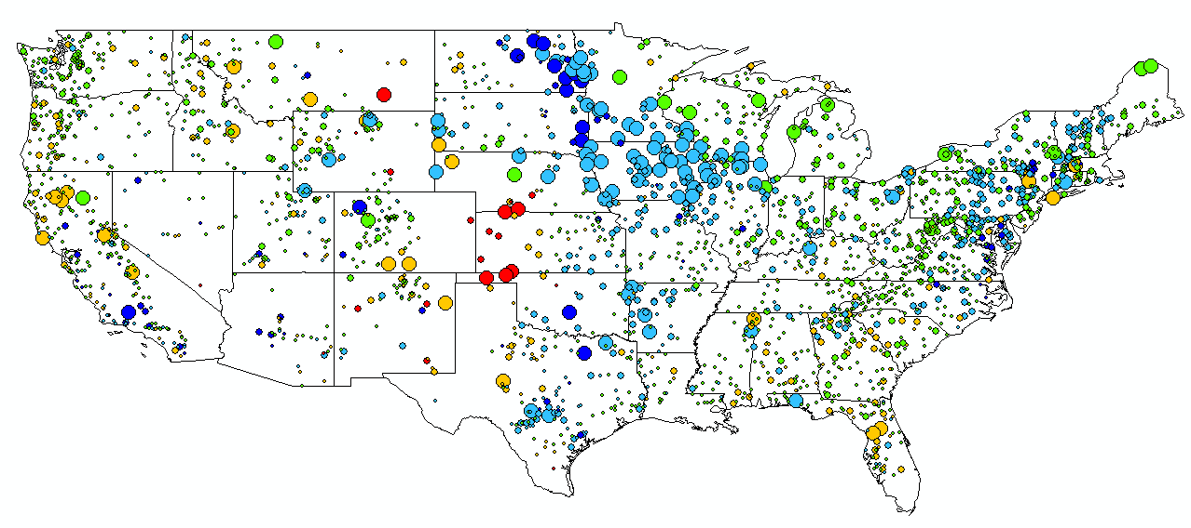
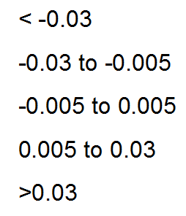
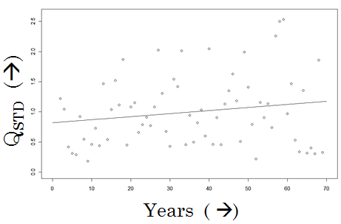
Trend Examination of Daily Discharge
P-Values
Highly Significant
Non Significant
Significant
< 0.001
0.001 – 0.1
>0.1
Notes:
How Trends were calculated?
Annual Averages were calculated
Scale was eliminated by dividing the annual averages by average over all years. (Qstd)
A simple linear regression was carried out between Qstd and No of years.
Qstd = a + b (Year)
b = Slope
The p-values were calculated to see if the trends were significant.
Slope No of Highly significant Stations
< -0.03 6 (5 of them are around Western Kansas)
-0.03 to -0.005 22
-0.005 to 0.005 17
0.005 to 0.03 80 (More than 55 of them are in the Central-Northern part of US - Iowa and northern parts)
>0.03 14 ( 10 of them are in Eastern parts of South Dakota and North Dakota)
Slope No of Significant Stations
< -0.03 9 ( 5 of them are around Western Kansas)
-0.03 to -0.005 110
-0.005 to 0.005 187
0.005 to 0.03 295 (More than 50 of them are in the Central-Northern part of US – Iowa and northern parts)
(More than 100 are on the eastern part of US from Vermont to northern Virginia)
>0.03 42 ( 8 are in Central-Northern part of US – Iowa and northern parts)
( 14 are in North eastern parts of US )

Slide 10
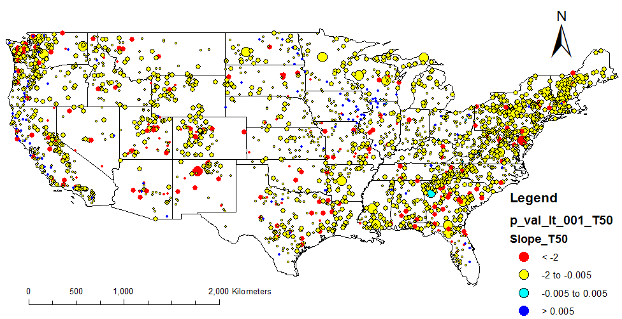
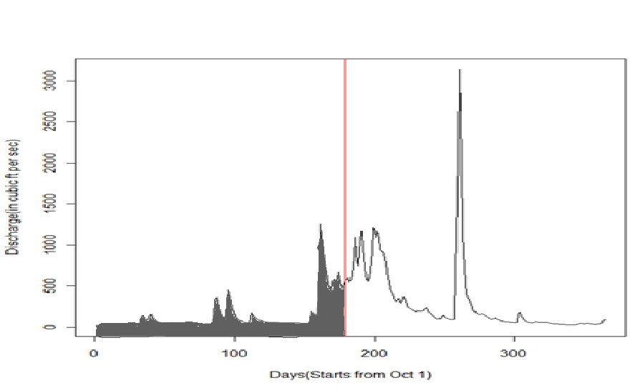
50% timing of Flow
T50 is getting earlier !
Notes:
Only 130 non-significant stations shows increasing trend in 50% timing of Flow.
Although no specific patterns exists at a specific region, we can clearly see that the timing of 50% flow is decreasing.
There are total of 32 Highly significant (p-values less than 0.001) and 1055 Significant Stations (p-values between 0.001 and 0.1) which shows decrease in the 50% timing of Flow.
Red :- There are 138 sites for which the T50 is getting earlier by more than 2 days per year.

Slide 11
Conclusions
We can see some spatial patterns in some variables:
High BFI on Central Northern, Mid Western as well as the North Western part of US.
Coefficient of Variation of Daily Flows is relatively high on the Central and South Western US where Zero Flow Days are also higher.
The predictability is relatively higher on the Western US than the Eastern Part.
The Flood Durations is relatively high on the South Eastern coasts and in the Mid Western US.
Some Trends are also seen in some of the variables:
Daily discharge values are in increasing trend in the Central Northern US.
The Timing of 50% flow has also an increasing trend across the entire US.

Slide 12
Future Work
Will be examining how the patterns and trends are related to
Climate
Geology
Geography
Land Use / Land Cover
Will be examining connections to stream macro invertebrates

Slide 13
Questions?

Slide 14
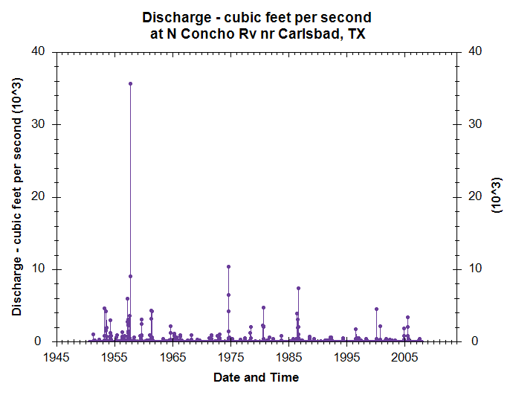
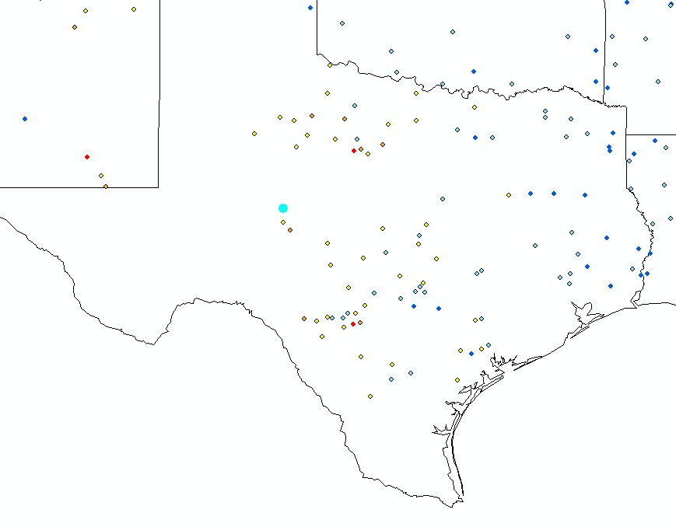
Time Series Data for 8134000
Coeff of Variation = 22.629

Slide 15
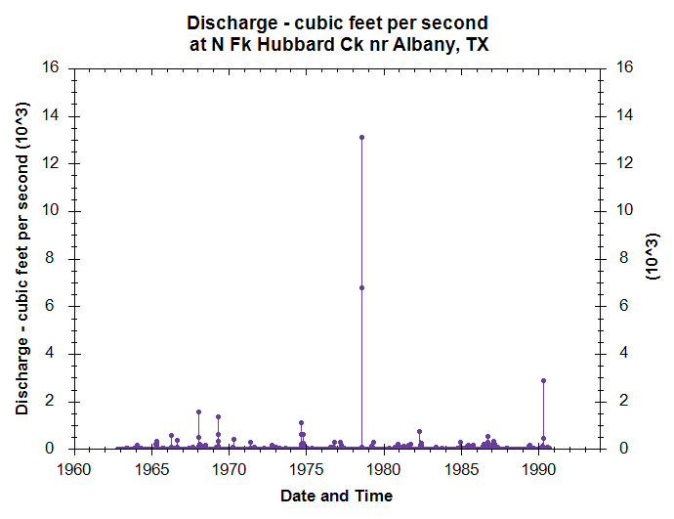
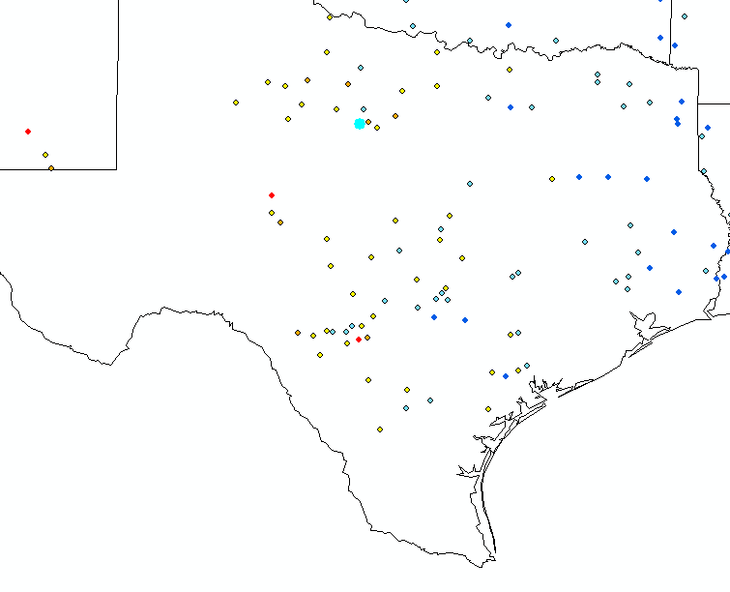
Time Series Data for 8086150
Coeff of Variation = 23.128

Slide 16
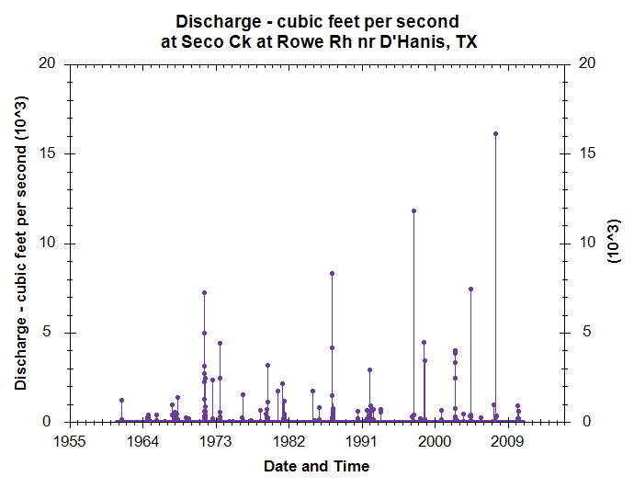
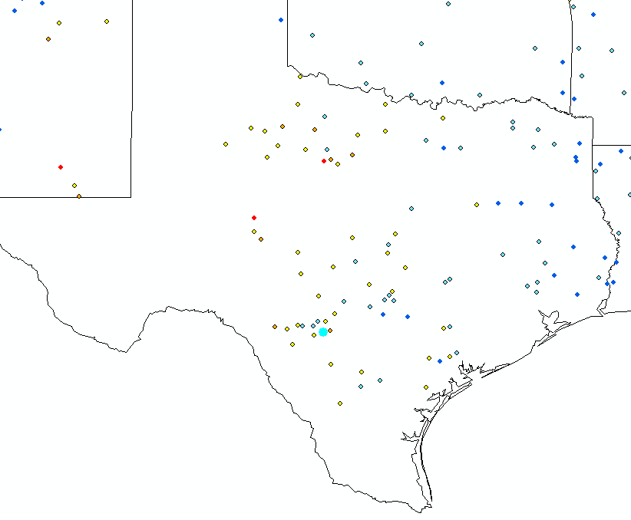
Time Series Data for 8202700
Coeff of Variation = 24.334

Slide 17
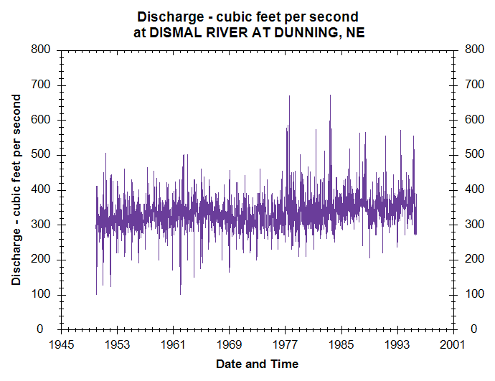
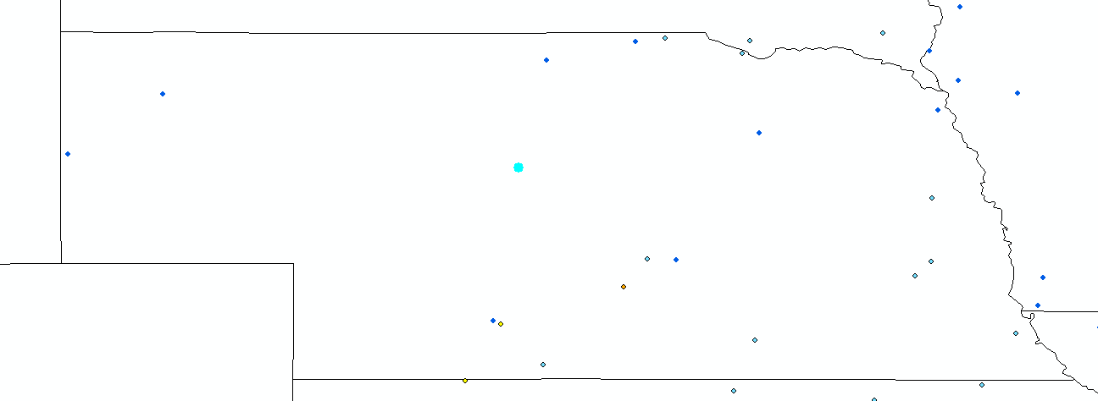
Time Series Data for 6776500
Coeff of Variation = 0.109

Slide 18
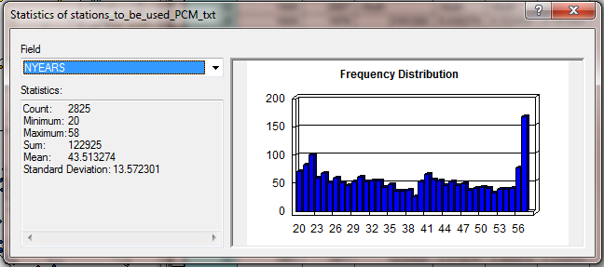
Distribution of Period of Record

