Slide 1
Indices of Road Erosion
Bear Valley Watershed, Idaho
CEE 6440: GIS in Water Resources
Nov. 30, 2010
Jeanny Wang Miles

Slide 2
Measuring Road Erosion Risk
Fine Sediment from Unsealed Roads harm downstream ecosystems (suffocate redds)
Roads Need Adequate Drainage & Maintenance
Inadequate Culverts Impede Fish Passage
Difficult to Assess Actual Impact from Roads
Good Models Need Good Field Data
Image Analysis to Help Prioritize Erosion Risk on Watershed Scale?

Slide 3
Primary Questions
  How and where does the road system modify surface and subsurface hydrology?
  How and where does the road system cause surface erosion?
  How and where is the road system hydrologically connected to stream system?
  How and where does the road system cause mass wasting?

Slide 4
Indicators of Road Hazard
Road Density (< 1, 1-2.5, > 2.5 mi/mi2)
Stream Channel Proximity (300 ft from stream)
Predicted Stream Crossings
Slope Class (within 10 percent gradients)
Mass wasting: Bedrock geology or geomorphology as indicators of road erosion hazard (unstable surfaces)
Not used in this analysis
Slope Position as an indicator of road hazard (upper 20%, middle 40%, lower 40%)
Maintenance: Best management practices as indicators of road hazard

Slide 5
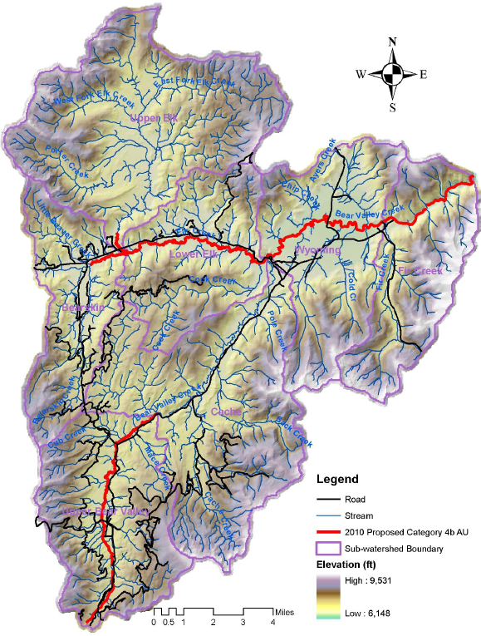
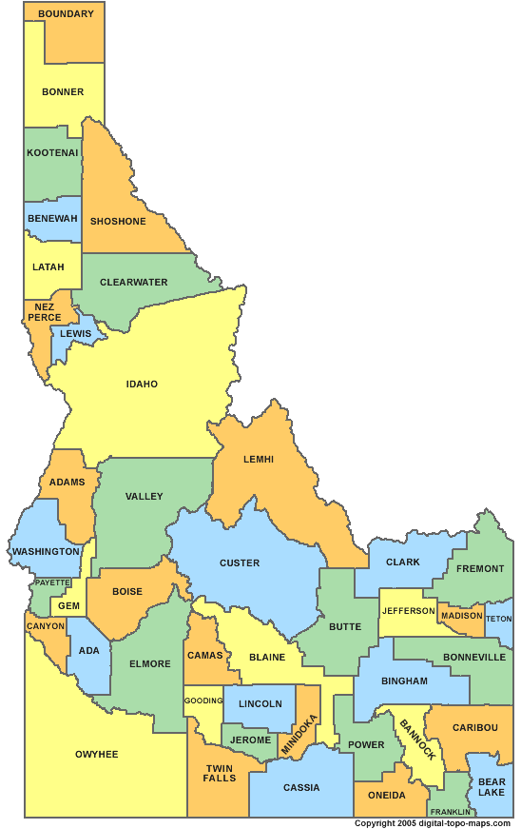
Bear Valley
Watershed,
Idaho
- Listed as 303(d) impaired for sediment under Clean Water Act
- 191 square miles in watershed
>148 miles of roads

Slide 6
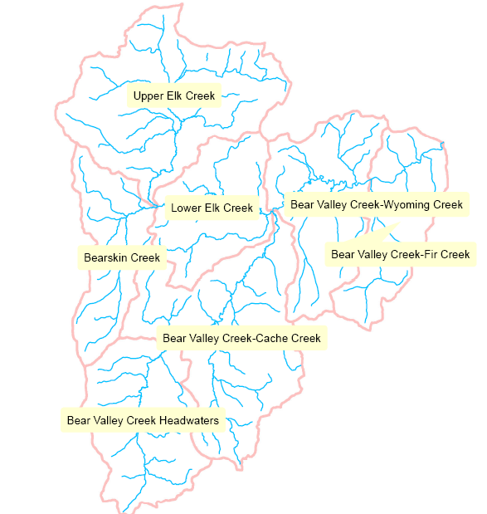
Subwatersheds
Includes two 5th HUC watersheds:
Bear Valley Creek and Elk Creek
Includes seven 6th HUC subwatersheds

Slide 7
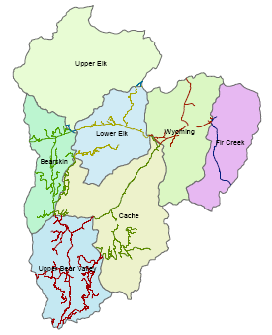
Road Density
0.88
mi/mi2
0.46 mi/mi2
Good : < 1 mi/mi2
Fair: 1 - 2.5 mi/mi2
Poor: > 2.5 mi2
1.5 mi/mi²
0.27 mi/mi2
HUC_12 | HU_6_NAME | Road (mi) | SqMi | Density
170602050101 | Upper Bear Valley | 49.00 | 26.28 | 1.86
170602050202 | Bearskin | 26.33 | 17.58 | 1.50
170602050203 | Lower Elk | 18.27 | 20.79 | 0.88
170602050102 | Cache | 34.37 | 39.97 | 0.86
170602050103 | Wyoming | 11.95 | 25.74 | 0.46
170602050104 | Fir Creek | 5.51 | 20.18 | 0.27
170602050201 | Upper Elk | 2.85 | 40.81 | 0.07
TOTAL | Bear Valley Watershed | 148.27 | 191.34 | 0.77
0.86
mi/mi2
1.86 mi/mi²

Slide 8
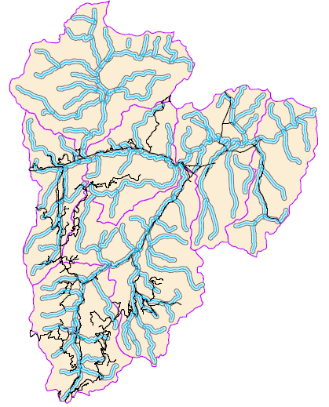
Stream Channel Proximity
Roads within
300 feet stream buffer
Good : <10% roads within buffer
Fair: 10-20% roads within buffer
Poor: >20% roads within buffer
Subwatershed | m | mi in Buffer | total mi | % rds
Fir Creek | 6930.6 | 4.3 | 5.1 | 79%
Bearskin | 23080.3 | 14.3 | 14.9 | 56%
Wyoming | 9385.1 | 5.8 | 6.3 | 51%
Cache | 23313.6 | 14.5 | 14.9 | 43%
Upper Bear Valley | 27127.9 | 16.9 | 17.2 | 35%
Lower Elk | 8597.2 | 5.3 | 5.6 | 30%
Upper Elk | 956.7 | 0.6 | 0.9 | 28%

Slide 9
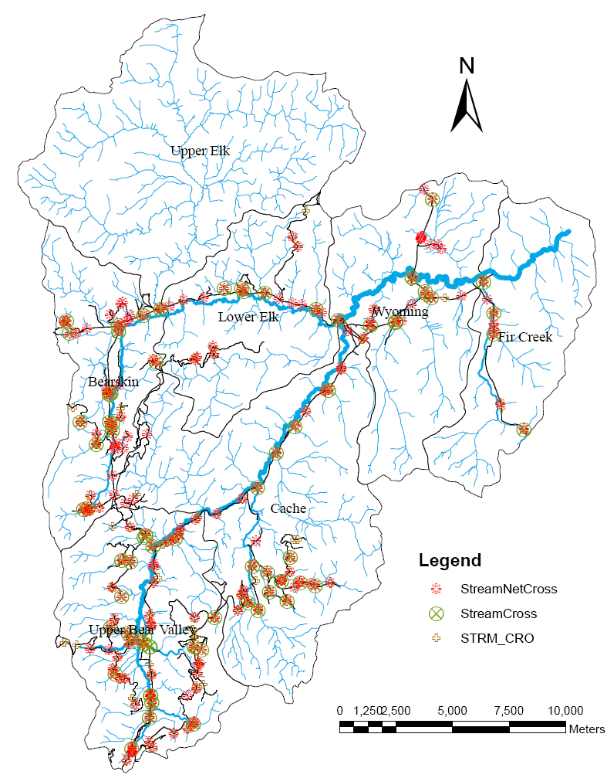
Stream Crossings
Good : < 0.2 X-ings/stream mi
Fair: 0.2 – 0.4 X-ings/str mi
Poor: > 0.4 X-ings/stream mi
StreamCross - intersect of roads & DEQ streams layers
180 StreamNetCross – intersect of roads & TauDEM flownet
176 STRM_CRO observations
191 inventoried from GRAIP
HU_6_NAME | Stream Density | Stream Crossings | Stream Miles | # Cross/ Str Mi
Upper Bear Valley | 1.2 | 19.0 | 31.5 | 0.60
Bearskin | 1.4 | 14.0 | 25.5 | 0.55
Cache | 1.2 | 13.0 | 49.1 | 0.26
Wyoming | 1.5 | 7.0 | 38.6 | 0.18
Fir Creek | 1.2 | 4.0 | 23.4 | 0.17
Lower Elk | 1.6 | 3.0 | 33.0 | 0.09
Upper Elk | 1.3 | 1.0 | 51.7 | 0.02
TOTAL (average) | 1.3 | 61 | 252.8 | 0.24

Slide 10
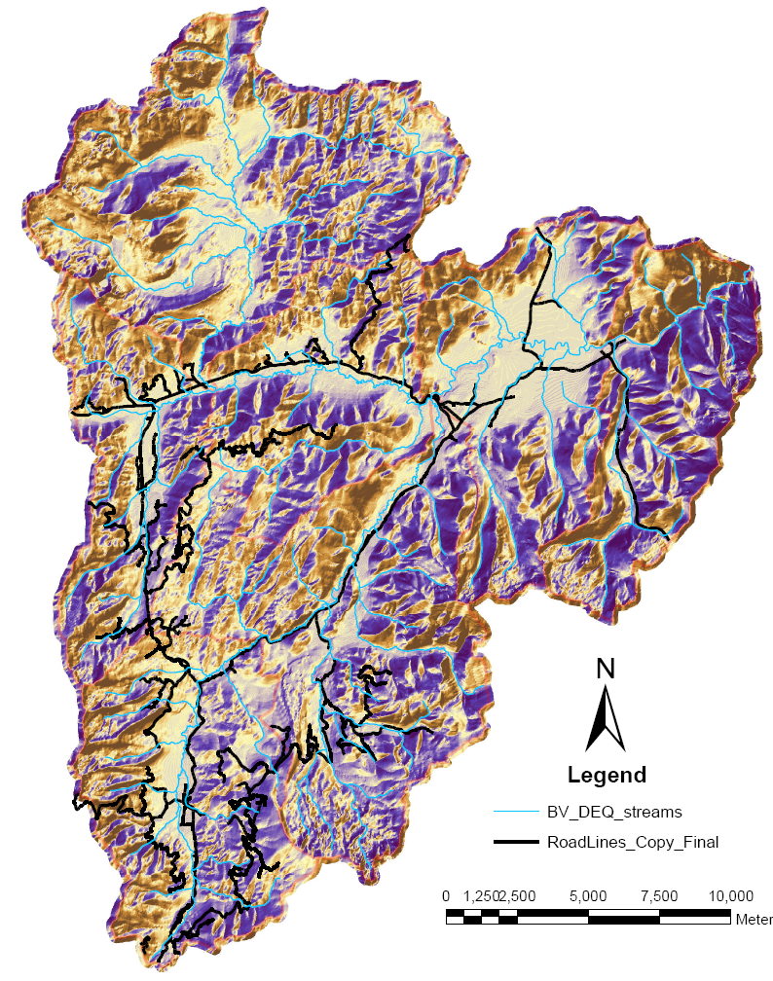
Slope Class
Slope at Drainpoints - Broad Based Dips

Slide 11
Mass Wasting
(LandTypes)
Percent of roads network
within “unstable” landtypes.
C1: Fluvial lands with moderate to high mass wasting potential
 | C1 | C2 | D1 | D2 | F1 | F5 | G1 | G2
Upper Elk |  | 31% | 19% | 15%
Wyoming | 7% | 3% | 63% | 12% |  | 0.4%
Fir Creek | 19.4% |  | 1.95% |  |  | 4.5% |  | 74 %
Lower Elk | 1.2% |  | 0.3% |  |  | 2.1% |  | 26.8%
Bearskin | 24.7% | 12.9% | 10.5% | 24.7% | 1 % |  |  | 1.0%
Cache | 17.3% | 19.6% | 47.1% |  |  |  | 0.2% | 2.6%
Upper Bear Valley | 19.0% | 49.9% | 0.7% | 20.0% |  |  |  | 2.7%

Slide 12
Geomorphic Road Assessment and Inventory Package (GRAIP)
- process and tools for analyzing road erosion
- combines road inventory with GIS analysis
- predicts road sediment production & delivery, mass wasting risk from gullies and landslides, and road hydrologic connectivity
- overlays road path on Digital Elevation Model (DEM) and uses TauDEM for flow accumulation
Sediment production for each road segment:
E = B x L x S x R x V
(base rate, length, slope, surface, vegetation)

Slide 13
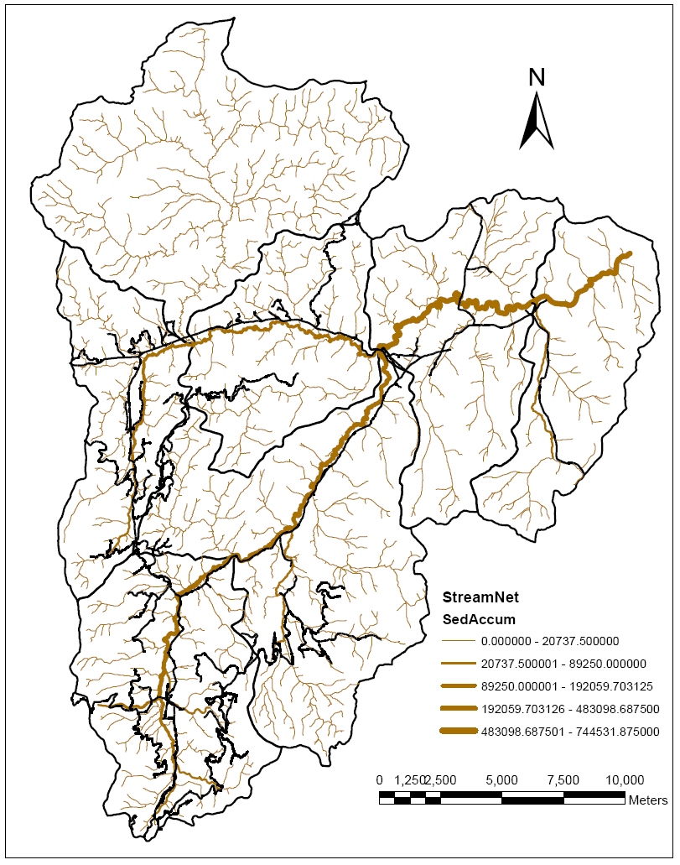
GRAIP
Sediment Accumulation
Percent SedDel / SedProd
 | %
Fir Creek | 20.4%
Upper Bear Valley | 12.6%
Bearskin | 11.2%
Wyoming | 8.1%
Cache | 7.5%
Lower Elk | 4.4%
Upper Elk | 2.0%

Slide 14
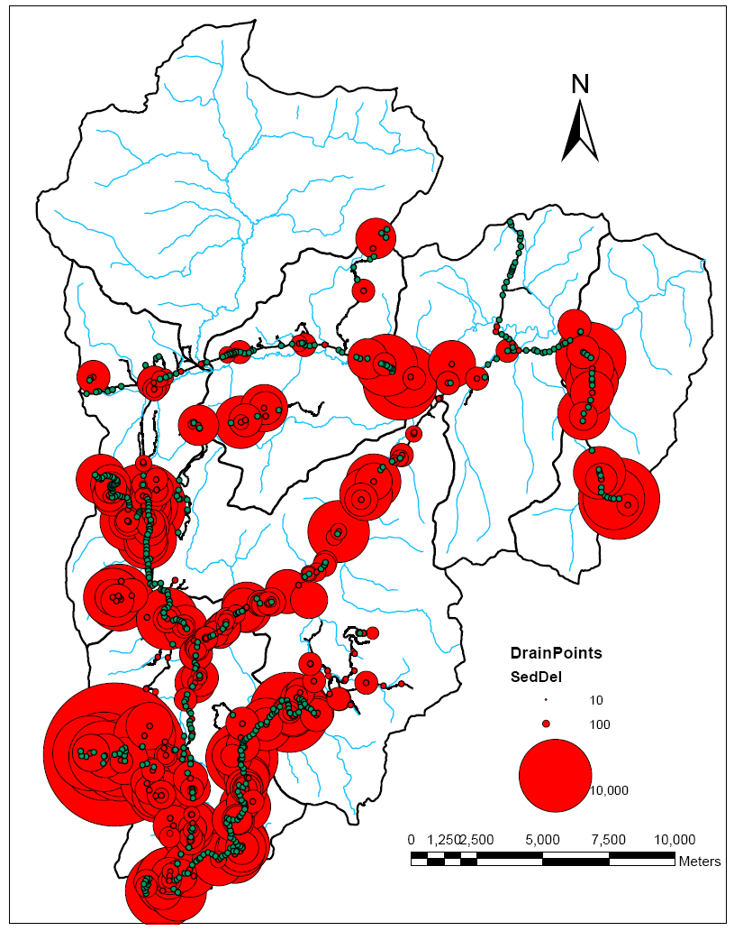
GRAIP
Sediment Delivery
Percent SedDel / SedProd
 | %
Fir Creek | 20.4%
Upper Bear Valley | 12.6%
Bearskin | 11.2%
Wyoming | 8.1%
Cache | 7.5%
Lower Elk | 4.4%
Upper Elk | 2.0%
Sediment Delivery (kg/yr)
 | sedDel
Upper Bear Valley | 388,658
Bearskin | 140,574
Cache | 94,441
Fir Creek | 58,874
Lower Elk | 48,336
Wyoming | 10,500
Upper Elk | 3,150

Slide 15
Relative Comparison
HUC_6_NAME | 1. Density | 2. Stream Proximity | 3. Crossings / Stream Mile | Ave ranking | 123 Index | sedDel (kg/yr) | % Total sedDel
Upper Bear Valley | 1.86 | 34% | 0.60 | 2.67 | 38.72% | 388,658 | 52.2%
Bearskin | 1.50 | 54% | 0.55 | 2.67 | 44.86% | 140,574 | 18.9%
Lower Elk | 0.88 | 29% | 0.26 | 2.00 | 6.80% | 48,336 | 6.5%
Cache | 0.86 | 42% | 0.18 | 1.67 | 6.57% | 94,441 | 12.7%
Wyoming | 0.46 | 49% | 0.17 | 1.67 | 3.87% | 10,500 | 1.4%
Fir Creek | 0.27 | 78% | 0.09 | 1.67 | 1.94% | 58,874 | 7.9%
Upper Elk | 0.07 | 21% | 0.02 | 1.67 | 0.03% | 3,150 | 0.4%
TOTAL | 0.77 | 44% | 0.24 | 2.0 | 8.23% | 744,532 | 100%

Slide 16
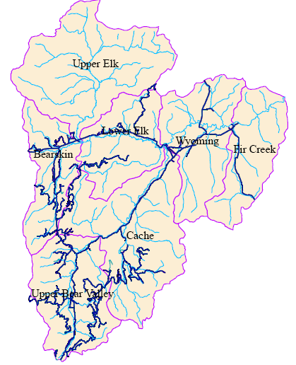
Conclusion
Bear Valley Watershed
Road Erosion
Upper Bear and Bearskin roads deliver most sediment to streams
Sediment Delivered (kg/yr)
 | sedDel
Upper Bear Valley | 388,658
Bearskin | 140,574
Cache | 94,441
Fir Creek | 58,874
Lower Elk | 48,336
Wyoming | 10,500
Upper Elk | 3,150

Slide 17
Conclusion
Image analysis can help prioritize erosion problems
Indicators confirm
GRAIP model predictions
(in a relative sense)
Sediment Delivered (kg/yr)
 | sedDel
Upper Bear Valley | 388,658
Bearskin | 140,574
Cache | 94,441
Fir Creek | 58,874
Lower Elk | 48,336
Wyoming | 10,500
Upper Elk | 3,150

Slide 18
Questions?

Slide 20
Secondary Questions
  How and where do road-stream crossings influence local stream channels and water quality?
  How and where does the road system restrict the migration and movement of aquatic organisms?
  How and where does the road system affect shading, litterfall, and riparian plant communities?
  How and where does the road system contribute to fishing, poaching, or direct habitat loss for at-risk aquatic species?
  How and where does road system facilitate introduction on non-native species?

