Slide 1


Refined NIDIS Application for the Upper Colorado River Basin

Slide 2
What is NIDIS?
National Integrated Drought Information System
Implementation of National Drought Policy Act of 1998
Goal of NIDIS:
  Develop the leadership and networks to implement an integrated drought monitoring and forecasting system at federal, state, and local levels
  Foster and support a research environment focusing on risk assessment, forecasting, and management
  Create an "early warning system" for drought to provide accurate, timely, and integrated information
  Develop interactive systems, such as the Web Portal, as part of the early warning system
  Provide a framework for public awareness and education about droughts

Slide 3
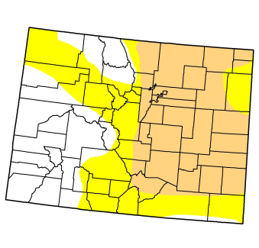
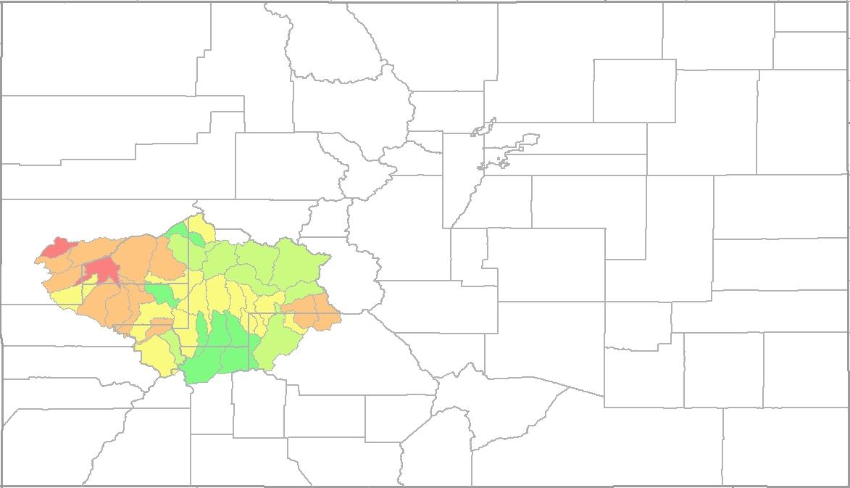
Goals
Provide platform for refined (smaller scale) visualization of drought index values
Provide framework for manual calculation of drought index values
  Import data
  Defining rules for interpolation
  Perform required calculations / spatial analysis

Slide 4
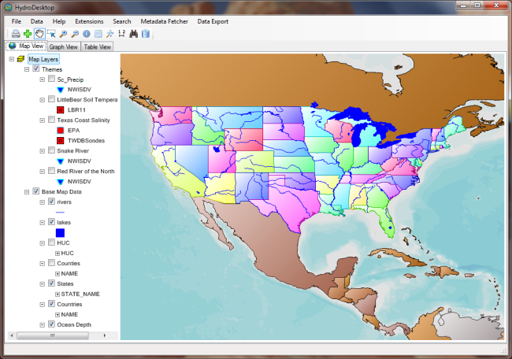
NWIS
WOF
SNOTEL
WOF
Reservoir
WOF
Precip
WOF
Soil Moisture
WOF
HydroDesktop Plug-in
Displays “published” drought index values
Calculates and displays “personal” index values
Harvest Utility
Get Data and Convert to Monthly
Monthly Data
ODM
WOF
GIS
Framework
Calculate Data Distributions
Calculate Drought Index Values
Map Application
ASP.Net
ArcGIS Server
ESRI Base Map Services
Calculated Values
ODM
WOF
Hosted Map Services
Time Series Analyst

Slide 5
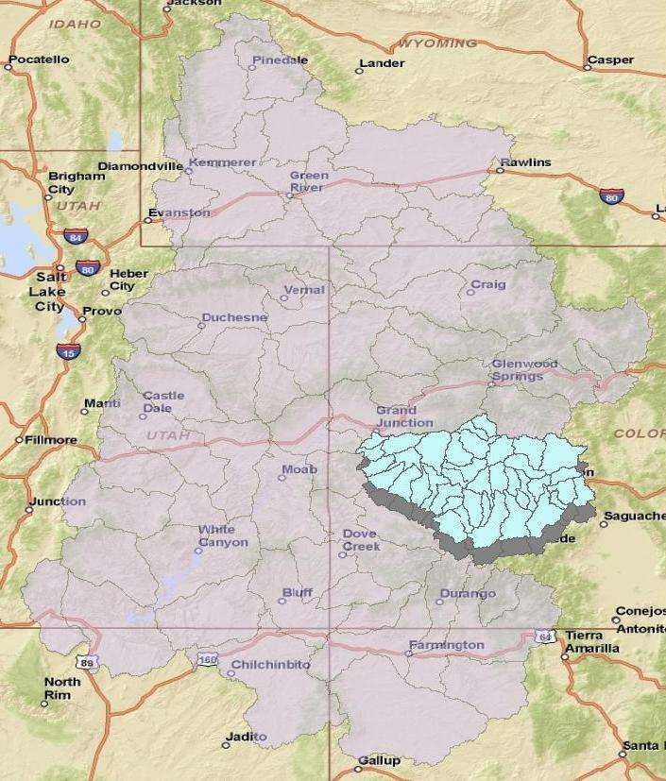
Parameters for Term Project
Subset of Upper Colorado River Basin
Visualize index values at scale of HUC 10 catchments
Calculate drought index values using the revised SWSI method

Slide 6
Revised SWSI
Currently used by state of Colorado for drought forecasts
Uses forecast streamflow and reservoir values
P = nonexceedance probability
SWSI index between -4.1 (extreme drought) and 4.1 (extremely wet)

Slide 7
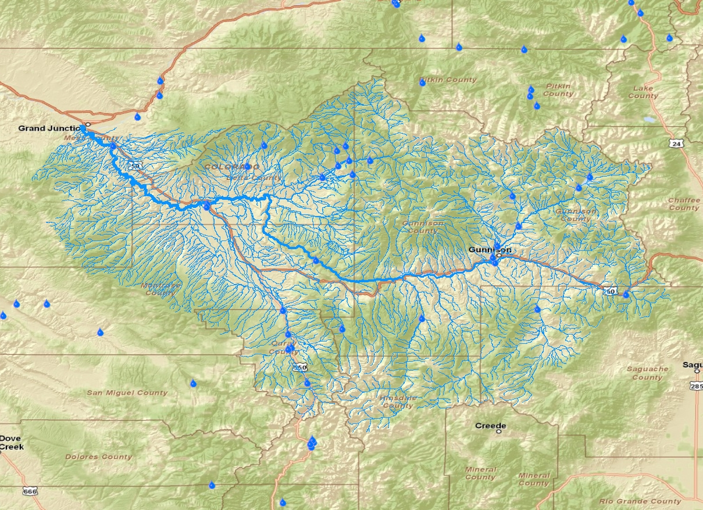
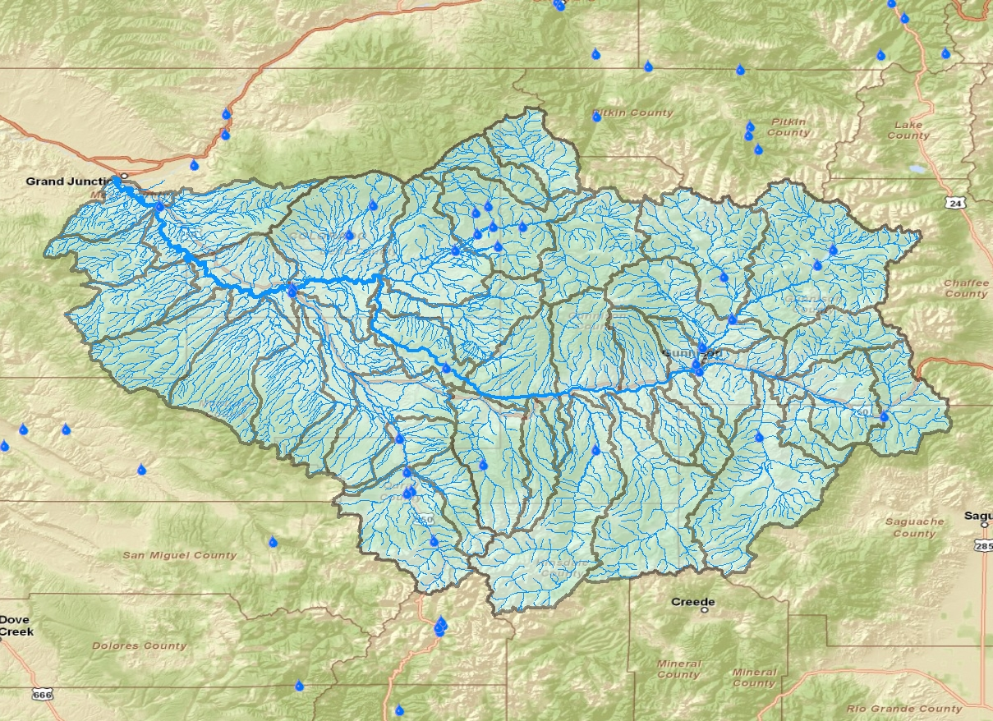
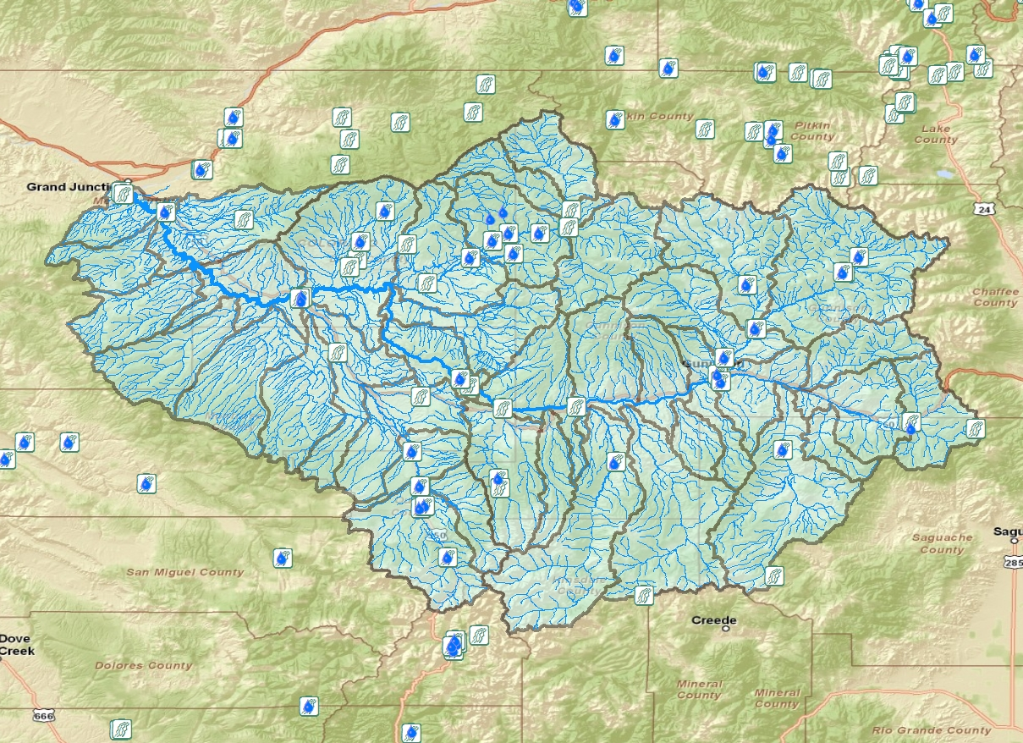
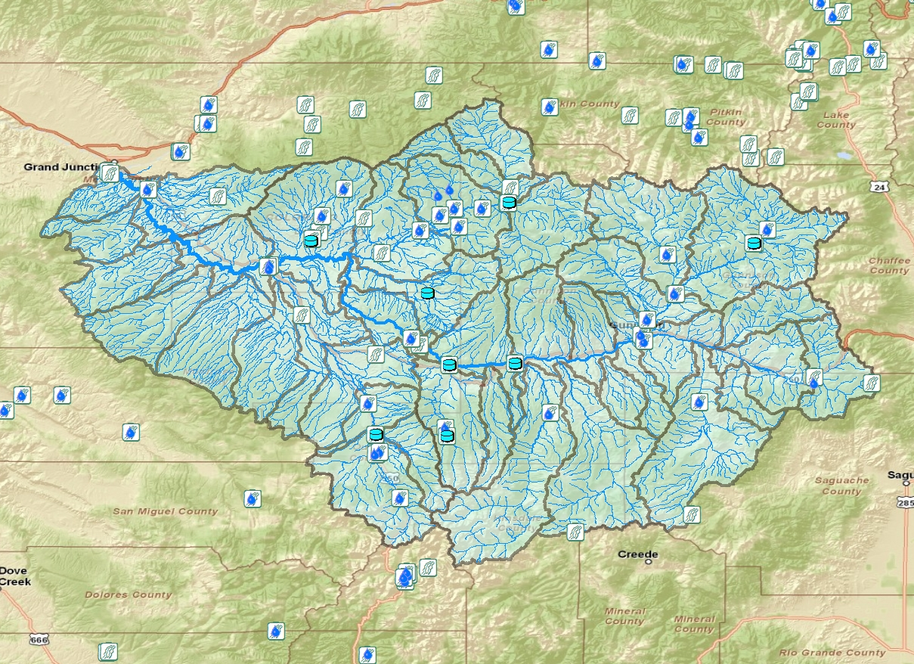
Data Collection
National Hydrologic Dataset
  Spatial data for USGS stream gages and river network
Watershed Boundary Dataset
  HUC 10 catchments
NRCS
  Spatial data for forecast stream gages
  Streamflow forecasts
USGS
  Historic streamflow data
Bureau of Reclamation
  Spatial data for reservoirs
  Historic reservoir data

Slide 8
Revised SWSI Calculation
Year | Q Apr – Jul (acft) | ΔS Apr - Jul (acft) | Total (acft)
2010 | 132776 | 24640 | 24640
2009 | 342358 | 24068 | 24068
2008 | 480627 | 15817 | 15817
2007 | 268674 | 12548 | 12548
2006 | 222310 | 17288 | 17288
2005 | 247864 | 21380 | 21380
2004 | 196515 | 15118 | 15118
2003 | 161306 | 35933 | 35933
2002 | 173066 | -9833 | -9833
2001 | 222625 | 14286 | 14286
2000 | 258390 | 11580 | 11580
… | … | … | …
Q tot (acft) | Rank | Non-exceedance (%)
106497.2 | 1 | 1.886792453
136693.5 | 2 | 3.773584906
141919.3 | 3 | 5.660377358
157416.2 | 4 | 7.547169811
163233.5 | 5 | 9.433962264
172549.1 | 6 | 11.32075472
187641 | 7 | 13.20754717
189837.1 | 8 | 15.09433962
197239.1 | 9 | 16.98113208
200912.9 | 10 | 18.86792453
200965.1 | 11 | 20.75471698
204366.1 | 12 | 22.64150943
… | … | …

Slide 9
Revised SWSI Calculation
Find correlations to forecast change in reservoir storage
Fit forecast total streamflow + change in reservoir storage in ranking to find non-exceedance probability
Use non-exceedance probability to calculate revised SWSI
Q tot (acft) | Rank | Non-exceedance (%)
106497.2 | 1 | 1.886792453
136693.5 | 2 | 3.773584906
141919.3 | 3 | 5.660377358
157416.2 | 4 | 7.547169811
163233.5 | 5 | 9.433962264
172549.1 | 6 | 11.32075472
… | … | …

Slide 10
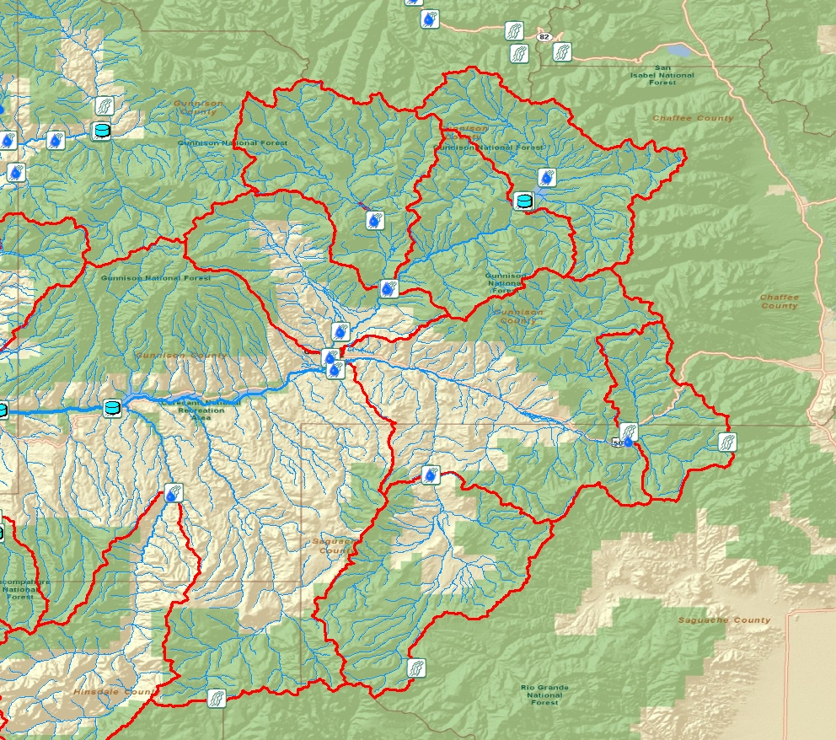
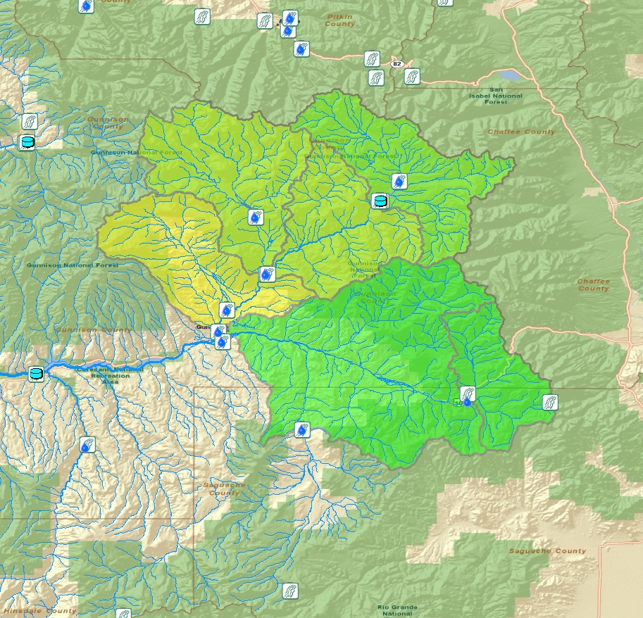
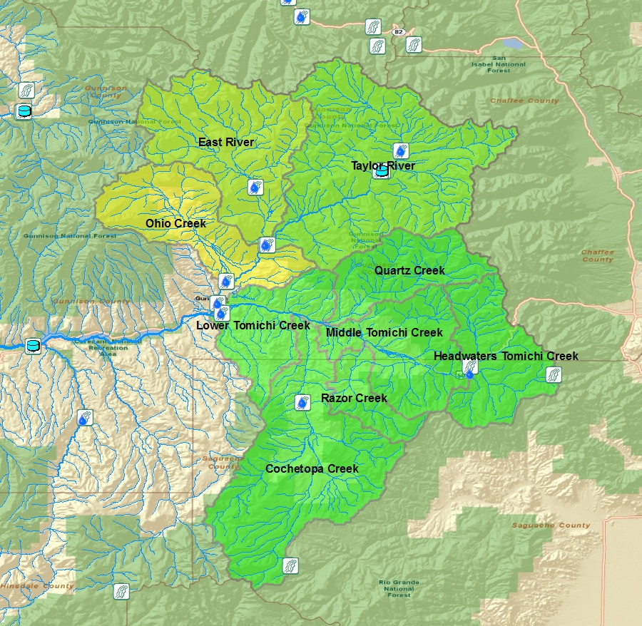
Interpolation
Gage subwatersheds (GWS) specified between streamflow gages
Revised SWSI values assigned
GSW interpolated to HUC 10 catchments

Slide 11
To Do:
Automate interpolation using model builder
Create time series visualizations for temporal variation and comparison between forecast and actual conditions
Complete process for entire study area

Slide 12

Questions?

