Slide 1
Spatial Analysis Using Grids
Learning Objectives
By the end of this class you should be able to:
describe some ways continuous surfaces or spatial fields are represented in GIS
list and describe the data elements that comprise a grid data structure
describe how integer, categorical and real valued data fields are represented using grids
use map algebra to perform raster calculations on grids and explain the scale issues involved in raster calculations where grids may not have the same cell size
define interpolation and describe aspects to be considered in interpolating a spatial field
use interpolation to determine watershed average precipitation
calculate the slope of a topographic surface represented by a grid using:
ArcGIS method based on finite differences,
D8 model in direction of steepest single flow direction,
D∞ model in direction of steepest outward slope on grid centered triangular facets.

Slide 2
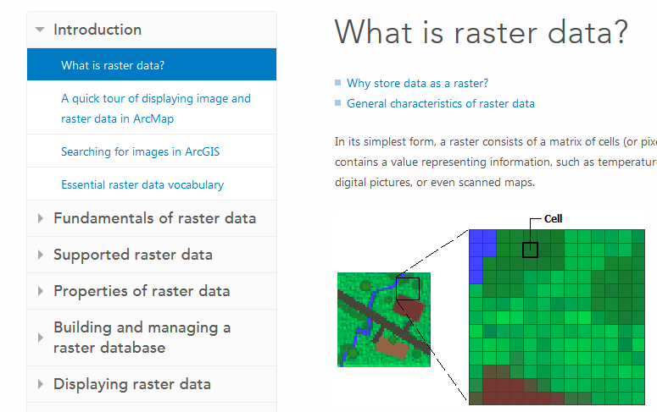
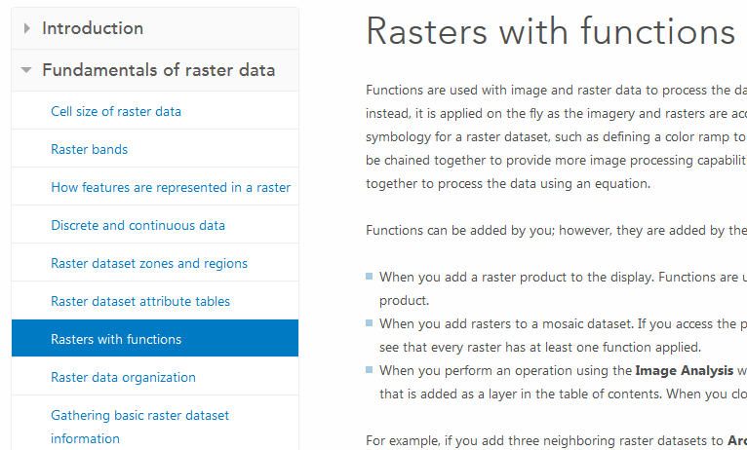
Readings – at http://resources.arcgis.com/en/help/
ArcGIS help on raster data from the Introduction "What is raster data?" to the end of "Rasters with functions" in Fundamentals of raster data http://desktop.arcgis.com/en/desktop/latest/manage-data/raster-and-images/what-is-raster-data.htm.

Slide 3
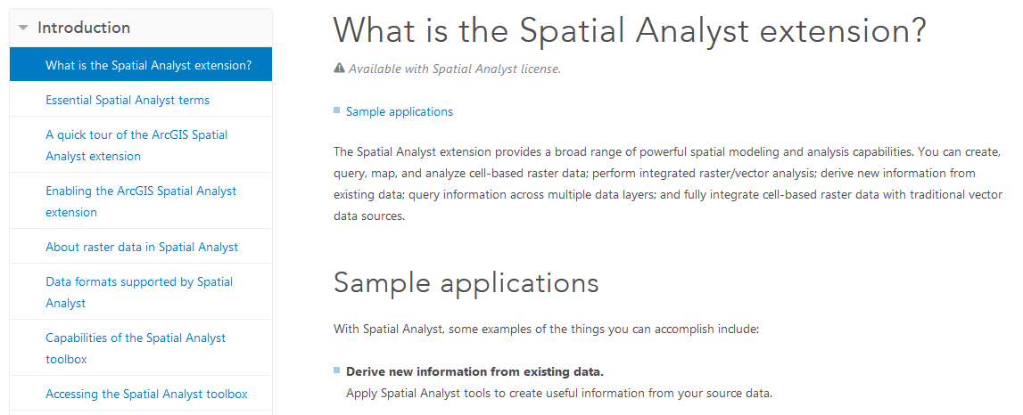
Readings – at http://resources.arcgis.com/en/help/
ArcGIS help on Spatial Analyst from the Introduction, "What is the Spatial Analyst Extension?" to "About raster data in Spatial Analyst“ http://desktop.arcgis.com/en/desktop/latest/guide-books/extensions/spatial-analyst/what-is-the-spatial-analyst-extension.htm.

Slide 4
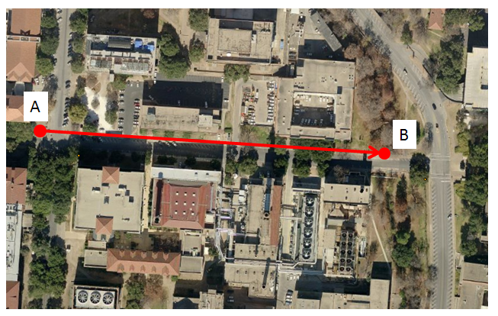
Slope Handout
http://www.neng.usu.edu/cee/faculty/dtarb/giswr/2015/Slope.pdf
Determine the length, slope and azimuth of the line AB.

Slide 5
Two fundamental ways of representing geography are discrete objects and fields.
f(x,y)
y
x
Notes:
DRM

Slide 6
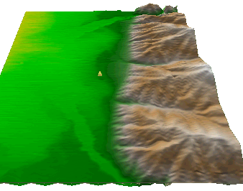
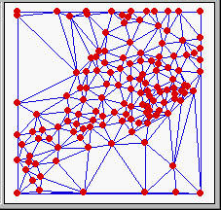
Numerical representation of a spatial surface (field)
Grid or Raster
TIN
Contour and flowline

Slide 7
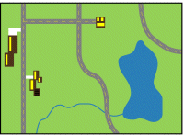
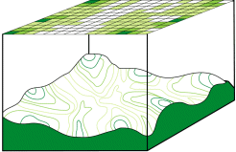
Discrete (vector) and continuous (raster) data
Images from http://resources.arcgis.com/en/help/main/10.1/index.html#/Discrete_and_continuous_data/009t00000007000000/

Slide 8
Raster and Vector Data
Raster data are described by a cell grid, one value per cell
Vector
Raster
Point
Line
Zone of cells
Polygon
Notes:
DRM

Slide 9
Line as a Sequence of Cells

Slide 10
Polygon as Zone of Grid Cells
From: http://resources.arcgis.com/en/help/main/10.2/index.html#/How_features_are_represented_in_a_raster/009t00000006000000/

Slide 11
Raster and Vector are two methods of representing geographic data in GIS
Both represent different ways to encode and generalize geographic phenomena
Both can be used to code both fields and discrete objects
In practice a strong association between raster and fields and vector and discrete objects
Notes:
DRM

Slide 12
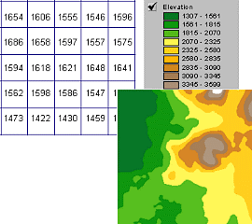
A grid defines geographic space as a mesh of identically-sized square cells. Each cell holds a numeric value that measures a geographic attribute (like elevation) for that unit of space.

Slide 13
The grid data structure
Grid size is defined by extent, spacing and no data value information
Number of rows, number of column
Cell sizes (X and Y)
Top, left , bottom and right coordinates
Grid values
Real (floating decimal point)
Integer (may have associated attribute table)
Number of Columns
Number
of
rows
(X,Y)
NODATA cell
Cell size

Slide 14
NODATA Cells

Slide 15
Cell Networks

Slide 16
Floating Point Grids
Continuous data surfaces using floating point or decimal numbers

Slide 17
Integer valued grids to represent zones

Slide 18
Value attribute table for categorical (integer) grid data
Attributes of grid zones

Slide 19
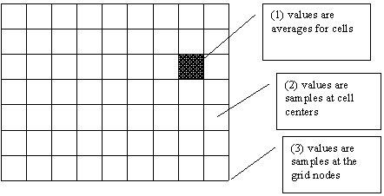
Raster Sampling
from Michael F. Goodchild. (1997) Rasters, NCGIA Core Curriculum in GIScience, http://www.ncgia.ucsb.edu/giscc/units/u055/u055.html, posted October 23, 1997

Slide 20
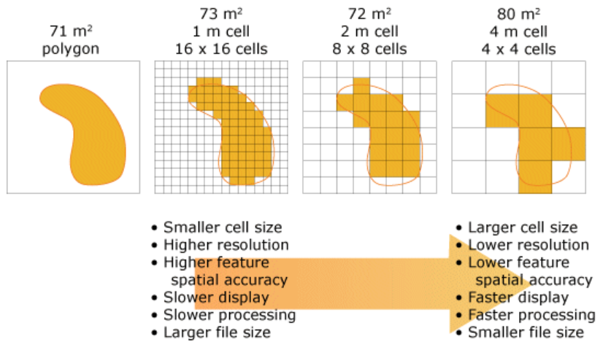
Cell size of raster data
From http://help.arcgis.com/en/arcgisdesktop/10.0/help/index.html#/Cell_size_of_raster_data/009t00000004000000/

Slide 21
Raster Generalization
Largest share rule
Central point rule

Slide 22
Map Algebra/Raster Calculation
Example
5
6
Precipitation
-
Losses (Evaporation, Infiltration)
=
Runoff
Cell by cell evaluation of mathematical functions
7
6
-
3
3
2
4
=
2
3
5
2

Slide 23
Runoff generation
P
Depends on
Rainfall intensity or amount
Antecedent conditions
Mechansim
Soils and vegetation
Depth to water table (topography)
Infiltration excess overland flow
aka Horton overland flow
P
f
P
q_{o}
f
Partial area infiltration excess overland flow
P
q_{o}
P
P
f
Saturation excess overland flow
P
Spatial variability in these factors suggests a geographic approach based on distributed information
q_{o}
P
P
q_{r}
q_{s}

Slide 24
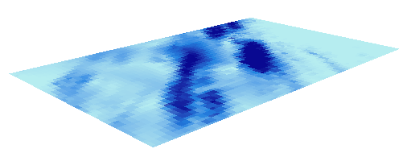
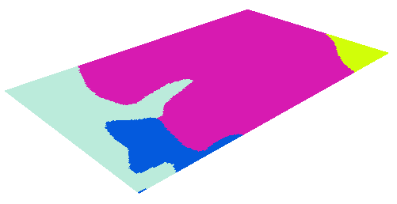
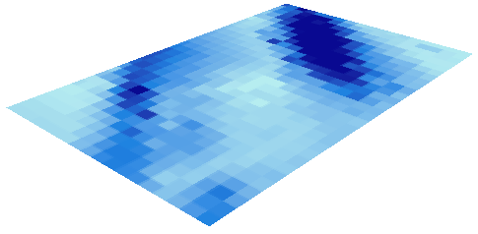
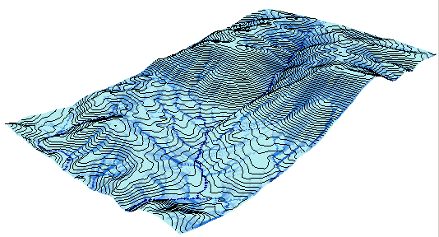
Cell based discharge mapping by accumulation of generated runoff
Radar Precipitation grid
Soil and land use grid
Runoff grid from raster calculator operations implementing runoff generation formula’s
Accumulation of runoff within watersheds

Slide 25
Raster calculation – some subtleties
Resampling or interpolation (and reprojection) of inputs to target extent, cell size, and projection within region defined by analysis mask
+
=
Analysis mask
Analysis cell size
Analysis extent

Slide 26
Runoff Generation Raster Calculation Example
Precipitation, P cm/hr
Infiltration Rate, f cm/hr
150 m
100 m
150 m
100 m
2.2
3
4
4
6
1.8
2.5
3.5
3.1
4
1.5
2
2.7
Runoff R = P-f

Slide 27
Lets Experiment with this in ArcGIS
precip.asc
ncols 2
nrows 2
xllcorner 0
yllcorner 0
cellsize 150
NODATA_value -9999
4 6
3.1 4
infiltration.asc
ncols 3
nrows 3
xllcorner 0
yllcorner 0
cellsize 100
NODATA_value -9999
2.2 3 4
1.8 2.5 3.5
1.5 2 2.7

Slide 28
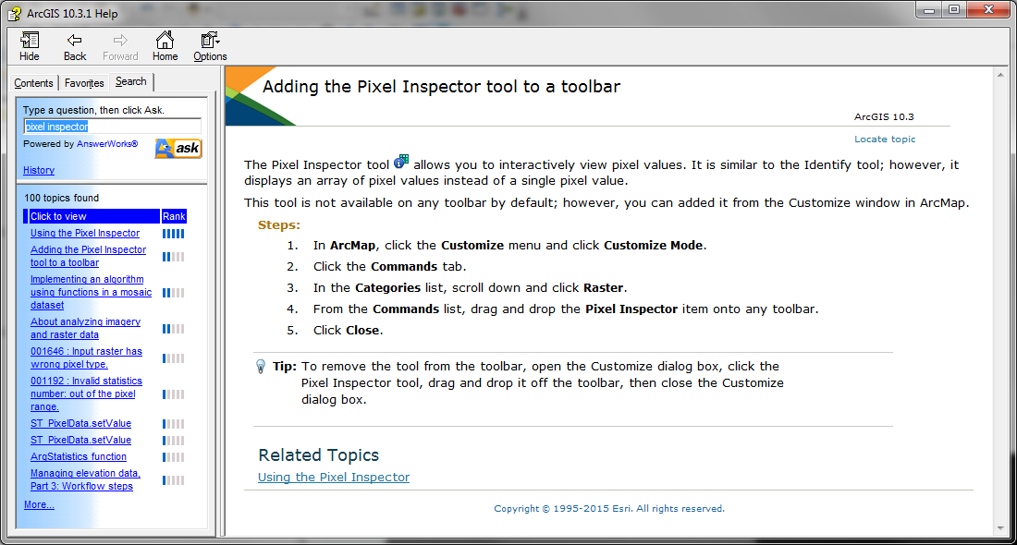
Example and Pixel Inspector

Slide 29
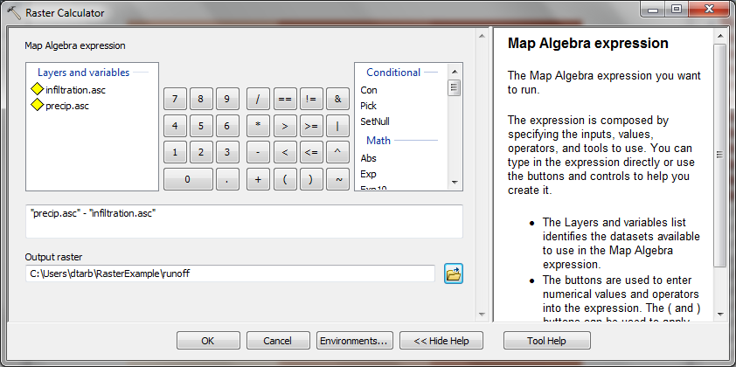
Runoff calculation using Raster Calculator
“precip.asc” - “infiltration.asc”

Slide 30
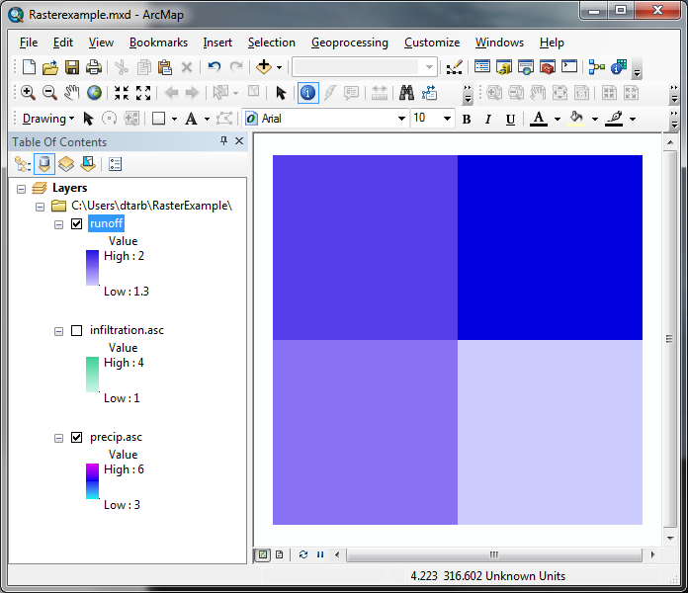
The Result
Outputs are on 150 m grid.
How were values obtained ?
1.8
2
1.6
1.3

Slide 31
Nearest Neighbor Resampling with Cellsize Maximum of Inputs
100 m
2.2
3
4
4 - 2.2 = 1.8
1.8
2.5
3.5
6 - 4 = 2
1.8
2
1.5
2
2.7
3.1 – 1.5 = 1.6
4 – 2.7= 1.3
1.6
1.3
150 m
4
6
3.1
4

Slide 32
Inferences
ArcGIS has used nearest neighbors to align scales
ArcGIS has done raster computation at the scale of the coarsest input
Is this what we want?
How to control scale?
What is meant by scale?

Slide 33
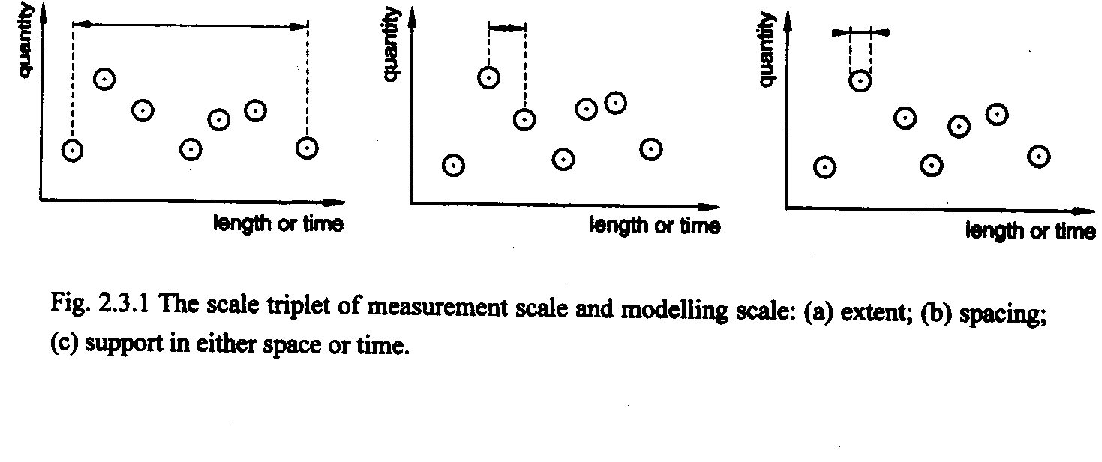
The scale triplet
a) Extent
b) Spacing
c) Support
From: Blöschl, G., (1996), Scale and Scaling in Hydrology, Habilitationsschrift, Weiner Mitteilungen Wasser Abwasser Gewasser, Wien, 346 p.

Slide 34
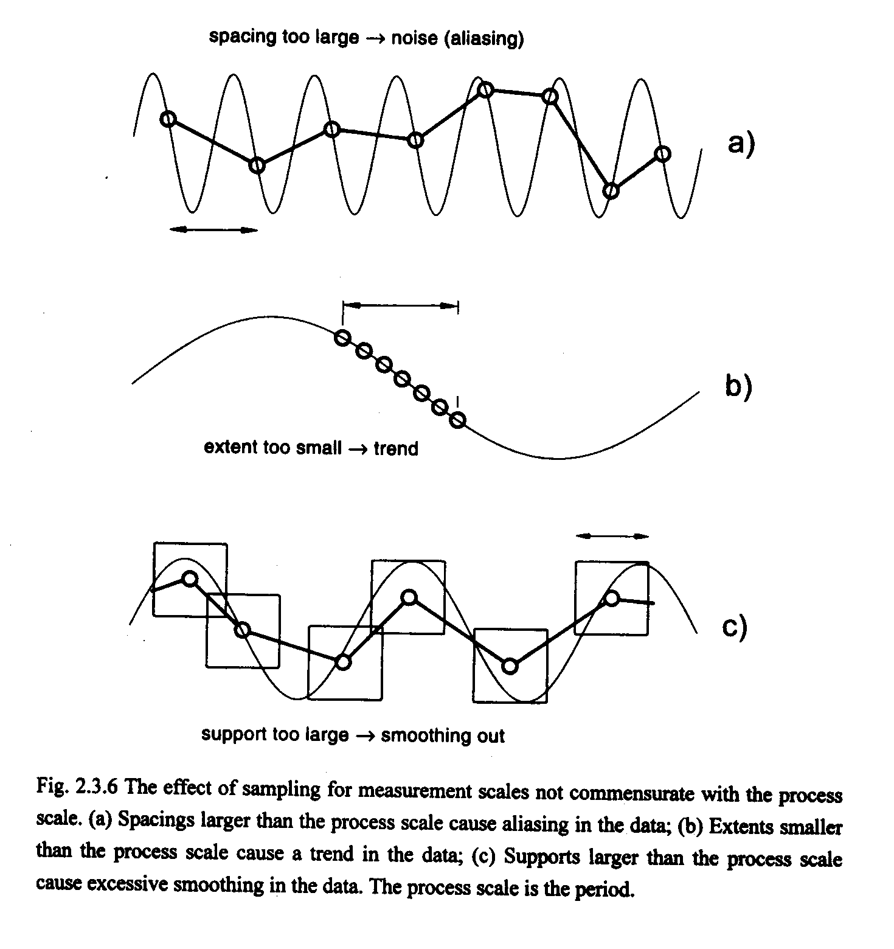
Scale and the interpretation of data
From: Blöschl, G., (1996), Scale and Scaling in Hydrology, Habilitationsschrift, Weiner Mitteilungen Wasser Abwasser Gewasser, Wien, 346 p.

Slide 35
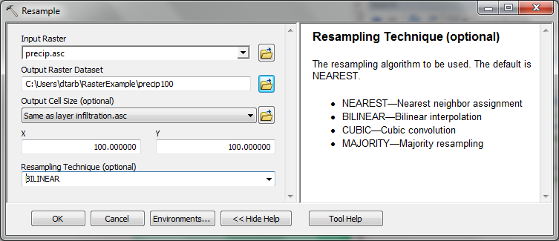
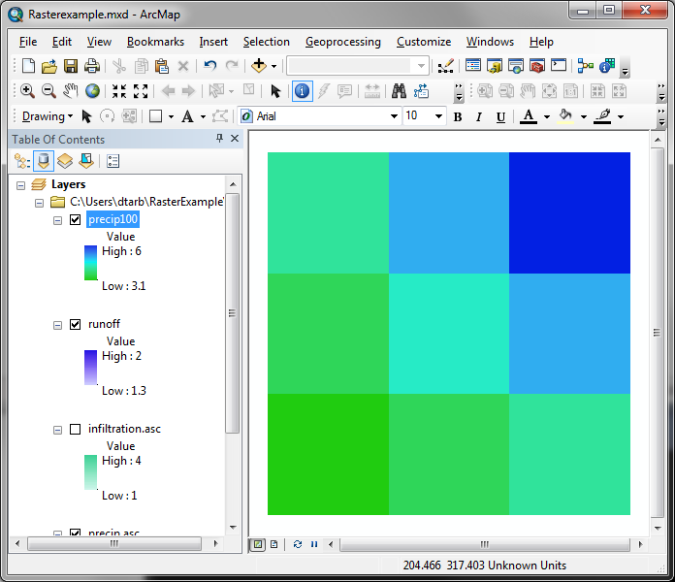
Resample to get consistent cell size
Spacing & Support
4
4
5
6
6
3.55
4.275
5
3.1
4
3.1
3.55
4

Slide 36
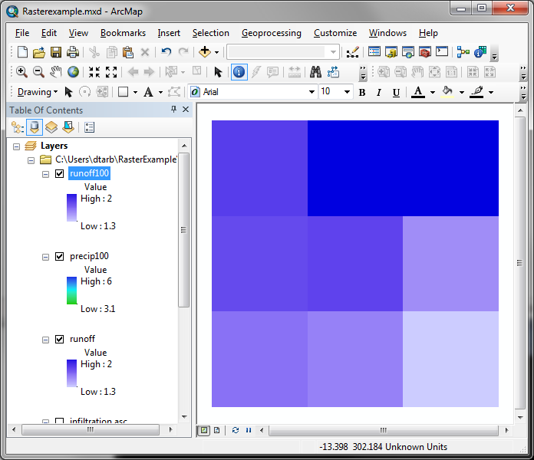
Calculation with consistent 100 m cell size grid
“precip100” - “infiltration”
Outputs are on 100 m grid as desired.
How were values obtained ?
1.8
2
2
1.75
1.775
1.5
1.6
1.55
1.3

Slide 37
100 m cell size raster calculation
4 – 2.2 = 1.8
100 m
4
5
6
5 – 3 = 2
6 – 4 = 2
3.55
4.275
5
3.55 – 1.8 = 1.75
1.8
2
2
3.1
3.55
4
4.275 – 2.5 = 1.775
5 – 3.5 = 1.5
1.75
1.775
1.5
3.1 – 1.5 = 1.6
100 m
2.2
3
4
3.55 – 2 = 1.55
1.6
1.55
1.3
4 – 2.7 = 1.3
1.8
2.5
3.5
1.5
2
2.7

Slide 38
Interpolation
Estimate values between known values.
A set of spatial analyst functions that predict values for a surface from a limited number of sample points creating a continuous raster.
Nearest neighbor
Inverse distance weight
Bilinear interpolation
Kriging (best linear unbiased estimator)
Spline

Slide 39
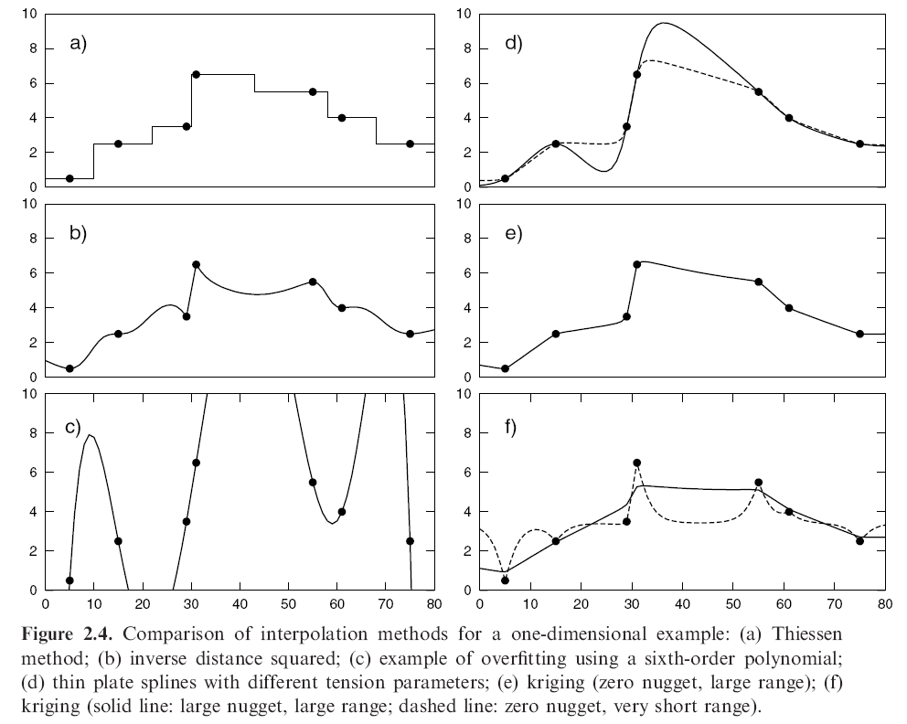
Interpolation Comparison
Grayson, R. and G. Blöschl, ed. (2000)

Slide 40
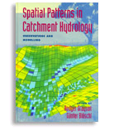
Further Reading
Grayson, R. and G. Blöschl, ed. (2000), Spatial Patterns in Catchment Hydrology: Observations and Modelling, Cambridge University Press, Cambridge, 432 p.
Chapter 2. Spatial Observations and Interpolation
Full text online at:
http://www.hydro.tuwien.ac.at/forschung/publikationen/engl-publikationen/spatial-patterns-in-catchment-hydrology.html

Slide 41
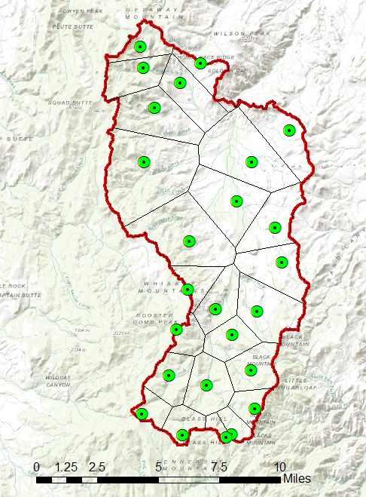
Interpolation for Watershed Precipitation Calculation
Thiessen Polygon Vector Approach
Assumption
Precipitation from each gage assumed for the nearest neighborhood polygon around each gage
Area weighted average
$$P=\frac{\sum_{k}{A_{k}P_{k}}}{\sum_{k}{A_{k}}}$$
With multiple subwatersheds average within each subwatershed i
$$P_{i}=\frac{\sum_{k}{A_{ik}P_{k}}}{\sum_{k}{A_{ik}}}$$

Slide 42
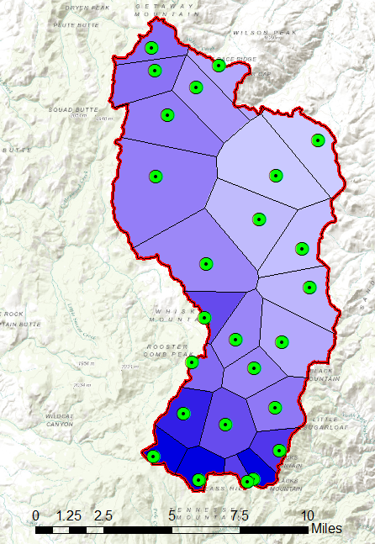
Interpolation for Watershed Precipitation Calculation
Thiessen Polygon Raster Approach
Assumption
Precipitation at each grid cell taken from nearest precipitation gage
Polygon to raster used to obtain precipitation raster
Zonal average used to obtain watershed precipitation
Simpler than vector approach
Precision depends on grid cell size
Easier to apply with multiple subwatersheds

Slide 43
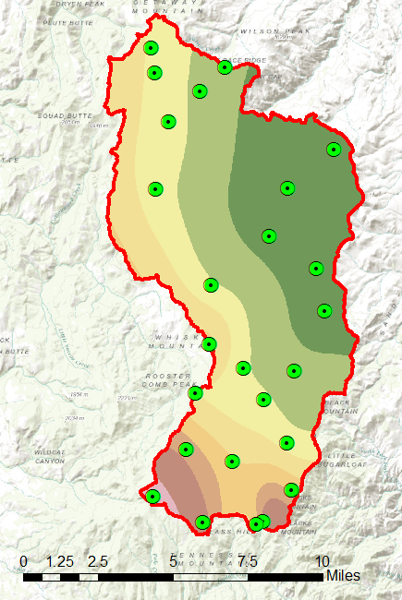
Interpolation for Watershed Precipitation Calculation
Surface Fitting Raster Approach
Assumption
Precipitation at each grid cell computed using interpolation from point measurements
E.g. spline, Natural Neighbor, Kriging
Zonal average used to obtain watershed precipitation
Avoids discontinuity associated with polygon edges
Flexible with many methods available
Can quantify error (e.g. using theory or leave one out cross validation)

Slide 44
Analysis of topographic surfaces represented by a Digital Elevation Model (DEM)

Slide 45
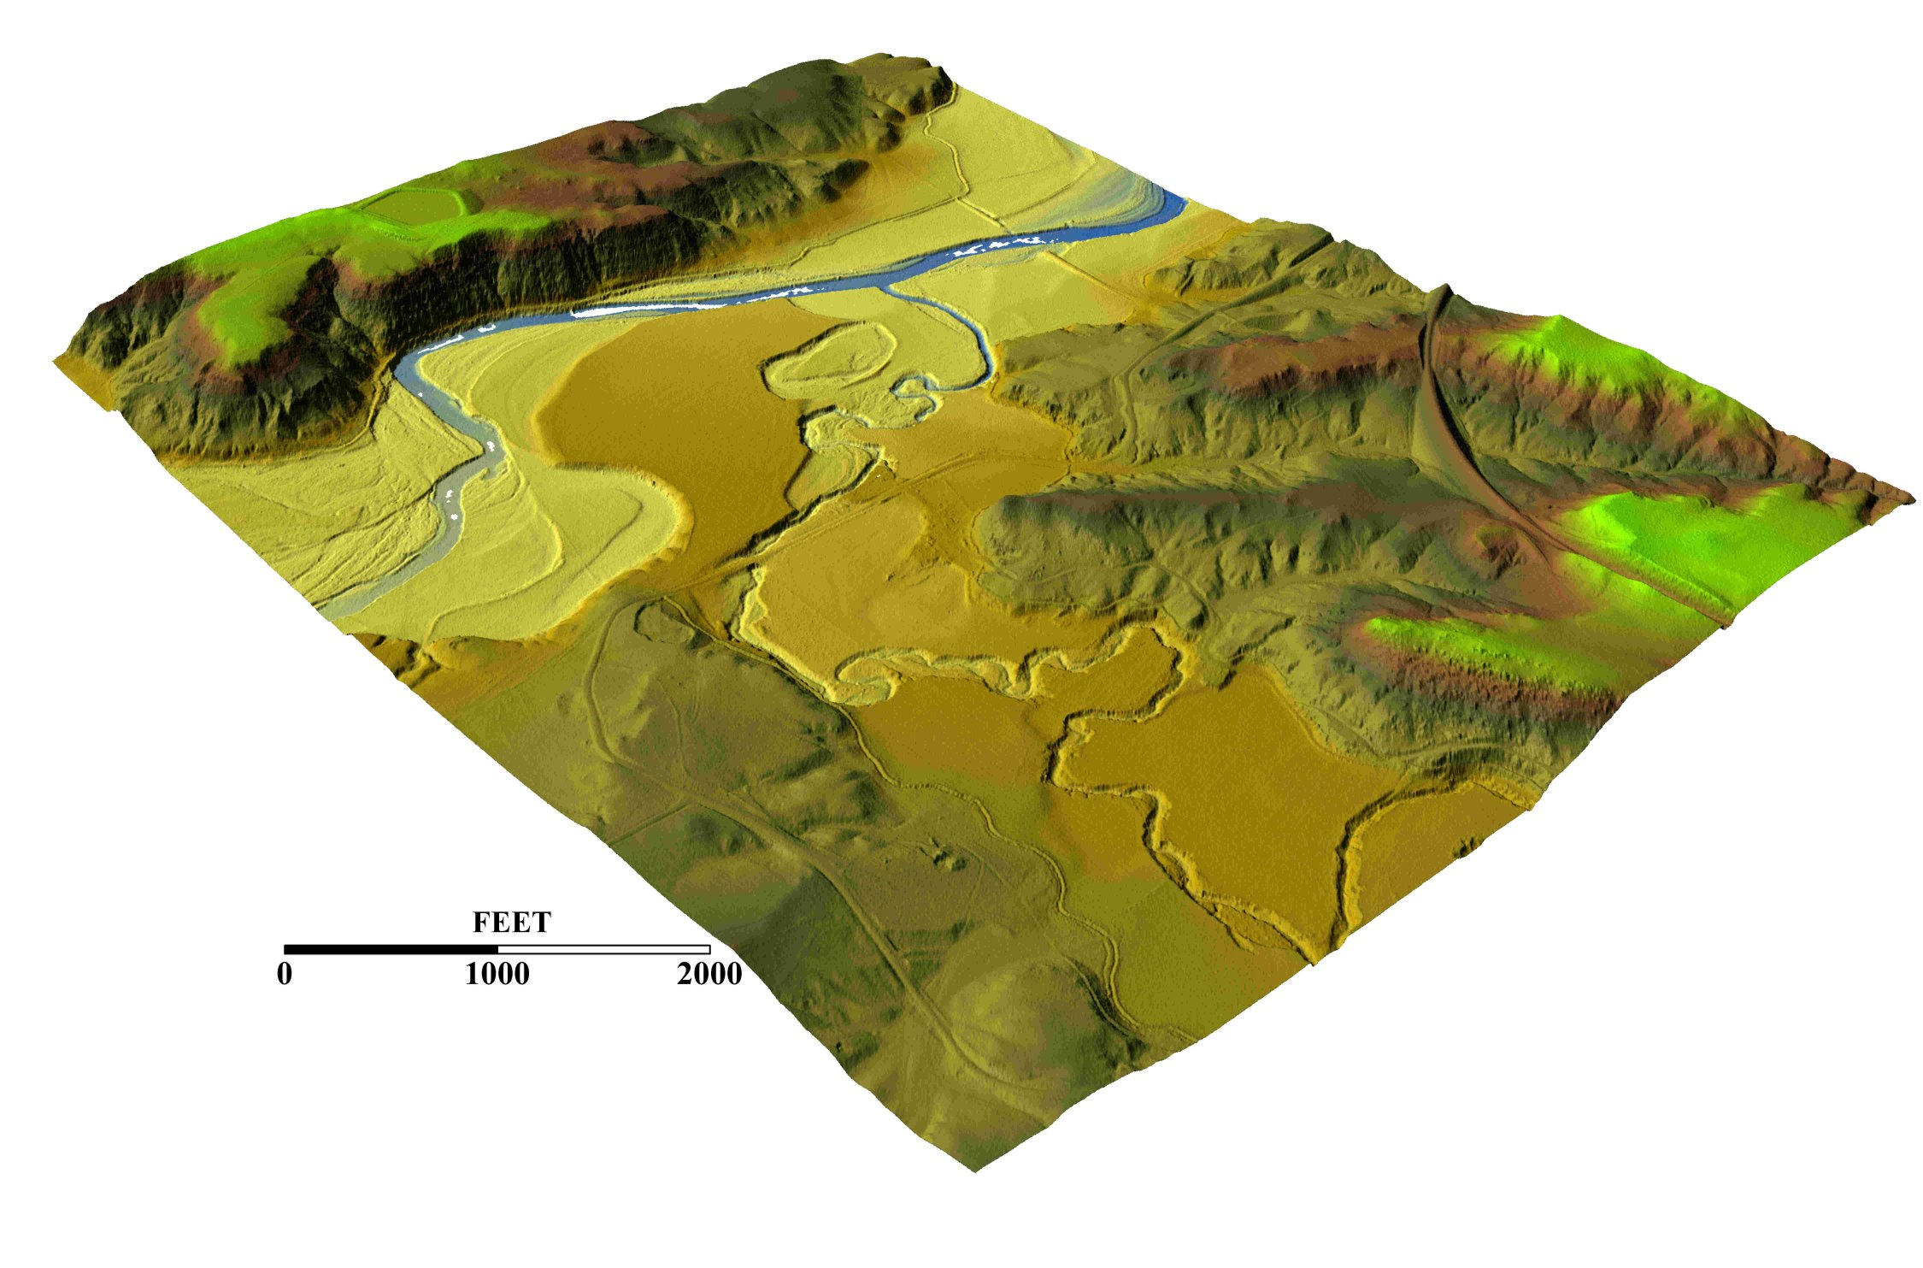
3-D detail of the Tongue river at the WY/Mont border from LIDAR.
Roberto Gutierrez
University of Texas at Austin

Slide 46
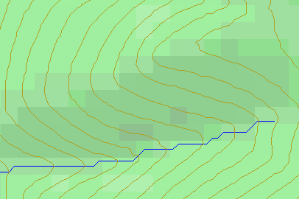
Topographic Slope
Defined or represented by one of the following
Surface derivative ∇z (dz/dx, dz/dy)
Vector with x and y components (S_{x}, S_{y})
Vector with magnitude (slope) and direction (aspect) (S, α)
See http://www.neng.usu.edu/cee/faculty/dtarb/giswr/2015/Slope.pdf

Slide 47
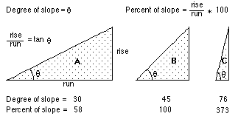
Slope and Aspect
$$y$$
$$Δx$$
$α$ = aspect clockwise from North
$$Δy$$
$$α$$
$$x$$

Slide 48
ArcGIS “Slope” tool
y
a
b
c
$$\frac{\frac{\frac{a−c}{2∆}+\frac{d−f}{2∆}}{2}+\frac{\frac{d−f}{2∆}+\frac{g−i}{2∆}}{2}}{2}$$
$$\frac{dz}{dx}=\frac{\left(a+2d+g\right)−\left(c+2f+i\right)}{8∆}$$
Similarly
$$\frac{dz}{dy}=\frac{\left(g+2h+i\right)−\left(a+2b+c\right)}{8∆}$$
Slope magnitude =
$$\sqrt{{\left(\frac{dz}{dx}\right)}^{2}+{\left(\frac{dz}{dy}\right)}^{2}}$$
d
e
f
g
h
i
x
$$\frac{a−c}{2∆}$$
$$\frac{d−f}{2∆}$$
c
$$\frac{g−i}{2∆}$$
$$∆$$
b
f
a
e
i
d
h
g
$$2∆$$
x
y

Slide 49
ArcGIS Aspect – the steepest downslope direction
$$Δy=$$
$$Δx=$$
$$Δx$$
Use atan2 to resolve ambiguity in atan direction
$$Δy$$
$$α$$
$$−Δx$$
$$−Δy$$
$$α+{180}^{o}$$

Slide 50
Example
30
a
b
c
80
74
63
d
e
f
145.2º
69
67
56
g
h
i
60
52
48

Slide 51
Hydrologic Slope (Flow Direction Tool)
- Direction of Steepest Descent
30
30
80
74
63
80
74
63
69
67
56
69
67
56
60
52
48
60
52
48
Slope:

Slide 52
Eight Direction Pour Point Model
32
64
128
16
1
8
4
2
ESRI Direction encoding

Slide 53
Limitation due to 8 grid directions.
?

Slide 54
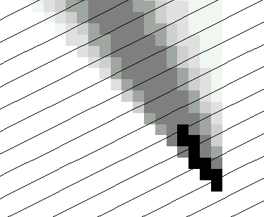
The D∞ Algorithm
Tarboton, D. G., (1997), "A New Method for the Determination of Flow Directions and Contributing Areas in Grid Digital Elevation Models," Water Resources Research, 33(2): 309-319.) (http://www.engineering.usu.edu/cee/faculty/dtarb/dinf.pdf)

Slide 55
The D∞ Algorithm
z₀
Elevations at each vertex z_{i}
z₂
z₁
Δ
If α₁ does not fit within the triangle the angle is chosen along the steepest edge or diagonal resulting in a slope and direction equivalent to D8

Slide 56
D∞ Example
30
80
74
63
69
e_{o}
67
56
60
e₇
e₈
52
48
284.9º
14.9º

Slide 57
Summary Concepts
Grid (raster) data structures represent surfaces as an array of grid cells
Raster calculation involves algebraic like operations on grids
Interpolation and Generalization is an inherent part of the raster data representation
Watershed average precipitation may be computed by interpolation from point gages

Slide 58
Summary Concepts (2)
The elevation surface represented by a grid digital elevation model is used to derive slope important for surface flow
The eight direction pour point model approximates the surface flow using eight discrete grid directions.
The D∞ vector surface flow model approximates the surface flow as a flow vector from each grid cell apportioned between down slope grid cells.

