Slide 1
GISWR 2015
Midterm Review

Slide 2
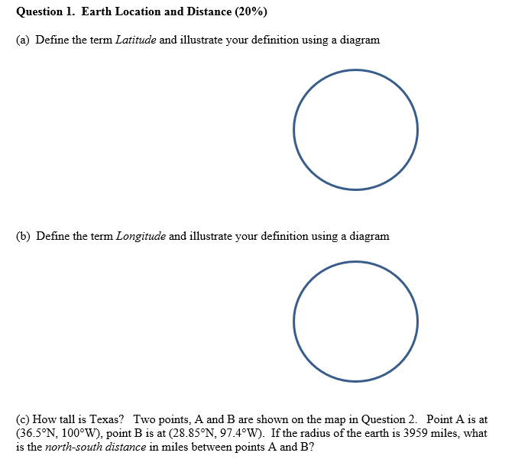

Slide 3
Definition of Latitude, φ
m
S
p
O
n
φ
q
r
(1) Take a point S on the surface of the ellipsoid and define there the tangent plane, mn
(2) Define the line pq through S and normal to the
tangent plane
(3) Angle pqr which this line makes with the equatorial
plane is the latitude φ, of point S

Slide 4
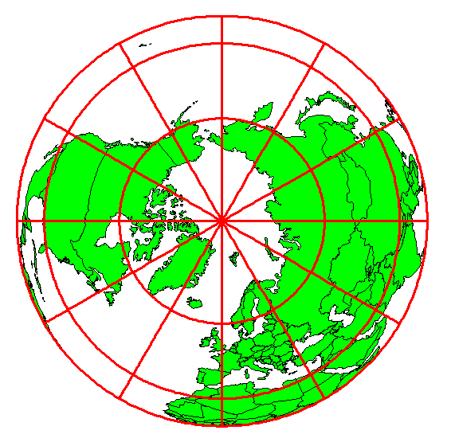
Definition of Longitude, λ
λ = the angle between a cutting plane on the prime meridian
and the cutting plane on the meridian through the point, P
180°E, W
-150°
150°
-120°
120°
90°W
(-90 °)
90°E
(+90 °)
-60°
P
λ
-60°
-30°
30°
0°E, W

Slide 5

Length on Meridians and Parallels
(Lat, Long) = (φ, λ)
Length on a Meridian:
AB = R_{e} Δφ
(same for all latitudes)
R
Δλ
D
30 N
R
C
R_{e}
Δφ
B
0 N
R_{e}
Length on a Parallel:
CD = R Δλ = R_{e} Δλ Cos φ
(varies with latitude)
A

Slide 6
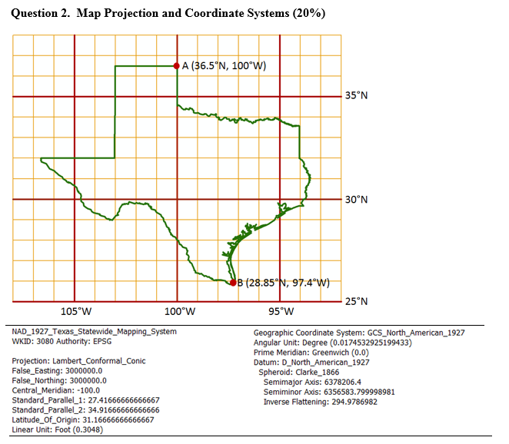
A map of Texas and a set of map projection parameters for the state are given above.
(a) Please draw and label on the map: the central meridian, the latitude of origin, and the two standard parallels.
(b) Give the numerical values (in degrees and minutes) for (ϕ₀, λ₀):
(c) Give the numerical values for (X₀, Y₀):
(d) What earth datum is used?
(e) What spheroid is used?
(f) What map projection is used?
(g) What are the distance units in the coordinate system?

Slide 7
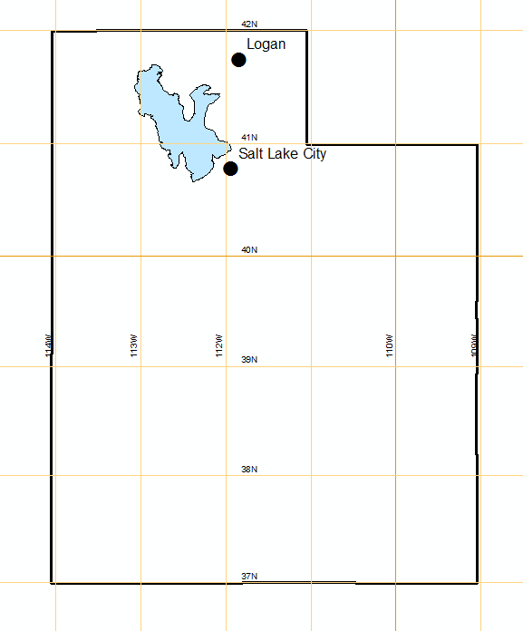
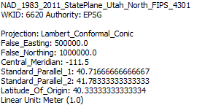
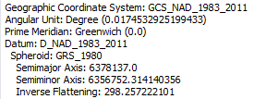
Utah State Plane System (North)
Central Meridian
Std Parallel 2
Origin
$$\left(φ_{0},λ_{0}\right)=\left(40.33° N, −111.5 W\right)$$
$$\left(x_{0},y_{0}\right)=\left(500000, 1000000\right)$$
Std Parallel 1
Latitude of Origin

Slide 8
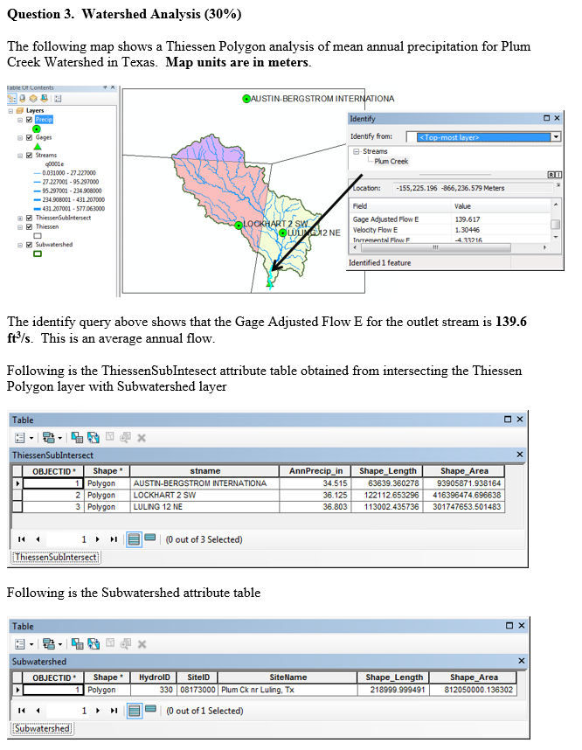
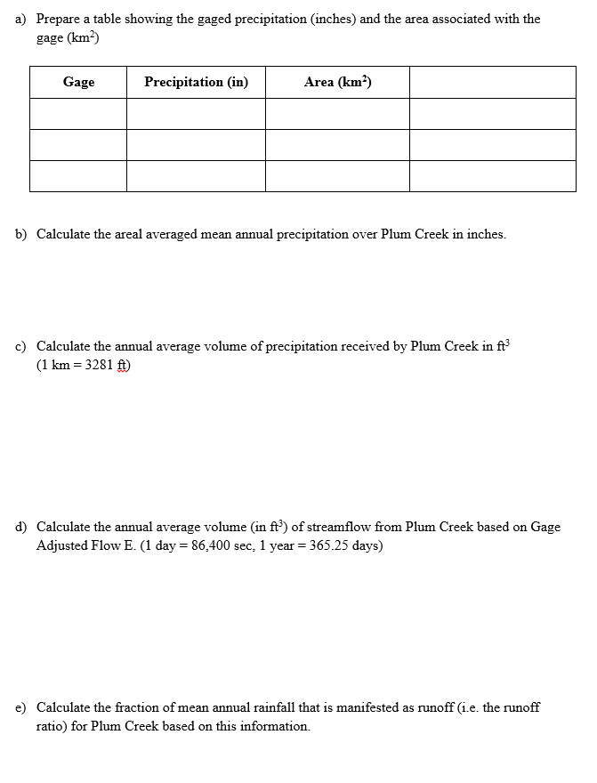

Slide 9
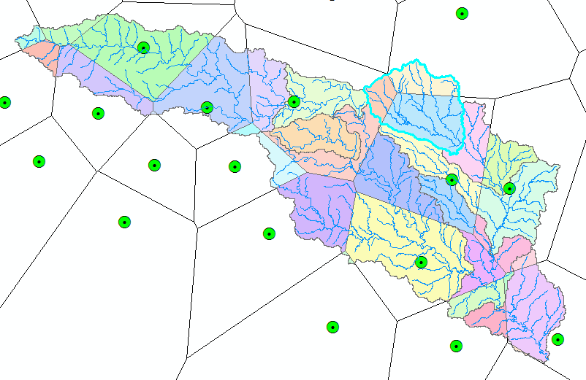
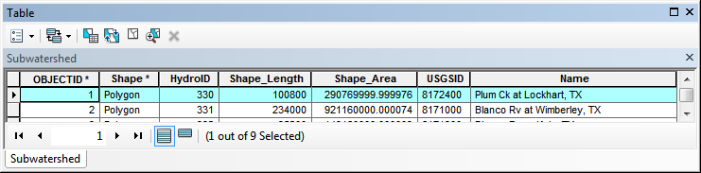
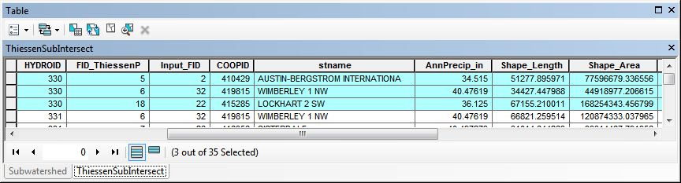
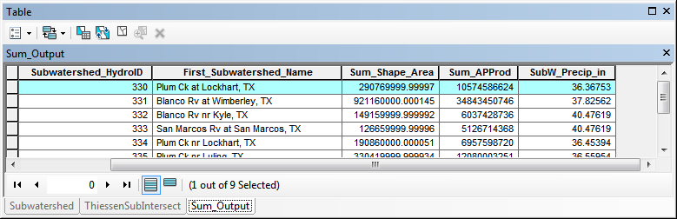
Subwatershed Precipitation by Thiessen Polygons
Thiessen Polygons
Intersect with Subwatersheds
Evaluate A*P Product
Summarize by subwatershed
$$P_{i}=\frac{\sum_{k}{A_{ik}P_{k}}}{\sum_{k}{A_{ik}}}$$

Slide 10
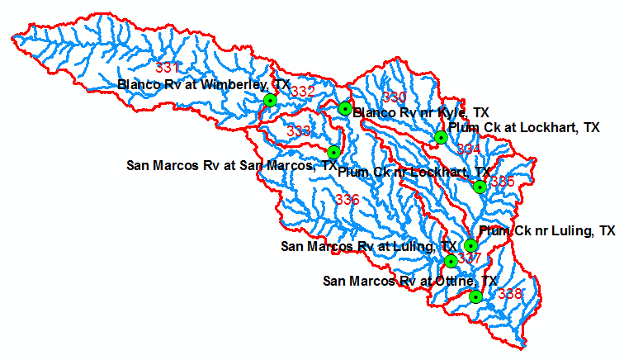
Runoff Coefficients
Interpolated precip for each subwatershed
Convert to volume, P
Sum over upstream subwatersheds in Excel
Runoff volume, Q
Ratio of Q/P
Watershed | HydroID's
Plum Ck at Lockhart, TX | 330
Blanco Rv nr Kyle, TX | 331, 332
San Marcos Rv at Luling, TX | 331,332,333,336

Slide 11
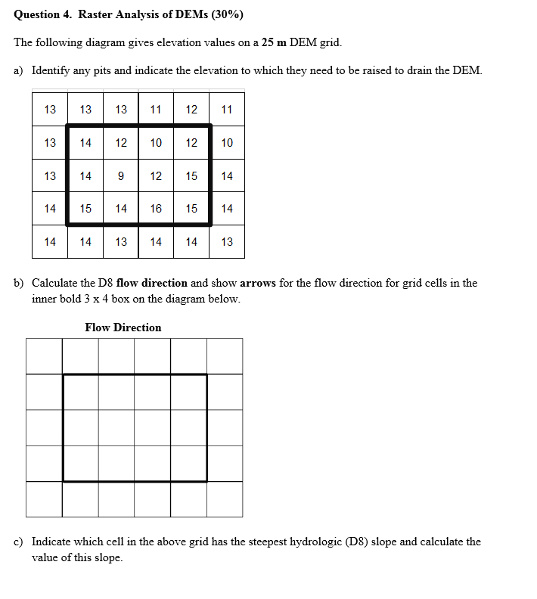

Slide 12
Pit Filling
Original DEM
Pits Filled
Pits
Pour Points
Grid cells or zones completely surrounded by higher terrain
The lowest grid cell adjacent to a pit
Notes:
Elevations are filled to that of the pools pour point

Slide 13
Hydrologic Slope
- Direction of Steepest Descent
30
30
80
74
63
80
74
63
69
67
56
69
67
56
60
52
48
60
52
48
Slope:

Slide 14
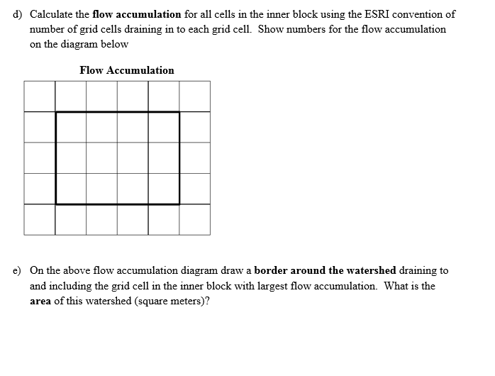

Slide 15
Flow Accumulation Grid.
Area draining in to a grid cell
0
0
0
0
0
0
0
0
0
0
0
2
2
2
0
0
2
2
2
0
0
0
10
0
1
0
0
1
0
10
1
0
0
14
0
1
0
0
0
14
0
4
1
19
1
0
4
1
1
19
ArcHydro Page 72

Slide 16
Watershed Draining to Outlet
Watershed mapped as all grid cells that drain to an outlet
Streams mapped as grid cells with flow accumulation greater than a threshold

Slide 17
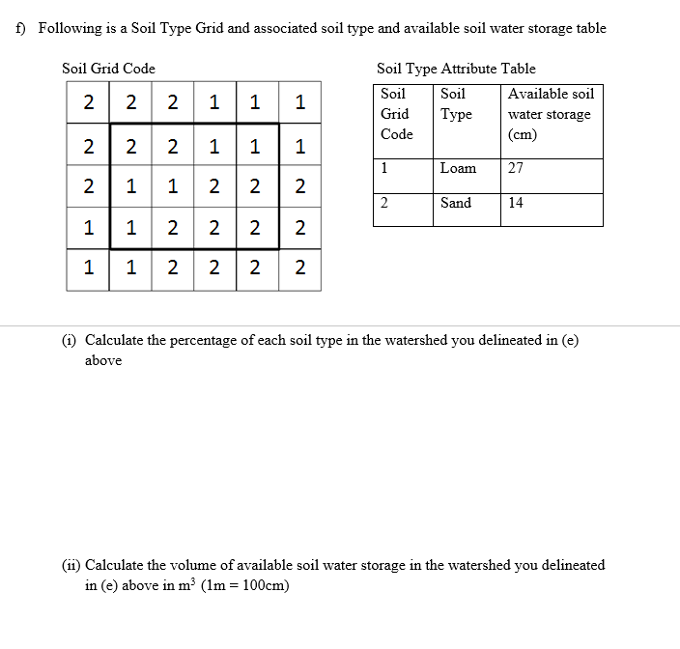

Slide 18
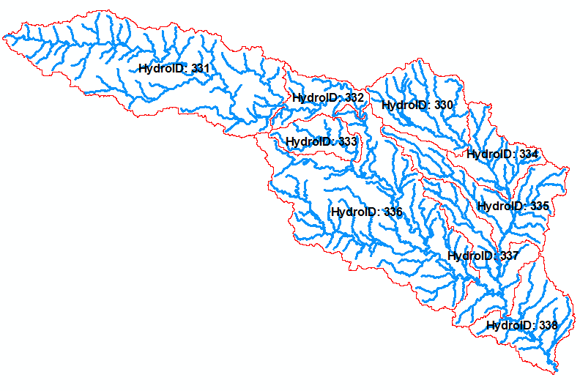
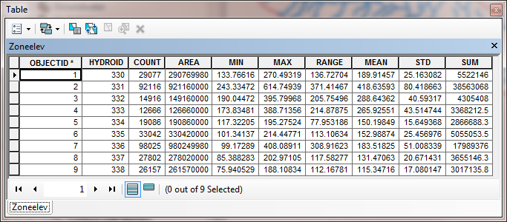
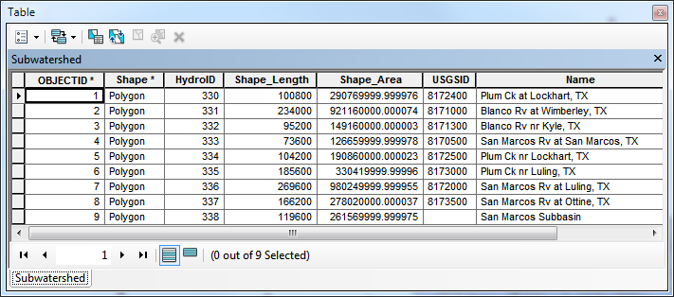
Zonal Average of Raster over Subwatershed
Join

Slide 19
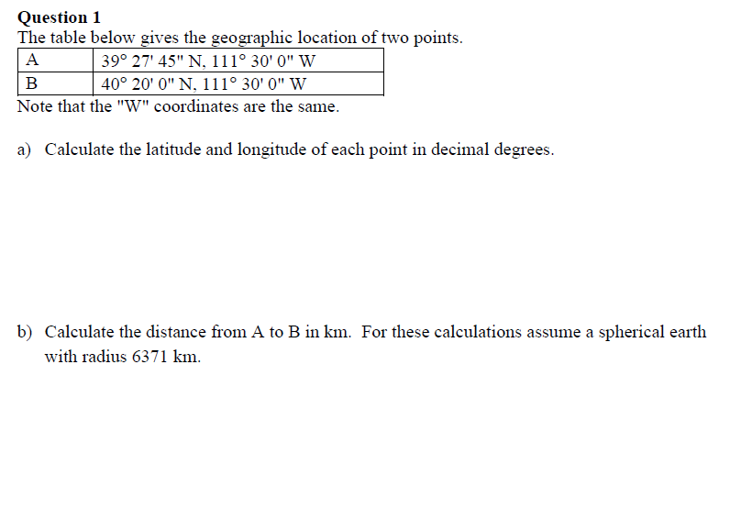
2013 Midterm Questions

Slide 20
Curved Earth Distance
(from A to B)
Shortest distance is along a “Great Circle”
A “Great Circle” is the intersection of a sphere with a plane going through its center.
1. Spherical coordinates converted to Cartesian coordinates.
2. Vector dot product used to calculate angle α from latitude and longitude
3. Great circle distance is Rα, where R=6378.137 km²
Z
B
A
α
•
Y
X
Ref: Meyer, T.H. (2010), Introduction to Geometrical and Physical Geodesy, ESRI Press, Redlands, p. 108

Slide 21
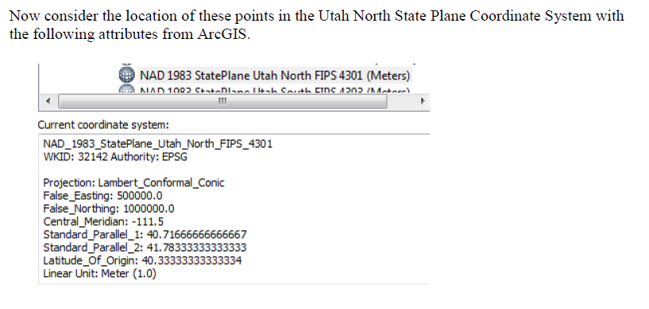
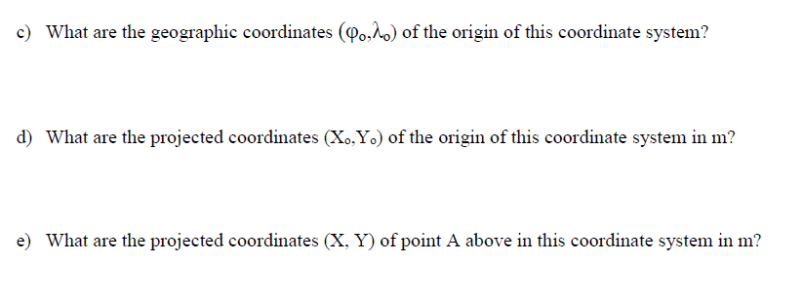

Slide 22
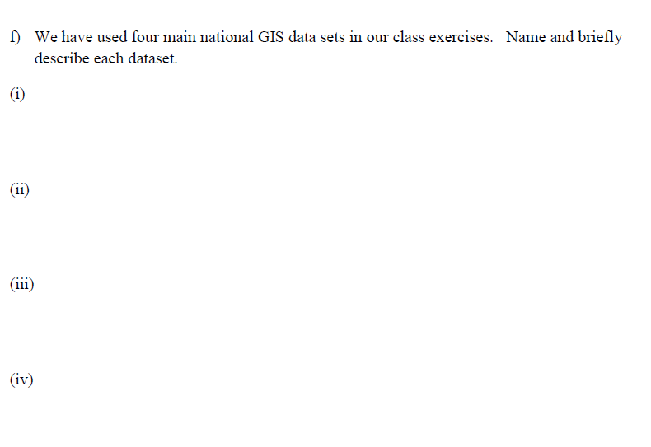

Slide 23
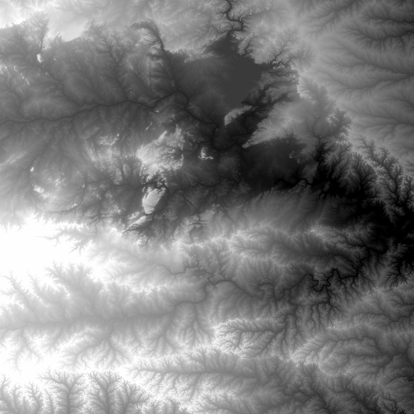
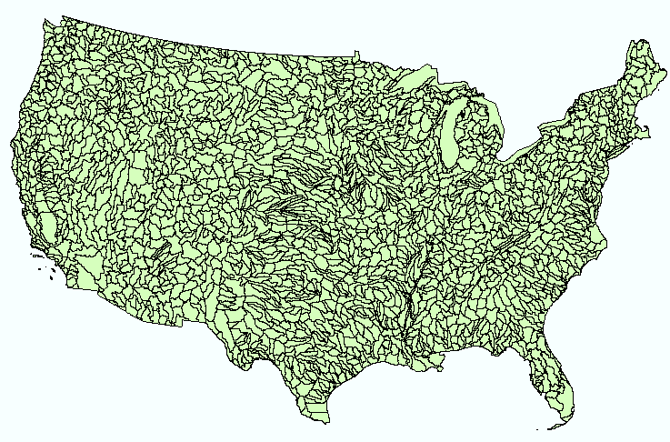
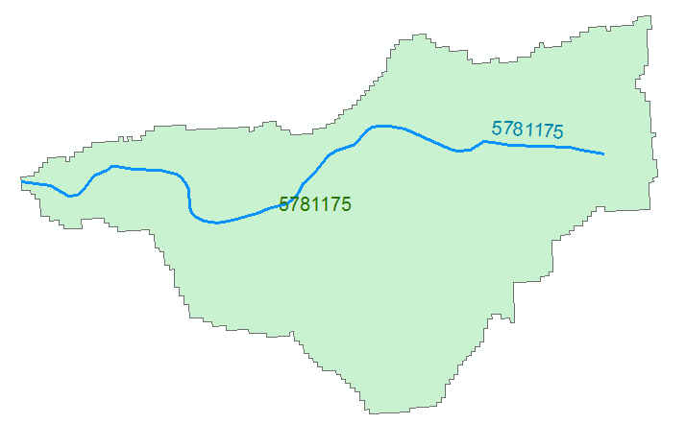
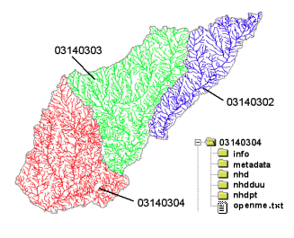
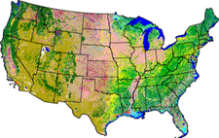
NHDPlus Version 2.1
Foundation for a Geospatial Hydrologic Framework for the United States
NHDPlus
2.7 million reach catchments in US
average area 3 km²
reach length 2 km
Uniquely labelled
National Elevation Dataset
Watershed Boundary Dataset
National Hydrography Dataset
National Land Cover Dataset

Slide 24
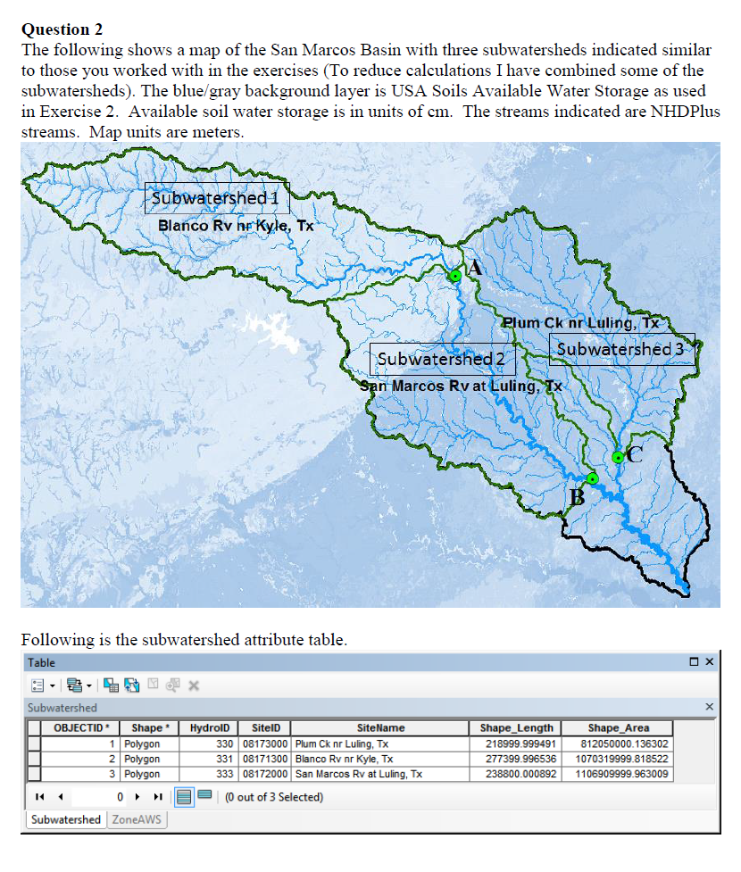
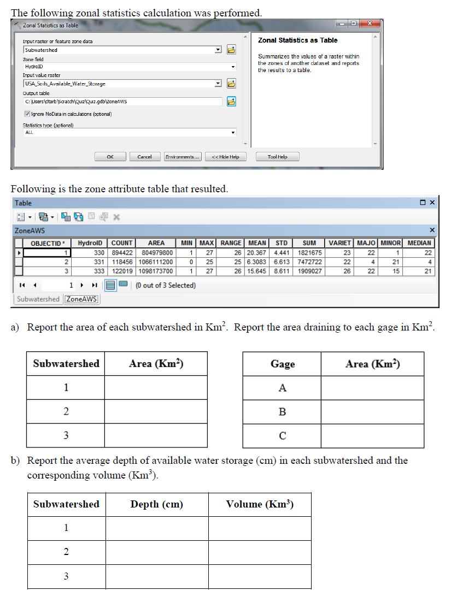

Slide 25
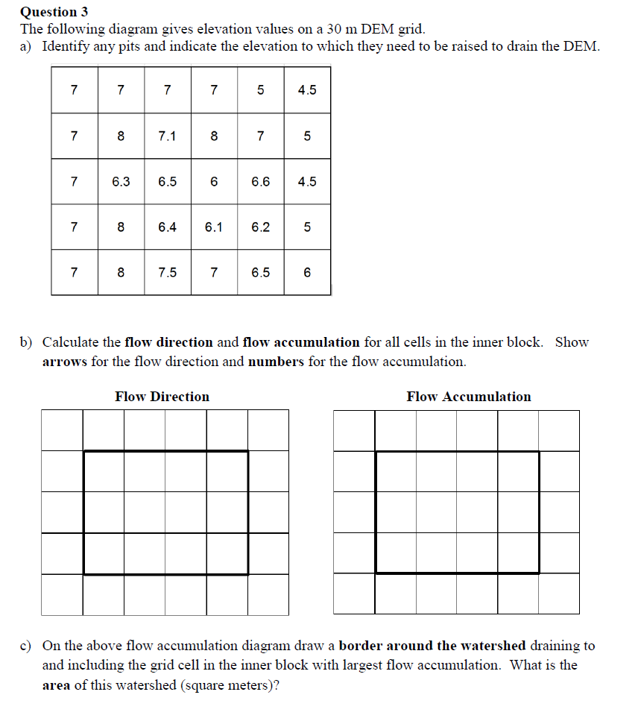

Slide 26
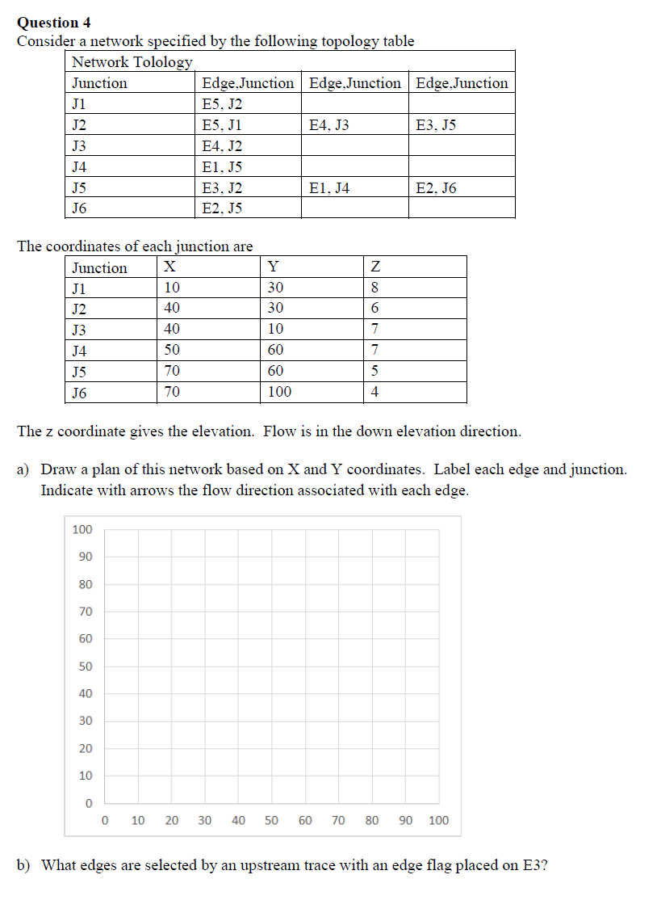
Note that behind “networks” in ArcGIS there is a data model that enables the network functionality that you used.
We did not cover that this year as it is hidden from a user so you would not get this question. However you should know how networks work and what they can be used for.

Slide 27
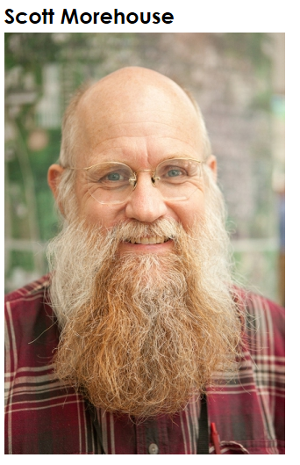
Geographic Data Model
“All geographic information systems are built using formal models that describe how things are located in space. A formal model is an abstract and well-defined system of concepts. A geographic data model defines the vocabulary for describing and reasoning about the things that are located on the earth. Geographic data models serve as the foundation on which all geographic information systems are built.”
Scott Morehouse, Preface to “Modeling our World”, First Edition. He is the chief software engineer at ESRI
Or, more simply: the way that data is organized can enhance or inhibit the analysis that can be done

Slide 28
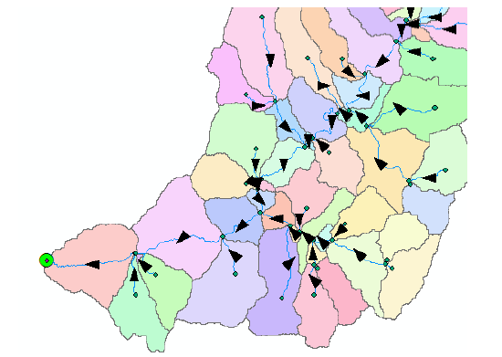
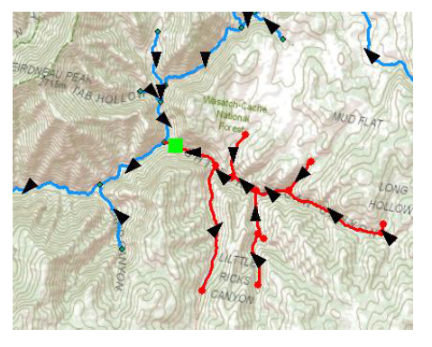
The connectivity in the network data model enables analyses such as tracing for selection of the upstream network and watershed

Slide 29
Subnetwork analysis enabled by attributes joined with a network

Slide 30
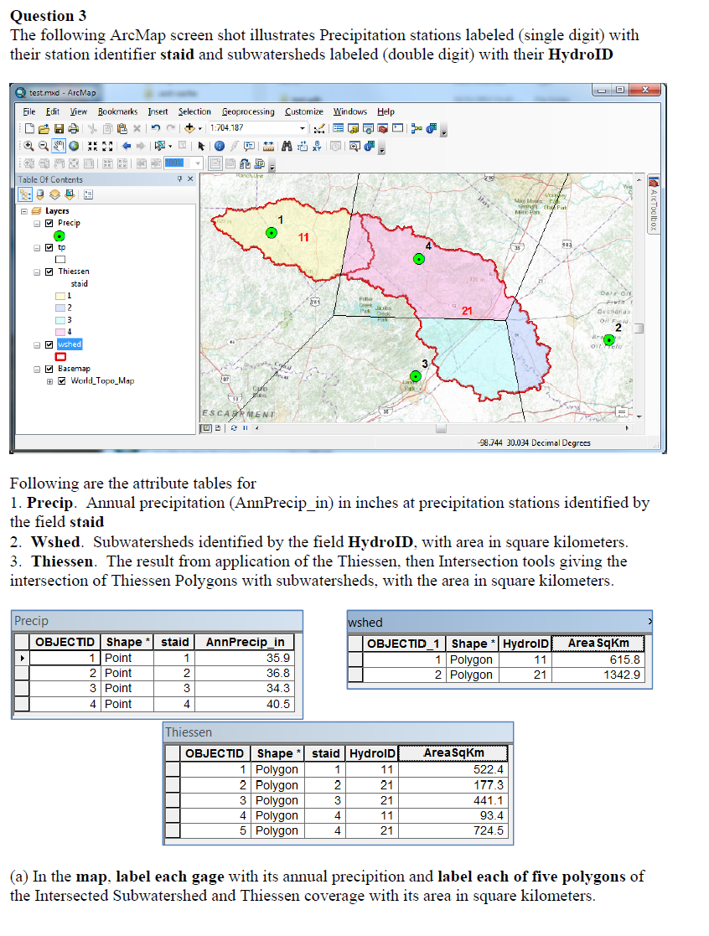
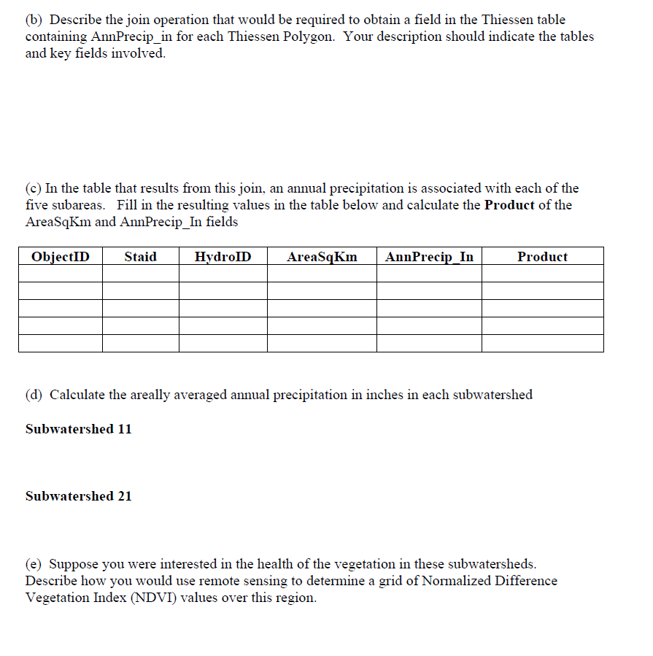
2012 Midterm Questions

Slide 31
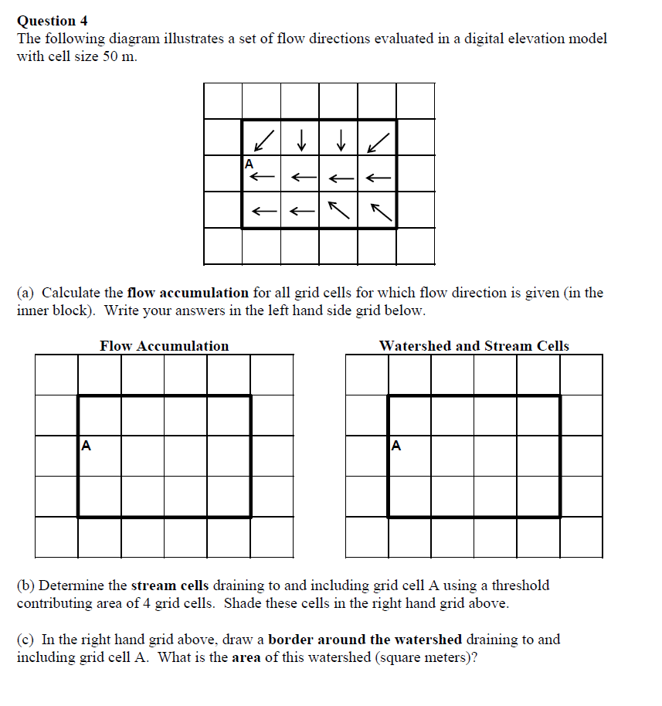

Slide 32
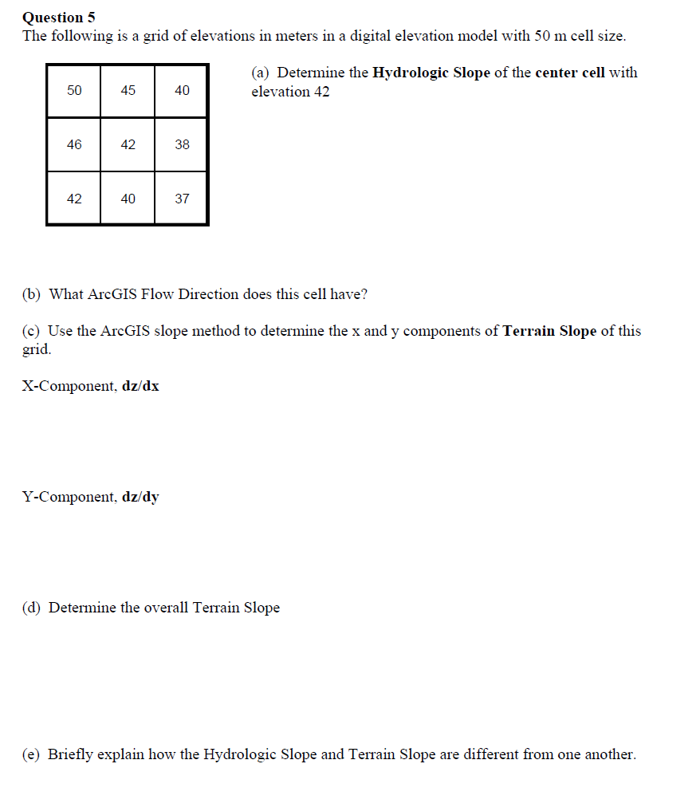

Slide 33

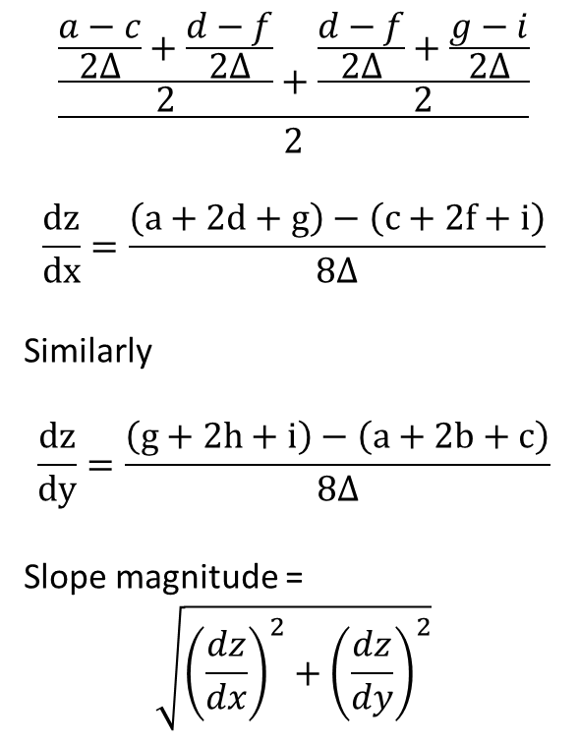


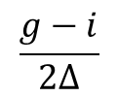
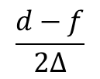
ArcGIS “Slope” tool
y
a
b
c
$$\frac{\frac{\frac{a−c}{2∆}+\frac{d−f}{2∆}}{2}+\frac{\frac{d−f}{2∆}+\frac{g−i}{2∆}}{2}}{2}$$
$$\frac{dz}{dx}=\frac{\left(a+2d+g\right)−\left(c+2f+i\right)}{8∆}$$
Similarly
$$\frac{dz}{dy}=\frac{\left(g+2h+i\right)−\left(a+2b+c\right)}{8∆}$$
Slope magnitude =
$$\sqrt{{\left(\frac{dz}{dx}\right)}^{2}+{\left(\frac{dz}{dy}\right)}^{2}}$$
d
e
f
g
h
i
x
$$\frac{a−c}{2∆}$$
$$\frac{d−f}{2∆}$$
c
$$\frac{g−i}{2∆}$$
$$∆$$
b
f
a
e
i
d
h
g
$$2∆$$
x
y

Slide 34








ArcGIS Aspect – the steepest downslope direction
$$Δy=$$
$$Δx=$$
$$Δx$$
Use atan2 to resolve ambiguity in atan direction
$$Δy$$
$$α$$
$$−Δx$$
$$−Δy$$
$$α+{180}^{o}$$

Slide 35
Example
30
a
b
c
80
74
63
d
e
f
145.2º
69
67
56
g
h
i
60
52
48

Slide 36
Hydrologic Slope (Flow Direction Tool)
- Direction of Steepest Descent
30
30
80
74
63
80
74
63
69
67
56
69
67
56
60
52
48
60
52
48
Slope:

