Slide 1
Welcome to GIS in Water Resources
2015
David Maidment, David Tarboton,

Slide 2
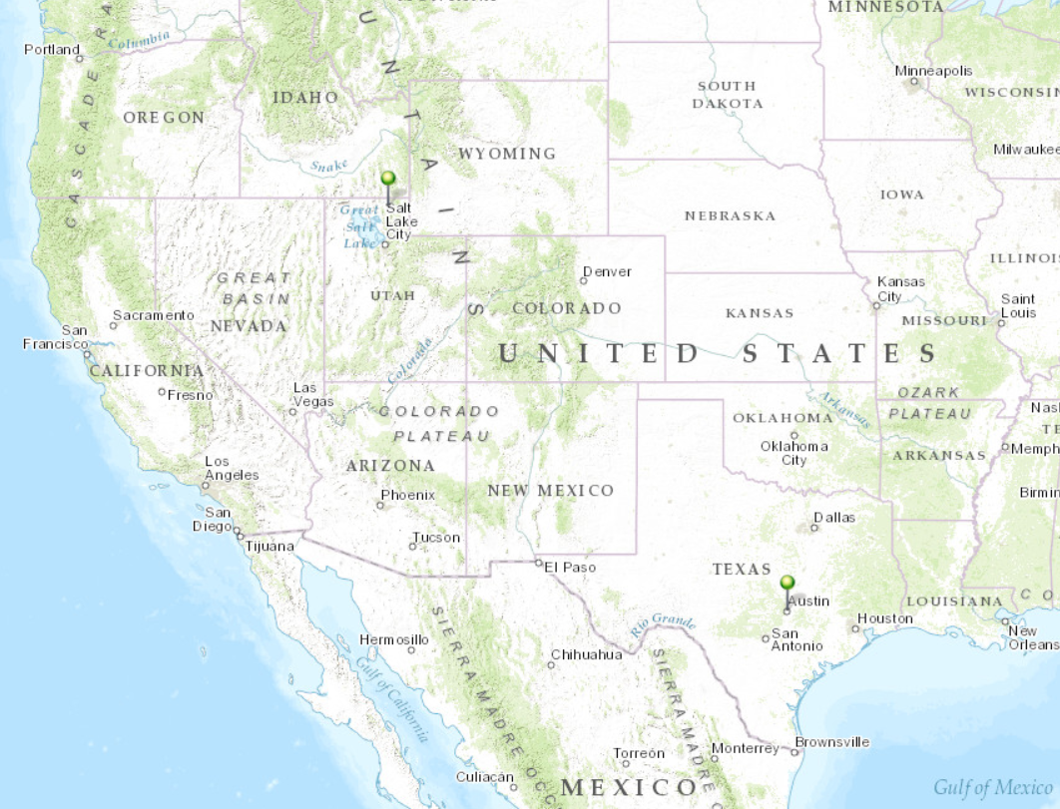
Our Classroom
Dr David Tarboton
Students at Utah State University
Dr David Maidment Students at University of Texas at Austin

Slide 3

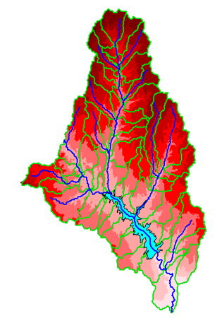
David R. Maidment
B.E. in Agricultural Engineering (with First Class Honors) from University of Canterbury, Christchurch, New Zealand, 1972
MS, PhD in Civil Engineering from University of Illinois, 1974 and 1976, respectively
1981 – joined University of Texas at Austin as an Assistant Professor, and have been on the faculty ever since. Now Hussein M. Alharthy Centennial Chair in Civil Engineering
Initiated the GIS in Water Resources course in 1991.
Worked with ESRI since 1994 on a GIS Hydro Preconference seminar for the ESRI Users Conference
Leader of the CUAHSI Hydrologic Information System project from 2004-2011
Developing World Water Online with ESRI and Kisters
Leader of the National Flood Interoperability Experiment

Slide 4

David Tarboton
B.Sc Eng in Civil Engineering from the University of Natal, Durban, South Africa 1981
M.S. and Sc.D from MIT, Cambridge, Massachusetts, 1987 and 1990 respectively
1990 - Joined Faculty at Utah State University in Civil and Environmental Engineering
1996 - Developed D-Infinity and gradually adapted research terrain analysis codes (Fortran and C) into TauDEM
Participated in GISWR since 1999 (this year is the 17th time)
Research includes snow energy balance, stochastic streamflow and physically based hydrologic modeling
Leader of HydroShare project to extend the capability of CUAHSI HIS to collaborative data sharing, additional data types and models

Slide 5
Six Basic Course Elements
Lectures
  Powerpoint slides
  Video streaming
Readings
  Assigned web materials
Homework
  Computer exercises
  Hand exercises
Term Project
  Oral presentation
  pdf report
Class Interaction
  Email
  Discussion
Examinations
  Midterm, final

Slide 6
Learning Objectives
Prepare maps using GIS
Use web mapping
Interpolate measured data to form raster surfaces
Perform hydrologic calculations using GIS layers
Build a geometric network for streams and rivers
Analyze a digital elevation model to derive watersheds and stream networks
Prepare a HEC-HMS hydrologic simulation model

Slide 7
GIS in Water Resources: Lecture 1
In-class and distance learning
Geospatial database of hydrologic features
GIS and HIS
Curved earth and a flat map
Reading Assignment: Introduction to Map Projections
http://desktop.arcgis.com/en/desktop/latest/guide-books/map-projections/what-are-map-projections.htm

Slide 8
University Without Walls
Traditional Classroom
Community
Inside and Outside
The Classroom

Slide 9
Learning Styles
Instructor-Centered Presentation
Community-Centered Presentation
Instructor
Student
We learn from the instructors and each other

Slide 10
GIS in Water Resources: Lecture 1
In-class and distance learning
Geospatial database of hydrologic features
GIS and HIS
Curved earth and a flat map

Slide 11




What is GIS
A geographic information system (GIS) is a system designed to capture, store, manipulate, analyze, manage, and present all types of geographical data. -- Wikipedia
data
computers
maps
tools

Slide 12
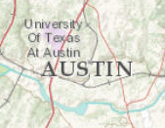
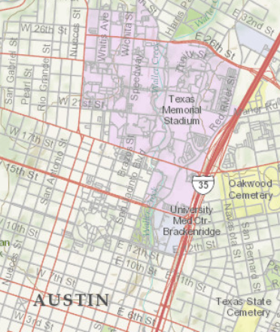
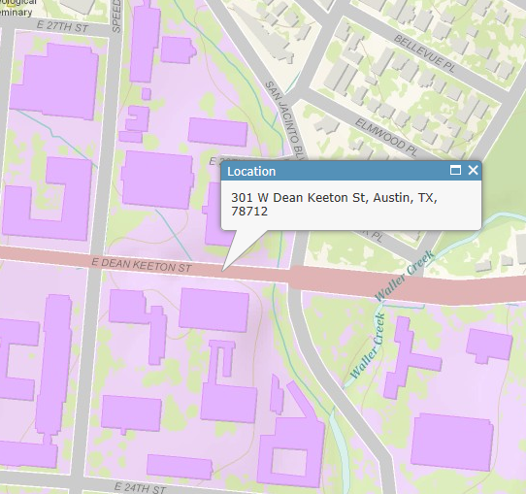
Geography is visualized in maps
map
www.arcgis.com

Slide 13
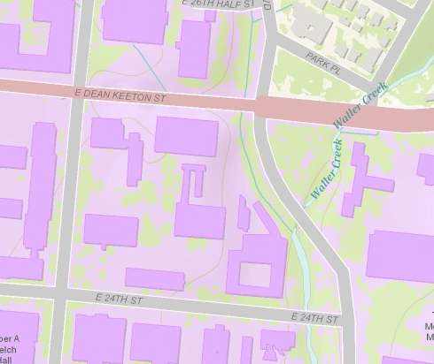
Maps are built from data
Road
Name: E. Dean Keeton St
Type: Div Highway
Speed: 35 mph
Shape: [Geometry]
Building
Name: Ernest Cockrell Jr Hall
Address: 301 E. Dean Keeton St
Shape: [Geometry]
data
Shape includes the geometry of the feature and where it is located on earth
map

Slide 14
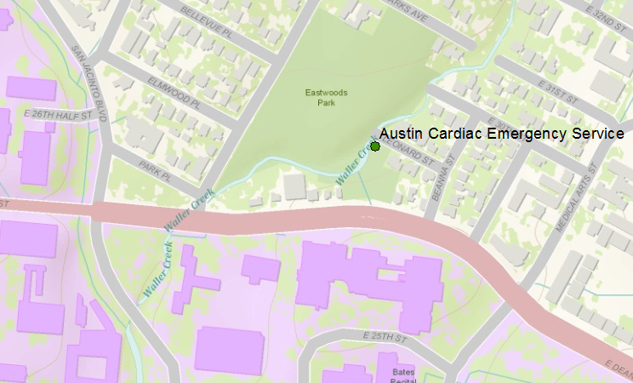
Vector data represent discrete features
points
lines
data
polygons
map

Slide 15
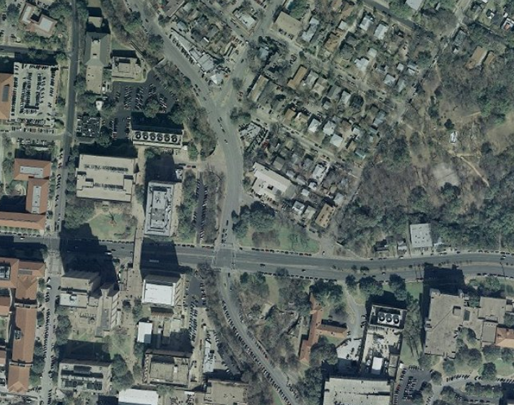
Raster data form a grid of cells or pixels
data
map

Slide 16
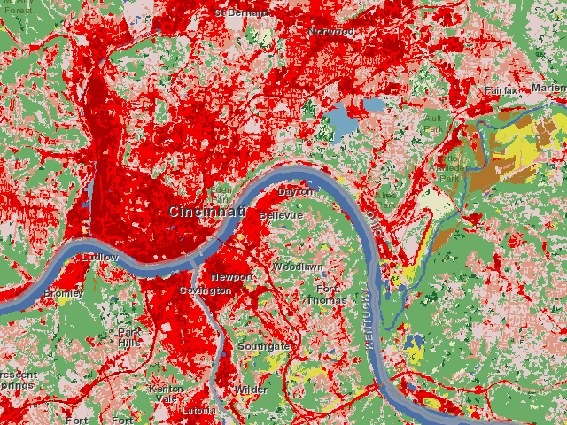
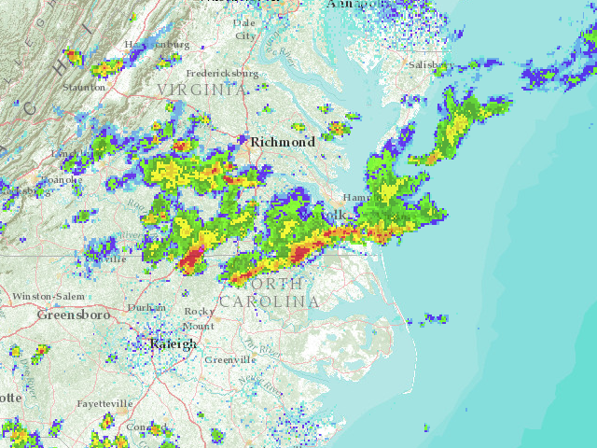
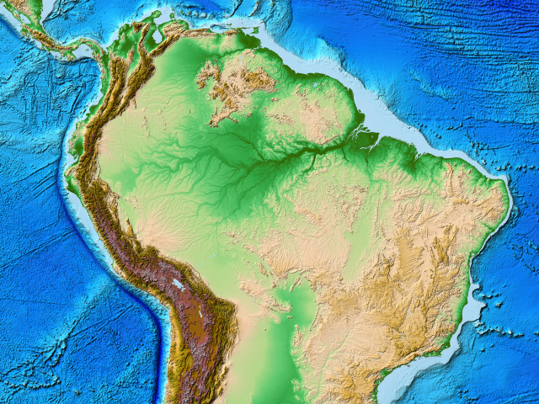
More Raster Examples
data
land use
rainfall
elevation
map

Slide 17
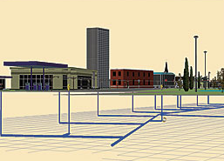
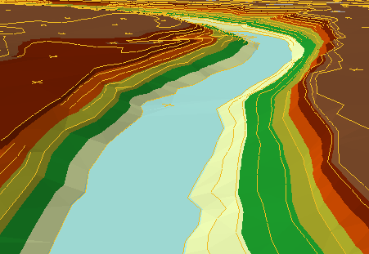
There are many more data types
multipatch
triangulated
irregular network
data
Martin Luther King Dr W
annotation
map

Slide 18
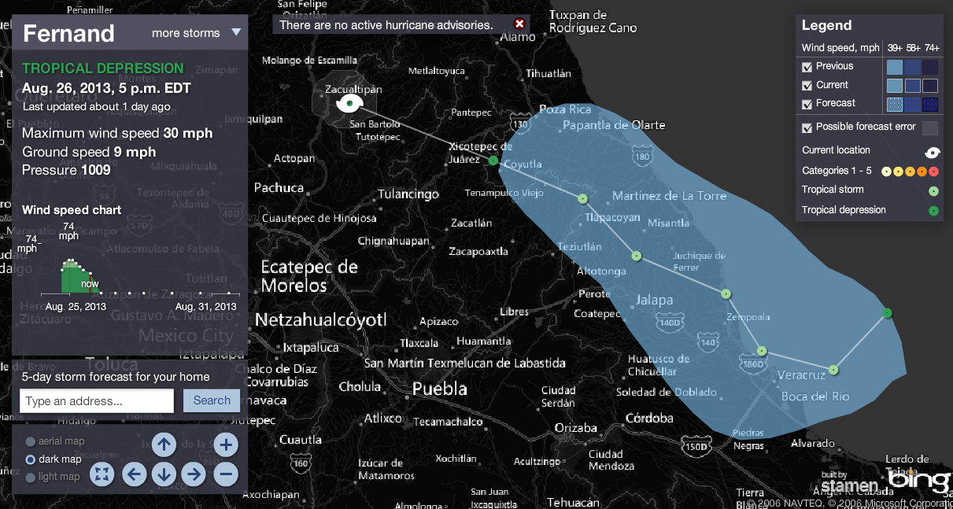
Connected Map, Chart and Animation
Tropical Storm Fernand
http://www.msnbc.msn.com/id/26295161/ns/weather/

Slide 19
Geographic Data Model
Conceptual Model – a set of concepts that describe a subject and allow reasoning about it
Mathematical Model – a conceptual model expressed in symbols and equations
Data Model – a conceptual model expressed in a data structure (e.g. ascii files, Excel tables, …..)
Geographic Data Model – a conceptual model for describing and reasoning about the world expressed in a GIS database

Slide 20
So what is a data model anyway?

Slide 21

The way that data is organized can enhance or inhibit the analysis that can be done
I have your information right here …
Picture from: http://initsspace.com/

Slide 22
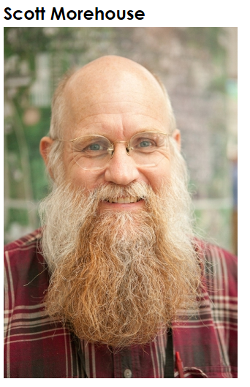
Geographic Data Model
“All geographic information systems are built using formal models that describe how things are located in space. A formal model is an abstract and well-defined system of concepts. A geographic data model defines the vocabulary for describing and reasoning about the things that are located on the earth. Geographic data models serve as the foundation on which all geographic information systems are built.”
Scott Morehouse, Preface to “Modeling our World”, First Edition. He is the chief software engineer at ESRI

Slide 23
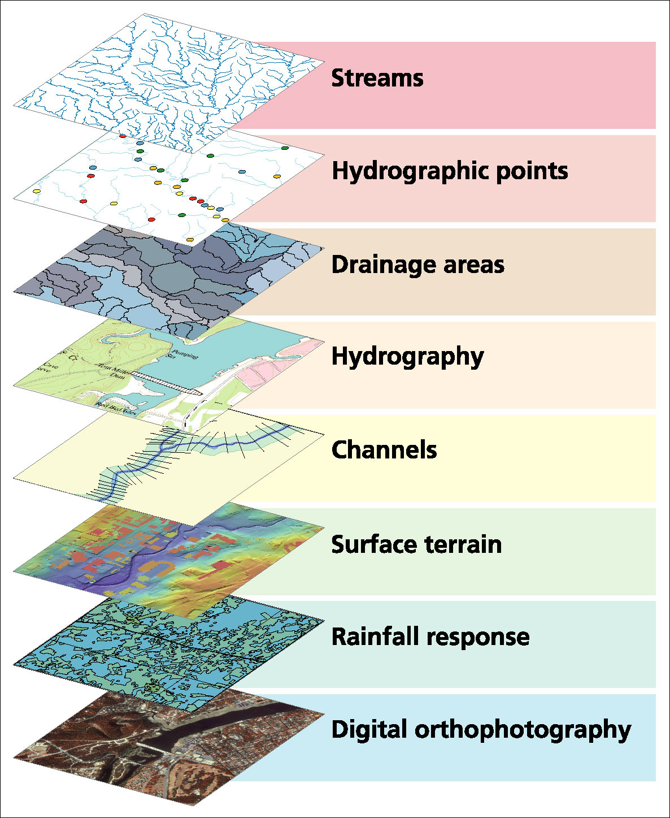
Data Model based on a collection of data themes

Slide 24
Spatial Data: Vector format
Vector data are defined spatially:
(x₁,y₁)
Point - a pair of x and y coordinates
vertex
Line - a sequence of points
Node
Polygon - a closed set of lines
Notes:
DRM

Slide 25
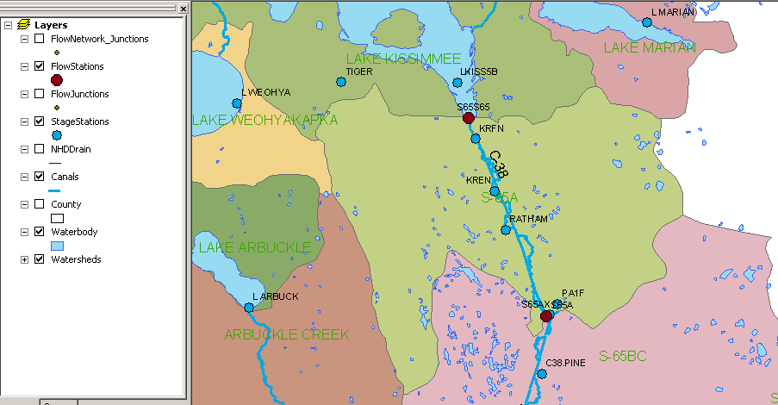
Kissimmee watershed, Florida
Themes

Slide 26
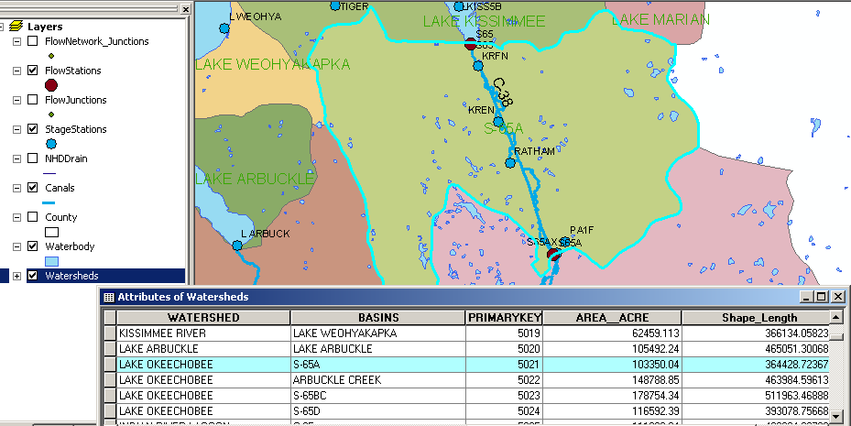
Attributes of a Selected Feature

Slide 27
Raster and Vector Data
Raster data are described by a cell grid, one value per cell
Vector
Raster
Point
Line
Zone of cells
Polygon
Notes:
DRM

Slide 28

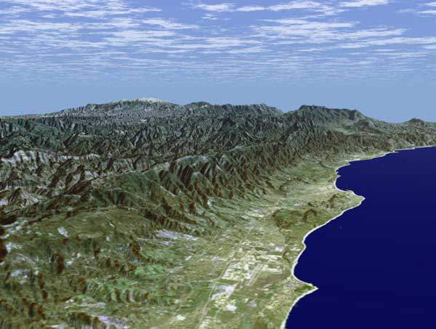
Santa Barbara, California
http://srtm.usgs.gov/srtmimagegallery/index.html

Slide 29




The challenge of increasing Digital Elevation Model (DEM) resolution
1980’s DMA 90 m
10² cells/km²
1990’s USGS DEM 30 m
10³ cells/km²
2000’s NED 10-30 m
10⁴ cells/km²
2010’s LIDAR ~1 m
10⁶ cells/km²

Slide 30
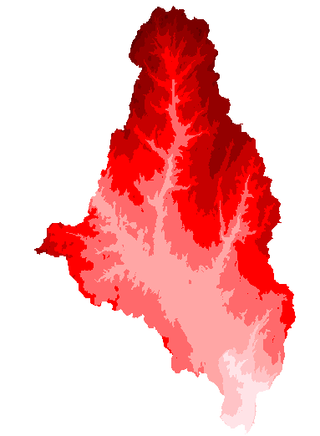
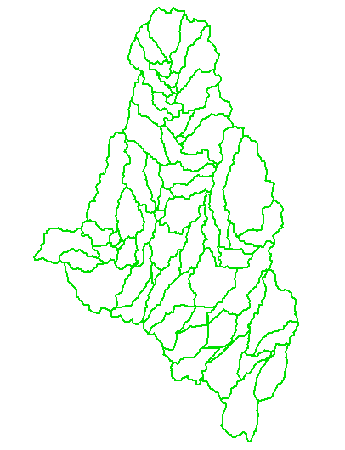
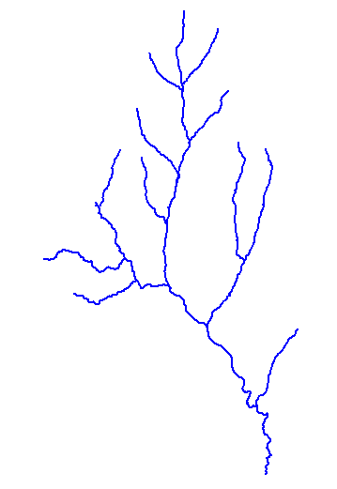
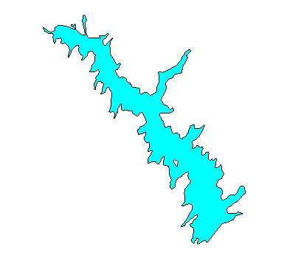
How do we combine these data?
Digital Elevation
Models
Watersheds
Streams
Waterbodies

Slide 31
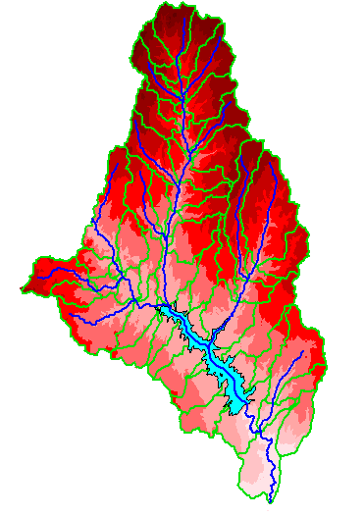
An integrated raster-vector database

Slide 32
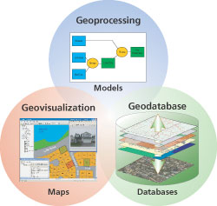
Three Views of GIS
Geodatabase view: Structured data sets that represent geographic information in terms of a generic GIS data model.
Geovisualization view: A GIS is a set of intelligent maps and other views that shows features and feature relationships on the earth's surface. "Windows into the database" to support queries, analysis, and editing of the information.
Geoprocessing view: Information transformation tools that derive new geographic data sets from existing data sets.
adapted from www.esri.com

Slide 33
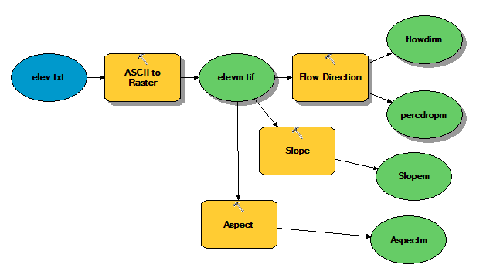
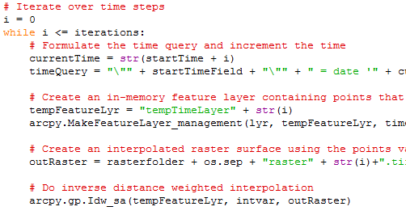
Programming
Automation of repetitive tasks (workflows)
Implementation of functionality not available (programming new behavior)

Slide 34
GIS in Water Resources: Lecture 1
In-class and distance learning
Geospatial database of hydrologic features
GIS and HIS
Curved earth and a flat map

Slide 35
Linking Geographic Information Systems and Water Resources
Water
Resources
GIS

Slide 36
Major Transitions in Geospatial Info
Paper maps to digital data
  National Spatial Data Infrastructure development
  Started in 1990’s
  Took more than a decade to complete
Digital data to web services
  Started several years ago
  Will take years to complete
Maps
Data
Services

Slide 37
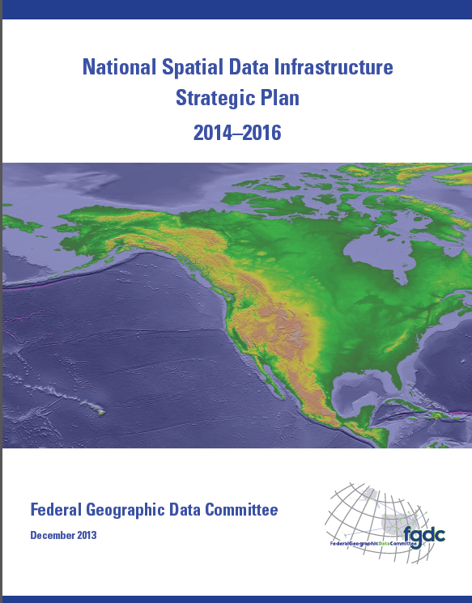
National Spatial Data Infrastructure (NSDI)
Desired Future State of NSDI
Create network of resources and services
Facilitate discovery, access and application of resources
Leverage shared standard-based services
Develop core set of information layers that interface with nonspatial data
Use real-time data feeds and sensor webs

Slide 38


Open Water Data Initiative
Subcommittee on Spatial Water Data will lead this effort
This reports to both FGDC and ACWI
Anne Castle, Asst Secretary for Water and Science, Dept of Interior
Chair

Slide 39
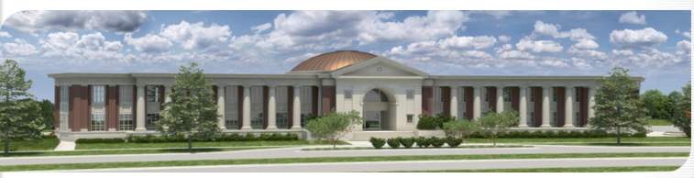
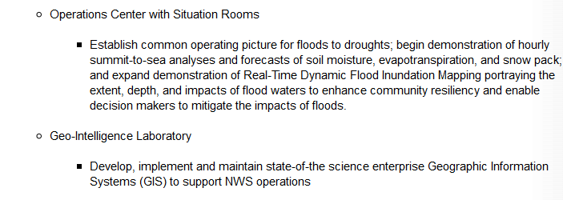
National Water Center – Tuscaloosa Alabama
Temporal information
Geospatial information

Slide 40
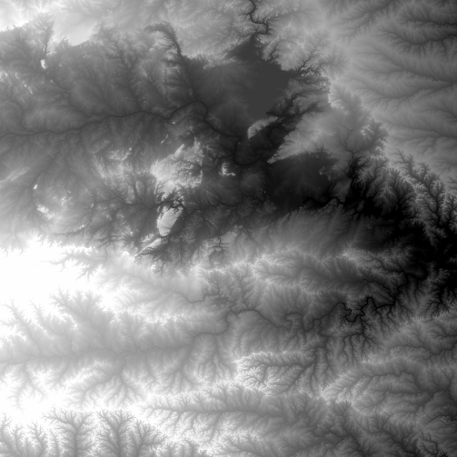
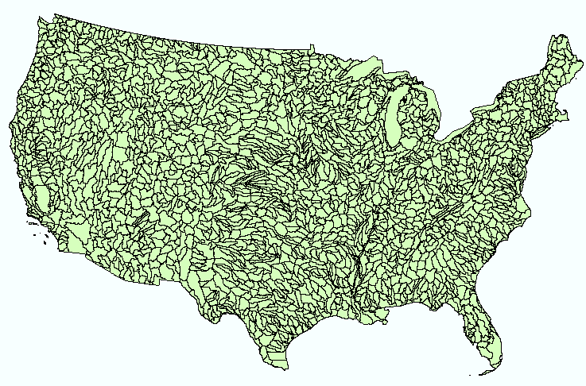
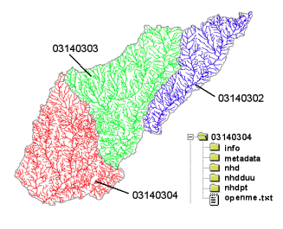
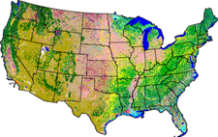
NHDPlus
Geospatial base for National Water Data Infrastructure
NHDPlus
(built 2004-2014)
National Elevation Dataset
Watershed Boundary Dataset
National Hydrography Dataset
National Land Cover Dataset
3 million catchments average area 3 km²,
reach length 2 km

Slide 41

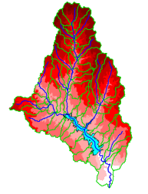
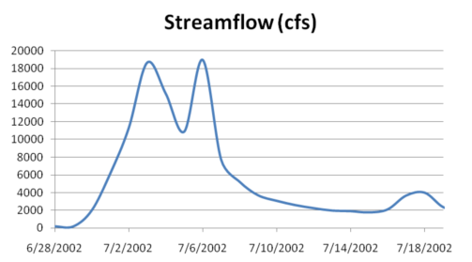

A Key Challenge
How to connect water environment with water observations
GIS
Water Environment
(Watersheds, streams,
gages, sampling points)
Time Series Data
Water Observations
(Flow, water level
concentration)

Slide 42
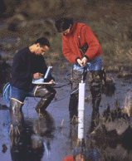


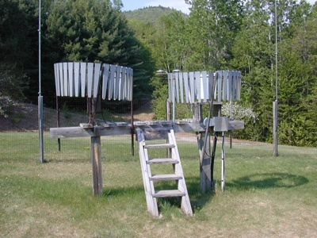
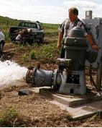
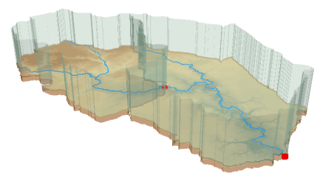
We collect lots of water data
Water quality
Water quantity
From dispersed federal agencies
From investigators collected for different purposes
Different formats
  Points
  Lines
  Polygons
  Fields
  Time Series
Rainfall and Meteorology
Soil water
Groundwater
The way that data is stored can enhance or inhibit the analysis that can be done
We need ways to organize the data we work with
GIS

Slide 43

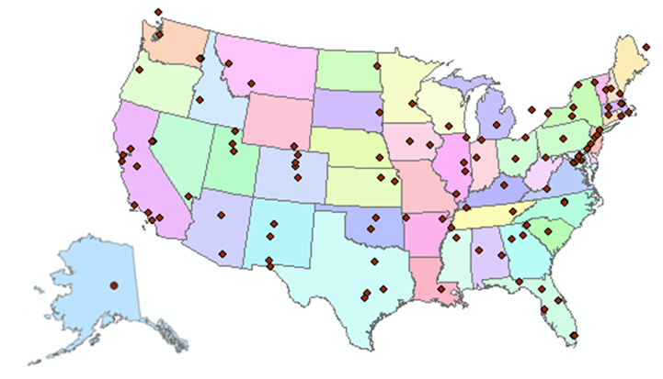
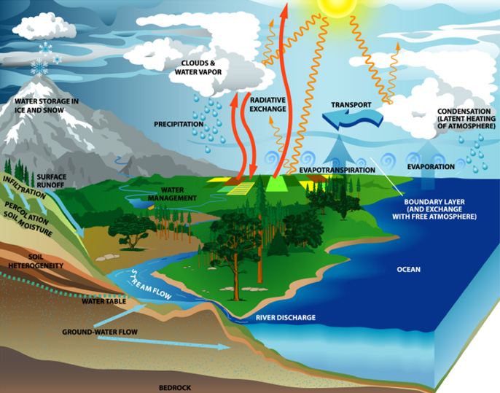
http://www.cuahsi.org
CUAHSI is a consortium representing 125 US universities
Supported by the National Science Foundation Earth Science Division
Advances hydrologic science in nation’s universities
Includes a Hydrologic Information Systems

Slide 44
How the web works
Catalog
(Google)
Catalog harvest
Search
Web Server
(CNN.com)
Access
Browser
(Firefox)
HTML – web language for text and pictures

Slide 45


CUAHSI Hydrologic Information System: A
Services-Oriented Architecture Based System for Sharing Hydrologic Data
HydroCatalog
Data Discovery and Integration
Metadata Services
WaterML, Other OGC Standards
Search Services
HydroServer
HydroDesktop
Data Publication
Data Services
Data Analysis and Synthesis

Slide 46
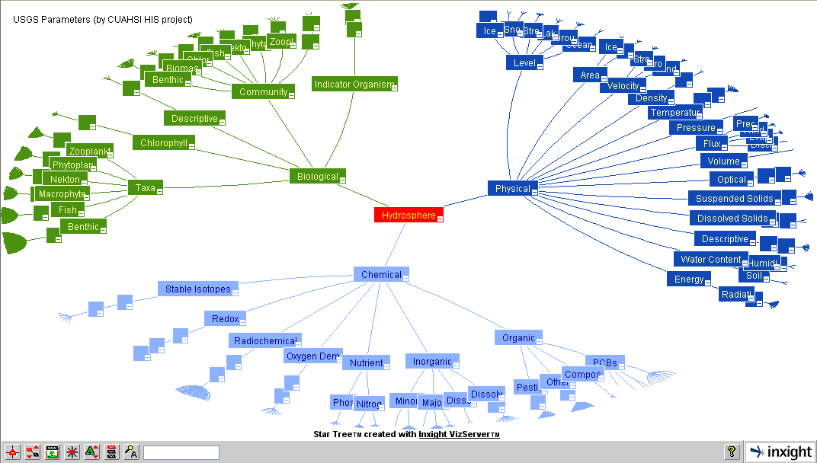
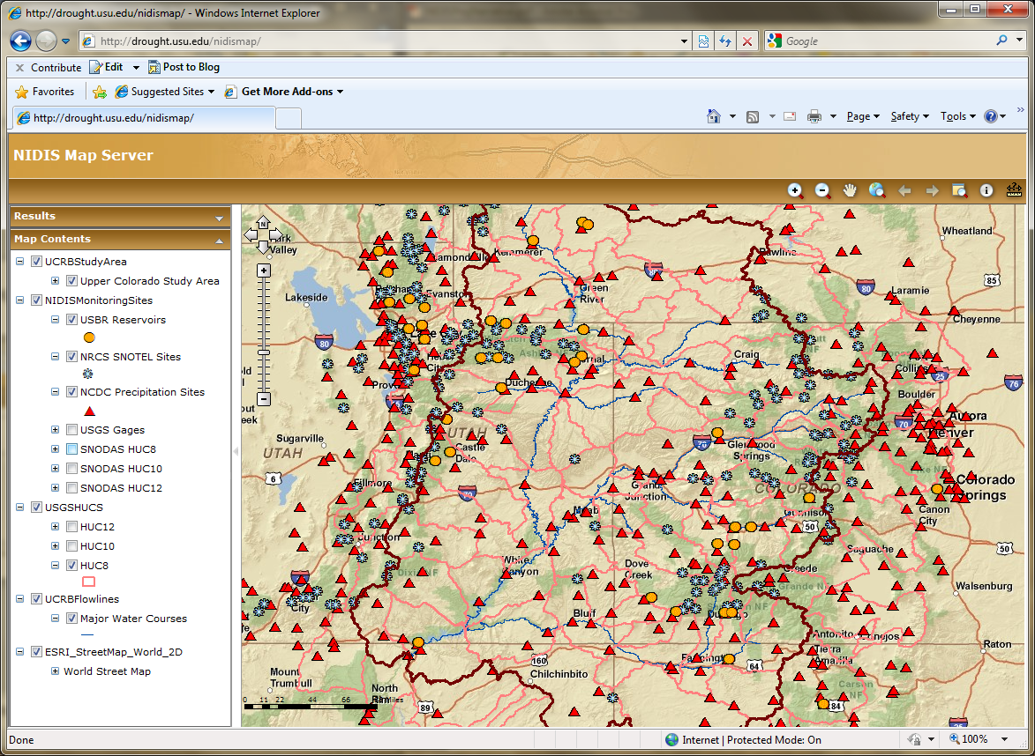
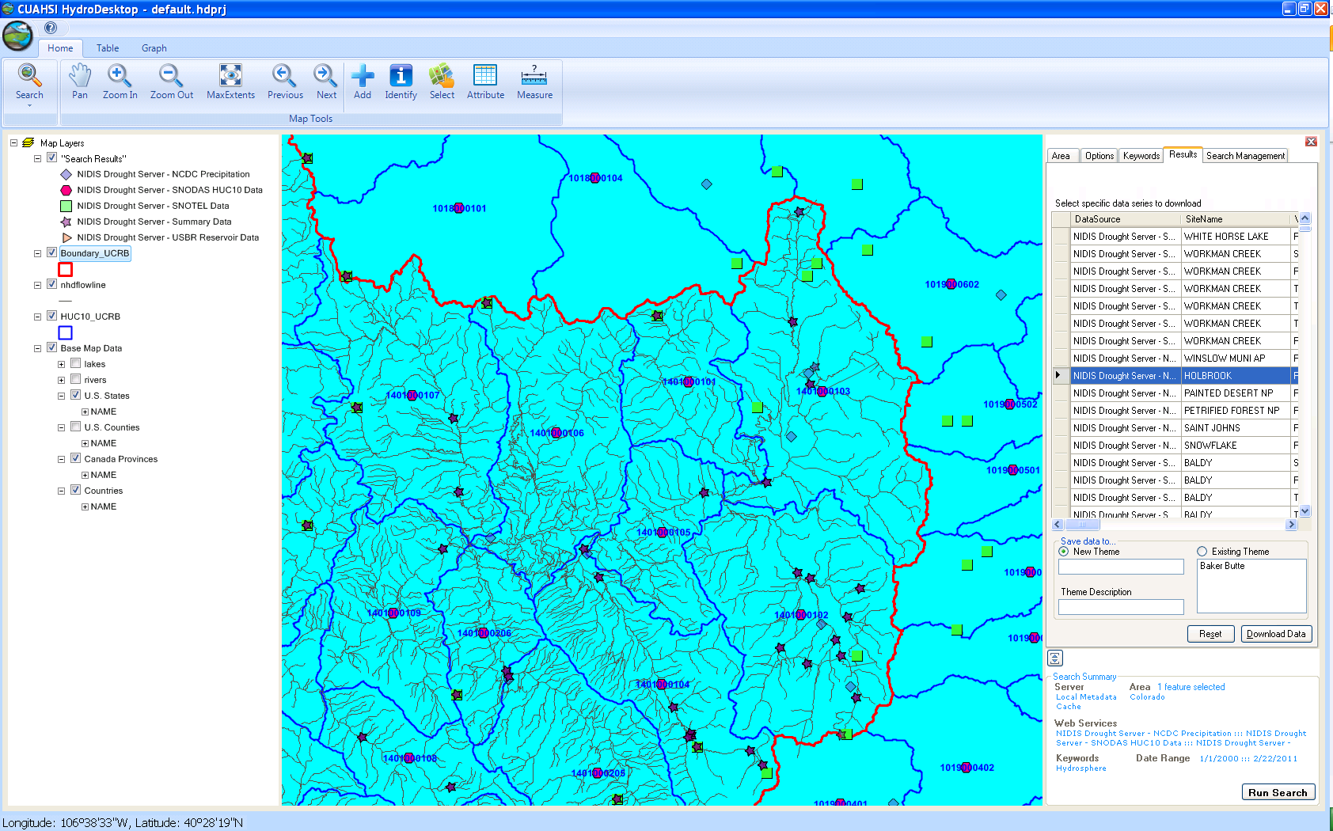
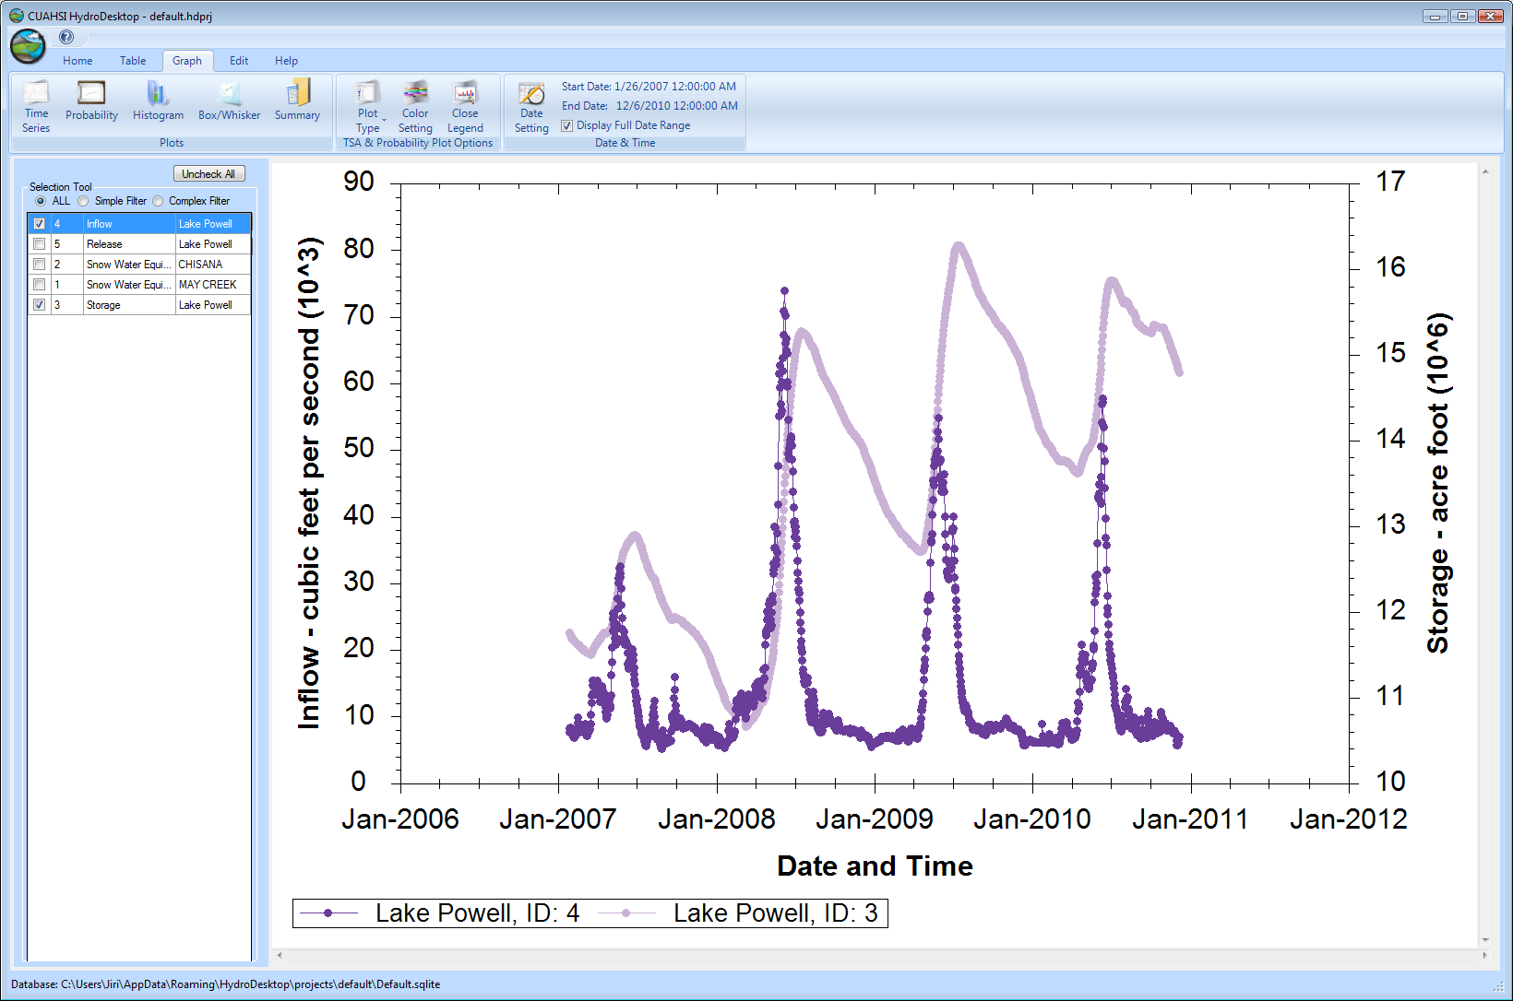
CUAHSI HIS
The CUAHSI Hydrologic Information System (HIS) is an internet based system to support the sharing of hydrologic data. It is comprised of hydrologic databases and servers connected through web services as well as software for data publication, discovery and access.
HydroServer – Data Publication
HydroCatalog
Data Discovery
Lake Powell Inflow and Storage
HydroDesktop – Data Access and Analysis
HydroDesktop – Combining multiple data sources

Slide 47
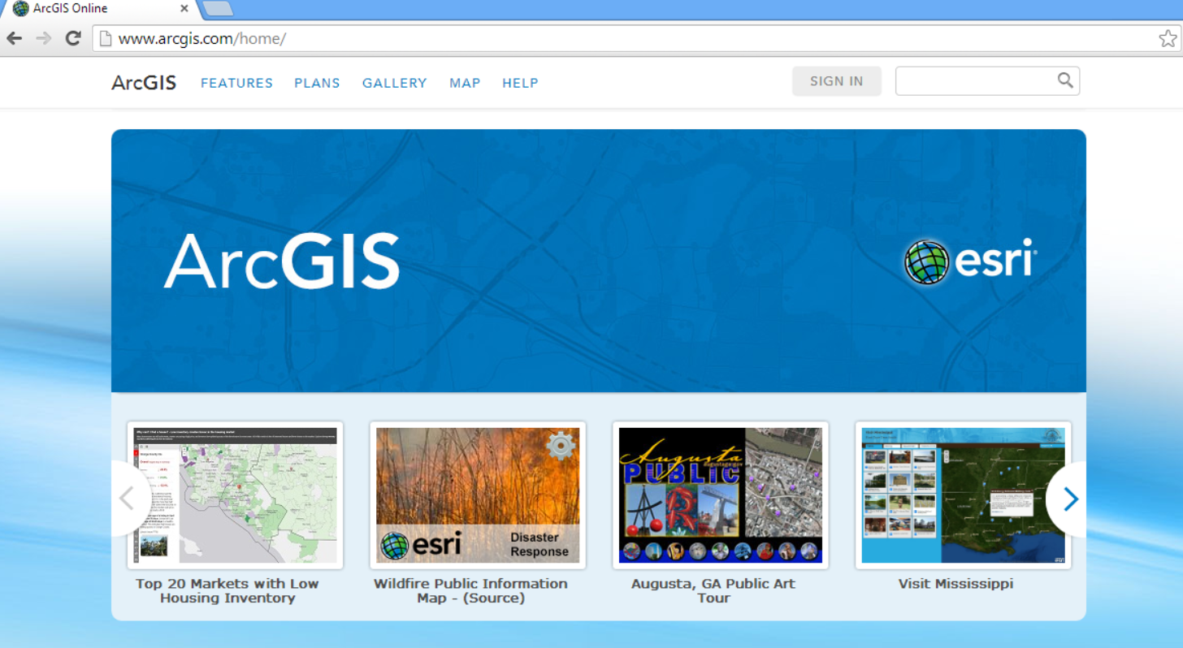
GIS on the web
ArcGIS online map services
http://www.arcgis.com

Slide 48
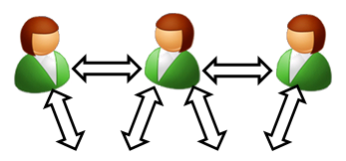
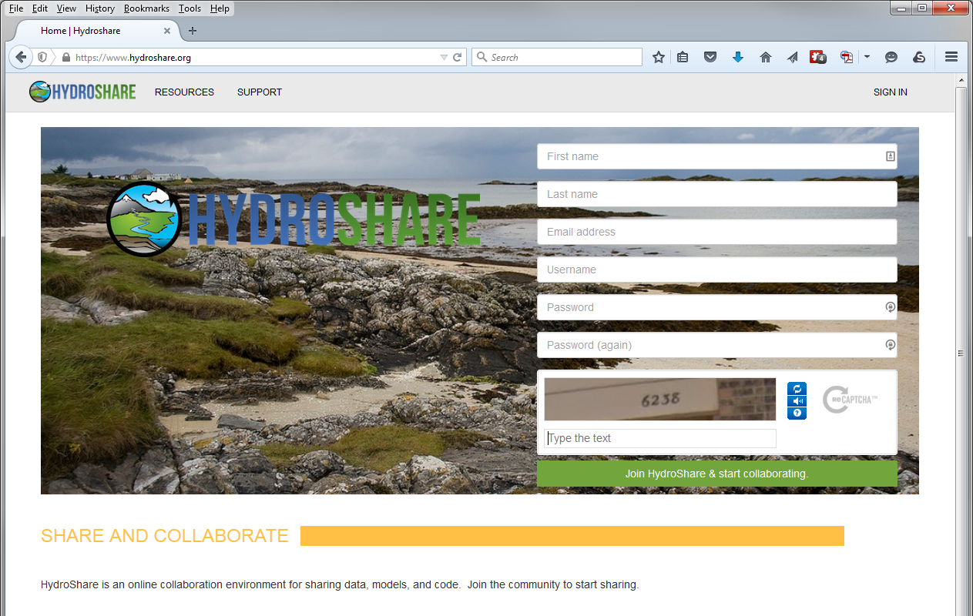
HydroShare is a web based collaborative system to support analysis, modeling and data publication
www.hydroshare.org
Notes:
HydroShare will be a collaborative environment for sharing hydrologic data and models aimed at giving hydrologists the technology infrastructure they need to address critical issues related to water quantity, quality, accessibility, and management.
HydroShare will expand the data sharing capability of the CUAHSI Hydrologic Information System by broadening the classes of data accommodated, expanding capability to include the sharing of models and model components, and taking advantage of emerging social media functionality to enhance information about and collaboration around hydrologic data and models.
Functionality will include
A web portal for model and data sharing
Sharing features added to HydroDesktop client software
Access to more types of hydrologic data using standards compliant data formats and interfaces
Enhanced catalog functionality that broadens discovery functionality to different data types and models
New model sharing and discovery functionality
Enhanced easy to use access to high performance computing
Social media and collaboration functionality
Linkages to other data and modeling systems such as USGS and CUAHSI data services, NASA earth exchange and HPC resources e.g. at CSDMS

Slide 49



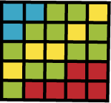








Clearing your desk. The trend towards network (cloud) computing.
Delivering Geographic and Hydrologic Analysis functionality as services over the web?
Data Sources
Server
Functions and Tools
Software as a Service
Users
Based on slide from Norm Jones

Slide 50
GIS in Water Resources: Lecture 1
In-class and distance learning
Geospatial database of hydrologic features
GIS and HIS
Curved earth and a flat map

Slide 51

Origin of Geographic Coordinates
Equator
(0,0)
Prime Meridian

Slide 52
Latitude and Longitude
Longitude line (Meridian)
N
W
E
S
Range: 180ºW - 0º - 180ºE
Latitude line (Parallel)
N
W
E
S
(0ºN, 0ºE)
Equator, Prime Meridian
Range: 90ºS - 0º - 90ºN

Slide 53

Latitude and Longitude in North America
Austin:
Logan:
(30°18' 22" N, 97°45' 3" W)
60 N
30 N
(41°44' 24" N, 111°50' 9" W)
120 W
60 W
90 W
0 N

Slide 54
Map Projection
Flat Map
Cartesian coordinates: x,y
(Easting & Northing)
Curved Earth
Geographic coordinates: φ, λ
(Latitude & Longitude)
Notes:
DRM

Slide 55


Earth to Globe to Map
Map Scale:
Map Projection:
Representative Fraction
Globe distance
Earth distance
Scale Factor
Map distance
Globe distance
=
=
(e.g. 1:24,000)
(e.g. 0.9996)

Slide 56
Coordinate Systems
A planar coordinate system is defined by a pair
of orthogonal (x,y) axes drawn through an origin
Y
Origin
X
(x_{o},y_{o})
(φ_{o},λ_{o})
Projected Coordinates
Geographic Coordinates

Slide 57

ArcGIS Help for Map Projections
http://desktop.arcgis.com/en/desktop/latest/guide-books/map-projections/what-are-map-projections.htm

Slide 58
Summary (1)
GIS in Water Resources is about empowerment through use of information technology – helping you to understand the world around you and to investigate problems of interest to you
This is an “open class” in every sense where we learn from one another as well as from the instructors

Slide 59
Summary (2)
GIS offers a structured information model for working with geospatial data that describe the “water environment” (watersheds, streams, lakes, land use, ….)
Water resources also needs observations and modeling to describe “the water” (discharge, water quality, water level, precipitation)

Slide 60
Summary (3)
Geography “brings things together” through georeferencing on the earth’s surface
Understanding geolocation on the earth and working with geospatial coordinate systems is fundamental to this field
GIS has traditionally been used on the desktop but increasingly there is a transition to information sharing on the web

