Slide 1




General workflow for Hydrologic Terrain Analysis Using Digital Elevation Models
Raw DEM
Pit Removal (Filling)
Channels, Watersheds, Flow Related Terrain Information
Flow Field
Watersheds are the most basic hydrologic landscape elements
Notes:
This slide shows the general model for deriving flow field related derivative surfaces from digital elevation data. The input is a raw digital elevation model, generally elevation values on a grid. This is basic information used to derive further hydrology related spatial fields that enrich the information content of this basic data. The first step is to remove sinks, either by filling, or carving. Then a flow field is defined. This enables the calculation of flow related terrain information. My focus has been on flow related information working within this framework. I try to leave other GIS functionality, like radiation exposure, line of sight analyses and visualization to others. I have distributed my software in ways that it easily plugs in to mainstream systems, such as ArcGIS to enhance ease of use.

Slide 2
Outline
Raster to Vector Connection and relational model of catchments, watersheds and channel networks
Using vector stream information (DEM reconditioning)
Enhanced pit removal
Channelization threshold selection
Hydrologic Terrain Analysis Software

Slide 3
Watershed Draining to Outlet
Watershed mapped as all grid cells that drain to an outlet
Streams mapped as grid cells with flow accumulation greater than a threshold

Slide 4
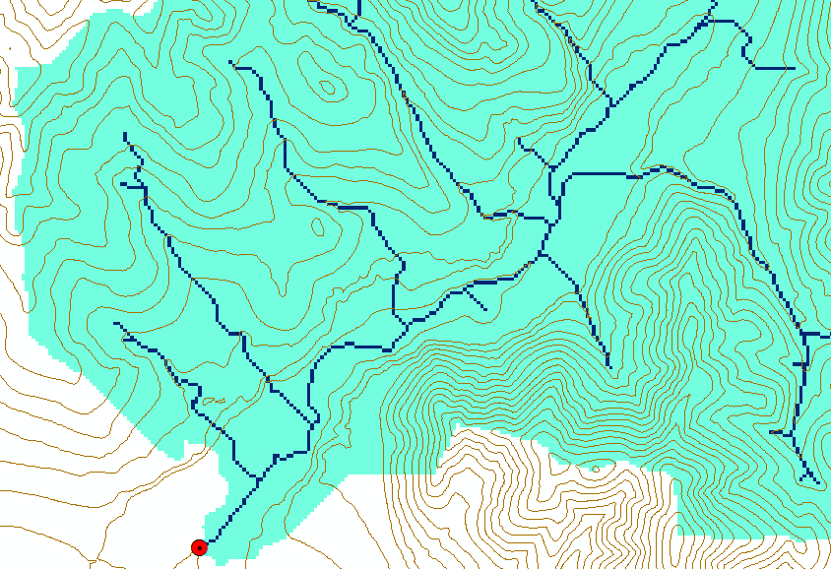
Watershed and Stream Grids
Watershed mapped as all grid cells that drain to an outlet
Streams mapped as grid cells with flow accumulation greater than a threshold

Slide 5
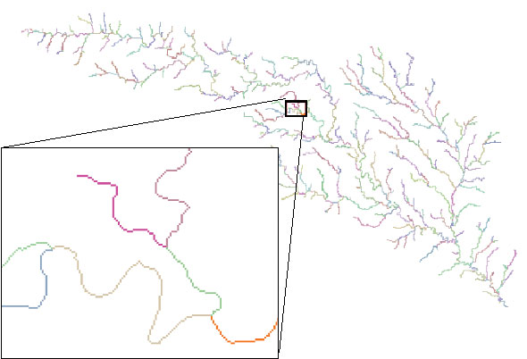
Stream Segments
201
172
202
203
206
204
209
Each link has a unique identifying number
ArcHydro Page 74

Slide 6
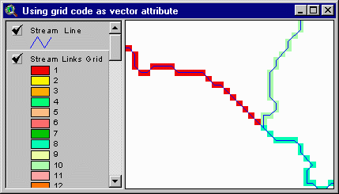
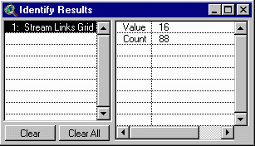
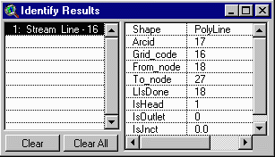
Vectorized Streams Linked Using Grid Code to Cell Equivalents
Vector
Streams
Grid
Streams
ArcHydro Page 75

Slide 7
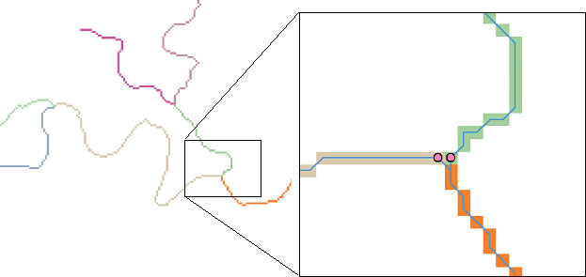
DrainageLines are drawn through the centers of cells on the stream links. DrainagePoints are located at the centers of the outlet cells of the catchments
ArcHydro Page 75

Slide 8
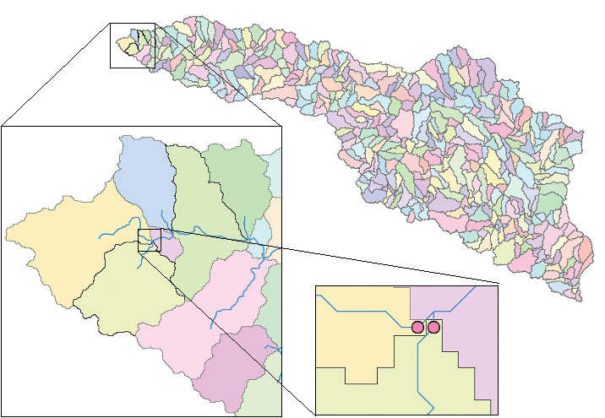
Catchments, DrainageLines and DrainagePoints of the San Marcos basin
ArcHydro Page 75

Slide 9
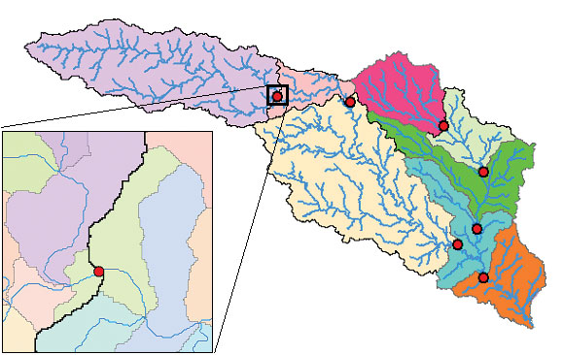
Catchment, Watershed, Subwatershed.
Subwatersheds
Catchments
Watershed
Watershed outlet points may lie within the interior of a catchment, e.g. at a USGS stream-gaging site.
ArcHydro Page 76

Slide 10
Using Vector Stream Information
“Burning In” the Streams
• Take a mapped stream network and a DEM
• Make a grid of the streams
• Raise the off-stream DEM cells by an arbitrary elevation
increment
• Produces "burned in" DEM streams = mapped streams
+
=

Slide 11
AGREE Elevation Grid Modification Methodology – DEM Reconditioning

Slide 12


Carving
Lower elevation of neighbor along a predefined drainage path until the pit drains to the outlet point

Slide 13
Carving
Original DEM
Carved DEM
Pits
Carve outlets
Notes:
Elevations are filled to that of the pools pour point

Slide 14
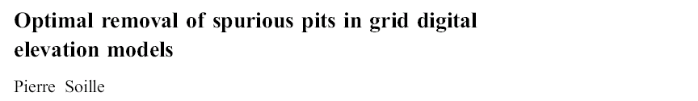
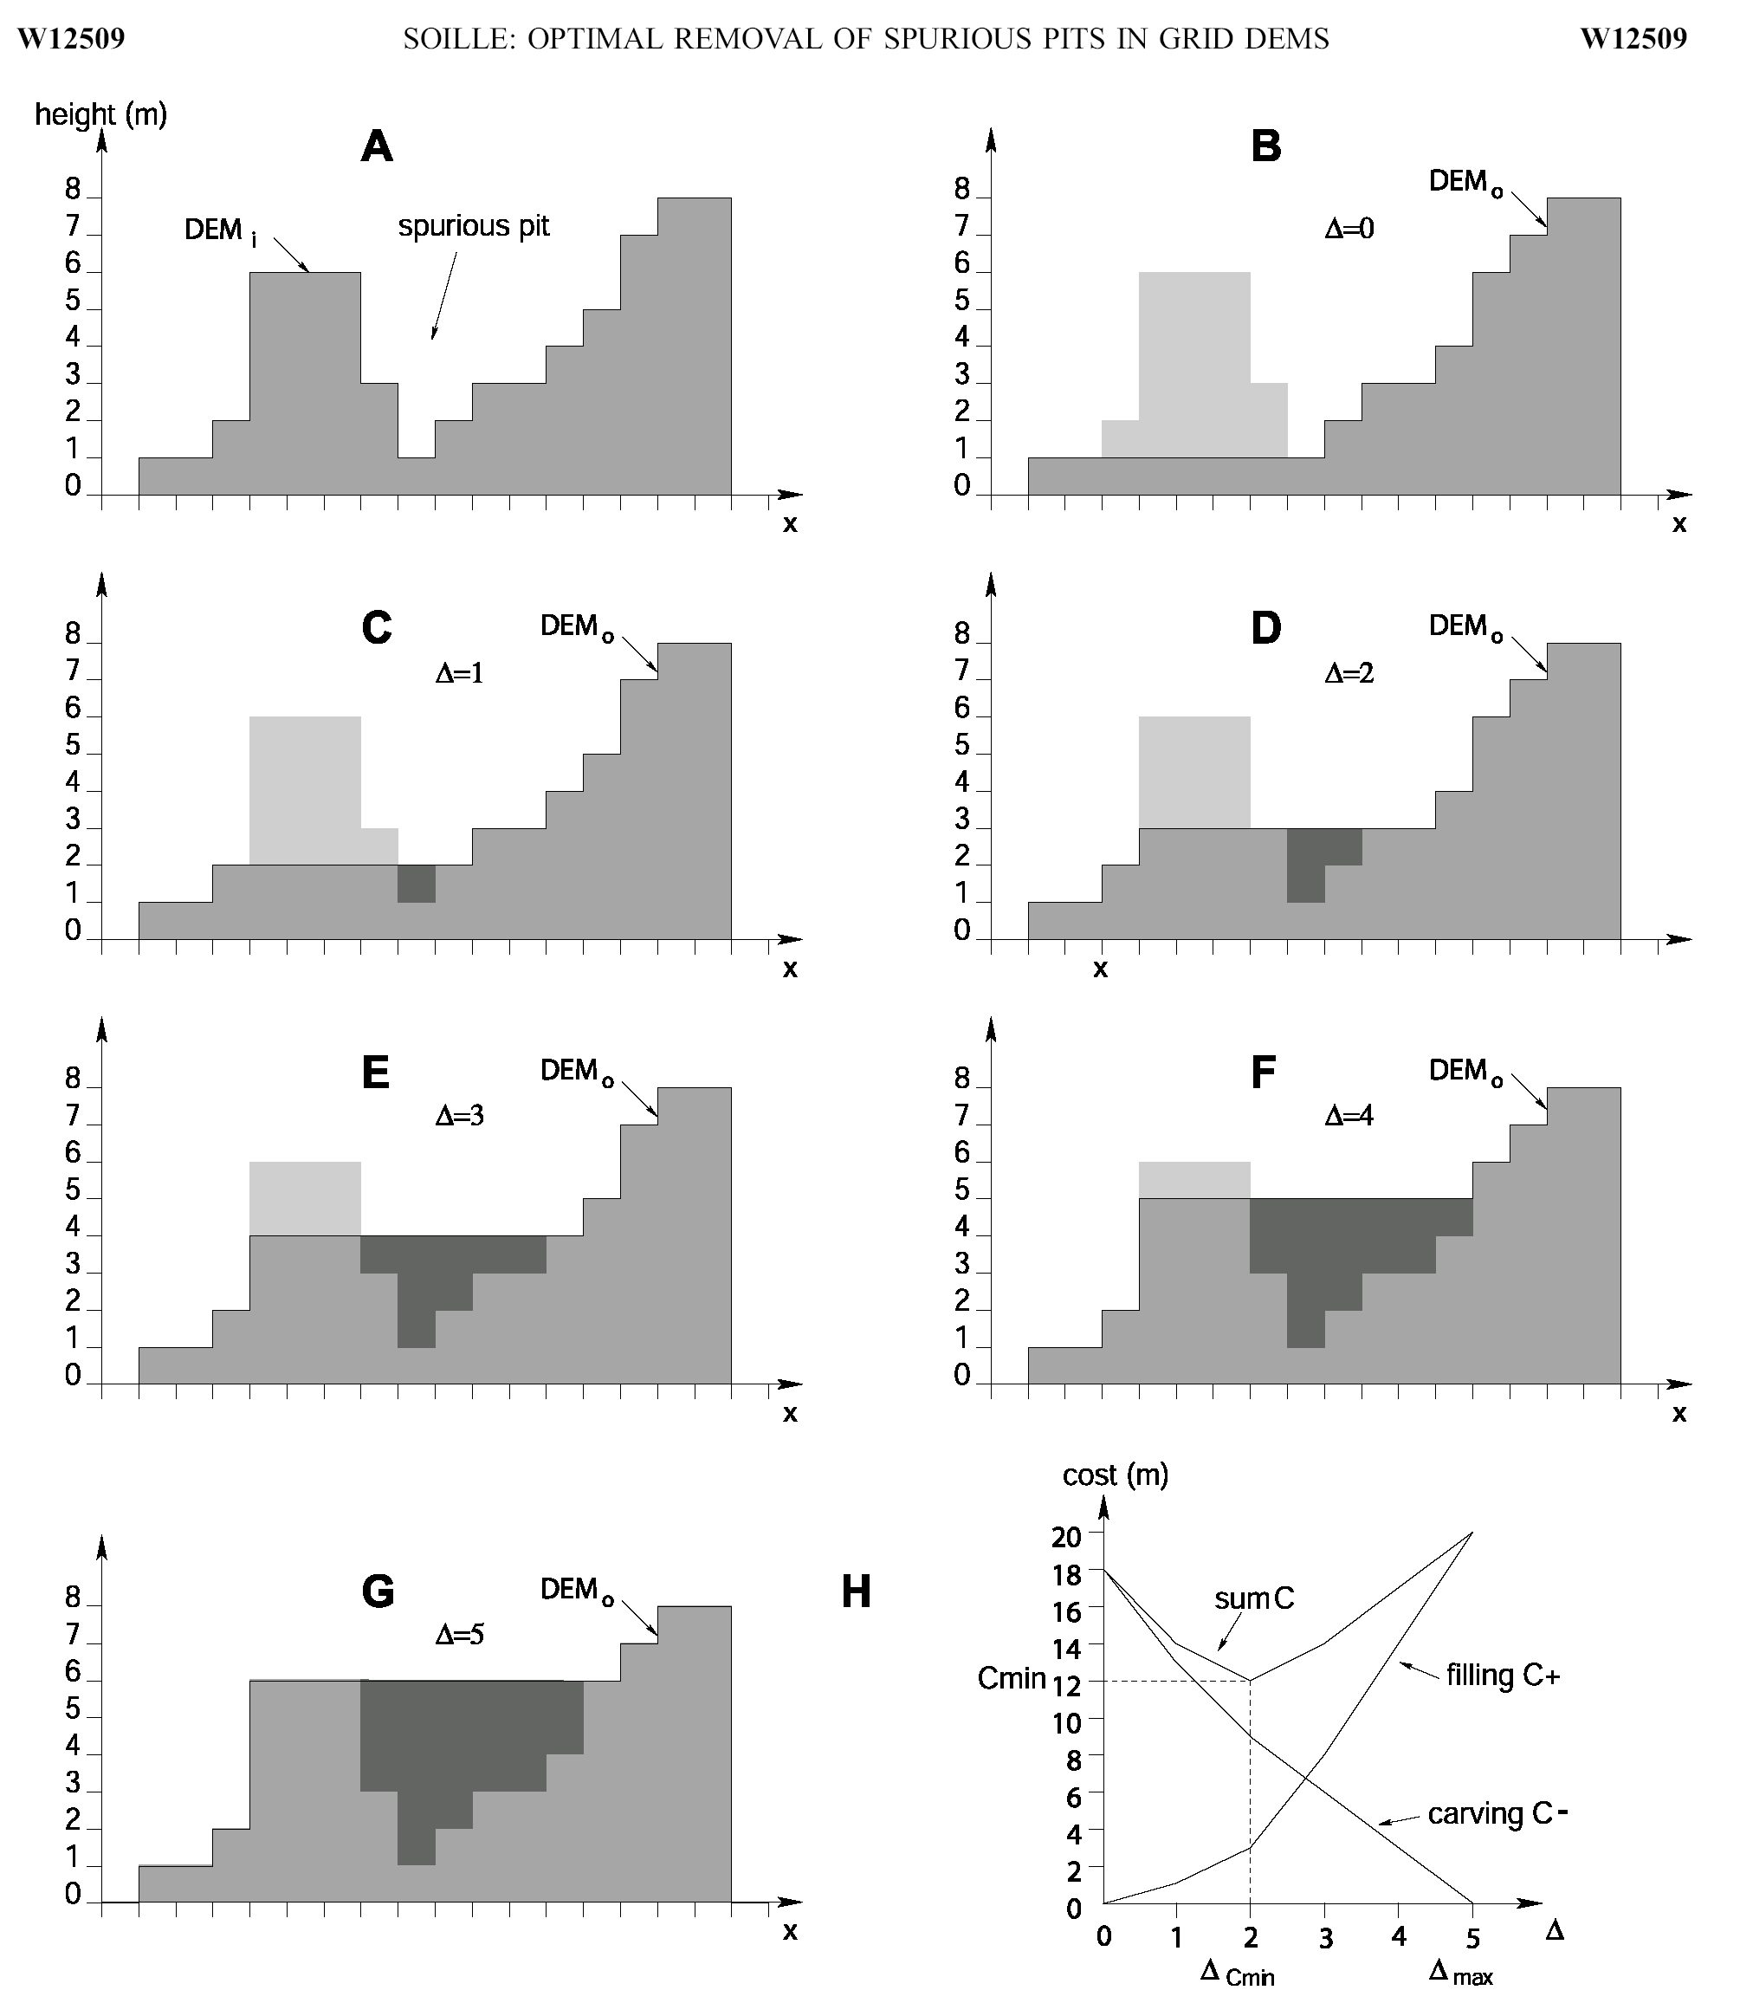
Filling
Minimizing Alterations
Carving

Slide 15
Minimizing DEM Alterations
Original DEM
Optimally adjusted
Carved
Pits
Filled
Notes:
Elevations are filled to that of the pools pour point

Slide 16
Summary of Key Processing Steps
[DEM Reconditioning]
Pit Removal (Fill Sinks)
Flow Direction
Flow Accumulation
Stream Definition
Stream Segmentation
Catchment Grid Delineation
Raster to Vector Conversion (Catchment Polygon, Drainage Line, Catchment Outlet Points)

Slide 17
How to decide on stream delineation threshold ?
AREA 2
3
AREA 1
12
Why is it important?

Slide 18
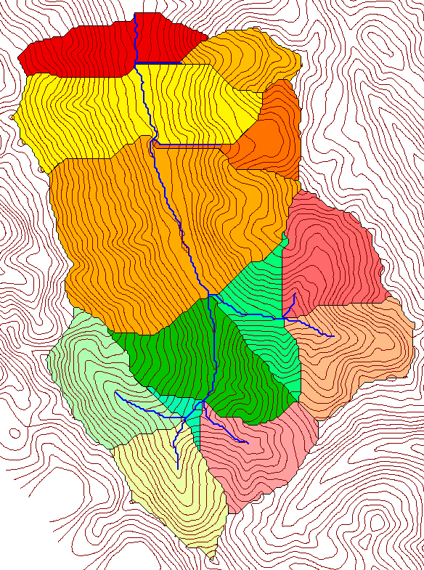
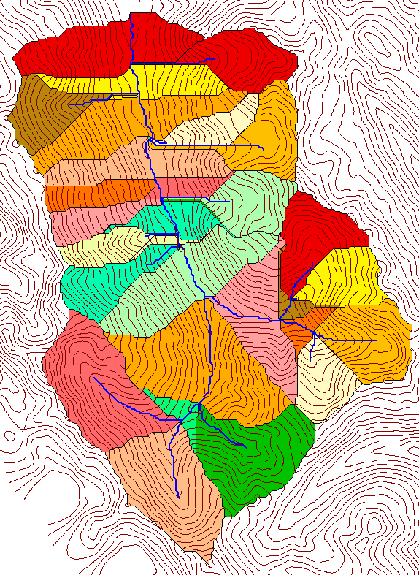
Delineation of Channel Networks and Catchments
500 cell theshold
1000 cell theshold

Slide 19
Hydrologic processes are different on hillslopes and in channels. It is important to recognize this and account for this in the delineation of streams.
Drainage area can be concentrated or dispersed (specific catchment area) representing concentrated or dispersed flow.

Slide 20
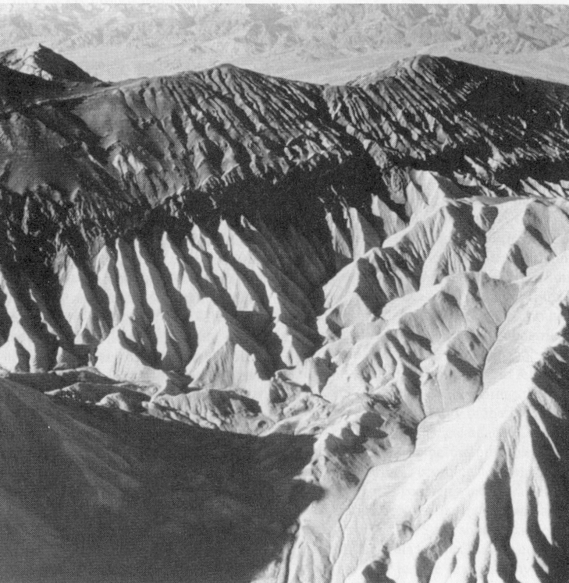
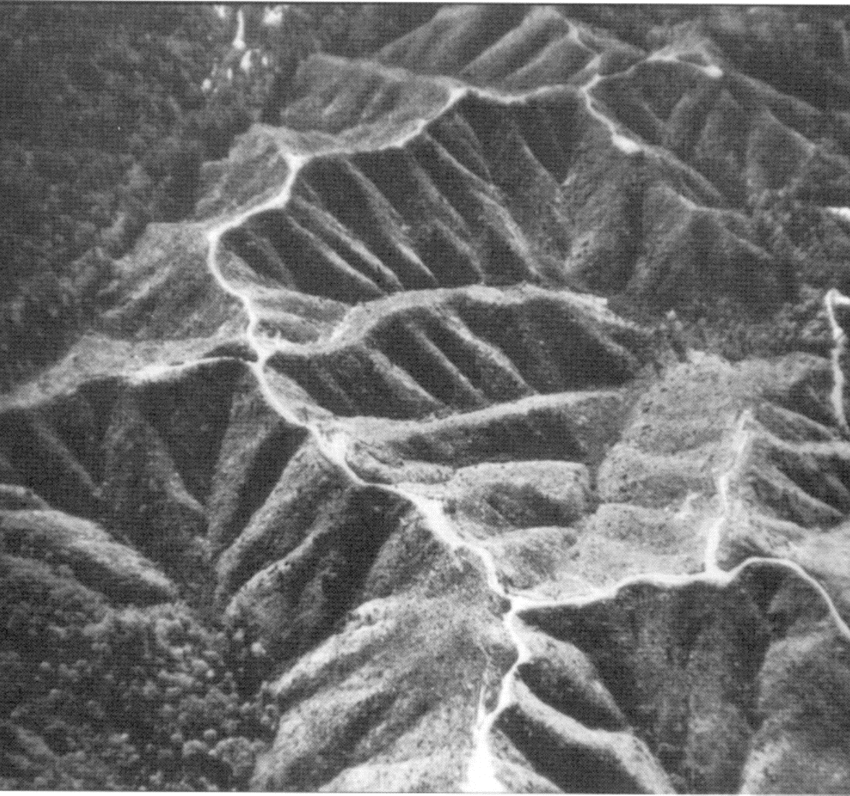
Examples of differently textured topography
Badlands in Death Valley.
from Easterbrook, 1993, p 140.
Coos Bay, Oregon Coast Range.
from W. E. Dietrich

Slide 21
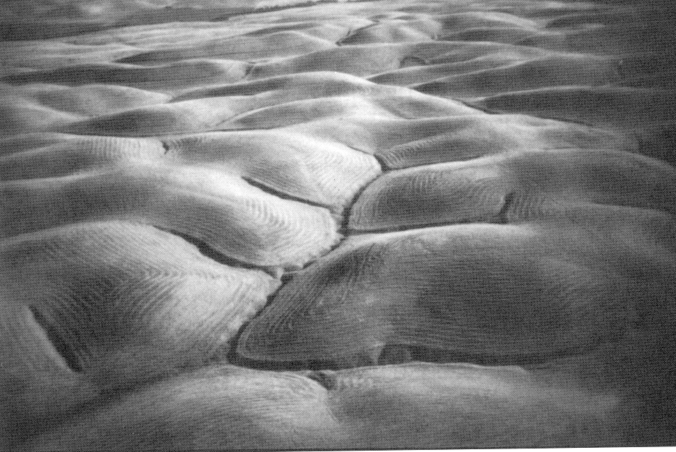
Gently Sloping Convex Landscape
From W. E. Dietrich

Slide 22
Topographic Texture and Drainage Density
Driftwood, PA
Same scale, 20 m contour interval
Sunland, CA

Slide 23
“landscape dissection into distinct valleys is limited by a threshold of channelization that sets a finite scale to the landscape.” (Montgomery and Dietrich, 1992, Science, vol. 255 p. 826.)
Suggestion: One contributing area threshold does not fit all watersheds.
Lets look at some geomorphology.
    Drainage Density
    Horton’s Laws
    Slope – Area scaling
    Stream Drops

Slide 24
Drainage Density
D_{d} = L/A
Hillslope length ≈ 1/(2D_{d})
B
B
Hillslope length = B
A = 2B L
D_{d} = L/A = 1/(2B)
∴ B= 1/(2D_{d})
L

Slide 25
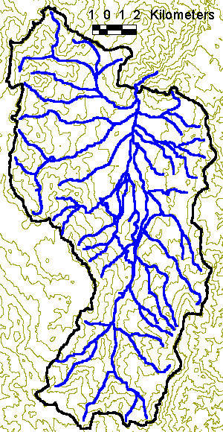
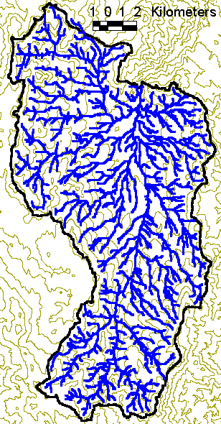
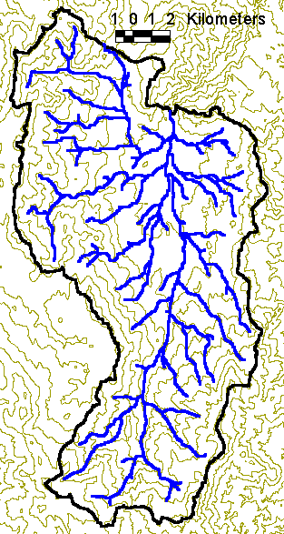
Drainage Density for Different Support Area Thresholds
EPA Reach Files
100 grid cell threshold
1000 grid cell threshold

Slide 26
Drainage Density Versus Contributing Area Threshold

Slide 27
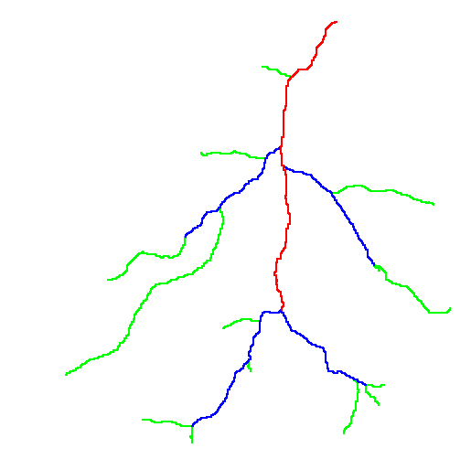
Hortons Laws: Strahler system for stream ordering
1
3
1
2
1
2
1
1
1
1
1
2
2
1
1
1
1
1
1

Slide 28
Length Ratio

Slide 29
Slope Ratio

Slide 30
Constant Stream Drops Law
Broscoe, A. J., (1959), "Quantitative analysis of longitudinal stream profiles of small watersheds," Office of Naval Research, Project NR 389-042, Technical Report No. 18, Department of Geology, Columbia University, New York.

Slide 31

Stream Drop
Elevation difference between ends of stream
Nodes
Links
Single Stream
Note that a “Strahler stream” comprises a sequence of links (reaches or segments) of the same order

Slide 32
Suggestion: Map channel networks from the DEM at the finest resolution consistent with observed channel network geomorphology ‘laws’.
Look for statistically significant break in constant stream drop property as stream delineation threshold is reduced
Break in slope versus contributing area relationship
Physical basis in the form instability theory of Smith and Bretherton (1972), see Tarboton et al. 1992

Slide 33
Statistical Analysis of Stream Drops

Slide 34
T-Test for Difference in Mean Values
0
72
130
T-test checks whether difference in means is large (> 2)
when compared to the spread of the data around the mean values

Slide 35
Objectively Selected Support Area Threshold

Slide 36
200 grid cell constant support area based stream delineation

Slide 37
Hydrologic Terrain Analysis Software
ArcGIS Online Hydro
ArcGIS Hydrology Tools
ArcHydro
TauDEM
[RiverTools]
[GRASS]

Slide 38
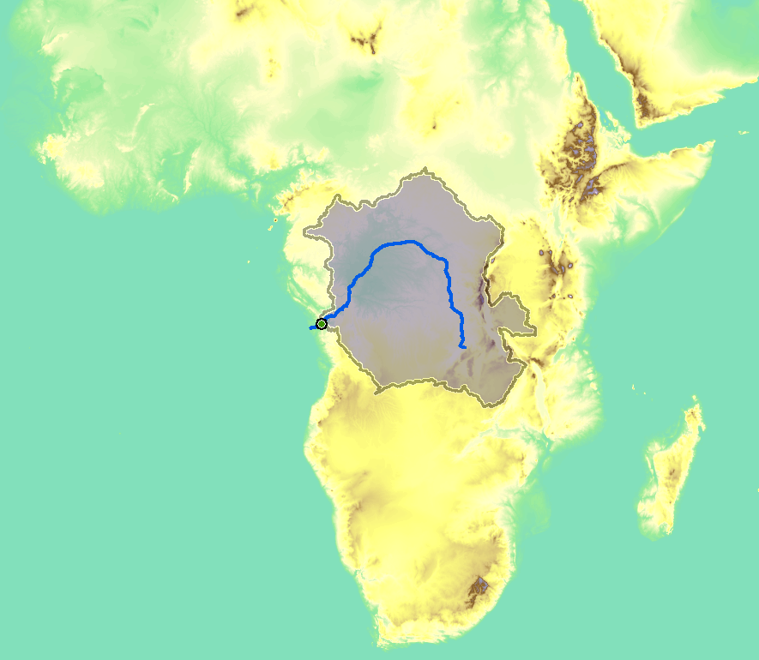
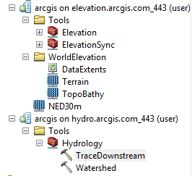
ArcGIS Online Hydro

Slide 39
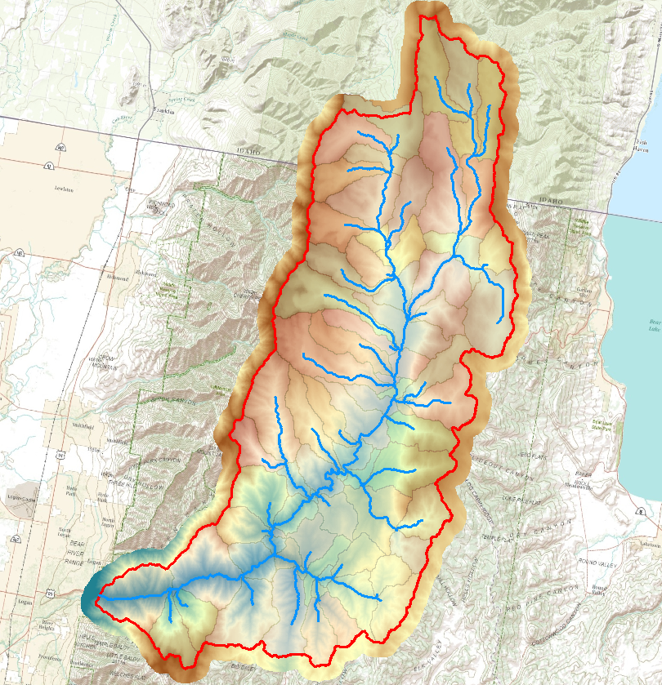
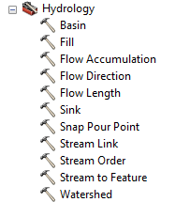
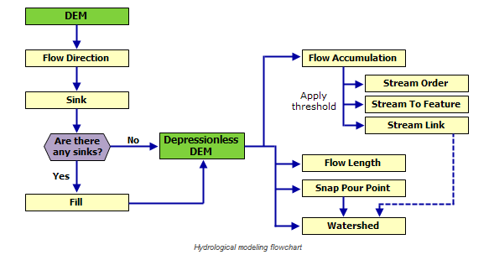
ArcGIS Hydrology Toolset

Slide 40
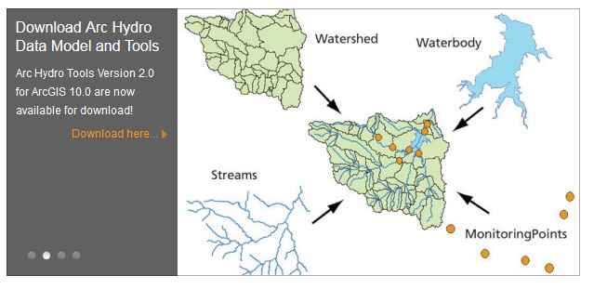
ArcHydro
http://resources.arcgis.com/en/communities/hydro/

Slide 41

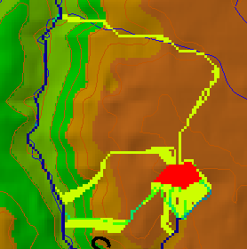
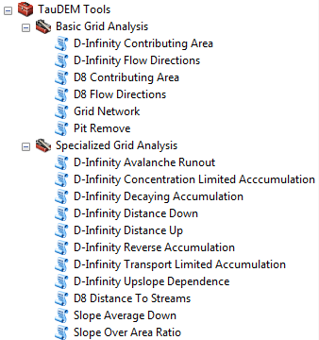

TauDEM
Stream and watershed delineation
Multiple flow direction flow field
Calculation of flow based derivative surfaces
MPI Parallel Implementation for speed up and large problems
Open source platform independent C++ command line executables for each function
Deployed as an ArcGIS Toolbox with python scripts that drive command line executables
CSDMS Cluster Implementation
Open Topography implementation
CyberGIS Implementation
http://hydrology.usu.edu/taudem/

Slide 42
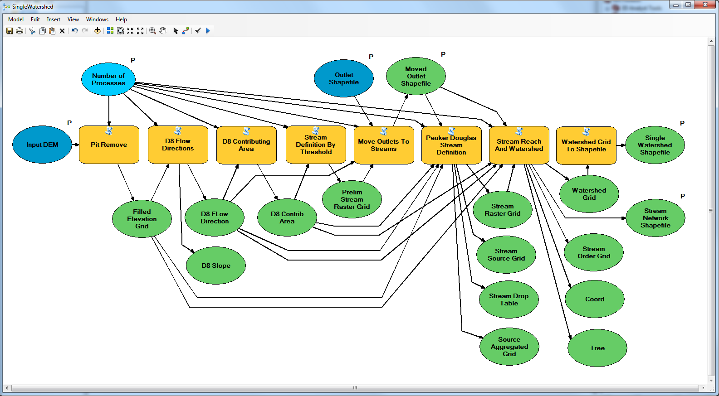
Workflow to automatically generate stream network upstream of outlet

Slide 43
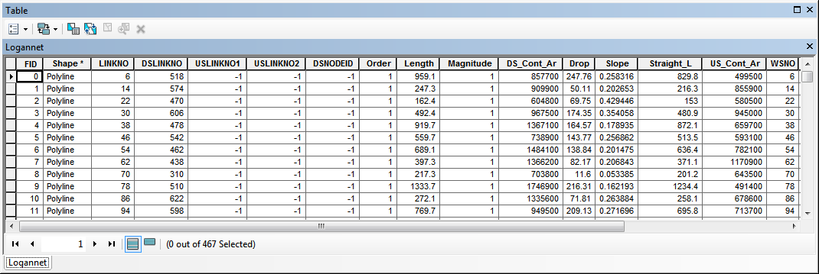
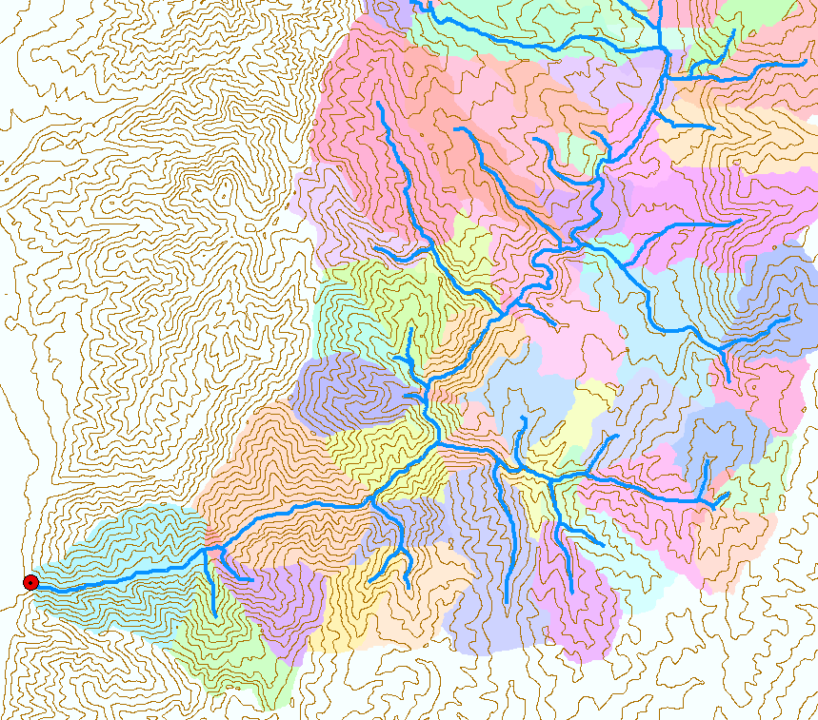
Catchments linked to Stream Network
The starting point for catchment based distributed hydrologic modeling

Slide 44
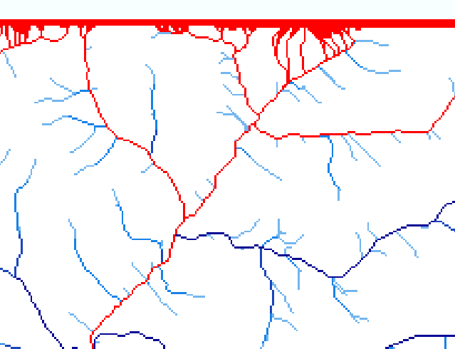
Edge contamination
Edge contamination arises when a contributing area value depends on grid cells outside of the domain. This occurs when drainage is inwards from the boundaries or areas with no data values. The algorithm recognizes this and reports "no data" resulting in streaks of "no data" values extending inwards from boundaries along flow paths that enter the domain at a boundary.

Slide 45
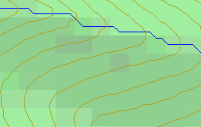
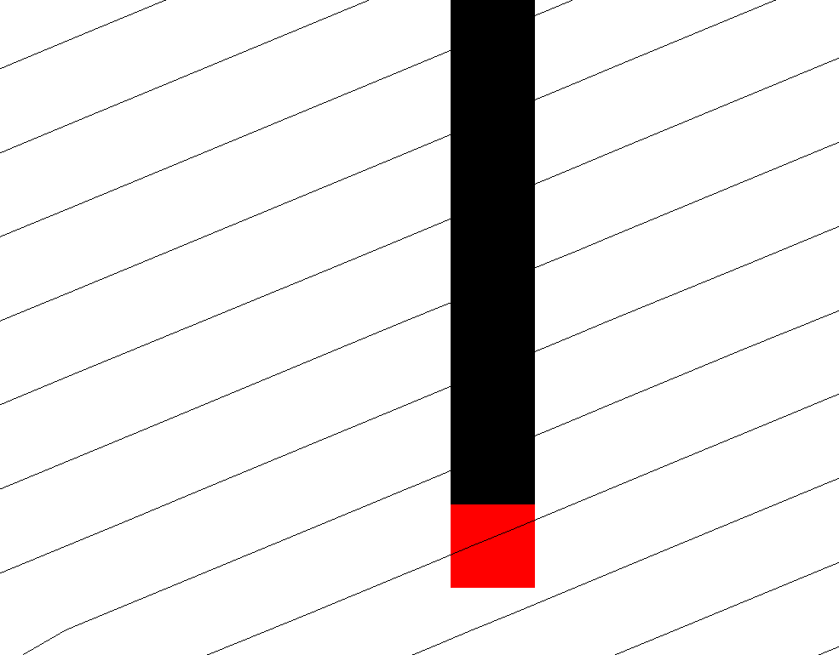
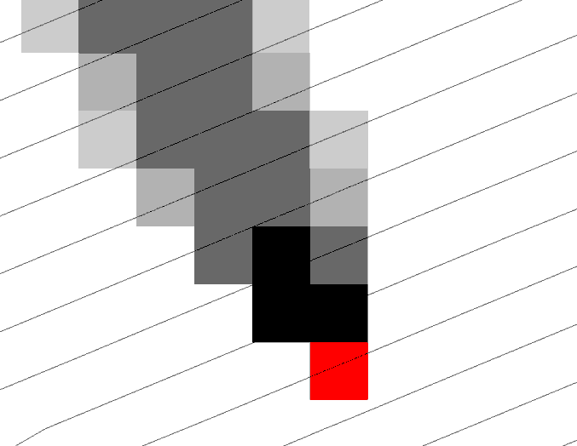
Representation of Flow Field
Steepest single direction
48
52
56
67
D8
D∞
Tarboton, D. G., (1997), "A New Method for the Determination of Flow Directions and Contributing Areas in Grid Digital Elevation Models," Water Resources Research, 33(2): 309-319.)
Notes:
This slide shows how the terrain flow field is represented. Early DEM work used a single flow direction model, D8. In 1997 I published the Dinfinity method that proportions flow from each grid cell among downslope neighbors. This, at the expense of some dispersion, allows a better approximation of flow across surfaces.

Slide 46
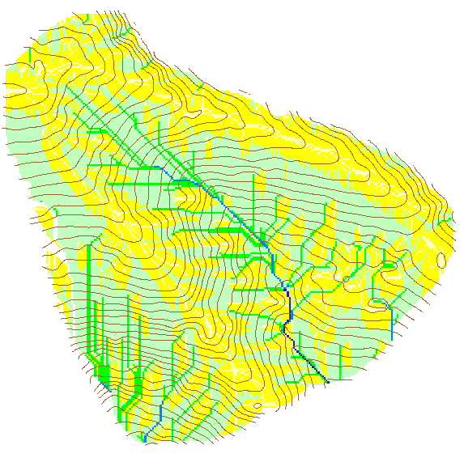
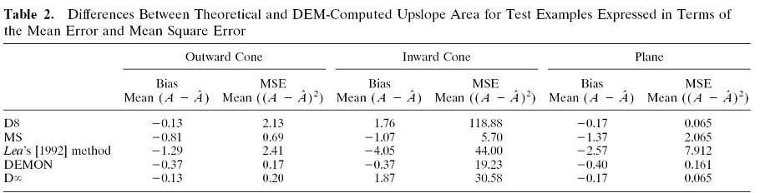
Contributing Area
D∞
D8

Slide 47
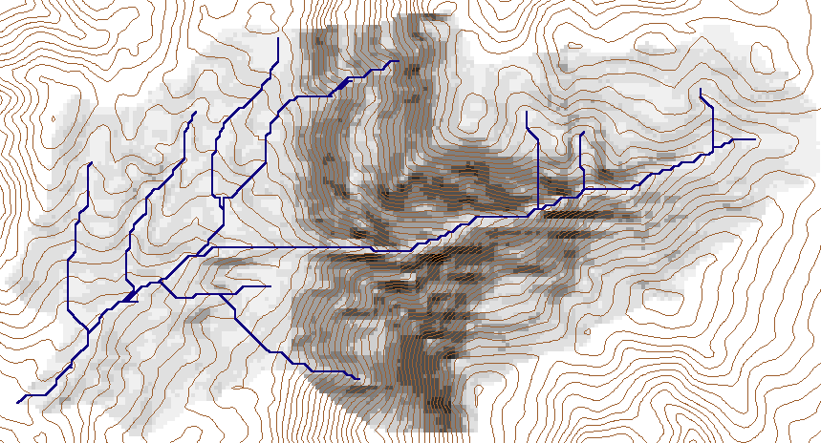
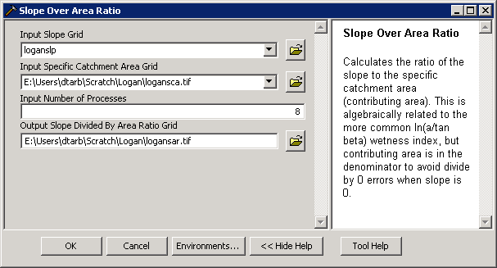
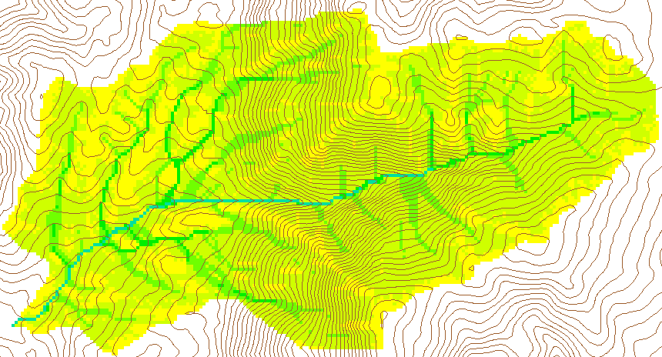
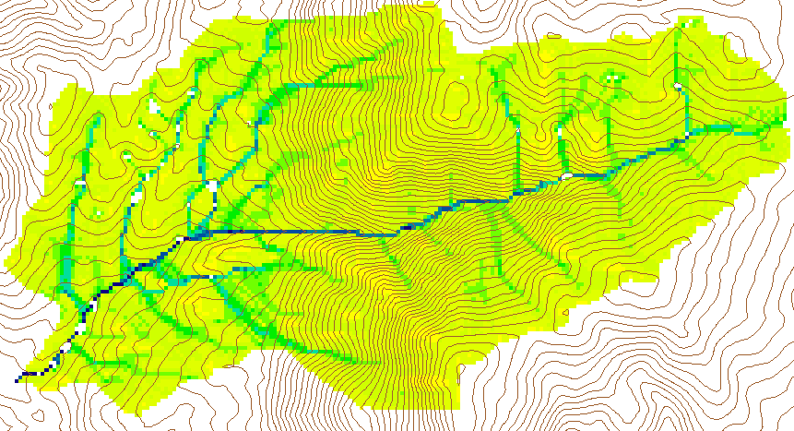
Wetness Index
Slope (S)
Specific Catchment Area (a)
Wetness Index ln(a/S)

Slide 48
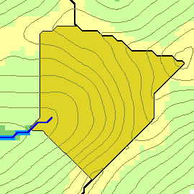
Generalized Flow Accumulation
w(x)
x

Slide 49
Generalization to Flow Algebra
Replace
P_{ki}
P_{ki}
P_{ki}
i
by general function

Slide 50
Useful for a tracking contaminant or compound subject to decay or attenuation

Slide 51
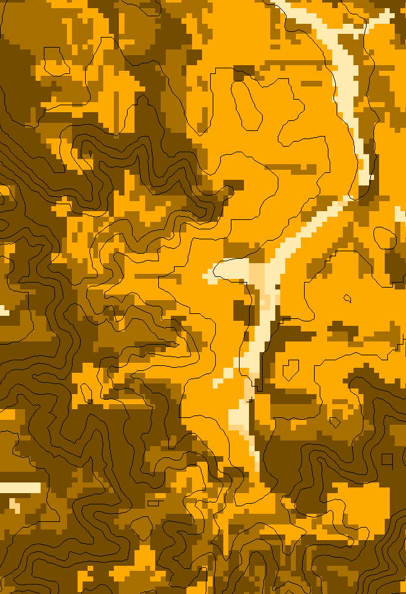
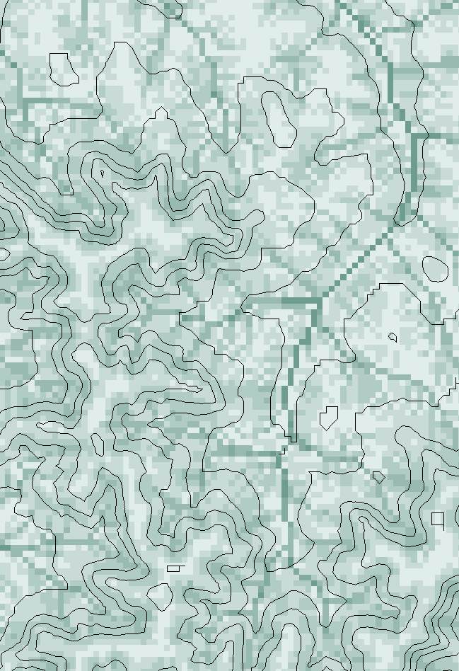
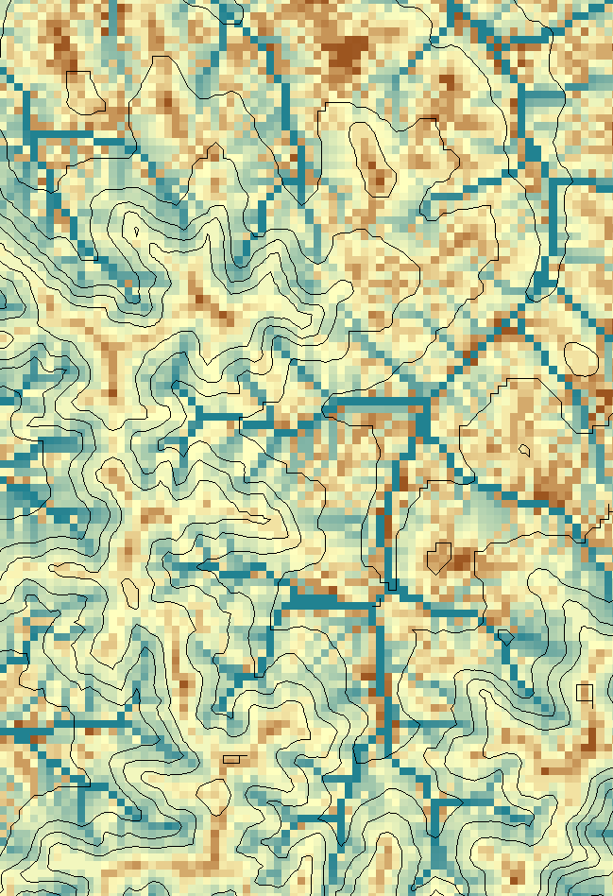
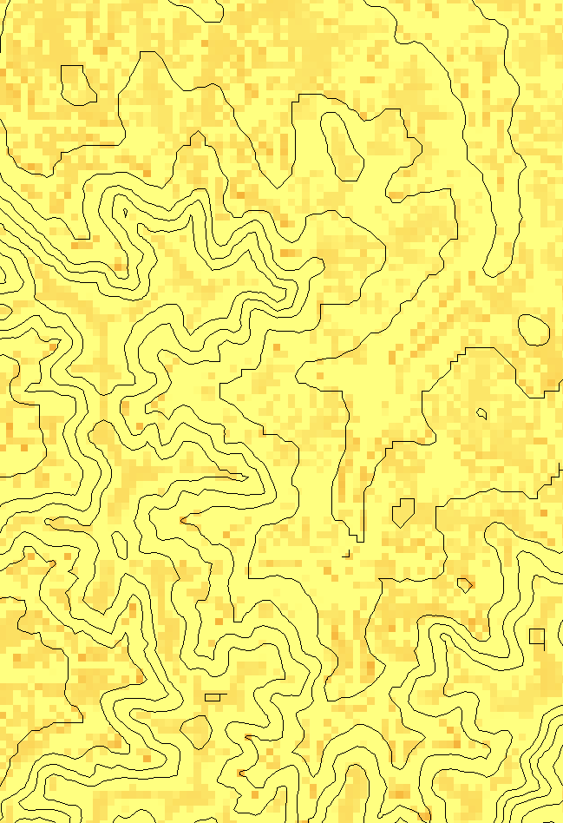
Transport limited accumulation
Supply
Capacity
Transport
Deposition
S
T
=
χa
2
tan(
b
)
2
T
=
min{
S
+
∑
T
,
T
}
D
=
S
+
∑
T
−
T
cap
out
in
cap
in
out
Useful for modeling erosion and sediment delivery, the spatial dependence of sediment delivery ratio and contaminant that adheres to sediment

Slide 52




The challenge of increasing Digital Elevation Model (DEM) resolution
1980’s DMA 90 m
10² cells/km²
1990’s USGS DEM 30 m
10³ cells/km²
2000’s NED 10-30 m
10⁴ cells/km²
2010’s LIDAR ~1 m
10⁶ cells/km²

Slide 53
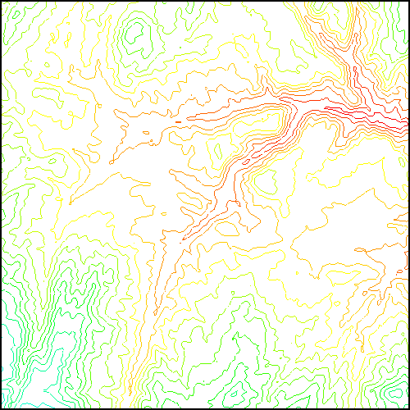
TauDEM Parallel Approach
MPI, distributed memory paradigm
Row oriented slices
Each process includes one buffer row on either side
Each process does not change buffer row
Improved runtime efficiency
Capability to run larger problems

Slide 54

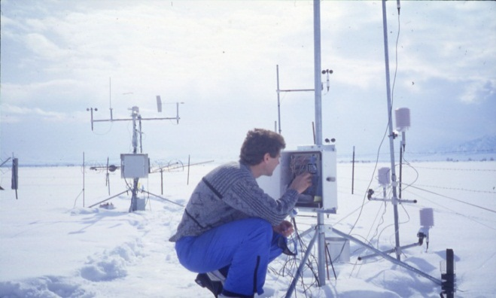
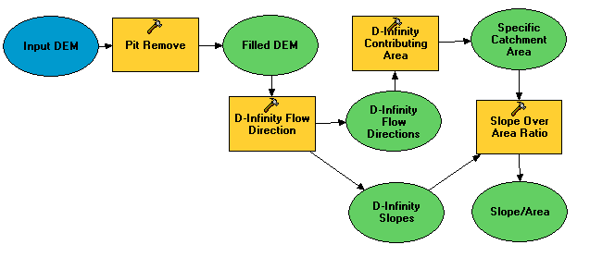
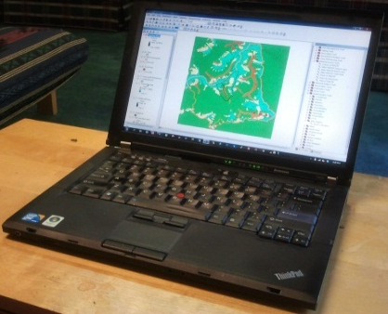
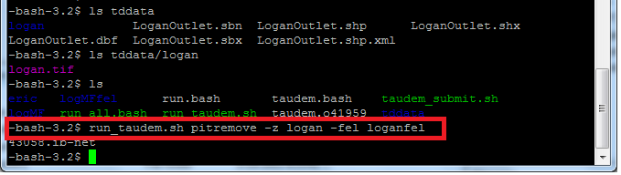
Do you have the access or know how to take advantage of advanced computing capability?
Researchers
Experimentalists
Modelers
HPC Specialists
#!/bin/bash
vi
chmod
#PBS -l nodes=4:ppn=8
grep
awk
mpiexec

Slide 55

Using TauDEM today requires
Expertise in Hydrologic DEM analysis
The software
  ArcGIS licenses
  The ability to install software
  TauDEM command functions with MPI installation
  Compilation for other platforms
Sufficient Hardware (RAM and Disk)
The data (uncompressed GeoTIFF, projected, consistent grid size and spatial reference)

Slide 56












Can we deliver GIS functionality in general, and TauDEM specifically, as a service over the web
Data Sources
Server
Functions and Tools
Software as a Service
Users
Based on slide from Norm Jones

Slide 57

XSEDE Extended Collaboration Support Services (ECSS) improvements
Reconfiguration of multiple file header reads to be broadcast from single node
Reconfiguration of output files to avoid spanning processors
Execution time of the three most costly TauDEM functions on a 36GB DEM dataset.
I/O Time Comparison (before / after; in seconds) for 2 GB DEM
#cores | Compute | Header Read | Data Read | Data Write
32 | 42.7 / 42.8 | 193.5 / 3.8 | 0.4 / 0.4 | 153.5 / 3.5
64 | 35.3 / 34.8 | 605.5 / 3.9 | 1.5 / 1.1 | 160.2 / 2.3
128 | 33.7 / 33.0 | 615.2 / 2.6 | 0.9 / 1.0 | 173.2 / 2.3
256 | 37.5 / 38.0 | 831.7 / 2.3 | 0.5 / 0.9 | 391.3 / 1.6

Slide 58


www.opentopography.org

Slide 59



Open Topography Data and Product Selection

Slide 60

Open Topography Result

Slide 61


TauDEM Wetness index
Eel River ln(a/S)
a in meters

Slide 62



Contributing area from D-Infinity
Notes:
Note the detail in the representation of flow paths at features such as roads

Slide 63


CyberGIS TauDEM App http://gateway.cigi.illinois.edu/ (Production) http://sandbox.cigi.illinois.edu/home/ (Experimental)

Slide 64



Slide 65

Select the products you want
The wizard configures the sequence of functions to run to get the result

Slide 66

Input parameters are set if needed

Slide 67



The job progresses through the system
Analysis submitted
Analysis running
Results data created
Results Ready

Slide 68

Results displayed in browser

Slide 69
Summary Concepts
The GIS grid based terrain flow data model enables derivation of a wide variety of information useful for the study of hydrologic processes.
Terrain surface derivatives enhanced by use of DInfinity model.
Flow algebra a general “recipe” for terrain flow related modeling.
Edge contamination checking important to ensure that results are not impacted by area outside the domain of the DEM analyzed
Parallelism required to process big terrain data.
Software as a service approach is moving functionality into the cloud

