Slide 1

The CUAHSI Hydrologic Information System
Jeffery S. Horsburgh
(With Many Slides from HIS Team Members)
GIS and Water Resources
Fall 2015

Slide 2
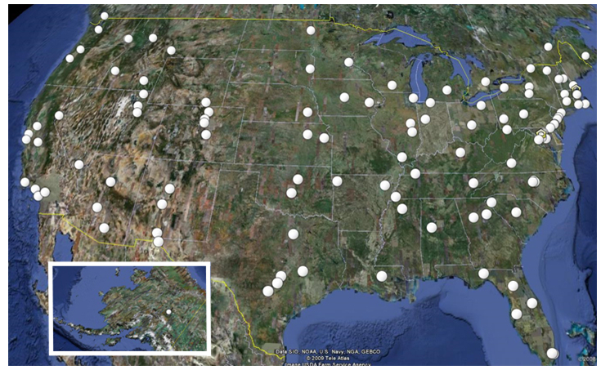
CUAHSI
Consortium of Universities for the Advancement of Hydrologic Science, Inc.
111 US University members
7 affiliate members
19 International affiliate members
An organization representing more than one hundred United States universities, receives support from the National Science Foundation to develop infrastructure and services for the advancement of hydrologic science and education in the U.S.

Slide 3
What is HIS?
HIS = Hydrologic Information System
The CUAHSI* Hydrologic Information System (HIS) provides web services, tools, standards and procedures that enhance access to more and better data for hydrologic analysis.
http://his.cuahsi.org
Notes:
HIS helps you discover and access hydrologic data.

Slide 4
Major Challenges Addressed by CUAHSI HIS
How do I find and access hydrologic observations for use in my work?
How can I store, manage, and share hydrologic observations in a way that makes my life easier and in a way that others could use them?

Slide 5
What proportion of your research time do you spend on preparing or preprocessing data into appropriate forms needed for research purposes?
http://his.cuahsi.org/documents/HISStatusSept15.pdf
Notes:
Surveys of the hydrology community have indicated that data gathering and preprocessing is an inordinate fraction of the time required for modeling and analysis
In hydrology most of the easy single site, single variable, low hanging fruit research problems are solved and advances in understanding and better predictions require
combining information from multiple sources,
sharing and collaboration
Easier access to advanced computational capability
Sustainability and reliability in software

Slide 6
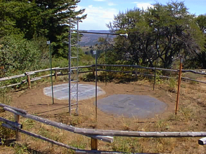
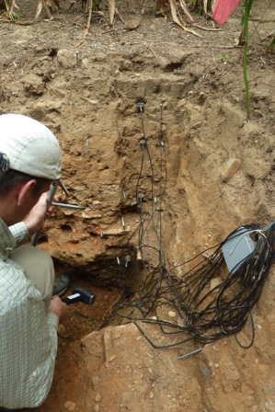
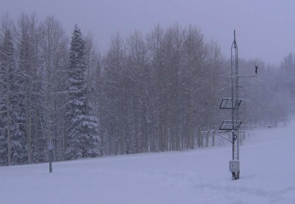
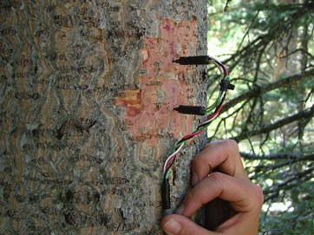
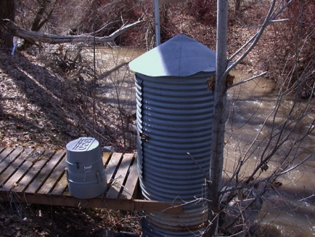
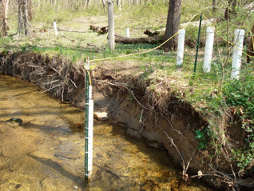
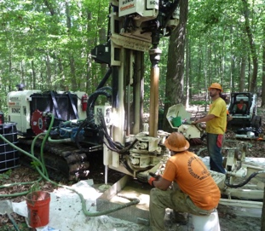
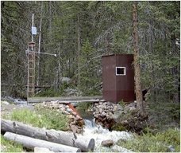
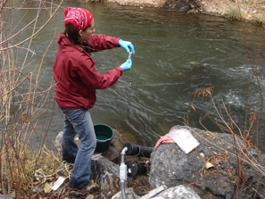
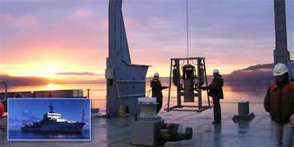
Challenges to Managing Hydrologic Observations
Rain, Snow, and
Climate
Soil water and chemistry
Volume of data
Data heterogeneity
Multiple watersheds
Multiple institutions
Multiple personnel
Scale
Data quality assurance and quality control
Standardize data editing
Synchronize timing, data access, equipment tracking
Sapflux
Water quality
Water quantity
Groundwater
Mobile Platforms
Notes:
In addition to the quantity of data, we are dealing with different types of data that need complete metadata descriptions.
Researchers and practitioners need tools for data import and storage as well as data access and management.
In addition to addressing the challenges presented by the sheer quantity of data, monitoring networks need practices to ensure high data quality, including procedures and tools for post processing.
Data quality is further enhanced if networks are able to track physical infrastructure such as equipment, deployments, calibrations, and other events related to site maintenance and associate these details with observational data.

Slide 7
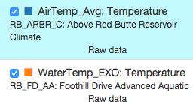
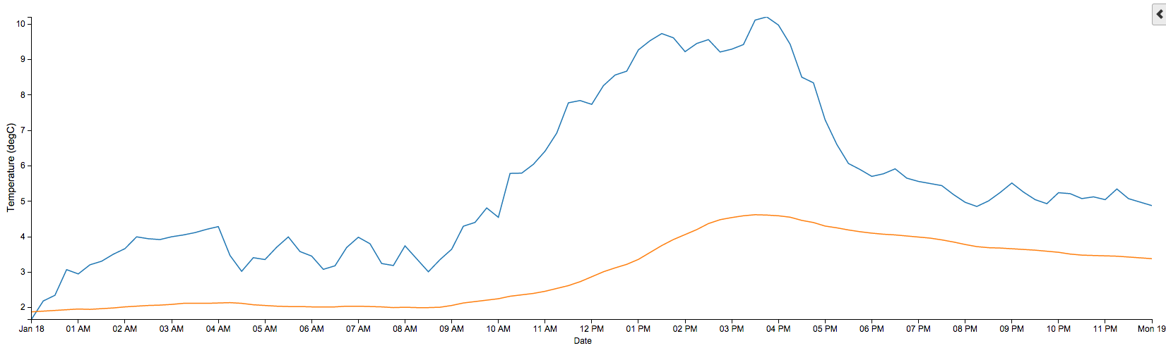
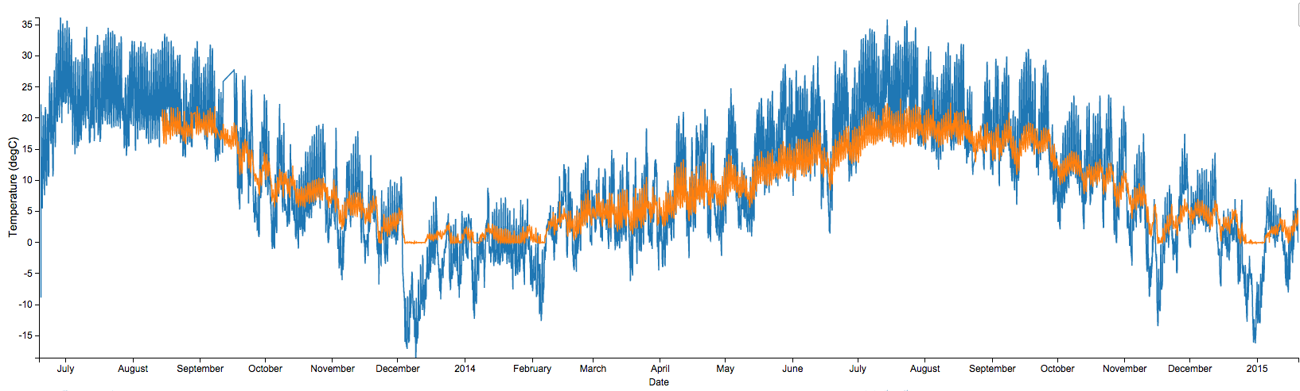
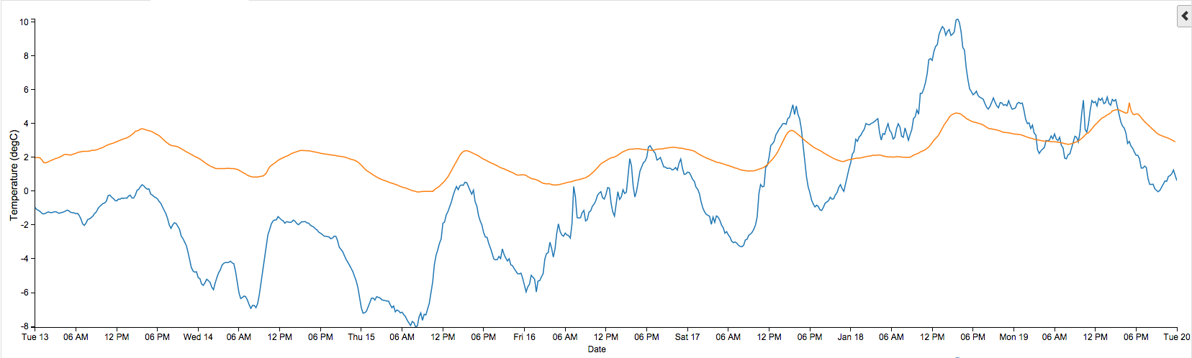
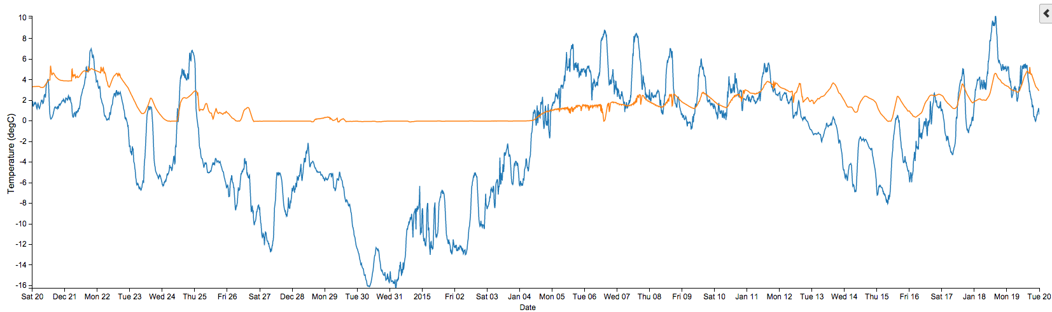
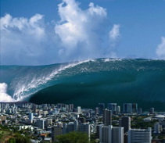
The Data Deluge
One week = 672 observations
One day = 96 observations
One month = 2880 observations
One year = 35,040 observations
So far (~1.5 years) = 55,000+ observations
Times 14 Aquatic Sites with ~26 Variables
Times 14 Climate Sites with ~74 Variables
Plus different versions of the data (raw versus checked) = 43,400,000+ observations
You need some infrastructure to manage and share the data.
Notes:
So, let’s talk about the volume of data being generated in the network.

Slide 8
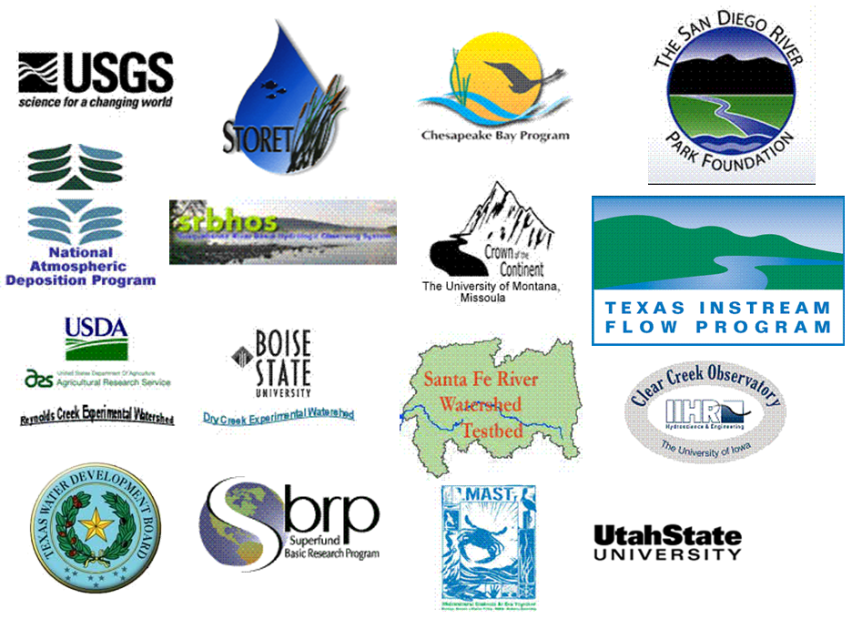
Sources of Observations Data
Academic, Government, Commercial, International

Slide 9
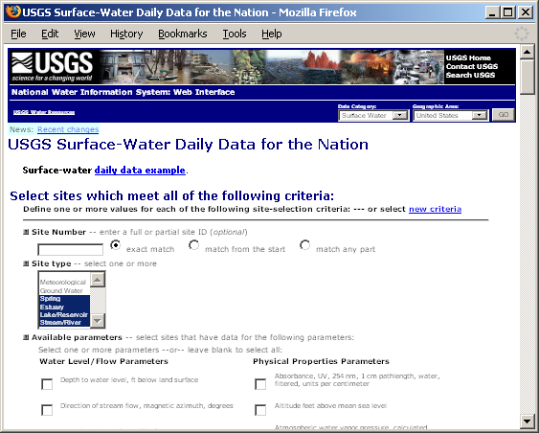
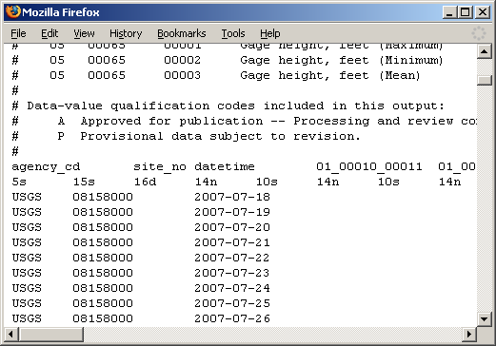
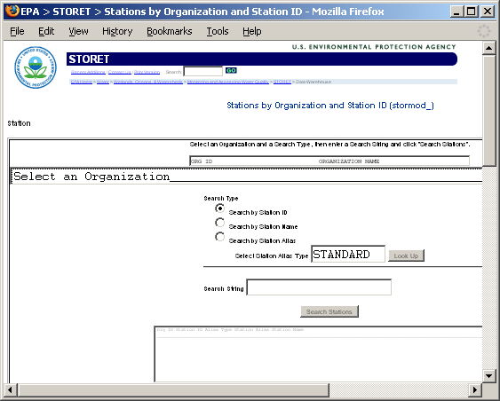
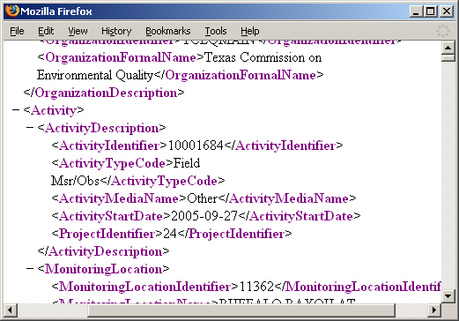
Getting Data from Agency Web Sites
Different Query Pages
Different Query Responses
Notes:
Much hydrologic data are online. However, each website has a different form for querying data, and each website returns data in a different format.

Slide 10










Data Searching – What we used to have to do
Searching each data source separately
NWIS
request
return
request
request
return
return
NAWQA
request
return
NAM-12
request
return
request
return
request
return
request
return
NARR
Michael Piasecki
Drexel University
Notes:
10

Slide 11

What HIS enables
Searching all data sources collectively
GetValues
GetValues
NWIS
GetValues
GetValues
generic
request
GetValues
GetValues
NAWQA
Michael Piasecki
Drexel University
GetValues
NARR
GetValues
ODM
Notes:
11

Slide 12
Service Oriented Architecture (SOA) and How the Internet Works
Catalog
Publish/Register
Find
Invoke
Server
Desktop

Slide 13




Service Oriented Architecture (SOA) and How the Internet Works
Catalog
Publish/Register
Find
Invoke
Server
Desktop

Slide 14
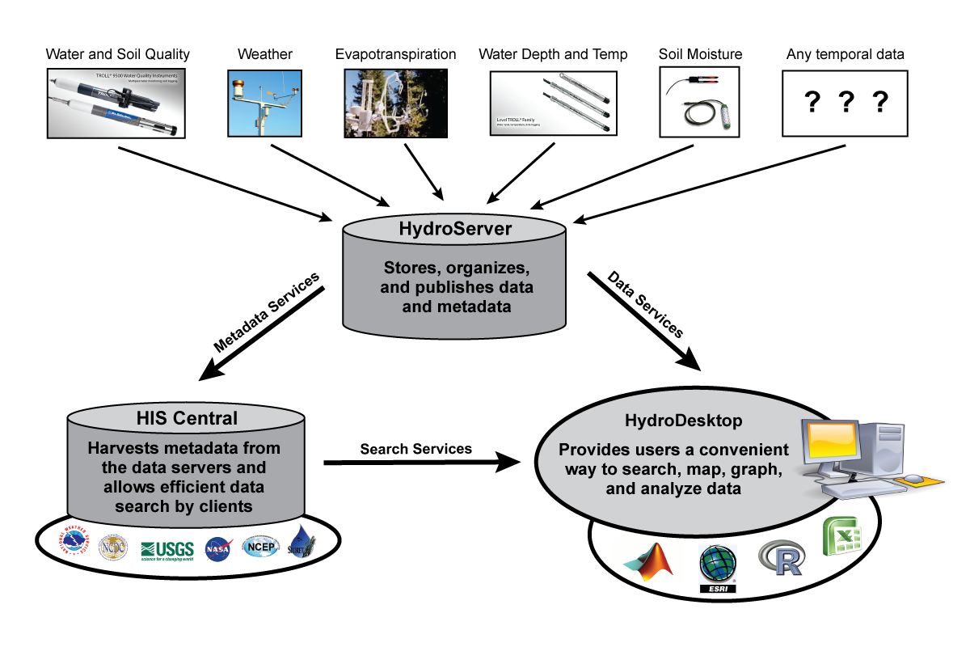


CUAHSI HIS SOA
Enabling Water Science Data Discovery

Slide 15
CUAHSI HIS SOA
Enabling Water Science Data Discovery

Slide 16

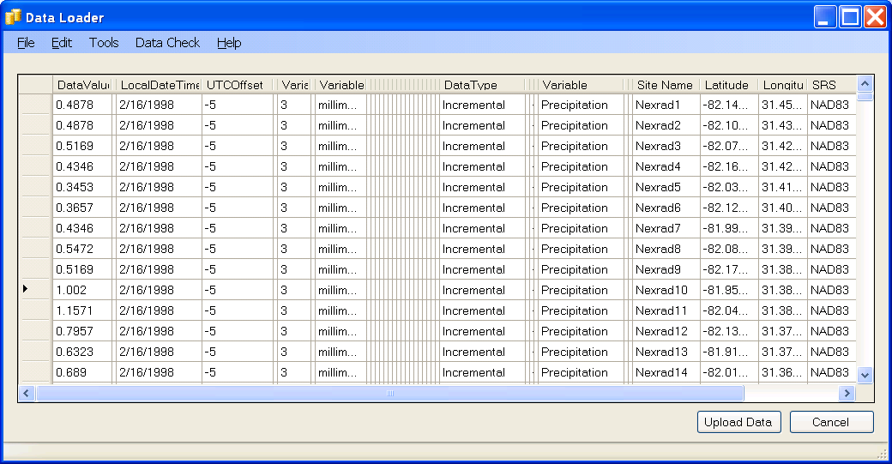
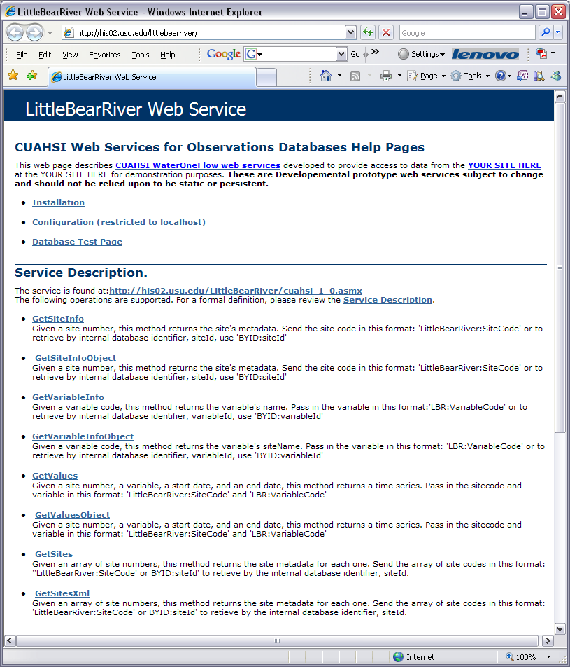
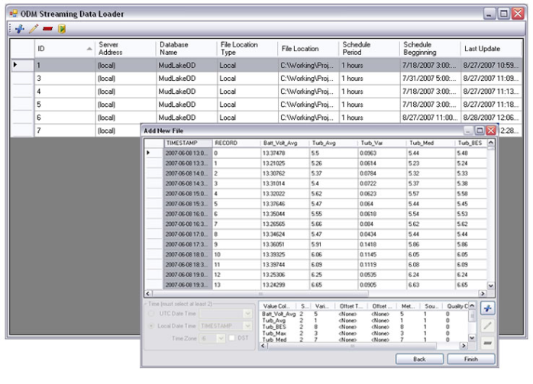
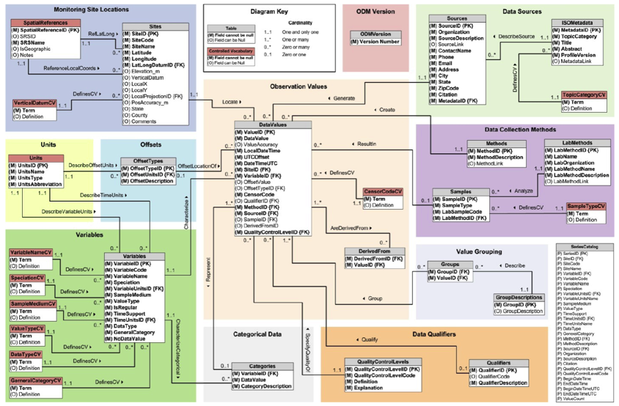
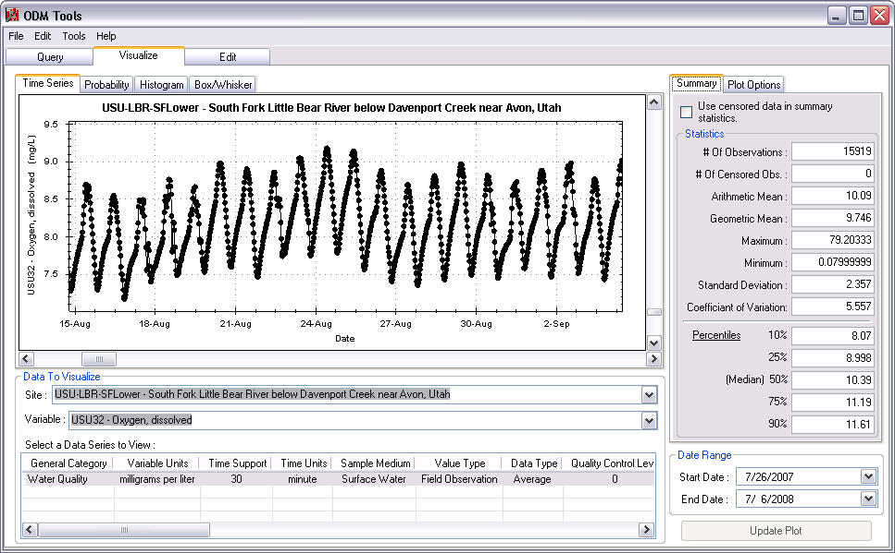
WaterOneFlow and WaterML
Observations Data Model
ODM Data Loader
ODM
ODM Streaming Data Loader
ODM Tools
http://hydroserver.codeplex.com

Slide 17
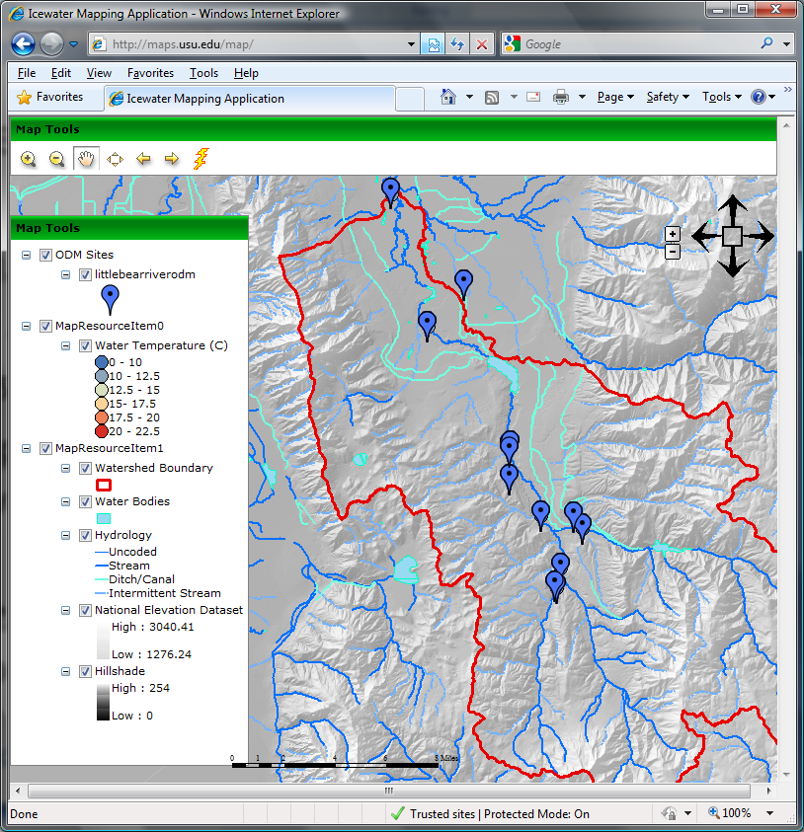
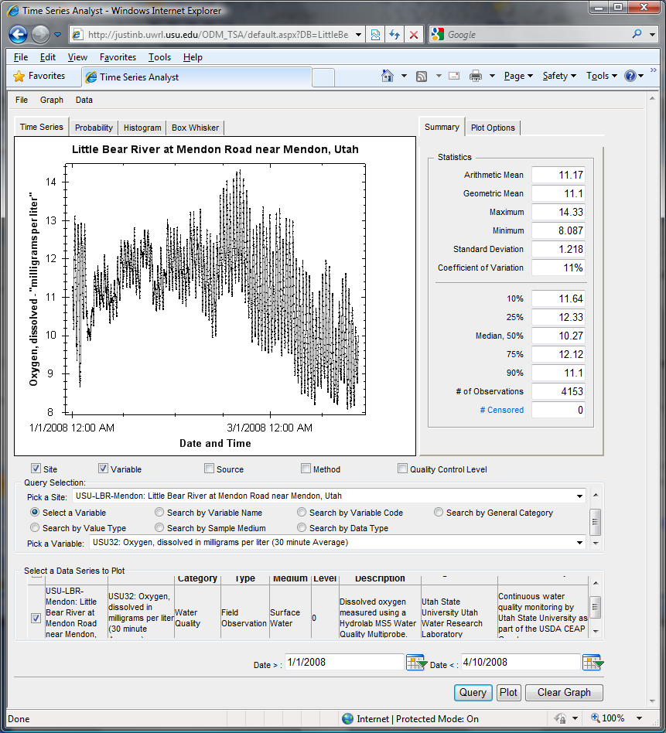
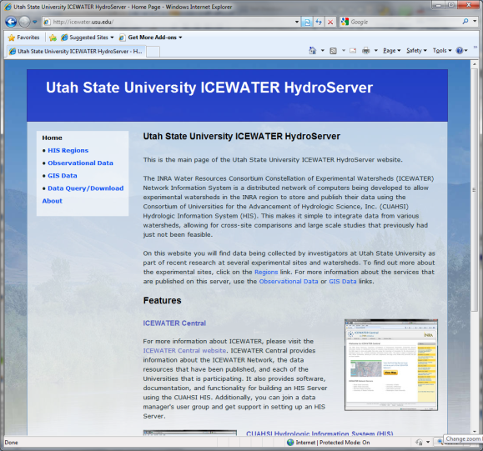
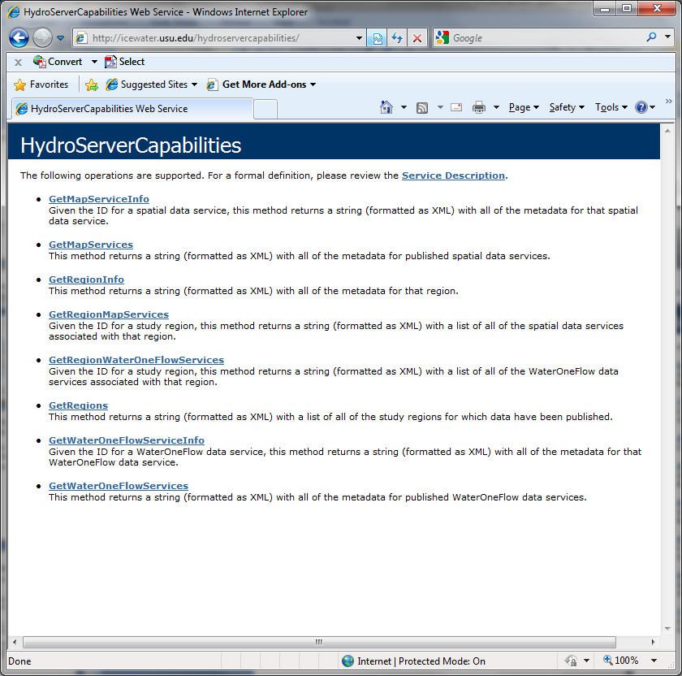
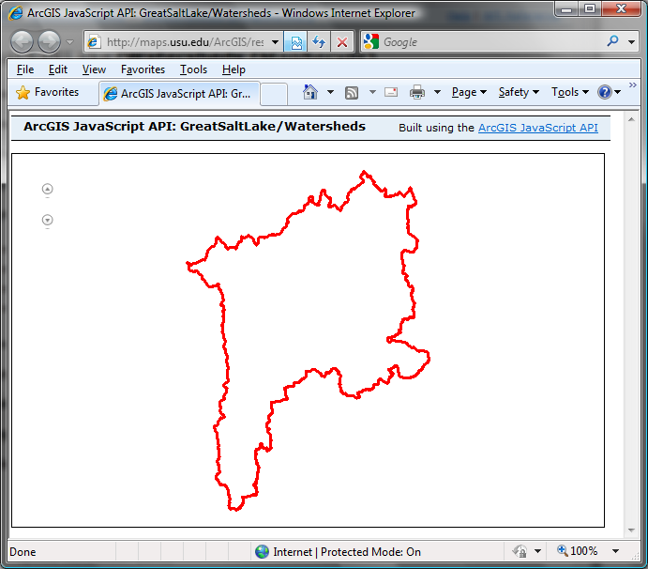
Add on Visualization
Capabilities
KEY HydroServer Functionality:
Read ODM
Share it with WebServices
Capabilities Database Configuration Tool
WaterOneFlow
Services
HydroServer
Capabilities
Database
Spatial
Services
WaterOneFlow
WaterOneFlow
WaterOneFlow
Add on GIS Services through ArcGIS Server
ODM
ODM
ODM
ODM Databases and Web Services
ArcGIS Server Spatial Data Services
Notes:
HydroServer software can be found at hydroserver.codeplex.com

Slide 18
The Data Cube – “what-where-when”
Time, T
“When”
t
A data value
3/4/2007
D
4.2
s
“Where”
Cane
Creek
Space, S
V_{i}
“What”
Streamflow
Variables, V
Notes:
The HIS relational database has its origins in the data cube, where a single data value is indexed by a description of what it represents, its location in space, and when it was recorded.

Slide 19
Data Series – Metadata Description
Time
There are C measurements of Variable V_{i} at Site S_{j} from time t₁ to time t₂
End Date Time, t₂
Count, C
Begin Date Time, t₁
Site, S_{j}
Space
Variable, V_{i}
Variables

Slide 20

Observations Data Model (ODM)
Sites
Values and Time
Variables
Horsburgh, J. S., D. G. Tarboton, D. R. Maidment and I. Zaslavsky, (2008), "A Relational Model for Environmental and Water Resources Data," Water Resour. Res., 44: W05406, doi:10.1029/2007WR006392.
Notes:
The DataValues table is at the center of the Observations Data Model, with other tables around it providing additional information using database relationships.

Slide 21

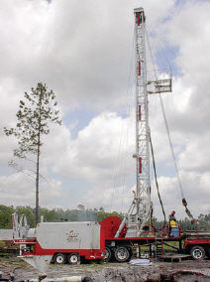

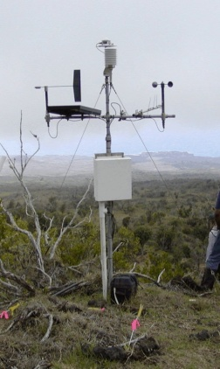
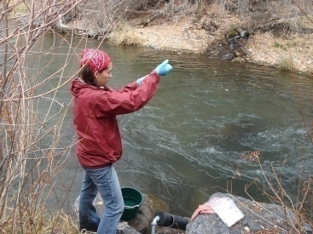
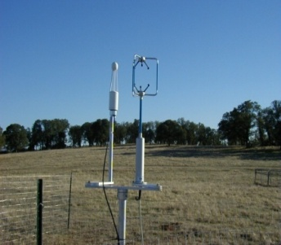
Observations Data Model (ODM)
Streamflow
Groundwater
levels
Precipitation
& Climate
Soil
moisture
data
Water Quality
Flux tower data
A relational data model at the single observation level
Metadata for unambiguous interpretation
Traceable heritage from raw measurements to usable information
Promote syntactic and semantic consistency
Cross dimension retrieval and analysis
Horsburgh, J. S., D. G. Tarboton, D. R. Maidment, and I. Zaslavsky (2008), A relational model for environmental and water resources data, Water Resources Research, 44, W05406, doi:10.1029/2007WR006392.

Slide 22
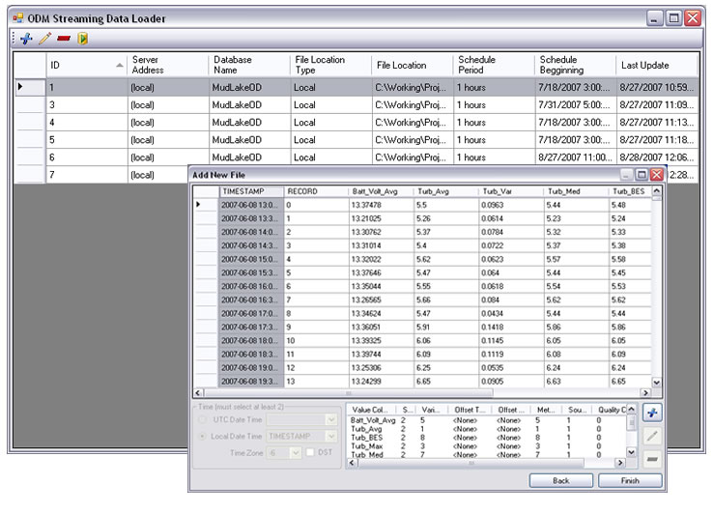
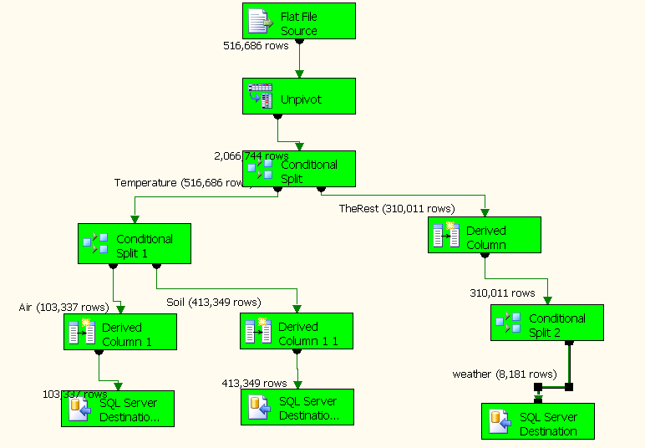
Loading Data into ODM
ODM Data Loader
Interactive ODM Data Loader
  Loads data from spreadsheets and comma separated tables in simple format
Streaming Data Loader (SDL)
  Loads data from datalogger files on a prescribed schedule
  Interactive configuration
SQL Server Integration Services (SSIS)
  Microsoft application accompanying SQL Server useful for programming complex loading or data management functions
ODM SDL
SSIS

Slide 23
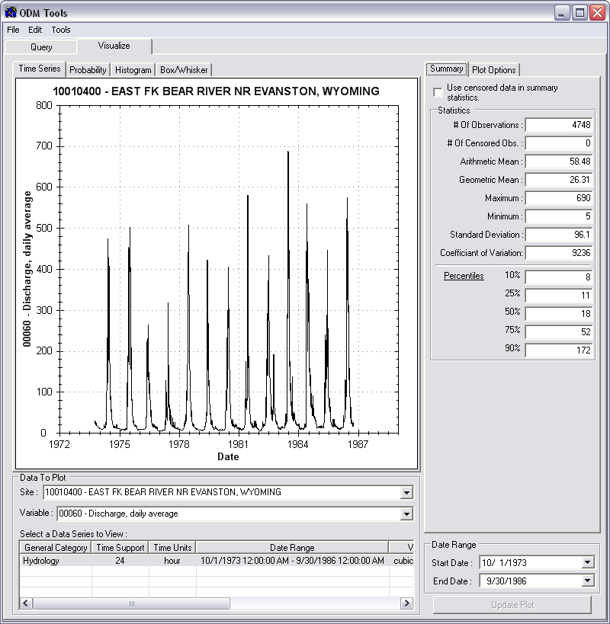
Managing Data Within ODM - ODM Tools
Query and export – export data series and metadata
Visualize – plot and summarize data series
Edit – delete, modify, adjust, interpolate, average, etc.

Slide 24
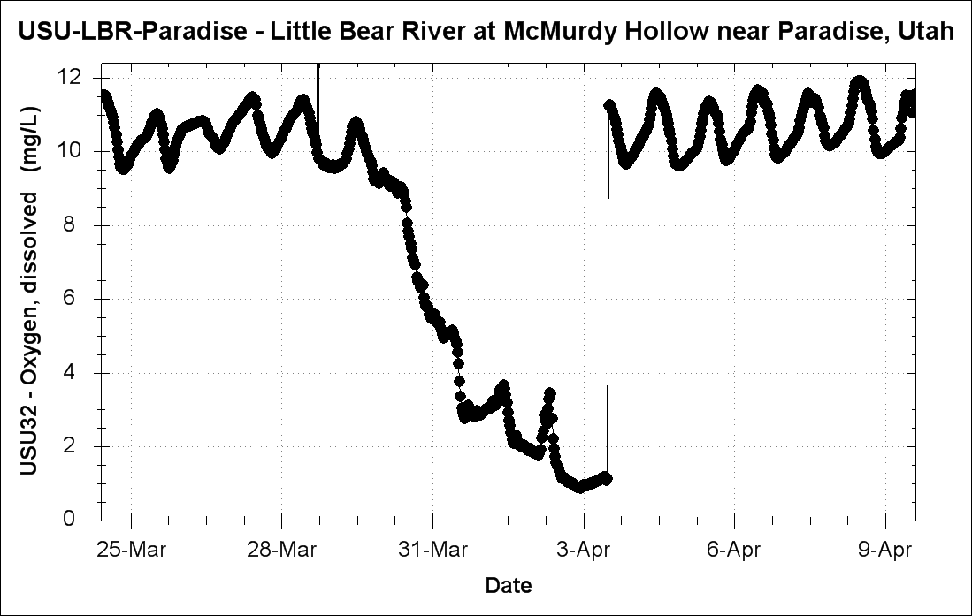
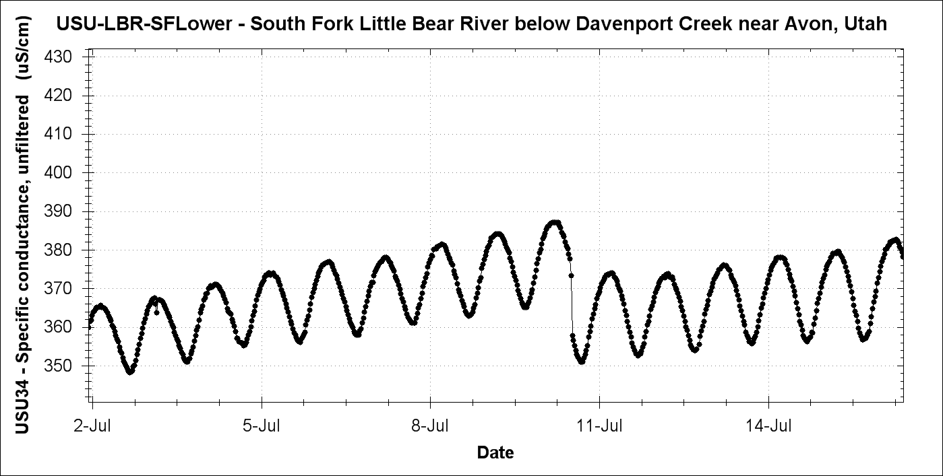
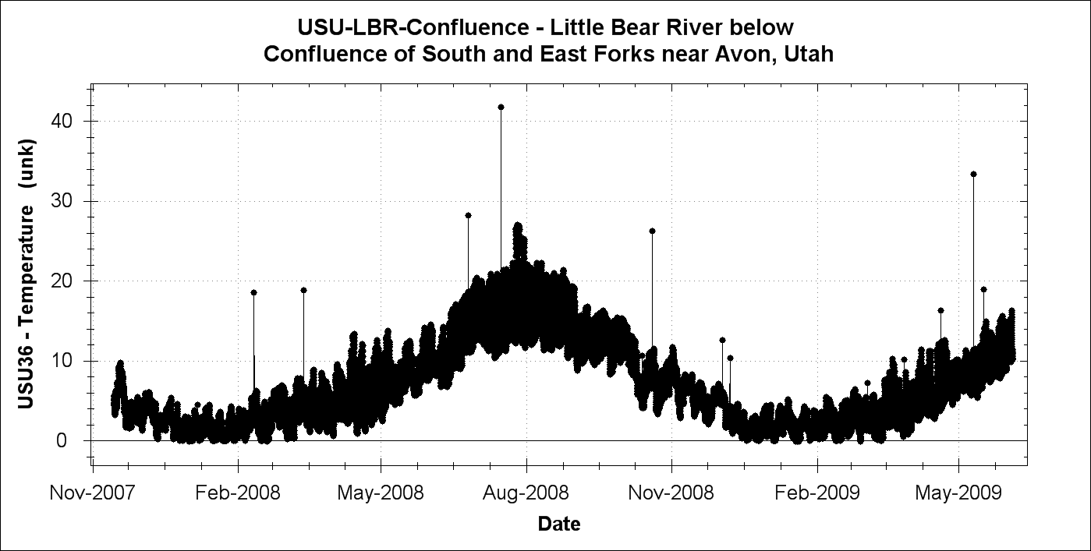
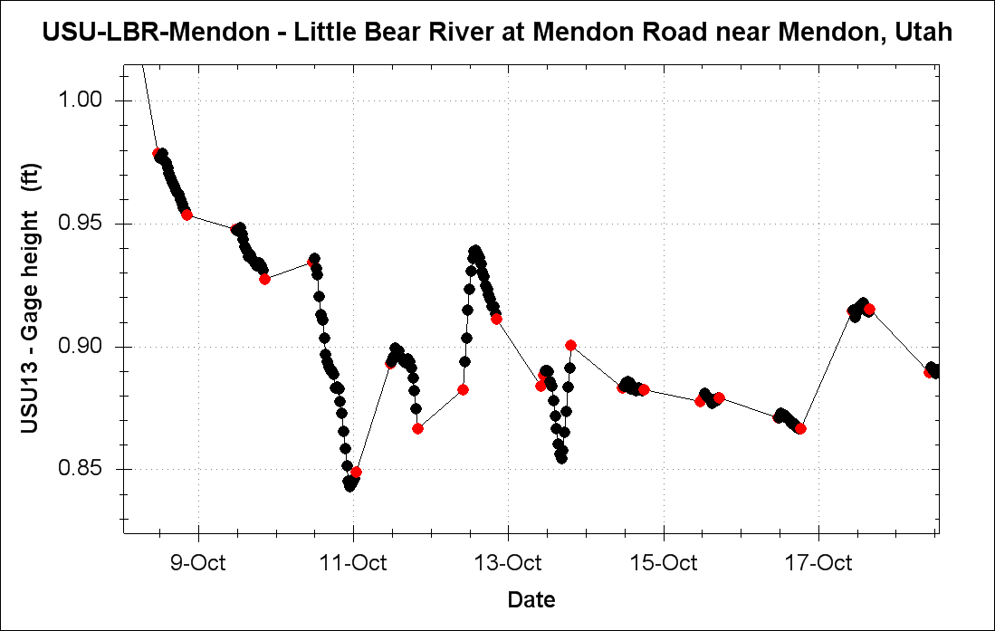
Sensor Data Quality Control
///
Sensor drift and calibration shift
///
Sediment in sensor cup
Strange anomalies
Dead battery

Slide 25
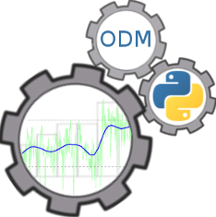
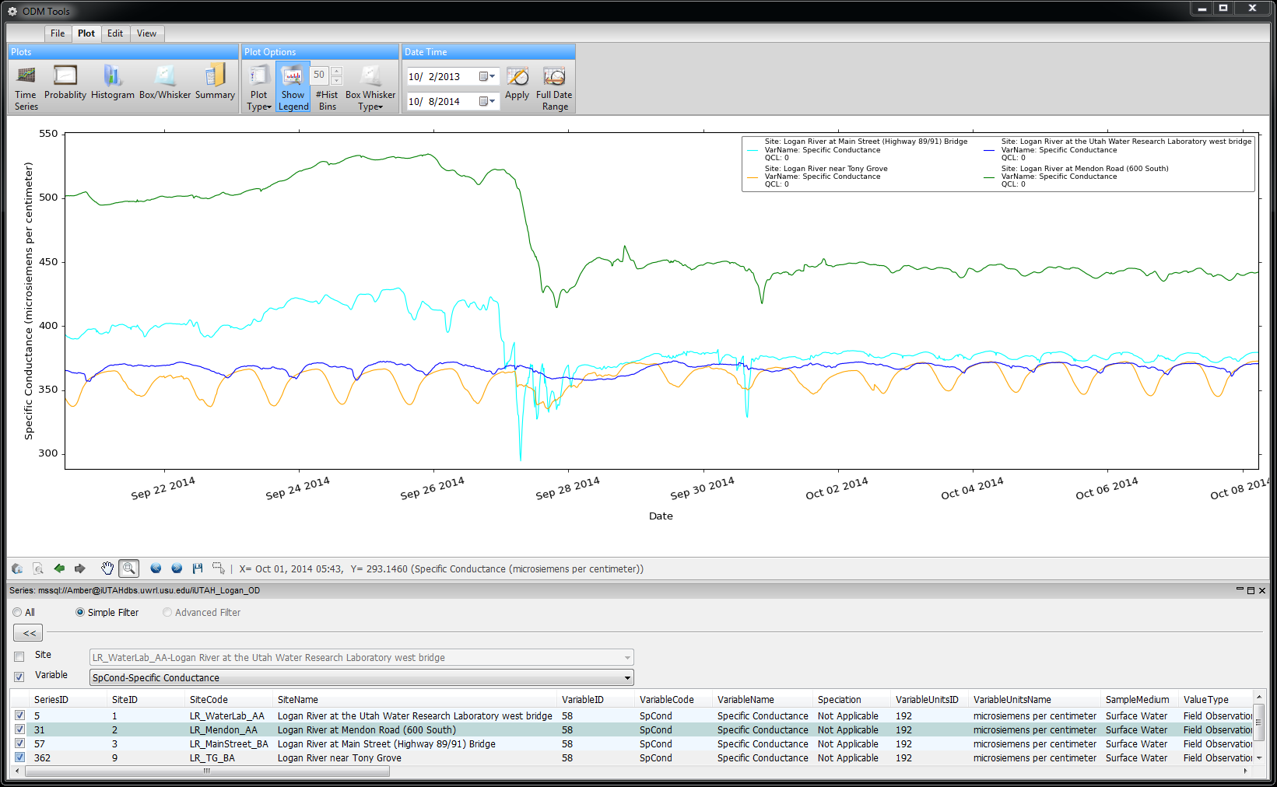
QAQC: Data Visualization and Management
Plot Display Options
Date Range Restrictions
Multiple Plot Types
Dynamic Zooming and Panning
Series Selection Filters
Time Series Selection
Notes:
ODM Tools Python:
Desktop client application for visualizing and managing data. This slide highlights some of its features.

Slide 26
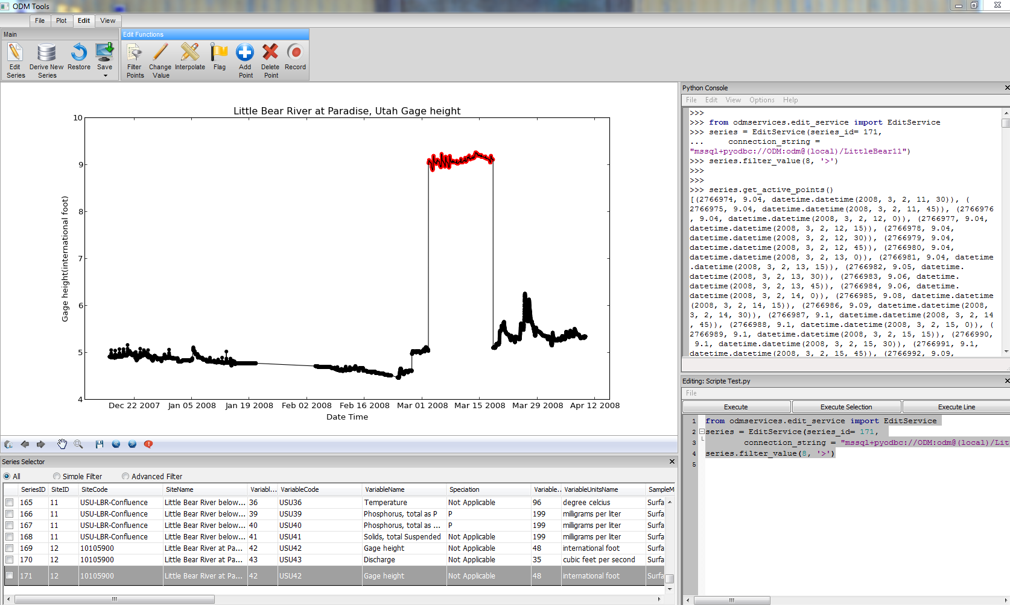
ODM Tools
Sensor Data Quality Control
Data Editing Tools
Python Code Console
Dynamic Data Editing Display
Python Script Editor

Slide 27
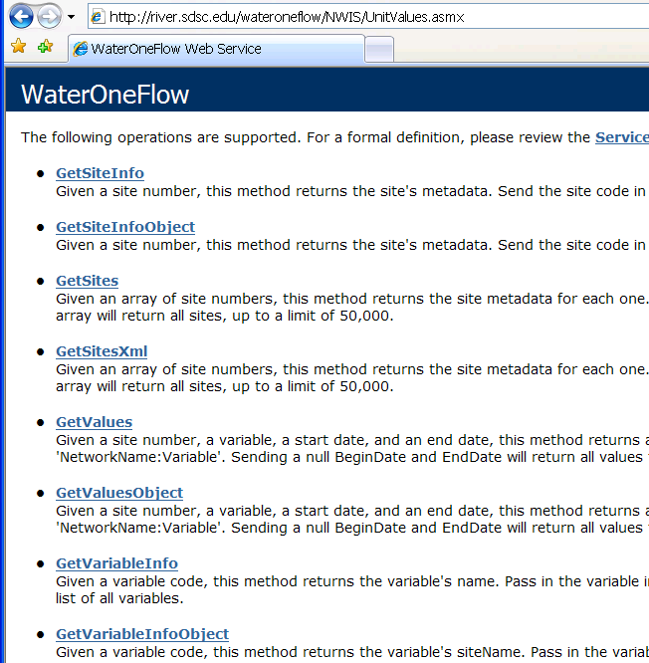
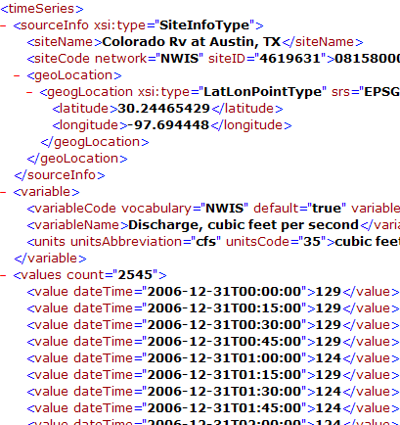
WaterML and WaterOneFlow
WaterML is an XML language for communicating water data and metadata
WaterOneFlow is a set of web services based on WaterML
Set of query functions
Returns data in WaterML
Notes:
27

Slide 28
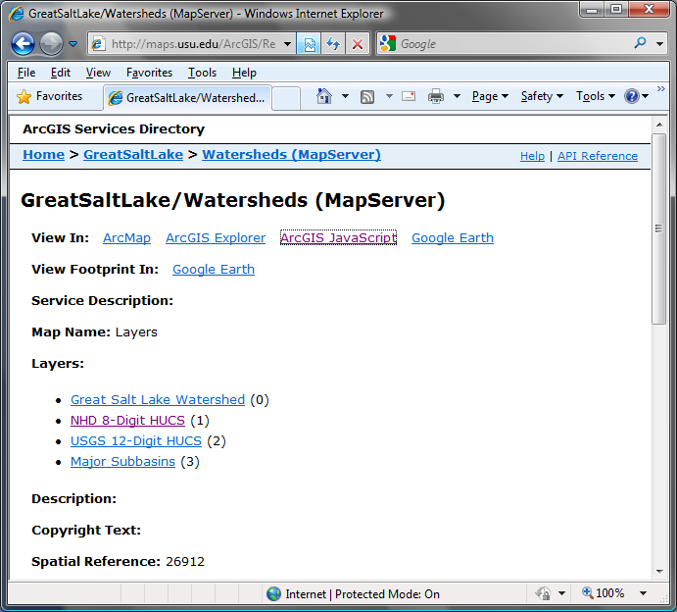
Publication of Geospatial (GIS) Datasets
Publishing spatial datasets using ArcGIS Server
  Using OGC standards that can be consumed by a number of GIS clients
  WMS, WFS, WCS

Slide 29

Data Presentation Via a Map Interface
Internet Map Server built using ArcGIS
Web browser client
Combine spatial data and observational data
Launch data visualization tools
Based on a “Region”

Slide 30

Data Preview, Visualization, and Analysis
Time Series Analyst
Web Browser Client
Multiple ODM Database Support
Variety of plot types
Descriptive statistics
Linked to the map application
Data preview and download

Slide 31



Summary: Publishing Observational Data Using the CUAHSI HIS
Load data into an ODM database
Deploy a WaterOneFlow web service for each ODM database on a web server
Register the web service with the CUAHSI Water Data Center
ODM
Database

Slide 32
CUAHSI HIS SOA
Enabling Water Science Data Discovery

Slide 33




HIS Central Catalog
Service Registry
Hydrotagger
Integrates data services from multiple sources
Supports concept based data discovery
WaterML
Harvester
Water Metadata Catalog
GetSites
GetSiteInfo
GetVariableInfo
GetValues
WaterOneFlow
Web Service
Search Services
CUAHSI Data Server
3rd Party Server
e.g. USGS
Discovery and Access
Hydro
Desktop
http://hiscentral.cuahsi.org

Slide 34

HIS Central Catalog Content
Map integrating NWIS, STORET, & Climatic Sites
>100 public services
>32,400 variables
>2.79 million sites
>33.9 million series
>Referencing 18 billion data values
>15,500+ download requests per day
Available via HISCentral
discovery services
Available via GetValues requests

Slide 35

CUAHSI HIS Central Demo

Slide 36
CUAHSI HIS SOA
Enabling Water Science Data Discovery

Slide 37






New CUAHSI HIS Data Search Web Client http://data.cuahsi.org/ (Official release on June 22, 2015)
Select a location
Select a time period
Select keywords
Select data services
Search map
Select a site and download time series as CSV

Slide 38

HydroDesktop
An open source
dotSpatial GIS based desktop client that supports discovery and analysis of hydrologic observations data

Slide 39


HydroDesktop Key Functions
Search for data by keyword(s), area, time range, service(s)
Graph, table view, and
data export functions
Map based interface
with common GIS
functions
Extension system for
additional functionality

Slide 40





Slide 41


Select a time range
& data sources
Select a search area
Select a keyword or
group of keywords

Slide 42

Search for all data that
meet the specified criteria

Slide 43


Download selected data sets

Slide 44

Observed data values
Downloaded data sets

Slide 45

Interactive graph

Slide 46
Time Series Graph

Slide 47
Probability Graph

Slide 48
Histogram Graph

Slide 49

Box and Whisker Graph
Notch shows median confidence
Red shows average and std dev

Slide 50

Edit values, derive series, interpolate, set flags

Slide 51


HydroDesktop Plug-in Development
Existing plugins
Search and Download
Graph View
Data Export
Metadata Fetcher
HydroModeler (Open MI)
HydroDesktop.exe
DotSpatial.dll
HydroDesktop.Database.dll
See “Documentation” Link on hydrodesktop.codeplex.com to learn how to write a plug-in.
CZO
HIS
OpenMI
HydroDesktop
Notes:
The functionality of HydroDesktop can be extended by plug-ins. Each plug-in needs to reference the library MapWindow.dll and implement the MapWindow 6 plugin interface. Any existing MapWindow 6 GIS plug-in can be used as a HydroDesktop plug-in. To easily access data from the HydroDesktop local database, a plugin can use functions from the HydroDesktop.Database.dll library (data abstraction layer)

Slide 52



EPA watershed delineation
web service

Slide 53

OpenMI HydroModeler
Anthony M. Castronova, Jonathan L. Goodall, A generic approach for developing process-level hydrologic modeling components, Environmental Modelling & Software, Volume 25, Issue 7, July 2010, Pages 819-825
Modular hydrologic modeling components

Slide 54


Generate R code to read
downloaded data
R console
Integration with “R” Statistics Package

Slide 55

CUAHSI HIS Resources
CUAHSI Water Data Center: https://www.cuahsi.org/wdc
Contact: Jon Pollak
  User Support Specialist
  jpollak@cuahsi.org
CUAHSI HIS HydroServer Codeplex Website: http://hydroserver.codeplex.com/
Get HydroDesktop:
http://hydrodesktop.codeplex.com/
CUAHSI HIS Central Web Service Registry:
http://hiscentral.cuahsi.org

