Slide 1
An Overview of Integrated Modeling for Water Resources
Tony Castronova
Utah State University
11/6/2014

Slide 2
Learning Objectives
Understand that many different modeling activities are going on within the water resources domain
Conceptual understanding of coupled modeling approaches, applications, and benefits
Understand the difference between loose and tight model integration.
Identify the ontological differences in how observed and modeled data are represented
Introduction into the model sharing efforts of HydroShare.

Slide 3
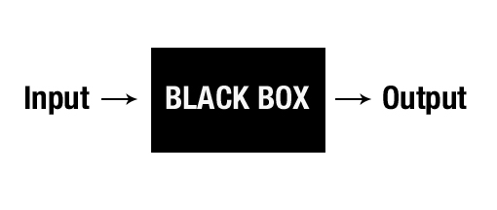
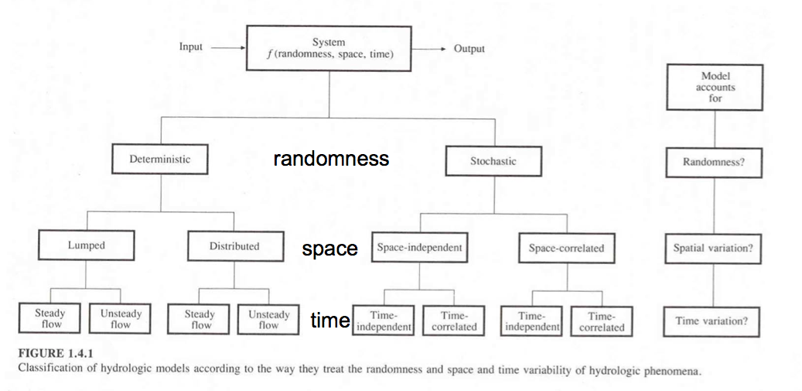
What is Modeling

Slide 4
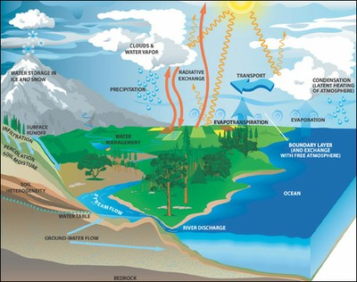
Hydrologists View
Water Cycle
Focus of hydrology
Flow of water through the environment
Complicated
Many physical processes
Complex interactions
Interdisciplinary
Atmospheric, Hydrologic, Geologic, Environmental, etc…
nasa.gov

Slide 5
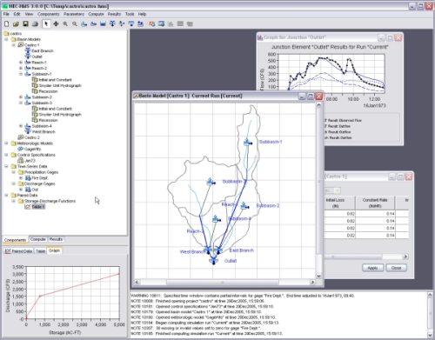
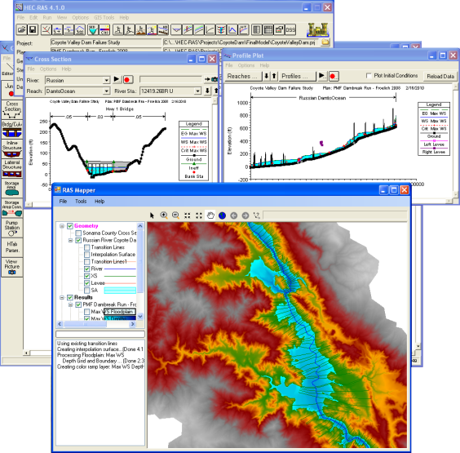
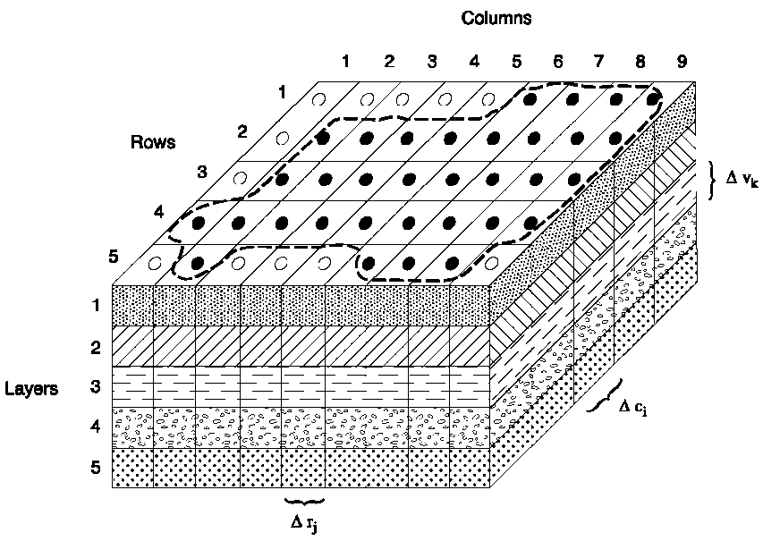
Lets Look at Some Common Models
hec.usace.army.mil
hec.usace.army.mil
pubs.usgs.gov

Slide 6
Model Coupling

Slide 7
Tight vs Loose Integration

Slide 8
How do these Systems Compare?
Tight Integration
Advantages
Disadvantages
Loose Integration
Advantages
Disadvantages
Improves ease of collaboration
Modular development
Model substitution
Code reuse
Complete control over system
Can be optimized for performance
Learning curve
Rewriting legacy code that has been tightly integrated
Performance?
Requires a great deal of expertise
Source code must be available
Requires customized integration for every model system
Notes:
Tight Integration
Advantages
Enables complete control over integrated modeling system
Can be optimized for performance
Disadvantages
Requires a great deal of expertise
Source code must be available
Requires customized integration for every model system
Loose Integration
Advantages
Improves the ease of collaboration, e.g. cross -disciplinary model studies
large problems that can not be explored by stand alone models.
predict the wider implications of policies and projects
Modular development
Simplifies model substitution
Helpful when changing spatial scales, and performing uncertainty or sensitivity analyses.
Simplify the construction of Decision Support Systems (DSS)
Develop models in isolation that can be guaranteed to connect to other models
reducing the time involved by standardizing data transfer
Models can be reused in future projects.
Disadvantages
Learning Curve
Need to redevelop legacy code that has been tightly integrated
Performance?

Slide 9
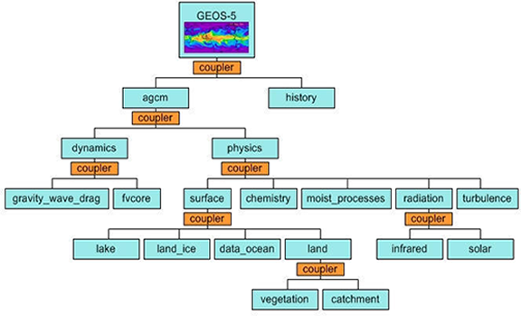
A Closer look at Loose Integration
Standard modeling interface defines the methods required by routines
Input and Output data is passed between routines.
Routines are discovered at runtime
Model compositions require more communication
Encourages model reuse

Slide 10
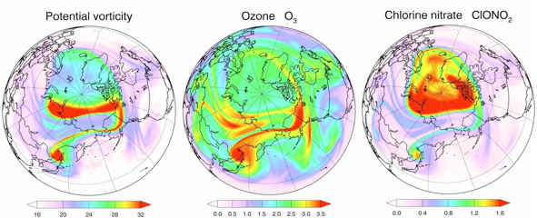
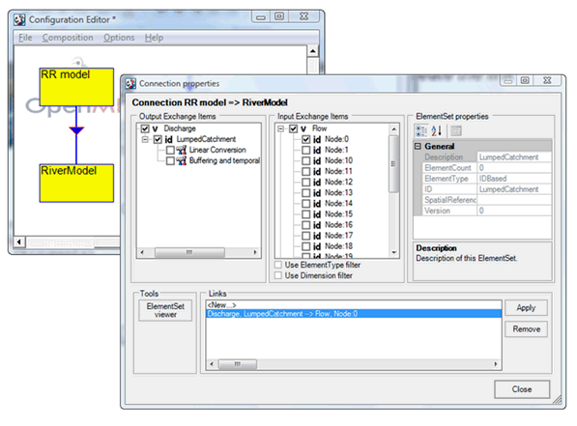
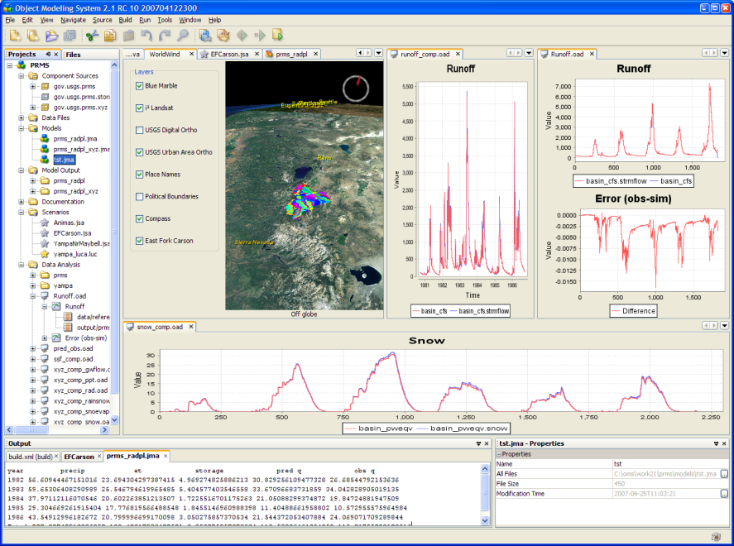
Existing Software Architectures

Slide 11
Data Communitcation
Rainfall
Runoff
Ground
Water
River
(Moore and Tindall, 2005)

Slide 12
Linking Data With Coupled Models
How can we feed forcing data into coupled models?
Establish a method for mapping data between the OpenMI and HIS
Map observation and model metadata
Create a integrated modeling application that uses this mapping
An OpenMI component to read data from the HIS
An OpenMI component to write data to the HIS
Demonstrate how these components can be used in a model simulation
Calculate evapotranspiration

Slide 13
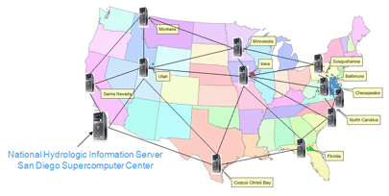
How can we feed data into coupled models?
Consortium of Universities for the Advancement of Hydrologic Science, Inc. Hydrologic Information System
Collaborative effort
University of Texas, Austin
Utah State University
San Diego Super Computing Center
Idaho State University
City College of New York
University of South Carolina
NSF Funded ($4.7 Million 2007-2011)
Goals
Make the nation's water information universally accessible and useful
Provide access to data sources, tools and models
Enable the synthesis, visualization and evaluation of the behavior of hydrologic systems.

Slide 14
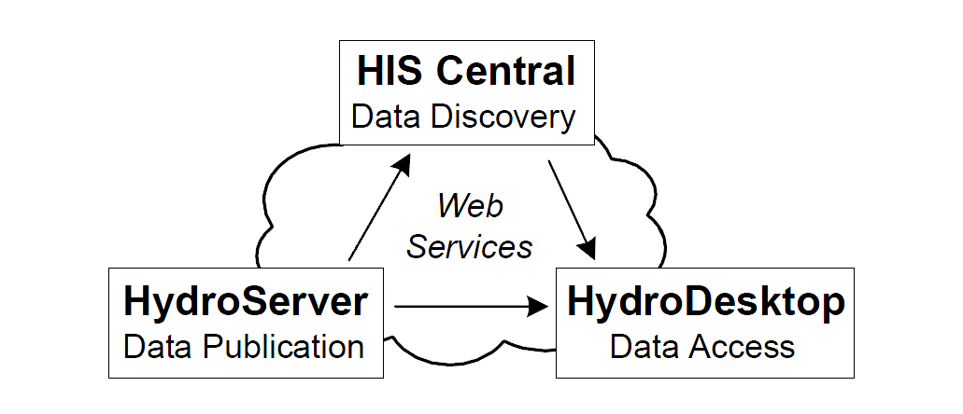
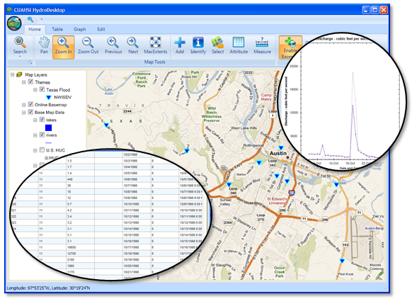
CUAHSI HydroDesktop
Web service network of hydrologic resources
Enables users to publish data
Searching across distributed HIS data
Open-source GIS
Entry point to the HIS observation data
Extendable through plugin development
hydrodesktop.codeplex.com

Slide 15
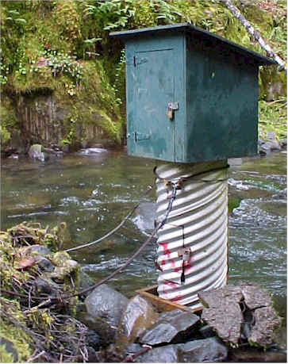
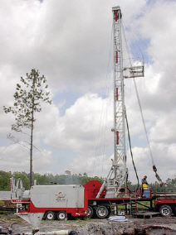
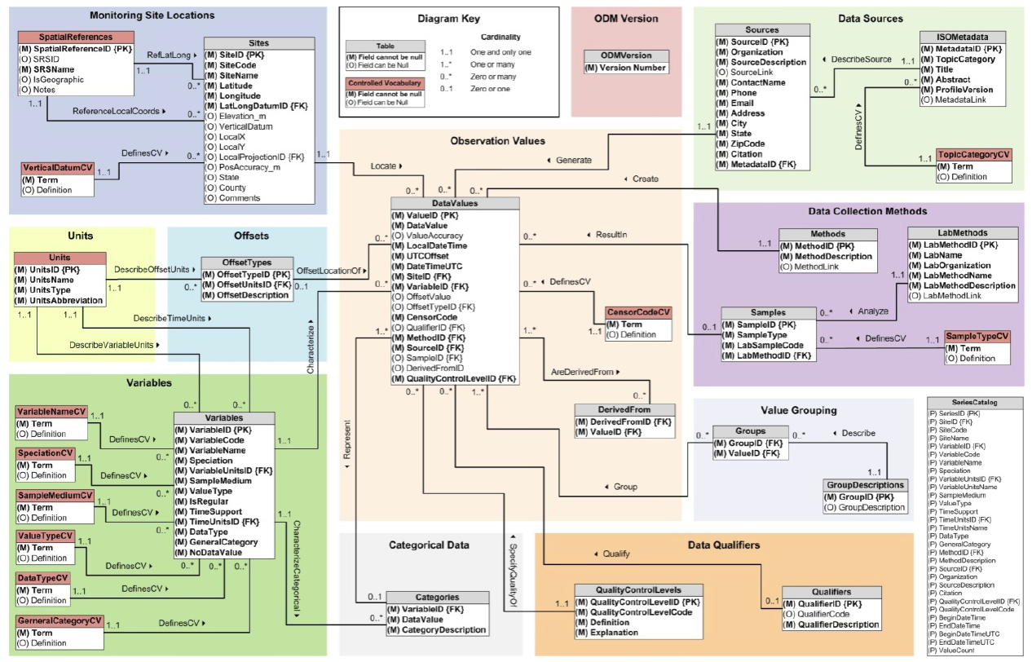
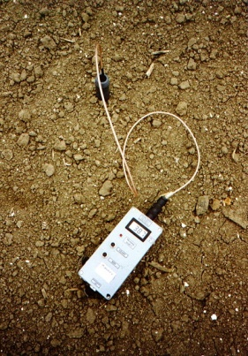
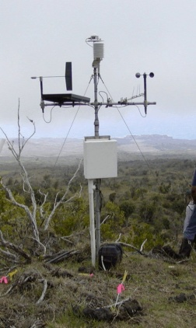
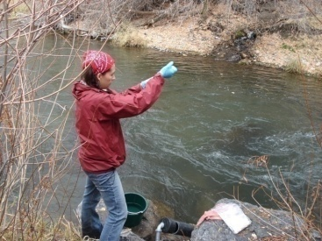
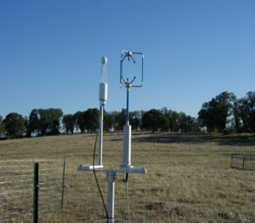
Observations Data Model (ODM)
Streamflow
Provides a common persistence model for data storage
Groundwater
levels
Precipitation
& Climate
Soil
moisture
data
Water Quality
Flux tower data
Horsburgh, J. S., D. G. Tarboton, D. R. Maidment, and I. Zaslavsky (2008), A relational model for environmental and water resources data, Water Resources Research, 44, W05406, doi:10.1029/2007WR006392.
Notes:
A relational database at the single observation level
Metadata for unambiguous interpretation
Traceable heritage from raw measurements to usable information
Promote syntactic and semantic consistency
Cross dimension retrieval and analysis

Slide 16
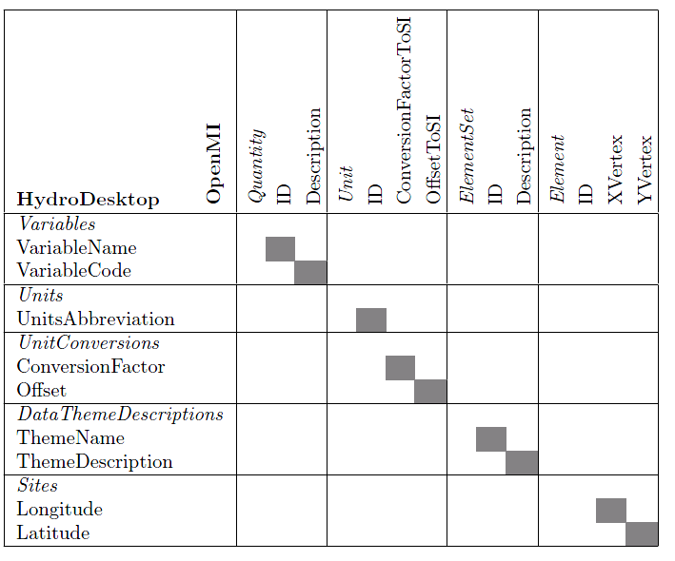
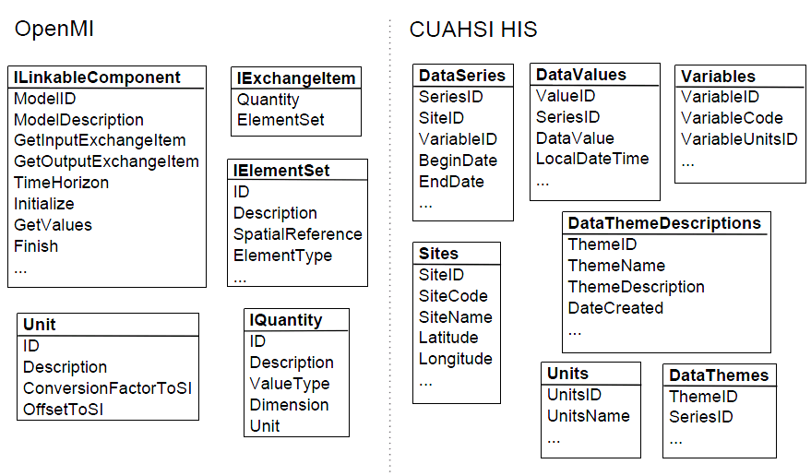
Mapping Model Data to HIS
HIS provides a standard for describing and accessing data repositories
OpenMI provides a standard for describing and executing models

Slide 17
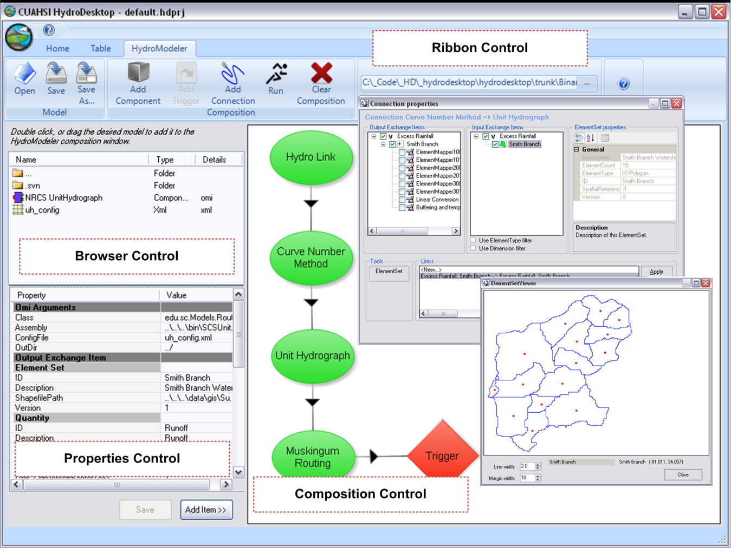
HydroModeler
Component modeling plugin for the HydroDesktop
Extends the original OpenMI configuration editor (OmiED)
Provides an extensible modeling environment

Slide 18
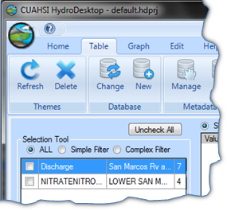
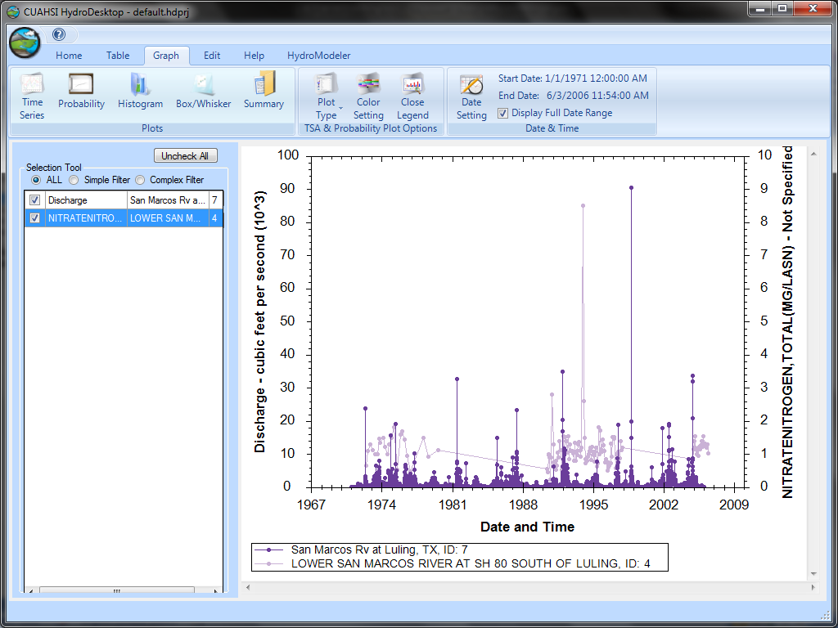
Example 1: Nitrogen Loading
Streamflow and nitrogen collected using HydroDesktop
Simplified nitrogen loading calculation averaged over time
Notes:
Loading = Flow_rate * Nitrogen Measurement * 86400

Slide 19
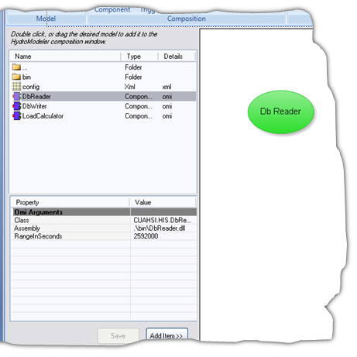
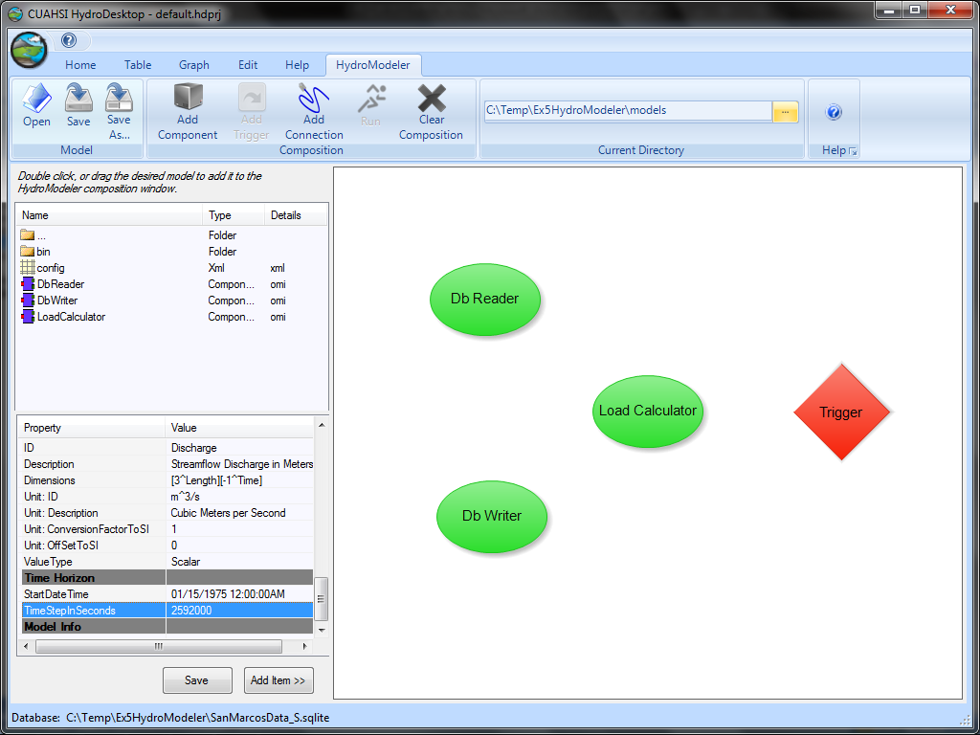
Building the Model

Slide 20
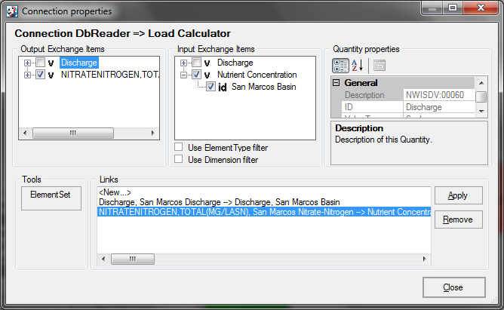
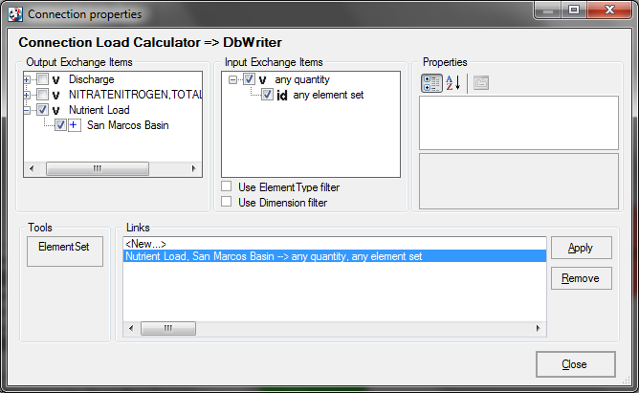
Linking Model Components

Slide 21
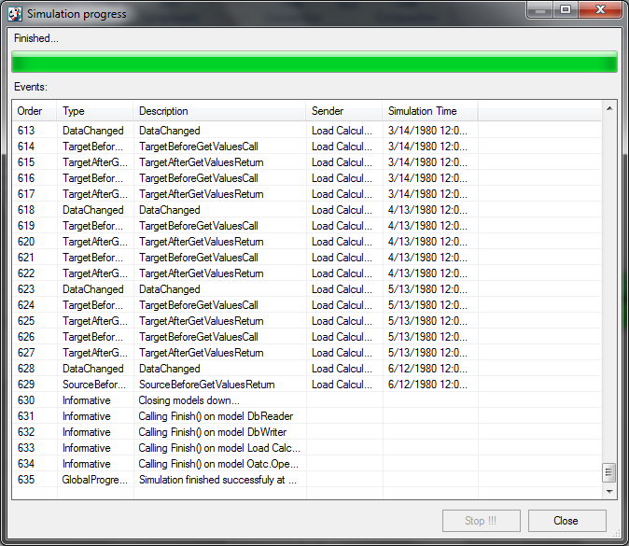
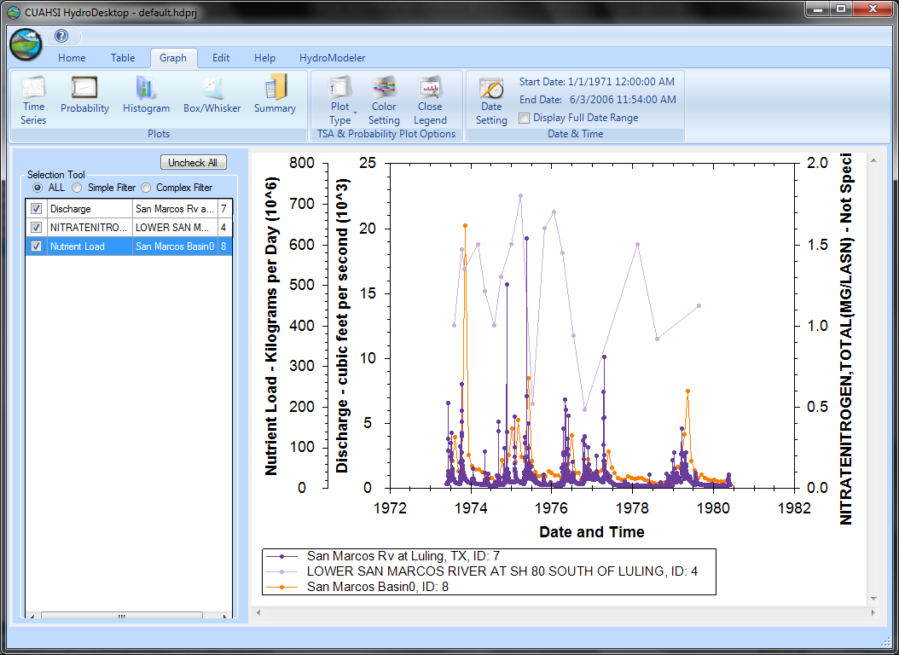
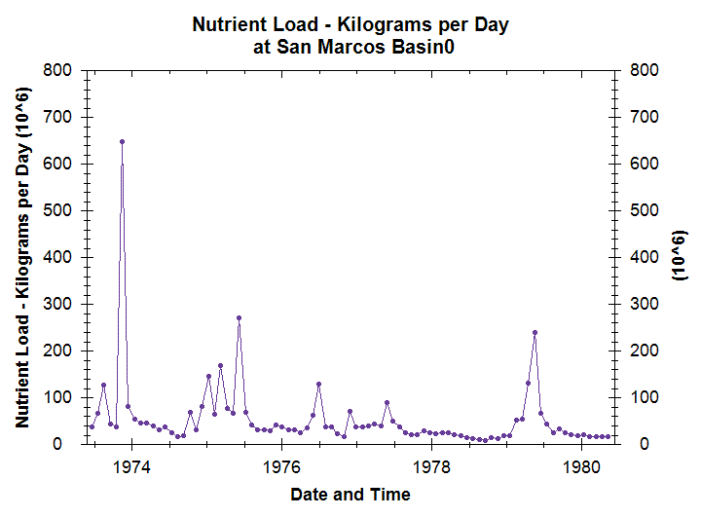
Data Visualization

Slide 22
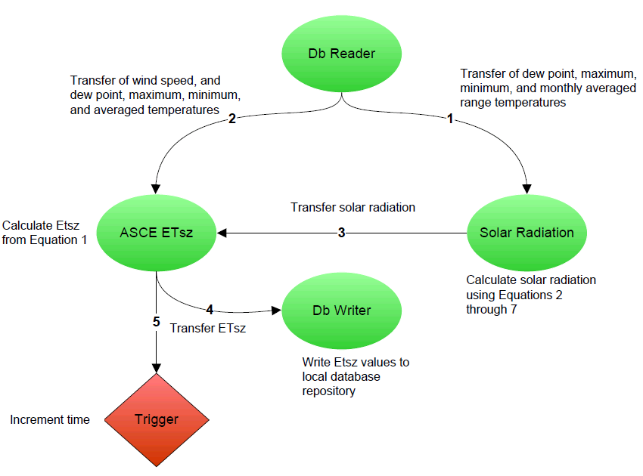
Example 2: Modeling ET

Slide 23
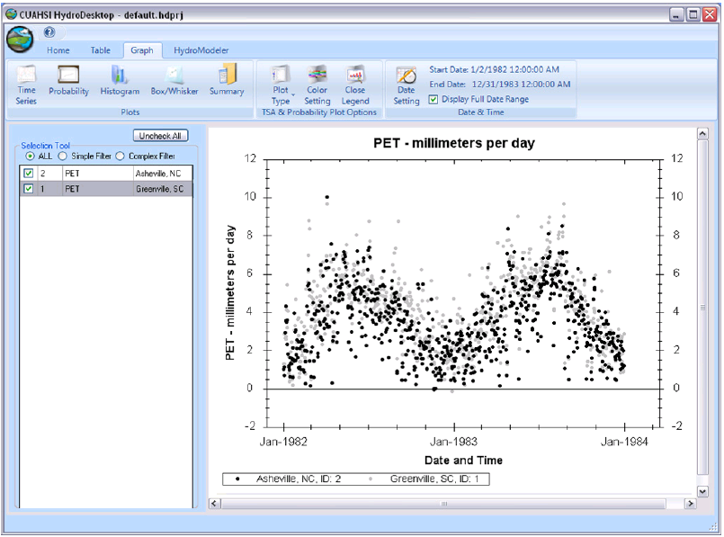
Data Visualization

Slide 24
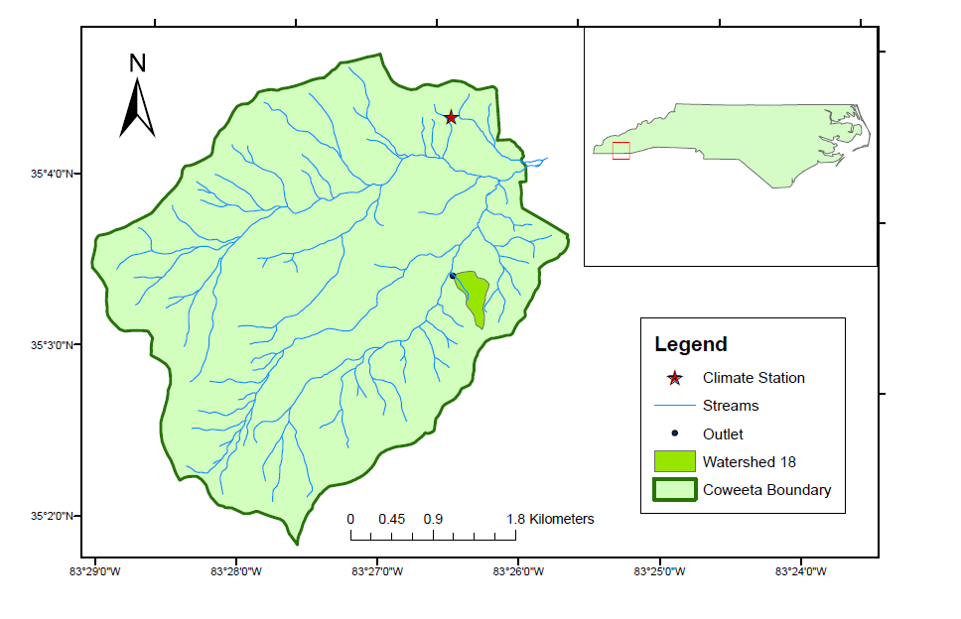
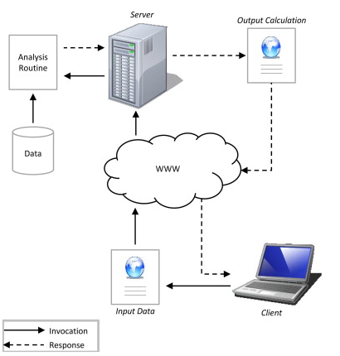
Example 3: Service Oriented TOPMODEL
Coweeta Watershed
Located in western NC
Long Term Ecological Research
Watershed 18, 0.12 km²
Readily available observations
Castronova, Anthony M., Jonathan L. Goodall, and Mostafa M. Elag. "Models as web services using the Open Geospatial Consortium (OGC) Web Processing Service (WPS) standard." Environmental Modelling & Software 41 (2013): 72-83.

Slide 25
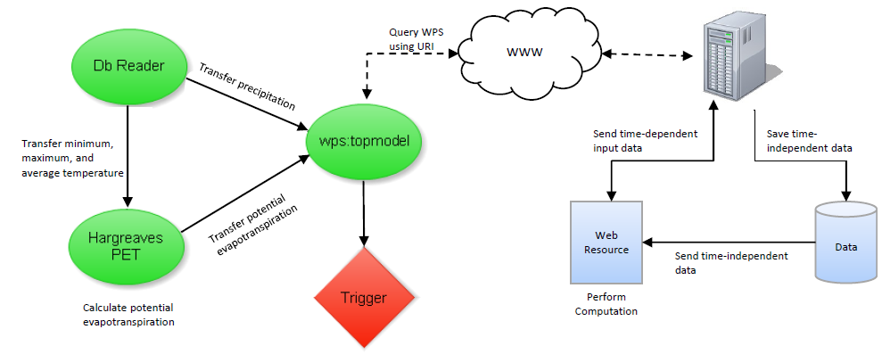
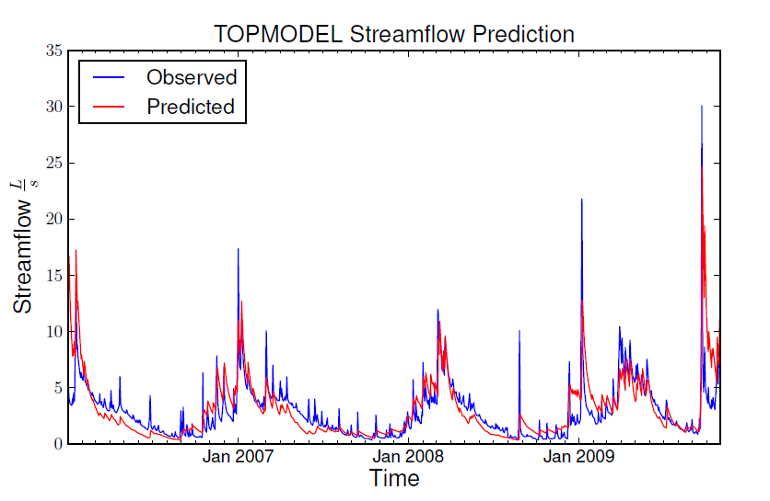
Service Oriented Model Design
GET
DbReader
Supplies CUAHSI HIS observation data
Hargreaves
Calculates PET using temperature data.
Wps:Topmodel
Wraps the web TOPMODEL web resource into an OpenMI-compliant form

Slide 26
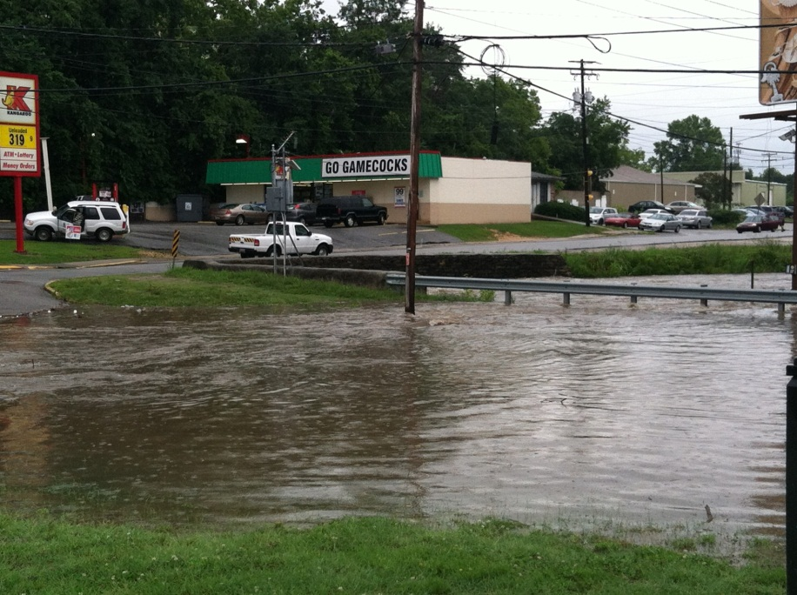
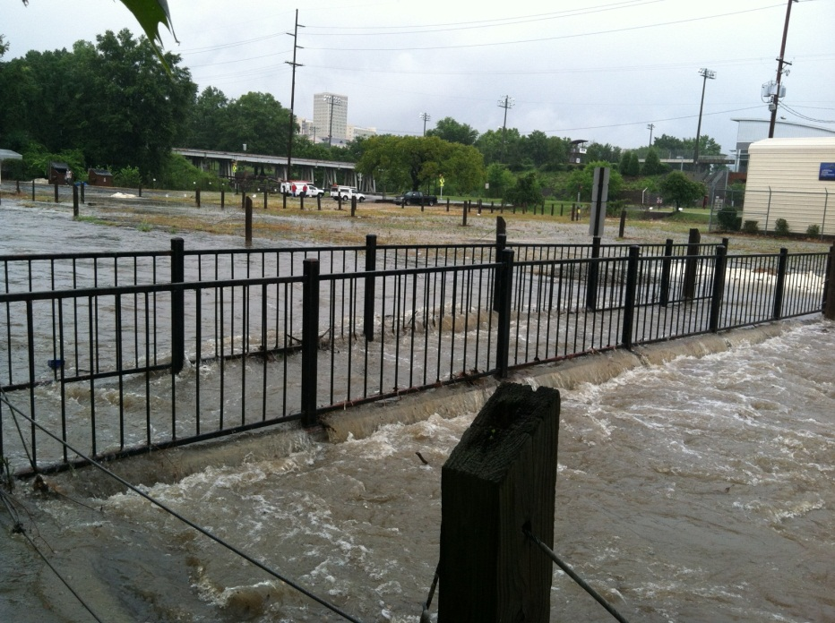
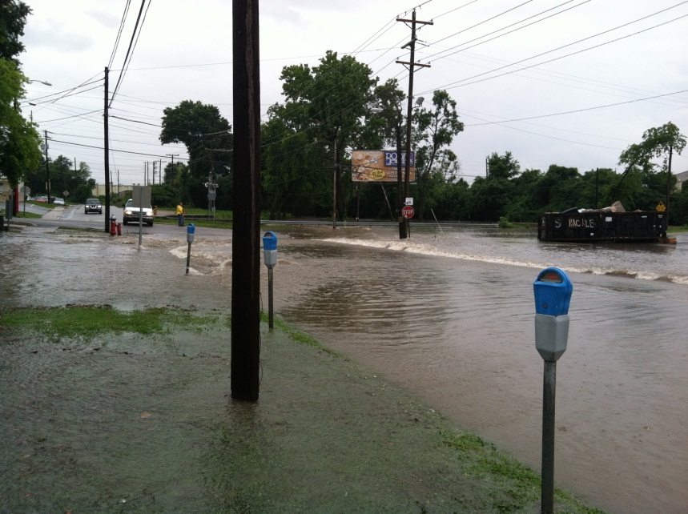
Example 4: Flood Modeling in Columbia, SC
Downtown Columbia floods often
Property damage
Infrastructure damage
Short, high intensity storms
2.26 in 1 hour
River depth from 10in to 10.74ft in 1 hour

Slide 27
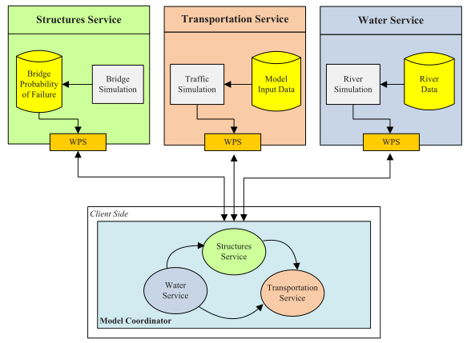
Urban Infrastructure Model Design
Web services are developed independently
RESTful
Use the OGC WPS to encapsulate data
Interaction between models is provided by a client-side script

Slide 28
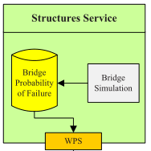
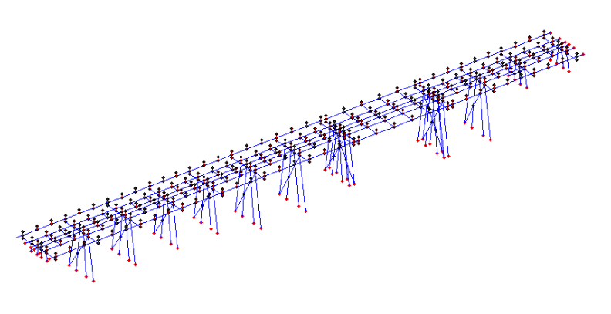
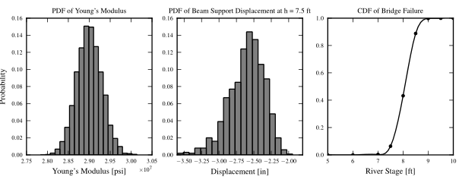
Structures Component
Estimates probability of bridge failure
Structure reliability
Strength decreases due to age
Finite element model
Designed to investigate
Failure of bridges due to scour of their foundation

Slide 29
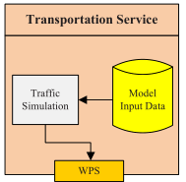
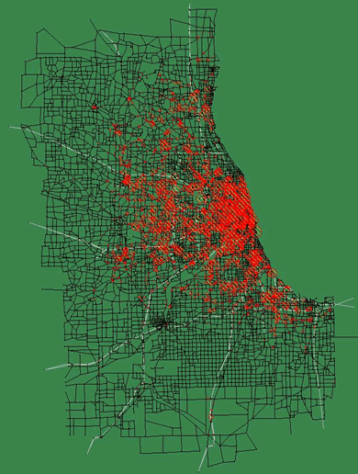
Transportation Component
Predicts the travel time of vehicles during rush hour in downtown Columbia, SC
Modifies input files, executes DTALite, and returns parsed output data.
Dynamic Traffic Assignment model (agent-based)
network algorithms
trip-maker behavior models
Captures the effects of
road closures
dynamic message signs
Advanced traveler information systems

Slide 30
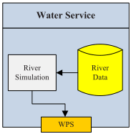
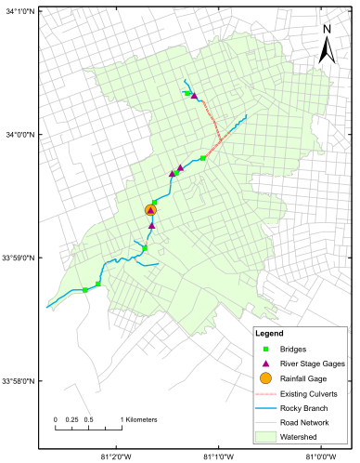
Water Resources Component
Estimate streamflow based on river stage observations
Streamflow is approximated using Manning’s equation
River stage and streamflow measurements are returned by the model.

Slide 31
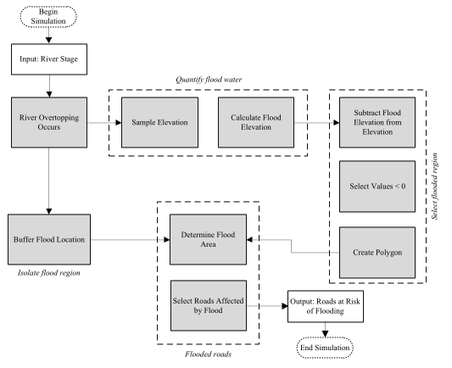
GIS River Overtopping
Geoprocessing routines are used to identify roads that may flood.
Common GIS tools and DEMs are used to determine if a roadway should be closed
Ignores the complicated hydraulic and hydrologic conditions that occur during floods
Provides a likelihood that the river will inundate roadways

Slide 32
Application: Study Area
Rocky Branch watershed
11 km²
Consists of commercial districts, university property, and residential neighborhoods
High intensity storms often cause flooding
Roads at low lying areas must be closed
City of Columbia has been attempting to alleviate this problem

Slide 33
Results

Slide 34
HydroShare
User accounts and data storage
Water related data are represneted as resources
social functionality (i.e. discovering resources and people)
Data publishing and documentation
Models
Visualization Tools
Analysis Tools
Interaction with common data store
Can take advantage of visualization loading and discovery tools
Data Loaders
Data Discovery Tools

Slide 35
Design Considerations
Make publishing, sharing, and discovering hydrologic data and models easy.
Support many different types of data
Web service API to interact with HydroShare remotely
epa.gov
waterdata.usgs.gov
Notes:
These are some of the resources that are currently under develeopment.
Web service Api is designed to provide interaction with HydroShare from 3rd party applications. Enable easy resource creation and publication

Slide 36
Representing Models In HydroShare
Model package
Bundled components
references existing resources
Model program
executable entity
may consist of submodules and other complex relationships
Model input
input required by a program
files, parameters, etc...
Model output
outputs produced by a program
files, plots, etc...

Slide 37
Describing Resources using Metadata
Collect metadata during resource creation
many possible fields
optional metadata added later
Use DublinCore standard
set of vocabulary terms
describes physical and web resources
our implementation is called the HydroShare Science Metadata
Expand DublinCore
many different types of resources
may require specialized terms
Resource Type
Generic Resource
Title
Logan River Streamflow at USGS 10109000
Creators
Tony Castronova
Contributors
Abstract
Streamflow measurements for the Logan river UT recorded by the USGS that have been processed by ...
Subject Keywords
streamflow
USGS
gap filled
Url
http://waterdata.usgs.gov/ut/nwis/uv/?site_no=10109000&
Rights
Create Resource
Notes:
Who else uses dublin core? Why should we use it?

Slide 38
What else do we need?
What Model Specific Metadata is missing?
Software Version
Software Language
Operating System
Release Date
Release Notes
Web Page
Repository
User Manual
Theoretical Manual
Source Code
Executable Code

Slide 39
Expanding a model program
Uses HS science metadata
creator, contributor, date, org...
Model program specific terms
expands Morsy et al. (2014)
software and requirements
Expand HS science metadata definition when necessary
does not describe every possible hydro-related entity
Morsy, M. M., Goodall, J.L., Bandaragoda, C., Castronova, A.M., Greenberg, J. (2014). Metadata for Describing Water Models. International Environmental Modelling and Software Society (iEMSs) 7th International Congress on Environmental Modelling and Software San Diego, California, USA, D.P. Ames, N. Quinn (Eds.). (Accepted)

Slide 40
Example Implementation

Slide 41
Creating Model Resources in HydroShare
Choose File
SWMM_Model.zip
General
Resource Type
Model Program
Manual metadata entry may become cumbersome
creators/contributors aren't users so additional information is needed
address, phone, name, affiliation, etc...
Specialized resources need more data!
metadata list will continue to grow
not all of this info is known during resource creation
Populating metadata the smart way
file recognition
resource file parsing
Metadata description file
Title
Storm Water Management Model
Creators
Lewis Rossman
Carl Chan
Contributors
Robert Dickinson
Trent Schade
Abstract
The EPA Storm Water Management Model (SWMM) is a dynamic rainfall-runoff simulation model used for single event or long-term (continuous) simulation of runoff quantity and quality from primarily urban areas.
Subject Keywords
continuous
quantity
quality
Url
http://www.epa.gov/athens/wwqtsc/html/swmm.html
Software
Rights
http://creativecommons.org/licenses/by/4.0/
Version
5.1.004
Release Date
04-14-2014
Source Code
http://www2.epa.gov/sites/production/files/2014-10/swmm51007_engine_0.zip/

Slide 42
Model Execution in HydroShare
Input and output Hydroshare resources
Link input, output, and program resources to create model packages
Execution of model package within the HydroShare environment to create "new" resources
Output
CREATE OUTPUT
CREATE PACKAGE
Instance
EXECUTE
Program
Input
Instance
Program
Input
Output

Slide 43
Summary
While many models already exist that can be used to simulate water resources systems, none can represent the water cycle holistically
Tight and Loose integration techniques can be used to expand the scope of a software model to represent cross-domain studies.
The HydroModeler is a coupled modeling environment built as a HydroDesktop plugin. This allows data to be supplied from HIS into models and from models into a local ODM-like database.
Web services can be used along with loosely integrated modeling techniques to remotely execute model routines.
HydroShare can be used to discover, archive, and share Water Resources models, as well as simulation instance inputs and outputs.

Slide 44
A Relational Data Model for Simulations

