Slide 1


HydroShare: Advancing Collaboration through Hydrologic Data and Model Sharing
David Tarboton, Ray Idaszak, Jeffery Horsburgh, Dan Ames, Jon Goodall, Larry Band, Venkatesh Merwade, Alva Couch, Jennifer Arrigo, Rick Hooper, David Valentine, David Maidment, Jeff Heard, Pabitra Dash, Tian Gan, Tony Castronova, Stephen Jackson, Cuyler Frisby, Stephanie Mills, Brian Miles
USU, RENCI, BYU, UNC, UVA, CUAHSI, Tufts, Texas, Purdue, SDSC
http://www.hydroshare.org
OCI-1148453
OCI-1148090
2012-2017

Slide 2

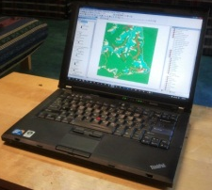
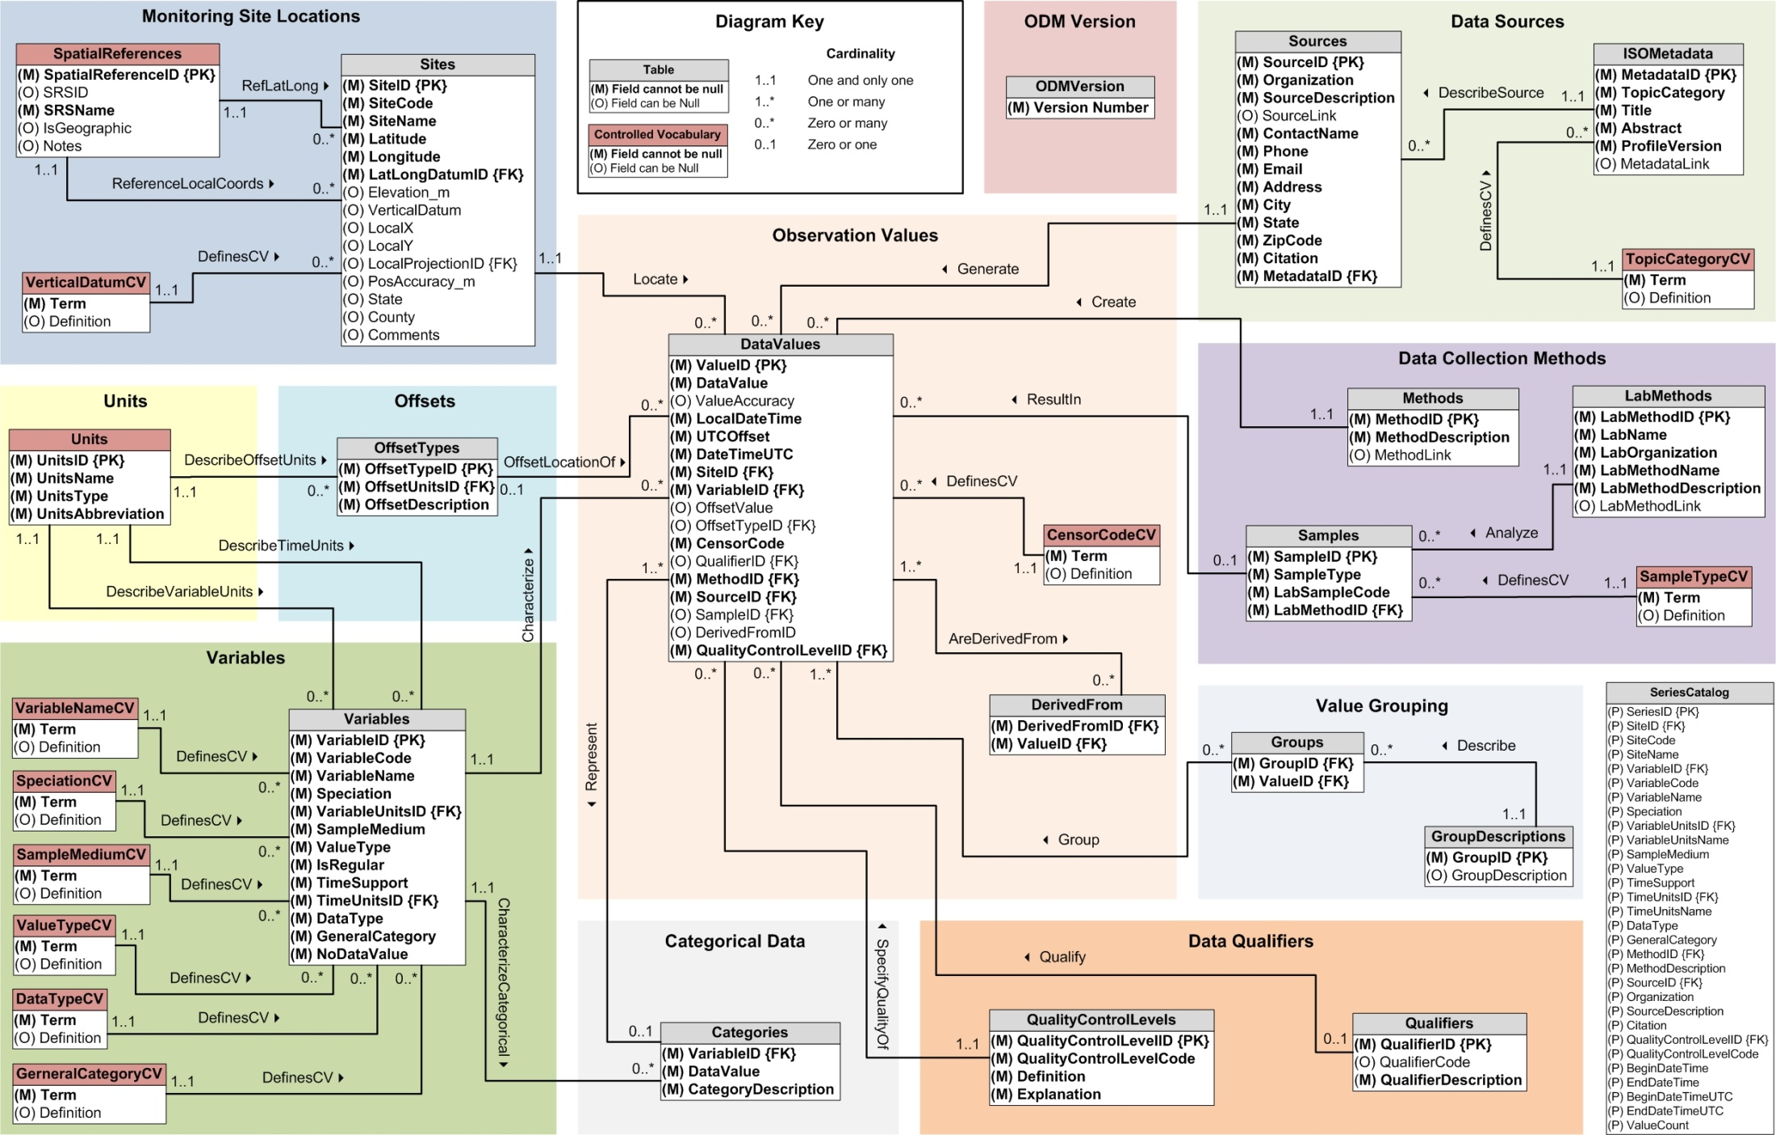
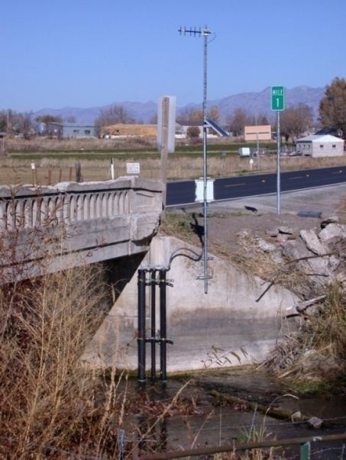
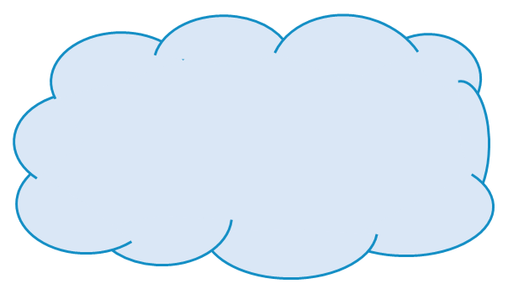
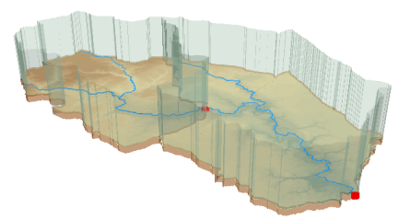



Outline
The need for better data access cyberinfrastructure
CUAHSI HIS Services-Oriented Architecture
  Standards for hydrologic data storage and exchange
  Catalog for data discovery
  Integration of information from multiple sources
HydroShare
  Collaborative data analysis and publication
  Collaborative integrated modeling
  Architecture (Resource Centric Paradigm)
  Resource Data Model
  Functionality (to be) developed

Slide 3
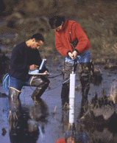


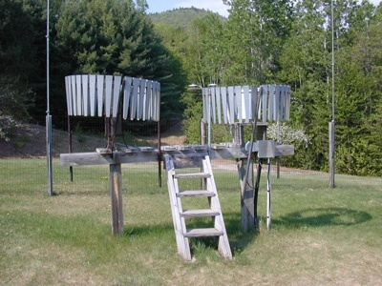
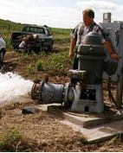
Hydrologic Data Challenges
Water quality
Water quantity
From dispersed federal agencies
From investigators collected for different purposes
Different formats
  Points
  Lines
  Polygons
  Fields
  Time Series
Rainfall and Meteorology
Soil water
Groundwater
GIS
Data Heterogeneity

Slide 4
What proportion of your research time do you spend on preparing or preprocessing data into appropriate forms needed for research purposes?
http://his.cuahsi.org/documents/HISStatusSept15.pdf
Notes:
Surveys of the hydrology community have indicated that data gathering and preprocessing is an inordinate fraction of the time required for modeling and analysis
In hydrology most of the easy single site, single variable, low hanging fruit research problems are solved and advances in understanding and better predictions require
combining information from multiple sources,
sharing and collaboration
Easier access to advanced computational capability
Sustainability and reliability in software

Slide 5
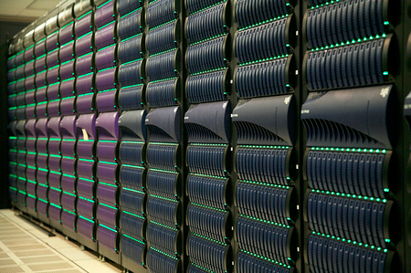
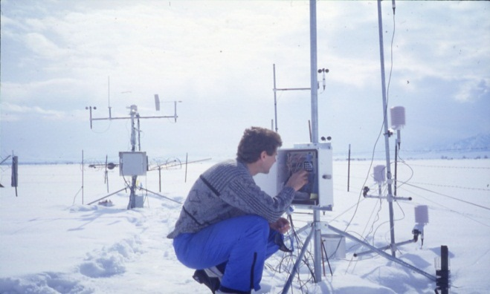
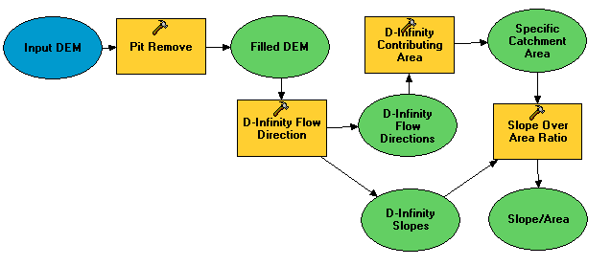

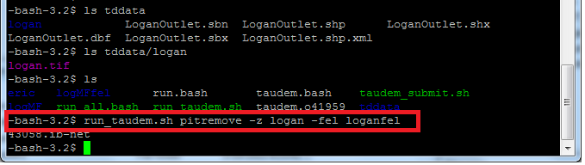
A digital divide
Researchers
Experimentalists
Modelers
Big Data and HPC
#!/bin/bash
vi
chmod
#PBS -l nodes=4:ppn=8
grep
awk
mpiexec
Do you have the access or know how to take advantage of advanced computing capability?
Gateways, Web Interfaces, Software services

Slide 6
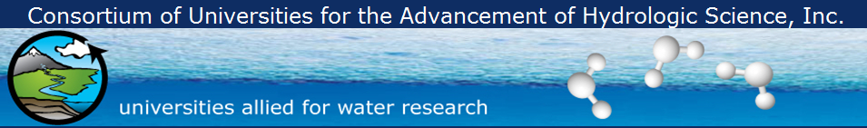
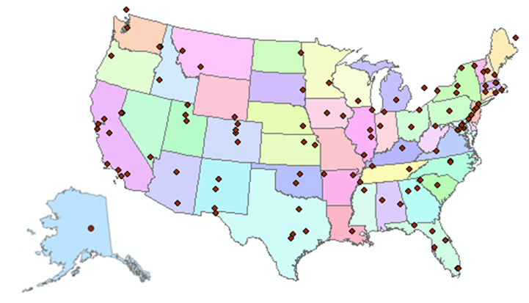
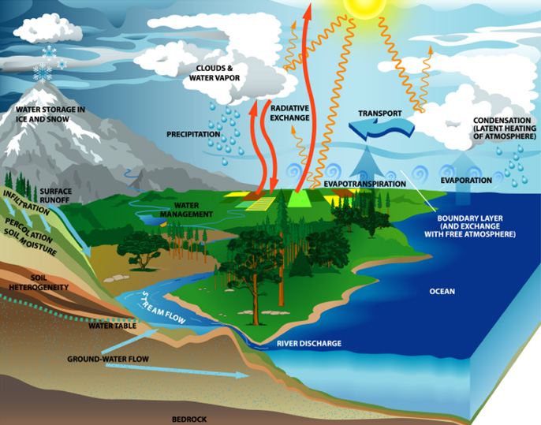
What is CUAHSI?
http://www.cuahsi.org
(as of January 2013)
109 US University members
7 affiliate members
20 International affiliate members
3 corporate members
provides community and research support services to advance water research
Support
EAR 0753521

Slide 7
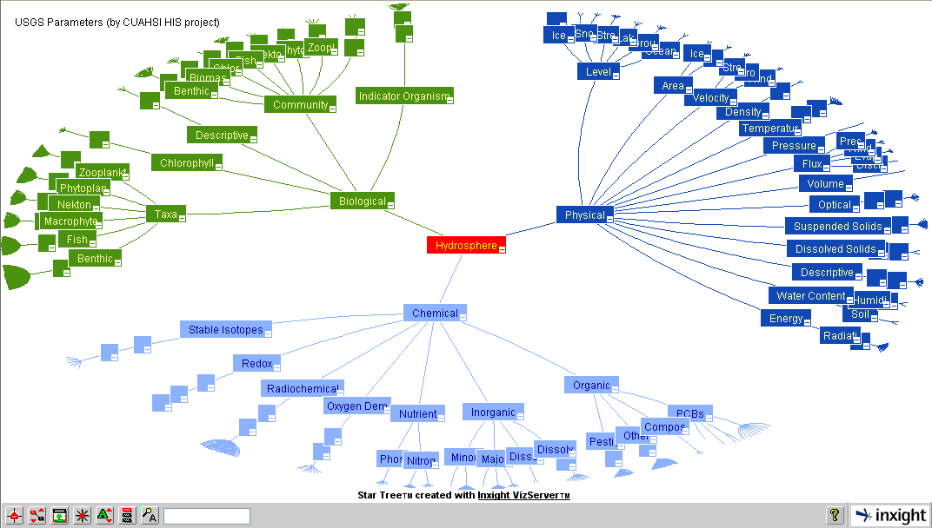
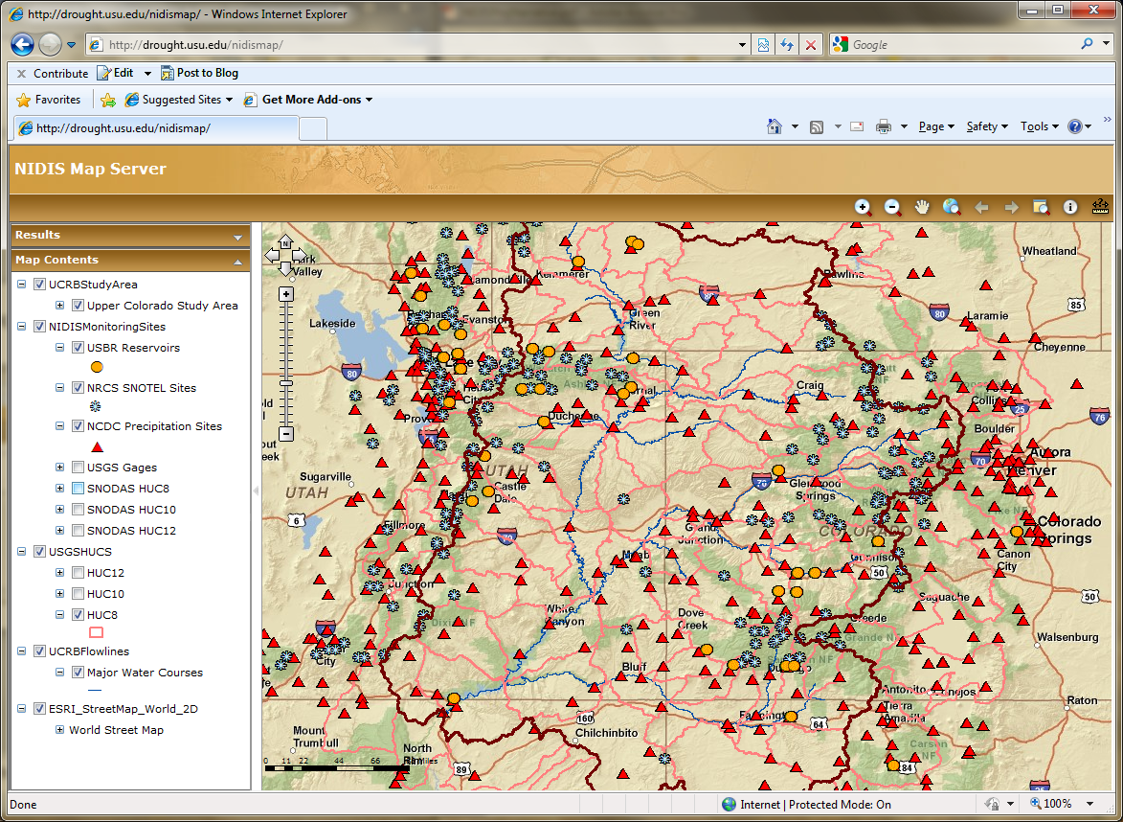
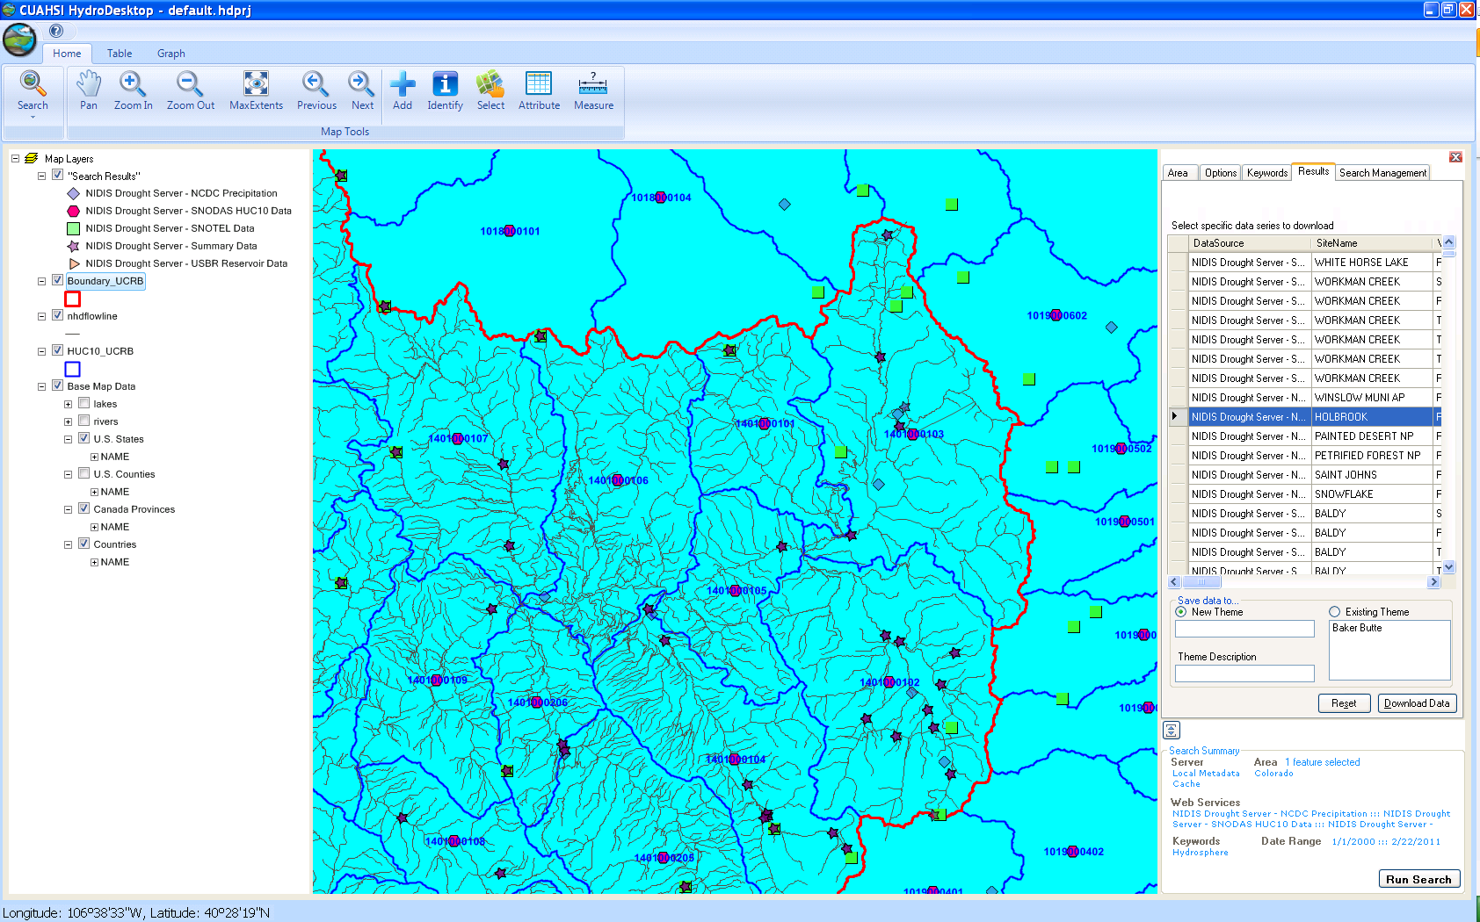
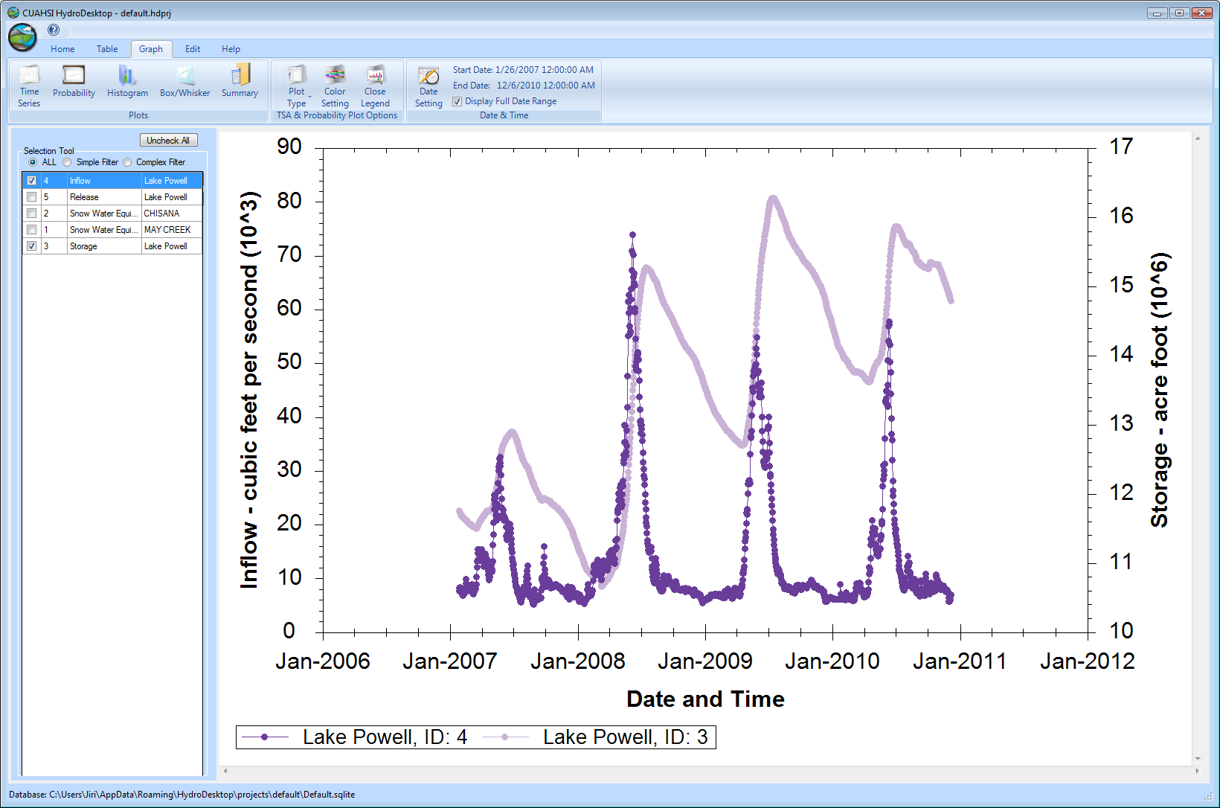
CUAHSI HIS
The CUAHSI Hydrologic Information System (HIS) is an internet based system to support the sharing of hydrologic data. It is comprised of hydrologic databases and servers connected through web services as well as software for data publication, discovery and access.
HydroServer – Data Publication
HydroCatalog
Data Discovery
Lake Powell Inflow and Storage
HydroDesktop – Data Access and Analysis
HydroDesktop – Combining multiple data sources

Slide 8










Data Searching – What we used to have to do
Searching each data source separately
NWIS
request
return
request
request
return
return
NAWQA
request
return
NAM-12
request
return
request
return
request
return
request
return
NARR
Slide: Michael Piasecki, Drexel University
Notes:
8

Slide 9

What CUAHSI HIS enables
Searching all data sources collectively
GetValues
GetValues
NWIS
GetValues
GetValues
generic
request
GetValues
GetValues
NAWQA
GetValues
NARR
GetValues
ODM
Slide: Michael Piasecki, Drexel University
Notes:
9

Slide 10
CUAHSI Hydrologic Information System: A
Services-Oriented Architecture Based System for Sharing Hydrologic Data
HydroCatalog
Data Discovery and Integration
Metadata Services
WaterML, Other OGC Standards
Search Services
HydroServer
HydroDesktop
Data Publication
Data Services
Data Analysis and Synthesis

Slide 11
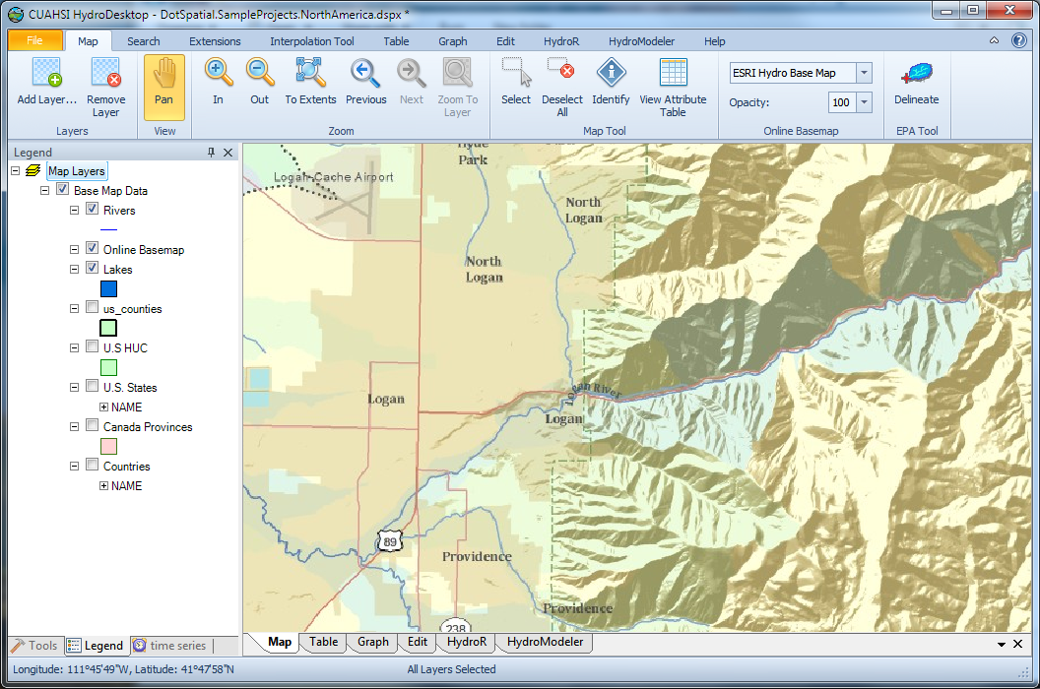
HydroDesktop
An open source
dotSpatial GIS based desktop client that supports discovery and analysis of hydrologic observations data
Uses EPA WATERS Web, Mapping, and Database Services at http://www.epa.gov/waters/geoservices/index.html to delineate Watersheds
Notes:
The service URLs that the HD tool uses are seen in http://hydrodesktop.codeplex.com/SourceControl/changeset/view/475b15a84bf4#Source%2fEPADelineation%2fCallWebService.cs The HD tool uses the Point Indexing Service to find the nearest NHD reach to where the user clicked. This returns a location on that reach. This point location is then used as input to the Navigation Delineation Service to get the watershed, and the Upstream/Downstream Service to get the river lines. The delineation service has two limitations: * It only works up to a certain distance upstream. I think we have it set to 100km. So for large watersheds (those with more than 100km of stream length upstream of where the user clicked), we don't get the most upstream portions of the watershed. * It doesn't delineate exactly to where the user clicked. It delineates to the endpoint of the NHD reach. (Can't remember if it is the clicked reach or the upstream reach -- try it and see.)

Slide 12
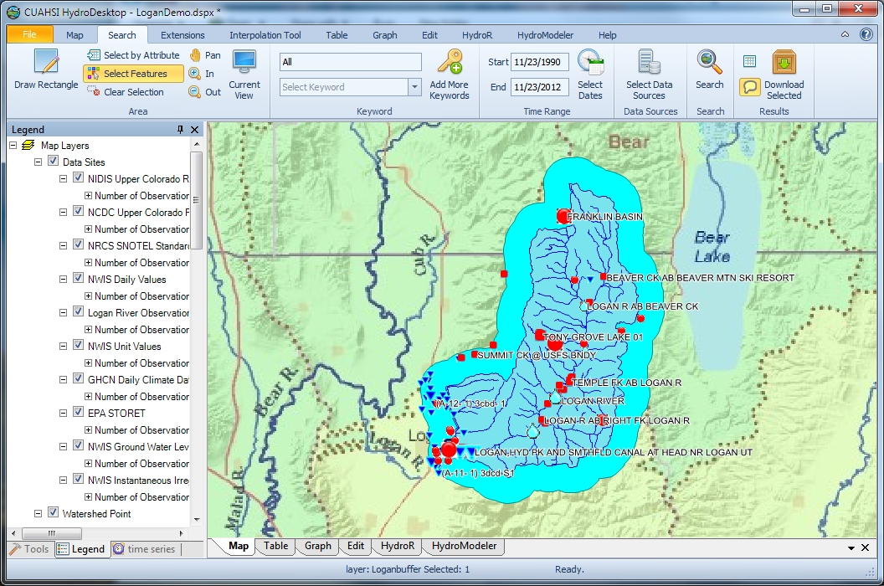
Search last 22 years for all data in buffer around watershed

Slide 13
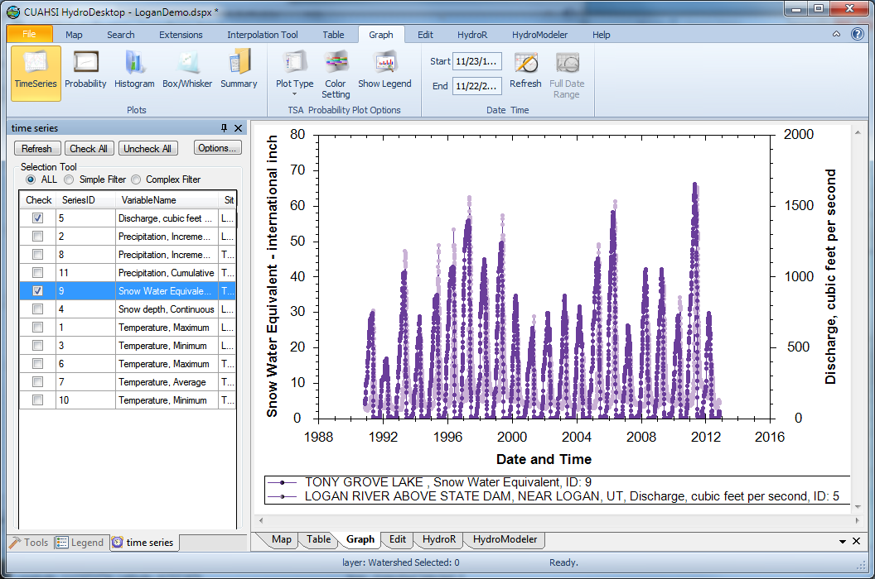
Download and Plot the Data
Combining information from multiple sources

Slide 14
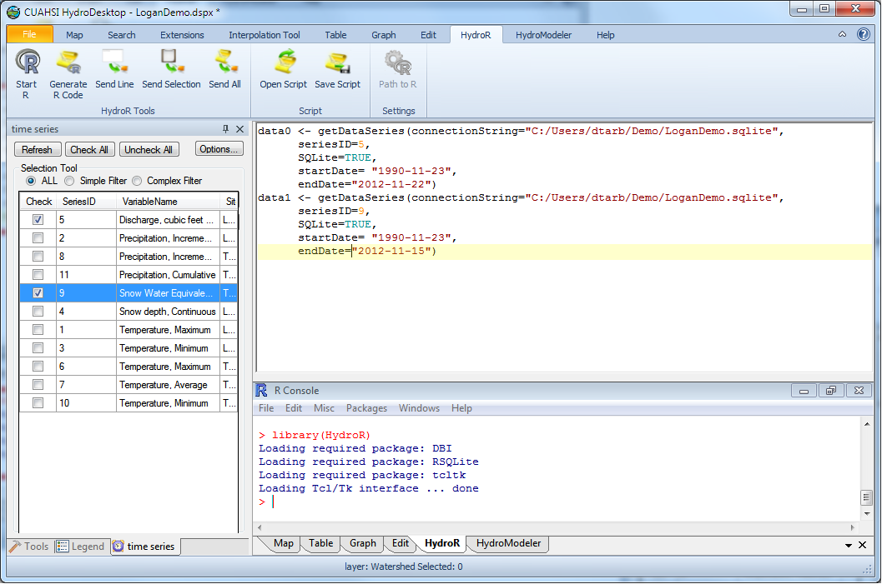
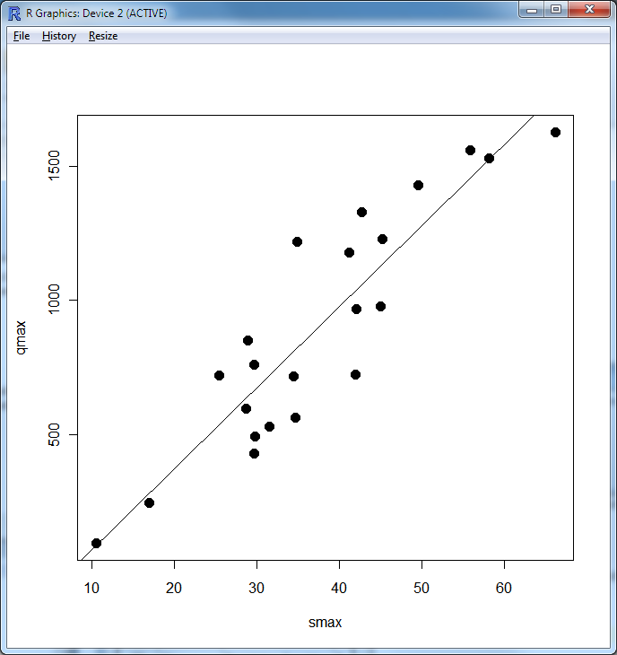
Perform an analysis using R
At your fingertips
the full analysis capability of R
data from multiple sources
accessed from distributed (cloud) resources.
importance of interoperability

Slide 15

The way that data is organized can enhance or inhibit the analysis that can be done
I have your information right here …
Picture from: http://initsspace.com/

Slide 16
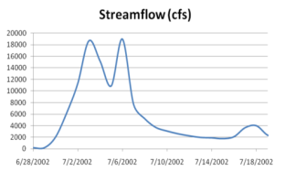
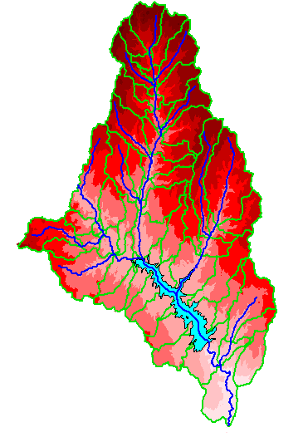
Hydrologic Science
It is as important to represent hydrologic environments precisely with
data as it is to represent hydrologic processes with equations
Physical laws and principles
(Mass, momentum, energy, chemistry)
Hydrologic Process Science
(Equations, simulation models, prediction)
Hydrologic conditions
(Fluxes, flows, concentrations)
Hydrologic Information Science
(Observations, data models, visualization
Hydrologic environment
(Physical earth)

Slide 17
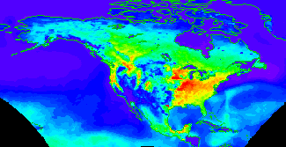


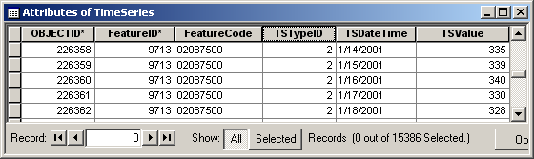

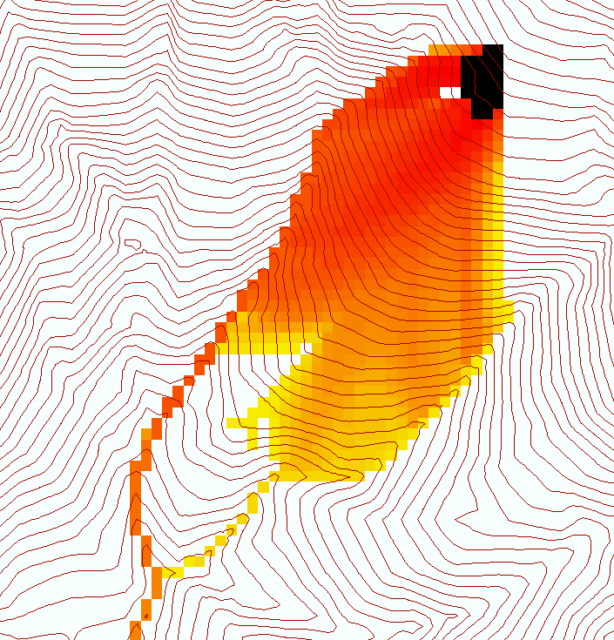
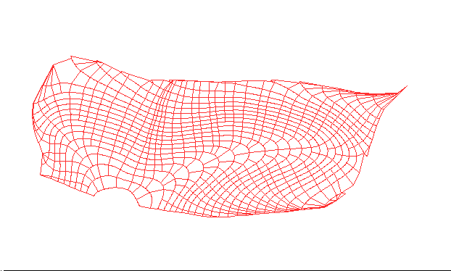

Data models capture the complexity of natural systems
NetCDF (Unidata) - A model for Continuous Space-Time data
ArcHydro – A model for Discrete Space-Time Data
Time, TSDateTime
Time, T
Coordinate
dimensions
{X}
TSValue
D
Space, FeatureID
Space, L
CUAHSI Observations Data Model: What are the basic attributes to be associated with each single data value and how can these best be organized?
Variables, TSTypeID
Variables, V
Variable dimensions
{Y}
Terrain Flow Data Model used to enrich the information content of a digital elevation model

Slide 18
What are the basic attributes to be associated with each single data value and how can these best be organized?
DateTime
Interval (support)
“When”
Time, T
t
A data value
v_{i} (s,t)
Variable
Method
Quality Control Level
Sample Medium
Value Type
Data Type
Source/Organization
“Where”
Location
Feature of interest
Latitude
Longitude
Site identifiers
s
Space, S
V_{i}
“What”
Variables, V
Units
Accuracy
Censoring
Qualifying comments

Slide 19
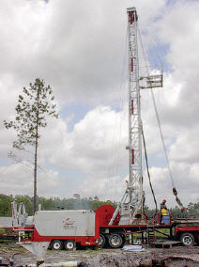
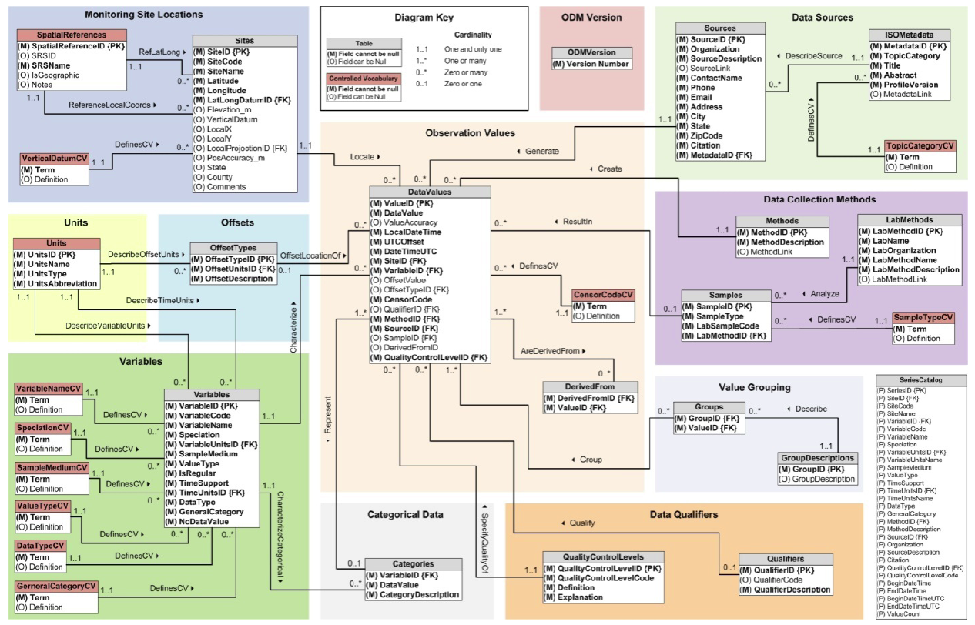
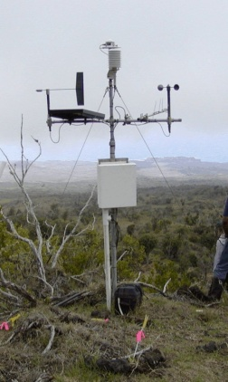
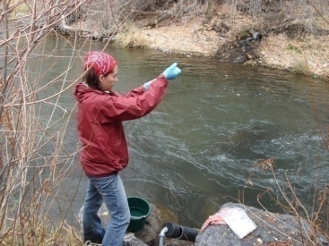
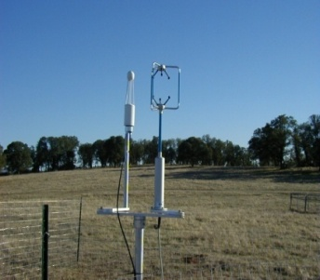
Observations Data Model (ODM)
Streamflow
Provides a common persistence model for data storage
Groundwater
levels
Precipitation
& Climate
Soil
moisture
data
Water Quality
Flux tower data
A relational database at the single observation level
Metadata for unambiguous interpretation
Traceable heritage from raw measurements to usable information
Promote syntactic and semantic consistency
Cross dimension retrieval and analysis
Horsburgh, J. S., D. G. Tarboton, D. R. Maidment, and I. Zaslavsky (2008), A relational model for environmental and water resources data, Water Resources Research, 44, W05406, doi:10.1029/2007WR006392.

Slide 20
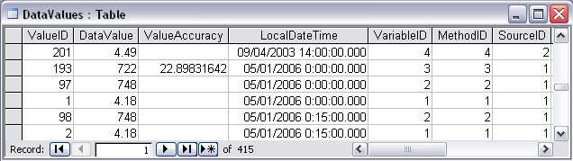
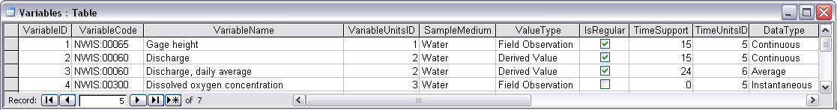
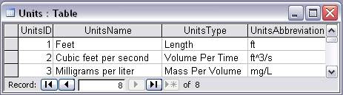
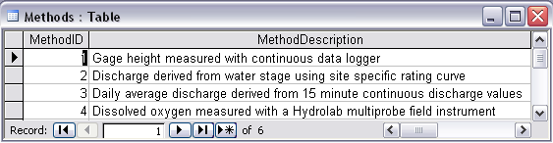
Discharge, Stage, Concentration and Daily Average Example

Slide 21
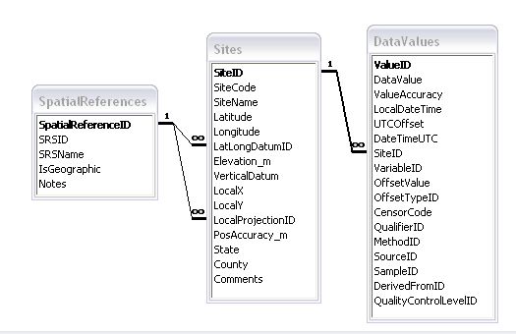
Site Attributes
SiteCode, e.g. NWIS:10109000
SiteName, e.g. Logan River Near Logan, UT
Latitude, Longitude Geographic coordinates of site
LatLongDatum Spatial reference system of latitude and longitude
Elevation_m Elevation of the site
VerticalDatum Datum of the site elevation
Local X, Local Y Local coordinates of site
LocalProjection Spatial reference system of local coordinates
PosAccuracy_m Positional Accuracy
State, e.g. Utah
County, e.g. Cache

Slide 22
Independent of, but can be coupled to Geographic Representation
ODM
e.g. Arc Hydro
Feature
Observations Data Model
1
HydroPoint
Waterbody
Watershed
Sites
1
HydroID
HydroID
HydroID
SiteID
HydroCode
*
HydroCode
HydroCode
SiteCode
FType
FType
DrainID
SiteName
OR
Name
Name
AreaSqKm
Latitude
JunctionID
AreaSqKm
JunctionID
Longitude
JunctionID
NextDownID
…
ComplexEdgeFeature
*
SimpleJunctionFeature
*
CouplingTable
1
SiteID
HydroID
1
HydroEdge
HydroJunction
HydroJunction
HydroID
1
HydroJunction
1
HydroID
HydroID
HydroCode
HydroID
HydroCode
HydroCode
ReachCode
HydroCode
NextDownID
NextDownID
Name
NextDownID
LengthDown
LengthDown
LengthKm
HydroNetwork
LengthDown
DrainArea
DrainArea
LengthDown
DrainArea
FType
FType
FlowDir
FType
Enabled
Enabled
FType
Enabled
AncillaryRole
AncillaryRole
EdgeType
AncillaryRole
Enabled
EdgeType
Flowline
Shoreline

Slide 23
Importance of the Observations Data Model
Provides a common persistence model for observations data
Syntactic consistency (File types and formats)
Semantic consistency
  Language for observation attributes (structural)
  Language to encode observation attribute values (contextual)
Publishing and sharing research data
Metadata to facilitate unambiguous interpretation
Enhance analysis capability

Slide 24
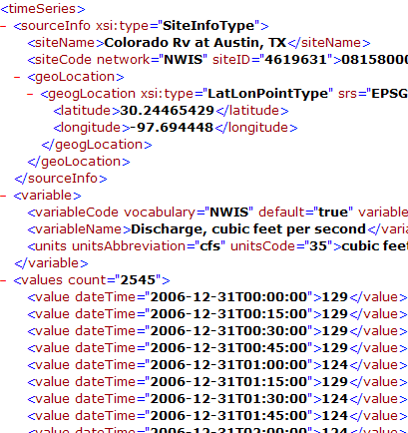
WaterML and WaterOneFlow
WaterML is an XML language for communicating water data
WaterOneFlow is a set of web services based on WaterML
Set of query functions
Returns data in WaterML
GetSites
GetSiteInfo
GetVariableInfo
GetValues
WaterOneFlow
Web Service
Notes:
24

Slide 25
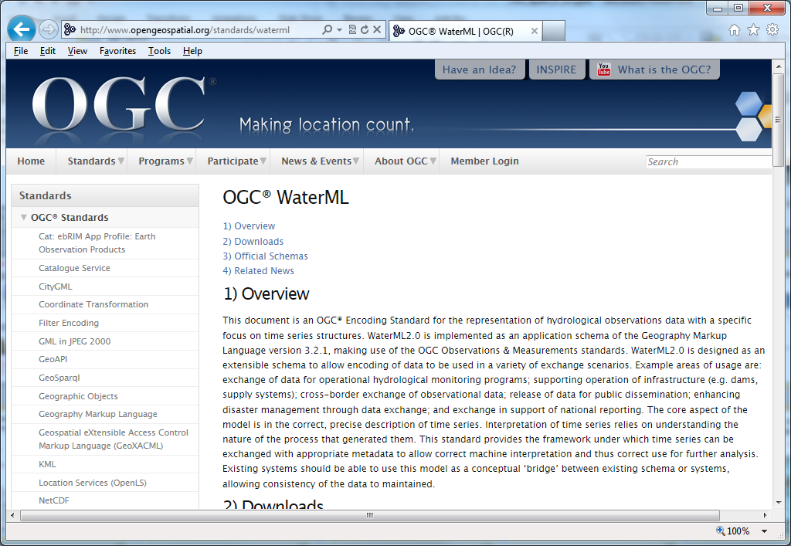
Open Geospatial Consortium Web Service Standards
http://www.opengeospatial.org/standards/waterml
This document is an OGC® Encoding Standard for the representation of hydrological observations data with a specific focus on time series structures.
These standards have been developed over the past 10 years …. by 400 companies and agencies ....

Slide 26
CUAHSI HIS: A common window on water observations data for the United States unlike any that has existed before
Storage in a community data model
Publication from a server
Data access through internet-based services using consistent language and format
Tools for access and analysis
Discovery through thematic and geographic search functionality
Integrated modeling and analysis combining information from multiple sources
Desktop
Catalog
Server

Slide 27
HydroShare
Enable more rapid advances in hydrologic understanding through collaborative data sharing, analysis and modeling
Analysis
Data
Models
USU, RENCI, BYU, UNC, UVA, CUAHSI, Tufts,, Texas, Purdue, SDSC
http://www.hydroshare.org
OCI-1148453
OCI-1148090

Slide 28
What is (will) HydroShare (be)?
HydroShare will be a community collaboration website that enables users to easily discover and access data and models, retrieve them to a desktop computer or perform analyses in a distributed computing environment that includes grid, cloud, or high performance computing model instances as necessary.
Understanding will be advanced through the ability to integrate information from multiple sources.
Outcomes (data, results, models) can then be published as new resources that can be shared with collaborators.
Analysis
Data
Models
Our goal is to make sharing of hydrologic data and models as easy as sharing videos on YouTube or shopping on Amazon.

Slide 29
CUAHSI HIS
Publishing data requires access to or setting up a HydroServer
Accessing data requires HydroDesktop
Generally limited to time series at a point
Desktop
Catalog
Server

Slide 30
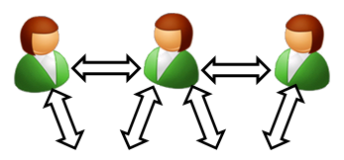


Collaborative data analysis and publication use case
Discover and Analyze/Model (in Desktop or Cloud)
Observe
Publish and Catalog
Collaboration
Analysis
3
CUAHSI Water Data Center
Observers and instruments
HydroServer (ODM)
Data
Models
1
2
Publication, Archival, Curation

Slide 31
Collaborative data analysis and publication use case
Share the results (Data and Models)
Collaboration
Analysis
4
CUAHSI Water Data Center
Observers and instruments
HydroShare resource
store
Data
Models
Publication, Archival, Curation

Slide 32

Collaborative data analysis and publication use case
Group Collaboration using HydroShare
Preparation of a paper
Collaboration
5
Analysis
6
CUAHSI Water Data Center
Observers and instruments
Data
Models
Publication, Archival, Curation

Slide 33
Collaborative data analysis and publication use case
Submittal of paper, review, archival of electronic paper with data, methods and workflow
Collaboration
Analysis
7
CUAHSI Water Data Center
Observers and instruments
Data
Models
Publication, Archival, Curation

Slide 34

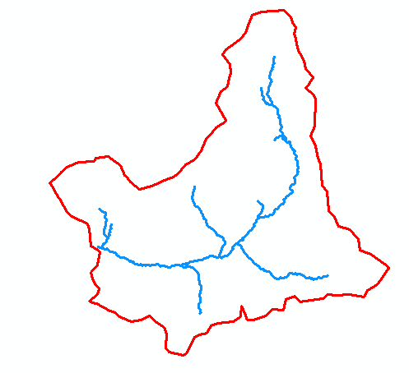
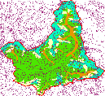
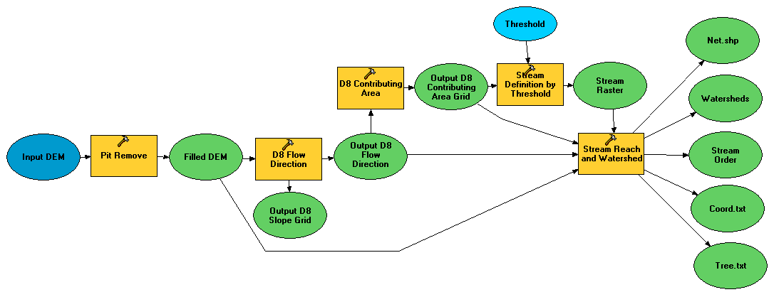
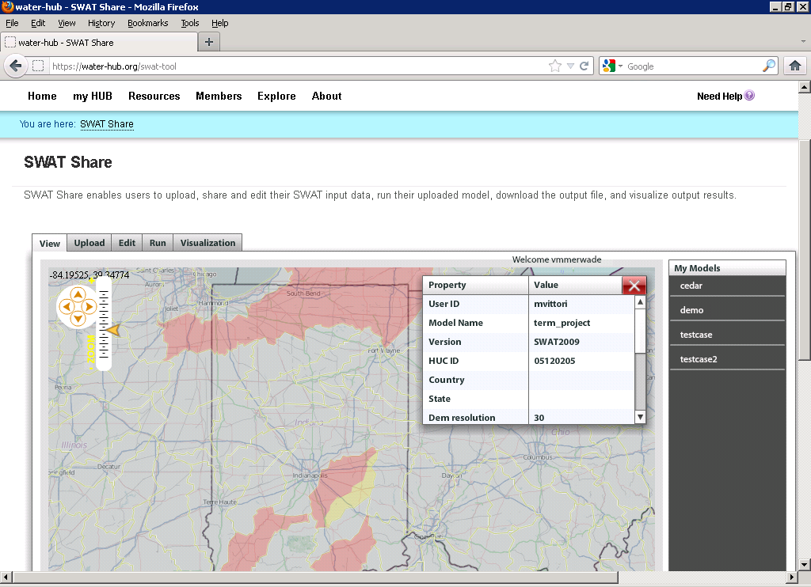
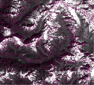
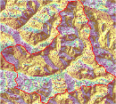
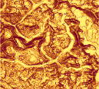





Collaborative Integrated Modeling Use Case
Flow
Time
P
Flow
Time
t
Time
Pre-processing and model linking
y
x
Modeling Services (e.g. SWATShare)
Data: Links to national and global data sets of essential terrestrial variables (e.g. NASA NEX, HydroTerre)
Tools to preprocess and configure inputs (EcoHydroLib, TauDEM, CyberGIS)
Preconfigured models and modeling systems as services (SWATShare)
Standards for information exchange for interoperability (OpenMI, CSDMS BMI)
Tools for visualization and analysis
Notes:
Data: Links to national and global data sets of essential terrestrial variables (e.g. NASA NEX, HydroTerre)
Tools to preprocess and configure inputs
Preconfigured models and modeling systems as services
Standards for information exchange for interoperability (OpenMI, CSDMS BMI)
Tools for Visualization and Analysis
Automated reasoning to couple models based on purpose, context, data and resources

Slide 35


Slide 36


Slide 37



Slide 38


Sharing and collaboration

Slide 39
Definition of Data
In OMB Circular A-110 research data is defined as “recorded factual material commonly accepted in the scientific community as necessary to validate research findings, but not any of the following: preliminary analyses, drafts of scientific papers, plans for future research, peer reviews, or communications with colleagues.”
Validating research findings may involve
Observations and measurements
Models, code and scripts
Simulation results
HydroShare resources need to accommodate all these types of “data”

Slide 40
Resource Repository Centric Paradigm for Modeling and Analysis
Models
Visualization Tools
Analysis Tools
Resource Repository
Data Loaders
Data Discovery Tools
Each model interacts with information in the common data store
The modeler does not need to be concerned with and can take advantage of standardized analysis, visualization loading and discovery tools
Enable multiple models to use common “best practice” tools

Slide 41



Resource Data Model
Open Archives Initiative – Object Reuse and Exchange (OAI-ORE) - standards for the description and exchange of aggregations of Web resources
BagIt – hierarchical file packaging format designed to support disk-based or network-based storage and transfer of generalized digital content
Compatible with DataOne

Slide 42
Types of data to support as resources
Resource Types
Generic ✓
Time Series (CUAHSI HIS)
Geographic feature set
Geographic Raster
Referenced HIS time series
Multidimensional Space Time dataset
River geometry
Sample based observations (ODM2 and CZO)
Documents
Tabular objects
HydroDesktop Project package
Scripts
Models
Model Components
Referenced data sets from other (non HIS) sources.
Tools
Uploaders to facilitate loading of resources
Viewers to visualize the resource
Exporters to download the resource
Best practice tools for hydrologic data preprocessing and analysis
Resource Data Model.
Data and metadata content
Logical relationships
File formats

Slide 43


Multidimensional Space Time Resource Type
Time Series Resource Type
t
ODM/WaterML
y
x
NetCDF

Slide 44




Representing River Geometry in HydroShare
LiDAR
Cross Sections Attached to River Network
Cross Sections
Hydraulic Calculations

Slide 45

Models
Model package
  Bundled components
  references existing resources
Model program
  executable entity
  may consist of submodules and other complex relationships
Model input
  input required by a program
  files, parameters, etc...
Model output
  outputs produced by a program
  files, plots, etc...

Slide 46

Model Execution in HydroShare
Input and output Hydroshare resources
Link input, output, and program resources to create model packages
Execution of model package within the HydroShare environment to create "new" resources
Output
CREATE OUTPUT
CREATE PACKAGE
Package
EXECUTE
Program
Input
Package
Program
Input
Output

Slide 47

SWATShare

Slide 48
RHESSys ecohydrology data preparation workflow
Common across many models
Manual workflows
Workflow framework
Notes:
Explain what pieces have been implemented as iRODS rules.
Explain what iRODS is.

Slide 49

People and Organizations
Used for
Resource Metadata
  Creators
  Contributors
System
  Users
  Access Control

Slide 50
Architecture
Users
Browser
Client (HydroDesktop)
3rd party clients, interoperable systems and web tools
Web Tools
Web Pages
Web Services (HydroShare REST API)
Compute Engines (Docker or HPC)
Connection point for partners
BiG CZ SSI
CI-WATER
SEAD
CyberGIS
SESYNC GI Venture
Django web application framework
iRODS Native REST API
iRODS “Network File System”
Content
Resource Files
Resource Science Metadata
User Accounts
Functionality
Authentication and Authorization Infrastructure (AAI) for Access Control
Discovery (using e.g. ElasticSearch via MSVC plugin)

Slide 51
Django Web Application Architecture
Web Pages
Internal API
REST API
Model (Object classes specified in models.py)
Single point of truth for the format of resource types
Encodes resource data model
Schema (SQL generated from models.py using Django manage.py)
Loader to generate science metadata from user entry based on Resource Model Schema
Reflector to validate and parse science metadata from iRODS into Django
Database (Postgres)
Single point of truth for system and social metadata
Holds reflected science metadata
iRODS (Resources, Users, Authentication and Authorization Infrastructure)
Single point of truth for resources and their science metadata

Slide 52
iRODS
Distributed Data Grid Middleware:
Metadata Catalog holding virtual file system information and associated metadata
Extensible number of ‘Resource Servers’ which may provide connectivity to storage resources
Integrated Rule Engine for Policy Driven Data Management triggered by Data Management Activities
Extensibility via Microservices (MSVC) – Plugins providing functionality to the Rule Engine
Users
Client
Resources
Catalog
MSVC
…
Messaging
iRODS
iRODS in HydroShare
Storage of HydroShare Resources Replicated across multiple institutions
Access to Computation
Access to Indexing for Discovery

Slide 53
Summary
A new, web-based system for advancing model and data sharing
Sharing features to HydroDesktop
Access more types of hydrologic data using standards compliant data formats and interfaces
Enhance catalog functionality that broadens discovery functionality to different data types
New model sharing and discovery functionality
Facilitate and ease access to use of high performance computing
New social media and collaboration functionality
Links to other data and modeling systems

Slide 54

Thanks to a lot of people
  USU
  RENCI/UNC
  CUAHSI
  BYU
  Tufts
  UVA
  Texas
  Purdue
  SDSC
http://hydroshare.cuahsi.org
OCI-1148453
OCI-1148090
Notes:
The HydroShare project is part of a broad effort in CUAHSI in the area of Hydrologic Information Systems. We have a team of developers and domain scientists from eight universities working on HydroShare. This is part of the even broader focus in NSF on data management, Cyberinfrastructure and sustainable software.

