Slide 1
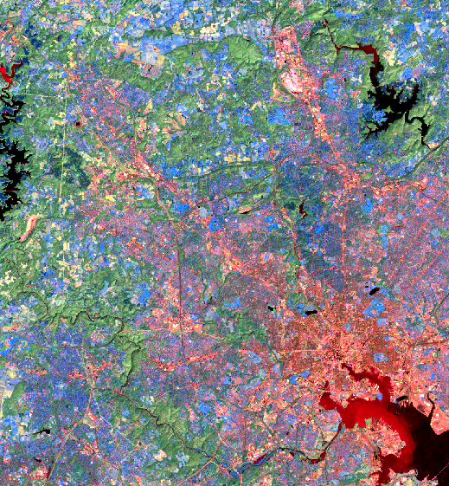
Green Infrastructure, Groundwater
and the Sustainable City
Larry Band
University of North Carolina
Visiting Professor
Chinese Academy of Science

Slide 2
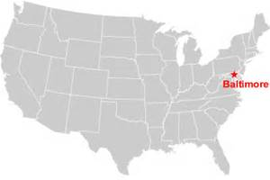
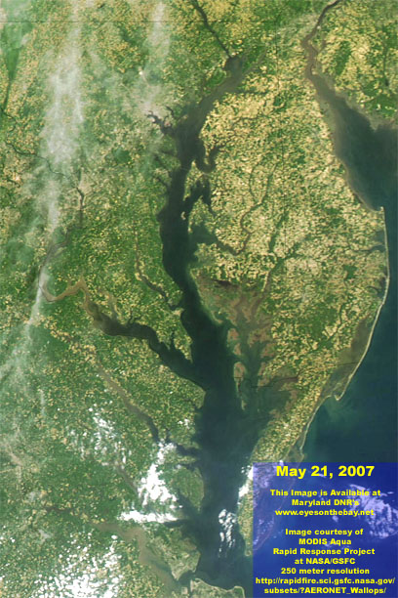
Baltimore City and County under consent decree to reduce N, P, sediment export to Chesapeake Bay

Slide 3
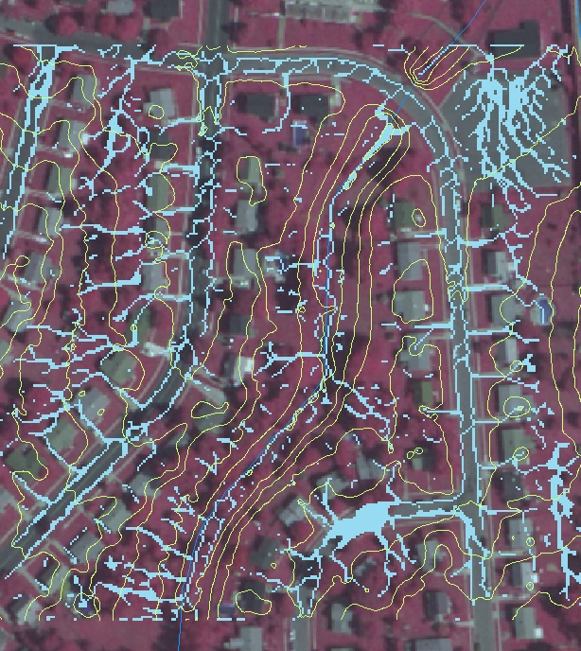
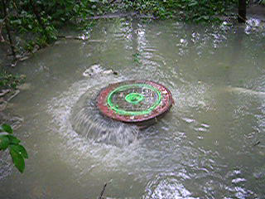
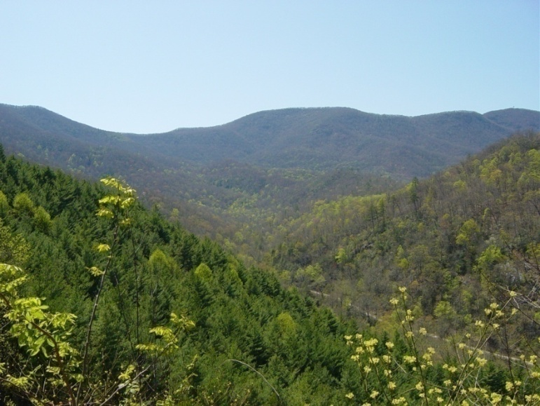
How can principles derived from natural ecosystems be applied to urban ecosystems?
The Baltimore Ecosystem Study
The Coweeta Hydrologic Lab
Otto, North Carolina

Slide 4
New Urban Water Balance
Piped supply/drainage augments inflow/outflow leaky pipes, irrigation, sewer inflow&infiltration (I&I)
GI opportunity?
Bhasker and Welty, 2012, Env. Eng. Sci.

Slide 5
Green Infrastructure (GI)
Network of vegetated features designed to provide specific ecosystem services by promoting infiltration and evapotranspiration
  stormwater mitigation, nutrient retention, carbon sequestration micro-climate modification
  green roofs, rain gardens, swale drains, constructed wetlands, expanded or retained tree canopy, downspout disconnection, …
  alternative or complement to traditional (grey) infrastructure
What GI elements and network designs most closely enable ecohydrological processes that mitigate urban stormwater while providing community benefits?

Slide 6
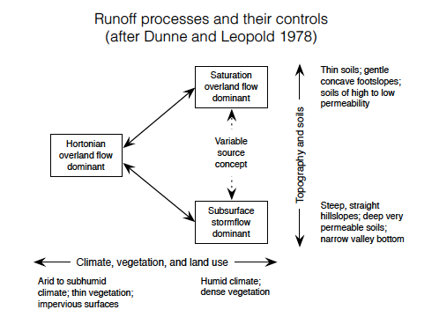

Slide 7
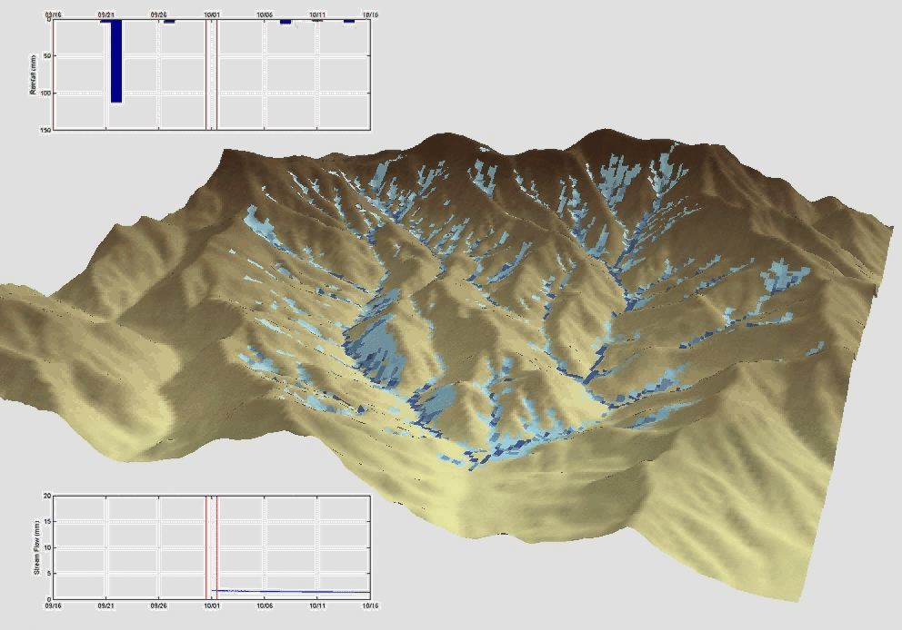

Slide 8
GI appropriate over a range of urban development: urban form and cultural preferences
Baisman Run
WS 263
Dead Run

Slide 9
Medium density suburban san sewer
Medium-hi density residential/commercial san sewer
Low density suburban septic
forest

Slide 10
N load from catchments with forest loads and areas subtracted

Slide 11
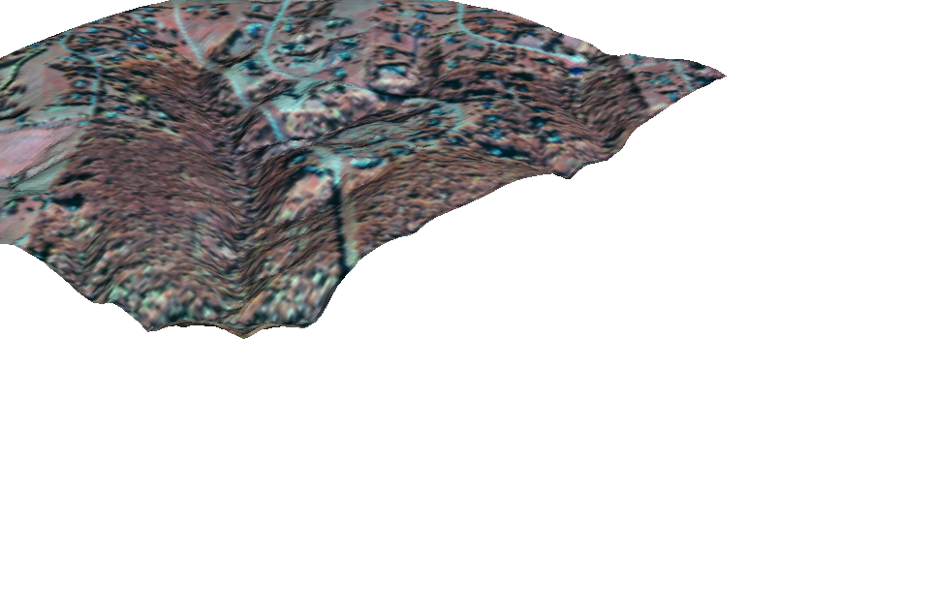
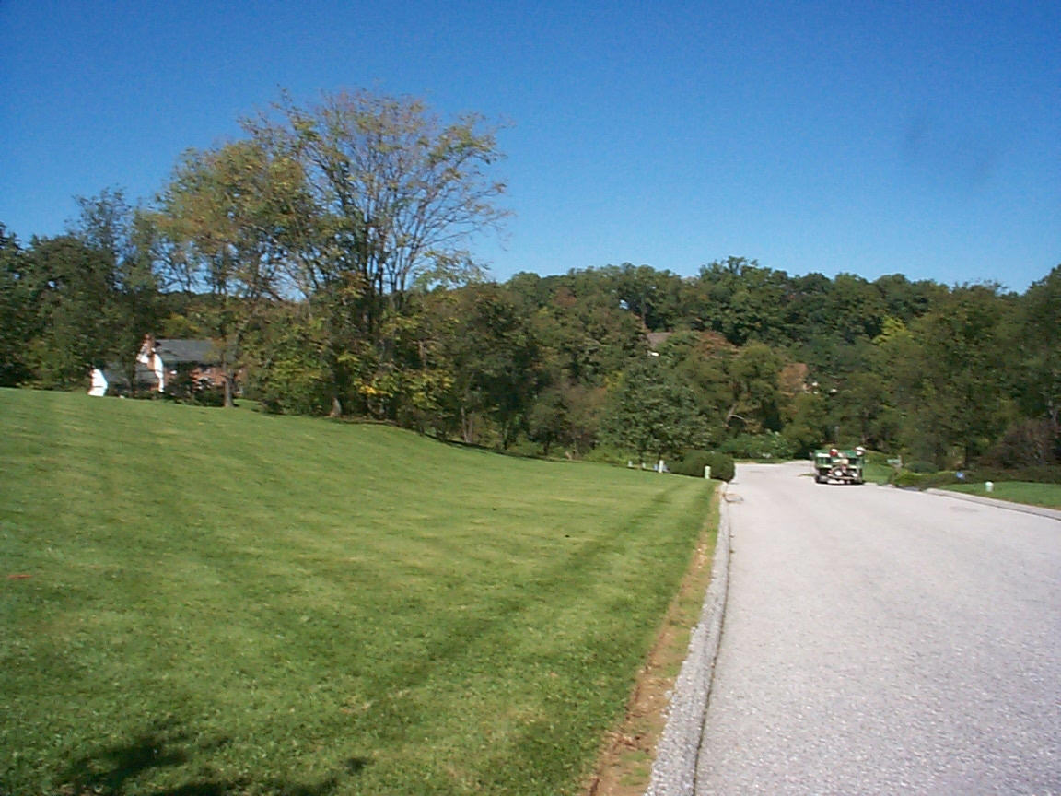
Baisman Run: Low density residential catchment, lawns, streets, septic systems

Slide 12
Urban impervious hydrology – W263 buried streams, dense pipe network
Ken Belt, BES, USFS

Slide 13
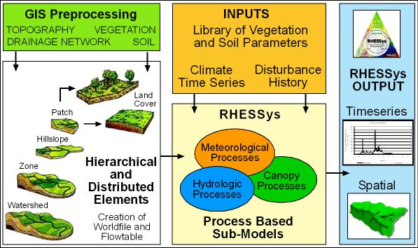
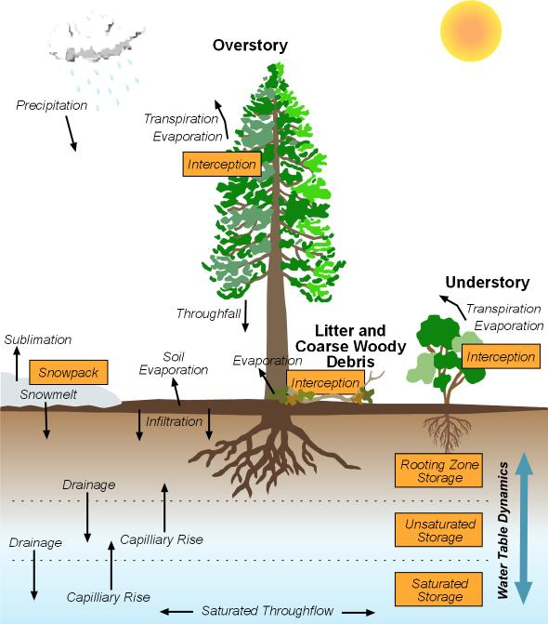
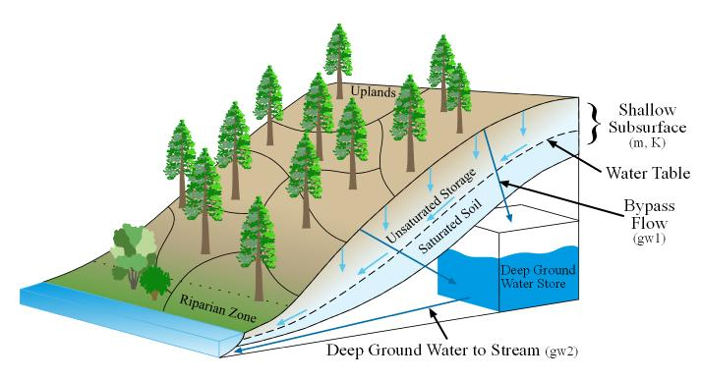
RHESSys:
Regional Hydro-Ecological Simulation System
(Courtesy of Janet Choate)
Notes:
Strata can be redefined any time

Slide 14
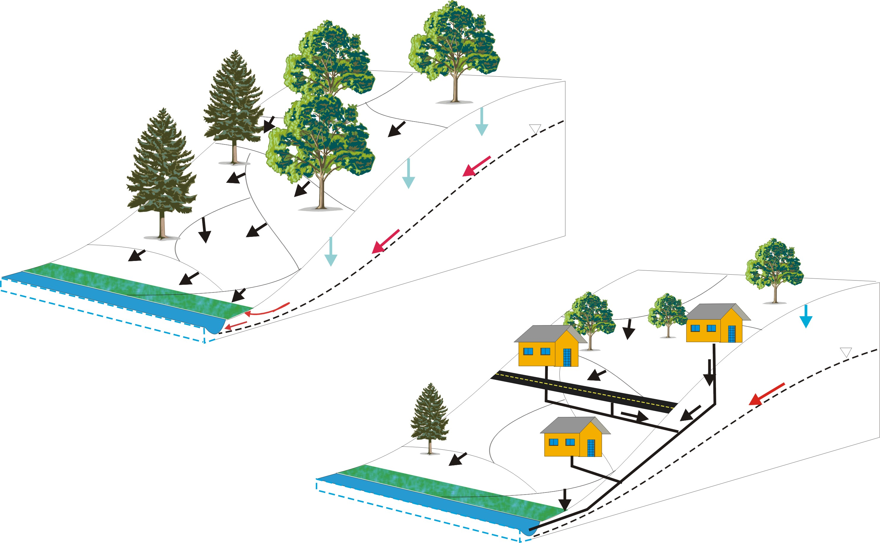
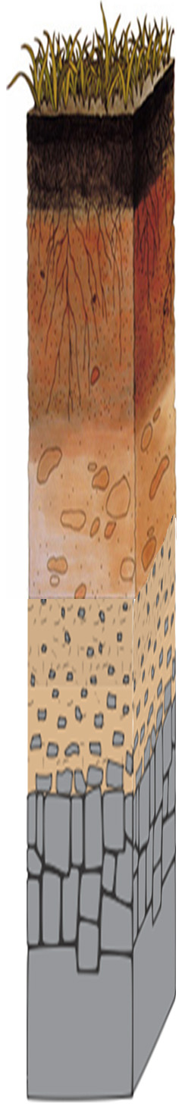
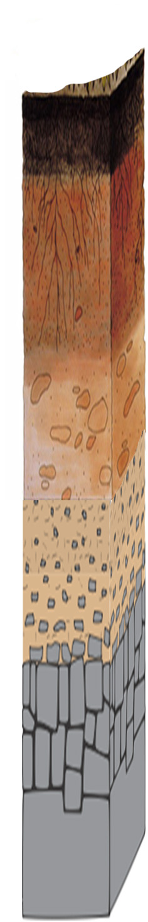
NSF Critical Zone Network criticalzone.org
“Natural” critical zone
Soil
Saprolite
The urban critical zone
Building inputs
Roof: PHAs, Zn
Paint: Legacy Pb
Ca from concrete
Fractured bedrock
Compacted fill
Lawn inputs
fertilizer,
pesticides
Saprolite
Road inputs
Car parts; Zn, Cd, Cu
Emissions: N, legacy Pb
Roads: PAHs, Ca, NaCl
Fractured bedrock
Leaky water supply, sewers, septic systems
C,N, P from human waste;
Pharmaceuticals and personal care products
Figure 1. The natural and urban critical zones. In the urban critical zone, topsoil is replaced by compacted fill, sewers and other utilities pierce the subsurface creating preferential flow paths, and there are additional chemical inputs from the built environment.

Slide 15
Sanitary paradigm: centralized treated supply, rapid removal of storm and waste water
Dense pipe networks for supply distribution, drainage some outdoor water use, more leakage
Ken Belt, BES, USFS

Slide 16
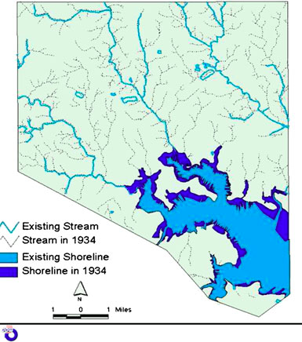
Loss of low order streams, expansion of drainage density
Kaushal and Belt, 2012

Slide 17
Current models use simple removal rates – no dynamics
Chesapeake Bay Program Expert Committee

Slide 18
Detention and infiltration paradigms

Slide 19
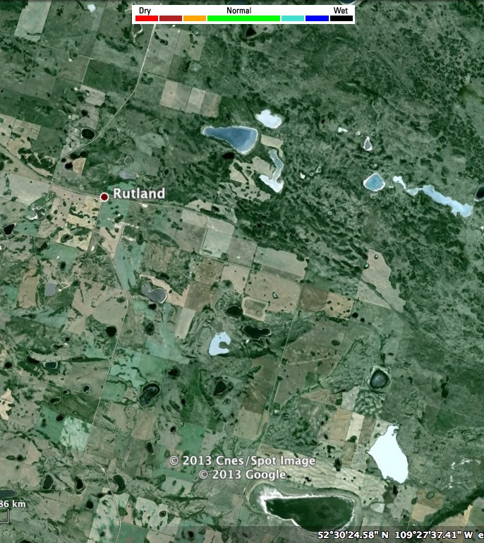
Prairie pothole hydrogeology:
Depression focused recharge
van der Kamp and Hayashi, 2009, Hydrogeology Journal

Slide 20
Potential for SCM infrastructure to replace lost riparian ecosystem retention function

Slide 21
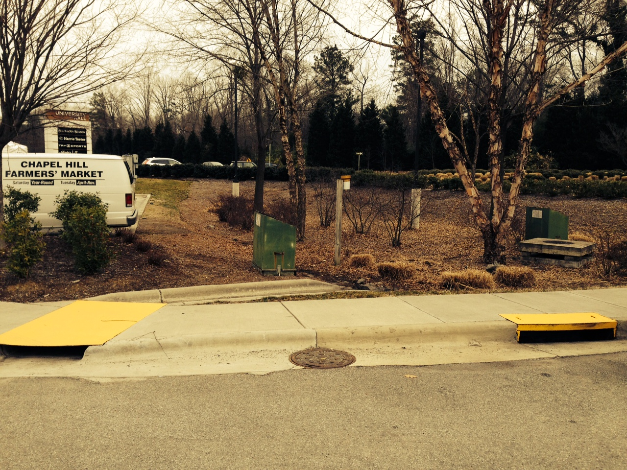
Rain garden receiving parking lot runoff

Slide 22
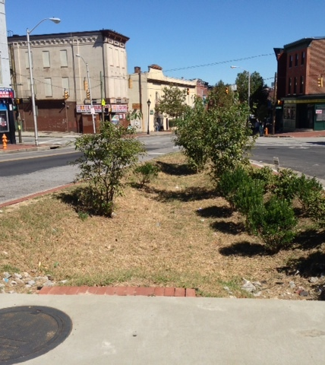
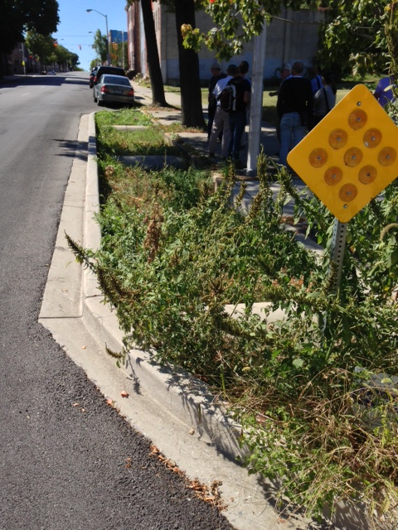
Urban rain garden stub outs: Impervious surface run-on infiltration and transpiration

Slide 23
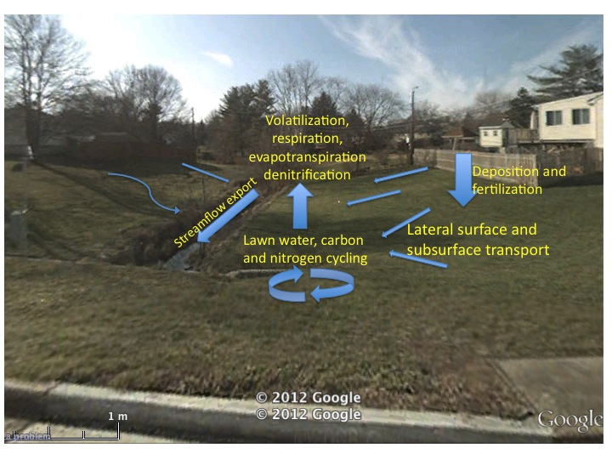
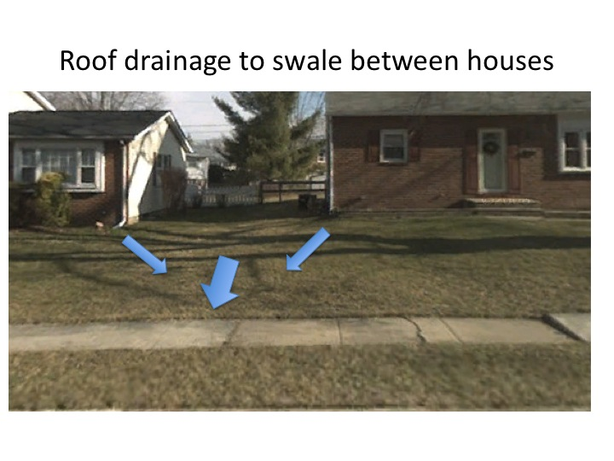

Slide 24
Challenges of distributed ecohydrology modeling
Ecohydrology models can improve understanding of residential stormwater management
But these models are data hungry
Data management is challenging
Scientific reproducibility is difficult to achieve
Brian Miles, UNC

Slide 25
Geoinformatics driven ecohydrology approach to residential stormwater management
Developing:
orkflow tools to improve data management and scientific reproducibility
Using models to assess how:
onnectivity of residential rooftops to adjacent impervious surfaces
ain gardens built on residential parcels
affect stormwater fate and transport in urban ecosystems

Slide 26
Manual workflows
Workflow tools
orkflow tools
Notes:
Explain what pieces have been implemented as iRODS rules.
Explain what iRODS is.

Slide 27
Brian Miles, UNC

Slide 28
Brian Miles, UNC

Slide 29
Brian Miles, UNC

Slide 30
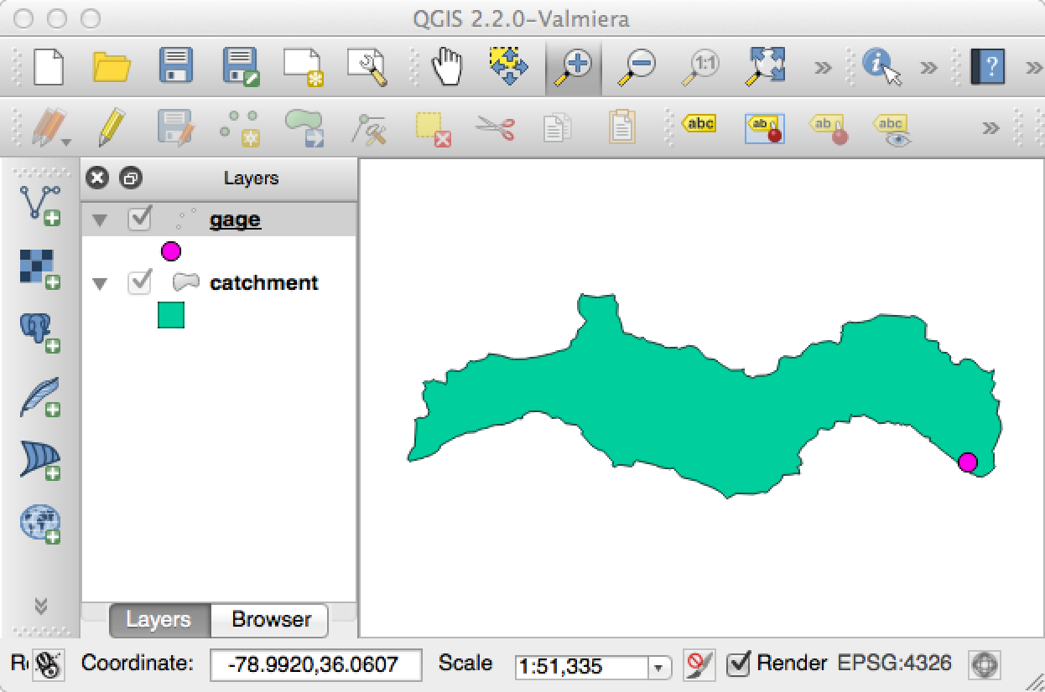
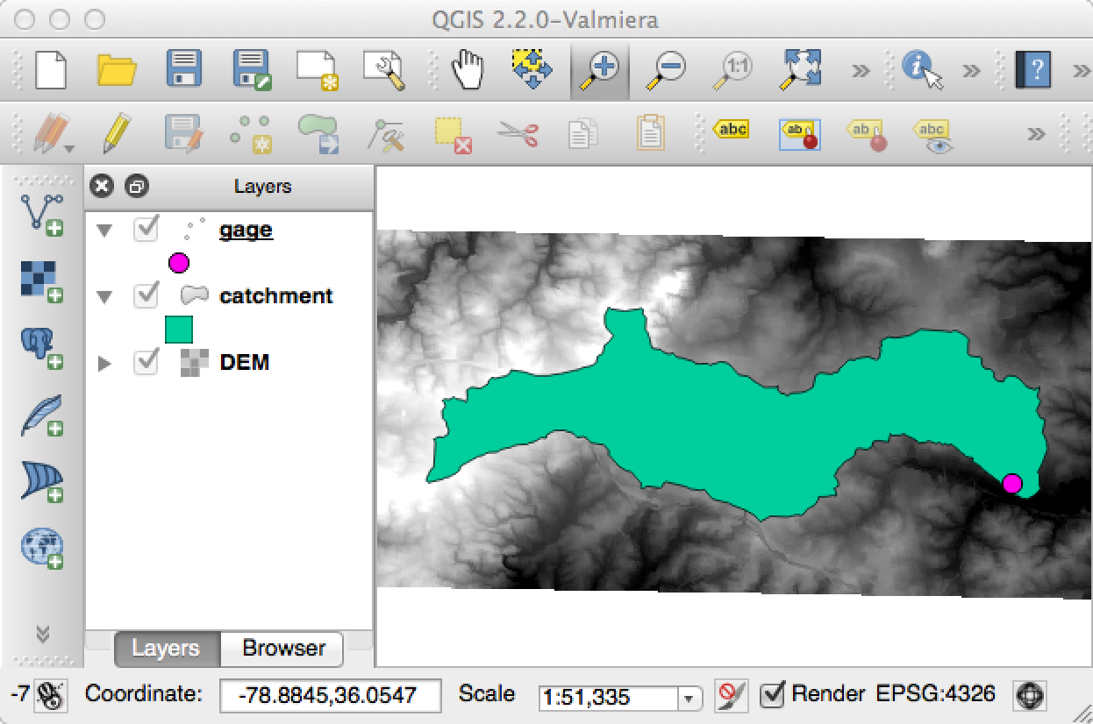
Brian Miles, UNC

Slide 31
Dead Run 5 (DR5) watershed
DR5
Landcover | Area %
Impervious | 41.8
Tree | 31.2
Lawn | 27.1
Impervious cover | % total area
Other impervious | 15.2
Roads | 15.0
Residential roof | 6.4
Non-residential roof | 5.2
Brian Miles, UNC

Slide 32
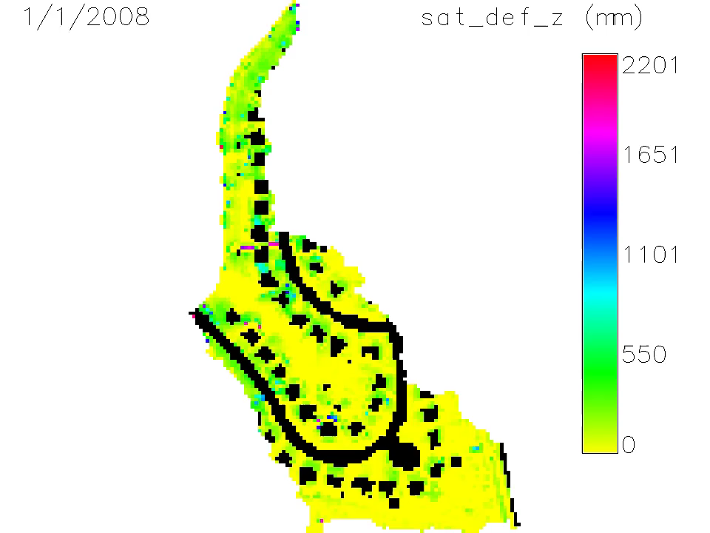
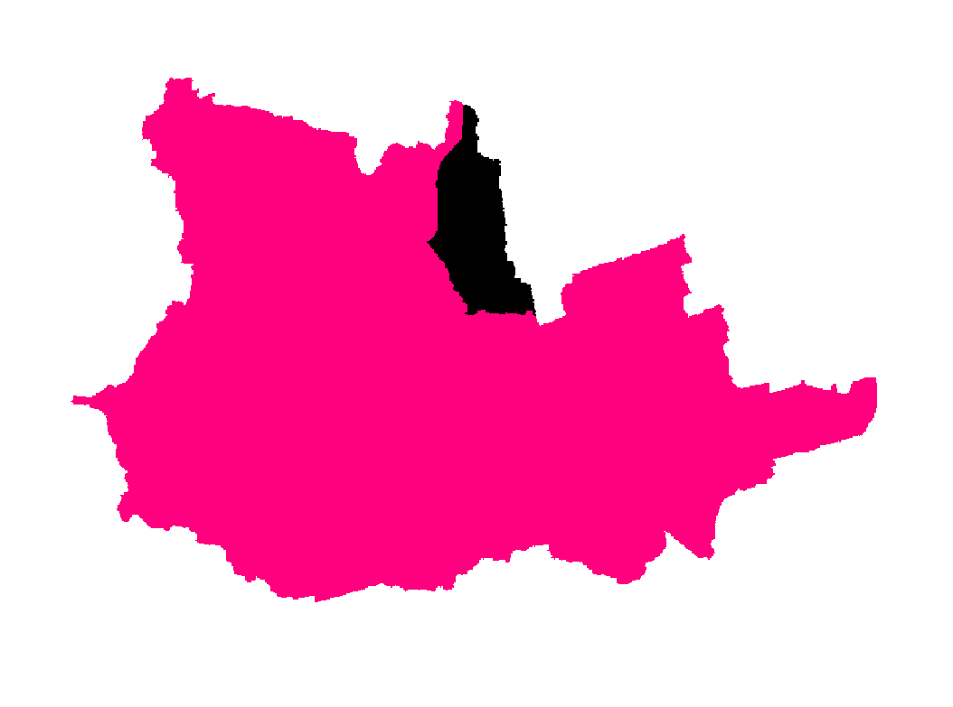
Roof downspout disconnection to specified rain garden placement

Slide 33
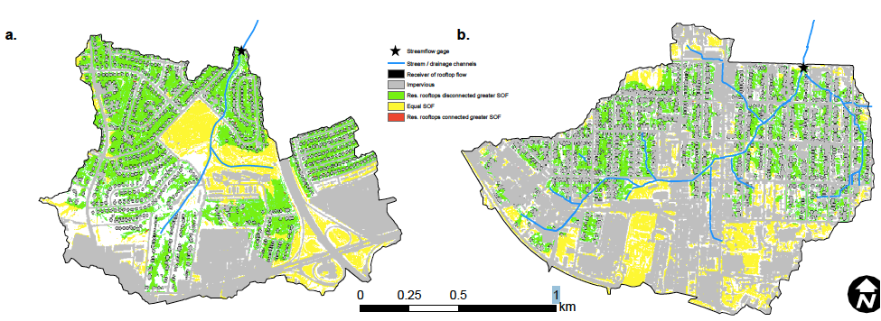
Ecohydrologic model tracks distribution of moisture stores and flowpaths with enhanced run-on infiltration: Green – increased saturation overland flow
Dead Run (Baltimore) shows significantly larger increase in saturation overland flow than S. Ellerbe Ck

Slide 34
Rooftop disconnection only: marginal decreases in peak flow, increases in baseflow
Needs to be coupled with soil/vegetation retrofit

Slide 35
Web service for rewiring urban drainage
Jeff Heard, UNC

Slide 36
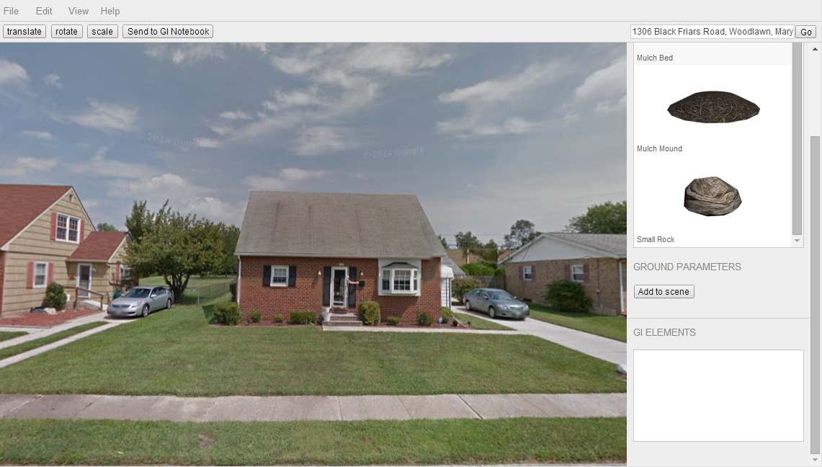
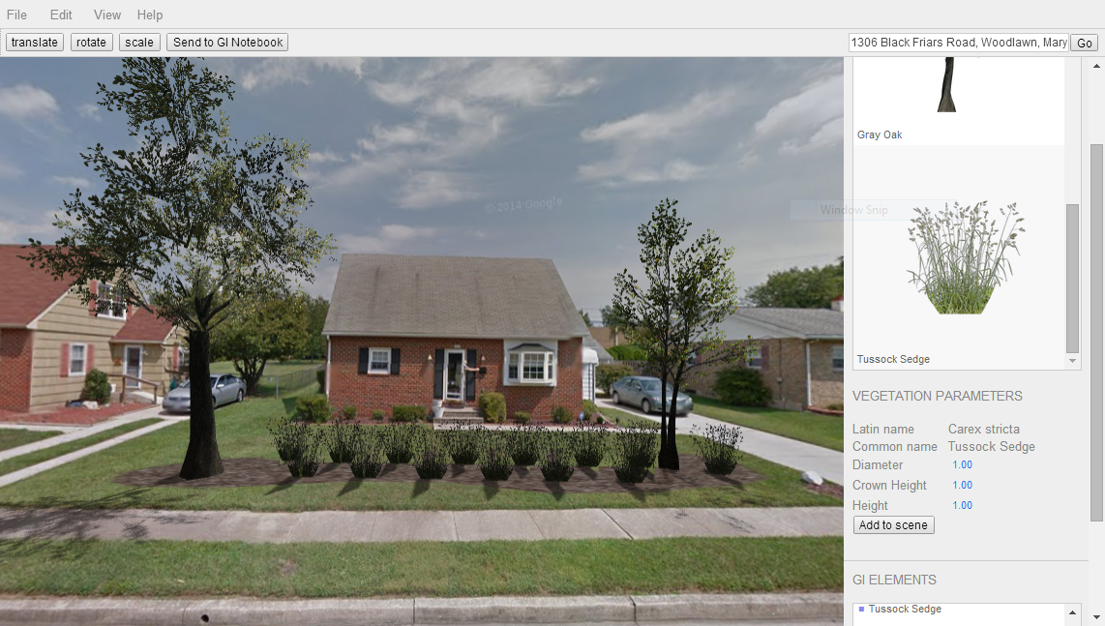
Interactive GI design to incorporate residential input and predict urban ecosystem outcomes
Residential Preference
Expected ecohydrology outcomes
GI parameters -> RHESSys models

Slide 37
Summary statements:
GI system design for urban restoration and development
  very initial phase
  Requires geohydrologic and social context
  Integrated GI networks, not independent elements
Ecohydrology models for urban stormwater and other ecosystem services (urban heat island, aesthetics, habitat)
  Coupled ecosystem dynamics
  spatially distributed surface water and groundwater
Developing sustainable and effective GI requires improved geoinformatics to advance models, facilitate implementation, incorporate community input into GI design;

Slide 38
Software availability – Brian Miles
https://github.com/selimnairb/EcohydroLib
https://github.com/selimnairb/RHESSysWorkflows
https://github.com/selimnairb/RHESSysCalibrator
https://github.com/RHESSys/RHESSys
http://grass.osgeo.org/grass64/manuals/addons/r.findtheriver.html

