Slide 1
Watershed and Stream Network Delineation
Exercise 4 Overview
Online Watershed Delineation and Data Retrieval
Hydrologic Terrain Analysis
Network Analysis

Slide 2
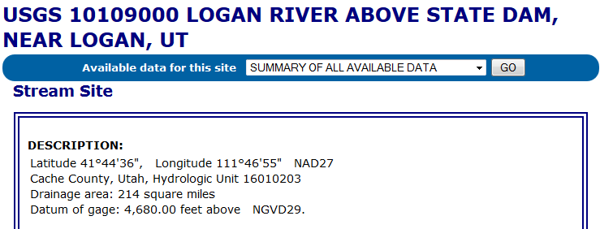
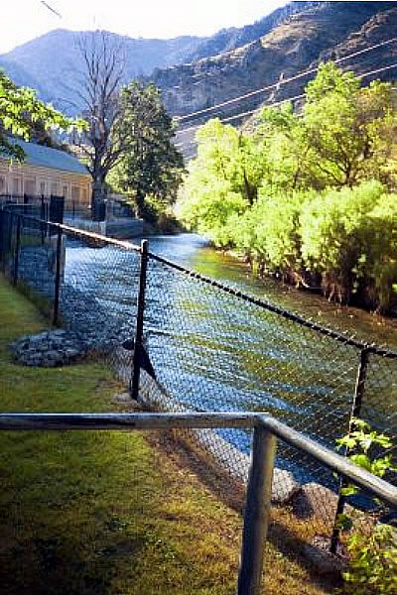
The Starting Point
http://waterdata.usgs.gov/nwis/inventory?agency_code=USGS&site_no=10109000

Slide 3
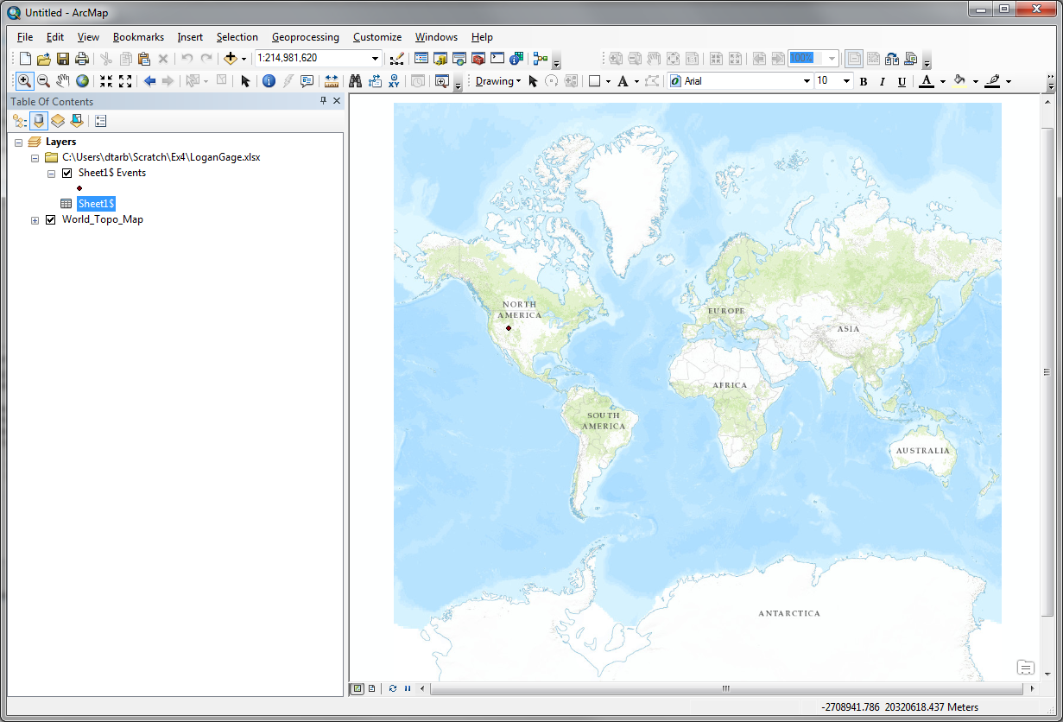
Locate on the Earth

Slide 4
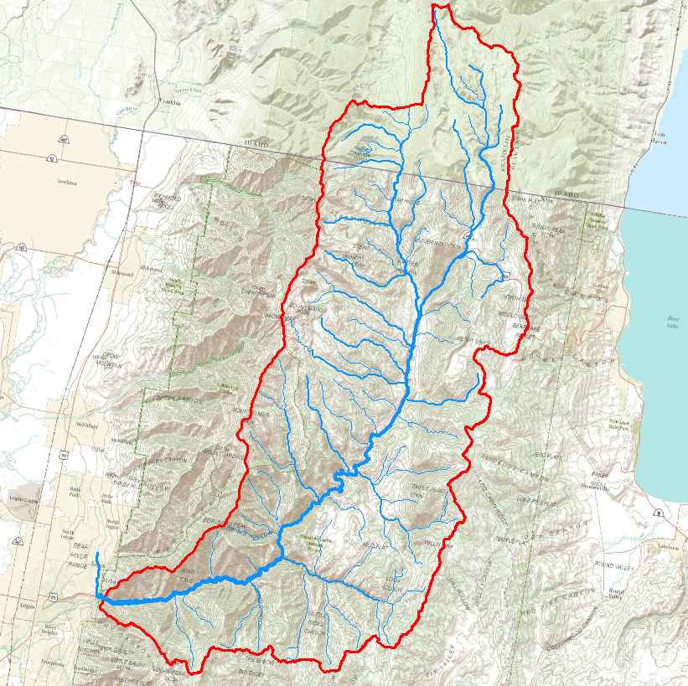
Map the Watershed
Using ArcGIS.com online services

Slide 5
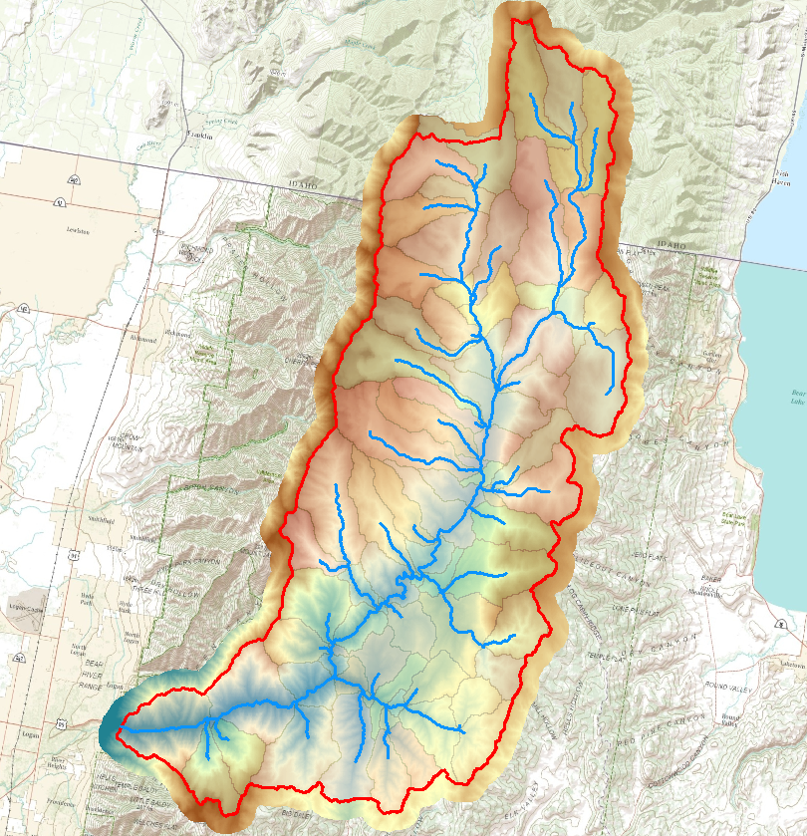
Retrieve DEM and do Hydrologic Terrain Analysis
Using Spatial Analyst Hydrology tools

Slide 6
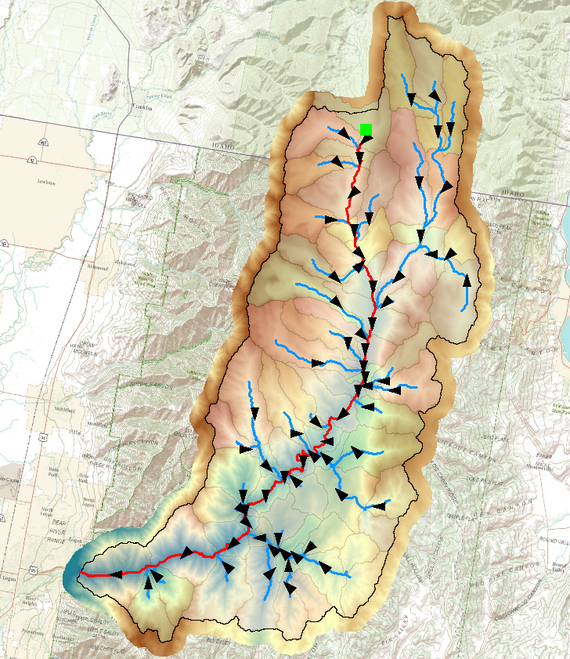
Network Analysis

