Slide 1
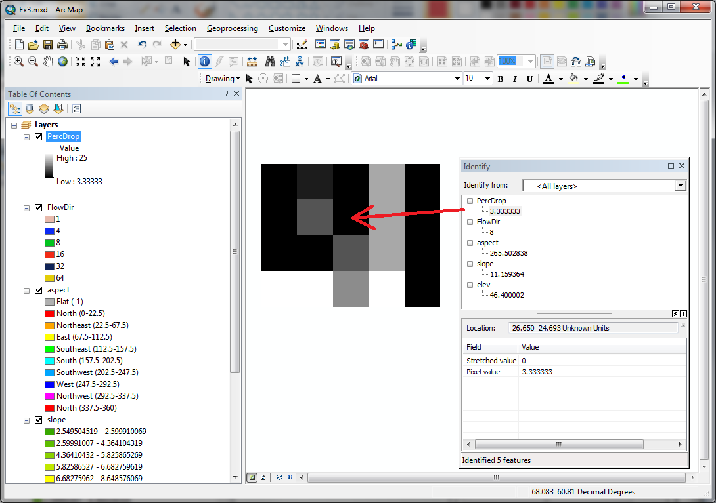
Bug in Flow Direction in Ex3 data
Grid cell size 10m
45.4 | 46.1 | 47 | 48.6 | 47.7
45 | 46.1 | 46.4 B | 47.9 | 47.4
45.1 | 45.8 | 46.8 A | 48.6 | 47.6
47.5 | 48 | 47.7 | 50.6 | 48.3
For D8 slope at B the percentage drop in direction 8 (indicated with arrow) should be
(46.4-45.8)/(SQRT(2)*10)=0.0424 = 4.24%
The fact that the ArcGIS function is reporting 3.33% is a bug
Important to know what is going on under the hood and check. As a software user you (not the manufacturer) are responsible for the results.

Slide 2
Confirmation
Nawajish Noman <nnoman@esri.com>
Hi Dave,
Thank you very much finding this bug for us. Yes you are right, our result is different. Source of the problem is not the formula. We are doing it the same way you are doing... but we implemented it differently to increase the efficiency - which led to some approximation.
I apologize for the inconvenience.
We are taking necessary steps to fix this problem. I will keep you posted.
Thanks
Noman

Slide 3
Term projects
Related to Land Use, Land Cover and Flooding (Ditmore, Gaffey, Kirkwood, Yaniero)
SWAT Hydrologic Modeling (Gold)
Natural Flows (Lutton)
Mortality of trees related to wetness (Jones)
Watershed restoration prioritization (Lovette)
Landslides (Martin)
Foodshed (Stanton)

Slide 4
Enhanced Terrain Analysis Using TauDEM
Learning Objectives
Describe some of the enhanced terrain analysis functionality provided by TauDEM
Encourage the use of TauDEM in term projects where appropriate
Motivate the need for GIS based programming

Slide 5
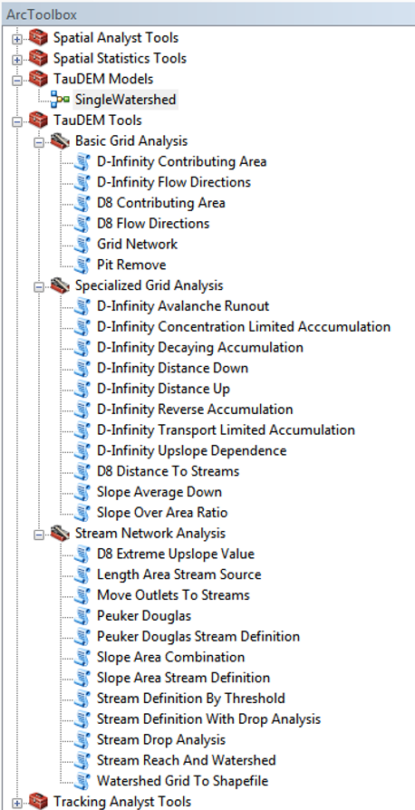


TauDEM
Stream and watershed delineation
Multiple flow direction flow field
Calculation of flow based derivative surfaces
MPI Parallel Implementation for speed up and large problems
Open source platform independent C++ command line executables for each function
Deployed as an ArcGIS Toolbox with python scripts that drive command line executables
http://hydrology.usu.edu/taudem/

Slide 6
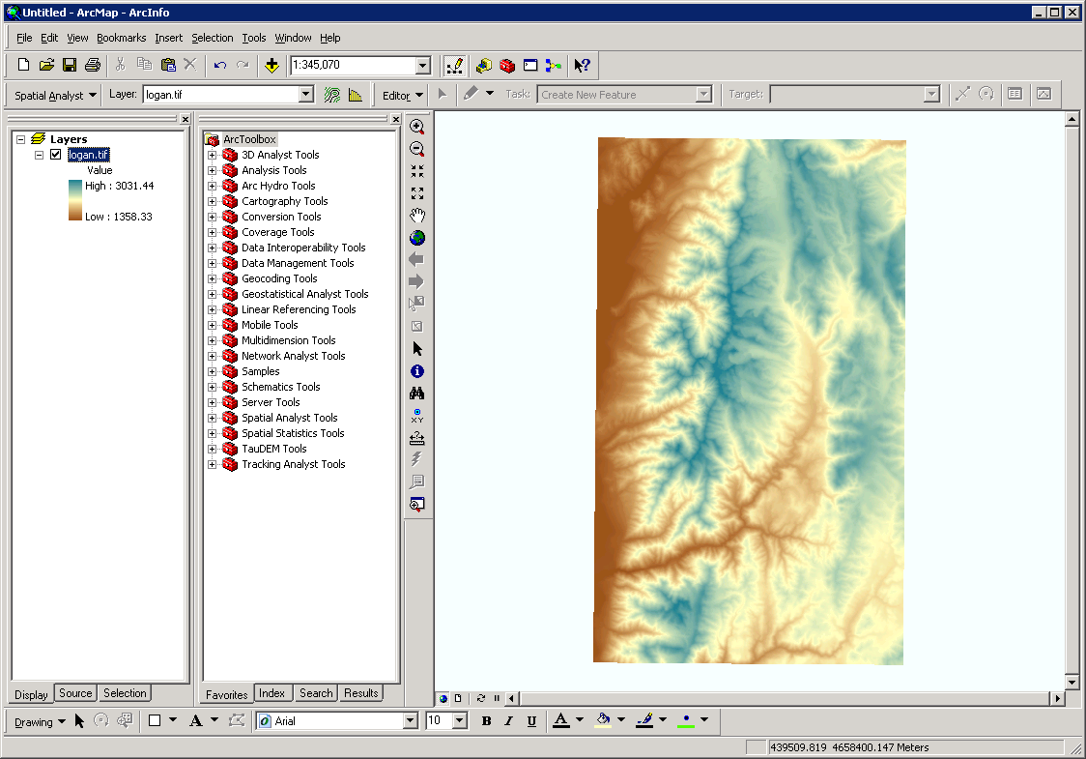
ArcMap

Slide 7
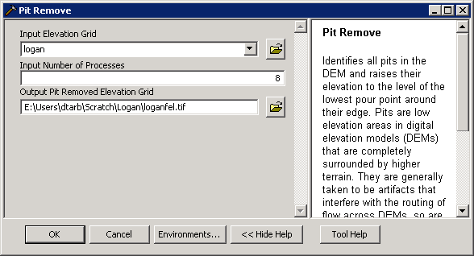
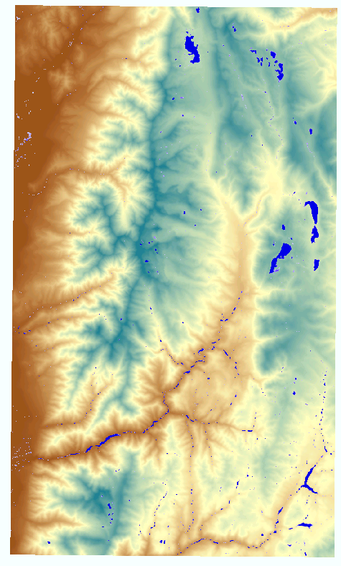
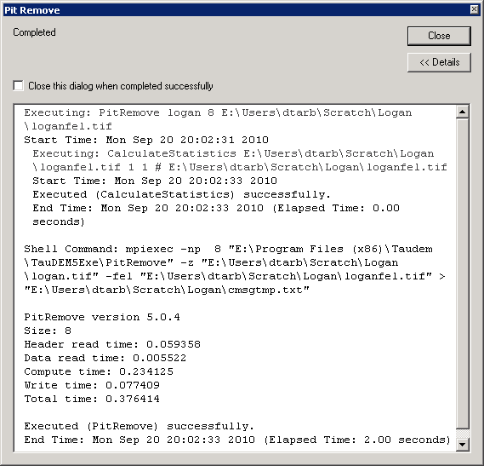
Pit Remove

Slide 8
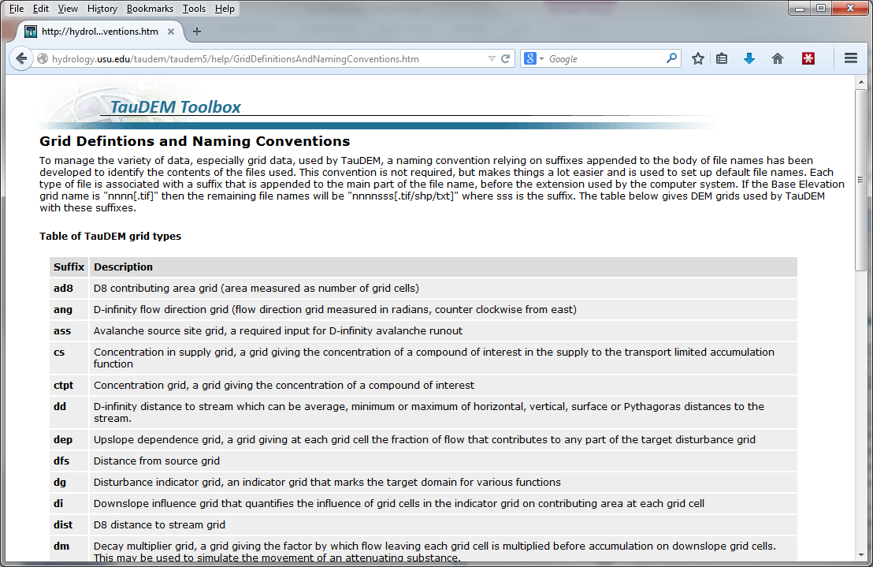
Default file name suffixes
For complete list see: http://hydrology.usu.edu/taudem/taudem5/help/GridDefinitionsAndNamingConventions.htm

Slide 9
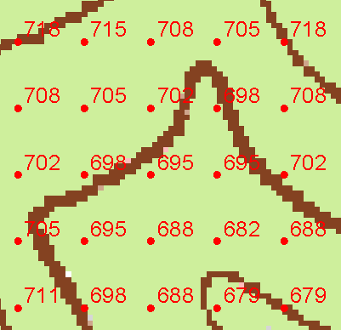
TauDEM Grid Data Format Assumptions
Input and output grids are uncompressed GeoTIFF
Maximum size 4 GB (~32,000 x 32,000 rows and cols for single file version)
For larger areas use multifile version
GDAL Nodata tag preferred (if not present, a missing value is assumed)
Grids are square (Δx= Δy)
Grids have identical extents, cell size and spatial reference
Spatial reference information is not used (no projection on the fly)

Slide 10
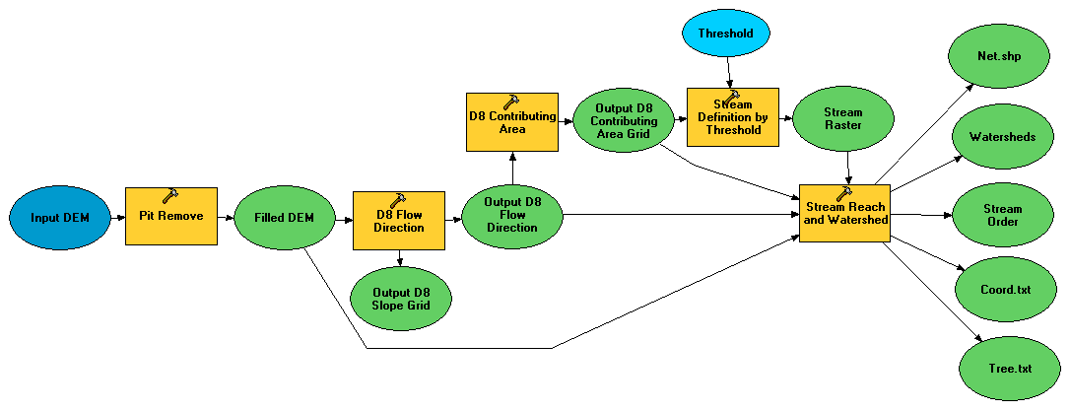
Illustrative Use Case: Delineation of channels and watersheds using a constant support area threshold
Steps
Pit Remove
D8 Flow Directions
D8 Contributing Area
Stream Definition by Threshold
Stream Reach and Watershed

Slide 11
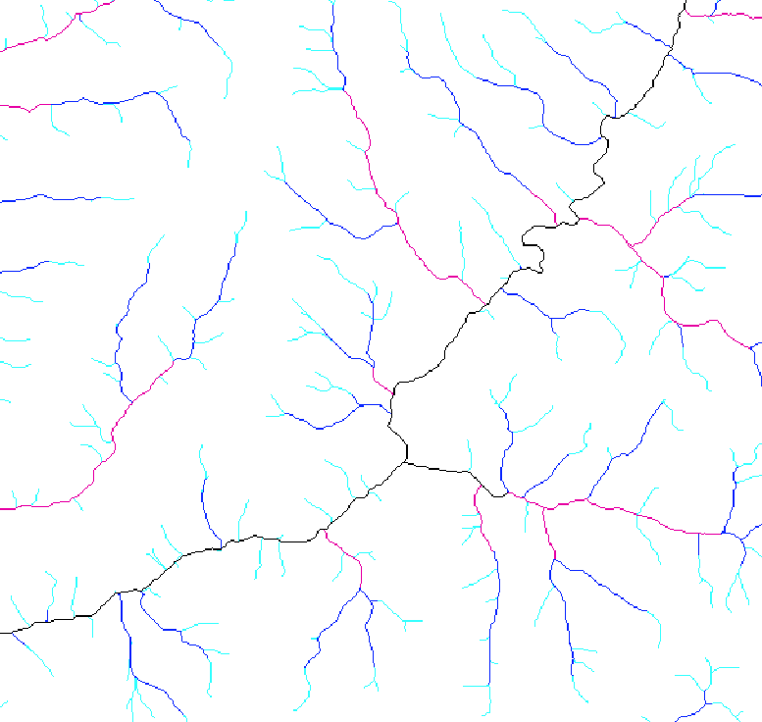
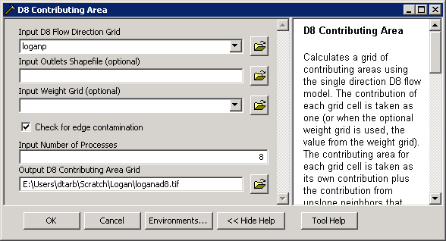
D8 Contributing Area

Slide 12

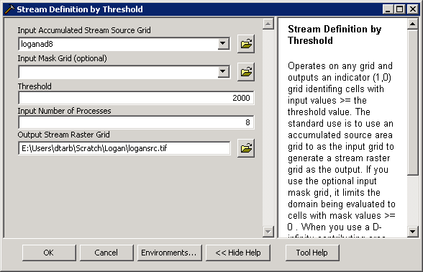
Stream Definition by Threshold

Slide 13
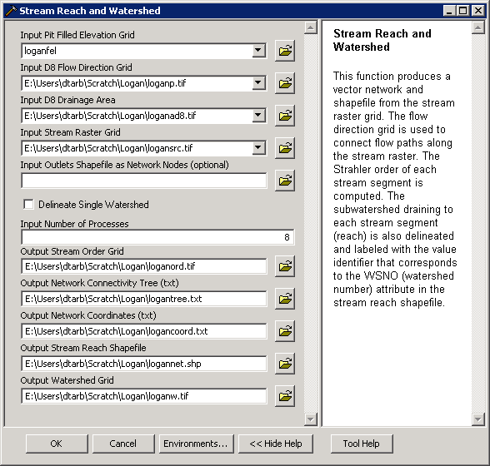
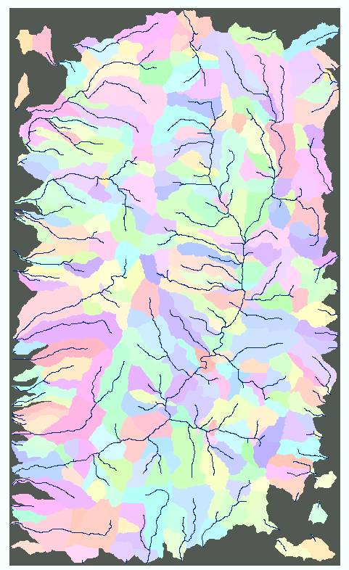
Stream Reach and Watershed

Slide 14
D8 Flow Direction Model
- Direction of steepest descent
30
80
74
63
4
3
2
69
67
56
5
1
60
52
48
6
7
8
Slope = Drop/Distance
Steepest down slope direction

Slide 15
Contributing Area (Flow Accumulation)
1
1
1
1
1
1
1
1
1
1
1
3
3
3
1
1
3
3
3
1
1
1
11
1
2
1
1
1
2
11
2
1
1
15
1
2
1
1
1
15
1
5
2
20
2
1
5
2
2
20
The area draining each grid cell includes the grid cell itself.

Slide 16
Stream Definition
Flow Accumulation
> 10 Cell Threshold
Stream Network for 10 cell Threshold Drainage Area
1
1
1
1
1
1
1
1
1
1
1
3
3
3
1
1
3
3
3
1
1
1
11
1
2
1
1
2
1
11
2
1
1
15
1
2
1
1
1
15
1
5
2
20
2
1
5
2
2
20

Slide 17
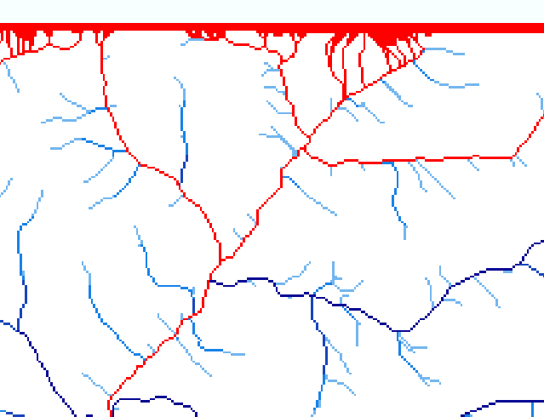
Edge contamination
Edge contamination arises due to the possibility that a contributing area value may be underestimated due to grid cells outside of the domain not being counted. This occurs when drainage is inwards from the boundaries or areas with no data values. The algorithm recognizes this and reports "no data" resulting in streaks of "no data" values extending inwards from boundaries along flow paths that enter the domain at a boundary.

Slide 18
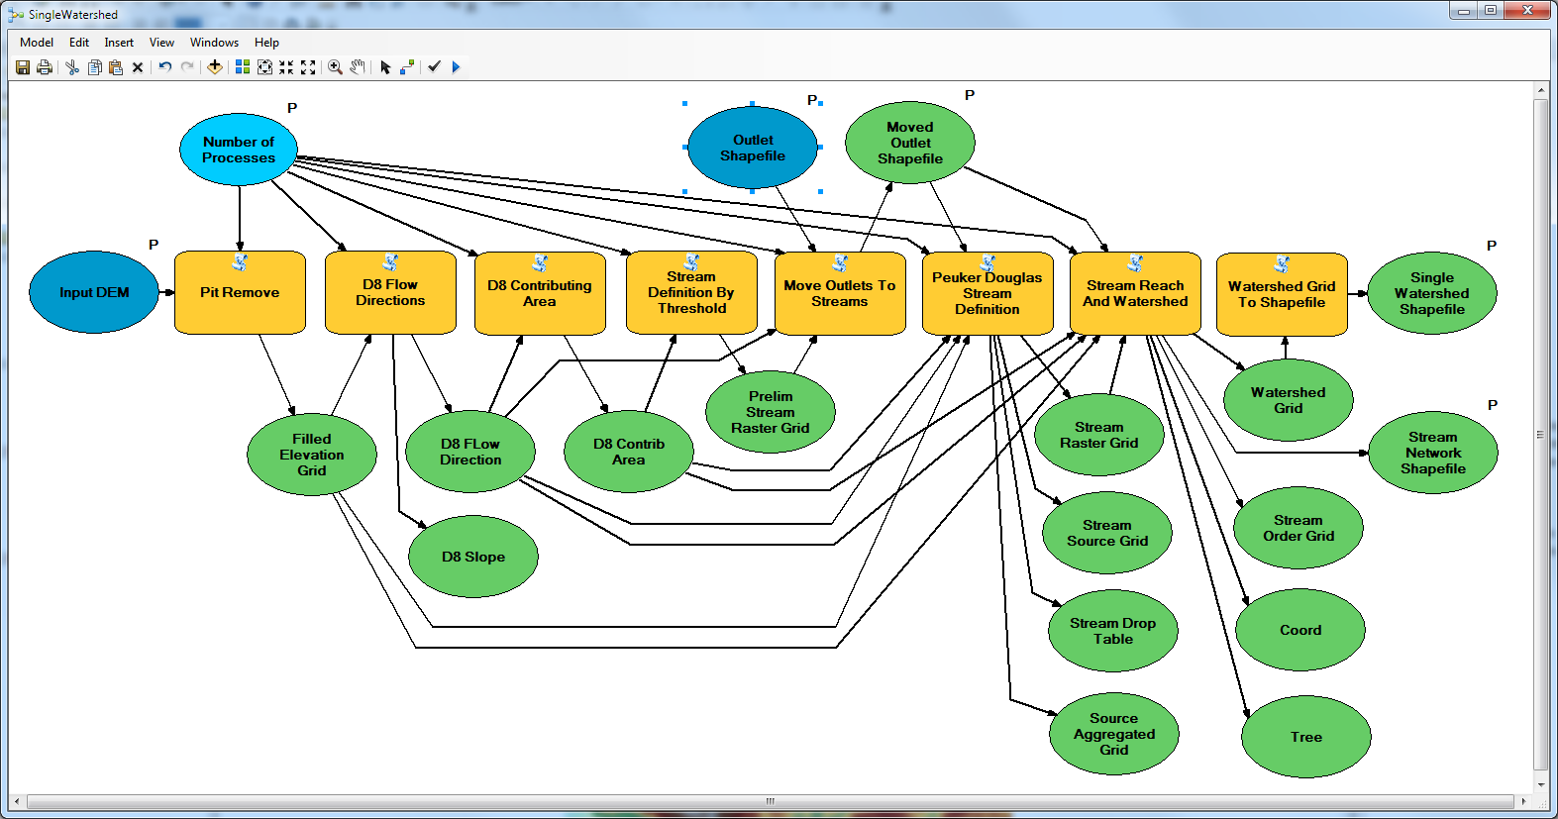
Peuker Douglas Watershed Delineation using TauDEM tools

Slide 19
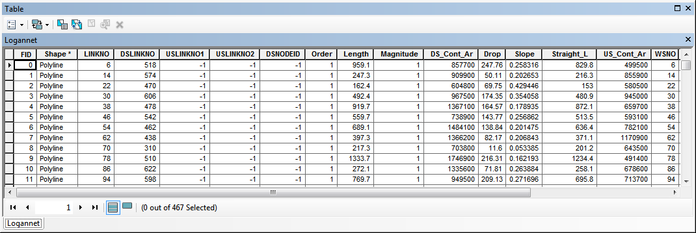
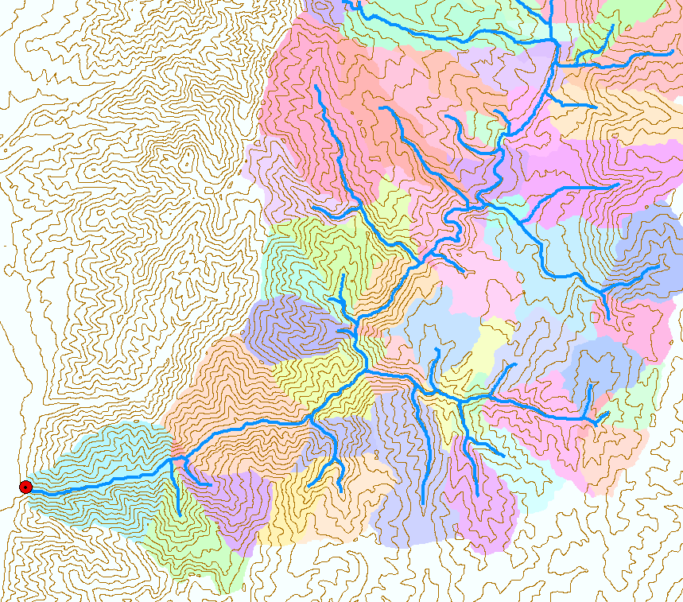
Catchments linked to Stream Network

Slide 20
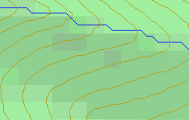
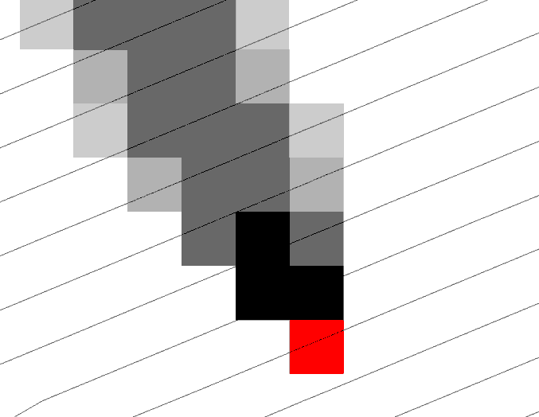
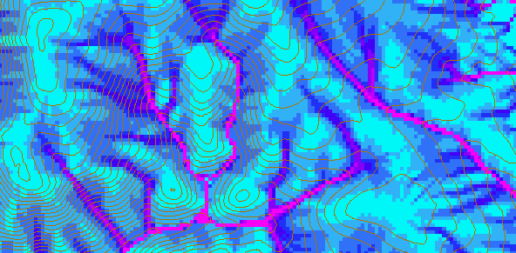
D-Infinity Contributing Area
D8
D∞
Tarboton, D. G., (1997), "A New Method for the Determination of Flow Directions and Contributing Areas in Grid Digital Elevation Models," Water Resources Research, 33(2): 309-319.)
Notes:
This slide shows how the terrain flow field is represented. Early DEM work used a single flow direction model, D8. In 1997 I published the Dinfinity method that proportions flow from each grid cell among downslope neighbors. This, at the expense of some dispersion, allows a better approximation of flow across surfaces.

Slide 21
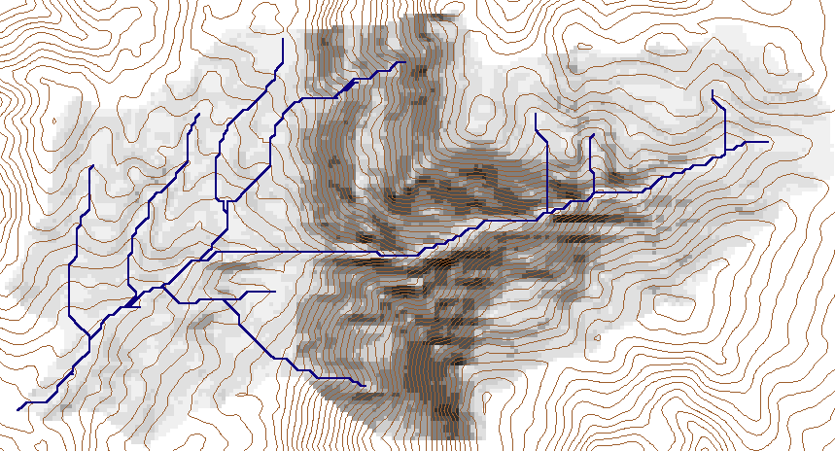
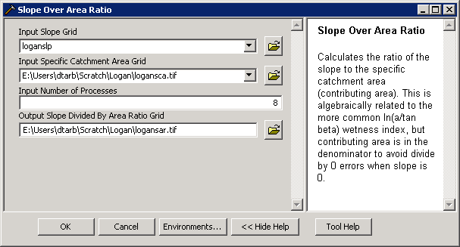
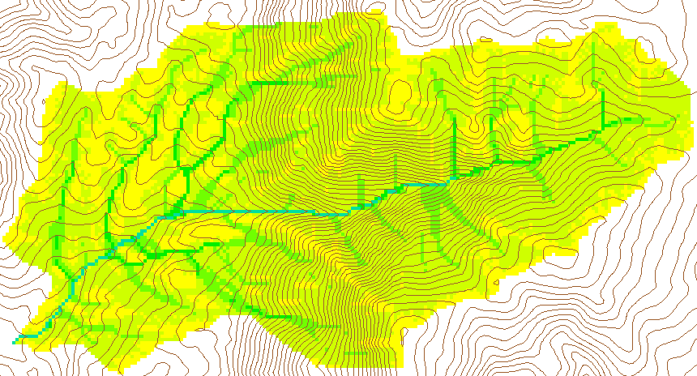
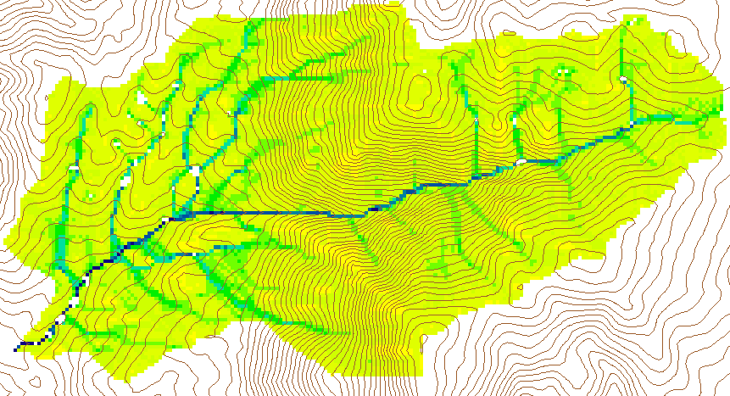
Wetness Index
Slope (S)
Specific Catchment Area (a)
Wetness Index ln(a/S)

Slide 22
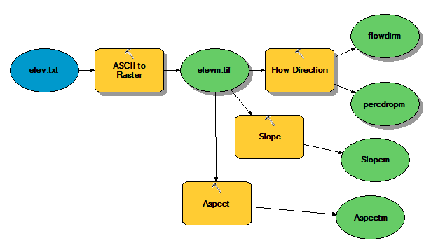
Why Programming
Automation of repetitive tasks (workflows)
Implementation of functionality not available (programming new behavior)

Slide 23
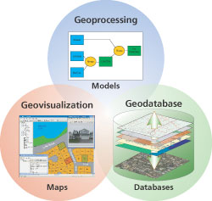
Three Views of GIS
Geodatabase view: Structured data sets that represent geographic information in terms of a generic GIS data model.
Geovisualization view: A GIS is a set of intelligent maps and other views that shows features and feature relationships on the earth's surface. "Windows into the database" to support queries, analysis, and editing of the information.
Geoprocessing view: Information transformation tools that derive new geographic data sets from existing data sets.
adapted from www.esri.com

Slide 24
ArcGIS programming entry points
Model builder
Python scripting environment
ArcObjects library (for system language like C++, .Net)
Open standard data formats that anyone can use in programs (e.g. shapefiles, geoTIFF, netCDF)

Slide 25
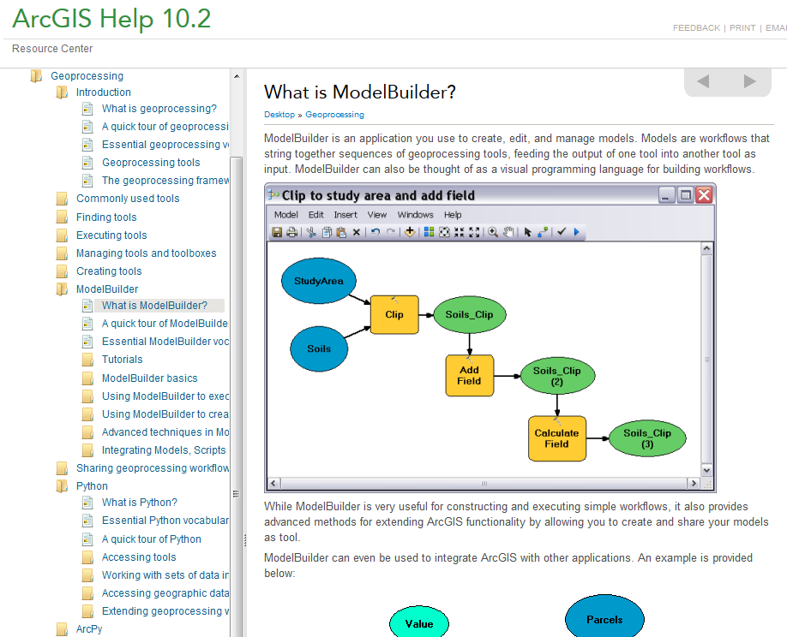
http://resources.arcgis.com/en/help/main/10.2/#/What_is_ModelBuilder/002w00000001000000/

Slide 26
Generalization to Flow Algebra
Replace
P_{ki}
P_{ki}
P_{ki}
i
by general function

Slide 27
Example: Retention limited runoff generation with run-on
Global P, (r,c), q FlowAlgebra(i) for all k neighbors of i if P_{ki}>0 FlowAlgebra(k) next k return
q_{k}
r
q_{i}
c

Slide 28
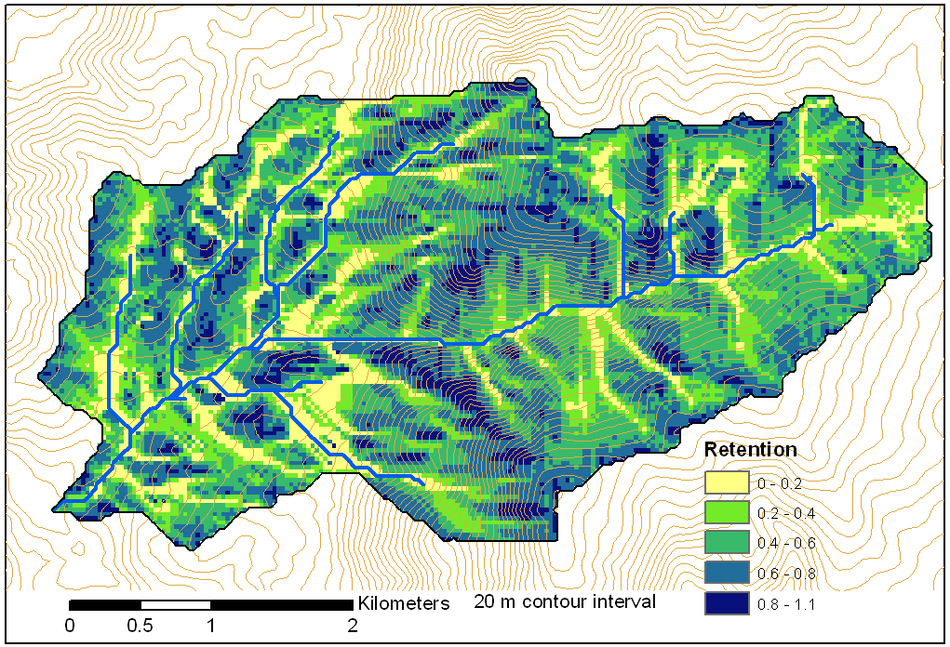
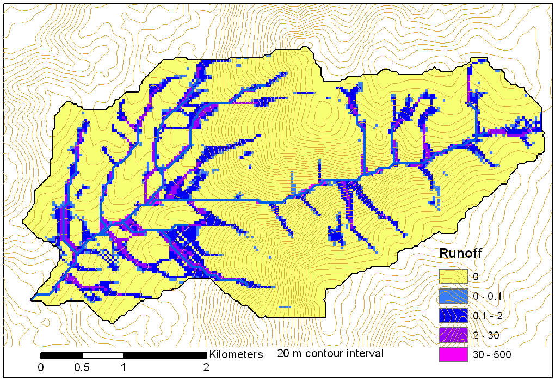
Retention limited runoff with run-on
Retention Capacity
A
C
r=5
c=6
q_{in}=1.8
q=0.8
r=7
c=4
q=3
0.6
1
Runoff from uniform input of 0.25
r=4
c=6
q=0
0.4
r=4
c=5
q_{in}=2
q=1
1
B
D
Notes:
Figure 2 illustrates the evaluation of infiltration capacity limited runoff generation with run on according to (5). Inputs are the r and c values indicated, with the proportional flow directions indicated by the arrows. Grid cells A and B on the left have no dependencies so may be immediately evaluated and using min(r-c,0) result in q=3 and 0 for grid cells A and B respectively. With these evaluated, the unevaluated dependencies of grid cell C become 0, so equation (5) can be evaluated for grid cell C. The inflow is q_{in}=0.6 x 3 = 1.8 from grid cell B. Then q=min(5-6+1.8,0)=0.8. Now all dependencies of D have been evaluated. Inflows from cells A, B, and C, accounting for the proportions are 3 x 0.4 + 0.8 = 2, so the runoff from D is q=min(4-5+2,0)=2.

Slide 29
General Pseudocode Downstream Flow Algebra Evaluation
Global P, γ, θ FlowAlgebra(i) for all k neighbors of i if P_{ik}>0 FlowAlgebra(k) next k θ_{i} = FA(γ_{i}, P_{ik}, θ_{k}, γ_{k}) return
P_{ki}

Slide 30
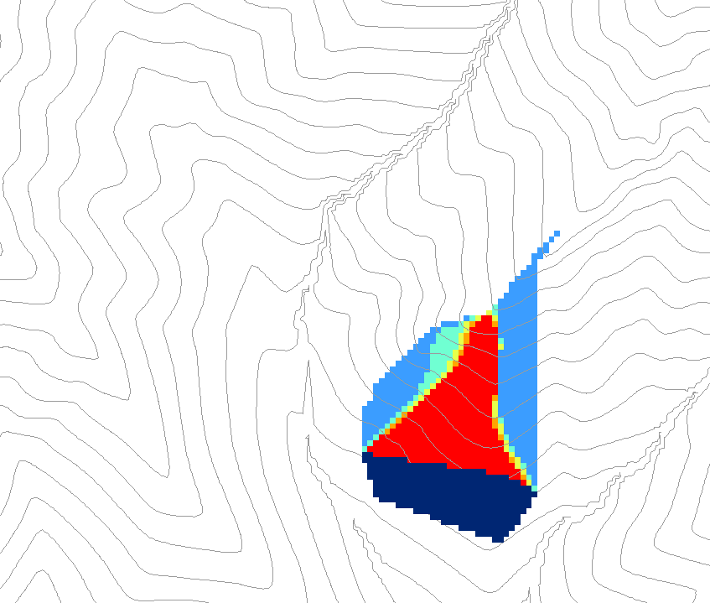
0.6
0
0
0.3
0.3
0
0
0.6
0
0
1
0
0
1
0
Grid cells y
Dependence function of grid cells y
Useful for example to track where a contaminant may come from

Slide 31
Weighted distance to target set
0
0
0
0
0
30*0.5/2
7.5
30
7.5+42.4*
(0.7+0.5)/2
32.9
38.2
38.2
38.2
38.2
38.2
To quantify effectiveness of riparian zone sediment capture based on buffer potential

Slide 32
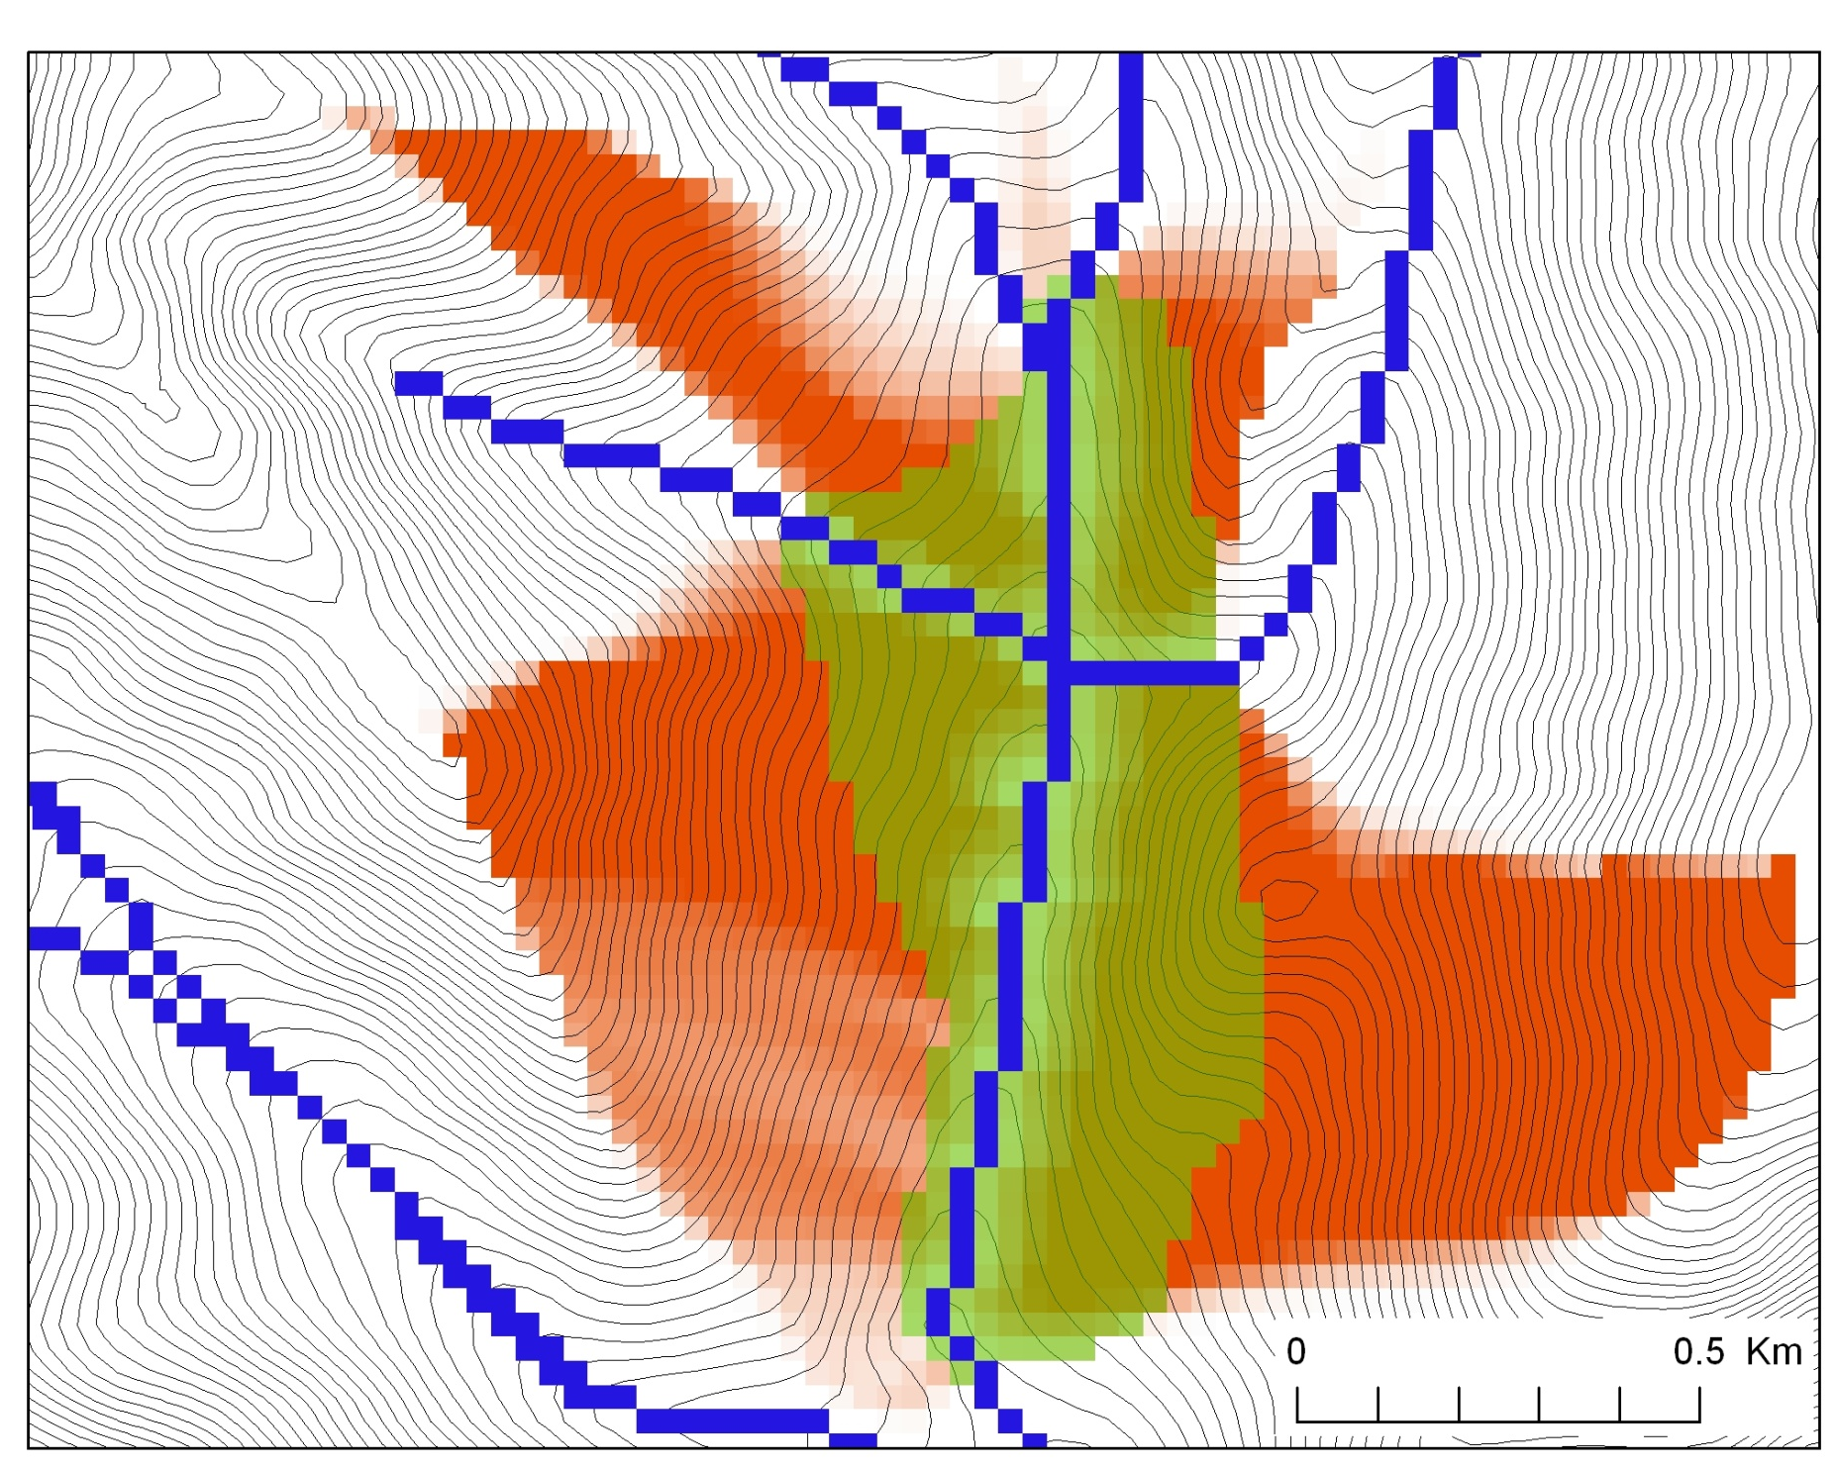
Buffer potential weighted distance to stream

Slide 33
Distance Down and Distance Up
Ridge
Ridge
sr
sr
pr
pr
vr
Point of interest
vr
Point of interest
Stream
Stream
ps
ps
vs
ss
vs
ss
hr
hs
hr
hs
Types of distance measurements possible in distance down and distance up functions.

Slide 34
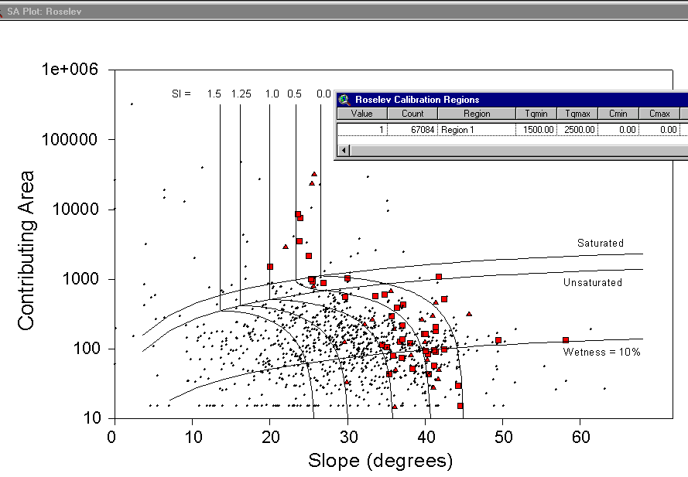
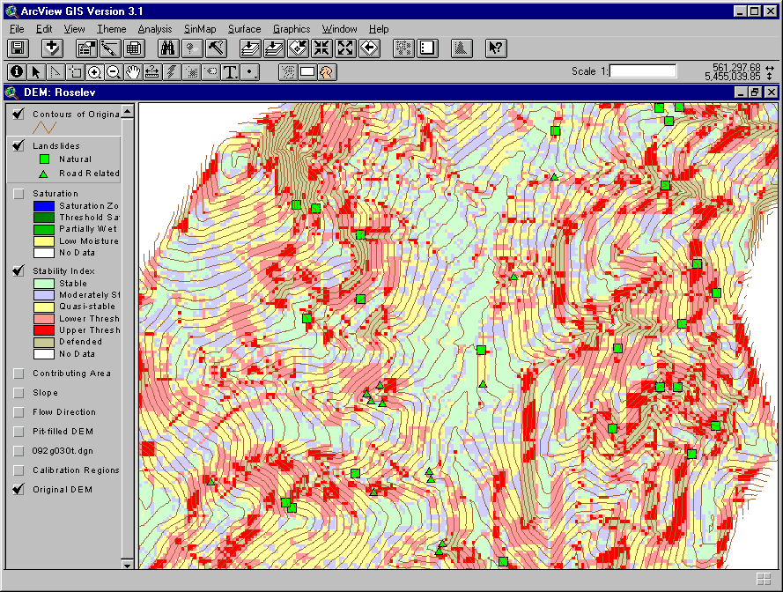
Terrain Stability Mapping
With Bob Pack. http://www.engineering.usu.edu/dtarb/sinmap.htm

Slide 35
SINMAP Theoretical Basis
Infinite Plane Slope Stability Model
h
D
D_{w}
FS=Factor of Safety
D
R
= DEM source
θ = slope
where
Relative Wetness
Density Ratio
Dimensionless Cohesion

Slide 36
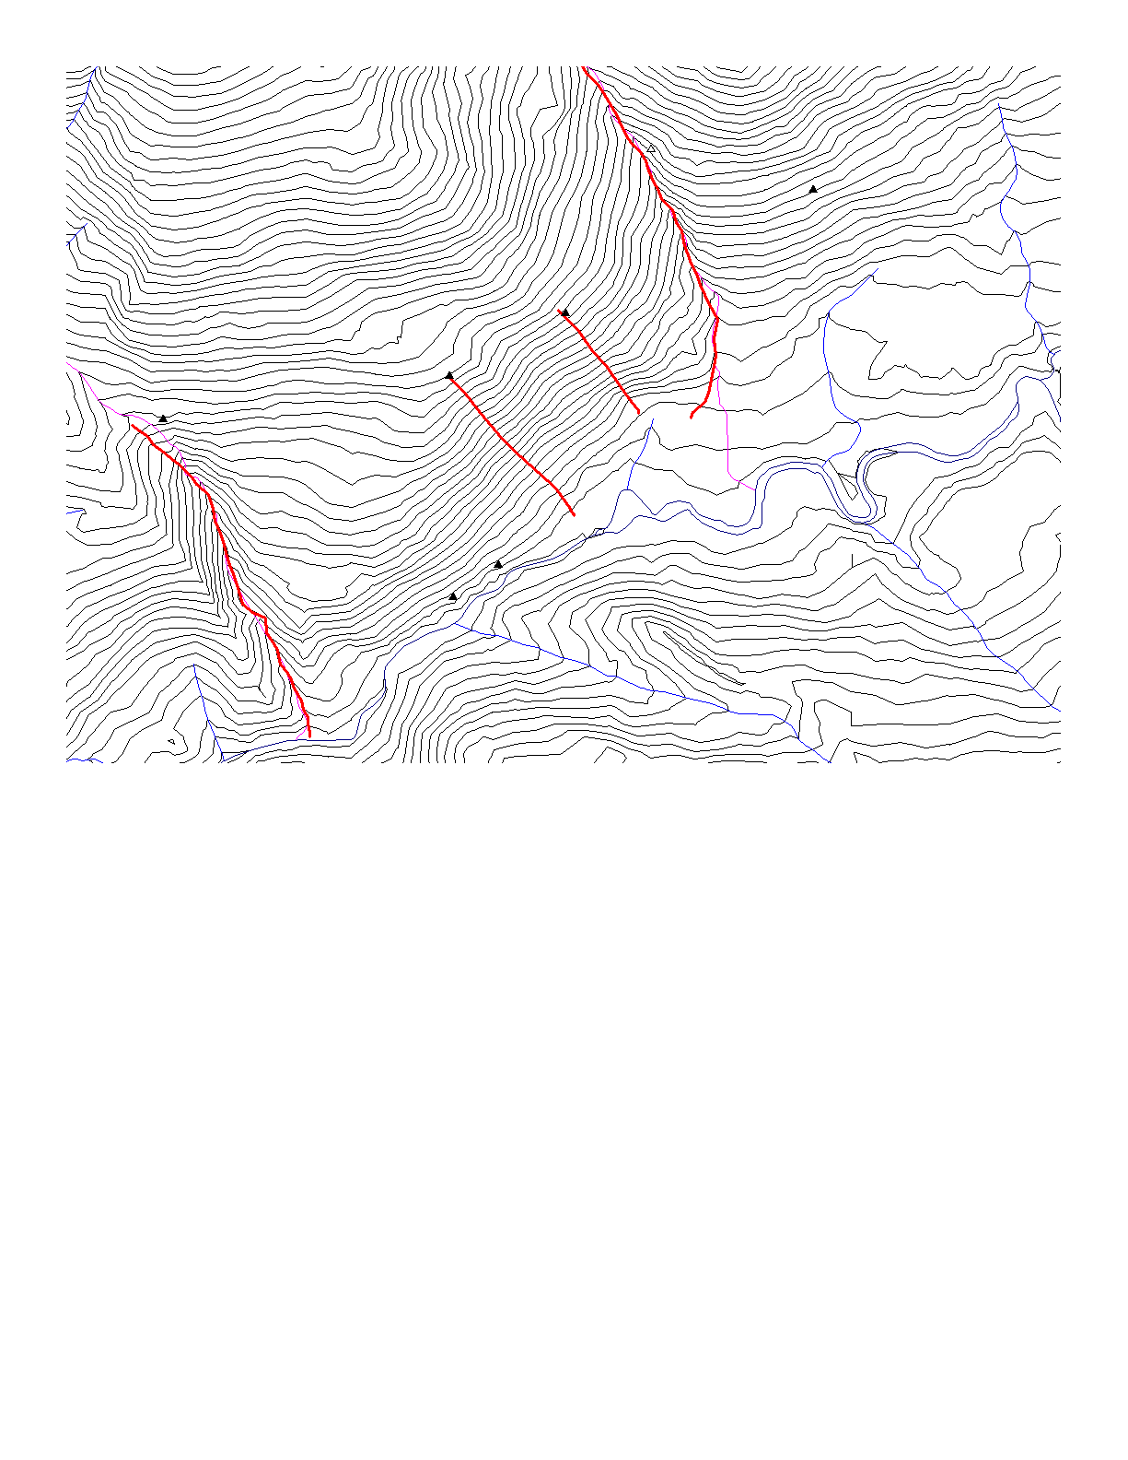
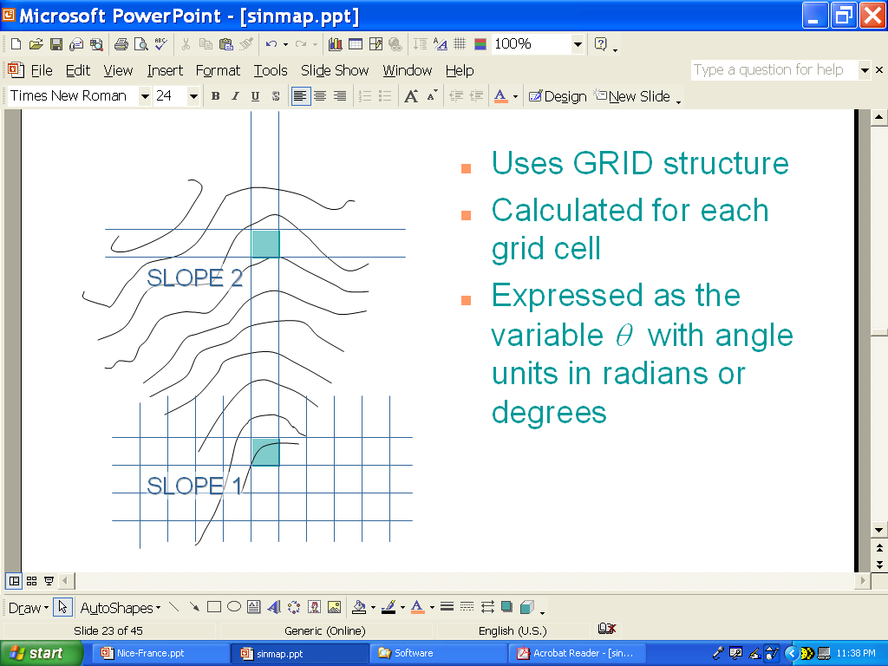
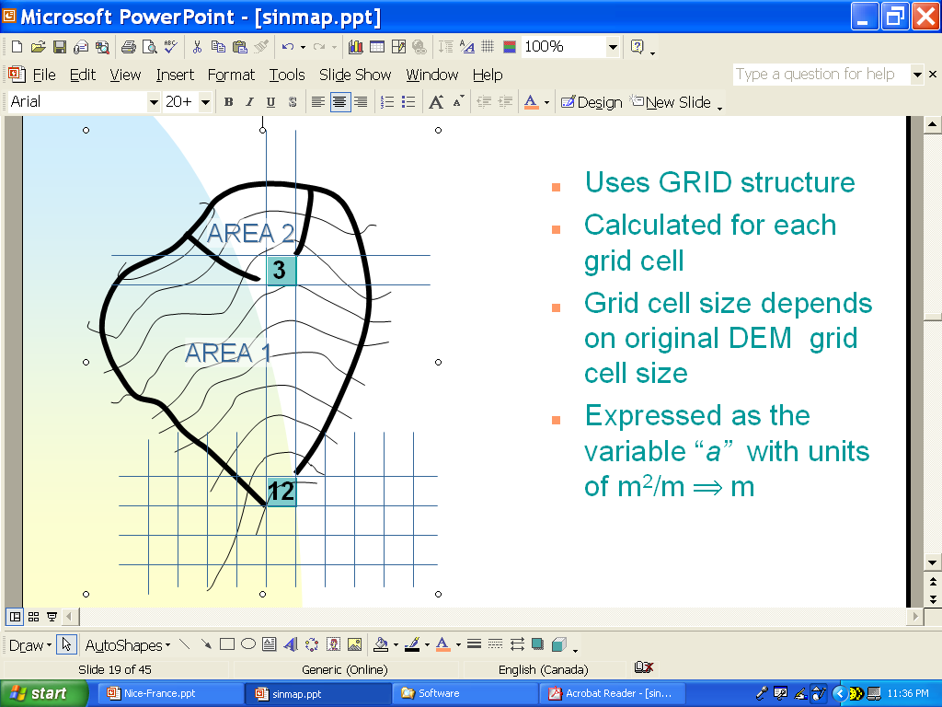
DEM Governs Slope & Flow Accumulation
Digital Terrain Model (DTM)
DTM Quality
Slope (θ)
Flow Accumulation (a)

Slide 37
Probabilistic Formulation
Shear Strength
Slope
Flow Accumulation
Wetness
MODEL
SI=FS &
P(FS>1)
Soil/Root Cohesion

Slide 38
Stability Class Definitions
1.0

Slide 39
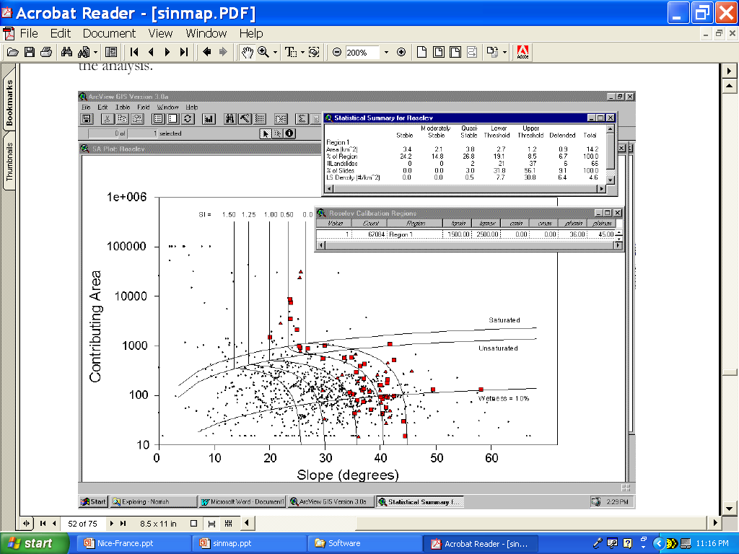
Interactive Calibration
Selection of ranges of Φ, R/T & c moves position of stability class breaks
Selection of range of R/T moves position of wetness class breaks

Slide 40
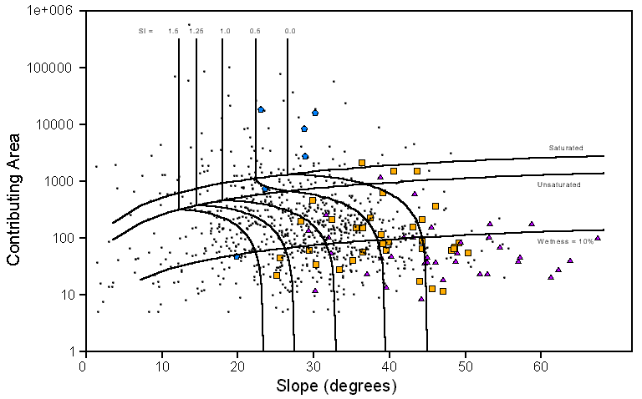
Example Result – Foster Ck
DRAINAGE AREA UPSLOPE
STABLE
UNSTABLE
SATURATED
UNSATURATED
Class 1
2
3
4
5
6
SLOPE

Slide 41
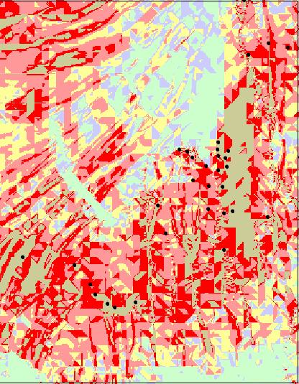
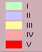
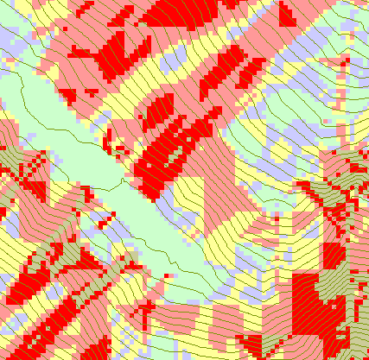
Foster Creek SI Map

Slide 42
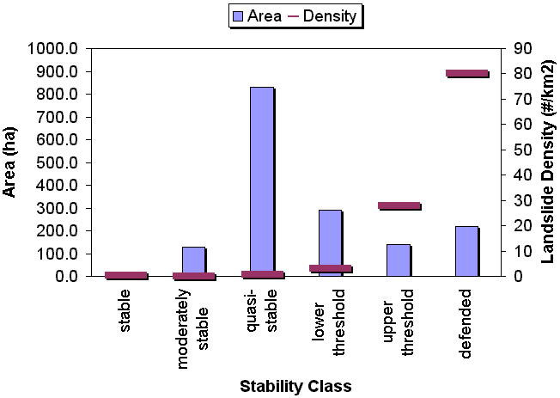
LANDSLIDE DENSITIES & AREAS FOR SI CLASSES

Slide 43
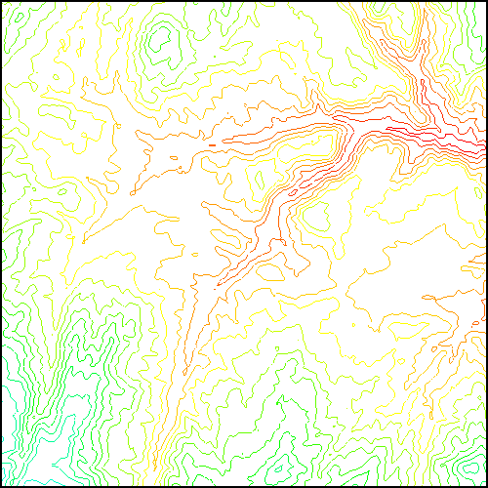
Parallelization of Flow Algebra
1. Dependency grid
2. Flow algebra function
Executed by every process with grid flow field P, grid dependencies D initialized to 0 and an empty queue Q. FindDependencies(P,Q,D) for all i for all k neighbors of i if P_{ki}>0 D(i)=D(i)+1 if D(i)=0 add i to Q next
Executed by every process with D and Q initialized from FindDependencies. FlowAlgebra(P,Q,D,θ,γ) while Q isn’t empty get i from Q θ_{i} = FA(γ_{i}, P_{ki}, θ_{k}, γ_{k}) for each downslope neighbor n of i if P_{in}>0 D(n)=D(n)-1 if D(n)=0 add n to Q next n end while swap process buffers and repeat

Slide 44
Programming
C++ Command Line Executables that use MPI
ArcGIS Python Script Tools
Python validation code to provide file name defaults
Shared as ArcGIS Toolbox

Slide 45
Q based block of code to evaluate any “flow algebra expression”
while(!que.empty())
{
//Takes next node with no contributing neighbors
temp = que.front(); que.pop();
i = temp.x; j = temp.y;
// FLOW ALGEBRA EXPRESSION EVALUATION
if(flowData->isInPartition(i,j)){
float areares=0.; // initialize the result
for(k=1; k<=8; k++) { // For each neighbor
in = i+d1[k]; jn = j+d2[k]; flowData->getData(in,jn, angle);
p = prop(angle, (k+4)%8);
if(p>0.){
if(areadinf->isNodata(in,jn))con=true;
else{
areares=areares+p*areadinf->getData(in,jn,tempFloat);
}
}
}
}
// Local inputs
areares=areares+dx;
if(con && contcheck==1)
areadinf->setToNodata(i,j);
else
areadinf->setData(i,j,areares);
// END FLOW ALGEBRA EXPRESSION EVALUATION
}
C++

Slide 46
Maintaining to do Q and partition sharing
C++
while(!finished) { //Loop within partition
while(!que.empty())
{ .... // FLOW ALGEBRA EXPRESSION EVALUATION
}
// Decrement neighbor dependence of downslope cell
flowData->getData(i, j, angle);
for(k=1; k<=8; k++) {
p = prop(angle, k);
if(p>0.0) {
in = i+d1[k]; jn = j+d2[k];
//Decrement the number of contributing neighbors in neighbor
neighbor->addToData(in,jn,(short)-1);
//Check if neighbor needs to be added to que
if(flowData->isInPartition(in,jn) && neighbor->getData(in, jn, tempShort) == 0 ){
temp.x=in; temp.y=jn;
que.push(temp);
}
}
}
}
//Pass information across partitions
areadinf->share();
neighbor->addBorders();

Slide 47
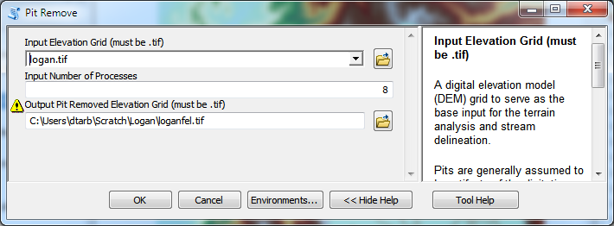
Python Script to Call Command Line
mpiexec –n 8 pitremove –z Logan.tif –fel Loganfel.tif

Slide 48
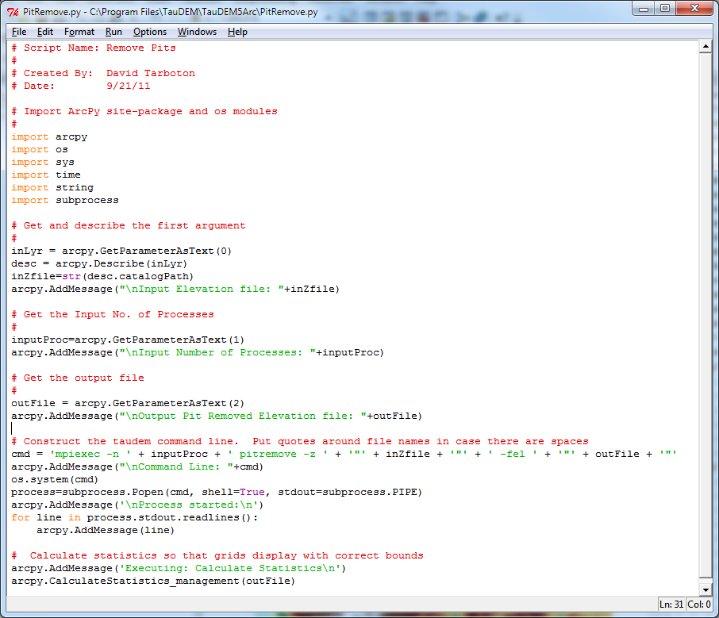
PitRemove
Python

Slide 49
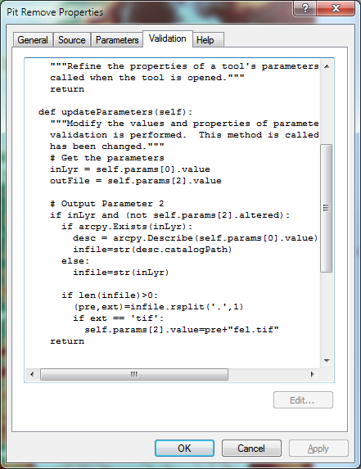
Validation code to add default file names
Python

Slide 50
Terrain Analysis Using Digital Elevation Models (TauDEM)
Readings
Tarboton, D. G., R. L. Bras and I. Rodriguez-Iturbe, (1991), "On the Extraction of Channel Networks from Digital Elevation Data," Hydrologic Processes, 5(1): 81-100. http://www.neng.usu.edu/cee/faculty/dtarb/hp91.pdf
Tarboton, D. G., (1997), "A New Method for the Determination of Flow Directions and Contributing Areas in Grid Digital Elevation Models," Water Resources Research, 33(2): 309-319. http://www.neng.usu.edu/cee/faculty/dtarb/96wr03137.pdf
Tarboton, D. G., K. A. T. Schreuders, D. W. Watson and M. E. Baker, (2009), "Generalized terrain-based flow analysis of digital elevation models," 18th World IMACS Congress and MODSIM09 International Congress on Modelling and Simulation, ed. R. S. Anderssen, R. D. Braddock and L. T. H. Newham, Modelling and Simulation Society of Australia and New Zealand and International Association for Mathematics and Computers in Simulation, July 2009, p.2000-2006, http://www.mssanz.org.au/modsim09/F4/tarboton_F4.pdf.

