Slide 1
Terrain Analysis Using Digital Elevation Models
David Tarboton
Utah State University
dtarb@usu.edu
http://hydrology.usu.edu/taudem

Slide 2
Outline
TauDEM software
D-Infinity flow model
Generalized flow accumulation (Flow algebra)
Parallel algorithms
Programming

Slide 3
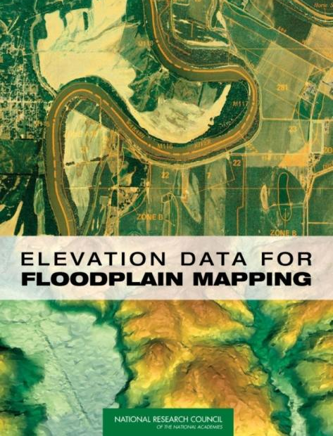
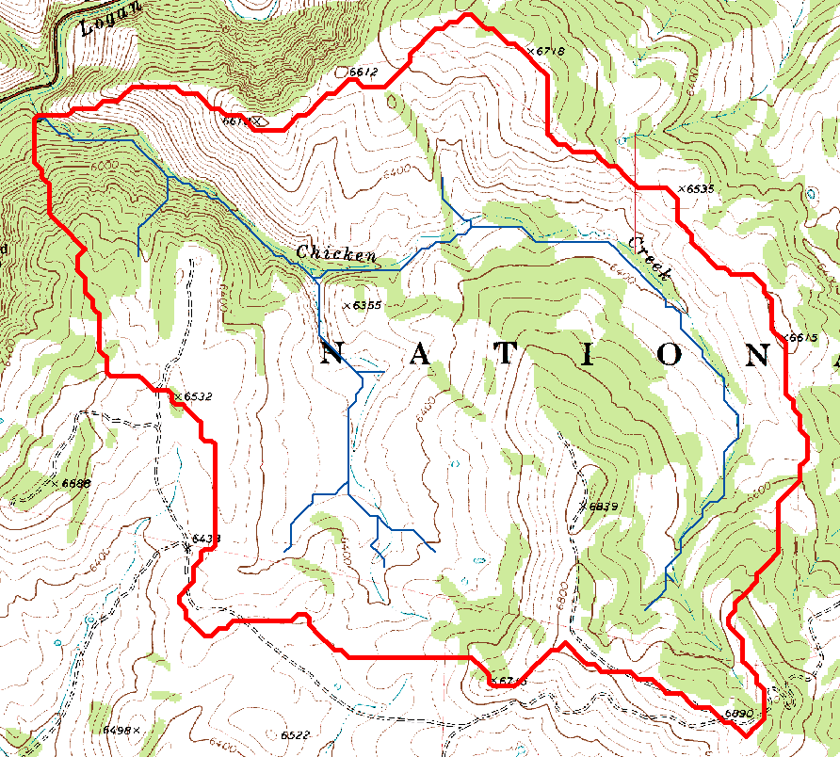
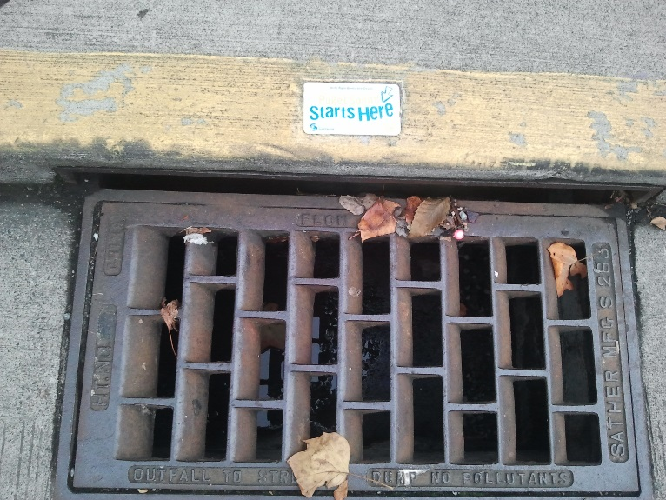

Topography defines watersheds which are fundamentally the most basic hydrologic landscape elements.
http://www.nap.edu/catalog/11829.html
www.hiwaysafety.com
Notes:
Topography defines watersheds which are the most basic hydrologic landscape elements
Almost all hydrologic research requires information about "the watershed". Knowing what is in a watershed, what its attributes are, what is upstream and what is downstream are fundamental to understanding and protecting our water resources
FEMA and other federal and state agencies are spending millions on improved flood plain mapping based on DEMs

Slide 4




Deriving Hydrologically Useful Information from Digital Elevation Models
Raw DEM
Pit Removal
Flow Field
Flow Related Terrain Information

Slide 5
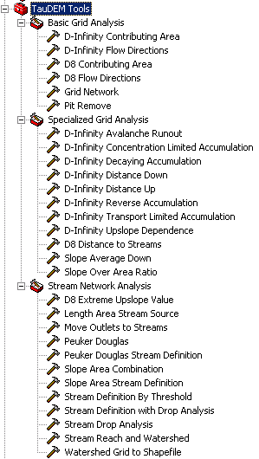

TauDEM Software
Stream and watershed delineation
Multiple flow direction flow field
Calculation of flow based derivative surfaces
MPI Parallel Implementation for speed up and large problems
Open source platform independent C++ command line executables for each function
Deployed as an ArcGIS Toolbox with python scripts that drive command line executables
http://hydrology.usu.edu/taudem/

Slide 6
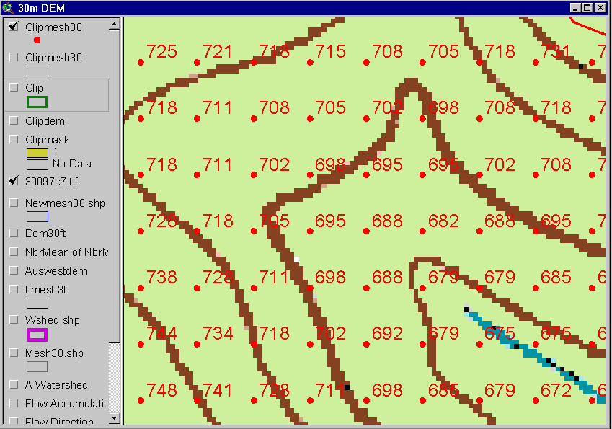
The starting point: A Grid Digital Elevation Model
Contours
740
720
700
680

Slide 7
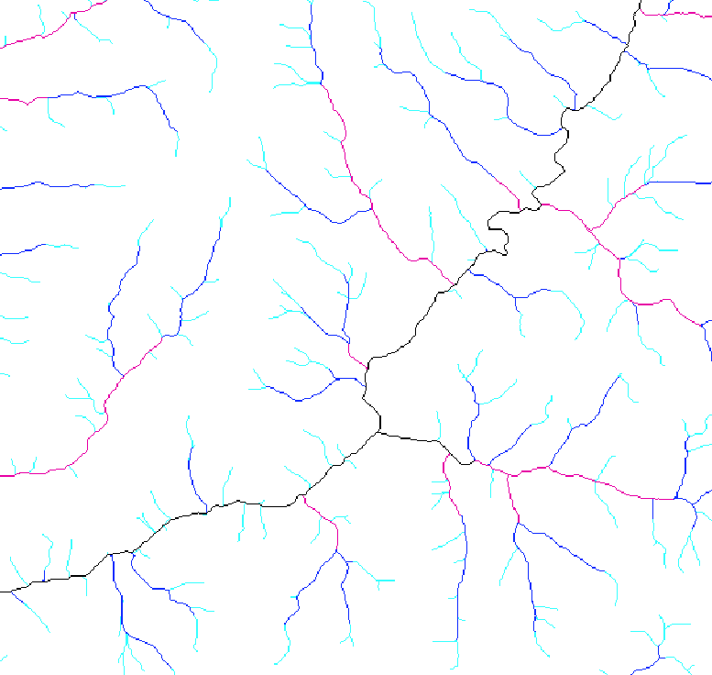
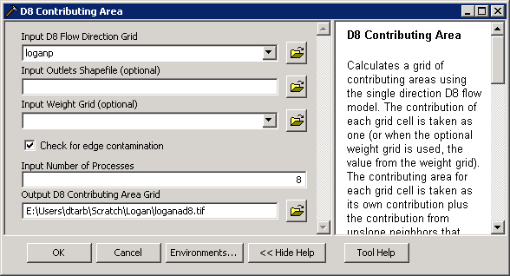
D8 Contributing Area

Slide 8
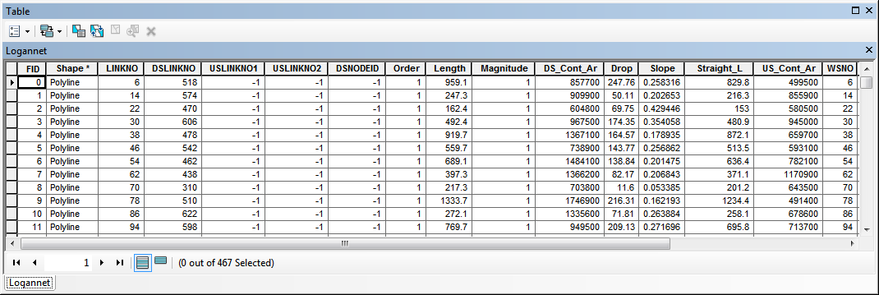
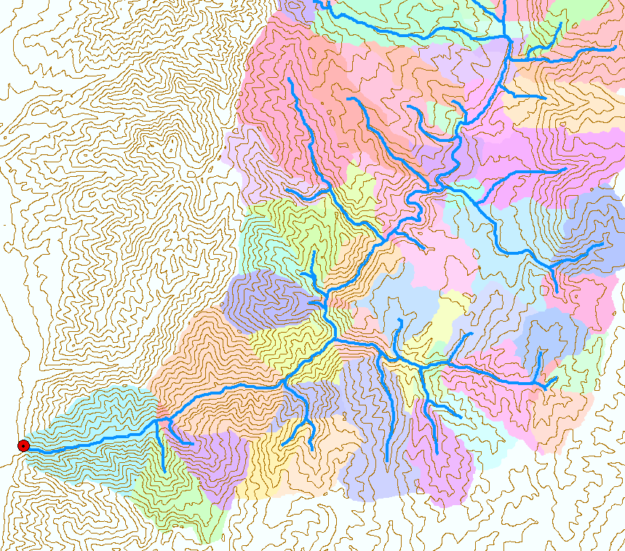
Stream Reach and Watershed

Slide 9
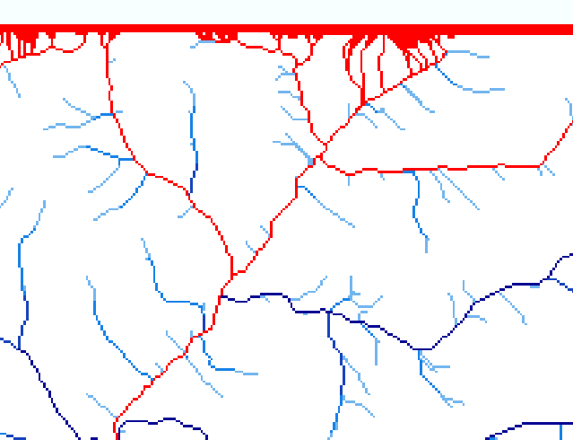
Edge contamination
Edge contamination arises when a contributing area value depends on grid cells outside of the domain. This occurs when drainage is inwards from the boundaries or areas with no data values. The algorithm recognizes this and reports "no data" resulting in streaks of "no data" values extending inwards from boundaries along flow paths that enter the domain at a boundary.

Slide 10
Outline
TauDEM software
D-Infinity flow model
Generalized flow accumulation (Flow algebra)
Parallel algorithms
Programming

Slide 11
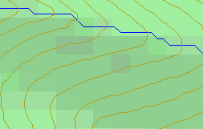
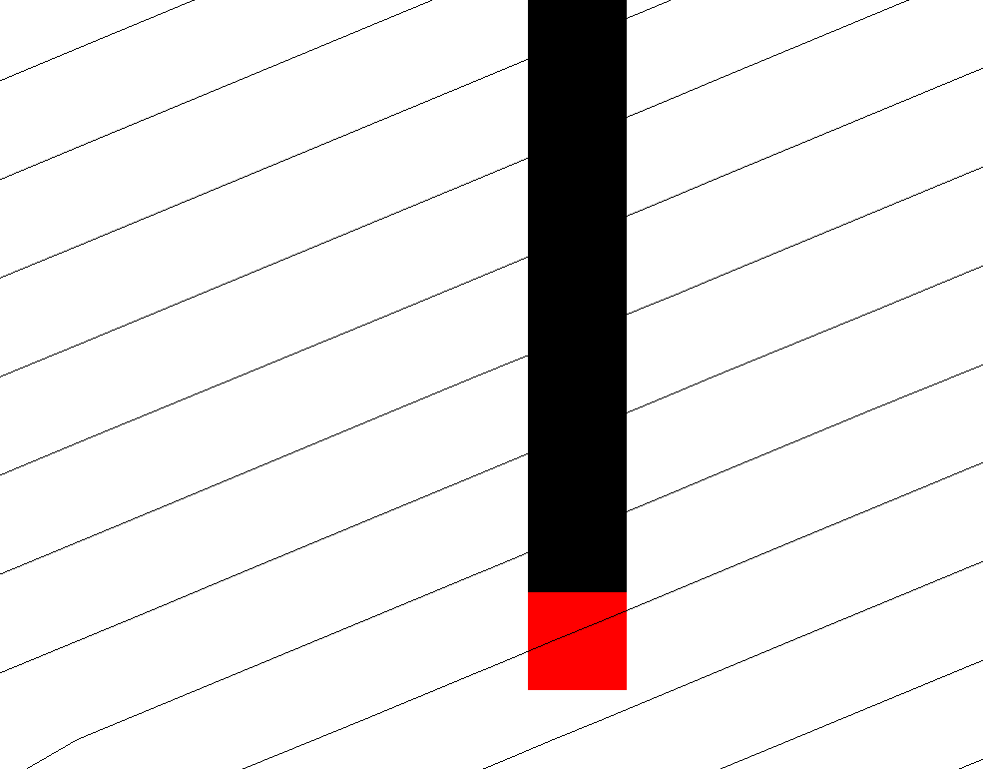
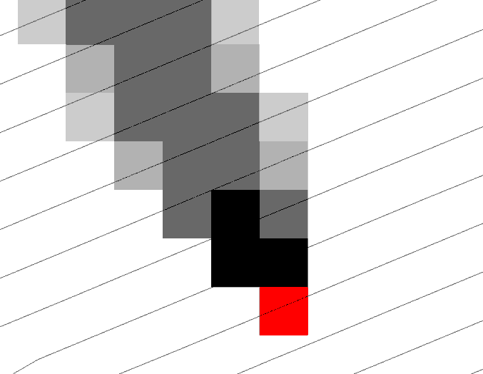
Representation of Flow Field
Steepest single direction
48
52
56
67
D8
D∞
Tarboton, D. G., (1997), "A New Method for the Determination of Flow Directions and Contributing Areas in Grid Digital Elevation Models," Water Resources Research, 33(2): 309-319.)
Notes:
This slide shows how the terrain flow field is represented. Early DEM work used a single flow direction model, D8. In 1997 I published the Dinfinity method that proportions flow from each grid cell among downslope neighbors. This, at the expense of some dispersion, allows a better approximation of flow across surfaces.

Slide 12

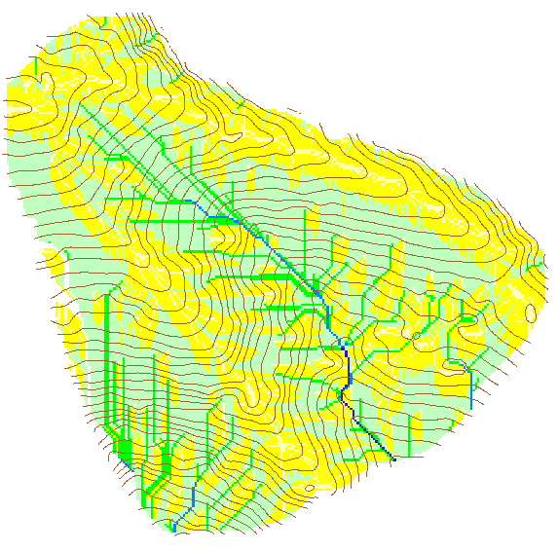
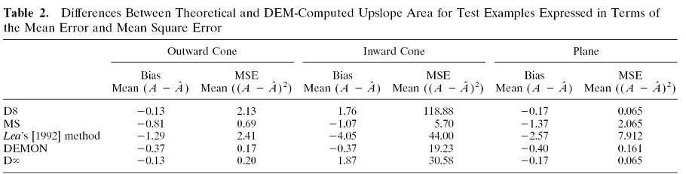
Contributing Area
D∞
D8

Slide 13
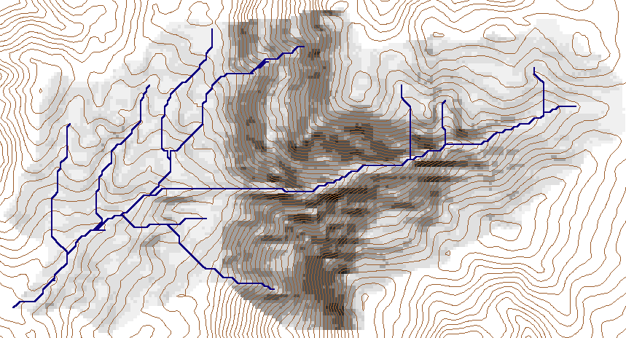
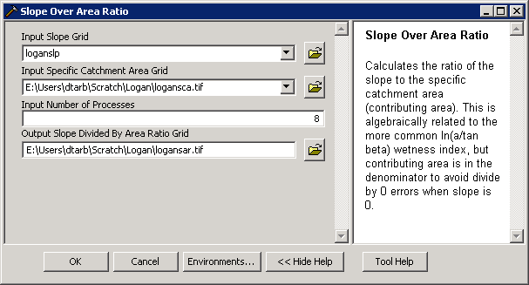
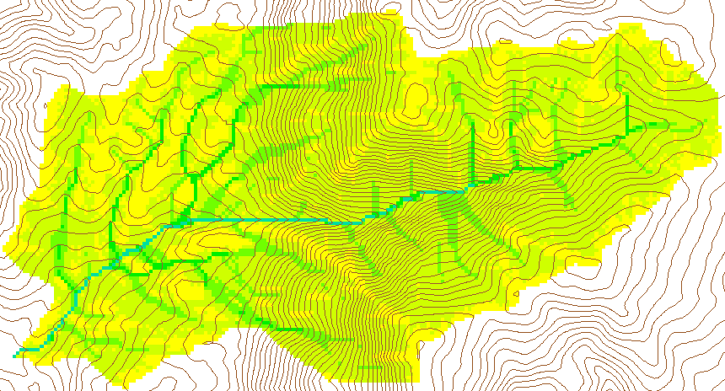
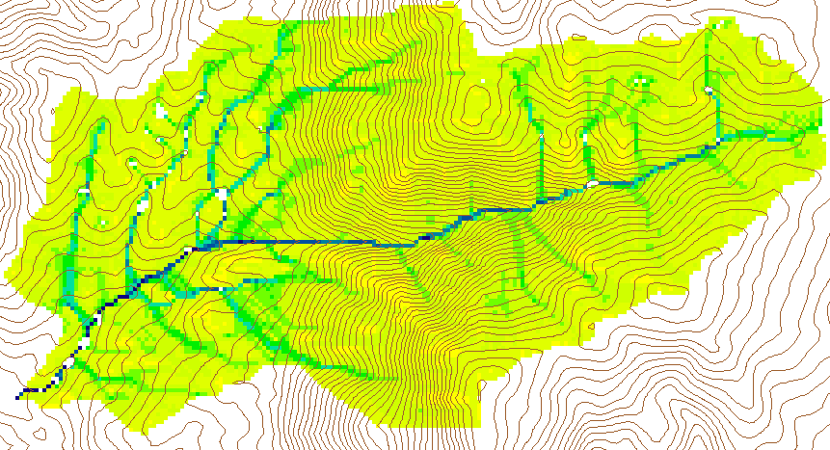
Wetness Index
Slope (S)
Specific Catchment Area (a)
Wetness Index ln(a/S)

Slide 14
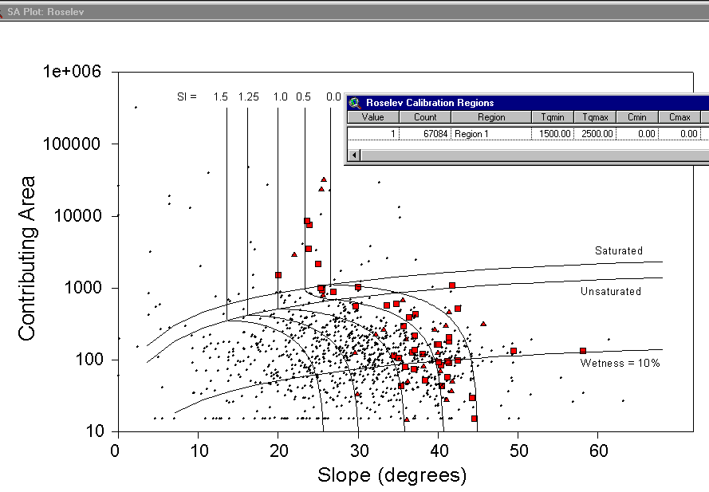
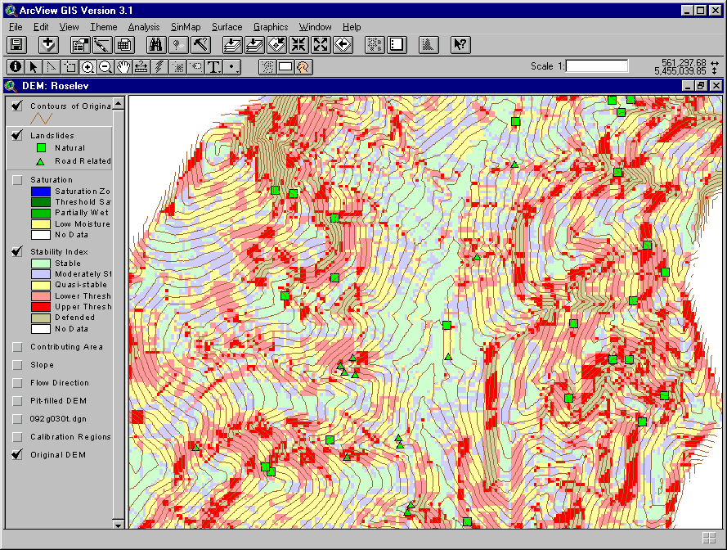
Terrain Stability Mapping
SINMAP - with Bob Pack. http://www.engineering.usu.edu/dtarb/sinmap.htm

Slide 15
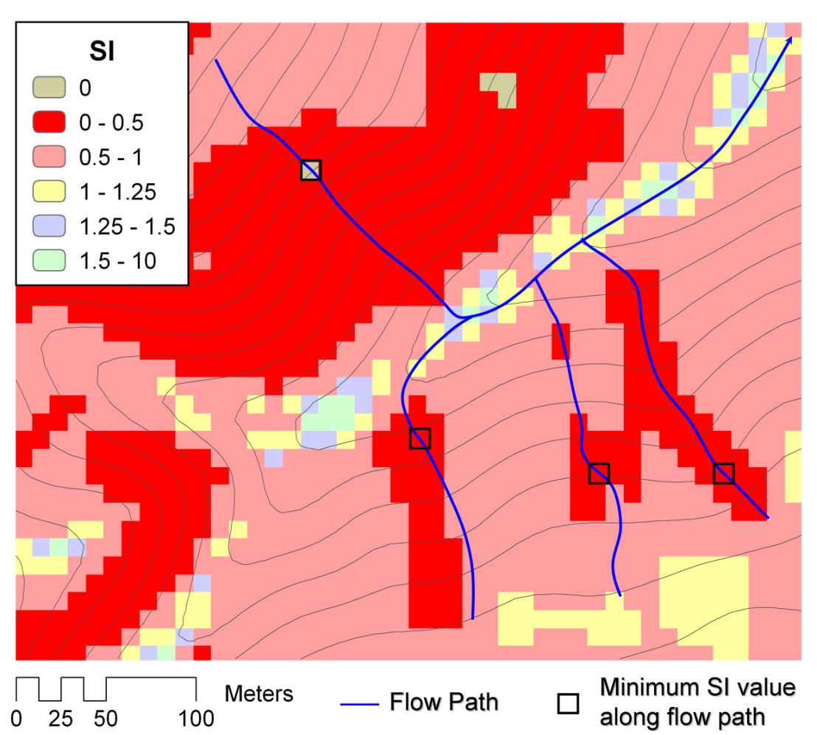
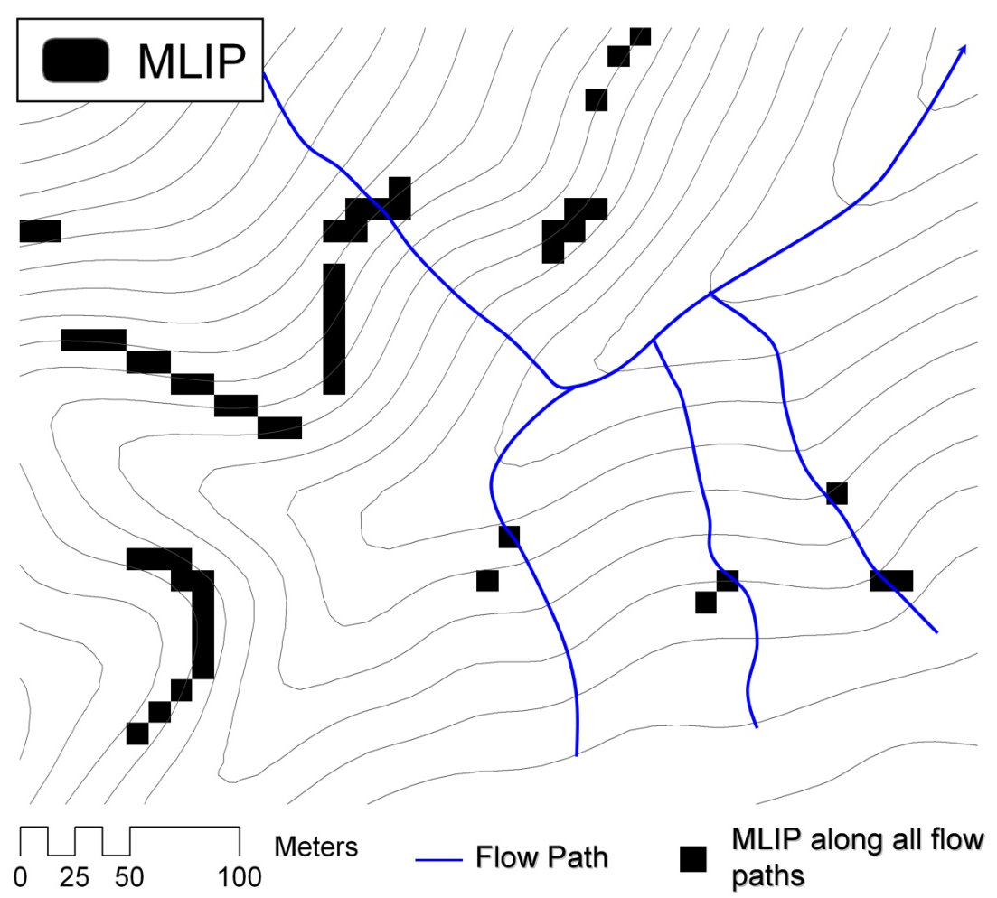
Most Likely Landslide Initiation Points
The location of the lowest Stability Index value along a flow path
Tarolli, P. and D. G. Tarboton, (2006), "A new method for determination of most likely landslide initiation points and the evaluation of digital terrain model scale in terrain stability mapping," Hydrol. Earth Syst. Sci., 10: 663-677, www.hydrol-earth-syst-sci.net/10/663/2006/.

Slide 16
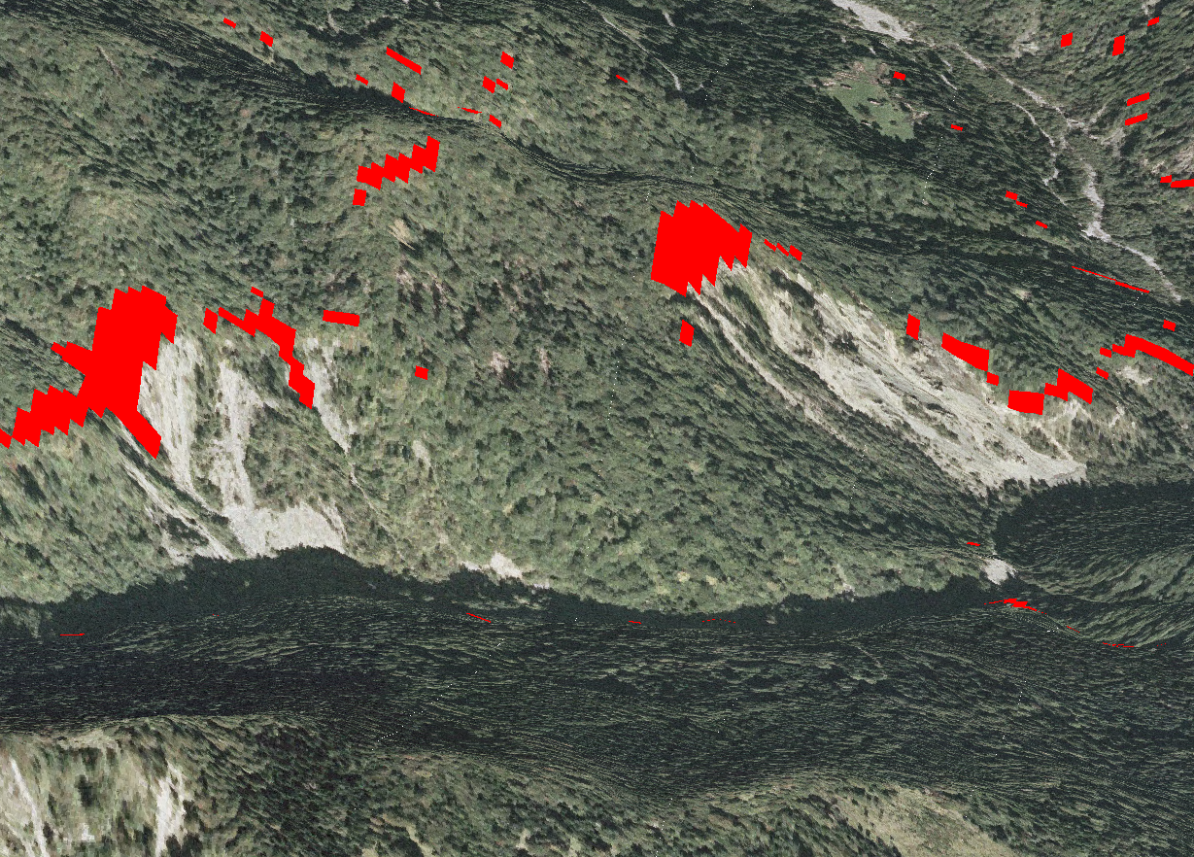
Most Likely Landslide Initiation Points compared to observed landslides
Tarolli, P. and D. G. Tarboton, (2006), "A new method for determination of most likely landslide initiation points and the evaluation of digital terrain model scale in terrain stability mapping," Hydrol. Earth Syst. Sci., 10: 663-677, www.hydrol-earth-syst-sci.net/10/663/2006/.

Slide 17
Outline
TauDEM software
D-Infinity flow model
Generalized flow accumulation (Flow algebra)
Parallel algorithms
Programming

Slide 18
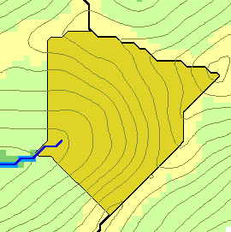
Flow Accumulation
w(x)
x

Slide 19
Generalization to Flow Algebra
Replace
P_{ki}
P_{ki}
P_{ki}
i
by general function

Slide 20
Useful for a tracking contaminant or compound subject to decay or attenuation

Slide 21
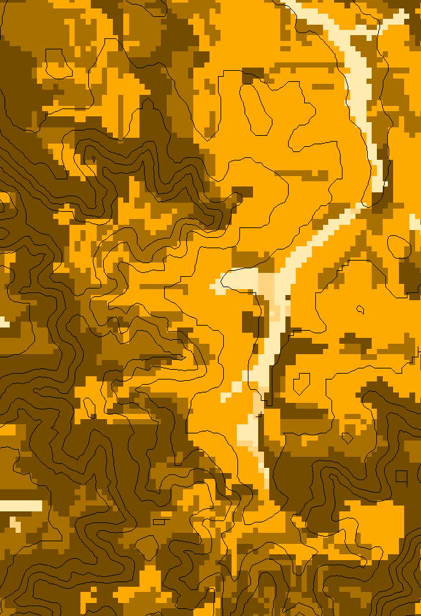
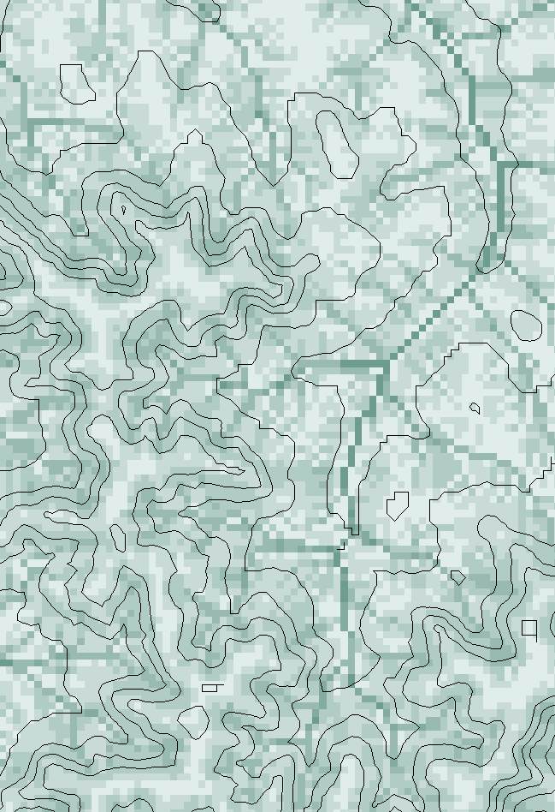
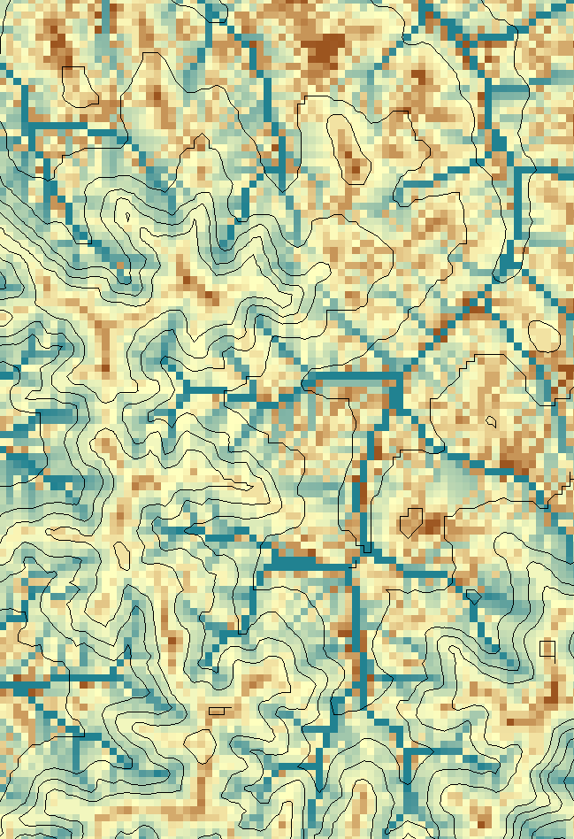
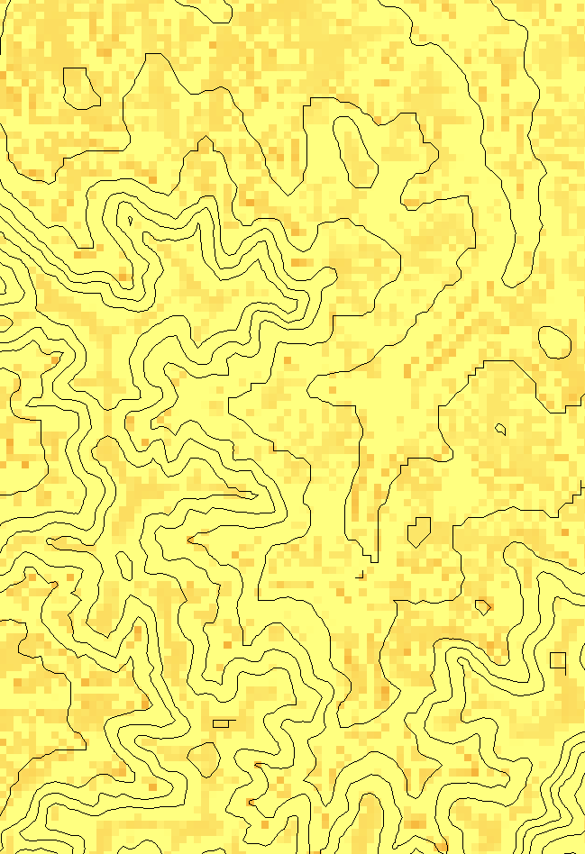
Transport limited accumulation
Supply
Capacity
Transport
Deposition
S
T
=
χa
2
tan(
b
)
2
T
=
min{
S
+
∑
T
,
T
}
D
=
S
+
∑
T
−
T
cap
out
in
cap
in
out
Useful for modeling erosion and sediment delivery, the spatial dependence of sediment delivery ratio and contaminant that adheres to sediment

Slide 22
Outline
TauDEM software
D-Infinity flow model
Generalized flow accumulation (Flow algebra)
Parallel algorithms
Programming

Slide 23




The challenge of increasing Digital Elevation Model (DEM) resolution
1980’s DMA 90 m
10² cells/km²
1990’s USGS DEM 30 m
10³ cells/km²
2000’s NED 10-30 m
10⁴ cells/km²
2010’s LIDAR ~1 m
10⁶ cells/km²

Slide 24
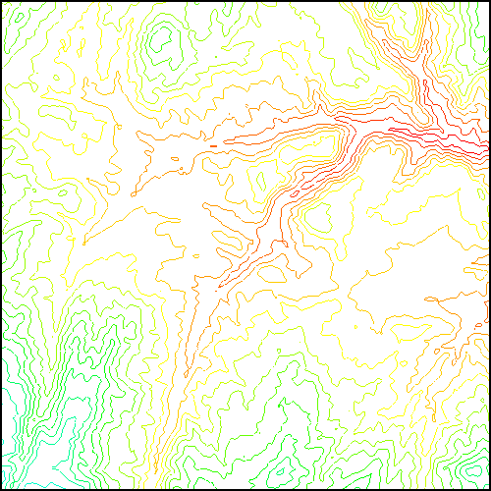
TauDEM Parallel Approach
MPI, distributed memory paradigm
Row oriented slices
Each process includes one buffer row on either side
Each process does not change buffer row

Slide 25
TauDEM Parallel Approach
MPI, distributed memory paradigm
Row oriented slices
Each process includes one buffer row on either side
Each process does not change buffer row

Slide 26
Parallelization of Flow Algebra
1. Dependency grid
2. Flow algebra function
Executed by every process with grid flow field P, grid dependencies D initialized to 0 and an empty queue Q. FindDependencies(P,Q,D) for all i for all k neighbors of i if P_{ki}>0 D(i)=D(i)+1 if D(i)=0 add i to Q next
Executed by every process with D and Q initialized from FindDependencies. FlowAlgebra(P,Q,D,θ,γ) while Q isn’t empty get i from Q θ_{i} = FA(γ_{i}, P_{ki}, θ_{k}, γ_{k}) for each downslope neighbor n of i if P_{in}>0 D(n)=D(n)-1 if D(n)=0 add n to Q next n end while swap process buffers and repeat

Slide 27
Parallelization of Contributing Area/Flow Algebra
1. Dependency grid
and so on until completion
resulting in new D=0 cells on queue
Queue’s empty so exchange border info.
Decrease cross partition dependency
Executed by every process with grid flow field P, grid dependencies D initialized to 0 and an empty queue Q. FindDependencies(P,Q,D) for all i for all k neighbors of i if P_{ki}>0 D(i)=D(i)+1 if D(i)=0 add i to Q next
A=1
A=1
A=1
A=1
A=1
A=1
A=1
A=1
D=0
A=1
A=1
A=1
A=1
D=0
D=0
A=1
A=1
A=1
D=0
D=0
A=1
D=0
A=1
A=1
A=1
A=1
A=1
A=1.5
A=1.5
A=3
D=0
A=1.5
A=1.5
D=1
D=0
D=1
D=0
D=0
A=3
D=0
D=3
D=2
D=1
D=0
D=0
D=1
D=1
A=1.5
D=1
A=1.5
A=3
A=3
A=1.5
A=1.5
2. Flow algebra function
B=-2
B=-1
Executed by every process with D and Q initialized from FindDependencies. FlowAlgebra(P,Q,D,θ,γ) while Q isn’t empty get i from Q θ_{i} = FA(γ_{i}, P_{ki}, θ_{k}, γ_{k}) for each downslope neighbor n of i if P_{in}>0 D(n)=D(n)-1 if D(n)=0 add n to Q next n end while swap process buffers and repeat
B=-2
B=-1
A=1
A=1
D=2
D=2
D=1
A=1
D=1
A=1
D=0
A=1
A=1
D=2
D=2
D=2
D=2
D=2
D=1
D=1
D=1
D=1
A=1
D=1
A=1
A=5.5
D=0
A=2.5
D=0
A=1
A=1
D=1
D=1
D=1
A=1
D=1
A=1
D=0
D=0
A=1
D=1
D=1
D=3
D=2
D=1
D=1
D=1
D=1
D=1
A=1
D=1
A=1
D=1
A=6
A=3.5
D=1

Slide 28
Improved runtime efficiency
Parallel Pit Remove timing for NEDB test dataset (14849 x 27174 cells ≈ 1.6 GB).
8 processor PC
Dual quad-core Xeon E5405 2.0GHz PC with 16GB RAM
128 processor cluster
16 diskless Dell SC1435 compute nodes, each with 2.0GHz dual quad-core AMD Opteron 2350 processors with 8GB RAM

Slide 29
Scaling of run times to large grids
Owl is an 8 core PC (Dual quad-core Xeon E5405 2.0GHz) with 16GB RAM
Rex is a 128 core cluster of 16 diskless Dell SC1435 compute nodes, each with 2.0GHz dual quad-core AMD Opteron 2350 processors with 8GB RAM
Virtual is a virtual PC resourced with 48 GB RAM and 4 Intel Xeon E5450 3 GHz processors

Slide 30
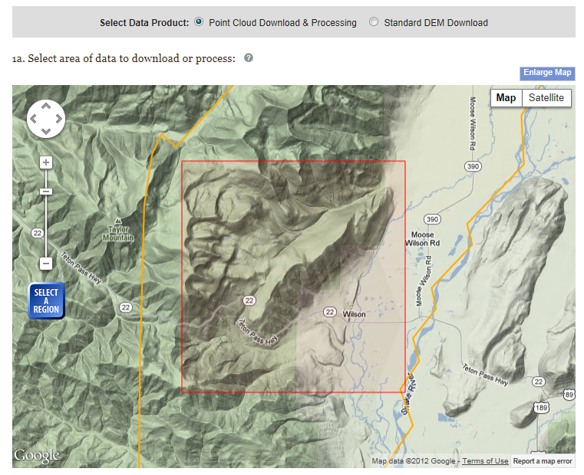
Teton Conservation District, Wyoming LIDAR Example
Open Topography http://www.opentopography.org/

Slide 31
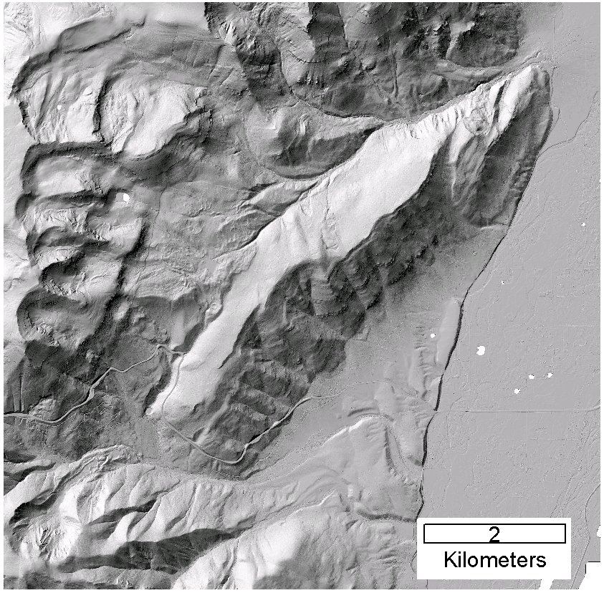
DEM derived from point cloud using TIN DEM Generation and output as GeoTIFF

Slide 32
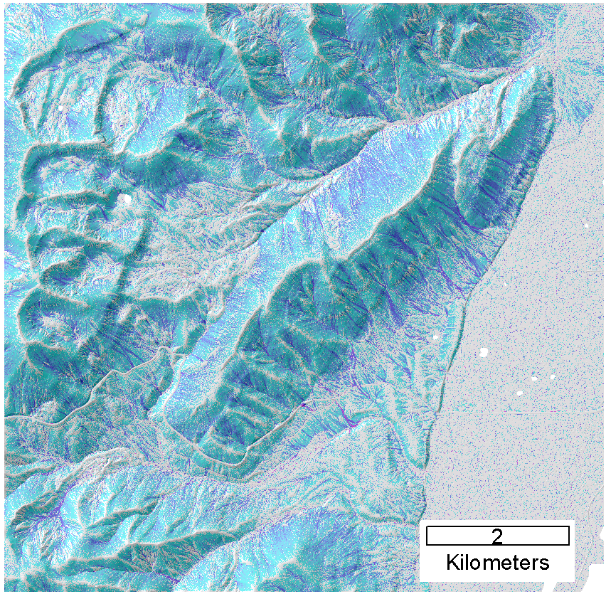
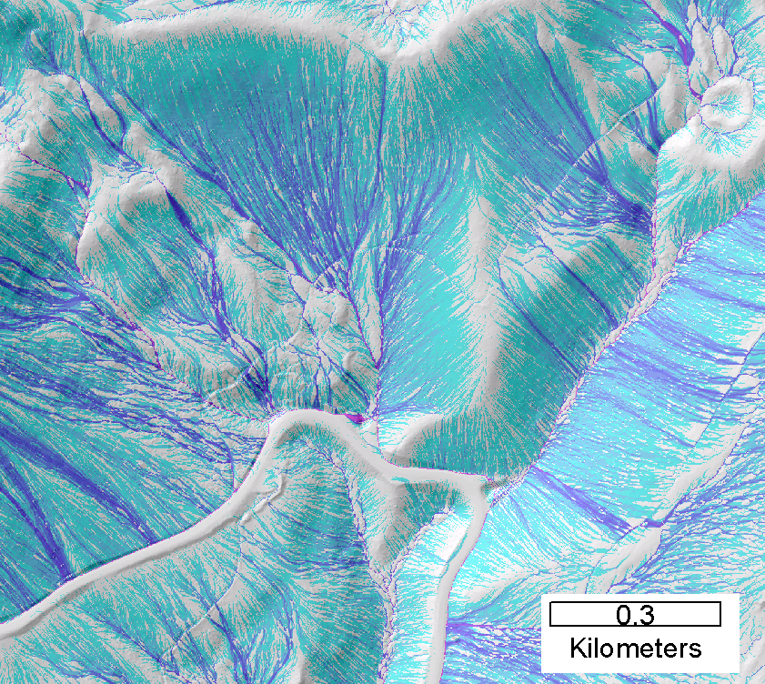
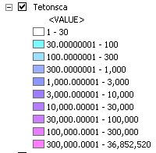
Contributing area from D-Infinity
Notes:
Note the detail in the representation of flow paths at features such as roads

Slide 33
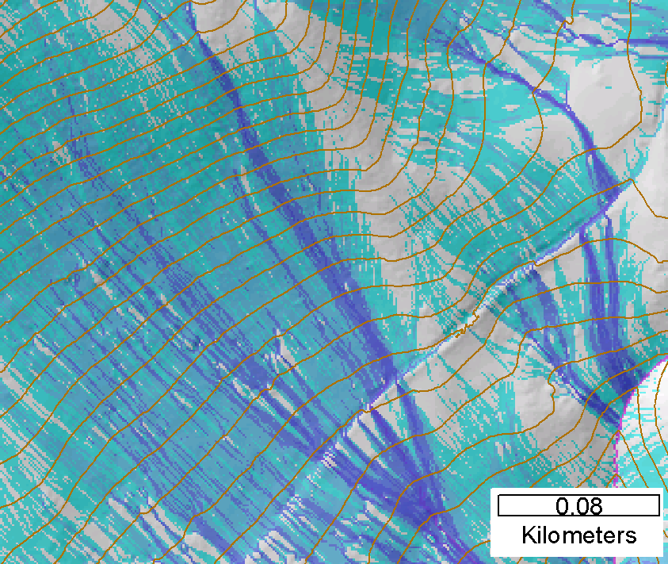
Contributing area from D-Infinity
Notes:
Note the detail in the representation of flow paths at features such as roads

Slide 34
Outline
TauDEM software
D-Infinity flow model
Generalized flow accumulation (Flow algebra)
Parallel algorithms
Programming

Slide 35
Programming
C++ Command Line Executables that use MPI
ArcGIS Python Script Tools
Python validation code to provide file name defaults
Shared as ArcGIS Toolbox

Slide 36
Q based block of code to evaluate any “flow algebra expression”
while(!que.empty())
{
//Takes next node with no contributing neighbors
temp = que.front(); que.pop();
i = temp.x; j = temp.y;
// FLOW ALGEBRA EXPRESSION EVALUATION
if(flowData->isInPartition(i,j)){
float areares=0.; // initialize the result
for(k=1; k<=8; k++) { // For each neighbor
in = i+d1[k]; jn = j+d2[k]; flowData->getData(in,jn, angle);
p = prop(angle, (k+4)%8);
if(p>0.){
if(areadinf->isNodata(in,jn))con=true;
else{
areares=areares+p*areadinf->getData(in,jn,tempFloat);
}
}
}
}
// Local inputs
areares=areares+dx;
if(con && contcheck==1)
areadinf->setToNodata(i,j);
else
areadinf->setData(i,j,areares);
// END FLOW ALGEBRA EXPRESSION EVALUATION
}
C++

Slide 37
Maintaining to do Q and partition sharing
C++
while(!finished) { //Loop within partition
while(!que.empty())
{ .... // FLOW ALGEBRA EXPRESSION EVALUATION
}
// Decrement neighbor dependence of downslope cell
flowData->getData(i, j, angle);
for(k=1; k<=8; k++) {
p = prop(angle, k);
if(p>0.0) {
in = i+d1[k]; jn = j+d2[k];
//Decrement the number of contributing neighbors in neighbor
neighbor->addToData(in,jn,(short)-1);
//Check if neighbor needs to be added to que
if(flowData->isInPartition(in,jn) && neighbor->getData(in, jn, tempShort) == 0 ){
temp.x=in; temp.y=jn;
que.push(temp);
}
}
}
}
//Pass information across partitions
areadinf->share();
neighbor->addBorders();

Slide 38
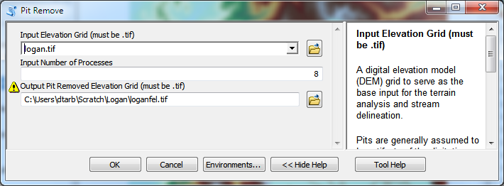
Python Script to Call Command Line
mpiexec –n 8 pitremove –z Logan.tif –fel Loganfel.tif

Slide 39
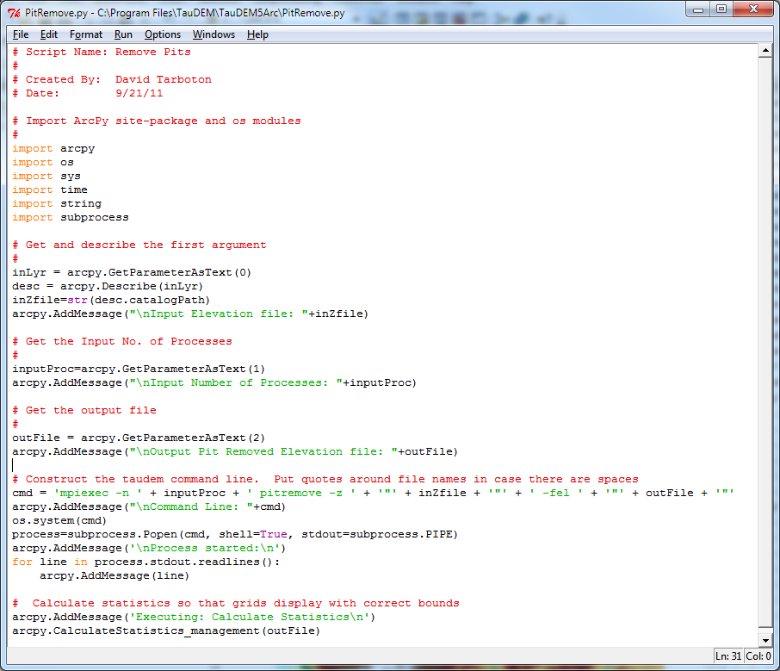
PitRemove
Python

Slide 40
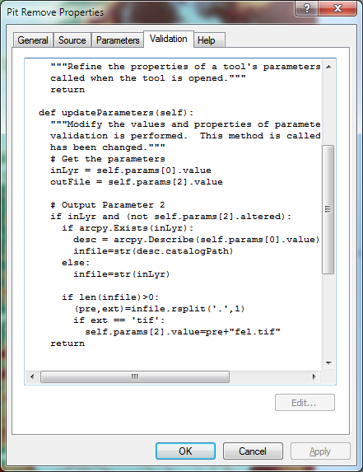
Validation code to add default file names
Python

Slide 41
Some TauDEM Demo’s
And fixing one of the functions …

Slide 42
Conclusions
The GIS grid based terrain flow data model enables derivation of a wide variety of information useful for the study of hydrologic processes.
Terrain surface derivatives enhanced by use of DInfinity model.
Flow algebra a general “recipe” for terrain flow related modeling.
Parallelism required to process big terrain data.
Saw how to dip into GIS based programming

