Slide 1
Extending ArcGIS using programming
David Tarboton

Slide 2
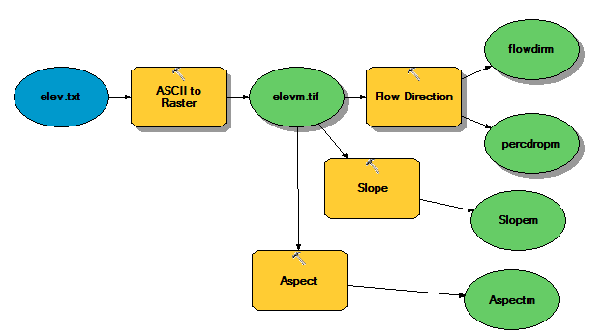
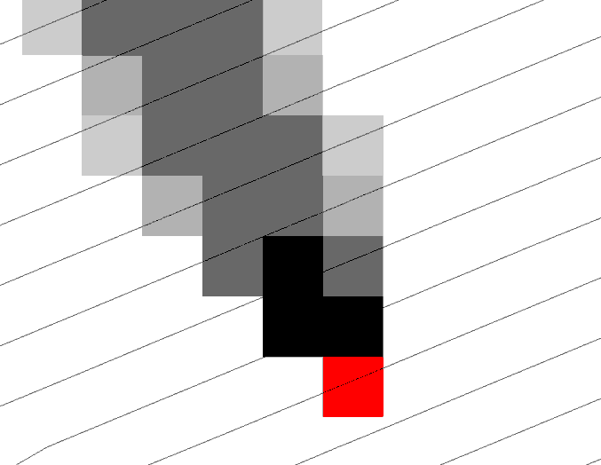
Why Programming
Automation of repetitive tasks (workflows)
Implementation of functionality not available (programming new behavior)

Slide 3
ArcGIS programming entry points
Model builder
Python scripting environment
ArcObjects library (for system language like C++, .Net)
Open standard data formats that anyone can use in programs (e.g. shapefiles, geoTIFF, netCDF)

Slide 4
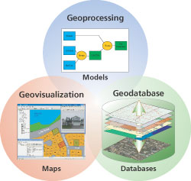
Three Views of GIS
Geodatabase view: Structured data sets that represent geographic information in terms of a generic GIS data model.
Geovisualization view: A GIS is a set of intelligent maps and other views that shows features and feature relationships on the earth's surface. "Windows into the database" to support queries, analysis, and editing of the information.
Geoprocessing view: Information transformation tools that derive new geographic data sets from existing data sets.
adapted from www.esri.com

Slide 5
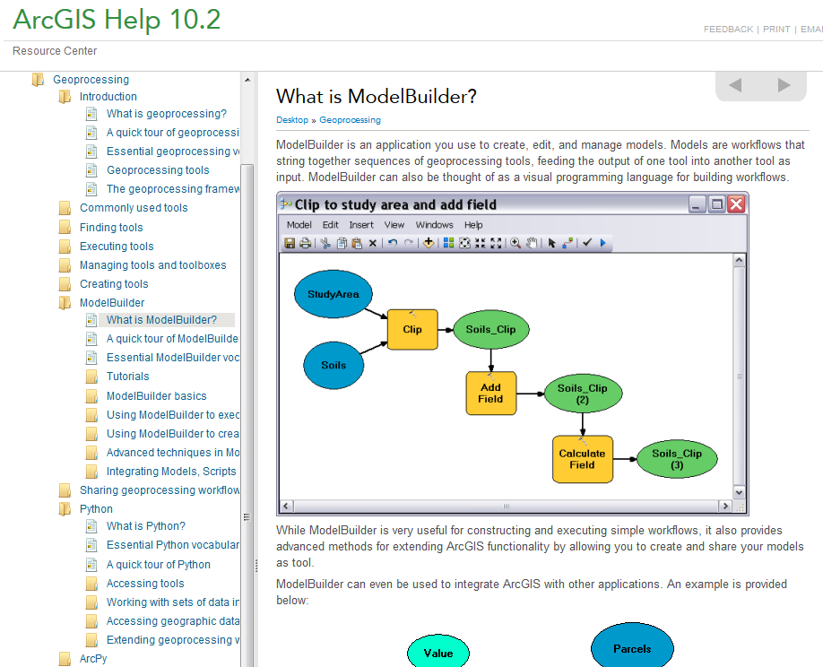
http://resources.arcgis.com/en/help/main/10.2/#/What_is_ModelBuilder/002w00000001000000/

Slide 6
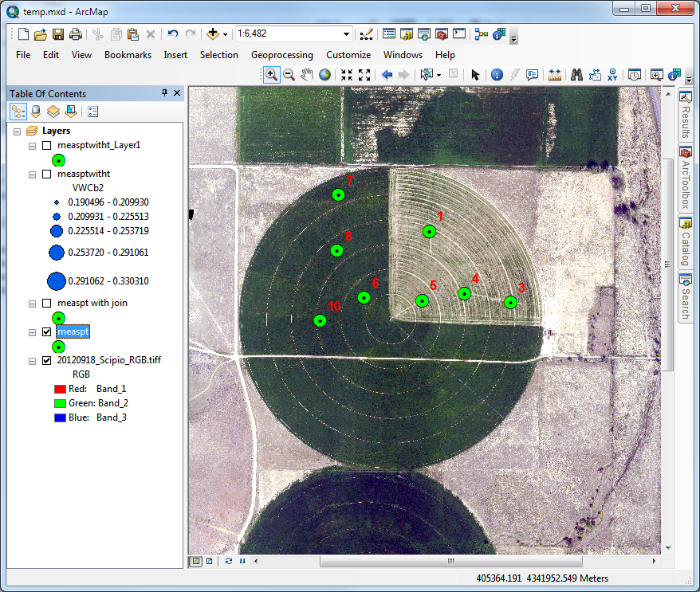
An example – time series interpolation
Soil moisture at 8 sites in field
Hourly for a month
~ 720 time steps
What is the spatial pattern over time
Data from Manal Elarab

Slide 7
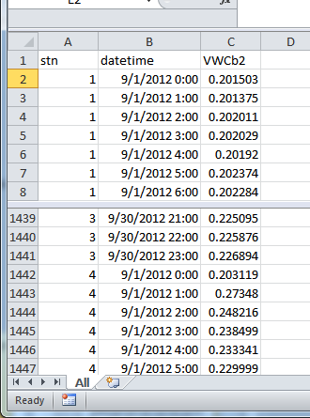
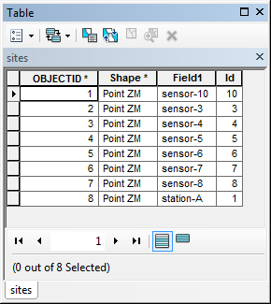
How to use in ArcGIS
Time series in Excel imported to Object class in ArcGIS
Joined to Feature Class (one to many)

Slide 8
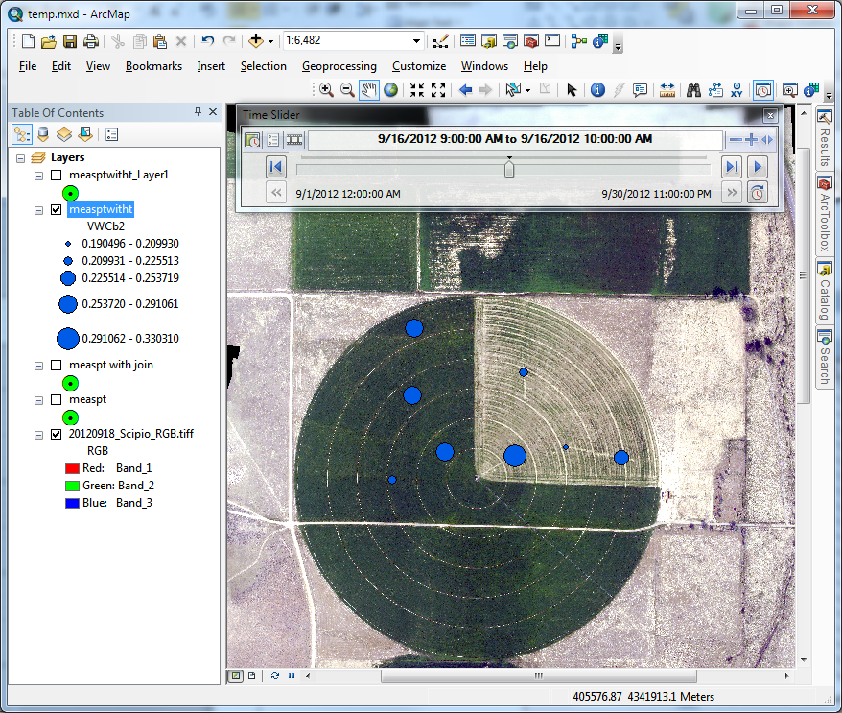
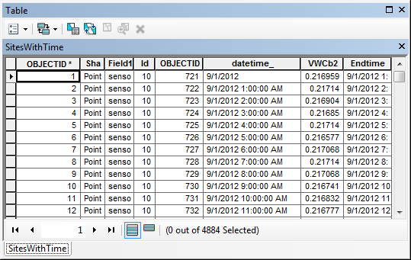
Time enabled layer with 4884 records that can be visualized using time slider

Slide 9
But what if you want spatial fields
Interpolate using spline or inverse distance weight at each time step
Analyze resulting rasters
30 days – 720 hours ???
A job for programming

Slide 10
The program workflow
Set up inputs
Get time extents from the time layer
Create a raster catalog (container for raster layers)
For each time step
  Query and create layer with data only for that time step
  Create raster using inverse distance weight
  Add raster to raster catalog
Add date time field and populate with time values

Slide 11
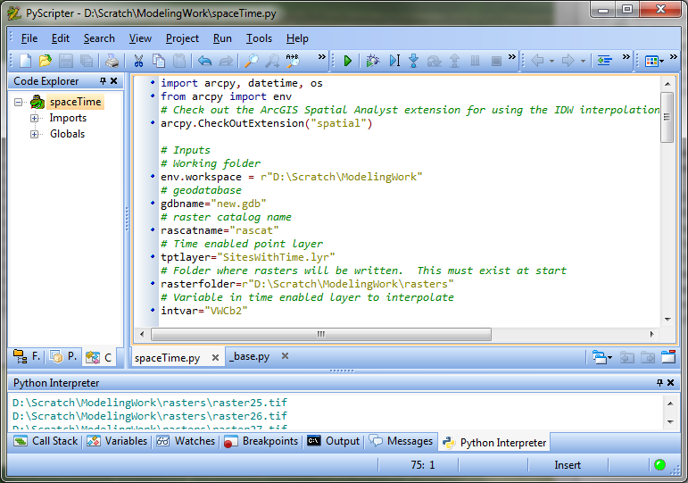
I used PyScripter
(as suggested by an ESRI programmer http://blogs.esri.com/esri/arcgis/2011/06/17/pyscripter-free-python-ide/)
http://code.google.com/p/pyscripter/

Slide 12
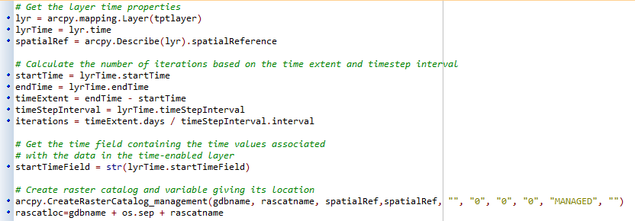
This shows the reading of time parameters and creation of raster catalog

Slide 13
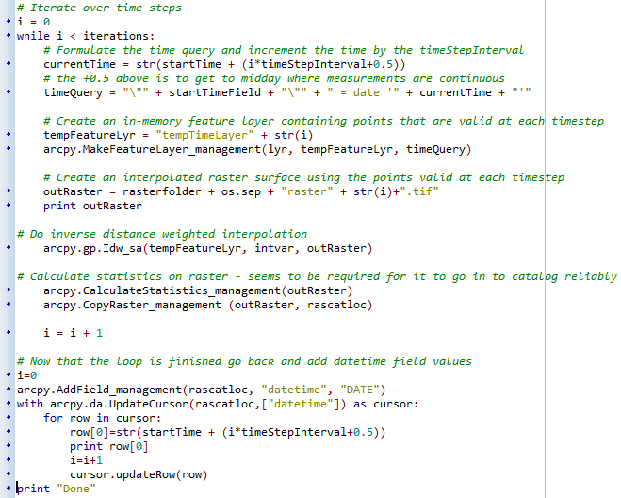
This shows the iterative part

Slide 14
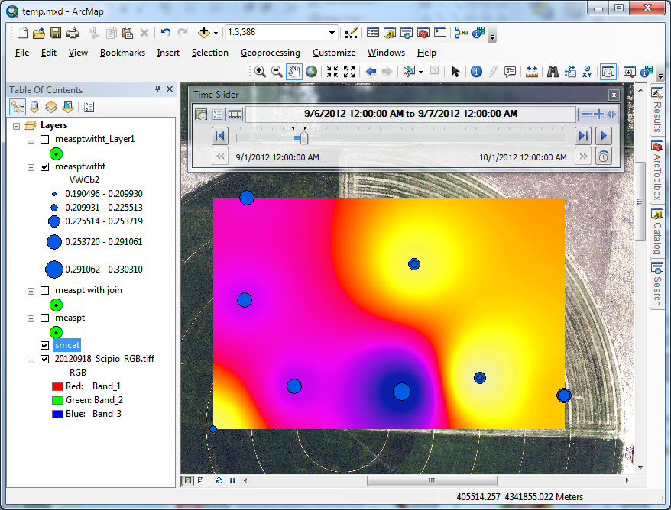
The result

Slide 15
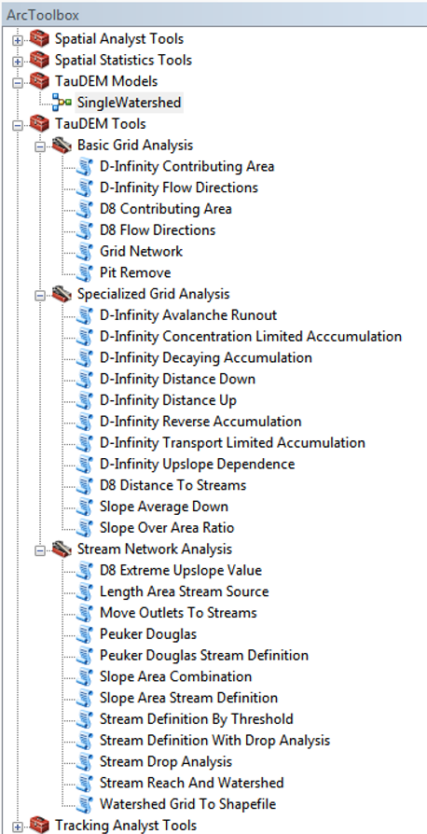


TauDEM
Stream and watershed delineation
Multiple flow direction flow field
Calculation of flow based derivative surfaces
MPI Parallel Implementation for speed up and large problems
Open source platform independent C++ command line executables for each function
Deployed as an ArcGIS Toolbox with python scripts that drive command line executables
http://hydrology.usu.edu/taudem/

Slide 16
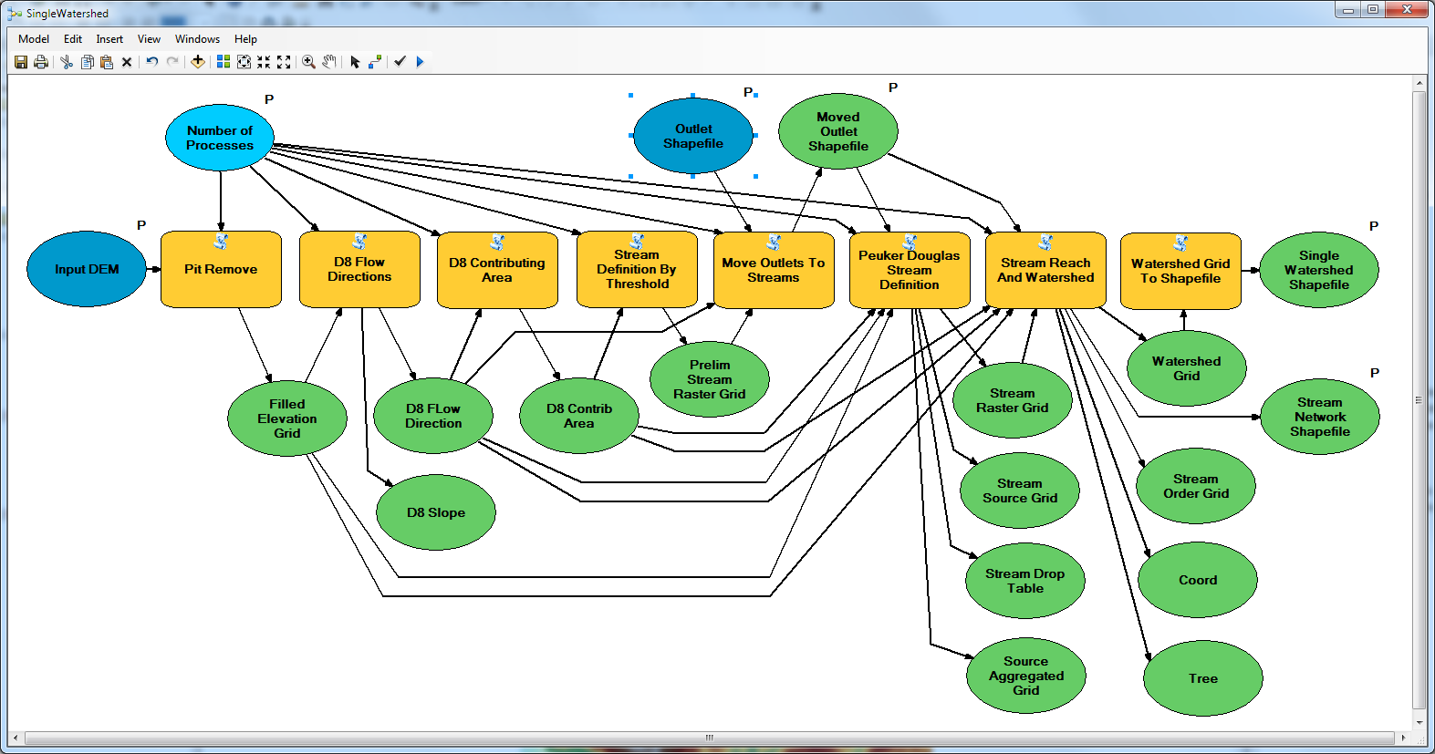
Model Builder Model to Delineate Watershed using TauDEM tools

Slide 17
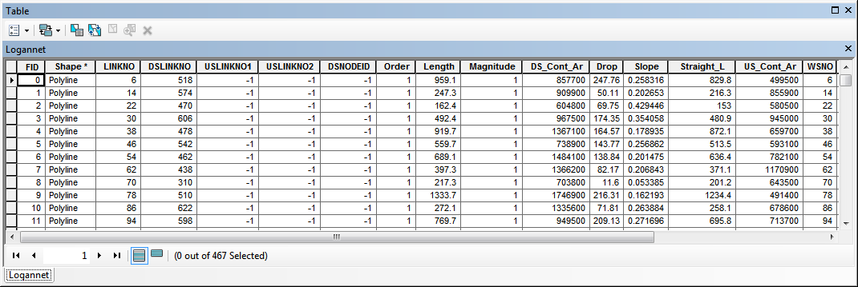
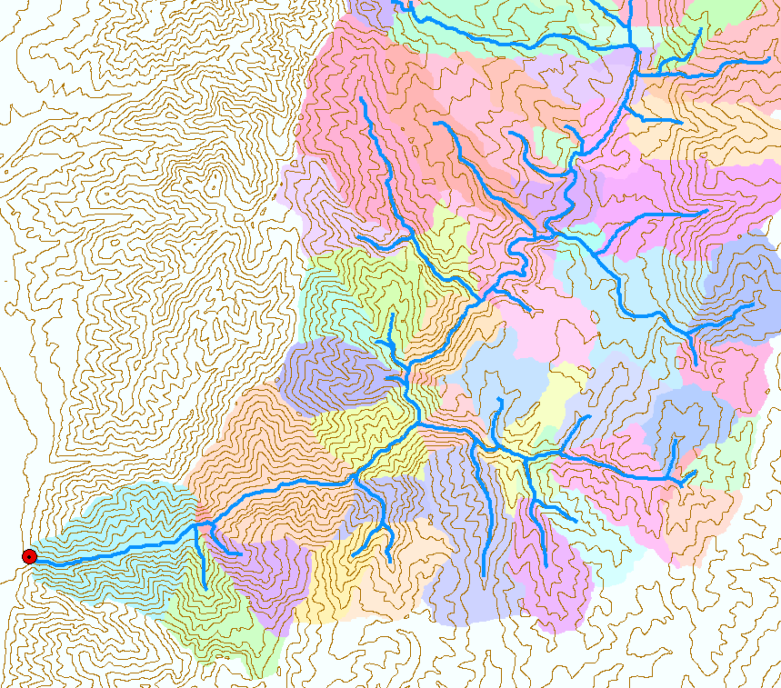
Catchments linked to Stream Network

Slide 18
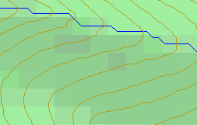
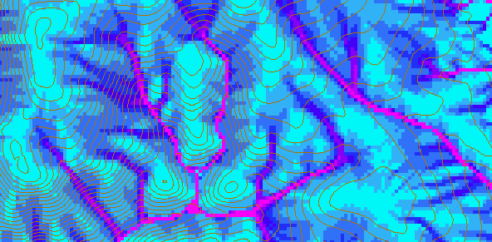
D-Infinity Contributing Area
D8
D∞
Tarboton, D. G., (1997), "A New Method for the Determination of Flow Directions and Contributing Areas in Grid Digital Elevation Models," Water Resources Research, 33(2): 309-319.)
Notes:
This slide shows how the terrain flow field is represented. Early DEM work used a single flow direction model, D8. In 1997 I published the Dinfinity method that proportions flow from each grid cell among downslope neighbors. This, at the expense of some dispersion, allows a better approximation of flow across surfaces.

Slide 19
Generalization to Flow Algebra
Replace
P_{ki}
P_{ki}
P_{ki}
i
by general function

Slide 20
Useful for a tracking contaminant or compound subject to decay or attenuation

Slide 21
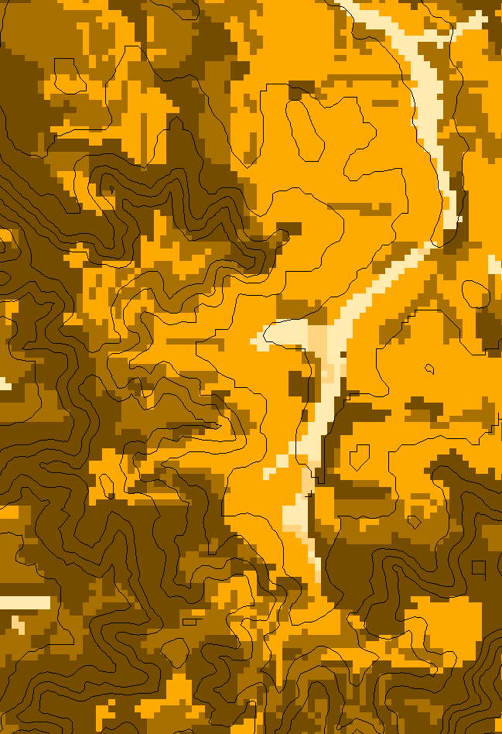
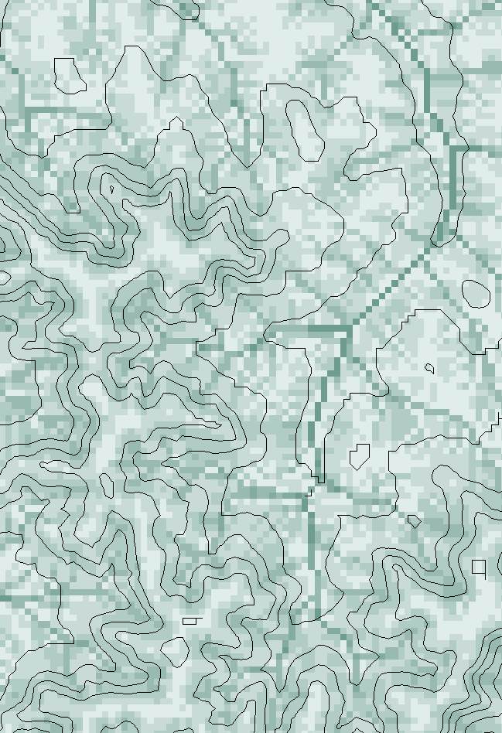
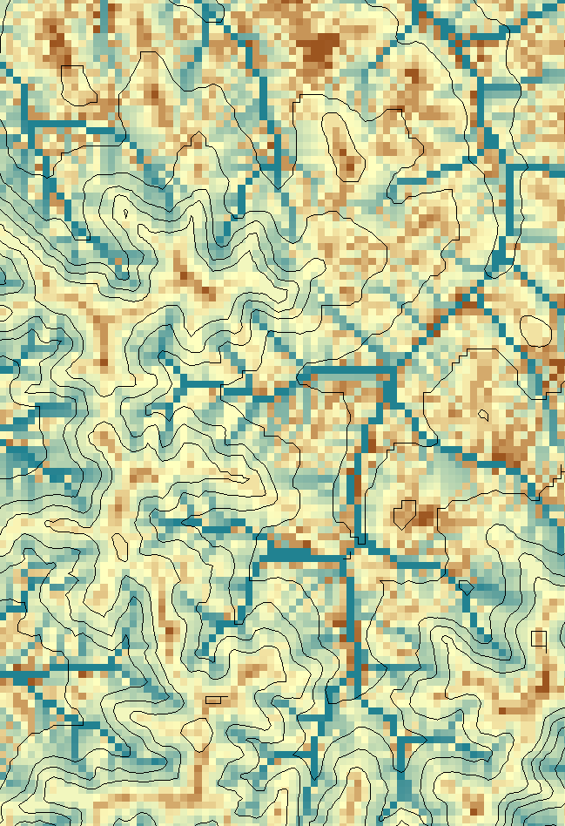
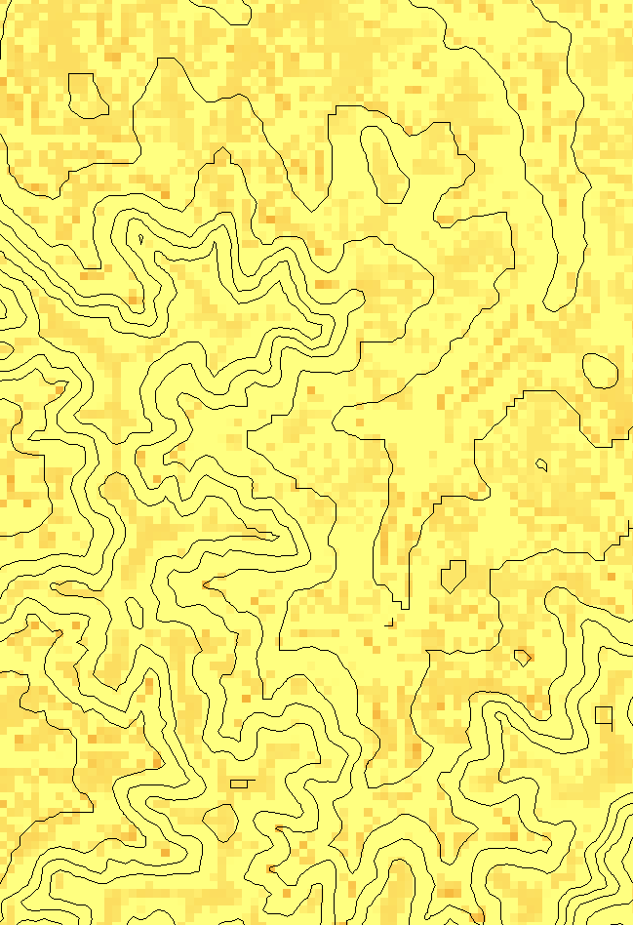
Transport limited accumulation
Supply
Capacity
Transport
Deposition
S
T
=
χa
2
tan(
b
)
2
T
=
min{
S
+
∑
T
,
T
}
D
=
S
+
∑
T
−
T
cap
out
in
cap
in
out
Useful for modeling erosion and sediment delivery, the spatial dependence of sediment delivery ratio and contaminant that adheres to sediment
Flow Algebra provides a general modeling framework for static flow field based geospatial concepts

Slide 22
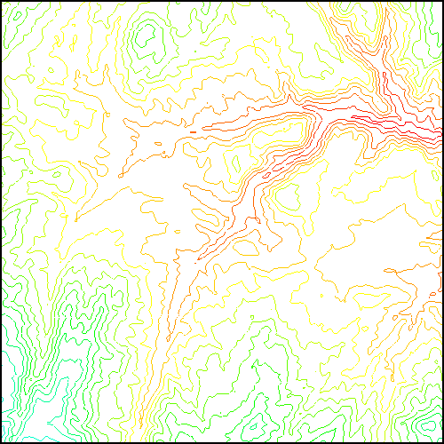
TauDEM Parallel Approach
MPI, distributed memory paradigm
Row oriented slices
Each process includes one buffer row on either side
Each process does not change buffer row

Slide 23
Parallelization of Flow Algebra
1. Dependency grid
2. Flow algebra function
Executed by every process with grid flow field P, grid dependencies D initialized to 0 and an empty queue Q. FindDependencies(P,Q,D) for all i for all k neighbors of i if P_{ki}>0 D(i)=D(i)+1 if D(i)=0 add i to Q next
Executed by every process with D and Q initialized from FindDependencies. FlowAlgebra(P,Q,D,θ,γ) while Q isn’t empty get i from Q θ_{i} = FA(γ_{i}, P_{ki}, θ_{k}, γ_{k}) for each downslope neighbor n of i if P_{in}>0 D(n)=D(n)-1 if D(n)=0 add n to Q next n end while swap process buffers and repeat

Slide 24
Programming
C++ Command Line Executables that use MPI
ArcGIS Python Script Tools
Python validation code to provide file name defaults
Shared as ArcGIS Toolbox

Slide 25
Q based block of code to evaluate any “flow algebra expression”
while(!que.empty())
{
//Takes next node with no contributing neighbors
temp = que.front(); que.pop();
i = temp.x; j = temp.y;
// FLOW ALGEBRA EXPRESSION EVALUATION
if(flowData->isInPartition(i,j)){
float areares=0.; // initialize the result
for(k=1; k<=8; k++) { // For each neighbor
in = i+d1[k]; jn = j+d2[k]; flowData->getData(in,jn, angle);
p = prop(angle, (k+4)%8);
if(p>0.){
if(areadinf->isNodata(in,jn))con=true;
else{
areares=areares+p*areadinf->getData(in,jn,tempFloat);
}
}
}
}
// Local inputs
areares=areares+dx;
if(con && contcheck==1)
areadinf->setToNodata(i,j);
else
areadinf->setData(i,j,areares);
// END FLOW ALGEBRA EXPRESSION EVALUATION
}
C++

Slide 26
Maintaining to do Q and partition sharing
C++
while(!finished) { //Loop within partition
while(!que.empty())
{ .... // FLOW ALGEBRA EXPRESSION EVALUATION
}
// Decrement neighbor dependence of downslope cell
flowData->getData(i, j, angle);
for(k=1; k<=8; k++) {
p = prop(angle, k);
if(p>0.0) {
in = i+d1[k]; jn = j+d2[k];
//Decrement the number of contributing neighbors in neighbor
neighbor->addToData(in,jn,(short)-1);
//Check if neighbor needs to be added to que
if(flowData->isInPartition(in,jn) && neighbor->getData(in, jn, tempShort) == 0 ){
temp.x=in; temp.y=jn;
que.push(temp);
}
}
}
}
//Pass information across partitions
areadinf->share();
neighbor->addBorders();

Slide 27
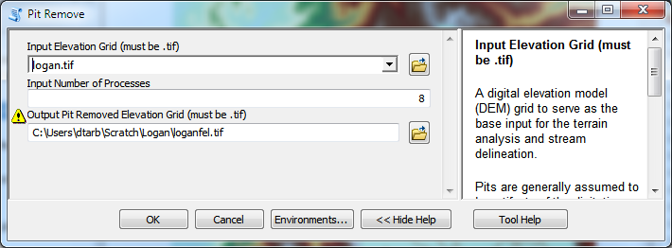
Python Script to Call Command Line
mpiexec –n 8 pitremove –z Logan.tif –fel Loganfel.tif

Slide 28
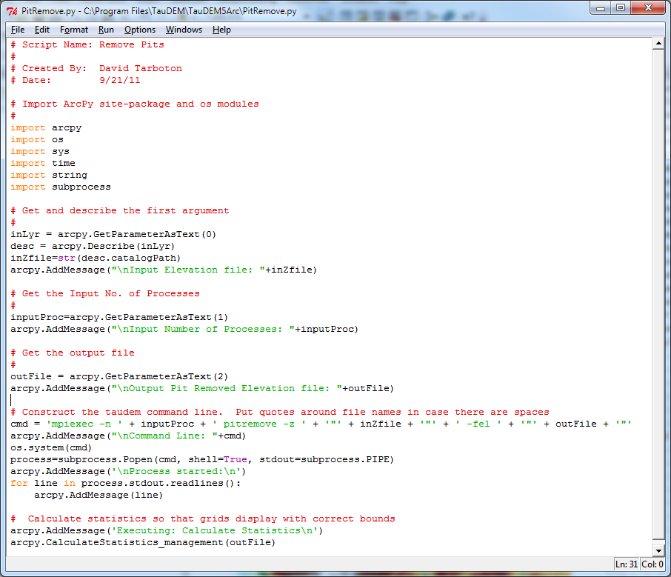
PitRemove
Python

Slide 29
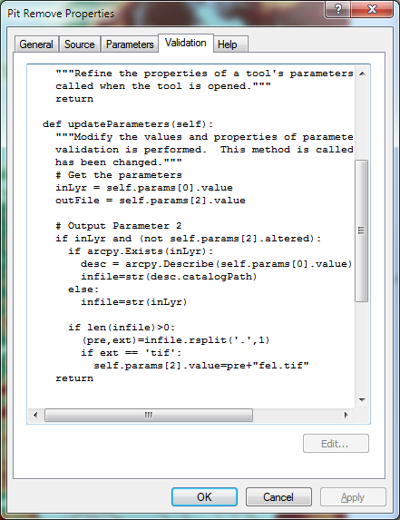
Validation code to add default file names
Python

Slide 30
Summary
GIS and Water Resources analysis capabilities are readily extensible with programming
to do something new
to repeat something needed frequently
Model builder provides visual programming and helps learn ArcGIS python commands
Python – cross platform, powerful and easy to use is a good programming language to start with (when your time is valuable)
Compiled language programming for developers (C++) to achieve optimal efficiency (when the computers time is valuable)

