Slide 1
Welcome to GIS in Water Resources 2013
David Maidment, David Tarboton

Slide 2
Learning Objectives
By the end of the class you should be able to:
Plot a map of a hydrologic region including measurement sites and associate it with time series of data measured at those locations;
Use web mapping to access geospatial and temporal water resources information;
Create a base map of a study region including watersheds, streams, and aquifers by selecting features from regional maps;
Interpolate measured data at points to form raster surfaces over a region, and spatially average those surfaces over polygons of interest;
Do hydrologic calculations using map algebra on raster grids;
Build a geometric network for streams and rivers;
Analyze a digital elevation model of land surface terrain to derive watersheds and stream networks;

Slide 3
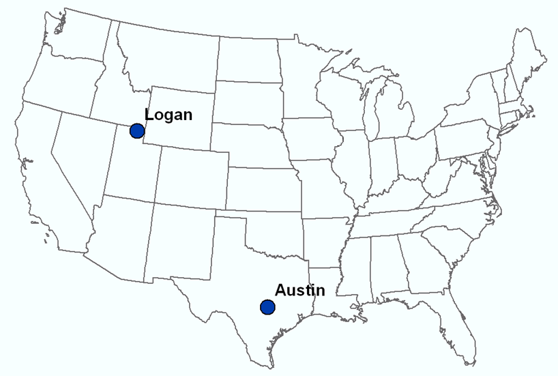
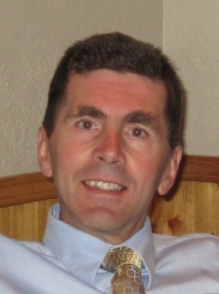
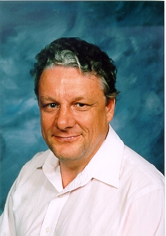
Our Classroom
Dr David Tarboton
Students at Utah State University
Dr David Maidment Students at UT Austin

Slide 4
Six Basic Course Elements
Lectures
Powerpoint slides
Video streaming
Readings
Assigned web materials
Homework
Computer exercises
Hand exercises
Term Project
Oral presentation
HTML report
Class Interaction
Email
Discussion
Examinations
Midterm, final

Slide 5
Websites
http://www.engineering.usu.edu/dtarb/giswr/2013
http://www.caee.utexas.edu/prof/maidment/giswr2013/giswr2012.htm

