Slide 1


HydroShare: Advancing Collaboration through Hydrologic Data and Model Sharing
David Tarboton, Ray Idaszak, Jeffery Horsburgh, Dan Ames, Jon Goodall, Larry Band, Venkatesh Merwade, Alva Couch, Jennifer Arrigo, Rick Hooper, David Valentine
http://www.hydroshare.org
OCI-1148453
OCI-1148090

Slide 2
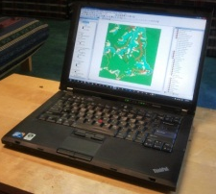
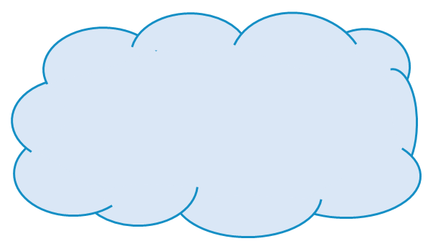
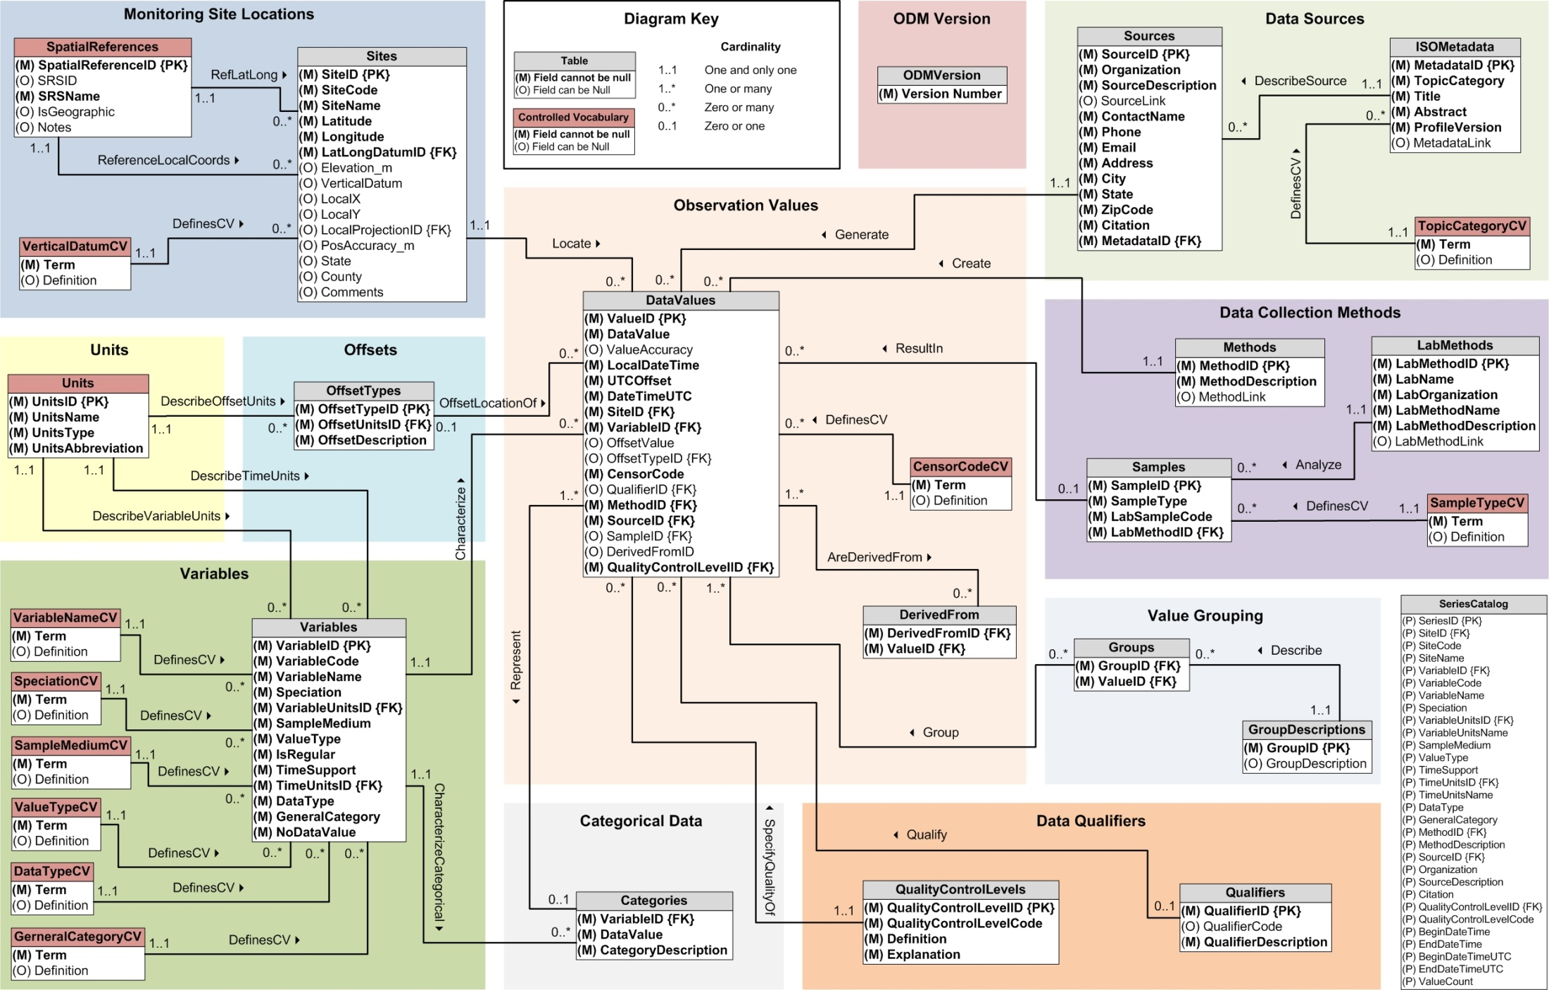
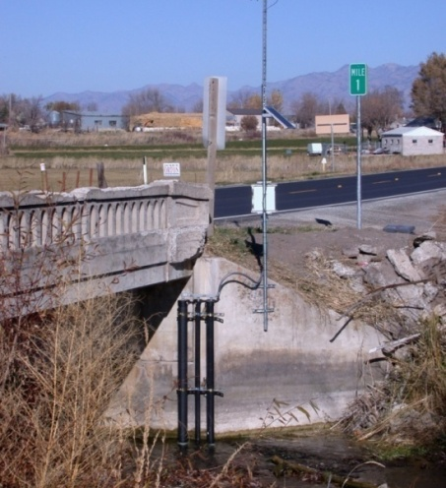
CUAHSI HIS Challenges
Publishing data requires access to or setting up a HydroServer
Accessing data requires HydroDesktop
Generally limited to time series at a point
Desktop
Catalog
Server

Slide 3
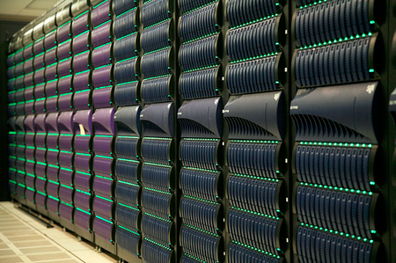
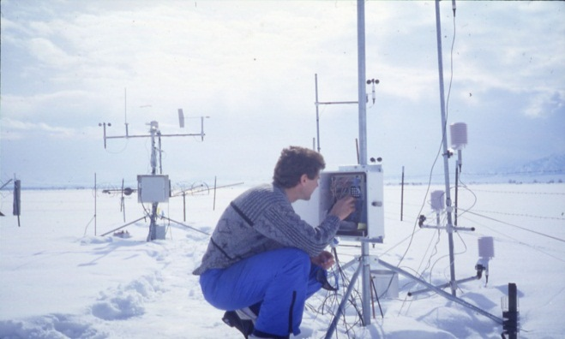
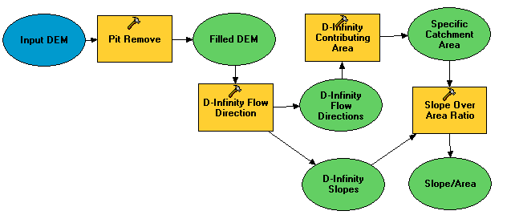

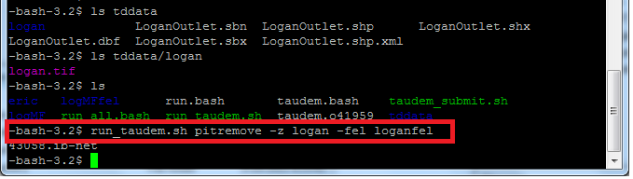
A digital divide
Researchers
Experimentalists
Modelers
Big Data and HPC
#!/bin/bash
vi
chmod
#PBS -l nodes=4:ppn=8
grep
awk
mpiexec
How can we best structure data and computer models to enable the use of high-performance and data-intensive computing by discipline scientists coming to this problem without extensive computational knowledge and algorithmic experience?
Gateways, Web Interfaces, CyberGIS

Slide 4
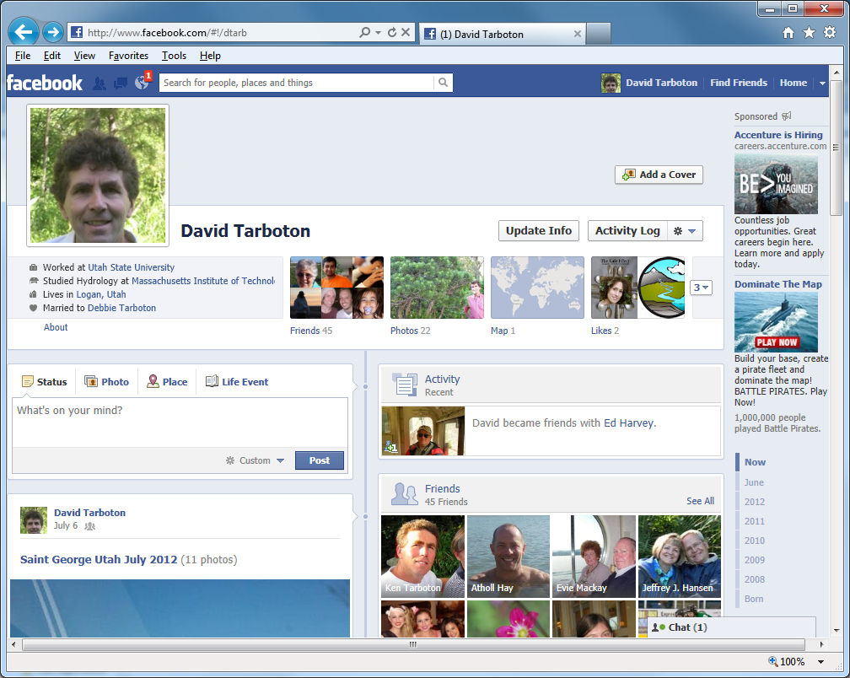
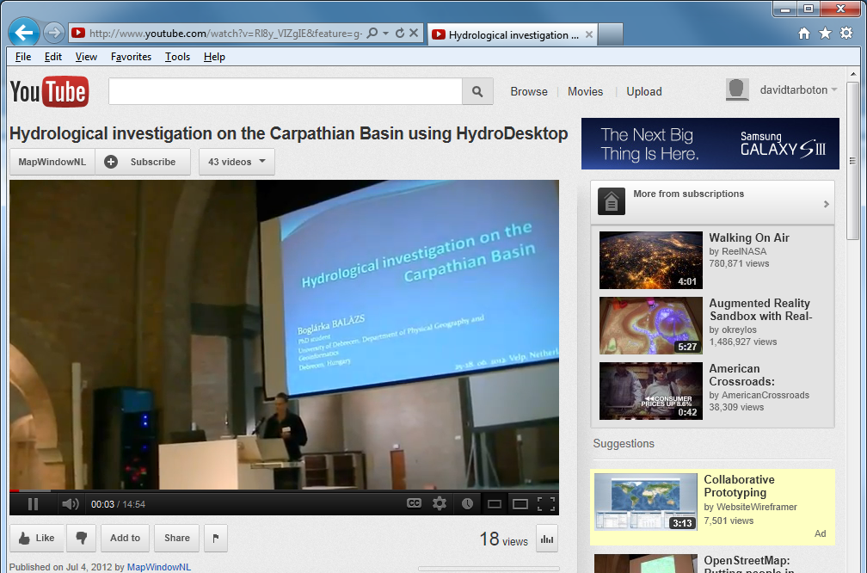
Can sharing data and models be as easy as sharing photos on Facebook or videos on YouTube?
Notes:
In short, we would like to see if sharing hydrologic data and models can be as easy as sharing photos on Facebook or videos on YouTube.

Slide 5
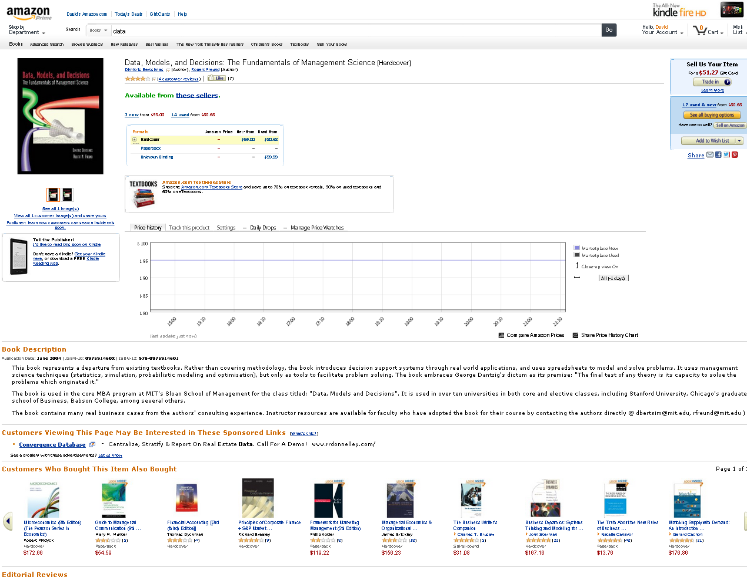
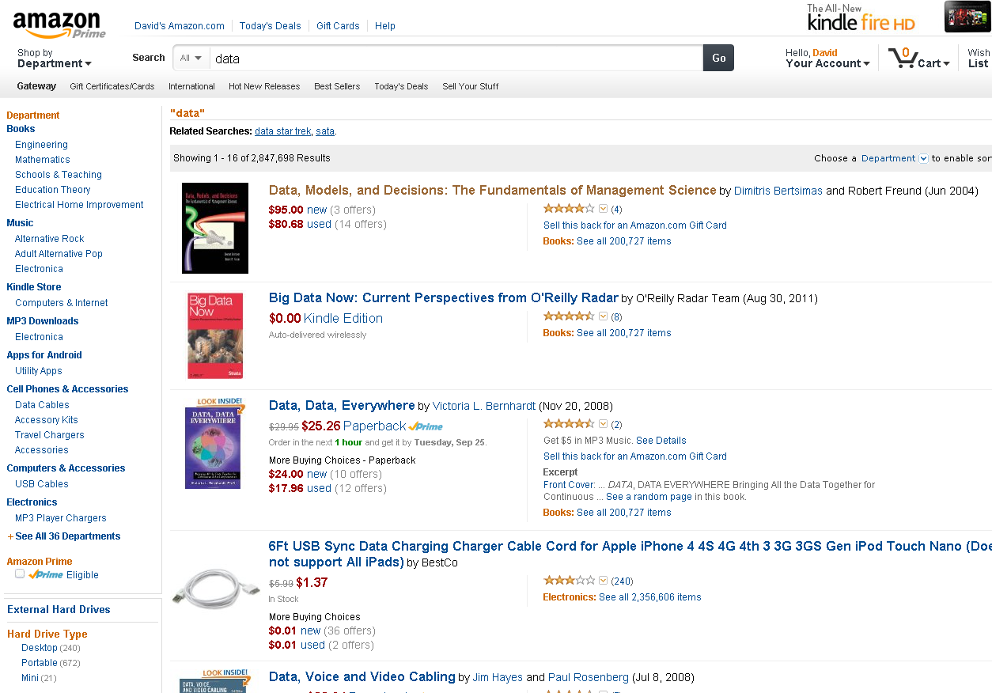
Can finding data and models be as easy as shopping on Amazon?
Possible Filters
Available Formats
Items
Recommendations
Prices (perhaps usage)
Notes:
Or whether finding data and models can be as easy as shopping on Amazon, and perhaps not as heavy on your credit card.
List of items also includes other providers, aka not shipped by amazon.
List of data shows ‘facets’
,
Items show formats recommendations. Add-in shows pricetracking

Slide 6

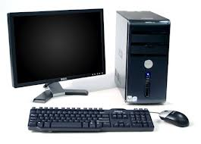



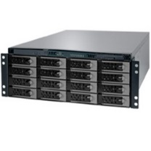
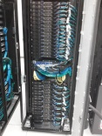
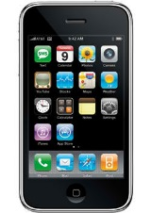
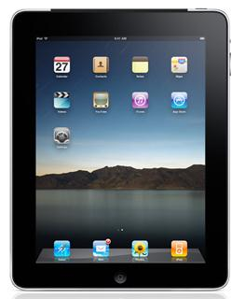
Cloud Computing
Applications
Models
Storage
Computation
Services
Wikipedia: Cloud computing is the use of computing resources (hardware and software) that are delivered as a service over a network (typically the Internet)
Google, Amazon, Microsoft, Apple, DropBox
XSEDE, Condor, BOINC

Slide 7
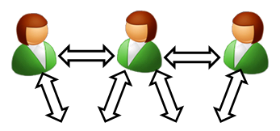


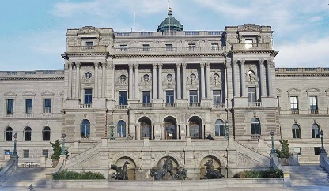
HydroShare is a web based collaborative system to support analysis, modeling and data publication
Collaboration
Analysis
Observers and instruments
Data
Models
Publication, Archival, Curation
Notes:
HydroShare will be a collaborative environment for sharing hydrologic data and models aimed at giving hydrologists the technology infrastructure they need to address critical issues related to water quantity, quality, accessibility, and management.
HydroShare will expand the data sharing capability of the CUAHSI Hydrologic Information System by broadening the classes of data accommodated, expanding capability to include the sharing of models and model components, and taking advantage of emerging social media functionality to enhance information about and collaboration around hydrologic data and models.
Functionality will include
A web portal for model and data sharing
Sharing features added to HydroDesktop client software
Access to more types of hydrologic data using standards compliant data formats and interfaces
Enhanced catalog functionality that broadens discovery functionality to different data types and models
New model sharing and discovery functionality
Enhanced easy to use access to high performance computing
Social media and collaboration functionality
Linkages to other data and modeling systems such as USGS and CUAHSI data services, NASA earth exchange and HPC resources e.g. at CSDMS

Slide 8
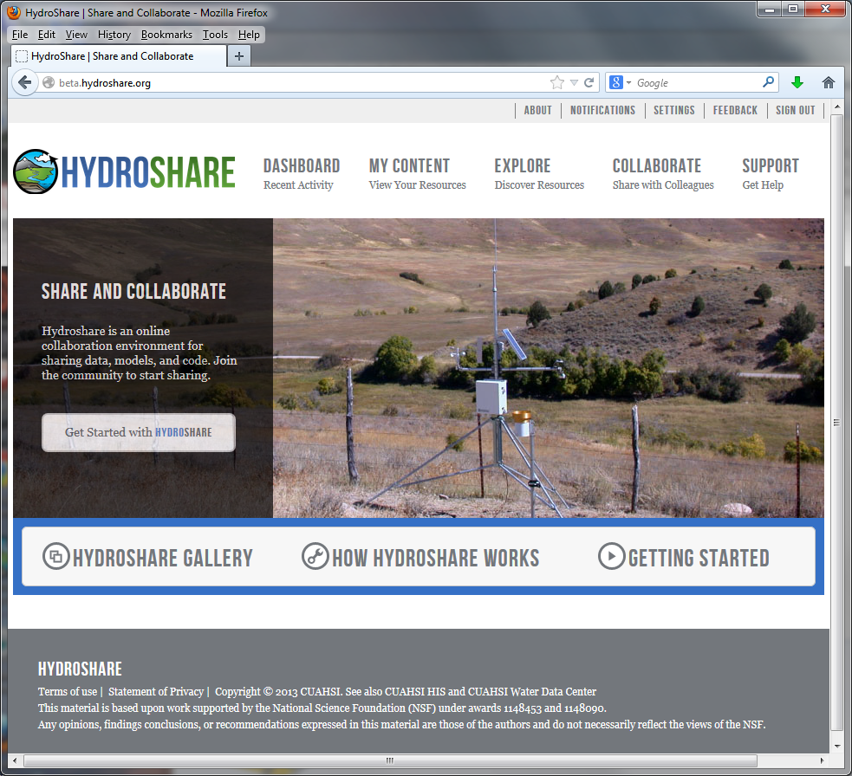
Currently in beta testing
http://beta.hydroshare.org

Slide 9
HydroShare Functionality to be Developed
A new, web-based system for advancing model and data sharing
Sharing features to HydroDesktop
Access more types of hydrologic data using standards compliant data formats and interfaces
Enhance catalog functionality that broadens discovery functionality to different data types
New model sharing and discovery functionality
Facilitate and ease access to use of high performance computing
New social media and collaboration functionality
Links to other data and modeling systems

Slide 10
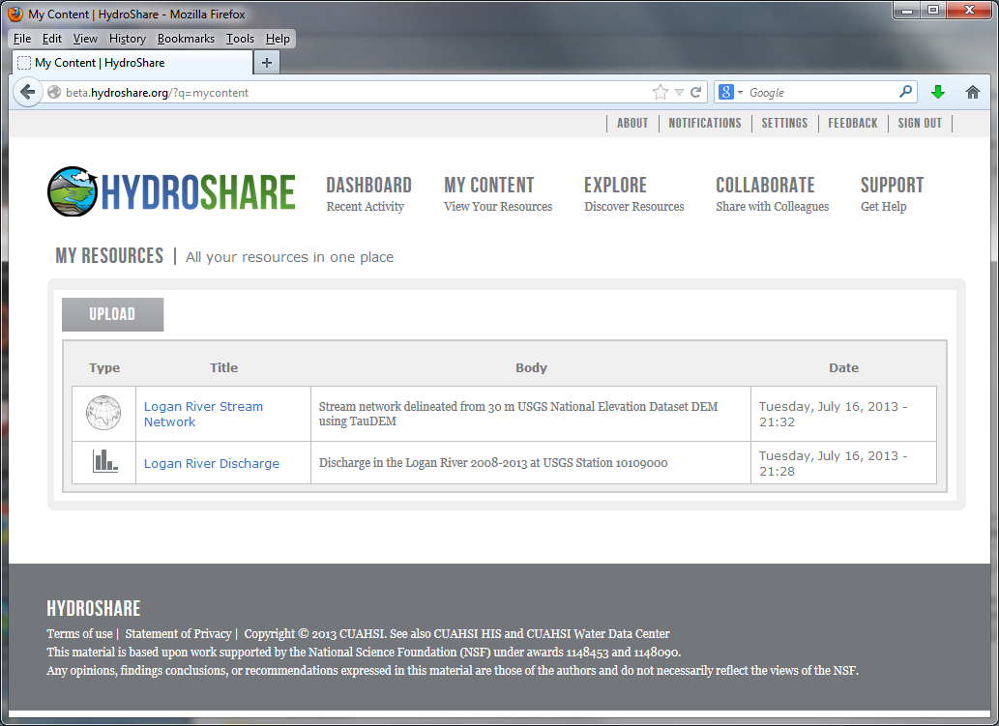

Slide 11
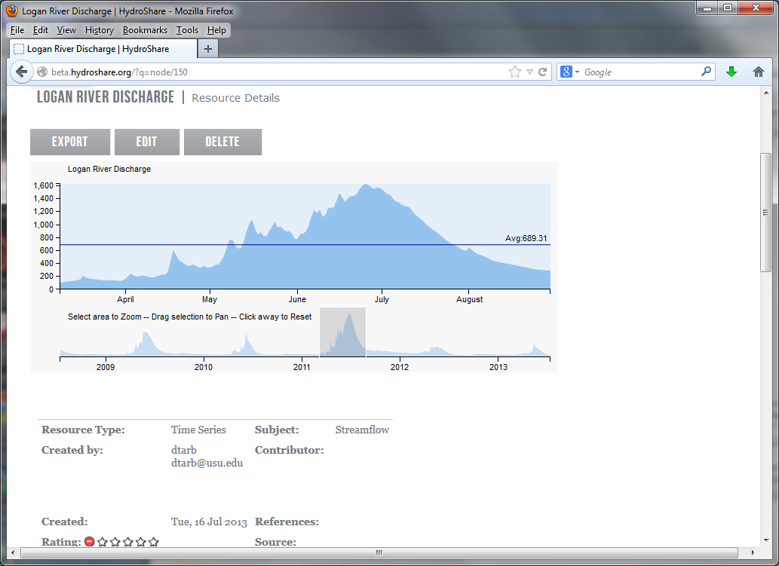

Slide 12
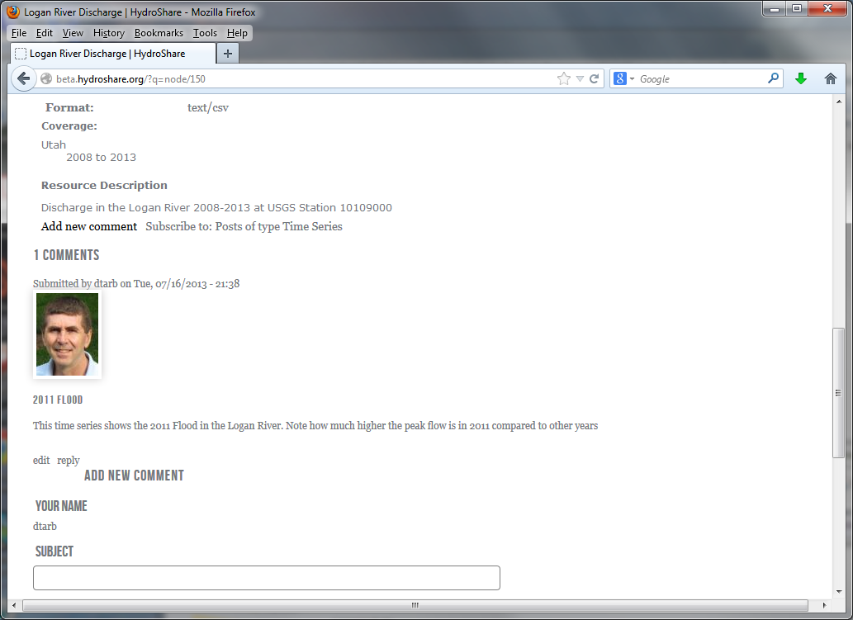

Slide 13
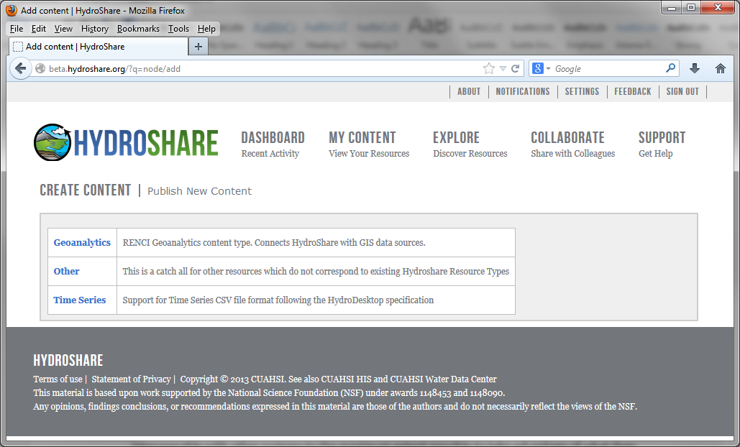
Upload

Slide 14
Support additional types of data
Resource Types
Time Series
Geographic feature set
Other
Referenced HIS time series
Geographic Raster
Multidimensional Space Time dataset
River geometry
Sample based observations (ODM2 and CZO)
Documents
Tabular objects
HydroDesktop Project package
Scripts
Models
Model Components
Referenced data sets from other (non HIS sources).
Tools
Uploaders to facilitate loading of resources
Viewers to visualize the resource
Exporters to download the resource
Best practice tools for hydrologic data preprocessing and analysis
Requires a Resource Data Model
Documented resource content specification that dictates how the resource is stored in HydroShare

Slide 15

_{Imagine the Possibilities…}
Discover and Analyze/Model (in Desktop or Cloud)
Observe
Publish and Catalog
Collaboration
Analysis
3
Observers and instruments
HydroServer (ODM)
Data
Models
1
2
Publication, Archival, Curation
HydroShare to support integrated collaborative analysis, modeling and data publication

Slide 16
_{Imagine the Possibilities…}
Share the results (Data and Models)
Collaboration
Analysis
4
Observers and instruments
HydroShare resource
store
Data
Models
Publication, Archival, Curation
HydroShare to support integrated collaborative analysis, modeling and data publication

Slide 17

_{Imagine the Possibilities…}
Group Collaboration using HydroShare
Preparation of a paper
Collaboration
5
Analysis
6
Observers and instruments
Data
Models
Publication, Archival, Curation
HydroShare to support integrated collaborative analysis, modeling and data publication

Slide 18
_{Imagine the Possibilities…}
Submittal of paper, review, archival of electronic paper with data, methods and workflow
Collaboration
Analysis
7
Observers and instruments
Data
Models
Publication, Archival, Curation
HydroShare to support integrated collaborative analysis, modeling and data publication
DataOne, EarthCube, …

Slide 19

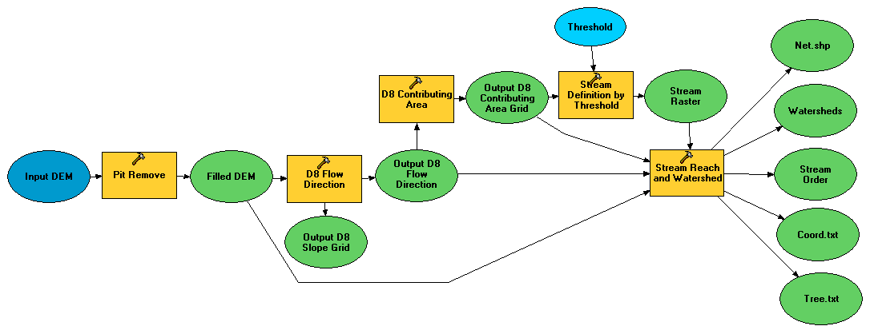

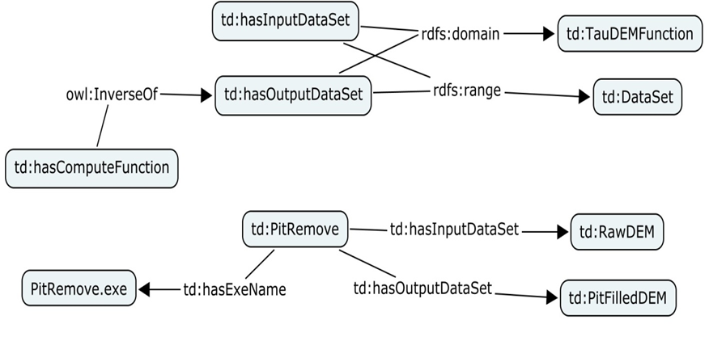
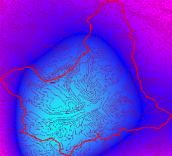

HydroShare Modeling
Flow
Time
t
y
x
Data: Links to national and global data sets of essential terrestrial variables (e.g. NASA NEX, HydroTerre)
Tools to preprocess and configure inputs (TauDEM + CyberGIS)
Preconfigured models and modeling systems as services (CI-WATER)
Standards for information exchange for interoperability (OpenMI, CSDMS BMI)
Tools for visualization and analysis
Automated reasoning to couple models based on purpose, context, data and resources (Aaron Byrd)
Notes:
Data: Links to national and global data sets of essential terrestrial variables (e.g. NASA NEX, HydroTerre)
Tools to preprocess and configure inputs
Preconfigured models and modeling systems as services
Standards for information exchange for interoperability (OpenMI, CSDMS BMI)
Tools for Visualization and Analysis
Automated reasoning to couple models based on purpose, context, data and resources

Slide 20
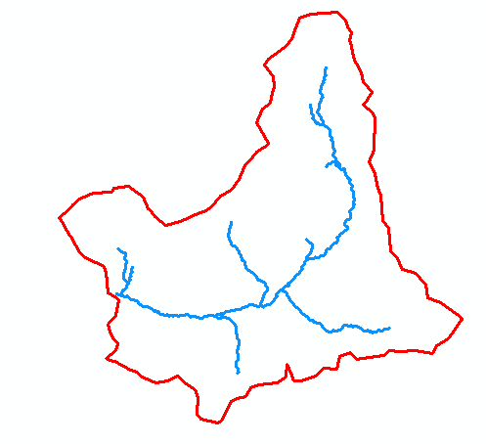
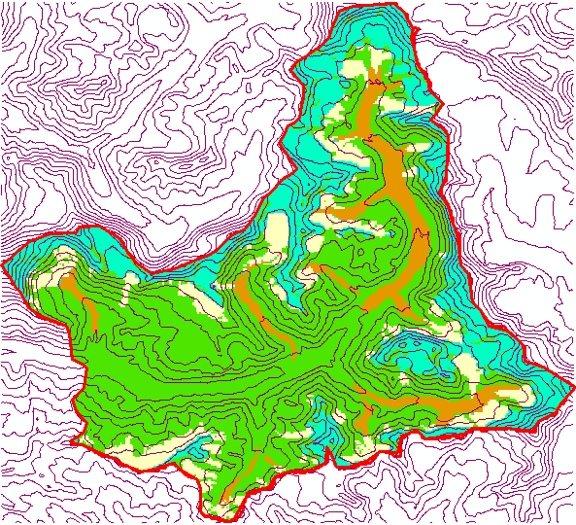
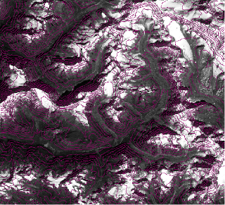
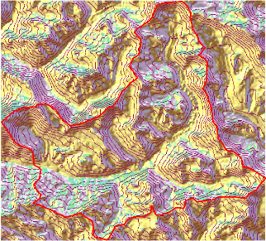
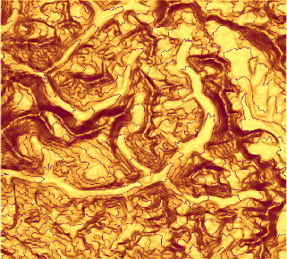
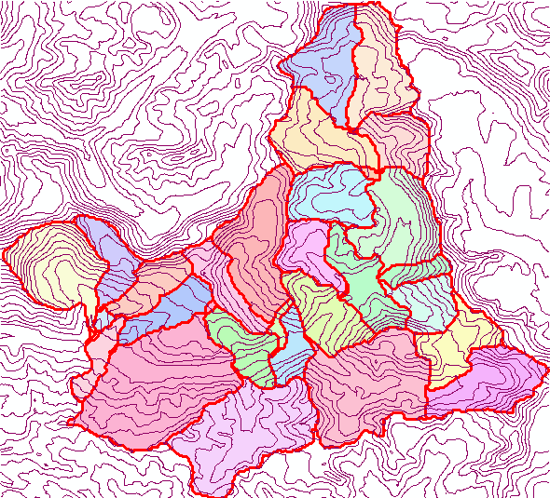
A specific example
Big snow year
Will my city flood?
Click to delineate watershed (model domain)
Generate model package from Essential Terrestrial Variables
Generate suite of input scenarios
Execute model and view results
P
Time
Flow
Time

Slide 21
But there is more…
What if I could express my decision needs to the system and have it reason and deduce which models need to run, then configure and run them based on the inputs available, precision needs and resources and time available.

Slide 22
Resource Repository Centric Paradigm for Modeling and Analysis
Models
Visualization Tools
Analysis Tools
Resource Repository
Data Loaders
Data Discovery Tools
Enable multiple models to use common “best practice” tools

Slide 23
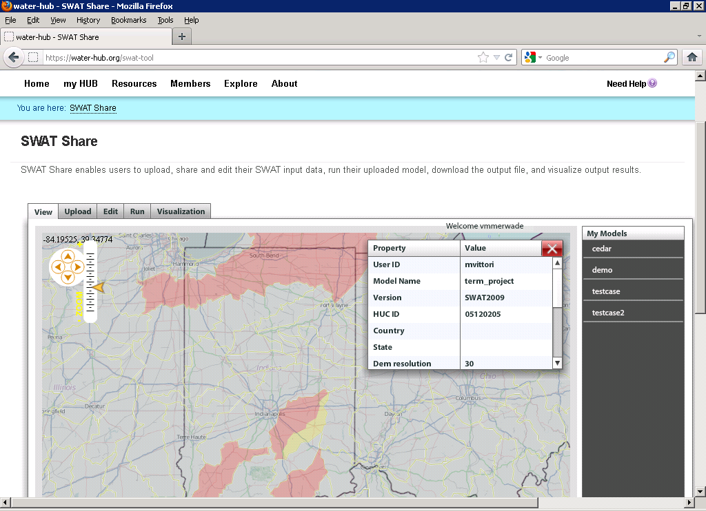
E.g. SWATShare
A web based tool for publishing, sharing, and accessing Soil Water Assessment Tool (SWAT)
www.water-hub.org/swat-tool
Notes:
You need to log-in to use the functions of SWAT share. On this slide, you see a map the watershed in red are the one for which SWAT models are available. Once you click a on one of the watersheds (highlighted in yellow), then you see then you see the associated metadata with the model. If the model is only published (and not shared), one cannot download or run the model. However, if the model is published and shared, any user can download, modify, and run the model on the SWATShare.

Slide 24
Model pre and post processing workflow
Model
Models
Visualization Tools
Analysis Tools
Input Files
Output Files
Resource Repository
Pre-Processing
Post -Processing
Data Loaders
Data Discovery Tools
Resource Repository
Each model interacts with information in the common data store
The modeler does not need to be concerned with and can take advantage of standardized analysis, visualization loading and discovery tools

Slide 25
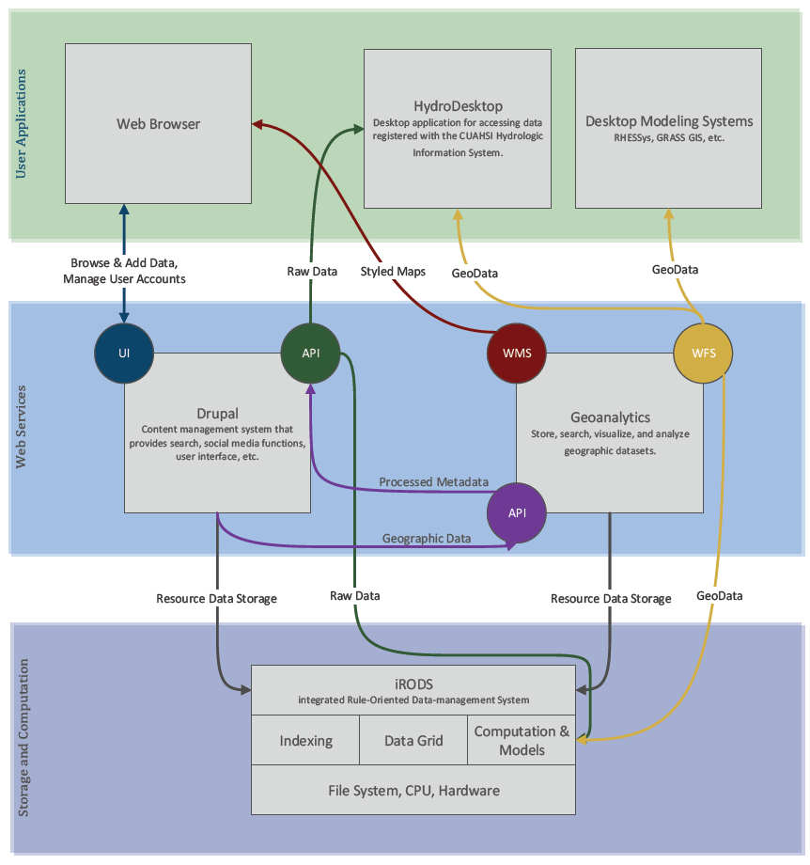
Architecture and Development

Slide 26
Drupal – Content Management System
Extensible Open Source Content Management Framework for Publication written in PHP
  Over 14,000 user contributed modules
Themed and Styled Presentation of HydroShare Resources with in page visualization
Off the shelf modules provide a Social Experience surrounding Hydrologic Data: Comments, Ratings, Group Behavior
Custom module development supports HydroShare Data Model, GeoAnalytics and iRODS Integration

Slide 27
Enterprise iRODS
Users
Distributed Data Grid Middleware:
Metadata Catalog holding virtual file system information and associated metadata
Extensible number of ‘Resource Servers’ which may provide connectivity to storage resources
Integrated Rule Engine for Policy Driven Data Management triggered by Data Management Activities
Extensibility via Microservices (MSVC) – Plugins providing functionality to the Rule Engine
Client
iCAT
Rule Engine
MSVC
R. Server
…
R. Server
E-iRODS in HydroShare
Storage of HydroShare Resources Replicated across multiple institutions
Access to Computation
Access to Indexing for Discovery

Slide 28

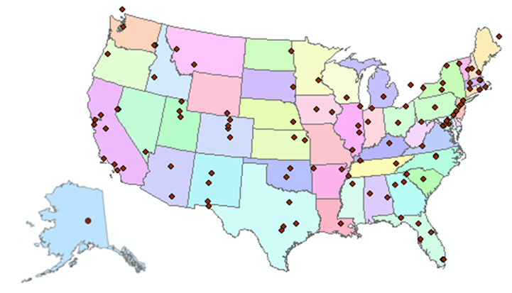
A community project
http://www.cuahsi.org
109 US University members
7 affiliate members
20 international affiliate members
3 corporate members
  (as of January 2013)
Informatics Standing Committee
Users Committee

Slide 29
Community Governance
CUAHSI Board
Standing Committee on Informatics
Oversight
HydroShare
Executive Committee
Prioritization
Decision Making
Specification Requests
Prototype
CUAHSI
User Community
HydroShare
Development Team
HydroShare
Evaluation
Community / User Requirements
  Surveys
  Conferences
  Workshops
  Embed UI with “Help us make our software better”
Implementation (Agile)
  Hydrologic Information System (HIS)
  Integrated Rule-Oriented Data System (iRODS)
  Drupal
Metrics
  End-user involvement
  Quantitative and qualitative measurement
  Sustainability
Released Software

Slide 30
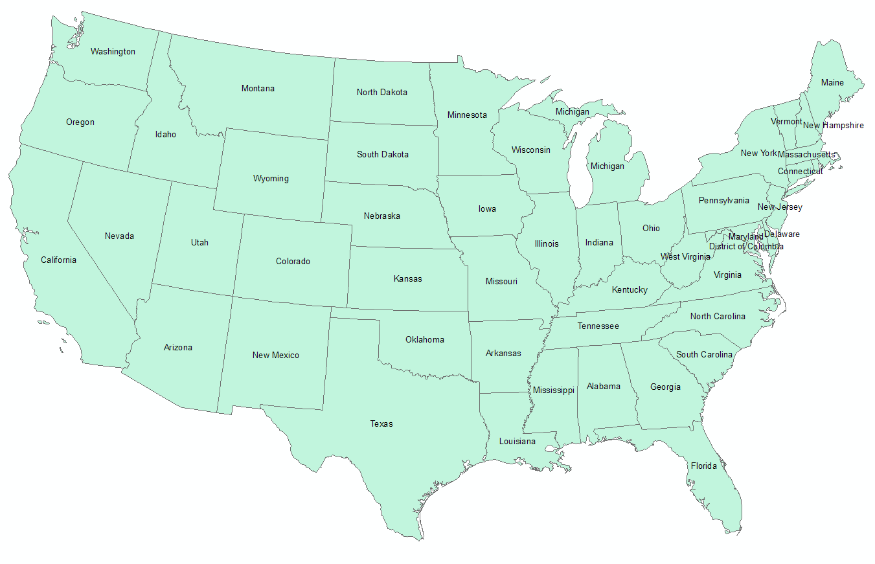
HydroShare project team
  USU
  RENCI/UNC
  CUAHSI
  BYU
  Tufts
  UVA
  Texas
  Purdue
  SDSC
OCI-1148453
OCI-1148090
2012-2017
Notes:
The HydroShare project is part of a broad effort in CUAHSI in the area of Hydrologic Information Systems. We have a team of developers and domain scientists from eight universities working on HydroShare. This is part of the even broader focus in NSF on data management, Cyberinfrastructure and sustainable software.

Slide 31
User driven use cases
Annotate uploaded hydrology models using an ontology
Register a Package with HydroShare
Add data resource for a model
Notify Me When Related Resources Are Registered
Register a Resource with HydroShare
Evaluate Load Reduction Scenarios
Suggest a Resource Related to the Current Resource
Building an Intelligent Digital Watershed (IDW)
Contribute to a Community Dataset
Define Relationships between Resources
Discover a Community Dataset to which I Can Contribute
Execute a Model in HydroShare
Register a Workflow with HydroShare
Register a Community Dataset
Download a Model, Execute It, and Share the Model and Results
Define a Composite Resource
Crowd sourcing modeling tasks
Automated Visualization (thumbnails)
User displays HydroShare Gallery
Existing User Logs into HydroShare
New User Creates a HydroShare User Account
User Sets Personal Preferences
User is provided a personal Dashboard
User Chooses to “Follow” Another User
User Chooses to “Follow” a Group
User Views His/Her Personal Content
User Uploads a Resource
User Deletes a Resource
User Shares a Resource in HydroShare
User Publishes a Resource to DataONE
User Publishes a Resource to the CUAHSI Water Data Center
User Exports a Resource to their Local Machine
User Searches / Filters / Sorts their Personal Resources
User Views Details Page for a Resource
User Groups Resources into a “Folder” or “Collection”
User “Opens” a Resource
User Edits Metadata Description for a Resource
User Adds a Comment to a Resource
User Rates / Reviews a Resource
User Derives a New Resource from an Existing Resource
User Executes a Resource
User Explores / Searches Available HydroShare Resources
User “Pins” a Discovered Resource to a “Resource Collection”
User Filters Discovered Resources
User Imports Data from Externally Hosted Resources
User Searches For Collaboration Groups
User Views Group Details
User Creates a Collaboration Group
User Requests Group Membership
User Creates a Comment on a Collaboration Group
User Creates a Discussion in a Collaboration Group Discussion Forum
User Edits a Collaboration Group’s Description
User Searches / Filters / Sorts a Group’s Resources
User Views Documentation and Gets Support
User Views / Subscribes to the HydroShare Blog
User Exports a HydroShare Resource Citation into Mendeley or Zotero
User Transfers Ownership of a Resource to Another User
User Receives HydroShare Social Media Notifications via Mobile Device
User Views Access / Download Statistics for a Resource
User Views HydroShare Resources via Mobile Devices
Searching and/or browsing HydroShare
Translate data automatically for HydroShare operations.
Translate data automatically for export.
Publish translated data.
Translate replicated data.
Registration of a new HydroShare Tool
Editing a Published (with DOI) resource
User Creates New “Model Package” Resource
User Transfers Ownership of a Group to Another User
User Develops a Client for HydroShare
Summarize hydrologic model input parameters for a user defined region
Discover specialist/ Promote specialized services
Visualize Time Series
Upload a Model

Slide 32
Metrics
Metric | Number
Number of registered users | 35
Number of host institutions | 15
Github HydroShare code repository owners and members | 15
Use Metric | Number of active users | Number of resources stored | Number of resources downloaded | Size of resources stored (GB) | CPU hours of compute resources used | Number of compute jobs run | Number of logons | Average duration of session
Total use
Use by user type
University Faculty
Post-Doctoral Fellow
….
Use by Geographic Location
State
Country
Use by resource type
Time Series
Geographic Feature Set
….
User Types: University Faculty, University Professional or Research Staff, Post-Doctoral Fellow, University Graduate Student, University Undergraduate Student, Commercial/Professional, Government Official, School Student Kindergarten to 12th Grade, School Teacher Kindergarten to 12th Grade, Other, Unspecified
Resource Types: Time Series, Geographic Feature Set, Geographic Raster, Multidimensional Space Time Array, River Geometry, Model, Workflow, Other, …

Slide 33
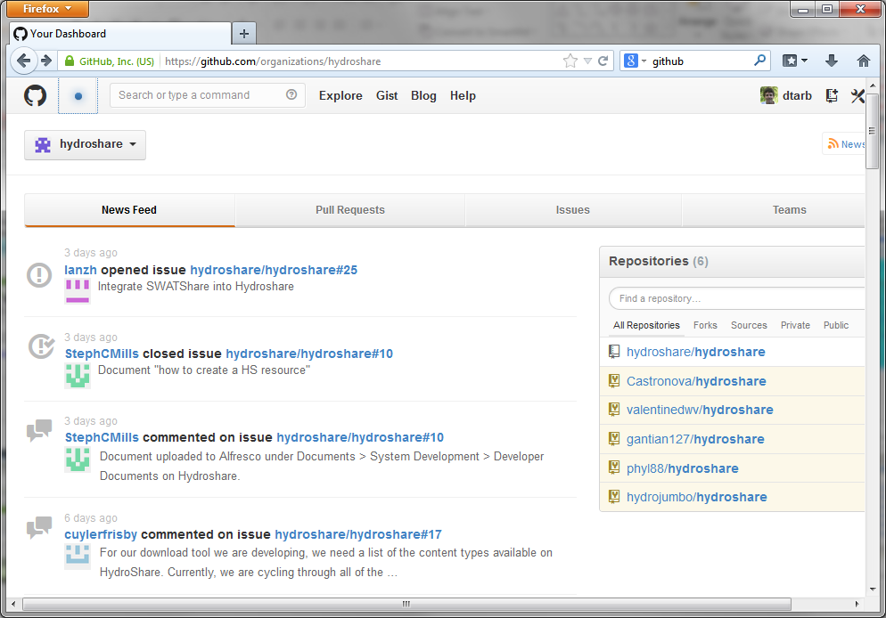
Collaborative Open Development
http://github.com/organizations/hydroshare
http://hydrodesktop.codeplex.com

Slide 34
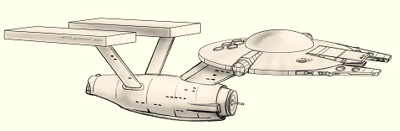
Summary
A collaborative website for the sharing of hydrologic data and models
To expand data sharing capability of CUAHSI HIS
  Additional data classes
  Models, scripts, tools and workflows
Community Participation
Interoperability
Standards
Open Development
To boldly go where no one has gone before

Slide 35
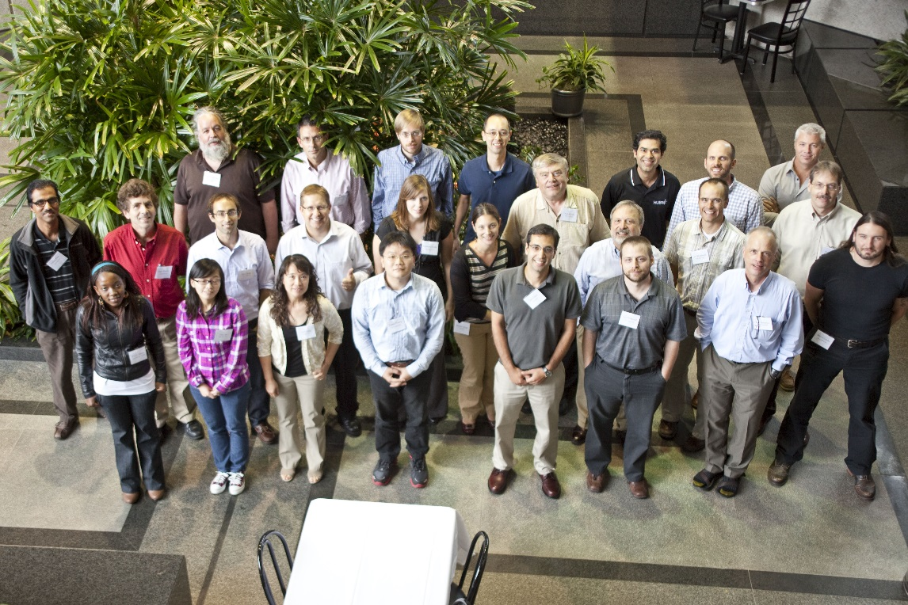
Thanks to a lot of people
  USU
  RENCI/UNC
  CUAHSI
  BYU
  Tufts
  USC
  Texas
  Purdue
  SDSC
HydroShare team: Dave Tarboton, Ray Idaszak, Dan Ames, Jeff Horsburgh, Jon Goodall, Larry Band, Venkatesh Merwade, Jeff Heard, Carol Song, Alva Couch, David Valentine, Rick Hooper, Jennifer Arrigo, David Maidment, Tim Whiteaker, Alex Bedig, Laura Christopherson, Pabitra Dash, Tian Gan, Tony Castronova, Karl Gustafson, Stephen Jackson, Cuyler Frisby, Stephanie Mills, Brian Miles, Jon Pollak, Stephanie Reeder, Ash Semien, Yaping Xiao, Lan Zhao
http://www.cuahsi.org/hydroshare.aspx
OCI-1148453
OCI-1148090
Notes:
The HydroShare project is part of a broad effort in CUAHSI in the area of Hydrologic Information Systems. We have a team of developers and domain scientists from eight universities working on HydroShare. This is part of the even broader focus in NSF on data management, Cyberinfrastructure and sustainable software.

Slide 36
Next Class

Slide 37
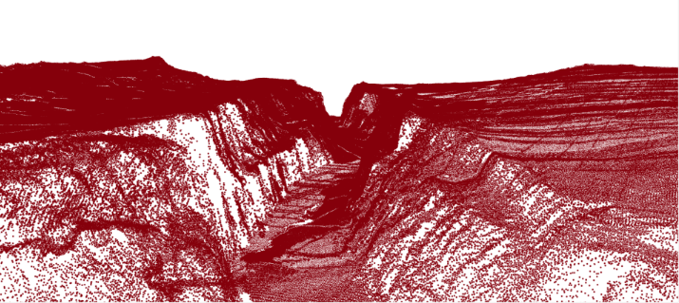
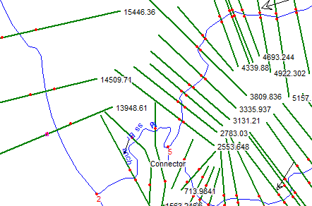
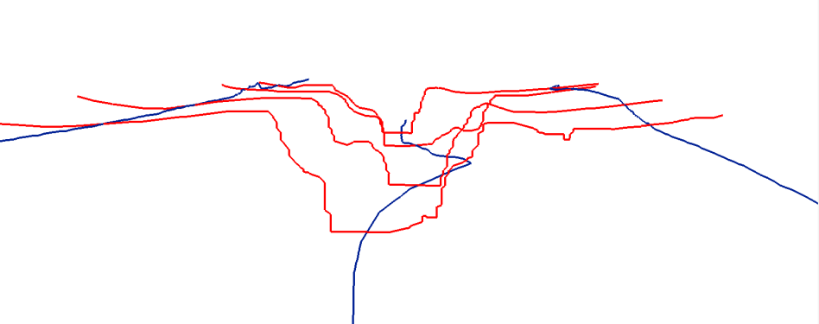
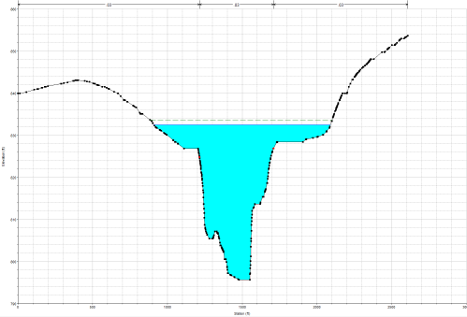
Representing River Geometry in HydroShare
LiDAR
Cross Sections Attached to River Network
Cross Sections
Hydraulic Calculations

Slide 38
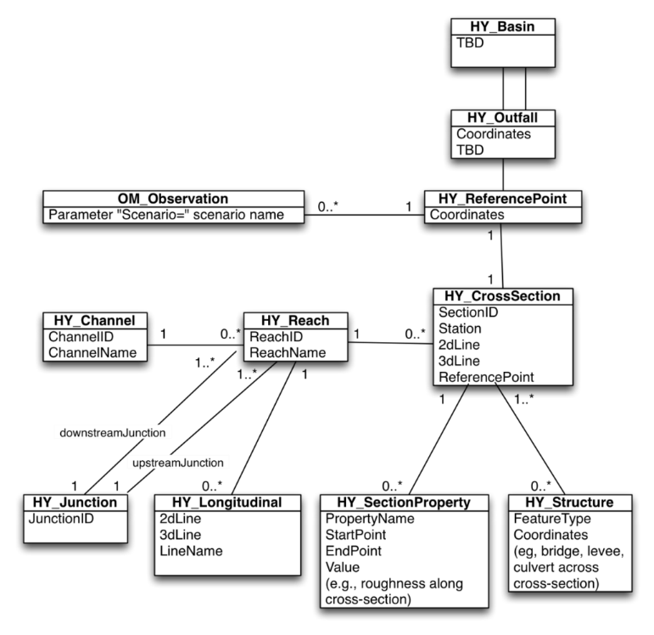
Modular design, linking river geometry, catchment geometry, network topology, and time series observations
  Data is linked by common reference points along the river, which can be represented as point or cross section shapefiles and shown on a map.
  Based on OGC HY_Features Model

