Slide 1
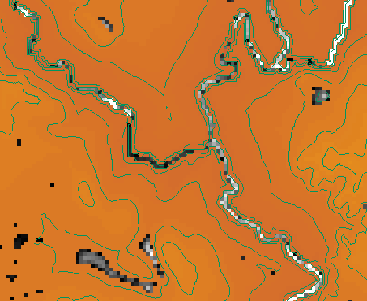
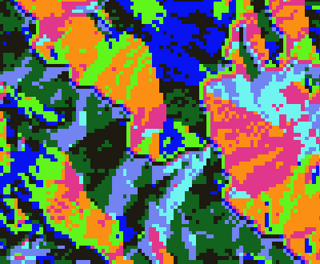
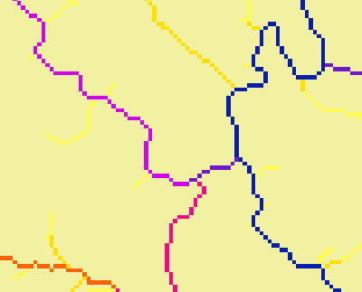
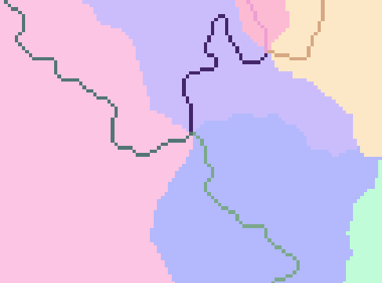
Key Concepts from Exercise 4 Raster Analysis Layers
Fill
Flow Direction
Flow Accumulation
Stream Definition
Stream Links
Catchments

Slide 2
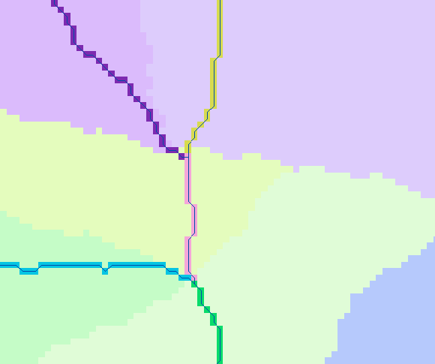
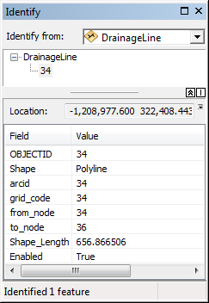
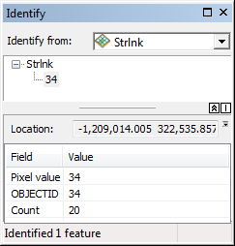
Vectorized Streams Linked Using Grid Code to Cell Equivalents
Grid
Streams
Vector
Streams

Slide 3
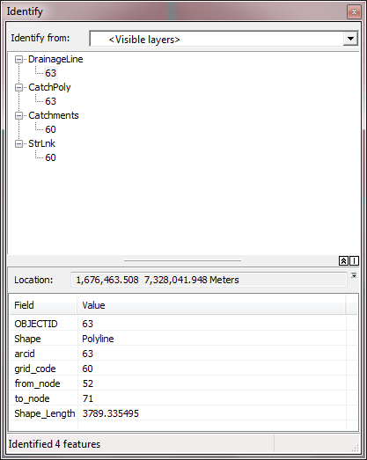
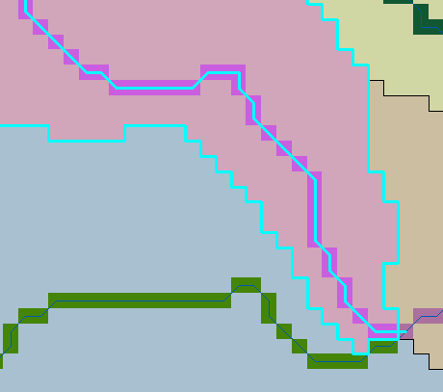
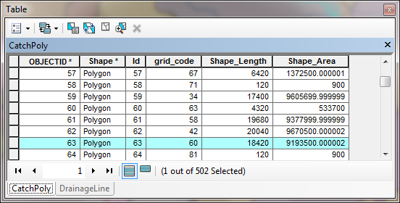
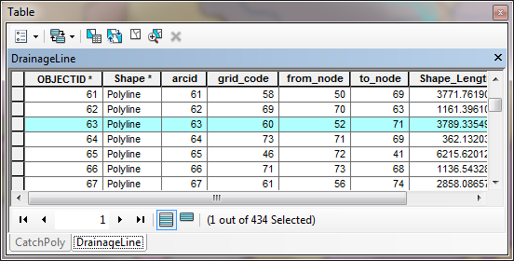
Relationships linking Catchments and Drainage Lines

Slide 4
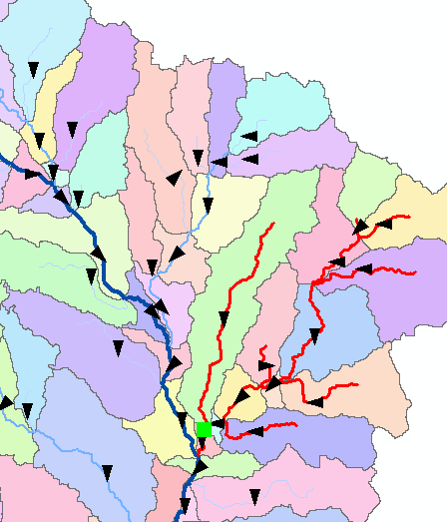
Vector Analysis Layers
Vector streams
Vector catchments
Attribute feature with raster zonal statistics
Geometric Network
Tracing
Selection statistics

