Slide 1
Welcome to GIS in Water Resources 2012
David Maidment, David Tarboton and Ayse Kilic

Slide 2
Learning Objectives
By the end of the class you should be able to:
Plot a map of a hydrologic region including measurement sites and associate it with time series of data measured at those locations;
Develop a Hydrologic Information System that links time series of water observations to locations where the measurements are made
Create a base map of a study region including watersheds, streams, and aquifers by selecting features from regional maps;
Interpolate measured data at points to form raster surfaces over a region, and spatially average those surfaces over polygons of interest;
Do hydrologic calculations using map algebra on raster grids;
Build a geometric network for streams and rivers;
Analyze a digital elevation model of land surface terrain to derive watersheds and stream networks;
Use remote sensing information in ArcGIS

Slide 3
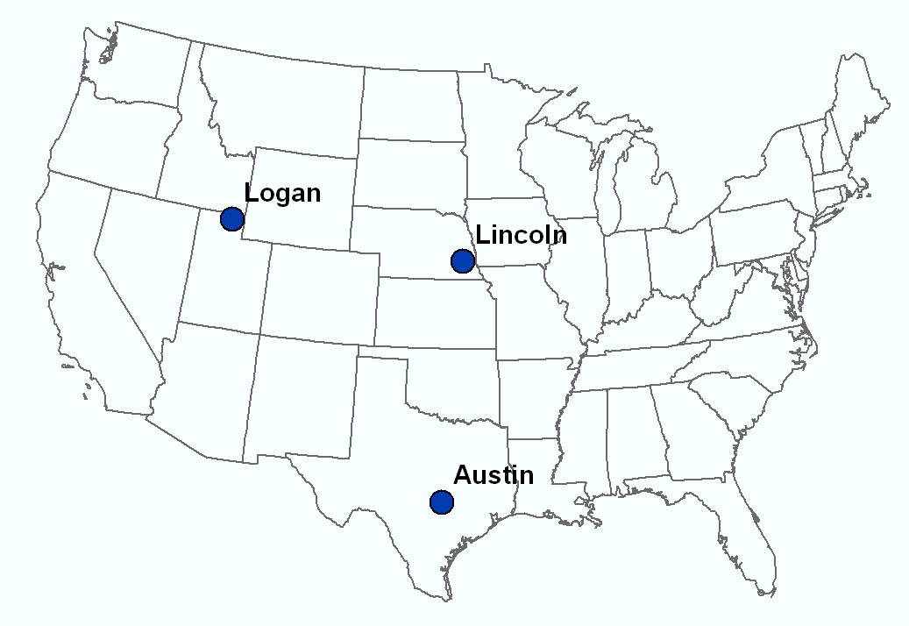
Our Classroom
Dr David Tarboton
Students at Utah State University
Dr Ayse Kilic Students at University of Nebraska - Lincoln
Dr David Maidment Students at UT Austin

Slide 4
Six Basic Course Elements
Lectures
Powerpoint slides
Video streaming
Readings
Assigned web materials
Homework
Computer exercises
Hand exercises
Term Project
Oral presentation
HTML report
Class Interaction
Email
Discussion
Examinations
Midterm, final

Slide 5
Websites
http://www.engineering.usu.edu/dtarb/giswr/2012
http://www.caee.utexas.edu/prof/maidment/giswr2012/giswr2012.htm
http://snr.unl.edu/airmak/giswr/2012/

