Slide 1
GIS in Water Resources: Lecture 1
In-class and distance learning
Geospatial database of hydrologic features
GIS and HIS
Curved earth and a flat map

Slide 2
Six Basic Course Elements
Lectures
  Powerpoint slides
  Video streaming
Readings
  Handouts and lecture synopses
Homework
  Computer exercises
  Hand exercises
Term Project
  Oral presentation
  HTML report
Class Interaction
  Email
  Discussion
Examinations
  Midterm, final

Slide 3
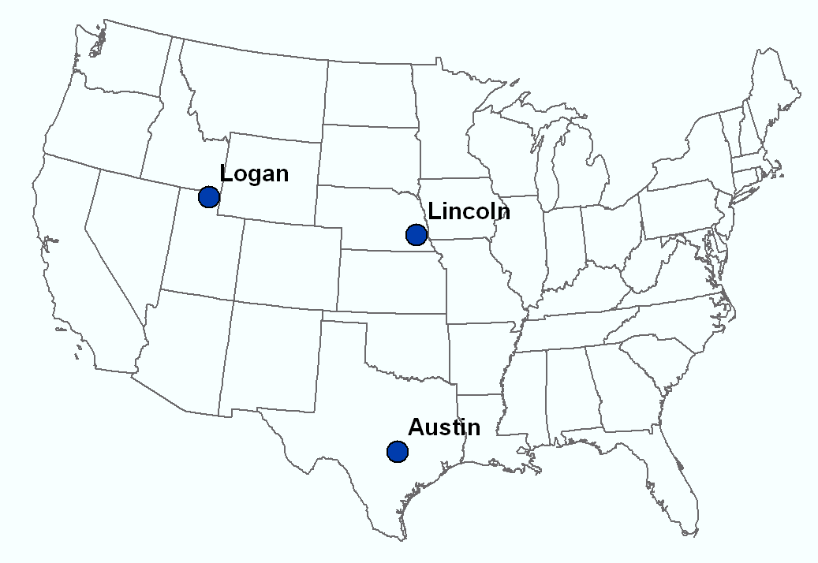
Our Classroom
Dr David Tarboton
Students at Utah State University
Dr Ayse Irmak Students at University of Nebraska - Lincoln
Dr David Maidment Students at University of Texas at Austin

Slide 4
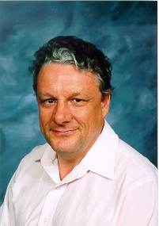
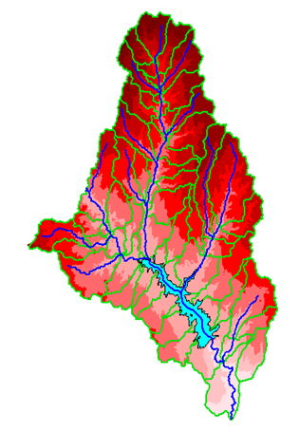
David R. Maidment
B.E. in Agricultural Engineering (with First Class Honors) from University of Canterbury, Christchurch, New Zealand, 1972
MS, PhD in Civil Engineering from University of Illinois, 1974 and 1976, respectively
1981 – joined University of Texas at Austin as an Assistant Professor, and have been on the faculty ever since. Now Hussein M. AlHarthy Centennial Chair in Civil Engineering
Initiated the GIS in Water Resources course in 1991 – this is the 20th anniversary!
Worked with ESRI since 1994 on a GIS Hydro Preconference seminar for the ESRI Users Conference
Leader of the CUAHSI Hydrologic Information System project since 2004

Slide 5

David Tarboton
Sc.D MIT 1990, Thesis: “The Analysis of River Basins and Channel Networks Using Digital Elevation Models”
  4 papers
  Fractal (space filling) River Networks
  Slope Scaling with Contributing Area
  On the Extraction of Channel Networks from Digital Elevation Data
  A Physical Basis for Drainage Density
  Relied on Fortran and C Codes. Largest grid analyzed 1719 x 1169 took days on MicroVAX and output results directly to tape due to insufficient disk space to hold results. Visualized using primitive XY and array plotting code.
1996 - Developed D-Infinity to have a better contributing area for study of landscape evolution – published 1997.
1997 - Contract to develop user friendly slope-stability tool based on D-infinity contributing area. Led to SINMAP developed for ArcView 3, the first GIS software I used.
Gradually adapted the set of Fortran and C codes that had accumulated from above research to use ESRI grid format and be distributable as TARDEM/TauDEM
Participated in GISWR since 1999 (this year is the 12th time – I skipped 2007 while working on WATERS Network conceptual design)

Slide 6
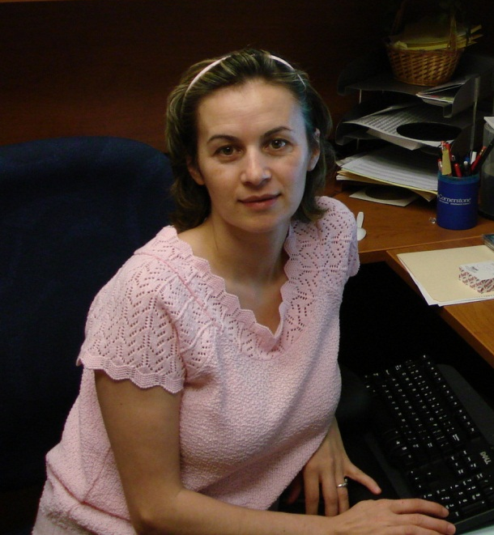
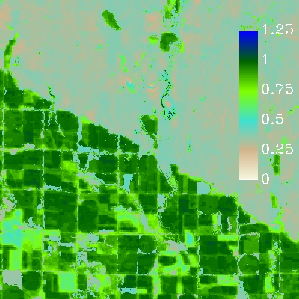
Ayse Irmak
M.E. (1998) & Ph.D (2002). Agricultural and Biological Engineering. University of Florida. Gainesville, FL. Dissertation: “Linking multiple layers of information to explain soybean yield variability” . 5 papers
  Linking multi-variables for diagnosing causes of spatial yield variability
  Analysis of spatial yield variability using a combined crop model-empirical approach
  Estimating spatially variable soil properties for crop model use
  Relationship between plant available soil water and yield
  Artificial neural network as a data analysis tool in precision farming
2004- Joined to UNL and continued to work on computer simulation of crop production for another year and gradually moved to Remote Sensing field with applications in Natural Resources Systems.
2006 - Remote Sensing-based Estimation of Evapotranspiration and other Surface Energy Fluxes
2008- Working on development of the Nebraska Hydrologic Information System (HIS), which is designed to provide improved access to evapotranspiration and other hydrologic data for end users.
Participated in GISWR since 2006 (this year is the 5th time – I skipped 2007 due to position change at UNL)

Slide 7
University Without Walls
Traditional Classroom
Community
Inside and Outside
The Classroom

Slide 8
Learning Styles
Instructor-Centered Presentation
Community-Centered Presentation
Instructor
Student
We learn from the instructors and each other

Slide 9
GIS in Water Resources: Lecture 1
In-class and distance learning
Geospatial database of hydrologic features
GIS and HIS
Curved earth and a flat map

Slide 10
Geographic Data Model
Conceptual Model – a set of concepts that describe a subject and allow reasoning about it
Mathematical Model – a conceptual model expressed in symbols and equations
Data Model – a conceptual model expressed in a data structure (e.g. ascii files, Excel tables, …..)
Geographic Data Model – a conceptual model for describing and reasoning about the world expressed in a GIS database

Slide 11
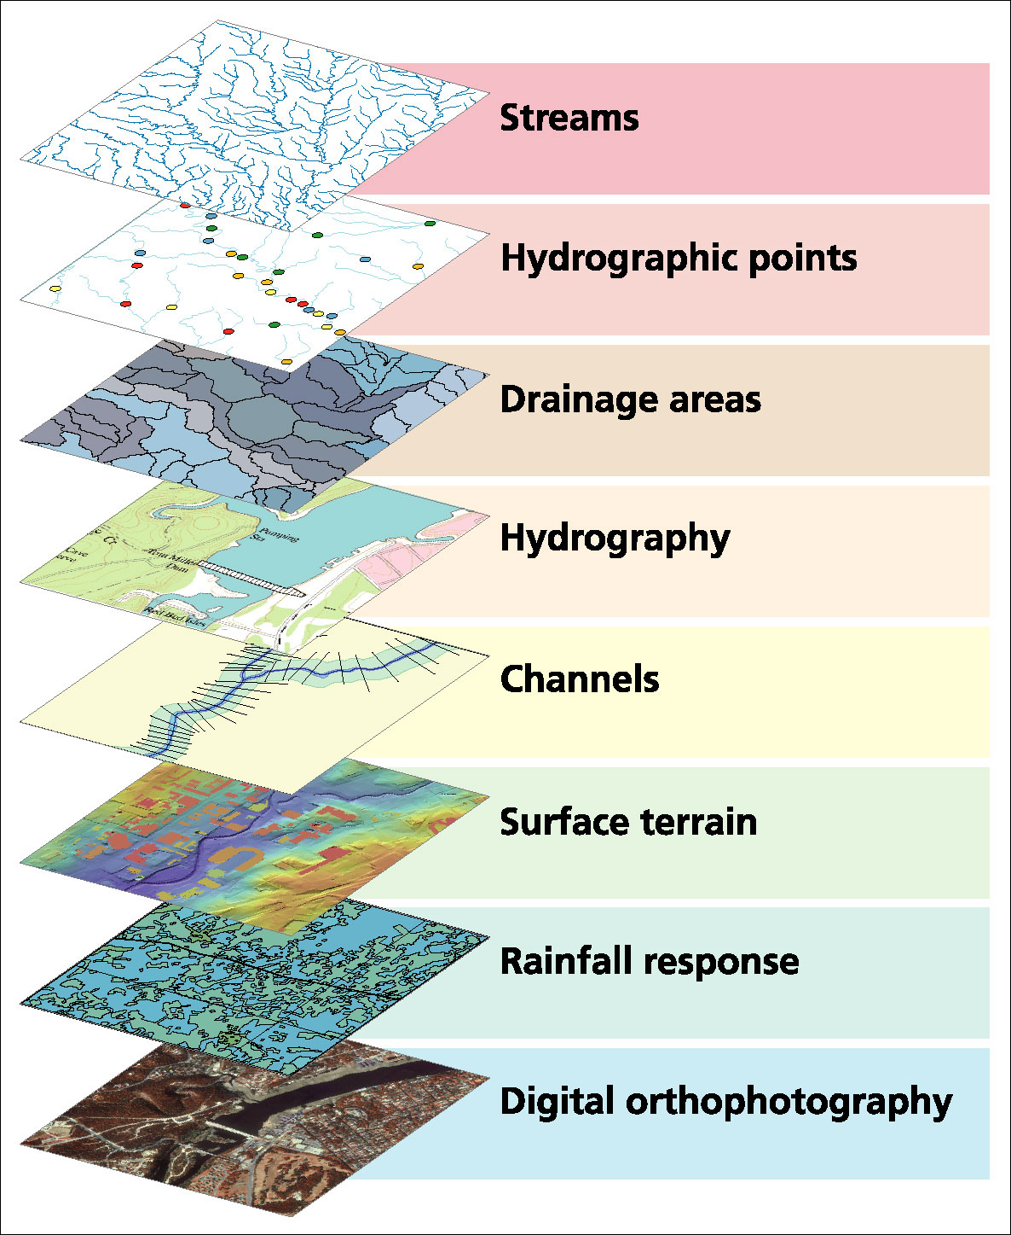
Data Model based on Inventory of data layers

Slide 12
Spatial Data: Vector format
Vector data are defined spatially:
(x₁,y₁)
Point - a pair of x and y coordinates
vertex
Line - a sequence of points
Node
Polygon - a closed set of lines
Notes:
DRM

Slide 13
Themes or Data Layers
Vector data: point, line or polygon features

Slide 14
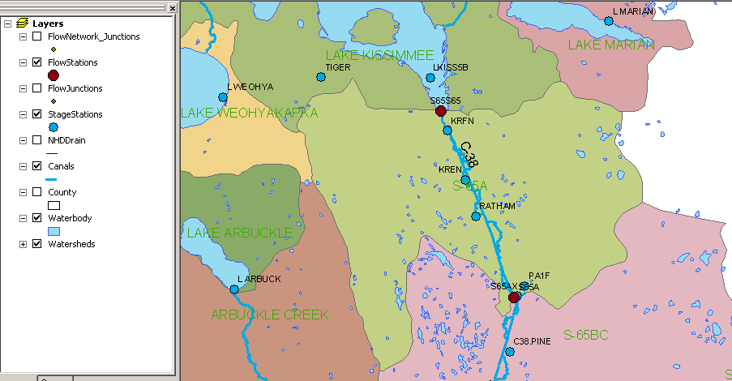
Kissimmee watershed, Florida
Themes

Slide 15
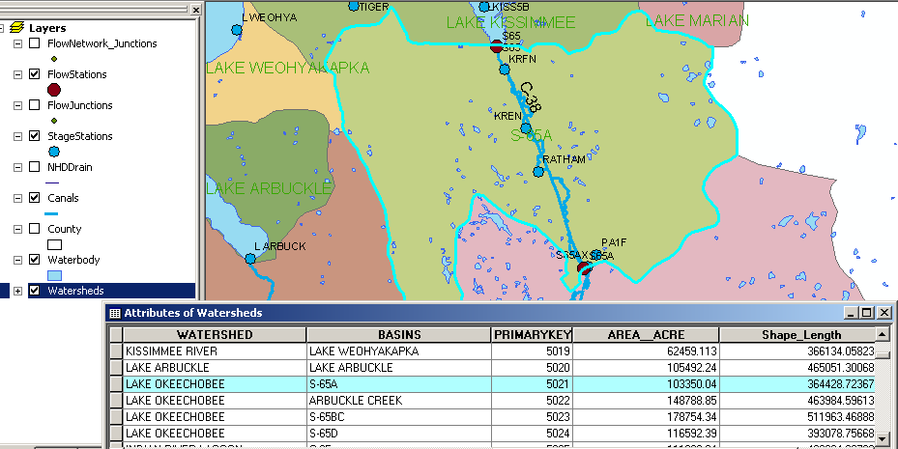
Attributes of a Selected Feature

Slide 16
Raster and Vector Data
Raster data are described by a cell grid, one value per cell
Vector
Raster
Point
Line
Zone of cells
Polygon
Notes:
DRM

Slide 17

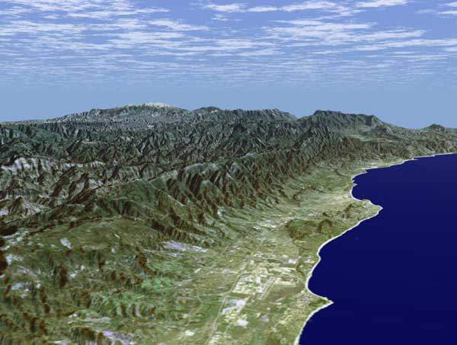
Santa Barbara, California
http://srtm.usgs.gov/srtmimagegallery/index.html

Slide 18




The challenge of increasing Digital Elevation Model (DEM) resolution (Dr Tarboton’s research)
1980’s DMA 90 m
10² cells/km²
1990’s USGS DEM 30 m
10³ cells/km²
2000’s NED 10-30 m
10⁴ cells/km²
2010’s LIDAR ~1 m
10⁶ cells/km²

Slide 19
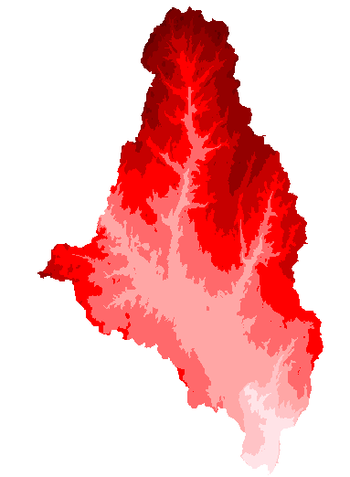
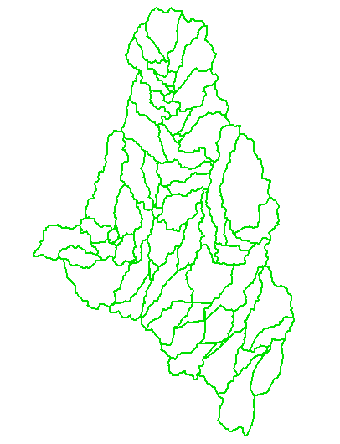
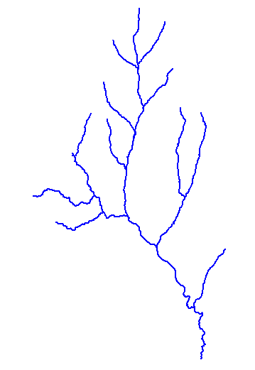
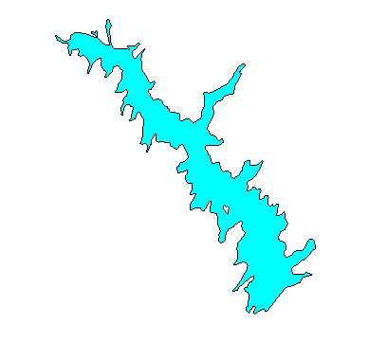
How do we combine these data?
Digital Elevation
Models
Watersheds
Streams
Waterbodies

Slide 20
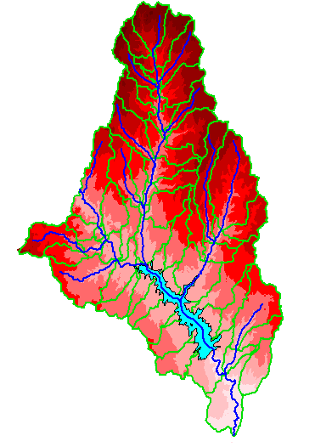
An integrated raster-vector database

Slide 21
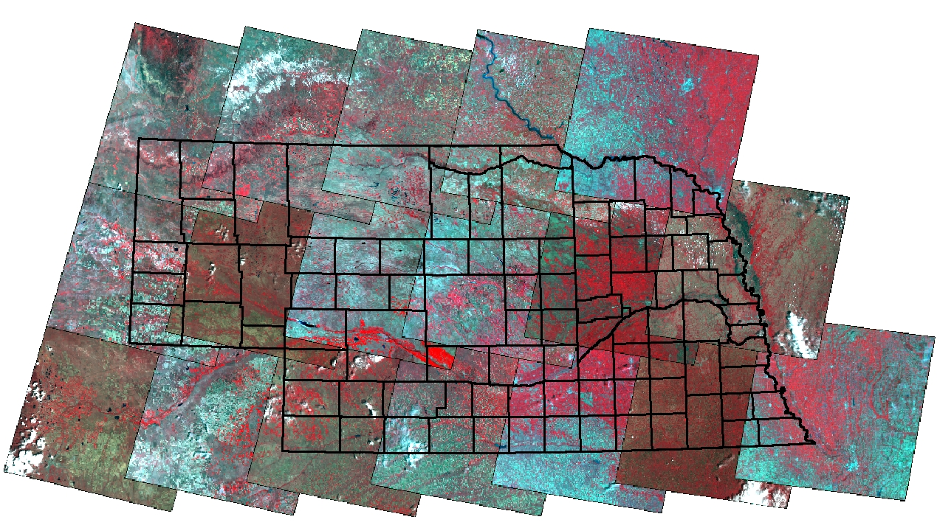
Remote Sensing Coverage of Nebraska
P33R30
10
P32R30
9
P31R30
10
P30R30
9
P29R30
10
P33R31
11
P32R31
10
P31R31
12
P30R31
9
P29R31
11
P28R31
8
P33R32
15
P32R32
8
P31R32
12
P30R32
10
P29R32
12
P28R32
10
P27R32
8

Slide 22
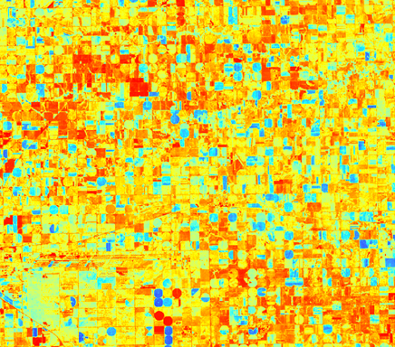
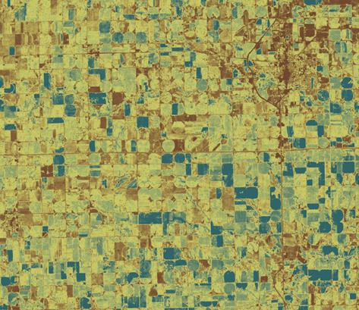


Evaporation from Remote Sensing (Dr Irmak)

Slide 23
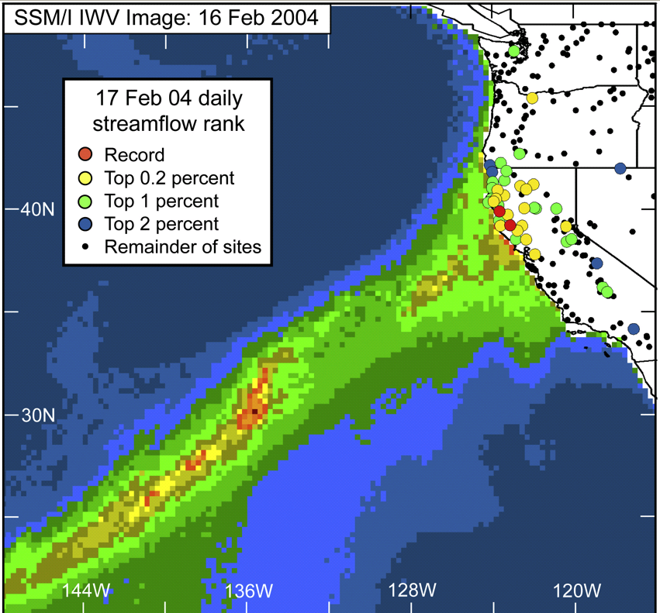
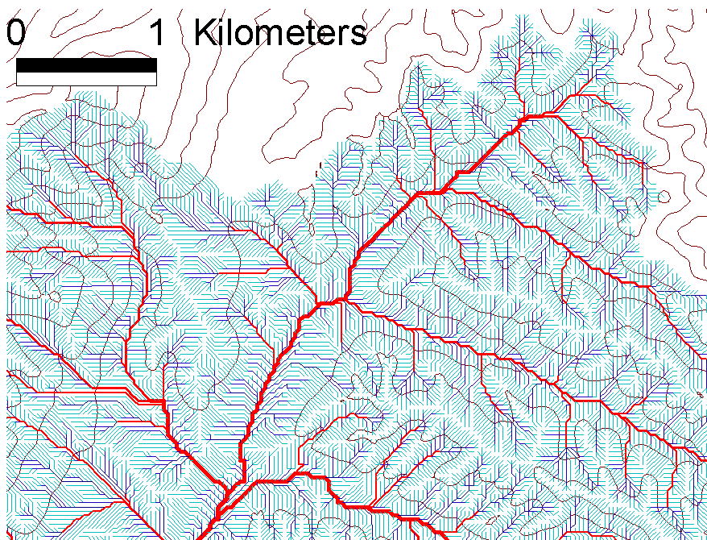
Data intensive science synthesizes large quantities of information (Hey et al., 2009).
exploiting advanced computational capability for the analysis and integration of large new datasets to elucidate complex and emergent behavior
In hydrology, the image at left (Ralph et al., 2006) illustrates connection between extreme floods recorded in USGS stream gages and atmospheric water vapor from space based sensors
Satellite remote sensing and massive datasets enhance understanding of multi-scale complexity in processes such as rainfall and river networks

Slide 24
GIS in Water Resources: Lecture 1
In-class and distance learning
Geospatial database of hydrologic features
GIS and HIS
Curved earth and a flat map

Slide 25
Linking Geographic Information Systems and Water Resources
Water
Resources
GIS

Slide 26

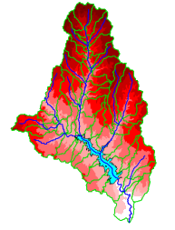
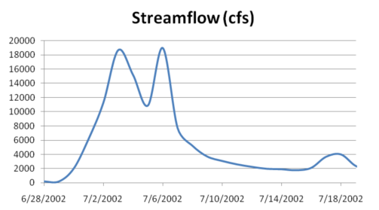

A Key Challenge
How to connect water environment with water observations
GIS
Water Environment
(Watersheds, streams,
gages, sampling points)
Time Series Data
Water Observations
(Flow, water level
concentration)

Slide 27

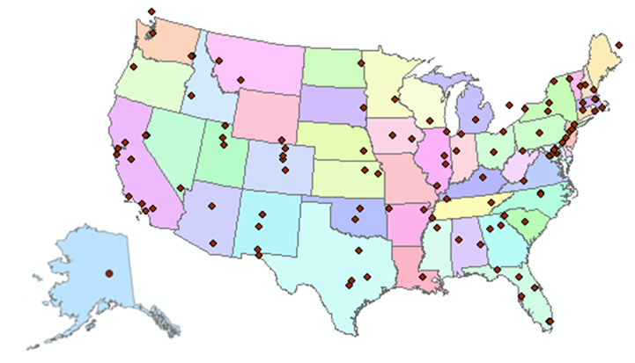
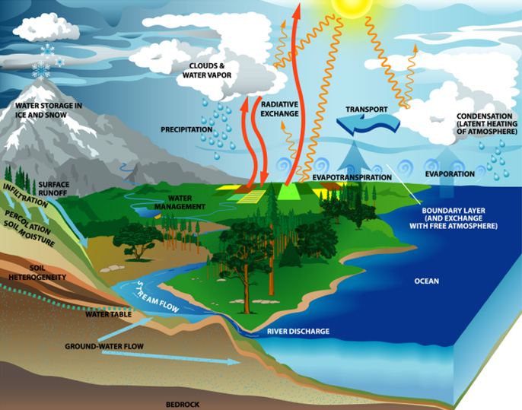
http://www.cuahsi.org
CUAHSI is a consortium representing 125 US universities
Supported by the National Science Foundation Earth Science Division
Advances hydrologic science in nation’s universities
Includes a Hydrologic Information System project

Slide 28
How the web works
Catalog
(Google)
Catalog harvest
Search
Web Server
(CNN.com)
Access
Browser
(Firefox)
HTML – web language for text and pictures

Slide 29

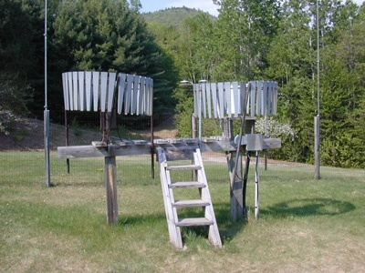

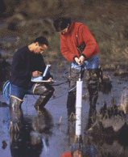
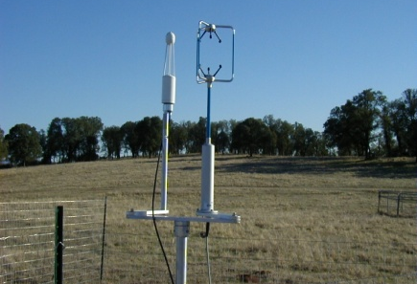
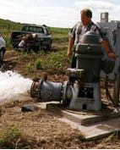
We Collect Lots of Water Data
Water quantity
Rainfall
Soil water
Water quality
Meteorology
Groundwater

Slide 30
The Data have a Common Structure
A point location in space
A series of values in time
Gaging – regular time series
Sampling – irregular time series
Notes:
These data are recorded over time to monitor a hydrologic process or property.

Slide 31
Services-Oriented Architecture for Water Data
Catalog
Service registration
Search
Catalog harvest
Server
Data access
User
WaterML – web language for water data

Slide 32
What is a “services-oriented architecture”?
Networks of computers connected through the web …….
Everything is a service
  Data, models, visualization, ……
A service receives requests and provides responses using web standards (WSDL)
It uses customized web languages
  HTML (HyperText Markup Language) for text and pictures
  WaterML for water time series (CUAHSI/OGC)
  GML for geospatial coverages (OGC)
….. supporting a wide range of users

Slide 33
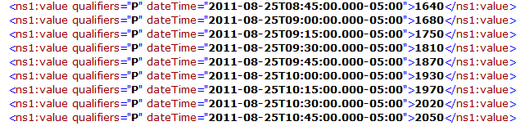
WaterML as a Web Language for Colorado River at Austin
I accessed this WaterML service from USGS at 11:22AM
http://waterservices.usgs.gov/nwis/iv?sites=08158000&period=P7D&parameterCd=00060
and got back these flow data from USGS which are up to 10:45AM
USGS has real-time WaterML services for about 22,000 sites available 24/7/365
http://waterservices.usgs.gov/nwis/iv?sites=08158000&period=P7D&parameterCd=00060

Slide 34
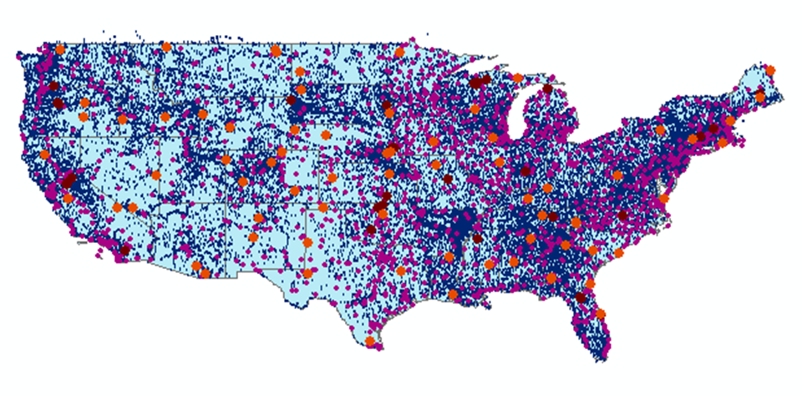
CUAHSI Water Data Services Catalog
All the data comes out in WaterML
69 public services
18,000 variables
1.9 million sites
23 million series
5.1 billion data values
And growing
The largest water data
catalog in the world
maintained at the San Diego Supercomputer Center

Slide 35
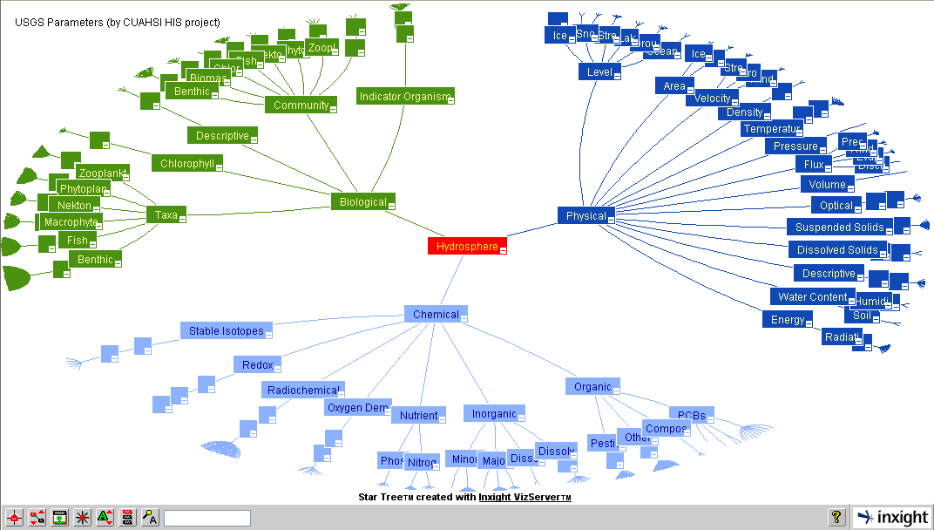
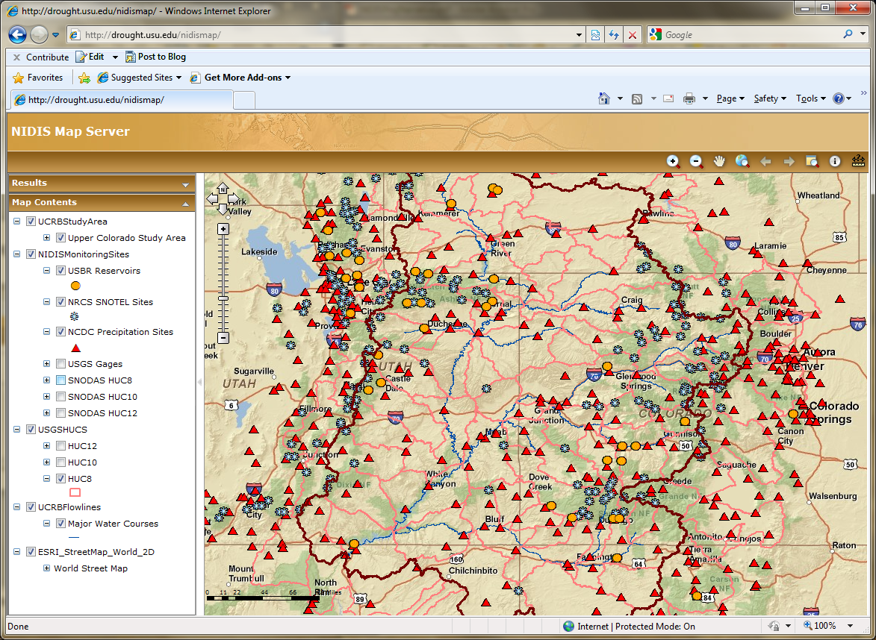
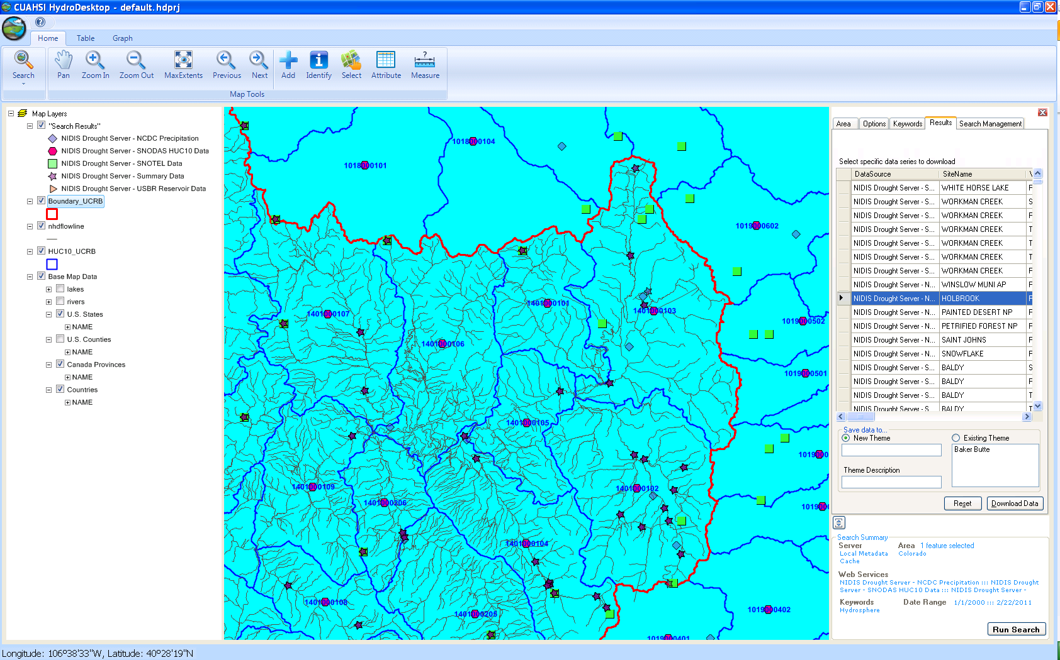
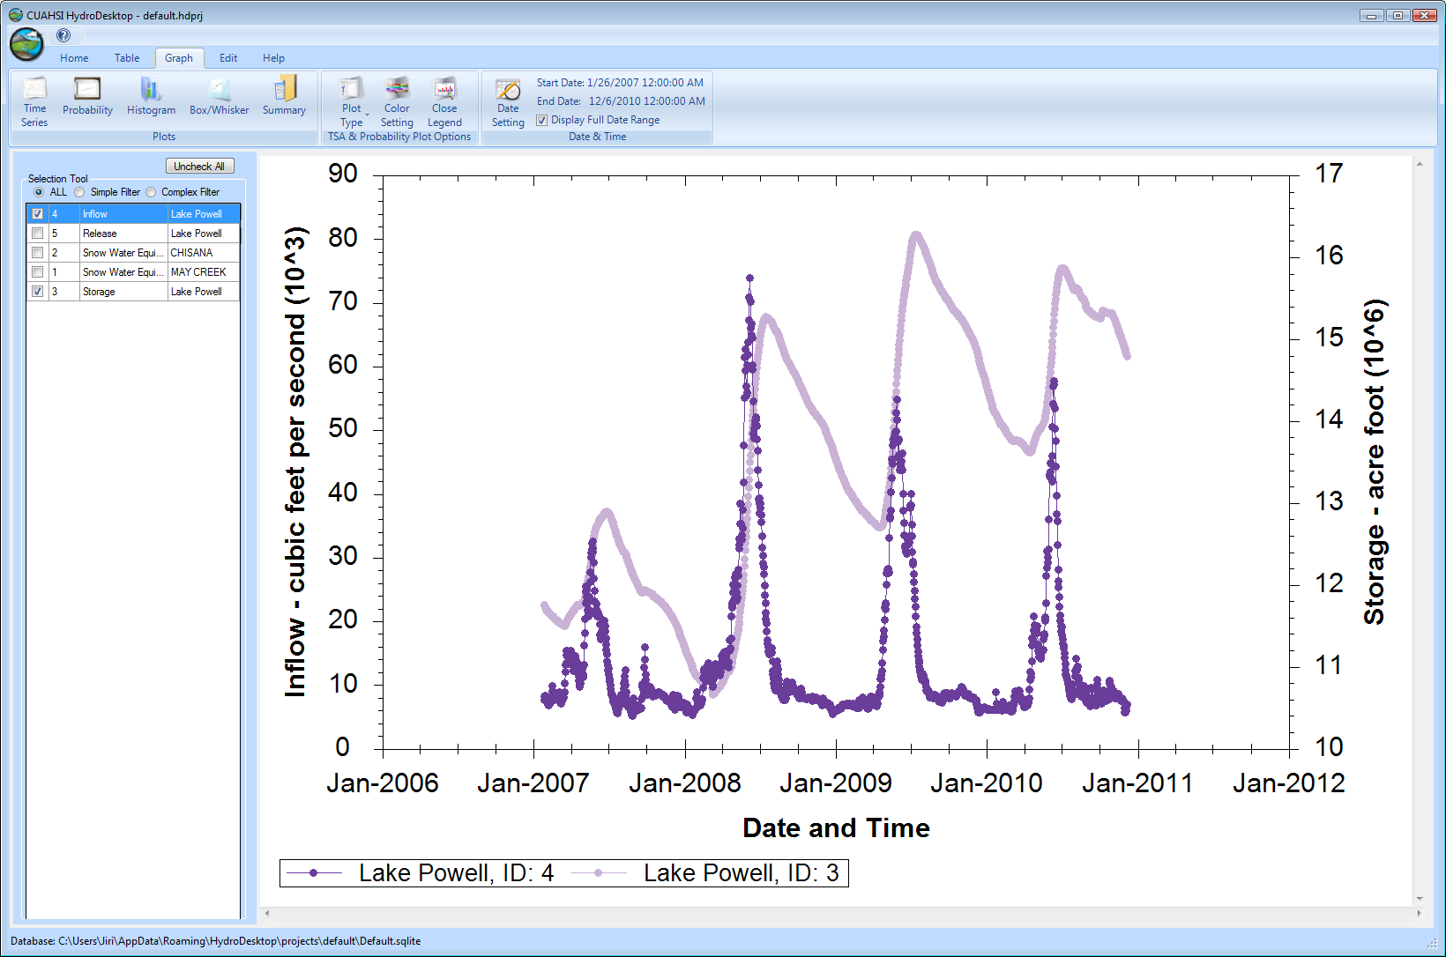
CUAHSI HIS
The CUAHSI Hydrologic Information System (HIS) is an internet based system to support the sharing of hydrologic data. It is comprised of hydrologic databases and servers connected through web services as well as software for data publication, discovery and access.
HydroServer – Data Publication
HydroCatalog
Data Discovery
Lake Powell Inflow and Storage
HydroDesktop – Data Access and Analysis
HydroDesktop – Combining multiple data sources

Slide 36
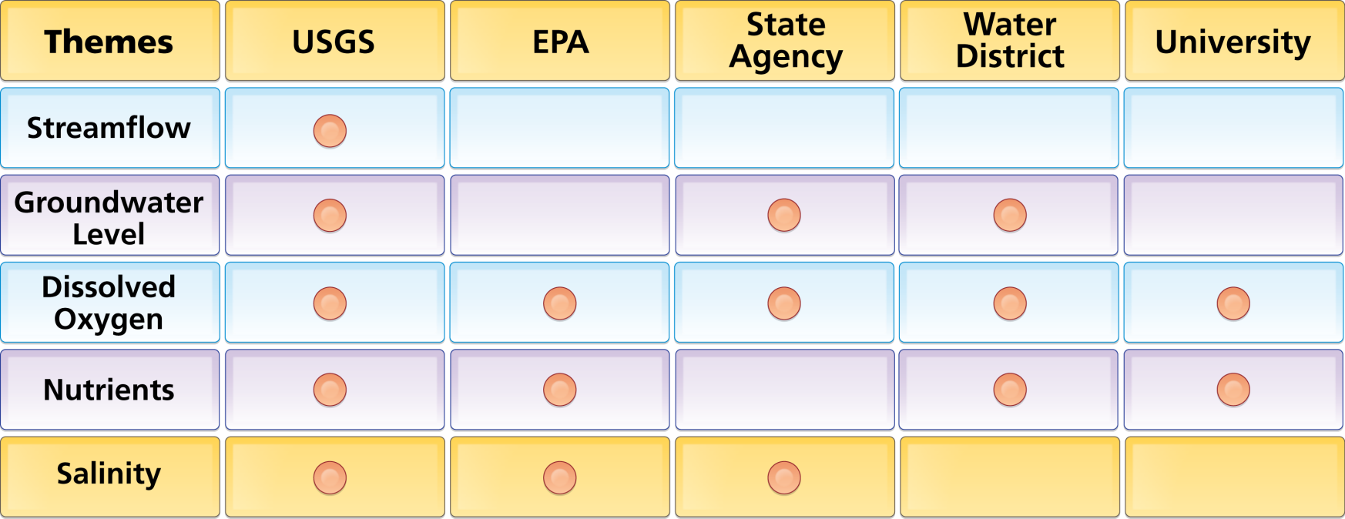
Organize Water Data Into “Themes”
Integrating Water Data Services From Multiple Agencies
. . . Across Groups of Organizations

Slide 37
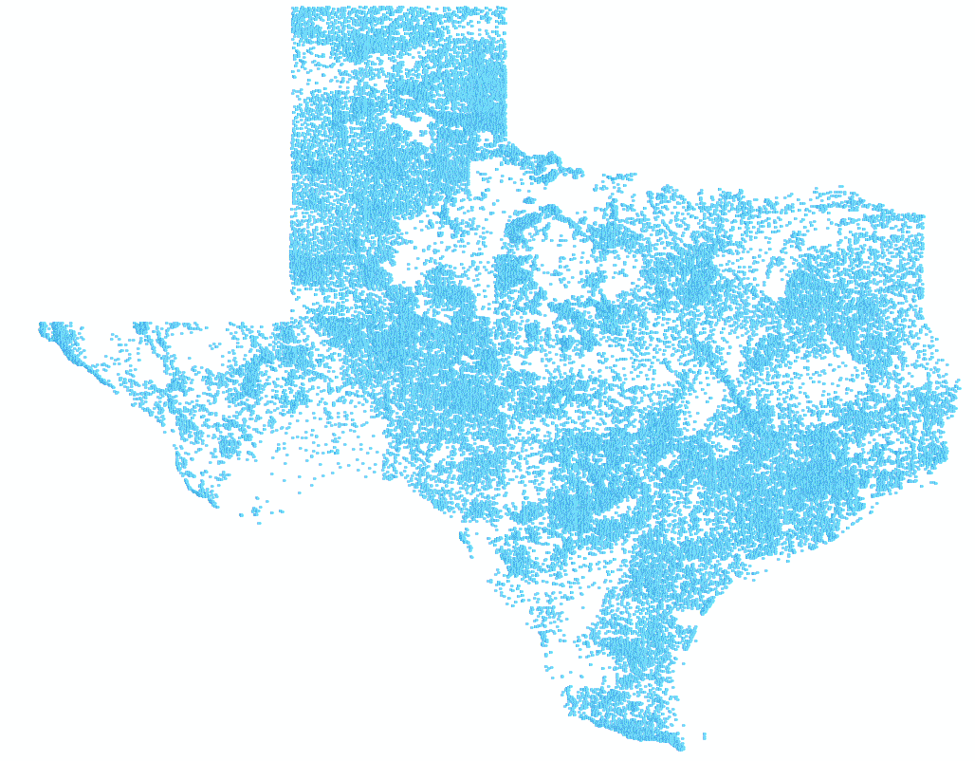
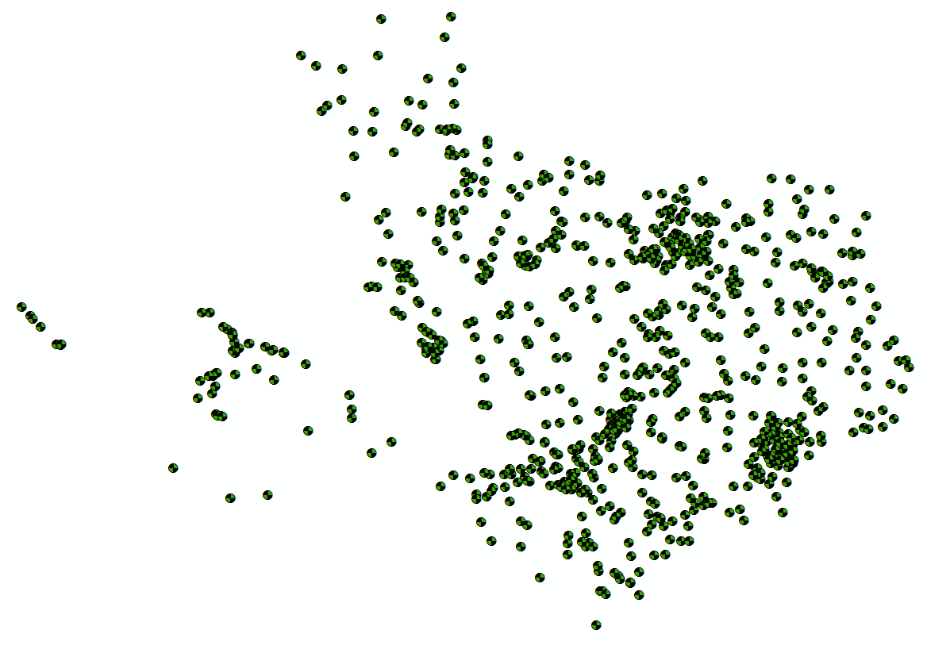
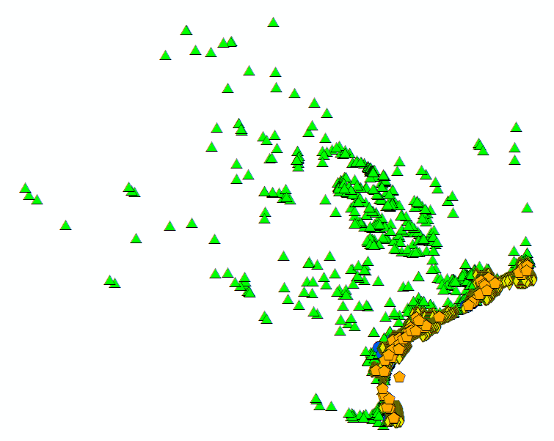
Bringing Water Into GIS
Thematic Maps of Water Observations as GIS Layers
Groundwater
Streamflow
Salinity
Unified access to water data in Texas ….

Slide 38
Geospatial Data Services
ArcGIS Online
Service registration
Search
Catalog harvest
ArcGIS Server
Data access
ArcGIS Desktop
Map services – web language for geospatial data

Slide 39
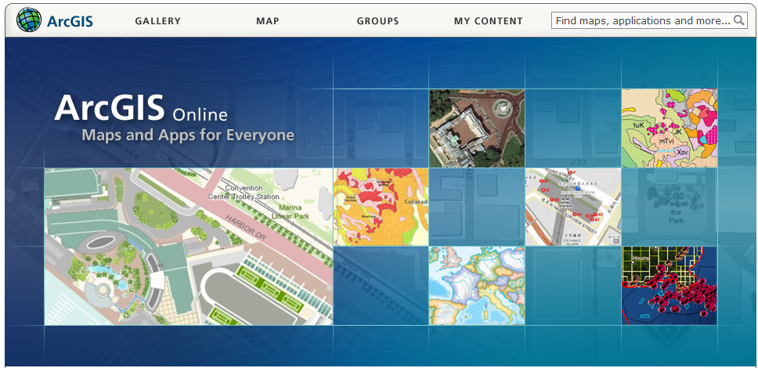
ArcGIS Online
GIS on the web – online map services
http://www.arcgis.com

Slide 40
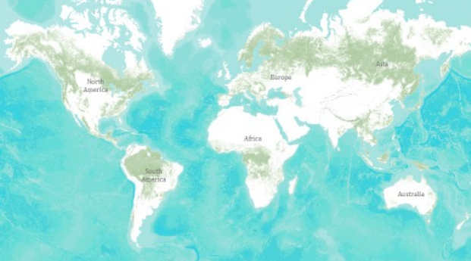
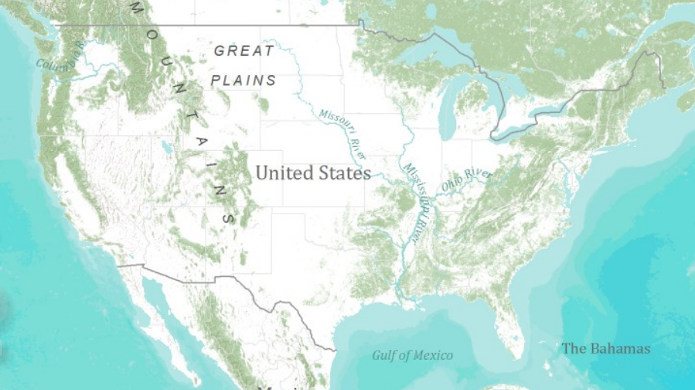
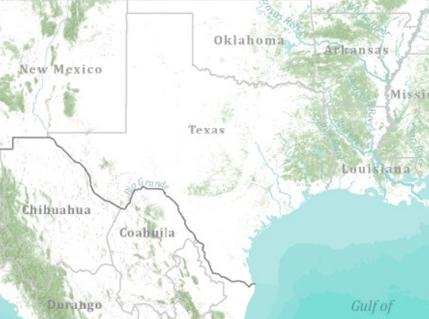
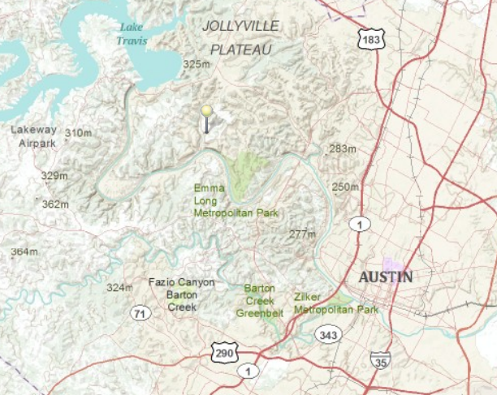
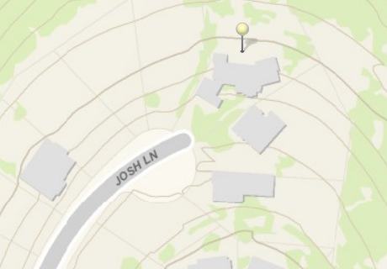
Topographic Base Map in ArcGIS Online
World
United States
Texas
Austin
Home

Slide 41
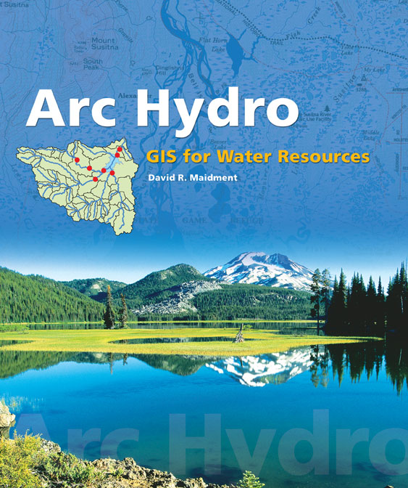
Arc Hydro: GIS for Water Resources
Published in 2002
Arc Hydro
  An ArcGIS data model for water resources
  Arc Hydro toolset for implementation
  Framework for linking hydrologic simulation models
The most comprehensive terrain analysis and watershed toolset available
Work of Dean Djokic and his team at ESRI Water Resources Applications

Slide 42
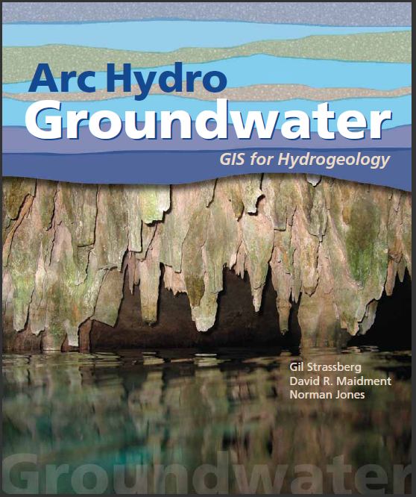
Arc Hydro Groundwater: GIS For Hydrogeology
Describes the data model – public domain
Toolset and data model available now from Aquaveo
Book from ESRI Press, published in Spring 2011
Adapted for a National Groundwater Information System for Australia

Slide 43
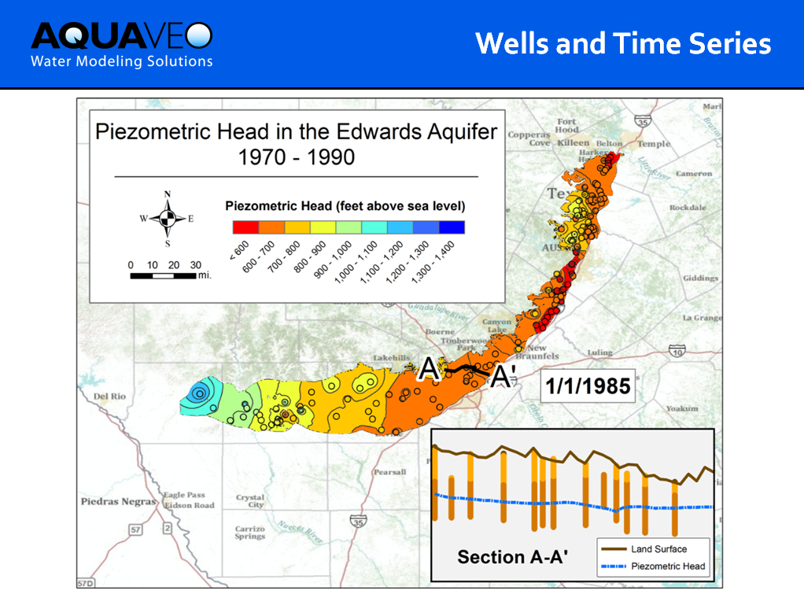

Slide 44
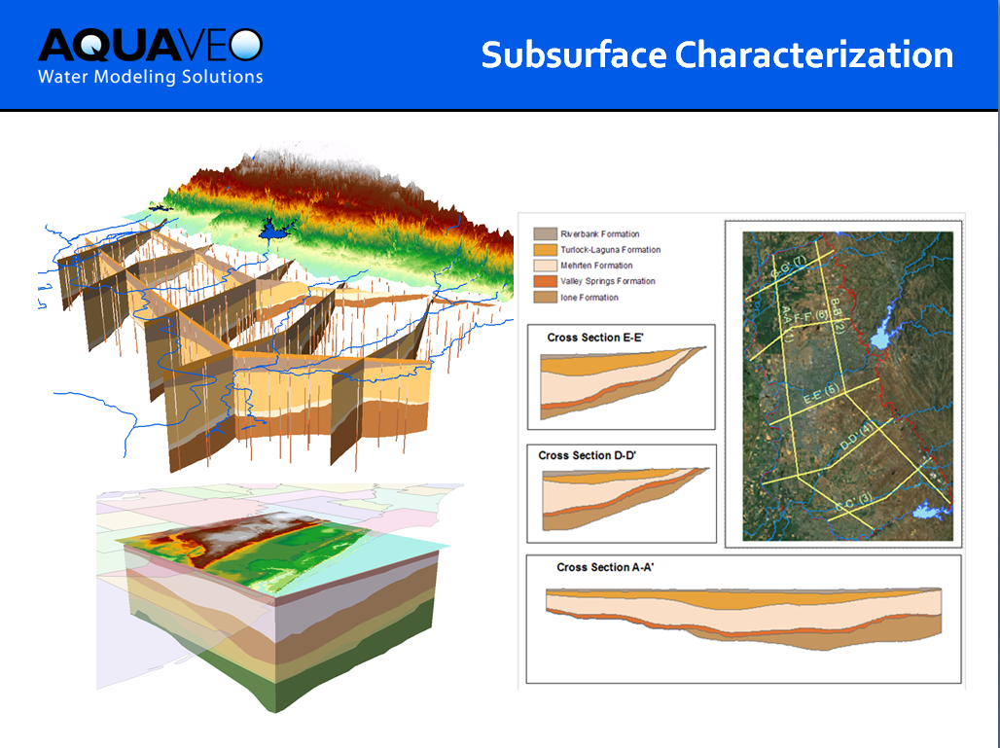

Slide 45
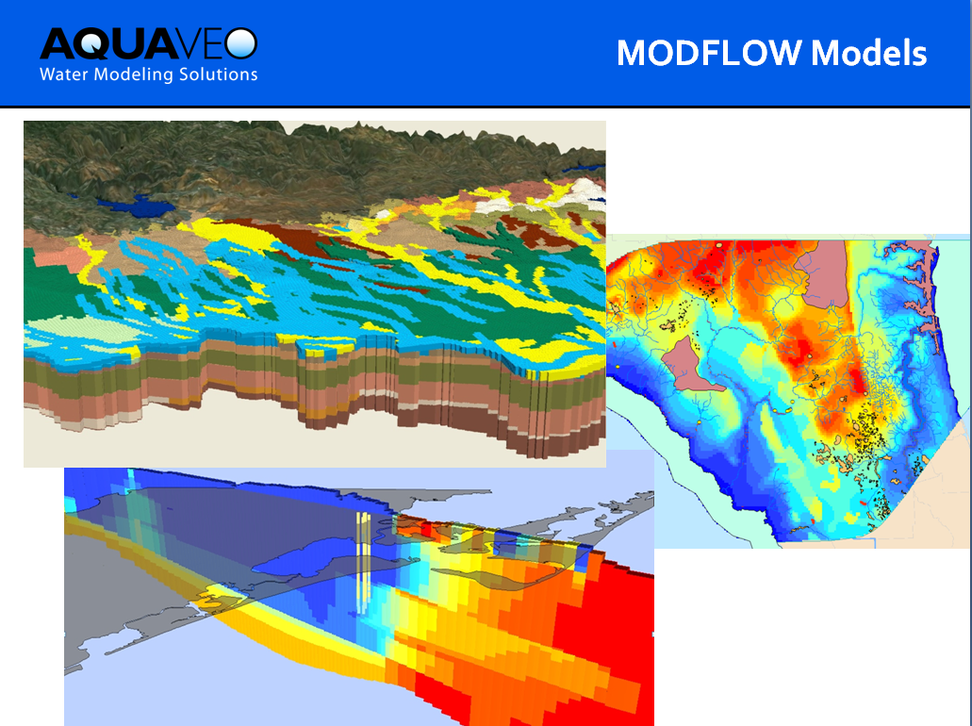

Slide 46
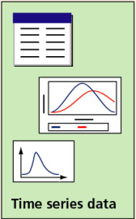
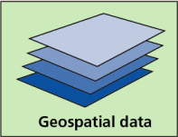
Hydrologic Information System
Analysis, Modeling,
Decision Making
Arc Hydro
Geodatabase
A synthesis of geospatial and temporal data supporting hydrologic analysis and modeling

Slide 47
GIS in Water Resources: Lecture 1
In-class and distance learning
Geospatial database of hydrologic features
GIS and HIS
Curved earth and a flat map

Slide 48

Origin of Geographic Coordinates
Equator
(0,0)
Prime Meridian

Slide 49
Latitude and Longitude
Longitude line (Meridian)
N
W
E
S
Range: 180ºW - 0º - 180ºE
Latitude line (Parallel)
N
W
E
S
(0ºN, 0ºE)
Equator, Prime Meridian
Range: 90ºS - 0º - 90ºN

Slide 50

Latitude and Longitude in North America
40 50 59 96 45 0
Austin:
Logan:
Lincoln:
(30°18' 22" N, 97°45' 3" W)
60 N
30 N
(41°44' 24" N, 111°50' 9" W)
120 W
60 W
90 W
0 N
(40°50' 59" N, 96°45' 0" W)

Slide 51
Map Projection
Flat Map
Cartesian coordinates: x,y
(Easting & Northing)
Curved Earth
Geographic coordinates: φ, λ
(Latitude & Longitude)
Notes:
DRM

Slide 52


Earth to Globe to Map
Map Scale:
Map Projection:
Representative Fraction
Globe distance
Earth distance
Scale Factor
Map distance
Globe distance
=
=
(e.g. 1:24,000)
(e.g. 0.9996)

Slide 53
Coordinate Systems
A planar coordinate system is defined by a pair
of orthogonal (x,y) axes drawn through an origin
Y
Origin
X
(x_{o},y_{o})
(φ_{o},λ_{o})

Slide 54
Summary (1)
GIS in Water Resources is about empowerment through use of information technology – helping you to understand the world around you and to investigate problems of interest to you
This is an “open class” in every sense where we learn from one another as well as from the instructors

Slide 55
Summary (2)
GIS offers a structured information model for working with geospatial data that describe the “water environment” (watersheds, streams, lakes, land use, ….)
Water resources also needs observations and modeling to describe “the water” (discharge, water quality, water level, precipitation)

Slide 56
Summary (3)
A Hydrologic Information System depends on water web services and integrates spatial and temporal water resources data
Geography “brings things together” through georeferencing on the earth’s surface
Understanding geolocation on the earth and working with geospatial coordinate systems is fundamental to this field

