Slide 1
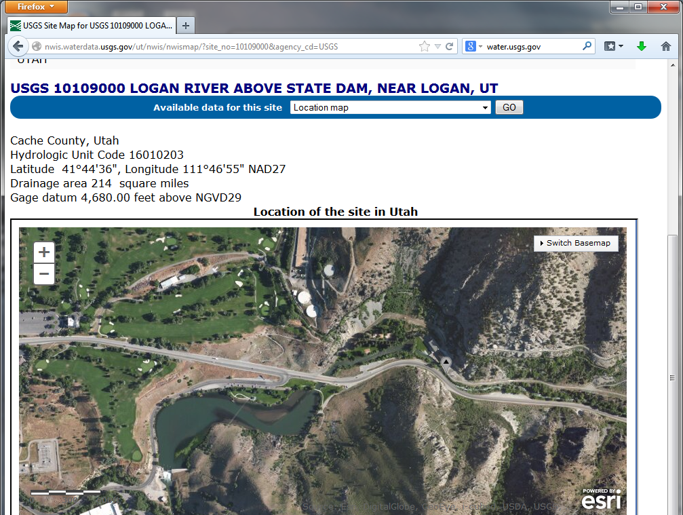
Wednesday March 19 – Stream Gauging Meet at Logan River Stream Gage
Gauge – N Side of Road up Logan Canyon after bridge
Park Here

