Slide 1
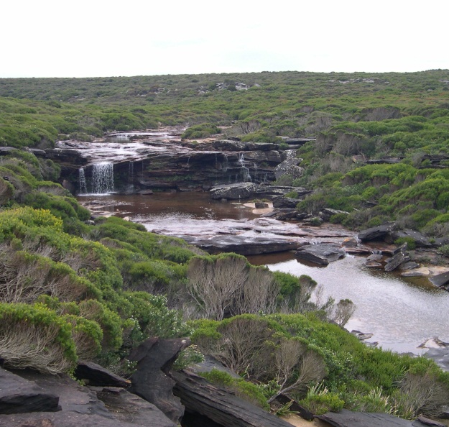
Hydrologic River Routing
Hydrologic Routing uses the continuity equation to relate inflows, outflows and storage to solve for outflows
Simpler, more empirical, parameters estimated at application scale from experience and data
Hydraulic Routing uses continuity and momentum to solve open channel flow equations
More complex, while elegant mathematically, often requires information on flow geometry that is difficult to obtain or not available
We will only cover Hydrologic Routing (Hydraulic routing part of Hydraulics – open channel flow)

Slide 2
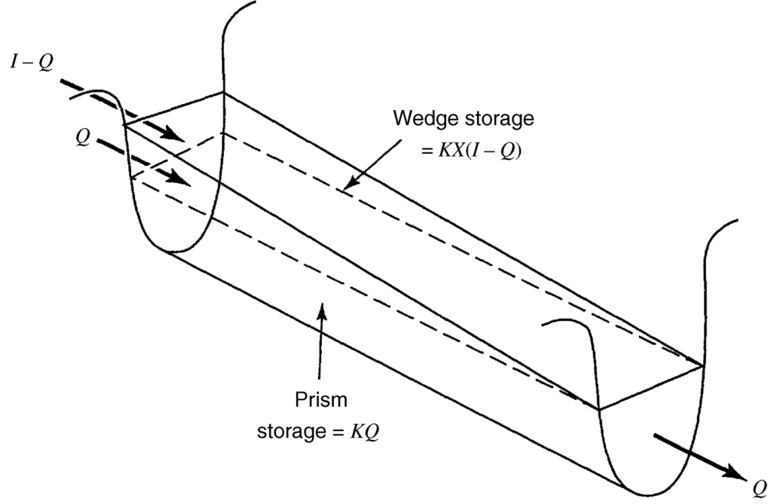
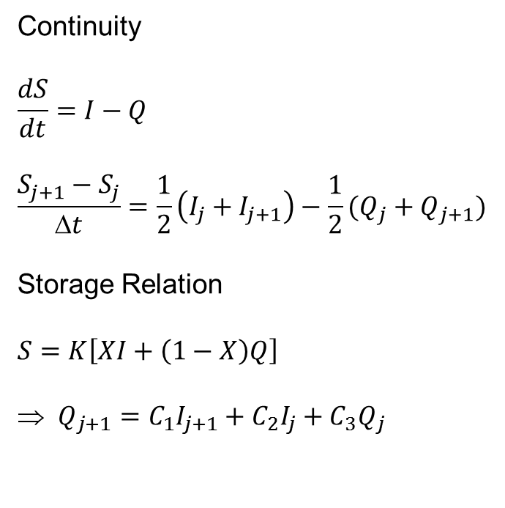
Hydrologic River Routing
Continuity
$$\frac{dS}{dt}=I−Q$$
$$\frac{S_{j+1}−S_{j}}{Δt}=\frac{1}{2}\left(I_{j}+I_{j+1}\right)−\frac{1}{2}(Q_{j}+Q_{j+1})$$
Storage Relation
$$S=K\left[XI+\left(1−X\right)Q\right]$$
⇒$Q_{j+1}=C_{1}I_{j+1}+C_{2}I_{j}+C_{3}Q_{j}$
Applications
Given K, X and I(t), solve Q(t)
Given I(t), Q(t) infer K and X

Slide 3
Example 9.3.2
Route the following inflow hydrograph using X=0.2, K=0.7 hr
Time (hr) | 0 | 1 | 2 | 3 | 4 | 5 | 6 | 7
Inﬂow (cfs) | 0 | 800 | 2000 | 4200 | 5200 | 4400 | 3200 | 2500
Time (hr) | 8 | 9 | 10 | 11 | 12 | 13
Inﬂow (cfs) | 2000 | 1500 | 1000 | 700 | 400 | 0

Slide 4
Example 9.3.1
Determine K, X from data
Day | Inflow (ft3/s) | Outflow (ft3/s)
0.5 | 2200 | 2000
1 | 14500 | 7000
1.5 | 28400 | 11700
2 | 31800 | 16500
2.5 | 29700 | 24000
3 | 25300 | 29100
3.5 | 20400 | 28400
4 | 16300 | 23800
4.5 | 12600 | 19400
5 | 9300 | 15300
5.5 | 6700 | 11200
6 | 5000 | 8200
6.5 | 4100 | 6400
7 | 3600 | 5200
7.5 | 2400 | 4600

Slide 5
Hydrologic Simulation Models
Learning Objectives
Use hydrologic simulation models to expedite hydrologic calculations
Determine the appropriate parameters for input to models depending on the setting and problem being addressed
Prepare the input to a hydrologic model (HEC HMS) for solution of hydrologic design problems
Run the model and interpret the output of hydrologic models for application in design

Slide 6
What Are Hydrologic Models used for?
to evaluate the response sensitivity of an input action in the context of design or solving a problem (Engineering)
to encode and encapsulate knowledge and test hypotheses (Science/Research)
to organize and structure the examination of available data and information focused on the problem at hand
to formalize communication across disciplines (solving problems involving multiple disciplines)

Slide 7
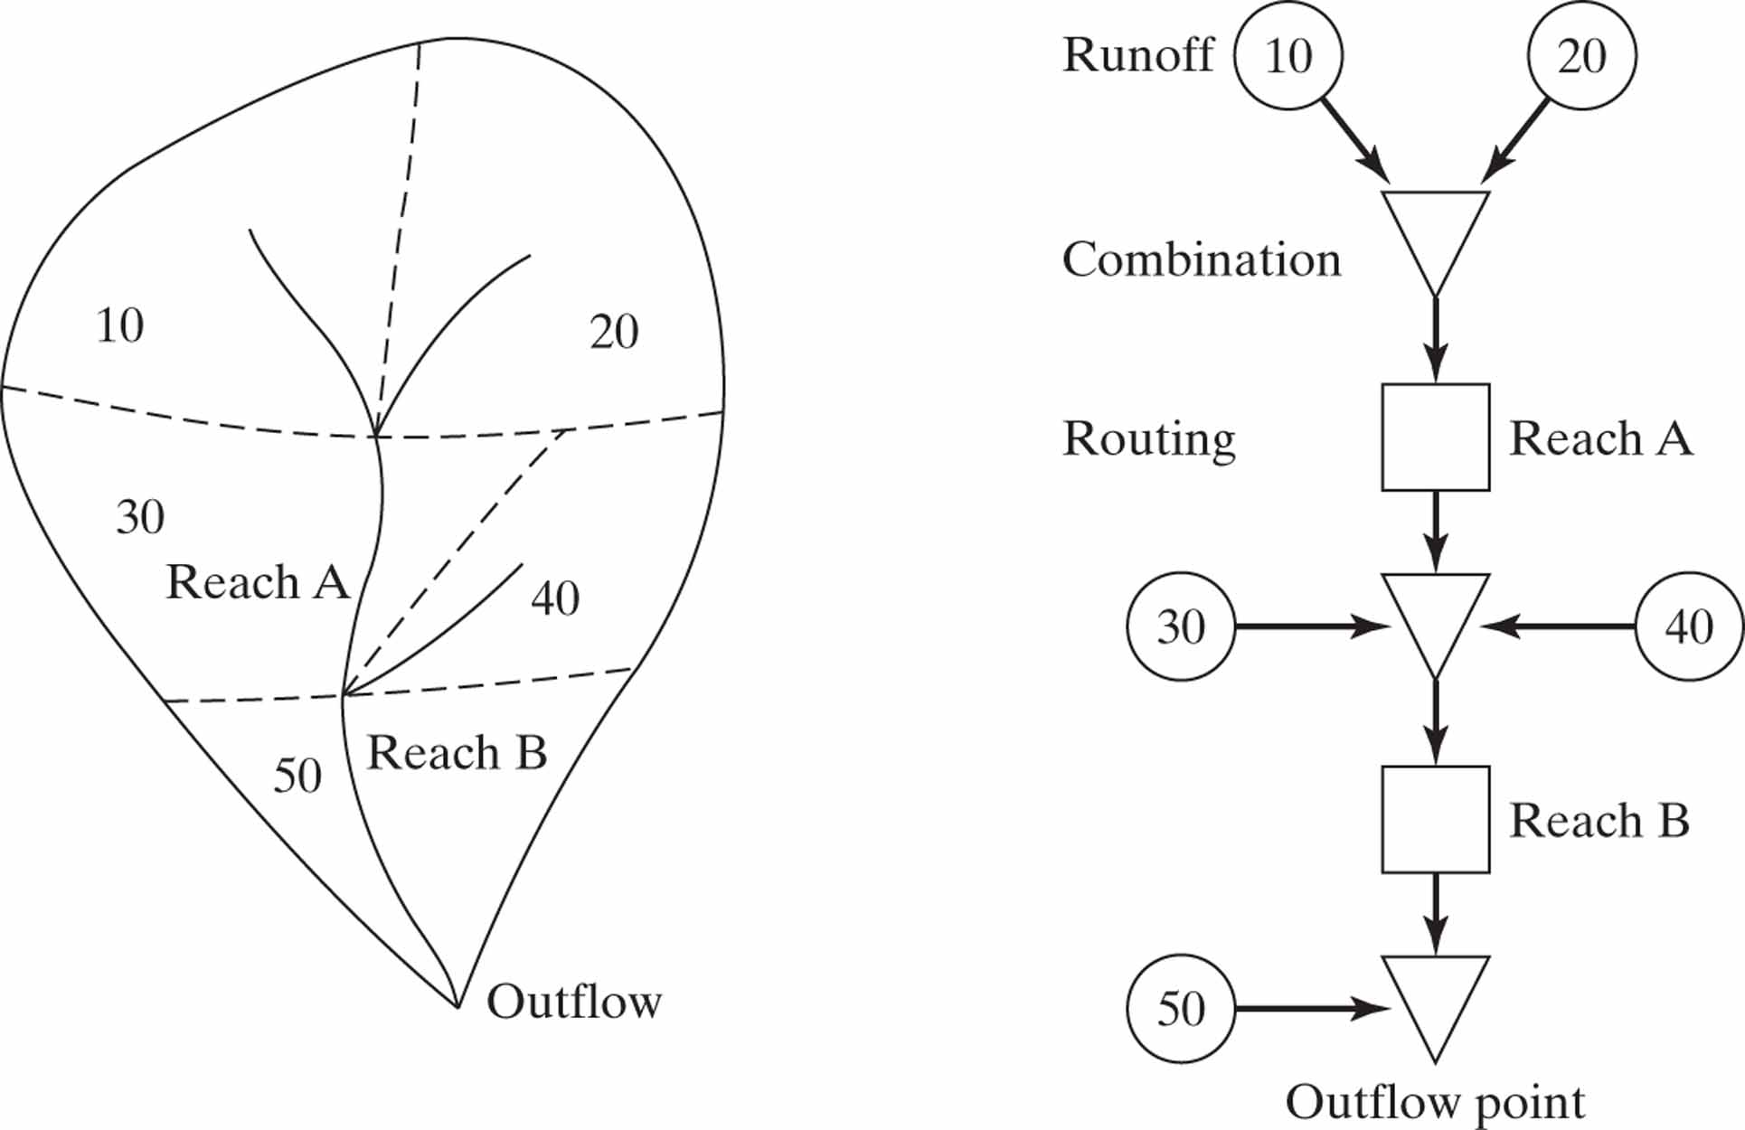
HEC HMS
http://www.hec.usace.army.mil/software/hec-hms/

Slide 8
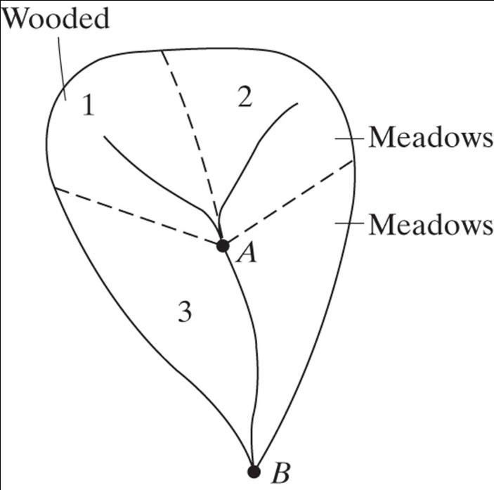
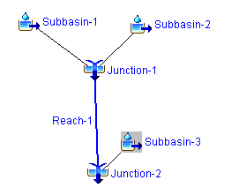
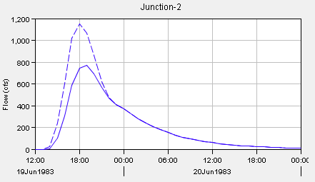
Example
Subbasin | Tc (hr) | R (hr) | CN | Area (mi²)
1 | 2.5 | 5.5 | 66 | 2.5
2 | 2.8 | 7.5 | 58 | 2.7
3 |  |  | 58 | 3.3
Suppose that a development is proposed that changes land use and the CN in subbasin 3 from 58 to 70, what is the impact on the hydrograph?
Can a detention basin be placed below junction to reduce peak to pre-development levels? How big should it be?

Slide 9
Components of an HEC-HMS Model
Basin Model
Basin
Subbasin, Reach, Reservoir, Junction, Diversion, Source, Sink
Meteorologic Model
Specified hyetograph, gage weights, frequency storm, gridded precipitation, inverse distance, SCS storm
Control Specifications
Start, end, time interval
Time series data
Precip, discharge, stage, temperature, solar radiation, wind speed, humidity, air pressure
Paired data
Storage-discharge, elevation-area, elevation-storage, elevation-discharge, inflow-diversion, diameter-percentage, cross-sections, unit hydrograph

Slide 10
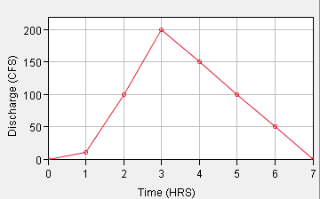
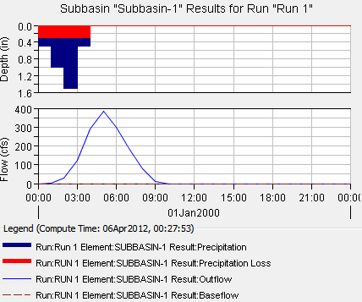
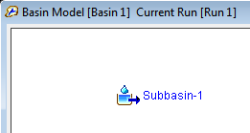
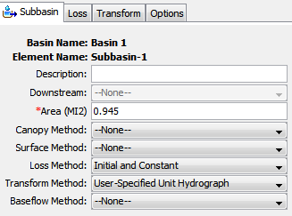
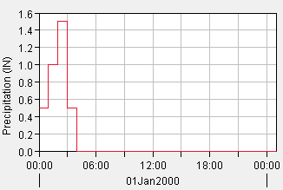
Example 8.3.1 in HEC HMS
The 1- hr unit hydrograph for a watershed is given below. Determine the runoff from this watershed for the storm pattern given. The abstractions have a constant rate of 0.3 in/ h.
Time ( hr) | 1 | 2 | 3 | 4 | 5 | 6
Precipitation ( in) | 0.5 | 1 | 1.5 | 0.5
Unit hydrograph ( cfs) | 10 | 100 | 200 | 150 | 100 | 50

