Slide 1
CEE 3430, Engineering Hydrology
David Tarboton
(Richard Peralta today)

Slide 2
Overview
Handouts
  Syllabus
  Schedule
  Student Information Sheet
  Homework 1
Web: http://www.engineering.usu.edu/dtarb/cee3430
Outline for today
  Review Syllabus and Schedule
  Introduce the Hydrologic Cycle and Water Balance Concepts

Slide 3


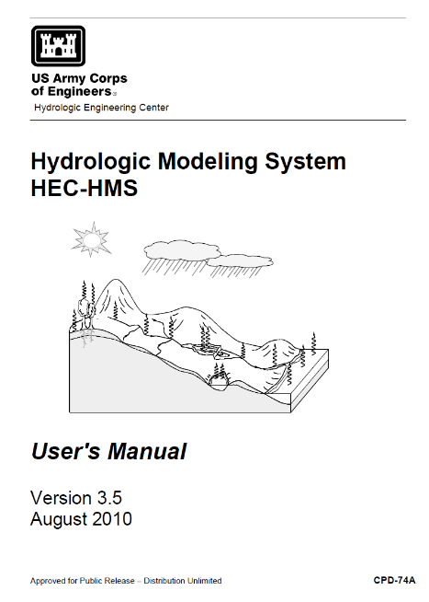
Texts
Ground and Surface Water Hydrology, by Mays, 2011 (Chapters 1-4 and 7-9)
Either full text or Custom book with just these chapters
Full textbook ISBN 9780470169872
Custom book
  Print version ISBN 9781119920403 (order through bookstore)
  Electronic version ISBN 9781119920403 (order at http://store.vitalsource.com/)
HEC-HMS Manual (last part of class only)
http://www.hec.usace.army.mil/software/hec-hms/documentation.aspx

Slide 4
Course Learning Objective
Upon successful completion of the course you should be able to apply the principles of hydrology to solve engineering hydrology design problems involving hydrologic modeling and analysis.

Slide 5
Please indicate your level of knowledge of
Excel
A – Never heard of
B – Know of but have not used
C – Used a little
D – Comfortable using
E - Expert

Slide 6

Please indicate your level of knowledge of
MATLAB
A – Never heard of
B – Know of but have not used
C – Used a little
D – Comfortable using
E - Expert

Slide 7

Please indicate your level of knowledge of
R
A – Never heard of
B – Know of but have not used
C – Used a little
D – Comfortable using
E - Expert
http://www.r-project.org/

Slide 8


Please indicate your level of knowledge of
HEC-HMS
A – Never heard of
B – Know of but have not used
C – Used a little
D – Comfortable using
E - Expert
http://www.hec.usace.army.mil/software/hec-hms/

Slide 9

Please indicate your level of knowledge of
CANVAS
A – Never heard of
B – Know of but have not used
C – Used a little
D – Comfortable using
E - Expert
https://online.usu.edu/

Slide 10
Great Salt Lake Evaporation
The Great Salt Lake has an average inflow from streamflow of 2,316,220 acre ft / year
The area is about 1 million acres
Average annual precipitation on the lake is about 10 inches/year
It is a closed basin with no outflows other than evaporation
Assuming the level is not changing what is the average annual evaporation ?

Slide 11
Evaporation depth E
Evaporation volume E x A
Inflows I
E x A
Level
Area, A

Slide 12
Assumed Great Salt Lake Volume Balance
Average inflow from streamflow = 2,316,220 acre ft/yr
Area = 1 million acres
Average annual precipitation on lake = 10 inches/yr
Total outflow = evaporation
Lake level is steady. What is the average annual Evaporation? --------------
Ks lake level is steady, lake area and volume are unchanging.
Δvolume =0 = Inflows – Outflows
Inflows = Streamflow + Precipitation + Groundwater (small) + Wastewater discharges (even smaller)
Volume = Depth x Area
Precipitation = 1 x 10⁶ (acres) x 10/12 (ft) = 8.33 x 10⁵ acre ft/yr
Inflow = 2.316 x 10⁶ acre ft/yr + 0.833 x 10⁶ acre ft/yr
= 3.149 x 10⁶ acre ft/yr = Outflow = Evaporation

Slide 13
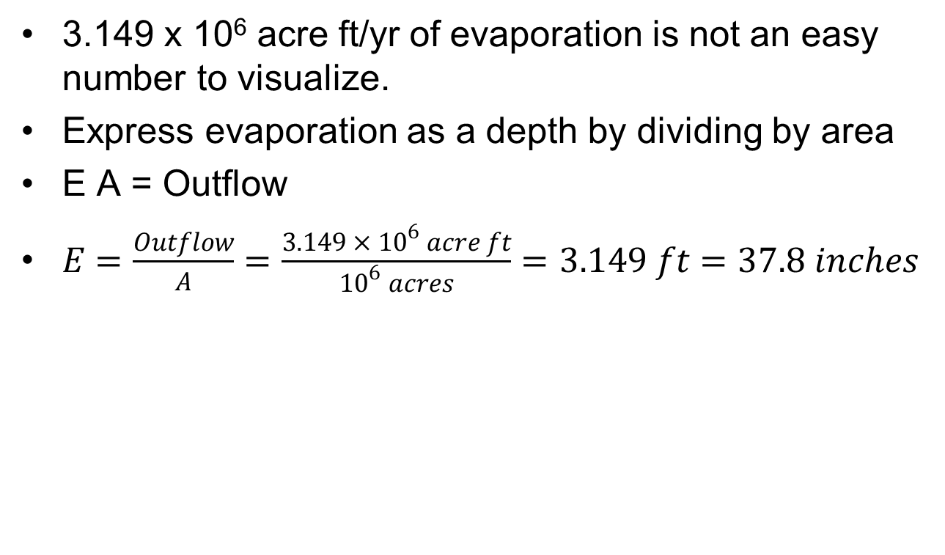
Alternative Evaporation Expression
3.149 x 10⁶ acre ft/yr of evaporation is not an easy number to visualize.
Express evaporation as a depth by dividing by area
E A = Outflow
$E=\frac{Outflow}{A}=\frac{3.149 × {10}^{6} acre ft}{{10}^{6} acres}=3.149 ft=37.8 inches$

Slide 14
How a closed basin (e.g. GSL works)
If I > E x A level rises
If I < E x A level falls
Level adjusts to fluctuating inputs so that on average
I = E x A
I includes inflows from streams and precipitation on the lake
I = Q + P x A
Subject to climate variability.
E is less variable, but also depends on climate and salinity, C.
As C increases E decreases
Evaporation depth E
Evaporation volume E x A
Inflows I
E x A
Level
Area, A
I
E x A
Level
Area, A
Volume, V
Salt Load L
Salt Concentration C=L/V

Slide 15
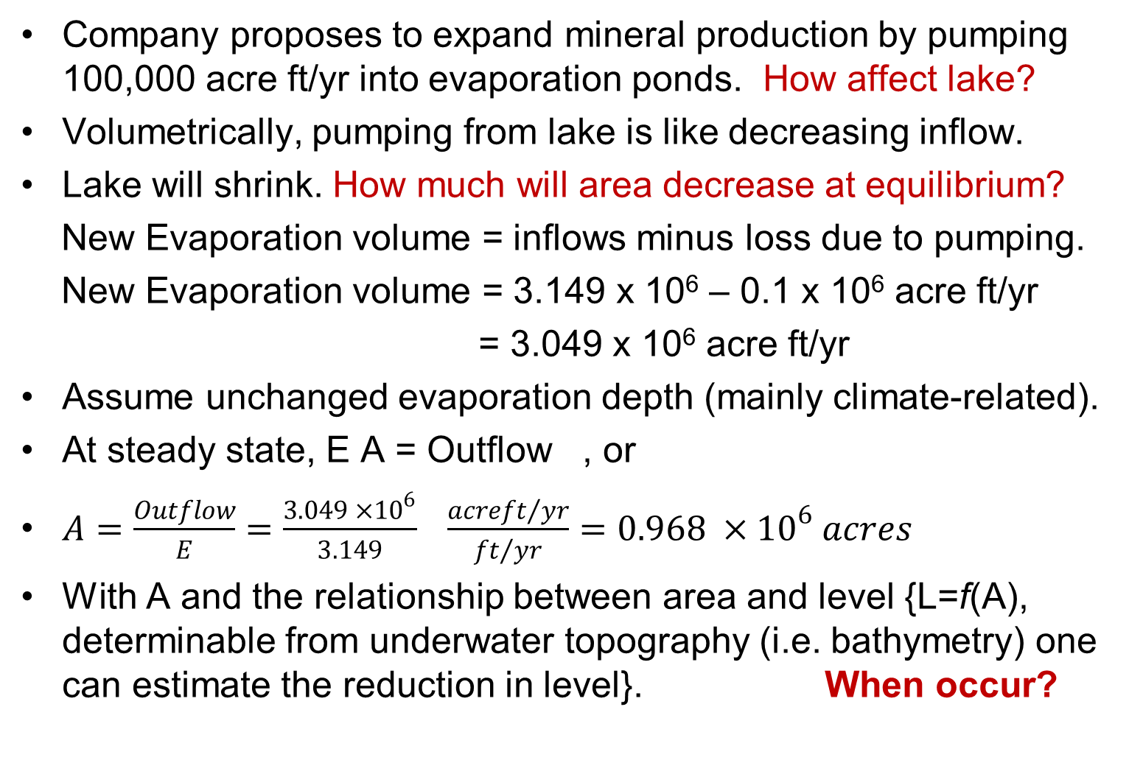
Predicting Effect of Management Change
Company proposes to expand mineral production by pumping 100,000 acre ft/yr into evaporation ponds. How affect lake?
Volumetrically, pumping from lake is like decreasing inflow.
Lake will shrink. How much will area decrease at equilibrium?
New Evaporation volume = inflows minus loss due to pumping.
New Evaporation volume = 3.149 x 10⁶ – 0.1 x 10⁶ acre ft/yr
= 3.049 x 10⁶ acre ft/yr
Assume unchanged evaporation depth (mainly climate-related).
At steady state, E A = Outflow , or
$A=\frac{Outflow}{E}=\frac{3.049 ×{10}^{6}}{3.149} \frac{acre{ft}/{yr}}{{ft}/{yr}}=0.968 ×{10}^{6} acres$
With A and the relationship between area and level {L=f(A), determinable from underwater topography (i.e. bathymetry) one can estimate the reduction in level}. When occur?

Slide 16
More Effects of Management Change
A lower level has implications for
  Brine shrimp
  Bird habitat
  Boating and other users
A more comprehensive analysis has to consider additional factors
  Climate variability and lake fluctuations
  Salinity. A lower lake has smaller volume, but the amount of salt is the same (apart from what the mineral co. is taking), so the salinity is more. This reduced evaporation
  Evaporation ponds actually occupy part of the lake
  The railway causeway splits the lake into two water bodies with different levels

Slide 17
Concepts Discussed
Fundamental equation in hydrology - mass balance (eqn 1.5.1)
Expressing quantities in units that are easier to interpret, such as depth for evaporation rather than volume
Equilibrium or steady-state assumption

Slide 18
Water Balance
Atmospheric Water
Soil Water
Surface Water
Groundwater
Change of Storage
Inflow – Outflow =

Slide 19
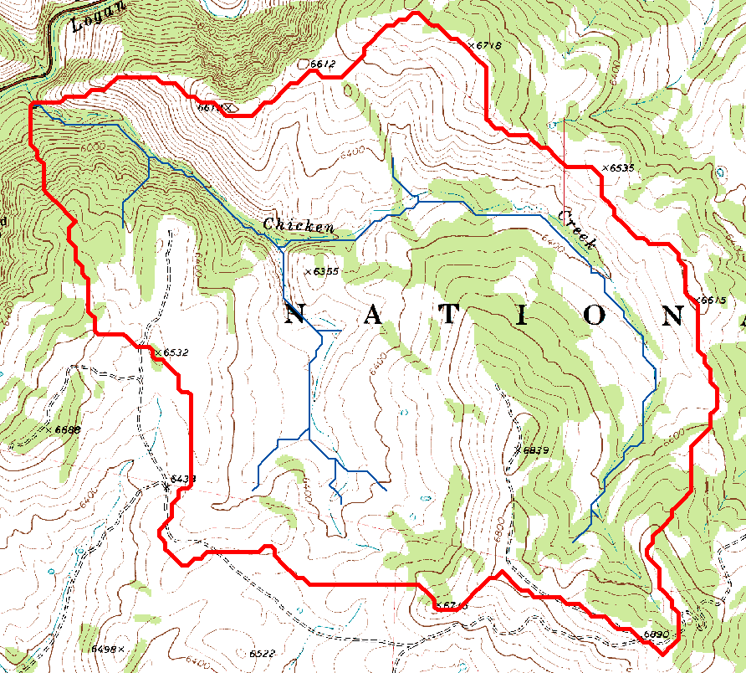
Watershed delineated on a topographic map

Slide 20
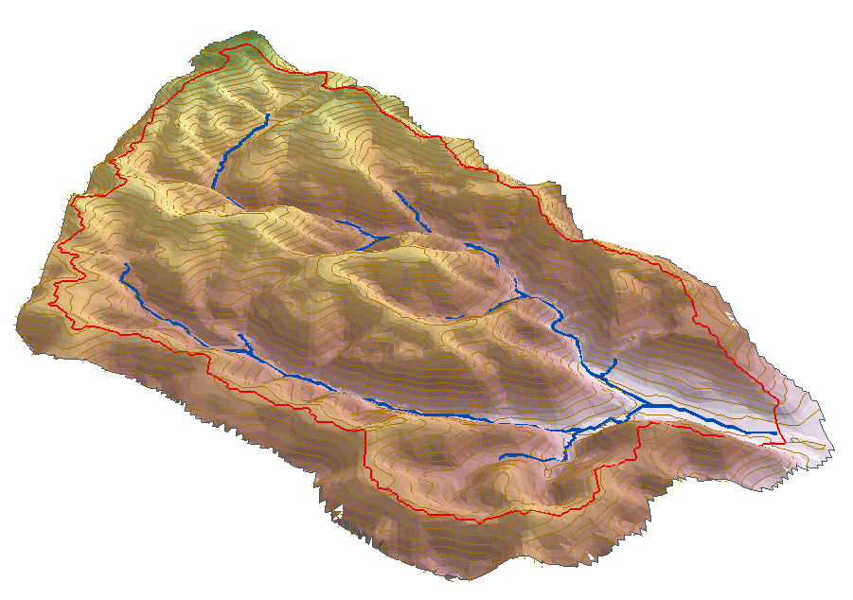
Watershed water balance
P
E+T
Q
S
G

Slide 21
The Hydrologic Cycle
Atmospheric Moisture
P
Runoff
Evap
ET
Evap
Streams
Runoff
Lake
GW
Reservoir

Slide 22
Hydrologic Science in the hierarchy from basic sciences to water resources management
Basic Sciences
Mathematics
Statistics
Physics
Chemistry
Biology
Geosciences
Geology
Soil Science
Atmospheric Science
Ocean Science
Glaciology
Geochemistry
Economics
Law
Sociology
Political Science
Engineering Hydrology
Agriculture
Forestry
Fluid Mechanics
Hydraulic Engineering
Meteorology
Hydrologic Science
Water Resources Management
Modified From: National Research Council Committee on Opportunities in the Hydrologic Sciences (COHS), (1991), Opportunities in the Hydrologic Sciences, Editor, P. S. Eagleson, National Academy Press, Washington, D.C.

Slide 23
Summary
The engineering hydrologist must be able to calculate or estimate various components of the hydrologic cycle to solve hydrologic problems
  Drainage design, flood protection, water supply
The concept of the water balance is fundamental to much hydrologic analysis
Become comfortable converting units and working with “incompatible” units, it is an unfortunate fact of life

