Slide 1
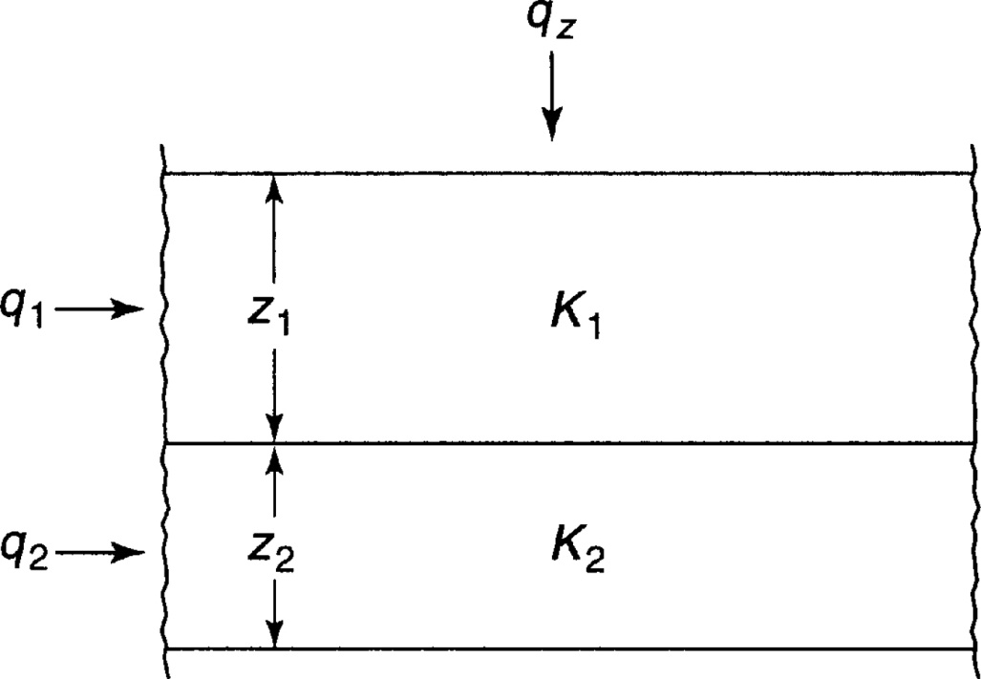
Anisotropy – Key ideas
Effective conductivity that represents aggregate effect of flow through a layered system
Effective conductivity is different parallel to than perpendicular to the layers
Material with this property is anisotropic – properties are different in different directions
From Mays, 2011, Ground and Surface Water Hydrology

Slide 2
Example
An aquifer has 3 layers with K values indicated. Compute the equivalent horizontal and vertical hydraulic conductivities
10 m
K=11.6 m/day
4.4 m
K=4.5 m/day
6.2 m
K=2.2 m/day

Slide 3
Aquifer Anisotropy and general flow equations
Objective
To be able to quantify the anisotropy of an aquifer due to layering
To be able to describe the equations used in general groundwater flow calculations

Slide 4
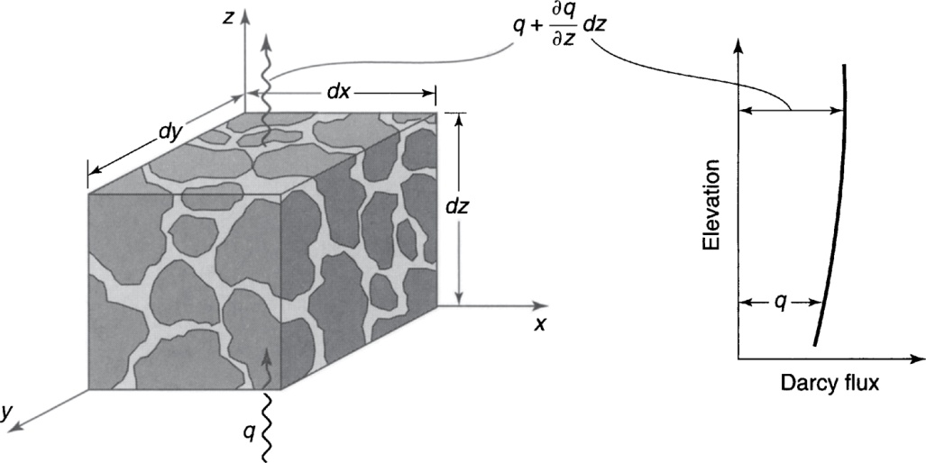
General Groundwater Flow Equations
Based on
Darcy’s Law
Storage properties
Used in groundwater models to examine more complex groundwater flow problems
From Mays, 2011, Ground and Surface Water Hydrology

