Slide 1
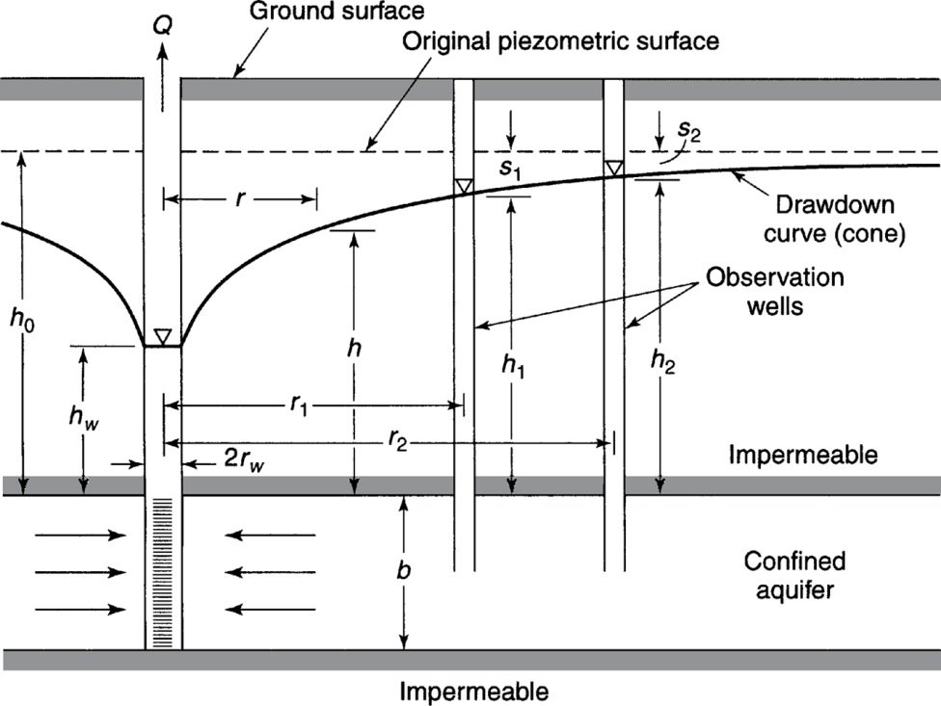
Radial flow to a confined aquifer
$$Q=2πKb\frac{h−h_{w}}{ln⁡(r/r_{w})}$$
$$h−h_{w}=\frac{Q\ln\left(r/r_{w}\right)}{2πKb}$$
From Mays, 2011, Ground and Surface Water Hydrology
Notes:
Work example 4.2.1 and 4.2.2

Slide 2
Radial flow to a confined aquifer
$$Q=2πKb\frac{h−h_{w}}{ln⁡(r/r_{w})}$$
$$h−h_{w}=\frac{Q\ln\left(r/r_{w}\right)}{2πKb}$$
In the above figure and equations, transmissivity is represented by
A $ln⁡(r/r_{w})$; B Q; C Kb; D h-h_{w}; E None of the options
From Mays, 2011, Ground and Surface Water Hydrology
Notes:
Work example 4.2.1 and 4.2.2

Slide 3
Radial flow to a confined aquifer
A
$$Q=2πKb\frac{h−h_{w}}{ln⁡(r/r_{w})}$$
$$h−h_{w}=\frac{Q\ln\left(r/r_{w}\right)}{2πKb}$$
The well labeled A is a
A Artesian well; B Flowing well; C Observation well; D Fracking well; E None of the options
From Mays, 2011, Ground and Surface Water Hydrology
Notes:
Work example 4.2.1 and 4.2.2

Slide 4
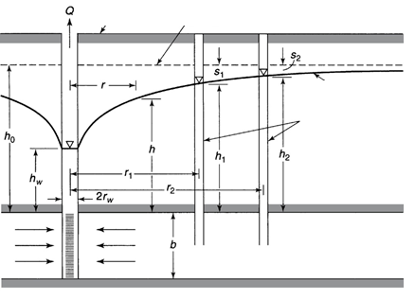
Radial flow to a confined aquifer
A
B
$$Q=2πKb\frac{h−h_{w}}{ln⁡(r/r_{w})}$$
C
D
$$h−h_{w}=\frac{Q\ln\left(r/r_{w}\right)}{2πKb}$$
E
The piezometric surface is labeled
A B C D E
From Mays, 2011, Ground and Surface Water Hydrology
Notes:
Work example 4.2.1 and 4.2.2

Slide 5
Radial flow to a confined aquifer
$$Q=2πKb\frac{h−h_{w}}{ln⁡(r/r_{w})}$$
$$h−h_{w}=\frac{Q\ln\left(r/r_{w}\right)}{2πKb}$$
The drawdown is denoted by
A r; B h; C s; D b; E Kb;
From Mays, 2011, Ground and Surface Water Hydrology
Notes:
Work example 4.2.1 and 4.2.2

Slide 6
The Dupoit assumptions mean
The groundwater flow is in a straight line
The groundwater flow is horizontal
The groundwater flow is radial to a confined aquifer
The groundwater flow has Reynolds number less than 1
Apply only to unconfined aquifers
Notes:
Work example 4.2.1 and 4.2.2

Slide 7
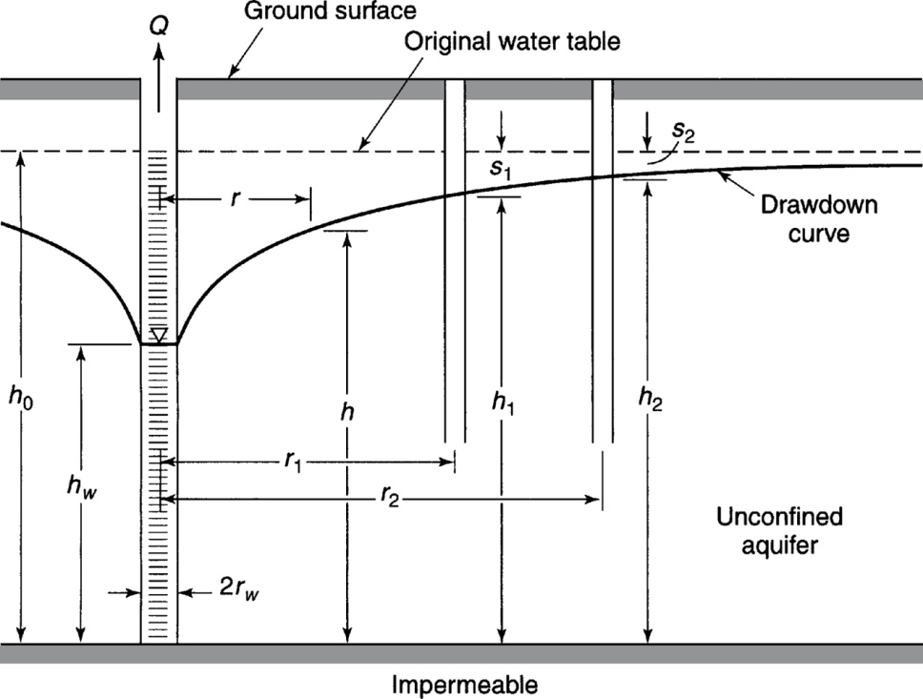
Radial Flow to an Unconfined Aquifer
A well penetrates an unconfined aquifer. The initial water level is h_{o}=25 m. After a long period of pumping at 0.05 m³/s, the drawdowns at 50 and 150 m from the well were observed to be 3 and 1.2 m respectively.
Compute the hydraulic conductivity and radius of influence
What type of deposit is the aquifer
If r_{w}=0.5 m, what is the drawdown at the well
If the water height in the well is h_{w}= 10 m, what are the head losses at the well
What is the drawdown at 500 m.
From Mays, 2011, Ground and Surface Water Hydrology
Notes:
Work example 4.2.3

Slide 8
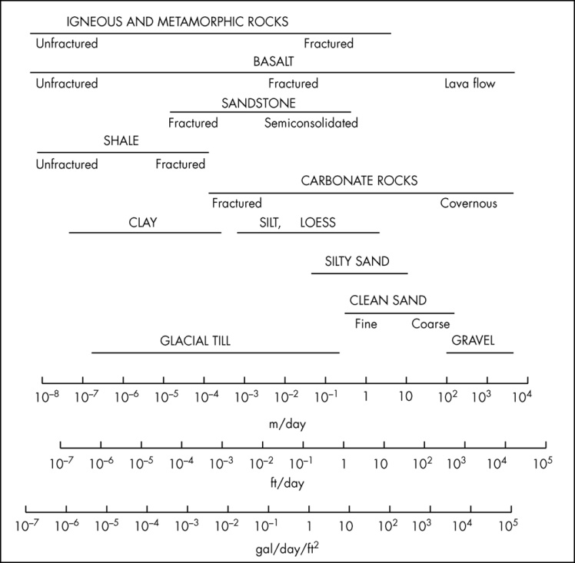
Range of Values of Hydraulic Conductivity
Figure 3.2.2
From Mays, 2011, Ground and Surface Water Hydrology

Slide 9
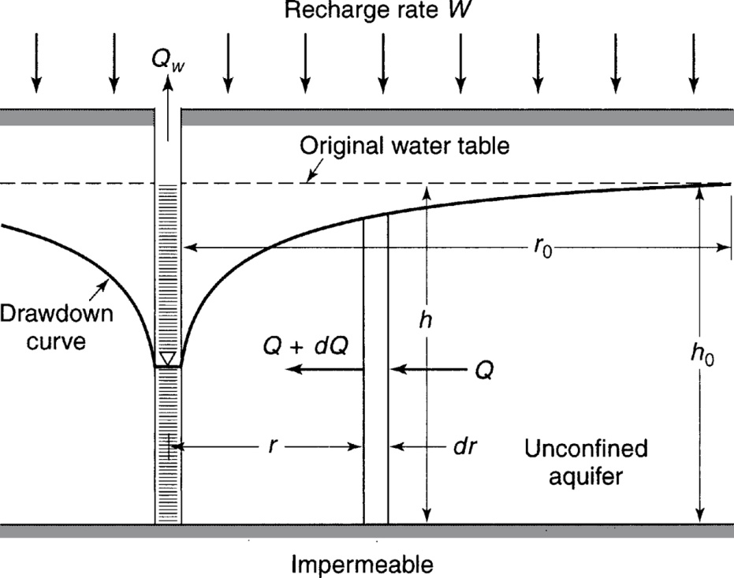
Radial Flow to an Unconfined Aquifer with Recharge
Example 4.2.5.
A pumping well is used to maintain a lowered water table at a construction site. 25 cm dia well. K=0.864 m/day, W=0.06 m/day. Water table must be lowered 3 m over the site that is 50 m square.
From Mays, 2011, Ground and Surface Water Hydrology
Notes:
Work example 4.2.5

