Slide 1
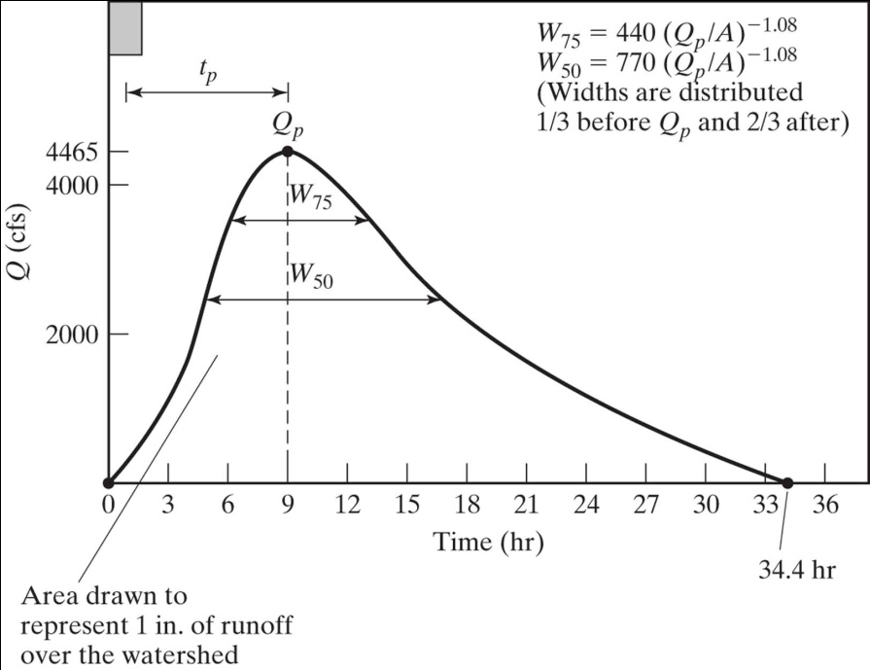
Recap on Synthetic Unit Hydrographs
A unit hydrograph is intended to quantify the unchanging characteristics of the watershed
The synthetic unit hydrograph approach quantifies the unit hydrograph from watershed attributes
1/3
2/3

Slide 2
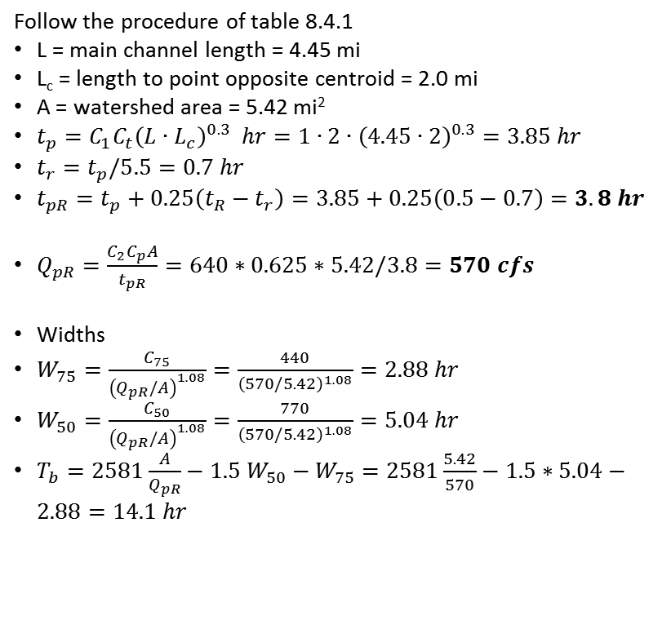
Example 8.4.1 Snyder's Synthetic Unit Hydrograph
A watershed has a drainage area of 5.42 mi²; the length of the main stream is 4.45 mi, and the main channel length from the watershed outlet to the point opposite the center of gravity of the watershed is 2.0 mi. Using Ct = 2.0 and Cp = 0.625, determine the standard synthetic unit hydrograph for this basin. What is the standard duration? Use Snyder’s method to determine the 30- min unit hydrograph parameter.
Follow the procedure of table 8.4.1
L = main channel length = 4.45 mi
L_{c} = length to point opposite centroid = 2.0 mi
A = watershed area = 5.42 mi²
$t_{p}=C_{1}C_{t}{\left(L∙L_{c}\right)}^{0.3} hr=1∙2∙{\left(4.45∙2\right)}^{0.3}=3.85 hr$
$t_{r}=t_{p}/5.5=0.7 hr$
$t_{pR}=t_{p}+0.25\left(t_{R}−t_{r}\right)=3.85+0.25\left(0.5−0.7\right)=3.8 hr$
$Q_{pR}=\frac{C_{2}C_{p}A}{t_{pR}}=640∗0.625∗5.42/3.8=570 cfs$
Widths
$W_{75}=\frac{C_{75}}{{\left(Q_{pR}/A\right)}^{1.08}}=\frac{440}{{\left(570/5.42\right)}^{1.08}}=2.88 hr$
$W_{50}=\frac{C_{50}}{{\left(Q_{pR}/A\right)}^{1.08}}=\frac{770}{{\left(570/5.42\right)}^{1.08}}=5.04 hr$
$T_{b}=2581\frac{A}{Q_{pR}}−1.5 W_{50}−W_{75}=2581\frac{5.42}{570}−1.5∗5.04−2.88=14.1 hr$
(4.05,570)
(3.09,427.5)
(5.97,427.5)
(2.37,285)
W₇₅
(7.41,285)
W₅₀
1/3
2/3
(14.1,0)

Slide 3
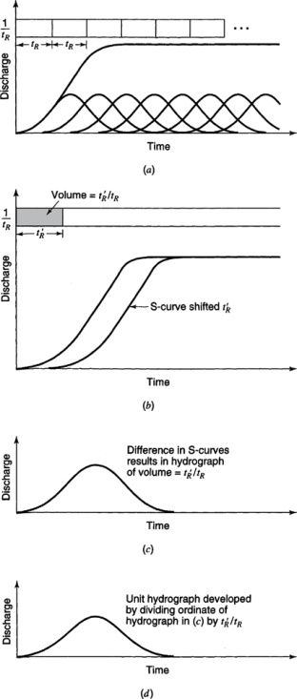
S Curves
From Mays, 2011, Ground and Surface Water Hydrology

Slide 4
Example
The 1- hr unit hydrograph for a watershed is given below. Determine the 2 hr unit hydrograph.
Time ( hr) | 1 | 2 | 3 | 4 | 5 | 6
Unit hydrograph ( cfs) | 10 | 100 | 200 | 150 | 100 | 50

Slide 5
Problem 8.5.3
Suppose the 4-hr unit hydrograph for a watershed is
Determine the 2-hr unit hydrograph
A design storm has 1 cm/hr in first 2 hr and 0.5 cm/hr in the second 2 hr. Baseflow = 10 m³/s. Calculate the total runoff hydrograph
Time (hr) | 0 | 2 | 4 | 6 | 8 | 10 | 12 | 14
Unit hydrograph (m³/s/10 mm) | 0 | 15 | 45 | 65 | 50 | 25 | 10 | 0

