Slide 1
Infiltration and unsaturated flow
Learning objective
Be able to calculate infiltration, cumulative infiltration and time to ponding using the Green-Ampt method as given in Mays Section 7.4

Slide 2
The class of problem we need to solve
Consider a soil of given type (e.g. silty clay loam) and given an input rainfall hyetograph, calculate the infiltration and the runoff.
Rainfall rate 2 cm/hr, for 3 hours
Initial soil moisture content 0.3

Slide 3
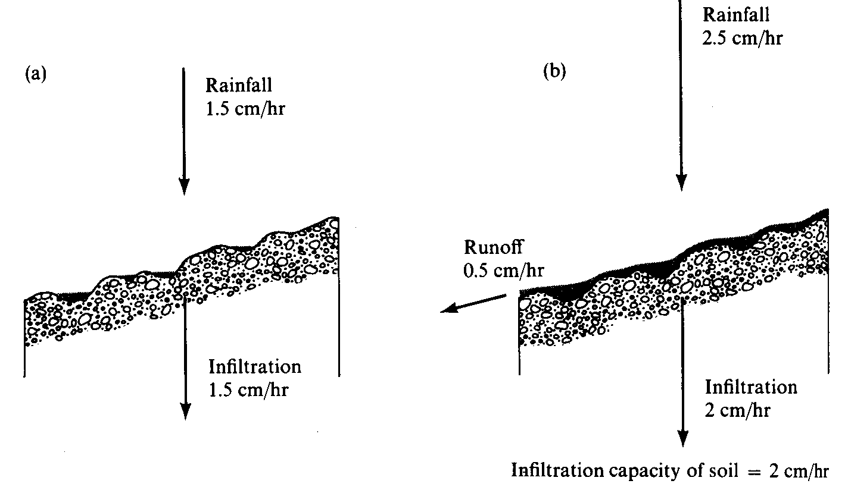
Surface Runoff occurs when surface water input exceeds infiltration capacity. (a) Infiltration rate = rainfall rate which is less than infiltration capacity. (b) Runoff rate = Rainfall intensity – Infiltration capacity. (from Dunne and Leopold, 1978)

Slide 4
Example 7.4.3
Use the Green-Ampt method to evaluate the infiltration rate and cumulative infiltration depth for a silty clay soil at 0.1 hr increments up to 6 hr from the beginning of infiltration. Assume an initial effective saturation of 20% and continuous ponding

Slide 5
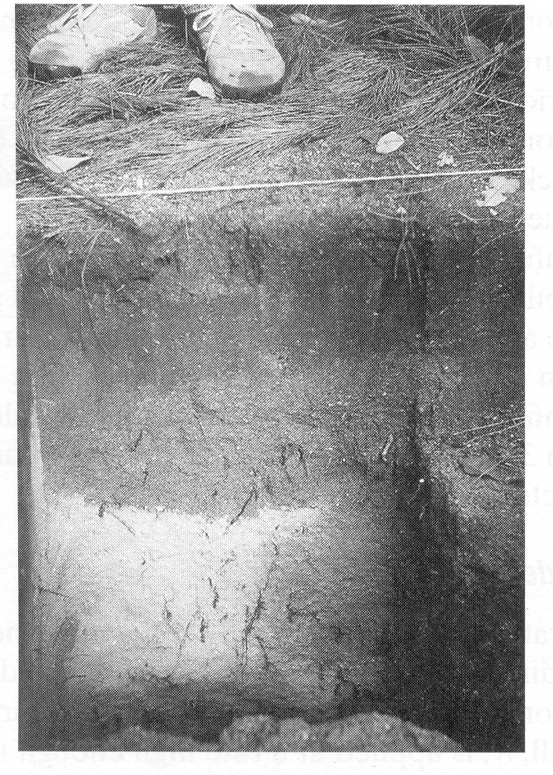
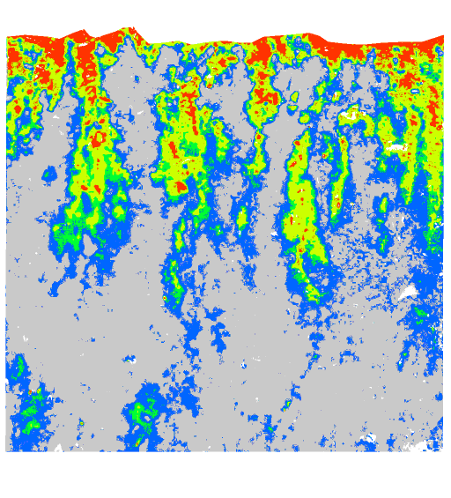
Wetting front in a sandy soil exposed after intense rain (from Dingman, 1994).
Preferential pathway infiltration (Markus Weiler, ETH Zurich)

Slide 6
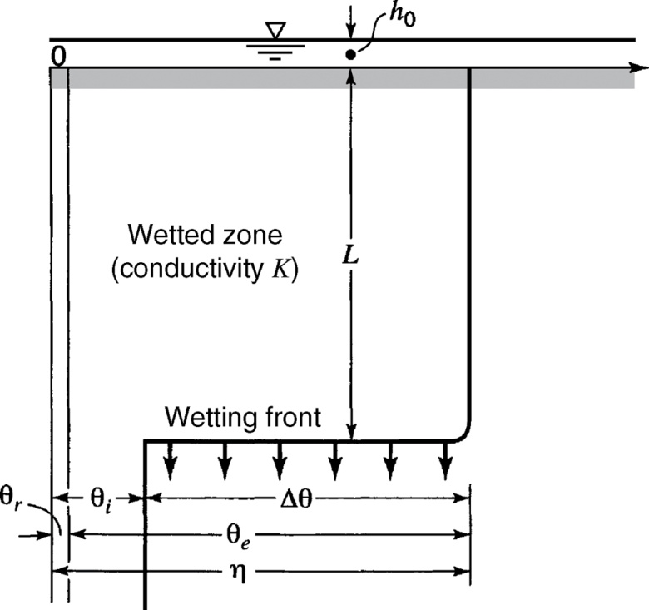
Green-Ampt model idealization of wetting front penetration into a soil profile
$$h_{1}=h_{0}$$
$$h_{2}=−L−ψ$$
$$F=L∆θ$$
$$f=−q=K\frac{h_{1}−h_{2}}{z_{1}−z_{2}}$$
$=K\frac{h_{o}−\left(−L−ψ\right)}{L}$
$=K\frac{F+ψ∆θ}{F}$ for h_{o} = 0
From Mays, 2011, Ground and Surface Water Hydrology

Slide 7
Green – Ampt infiltration parameters for various soil classes (Rawls et al., 1983). The numbers in parentheses are one standard deviation around the parameter value given.
Soil Texture | Porosity n | Effective porosity θ_{e} | Wetting front soil suction head ψ (cm) | Hydraulic conductivity K (cm/hr)
Sand | 0.437 (0.374-0.500) | 0.417 (0.354-0.480) | 4.95 (0.97-25.36) | 11.78
Loamy sand | 0.437 (0.363-0.506) | 0.401 (0.329-0.473) | 6.13 (1.35-27.94) | 2.99
Sandy loam | 0.453 (0.351-0.555) | 0.412 (0.283-0.541) | 11.01 (2.67-45.47) | 1.09
Loam | 0.463 (0.375-0.551) | 0.434 (0.334-0.534) | 8.89 (1.33-59.38) | 0.34
Silt loam | 0.501 (0.420-0.582) | 0.486 (0.394-0.578) | 16.68 (2.92-95.39) | 0.65
Sandy clay loam | 0.398 (0.332-0.464) | 0.330 (0.235-0.425) | 21.85 (4.42-108.0) | 0.15
Clay loam | 0.464 (0.409-0.519) | 0.309 (0.279-0.501) | 20.88 (4.79-91.10) | 0.1
Silty clay loam | 0.471 (0.418-0.524) | 0.432 (0.347-0.517) | 27.30 (5.67-131.50) | 0.1
Sandy clay | 0.430 (0.370-0.490) | 0.321 (0.207-0.435) | 23.90 (4.08-140.2) | 0.06
Silty clay | 0.479 (0.425-0.533) | 0.423 (0.334-0.512) | 29.22 (6.13-139.4) | 0.05
Clay | 0.475 (0.427-0.523) | 0.385 (0.269-0.501) | 31.63 (6.39-156.5) | 0.03

Slide 8
Infiltration capacity – Depth Function

Slide 9
Green Ampt Infiltration after Ponding
At ponding
$$f=K\left(1+\frac{ψ∆θ}{F}\right)$$
$$i=K\left(1+\frac{ψ∆θ}{it_{p}}\right)$$
Time of ponding
After ponding
$$t_{p}=\frac{Kψ∆θ}{i\left(i−K\right)}$$
$$F−F_{p}−ψ∆θ\ln\left(\frac{F+ψ∆θ}{F_{p}+ψ∆θ}\right)=K\left(t−t_{p}\right)$$
From Mays, 2011, Ground and Surface Water Hydrology

