Slide 1
Example 2.5.1
Estimate the average drawdown over an area where 25 million m³ of water has been pumped through a number of uniformly distributed wells. The area is 150 km² and the specific yield of the aquifer is 25%.

Slide 2
From Mays, 2011, Ground and Surface Water Hydrology

Slide 3
Estimate the average drawdown over an area where 25 million m³ of water has been pumped through a number of uniformly distributed wells. The area is 150 km² and the specific yield of the aquifer is 25%.
Now suppose that for this same aquifer there is 0.1 m of infiltration from rainfall. How much would the aquifer rise
A. 0.1 m, B. 0.2 m, C. 0.3
D. 0.4 m, E. 0.5 m

Slide 4
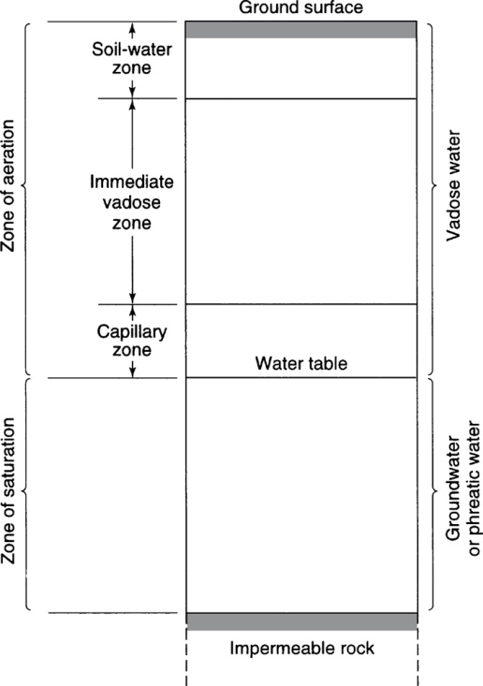
Vertical Distribution of Subsurface Water
From Mays, 2011, Ground and Surface Water Hydrology

Slide 5
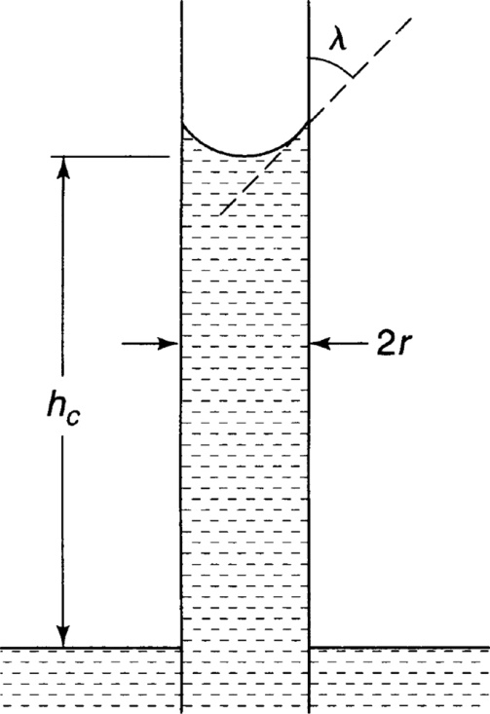
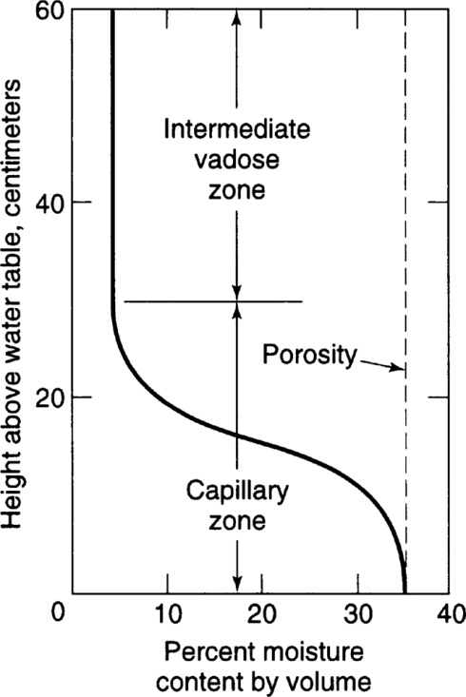
Rise of water above water table – due to capillary effects
Water in capillaries is at negative pressure, i.e. under suction or tension
From Mays, 2011, Ground and Surface Water Hydrology

Slide 6
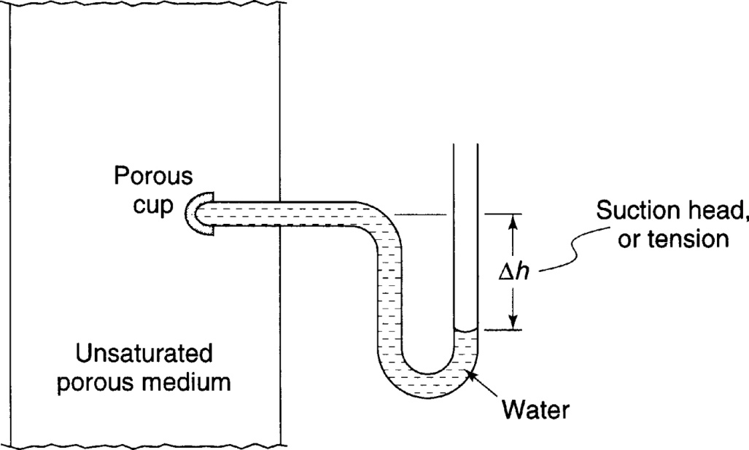
Tensiometer for measuring water tension
From Mays, 2011, Ground and Surface Water Hydrology

Slide 7
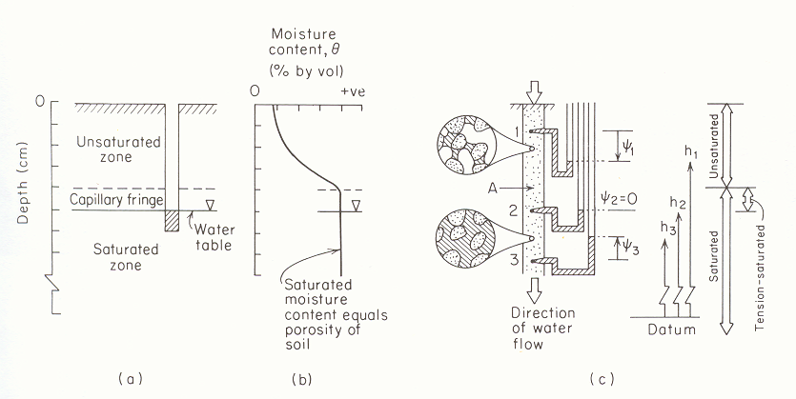
Negative Pressure Head. Suction vs Moisture content
(from Freeze and Cherry, 1979)

Slide 8
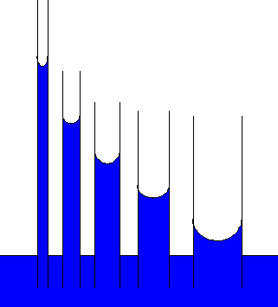
Suction head -|ψ|
Moisture Content θ
Illustration of capillary rise due to surface tension and relationship between pore size distribution and soil water retention curve.

Slide 9
Storage Coefficient for (a) confined and (b) unconfined aquifers
From Mays, 2011, Ground and Surface Water Hydrology

Slide 10
Example 2.8.2
Determine the volume of water released by lowering the piezometric surface of a confined aquifer by 5 m over an area of 1 km². The aquifer is 35 m thick and has a storage coefficient of 8.3 x 10⁻³.
What is the specific storage of this aquifer
If the aquifer was 50 m thick, what would the storage coefficient and volume of water be

