Slide 1
Groundwater
Learning objectives
Be able to quantify the properties of water held in and flowing through the subsurface (soil and rock). The properties of interest include
porosity,
moisture content,
pressure,
suction,
hydraulic conductivity
Mays Chapter 2

Slide 2
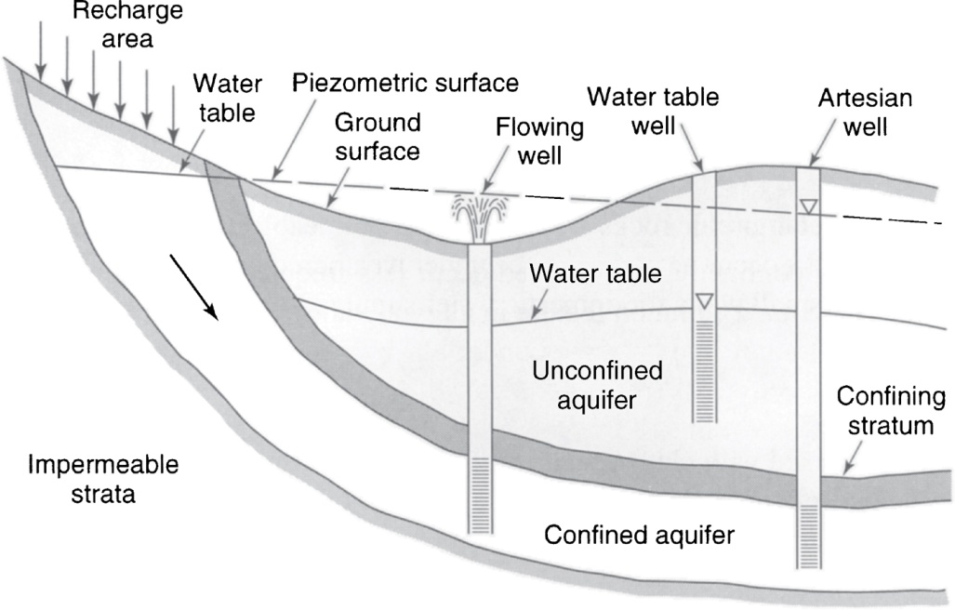
Schematic cross section illustrating unconfined and confined aquifers
From Mays, 2011, Ground and Surface Water Hydrology

Slide 3
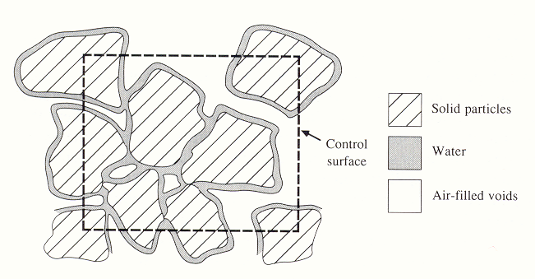
Notes:
Figure 21. Cross section through an unsaturated porous medium (from Chow et al. 1988)

Slide 4
Example 2.2.1
An undisturbed sample of a medium sand weighs 484.68 g. The core is 6 cm in dia and 10.61 cm high. After oven drying the core weighs 447.32 g. Determine the bulk density, void ratio, water content and saturation percentage of the soil.

Slide 5
Well graded silt, sand, gravel mixture
Uniformly graded sand
Illustrative grain-size distribution curves. The boundaries between size classes designated as clay, silt, sand and gravel are shown as vertical lines.

Slide 6
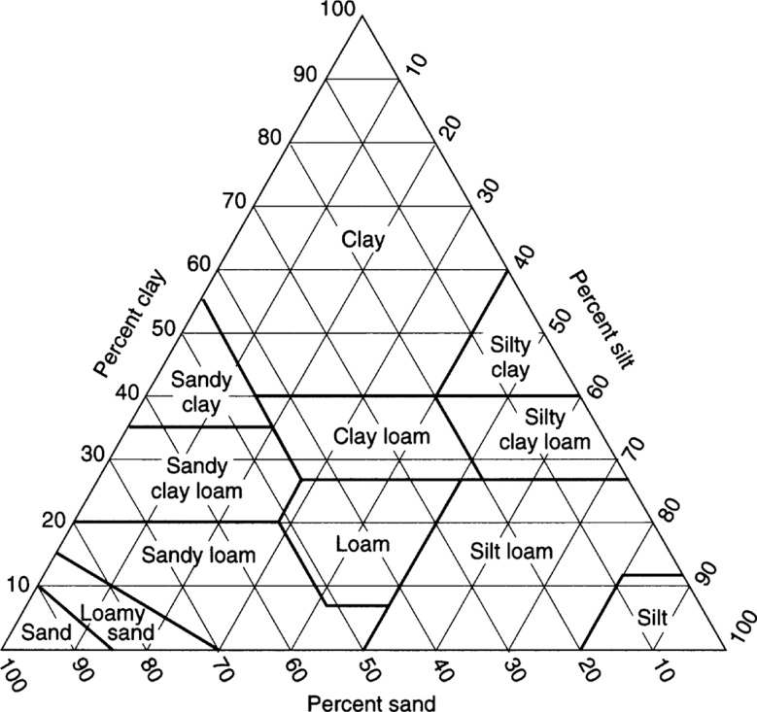
Soil Texture Triangle
From Mays, 2011, Ground and Surface Water Hydrology

Slide 7
Macroscopic and microscopic concepts of a porous medium. (from Freeze and Cherry, 1979)

