Slide 1
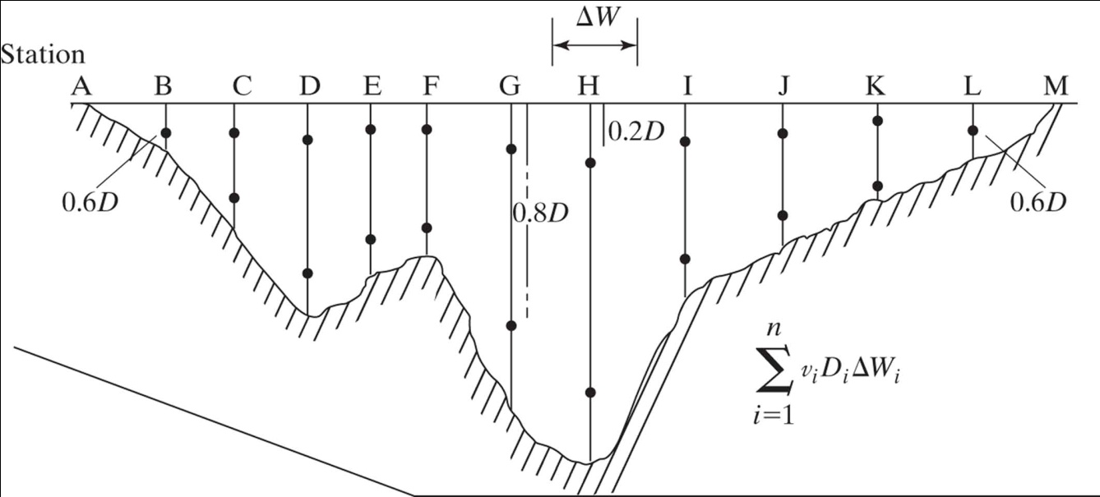
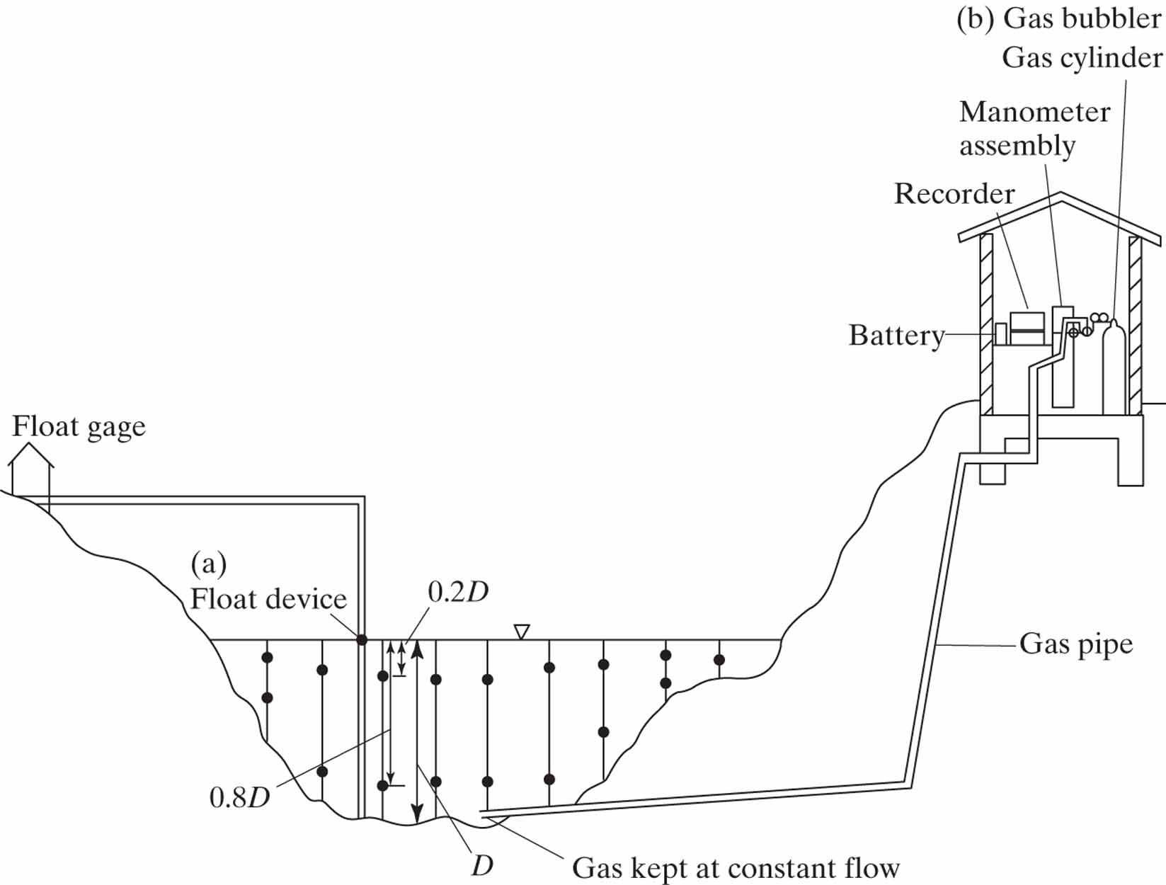
Figure 1-14
Streamflow Measurement

Slide 2
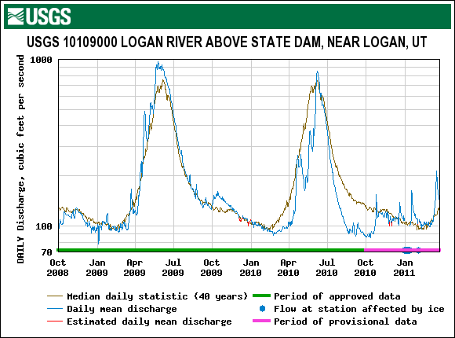
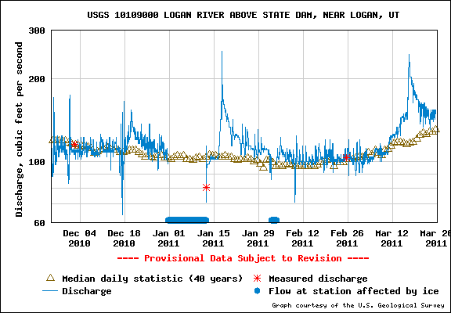
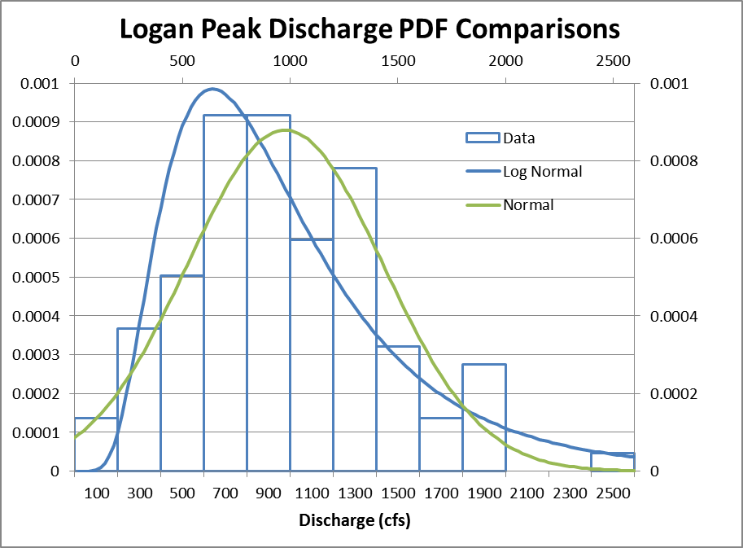
Data from March 25, 2011
From http://waterdata.usgs.gov/nwis/
2450 cfs in 1907
2000 cfs in 1916
1980 cfs in 1899
1980 cfs in 1984
1970 cfs in 1986

Slide 3
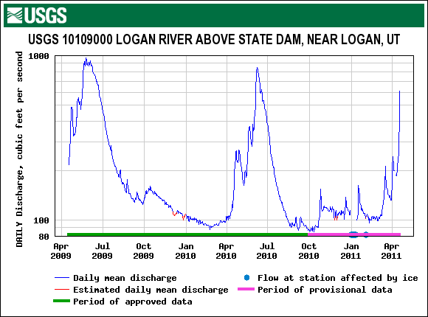
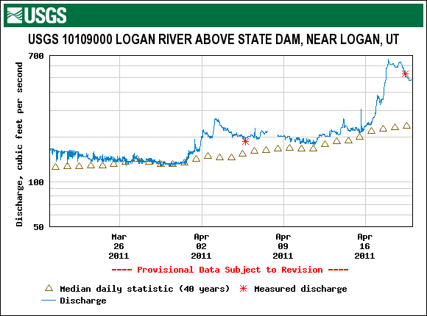
April 19, 2011
From http://waterdata.usgs.gov/nwis/

Slide 4
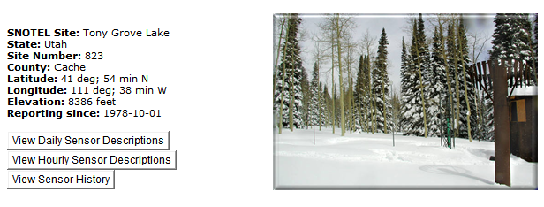
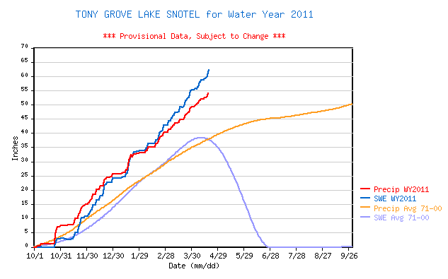
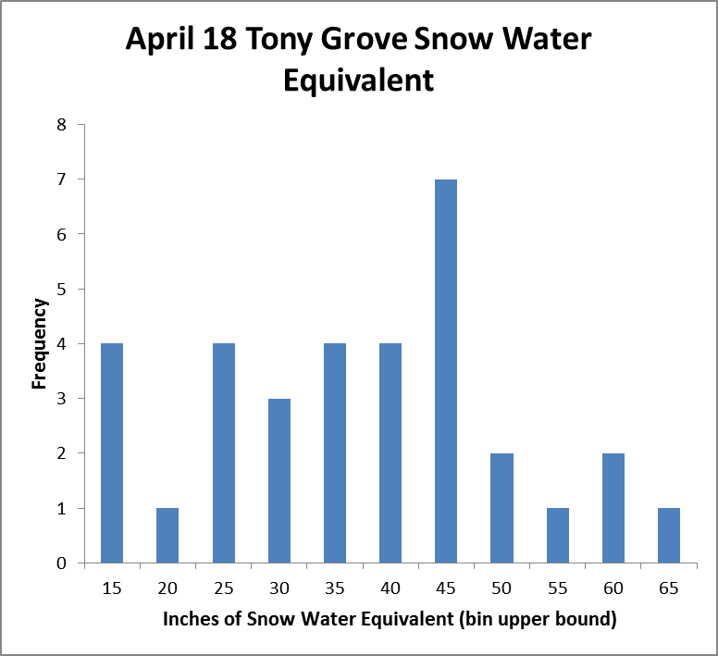
SNOTEL Data
From http://www.wcc.nrcs.usda.gov/snow/

Slide 5
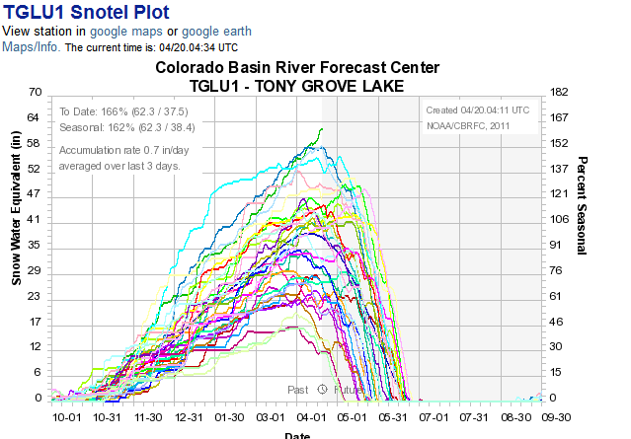
1982 (gray)
2006 (navy)
2011 (green)
1997 (light blue)
1984 (light yellow)
1986 (pink)
Peak Floods
1980 cfs in 1984
1970 cfs in 1986
1740 cfs in 1997
1530 cfs in 2006
1330 cfs in 1982
http://www.cbrfc.noaa.gov/

Slide 6
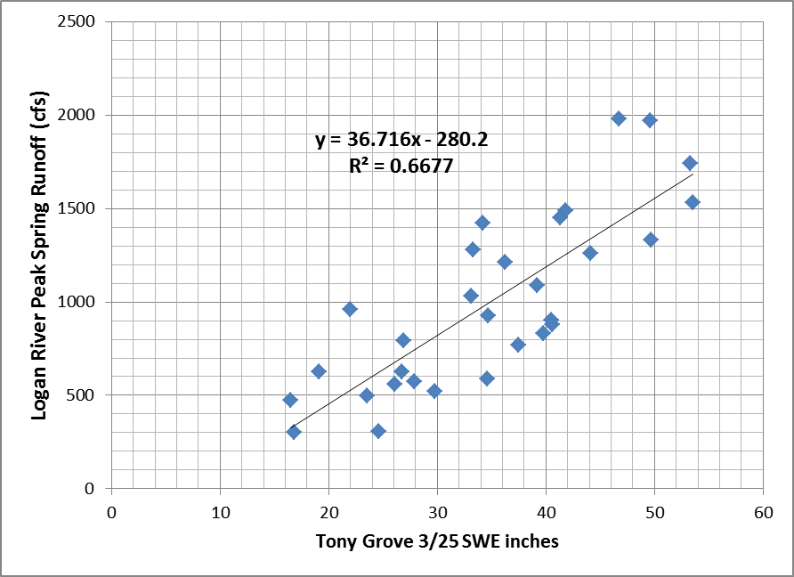
March 25 Quick 2011 Peak Runoff Prediction 1622 +- 540 cfs (95% confidence interval)
X=51.8 in
Y=1622 cfs
Var of Y 219657 cfs²
MSE = (1-R²)Var
RMSE = 270 (1 std dev error)
95% CI = 2 RMSE
=+-540 cfs
2450 cfs in 1907
2000 cfs in 1916
1980 cfs in 1899
1980 cfs in 1984
1970 cfs in 1986

Slide 7
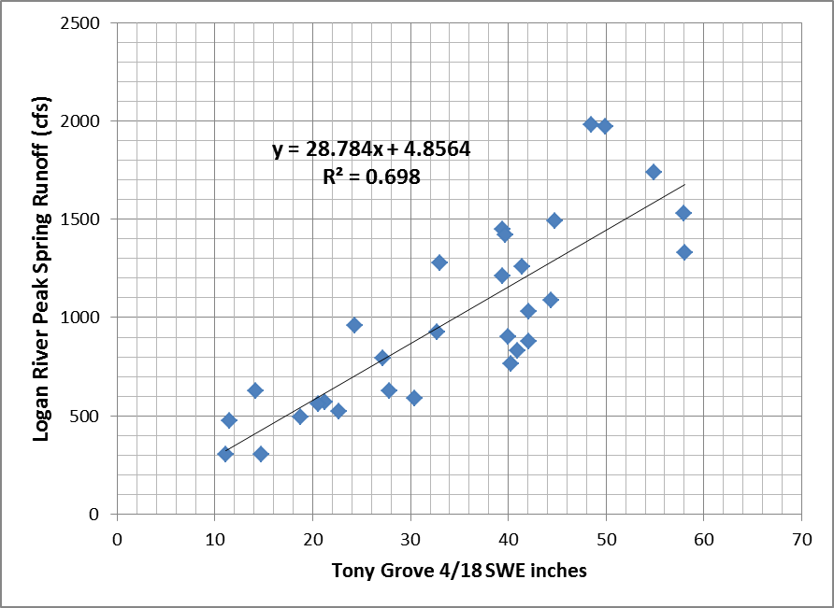
April 18 Quick Peak Runoff Prediction
X=62.3 in
Y=1798 cfs
Var of Y 219657 cfs²
MSE = (1-R²)Var
RMSE = 257 (1 std dev error)
95% CI = 2 RMSE
=+-515 cfs
1984
1986
2006
1997
1982
2450 cfs in 1907
2000 cfs in 1916
1980 cfs in 1899
1980 cfs in 1984
1970 cfs in 1986
1740 cfs in 1997
1530 cfs in 2006
1330 cfs in 1982

Slide 8
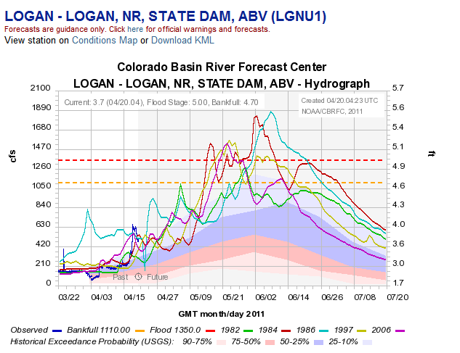
http://www.cbrfc.noaa.gov/

Slide 9
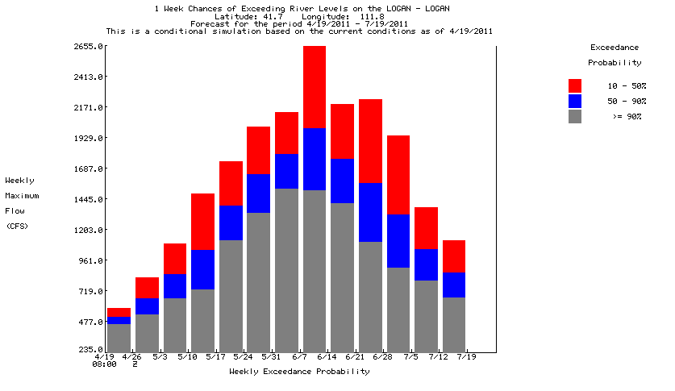
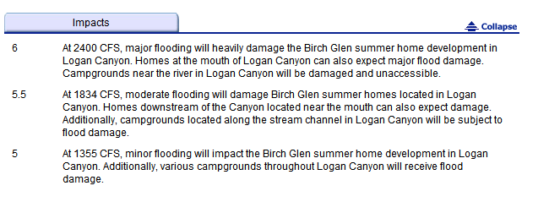
http://water.weather.gov/ahps2/

Slide 10
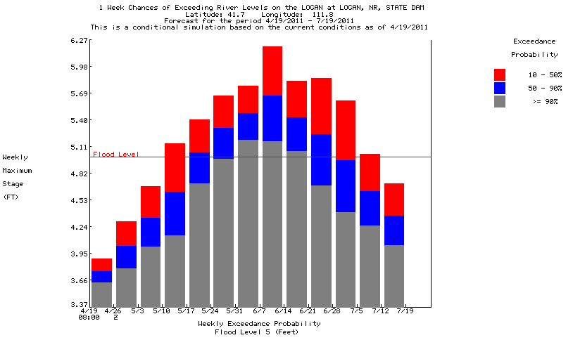
http://water.weather.gov/ahps2/

Slide 11
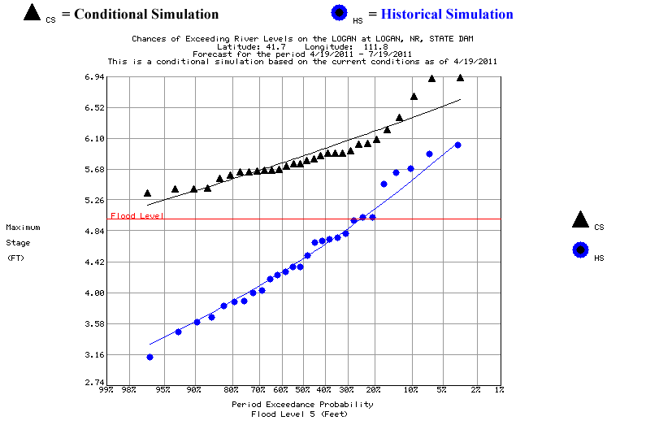
http://water.weather.gov/ahps2/

Slide 12
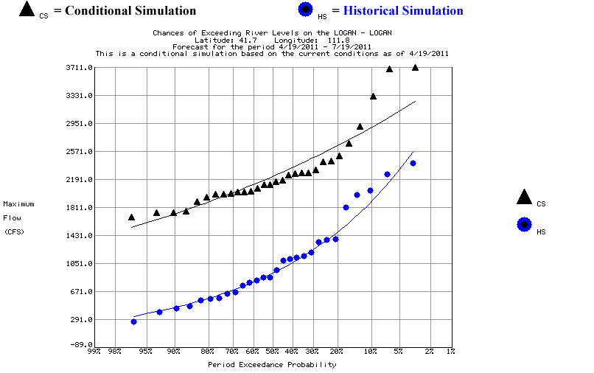
http://water.weather.gov/ahps2/

