Slide 1


Terrain Analysis Using Digital Elevation Models (TauDEM)
David Tarboton¹, Dan Watson², Rob Wallace,³ Kim Schreuders¹, Jeremy Neff¹
¹Utah Water Research Laboratory, Utah State University, Logan, Utah
²Computer Science, Utah State University, Logan, Utah
³US Army Engineer Research and Development Center, Information Technology Lab, Vicksburg, Mississippi
This research was funded by the US Army Research and Development Center under contract number W9124Z-08-P-0420

Slide 2




Deriving hydrologically useful information from Digital Elevation Models
Raw DEM
Pit Removal (Filling)
Flow Field
Flow Related Terrain Information
Notes:
This slide shows the general model for deriving flow field related derivative surfaces from digital elevation data. The input is a raw digital elevation model, generally elevation values on a grid. This is basic information used to derive further hydrology related spatial fields that enrich the information content of this basic data. The first step is to remove sinks, either by filling, or carving. Then a flow field is defined. This enables the calculation of flow related terrain information. My focus has been on flow related information working within this framework. I try to leave other GIS functionality, like radiation exposure, line of sight analyses and visualization to others. I have distributed my software in ways that it easily plugs in to mainstream systems, such as ArcGIS to enhance ease of use.

Slide 3
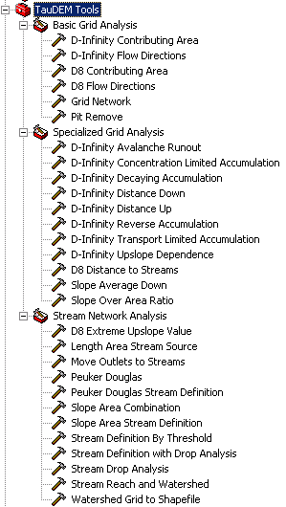

A parallel version of the TauDEM Software Tools
Improved runtime efficiency
Capability to run larger problems
Platform independence of core functionality
Deployed as an ArcGIS Toolbox with tools that drive accompanying command line executables, available from http://hydrology.usu.edu/taudem/

Slide 4




The challenge of increasing Digital Elevation Model (DEM) resolution
1980’s DMA 90 m
10² cells/km²
1990’s USGS DEM 30 m
10³ cells/km²
2000’s NED 10-30 m
10⁴ cells/km²
2010’s LIDAR ~1 m
10⁶ cells/km²

Slide 5
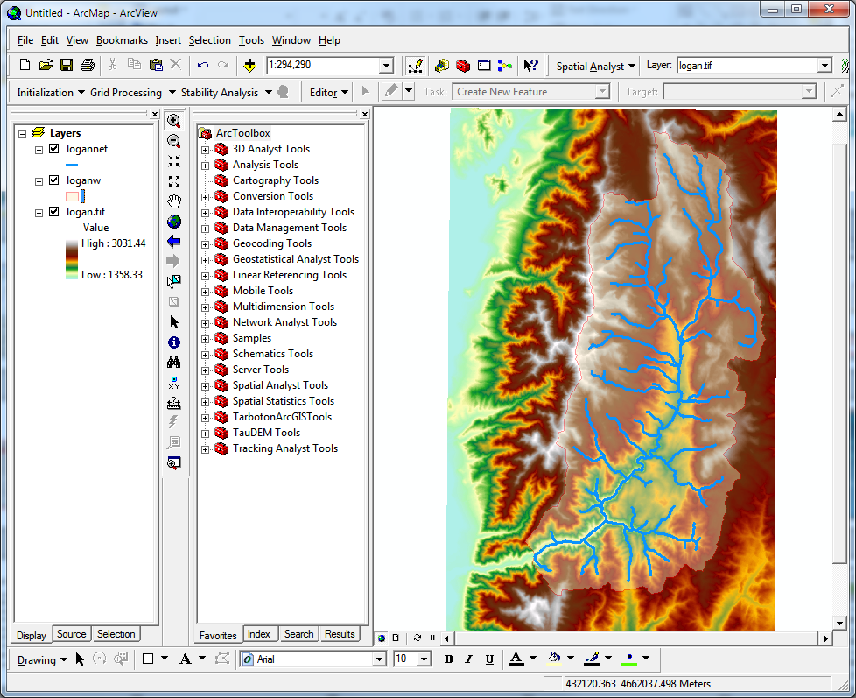
Website and Demo
http://hydrology.usu.edu/taudem

Slide 6
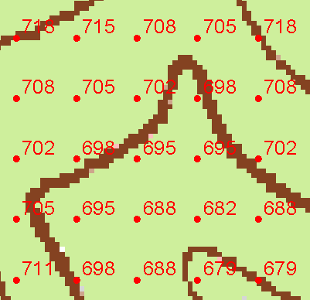
Grid Data Format Assumptions
Input and output grids are uncompressed GeoTIFF
Maximum size 4 GB
GDAL Nodata tag preferred (if not present, a missing value is assumed)
Grids are square (Δx= Δy)
Grids have identical in extent, cell size and spatial reference
Spatial reference information is not used (no projection on the fly)

Slide 7
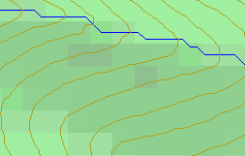
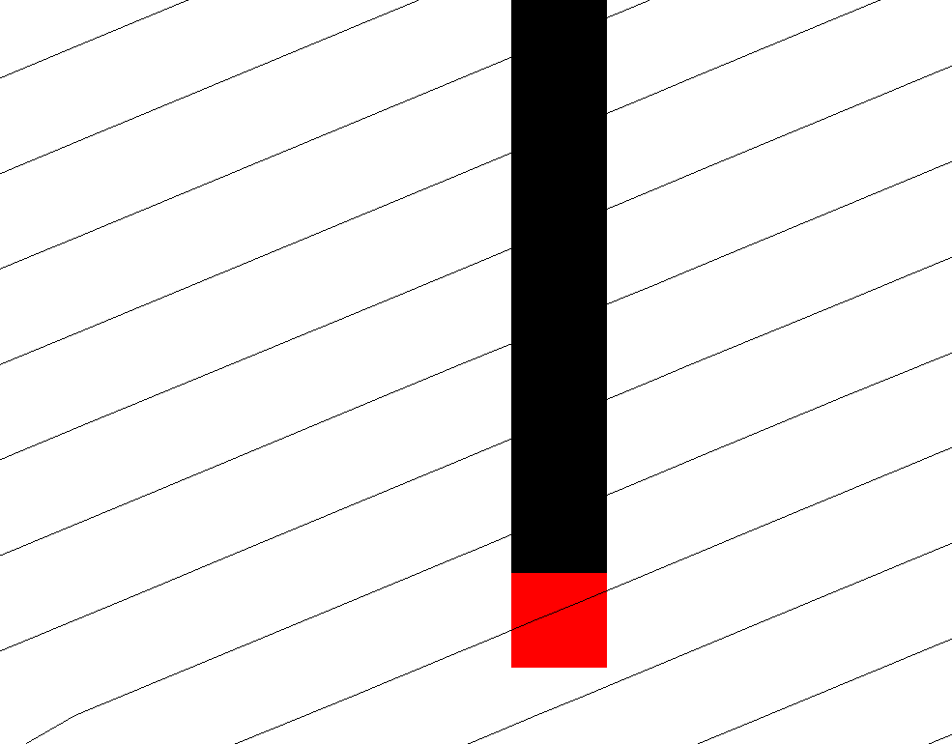
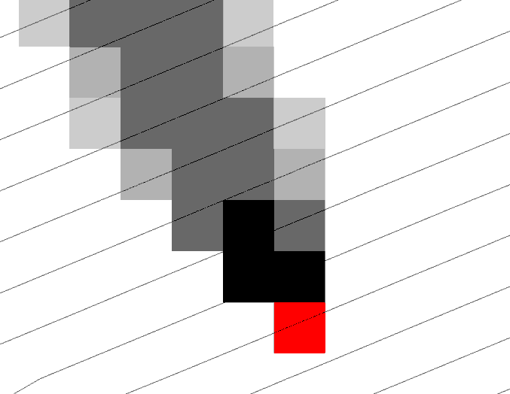
Representation of Flow Field
Steepest single direction
48
52
56
67
D8
D∞
Tarboton, D. G., (1997), "A New Method for the Determination of Flow Directions and Contributing Areas in Grid Digital Elevation Models," Water Resources Research, 33(2): 309-319.)
Notes:
This slide shows how the terrain flow field is represented. Early DEM work used a single flow direction model, D8. In 1997 I published the Dinfinity method that proportions flow from each grid cell among downslope neighbors. This, at the expense of some dispersion, allows a better approximation of flow across surfaces.

Slide 8
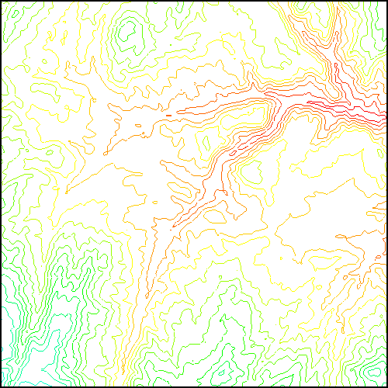
Parallel Approach
MPI, distributed memory paradigm
Row oriented slices
Each process includes one buffer row on either side
Each process does not change buffer row

Slide 9
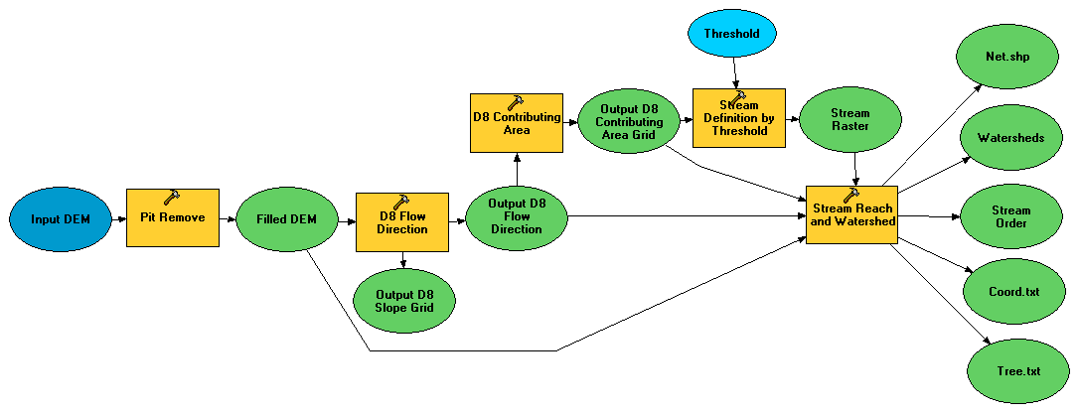
Illustrative Use Case: Delineation of channels and watersheds using a constant support area threshold
Steps
Pit Remove
D8 Flow Directions
D8 Contributing Area
Stream Definition by Threshold
Stream Reach and Watershed

Slide 10
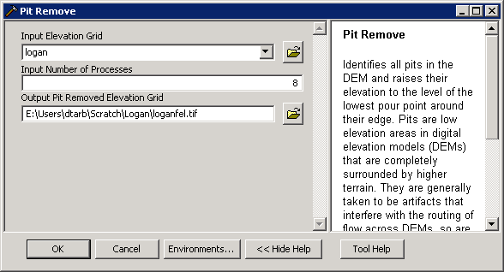
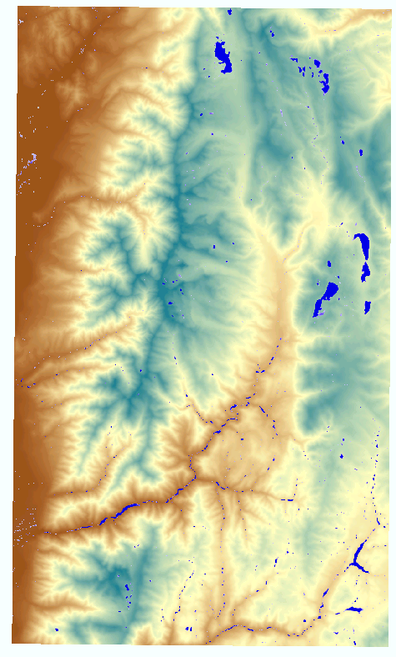
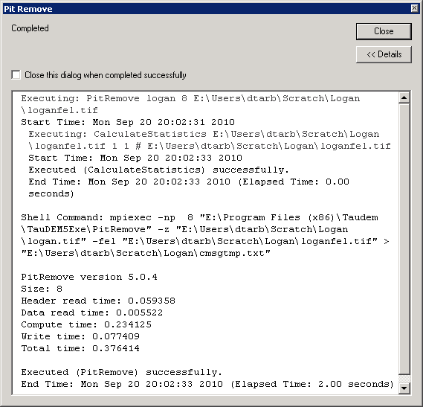
Pit Remove

Slide 11
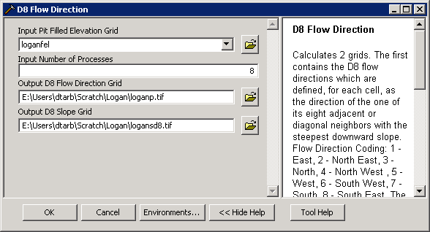
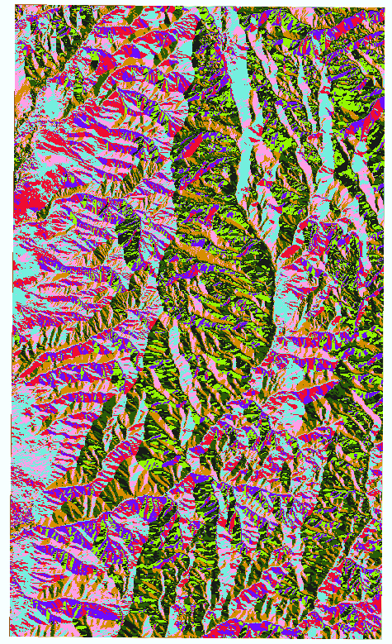
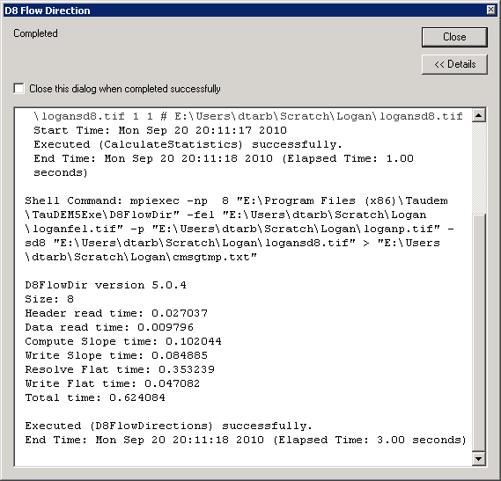

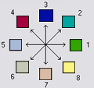
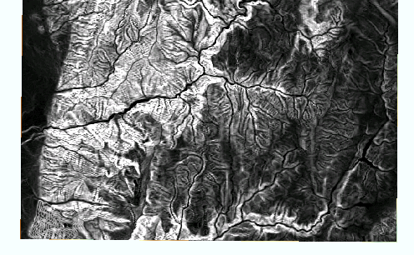

D8 Flow Direction (and Slope)

Slide 12
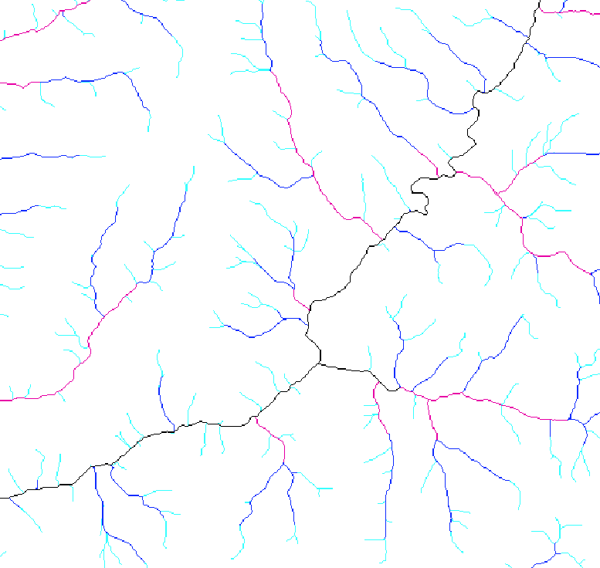
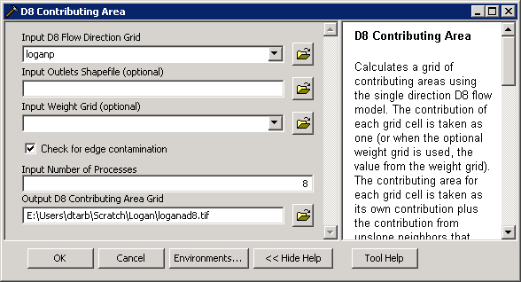
D8 Contributing Area

Slide 13
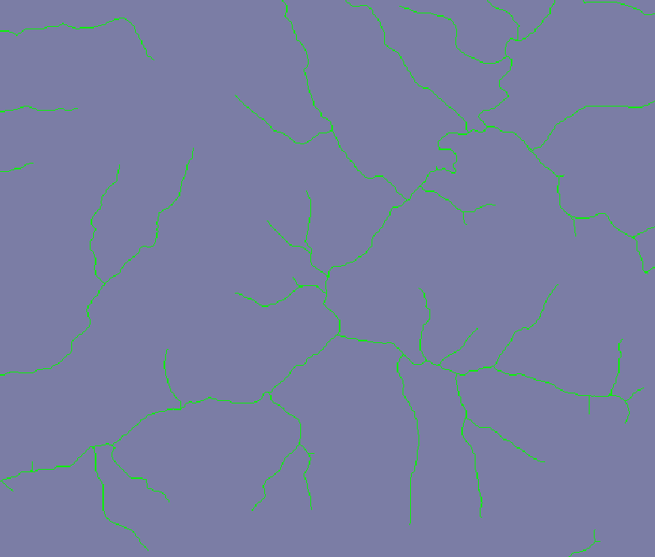
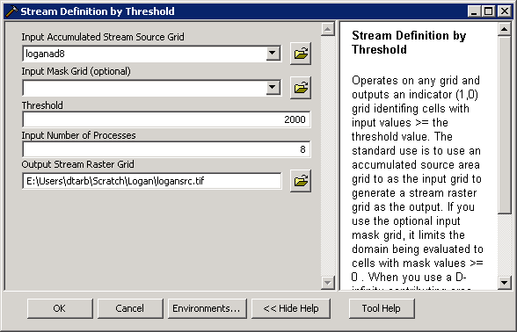
Stream Definition by Threshold

Slide 14
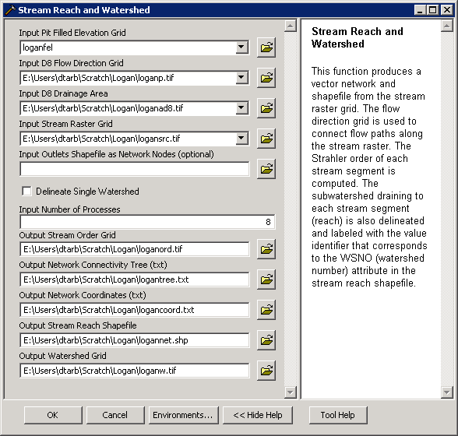
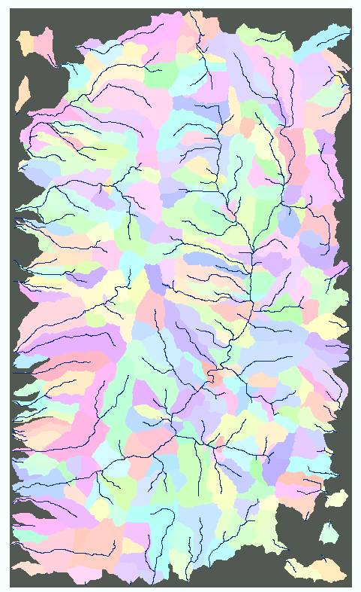
Stream Reach and Watershed

Slide 15
Some Algorithm Details
Pit Removal: Planchon Fill Algorithm
Initialization
1st Pass
2nd Pass
Planchon, O., and F. Darboux (2001), A fast, simple and versatile algorithm to fill the depressions of digital elevation models, Catena(46), 159-176.

Slide 16
Parallel Scheme
Communicate
Initialize( Z,F) Do for all grid cells i if Z(i) > n F(i) ← Z(i) Else F(i) ← n i on stack for next pass endfor Send( topRow, rank-1 ) Send( bottomRow, rank+1 ) Recv( rowBelow, rank+1 ) Recv( rowAbove, rank-1 ) Until F is not modified
Z denotes the original elevation.
F denotes the pit filled elevation.
n denotes lowest neighboring elevation
i denotes the cell being evaluated
Iterate only over stack of changeable cells

Slide 17
Parallelization of Contributing Area/Flow Algebra
1. Dependency grid
and so on until completion
resulting in new D=0 cells on queue
Queue’s empty so exchange border info.
Decrease cross partition dependency
Executed by every process with grid flow field P, grid dependencies D initialized to 0 and an empty queue Q. FindDependencies(P,Q,D) for all i for all k neighbors of i if P_{ki}>0 D(i)=D(i)+1 if D(i)=0 add i to Q next
A=1
A=1
A=1
A=1
A=1
A=1
A=1
A=1
D=0
A=1
A=1
A=1
A=1
D=0
D=0
A=1
A=1
A=1
D=0
D=0
A=1
D=0
A=1
A=1
A=1
A=1
A=1
A=1.5
A=1.5
A=3
D=0
A=1.5
A=1.5
D=1
D=0
D=1
D=0
D=0
A=3
D=0
D=3
D=2
D=1
D=0
D=0
D=1
D=1
A=1.5
D=1
A=1.5
A=3
A=3
A=1.5
A=1.5
2. Flow algebra function
B=-2
B=-1
Executed by every process with D and Q initialized from FindDependencies. FlowAlgebra(P,Q,D,θ,γ) while Q isn’t empty get i from Q θ_{i} = FA(γ_{i}, P_{ki}, θ_{k}, γ_{k}) for each downslope neighbor n of i if P_{in}>0 D(n)=D(n)-1 if D(n)=0 add n to Q next n end while swap process buffers and repeat
B=-2
B=-1
A=1
A=1
D=2
D=2
D=1
A=1
D=1
A=1
D=0
A=1
A=1
D=2
D=2
D=2
D=2
D=2
D=1
D=1
D=1
D=1
A=1
D=1
A=1
A=5.5
D=0
A=2.5
D=0
A=1
A=1
D=1
D=1
D=1
A=1
D=1
A=1
D=0
D=0
A=1
D=1
D=1
D=3
D=2
D=1
D=1
D=1
D=1
D=1
A=1
D=1
A=1
D=1
A=6
A=3.5
D=1

Slide 18
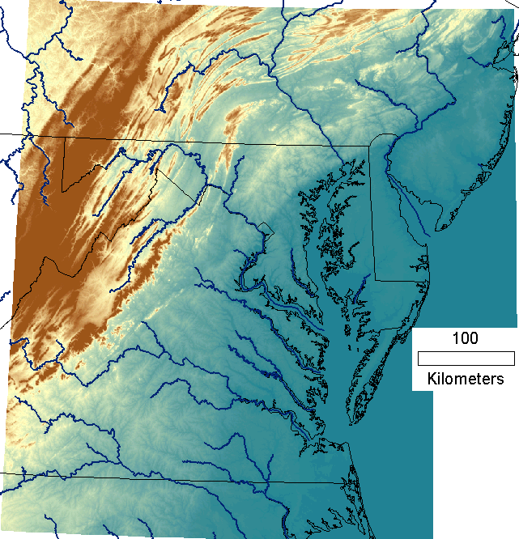
Capabilities Summary
Capability to run larger problems
 |  | Processors used | Grid size
 |  |  | Theoretcal limit | Largest run
2008 | TauDEM 4 | 1 | 0.22 GB | 0.22 GB
Sept 2009 | Partial implement-ation | 8 | 4 GB | 1.6 GB
June 2010 | TauDEM 5 | 8 | 4 GB | 4 GB
Sept 2010 | Multifile on 48 GB RAM PC | 4 | Hardware limits | 6 GB
Sept 2010 | Multifile on cluster with 128 GB RAM | 128 | Hardware limits | 11 GB
11 GB
6 GB
4 GB
1.6 GB
0.22 GB
Single file size limit 4GB
At 10 m grid cell size

Slide 19
Improved runtime efficiency
Parallel Pit Remove timing for NEDB test dataset (14849 x 27174 cells ≈ 1.6 GB).
8 processor PC
Dual quad-core Xeon E5405 2.0GHz PC with 16GB RAM
128 processor cluster
16 diskless Dell SC1435 compute nodes, each with 2.0GHz dual quad-core AMD Opteron 2350 processors with 8GB RAM

Slide 20
Improved runtime efficiency
Parallel D-Infinity Contributing Area Timing for Boise River dataset (24856 x 24000 cells ~ 2.4 GB)
8 processor PC
Dual quad-core Xeon E5405 2.0GHz PC with 16GB RAM
128 processor cluster
16 diskless Dell SC1435 compute nodes, each with 2.0GHz dual quad-core AMD Opteron 2350 processors with 8GB RAM

Slide 21
Scaling of run times to large grids
Dataset | Size | Hardware | Number of Processors | PitRemove (run time seconds) |  | D8FlowDir (run time seconds)
 | (GB) |  |  | Compute | Total | Compute | Total
GSL100 | 0.12 | Owl (PC) | 8 | 10 | 12 | 356 | 358
GSL100 | 0.12 | Rex (Cluster) | 8 | 28 | 360 | 1075 | 1323
GSL100 | 0.12 | Rex (Cluster) | 64 | 10 | 256 | 198 | 430
GSL100 | 0.12 | Mac | 8 | 20 | 20 | 803 | 806
YellowStone | 2.14 | Owl (PC) | 8 | 529 | 681 | 4363 | 4571
YellowStone | 2.14 | Rex (Cluster) | 64 | 140 | 3759 | 2855 | 11385
Boise River | 4 | Owl (PC) | 8 | 4818 | 6225 | 10558 | 11599
Boise River | 4 | Virtual (PC) | 4 | 1502 | 2120 | 10658 | 11191
Bear/Jordan/Weber | 6 | Virtual (PC) | 4 | 4780 | 5695 | 36569 | 37098
Chesapeake | 11.3 | Rex (Cluster) | 64 | 702 | 24045
Owl is an 8 core PC (Dual quad-core Xeon E5405 2.0GHz) with 16GB RAM
Rex is a 128 core cluster of 16 diskless Dell SC1435 compute nodes, each with 2.0GHz dual quad-core AMD Opteron 2350 processors with 8GB RAM
Virtual is a virtual PC resourced with 48 GB RAM and 4 Intel Xeon E5450 3 GHz processors
Mac is an 8 core (Dual quad-core Intel Xeon E5620 2.26 GHz) with 16GB RAM

Slide 22
Scaling of run times to large grids
Owl is an 8 core PC (Dual quad-core Xeon E5405 2.0GHz) with 16GB RAM
Rex is a 128 core cluster of 16 diskless Dell SC1435 compute nodes, each with 2.0GHz dual quad-core AMD Opteron 2350 processors with 8GB RAM
Virtual is a virtual PC resourced with 48 GB RAM and 4 Intel Xeon E5450 3 GHz processors

Slide 23
Summary and Conclusions
Parallelization speeds up processing and partitioned processing reduces size limitations
Parallel logic developed for general recursive flow accumulation methodology (flow algebra)
Documented ArcGIS Toolbox Graphical User Interface
32 and 64 bit versions (but 32 bit version limited by inherent 32 bit operating system memory limitations)
PC, Mac and Linux/Unix capability
Capability to process large grids efficiently increased from 0.22 GB upper limit pre-project to where < 4GB grids can be processed in the ArcGIS Toolbox version on a PC within a day and up to 11 GB has been processed on a distributed cluster (a 50 fold size increase)

Slide 24
Limitations and Dependencies
Uses MPICH2 library from Argonne National Laboratory http://www.mcs.anl.gov/research/projects/mpich2/
TIFF (GeoTIFF) 4 GB file size (for single file version)
[Prototype with capability to use multiple files to cover domain not yet on web site]
Processor memory

Slide 25
Additional Illustrative Use Cases
Start with a DEM and end up with a topographic wetness index from the Dinfinity method
Start with a DEM and end up with a delineation of channels and watersheds that are sensitive to spatial variability in topographic texture with spatially variable drainage density using the Peuker Douglas approach and channelization threshold objectively chosen by drop analysis
Flow algebra functions (Transport limited accumulation, decaying accumulation, upslope dependence, distances up and down, avalanche runout)

Slide 26
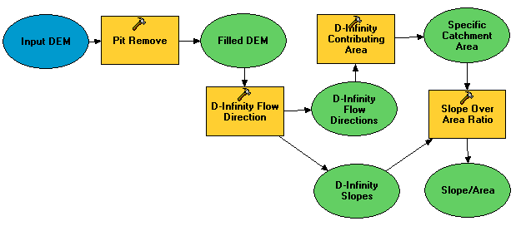
Topographic wetness index from the Dinfinity method
Steps
Pit Remove
D-Infinity Flow Directions (and Slopes)
D-Infinity Contributing Area
Slope Over Area Ratio

Slide 27
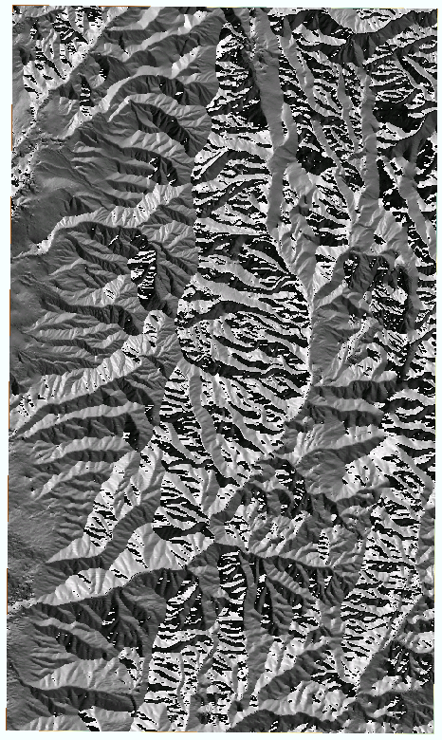

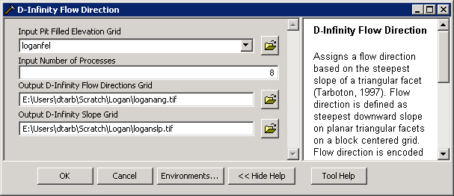
D-Infinity Flow Direction (and slope)

Slide 28
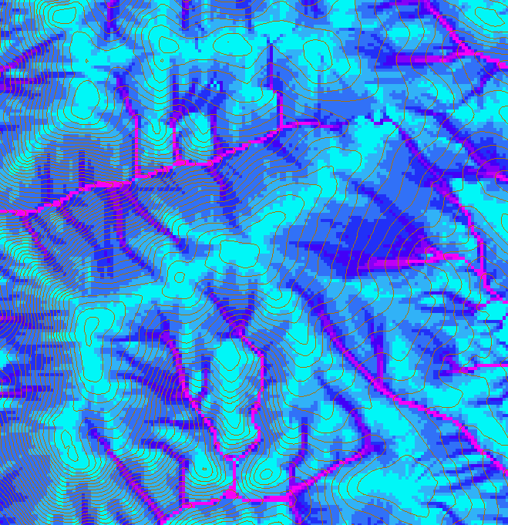
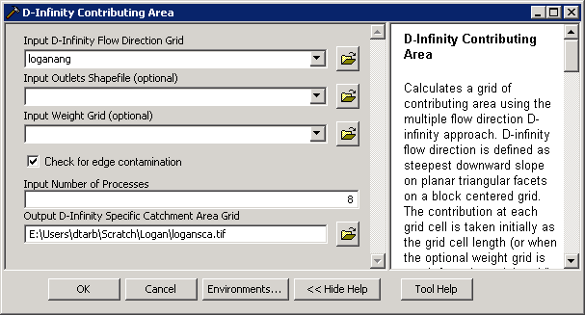
D-Infinity Contributing Area

Slide 29
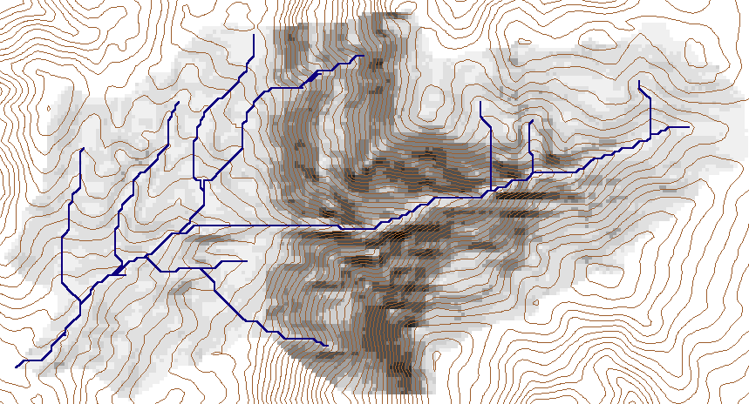
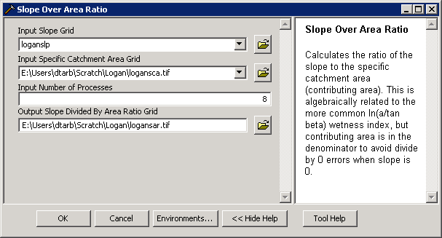
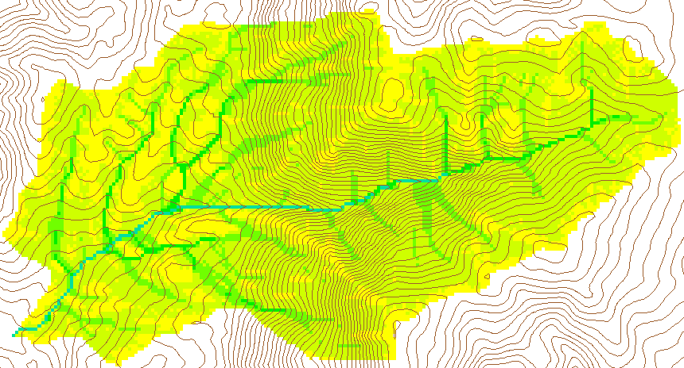
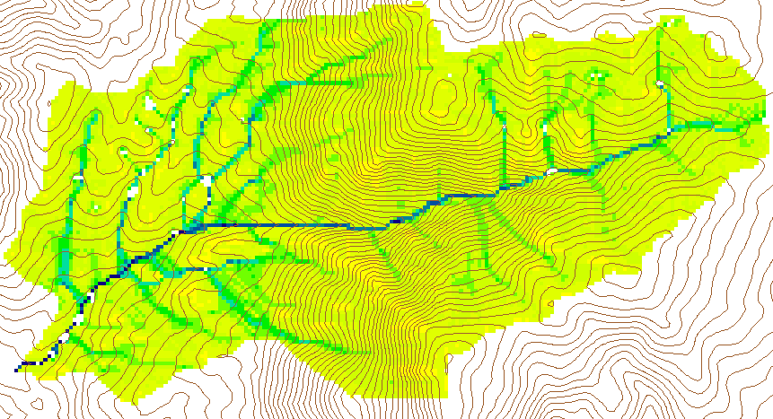
Wetness Index
Slope (S)
Specific Catchment Area (a)
Wetness Index ln(a/S)

Slide 30
Channels and watersheds with spatially variable drainage density using Peuker Douglas threshold objectively chosen by drop analysis
Steps
Pit Remove
D8 Flow Directions
D8 Contributing Area
Peuker Douglas
Weighted D8 Contributing Area
Stream Drop Analysis
Stream Definition by Threshold
Stream Reach and Watershed

Slide 31
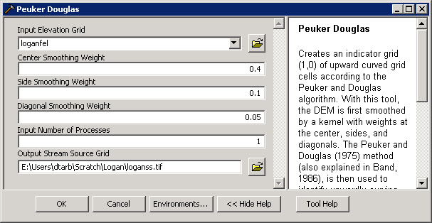
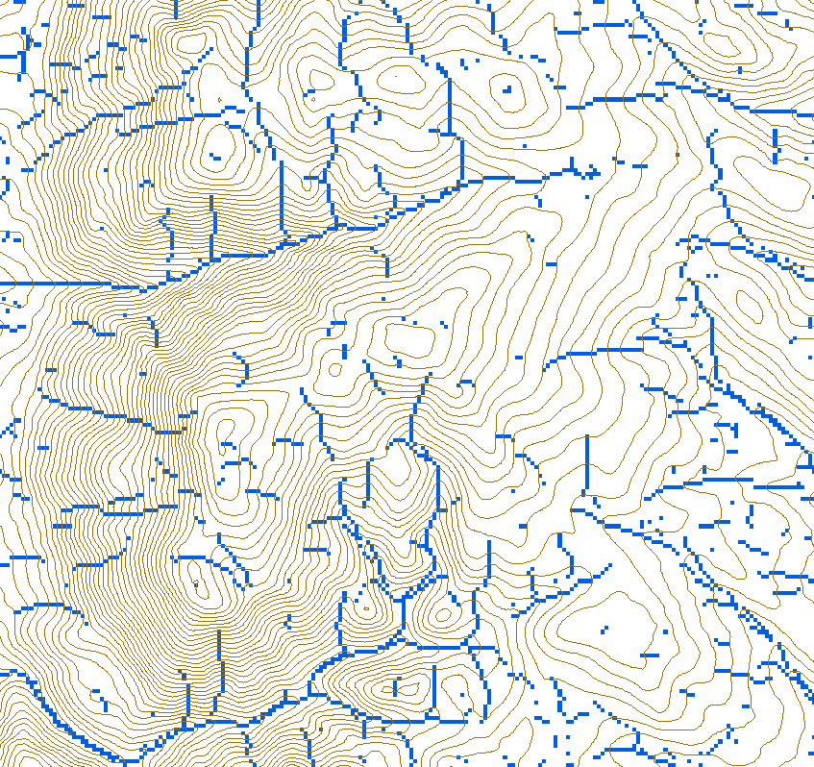
Peuker Douglas
43
48
48
51
51
56
41
47
47
54
54
58
Local Valley Form Computation
(Peuker and Douglas, 1975, Comput. Graphics Image Proc. 4:375)

Slide 32
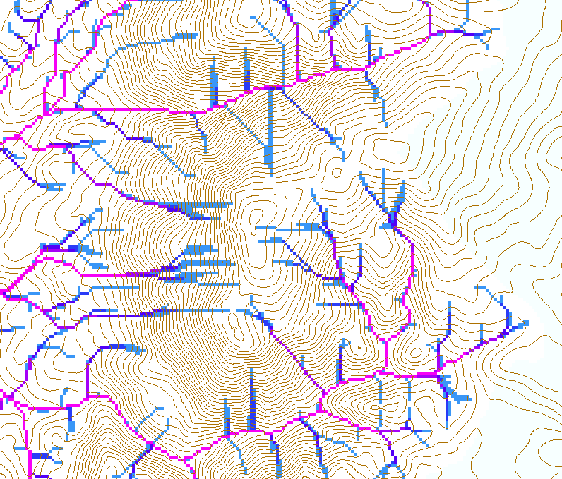
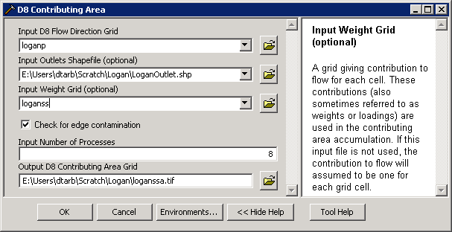
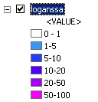
Weighted D8 Contributing Area
Contributing area only of valley form grid cells upstream of outlet

Slide 33
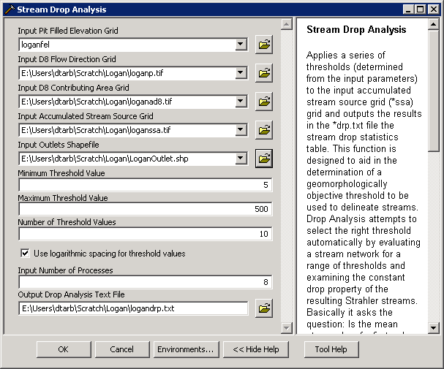
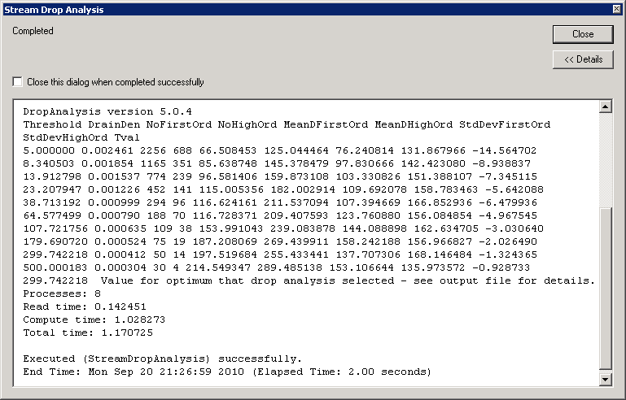
Stream Drop Analysis

Slide 34
How to decide on stream delineation threshold ?
AREA 2
3
AREA 1
12
Why is it important?

Slide 35
Hydrologic processes are different on hillslopes and in channels. It is important to recognize this and account for this in models.
Drainage area can be concentrated or dispersed (specific catchment area) representing concentrated or dispersed flow.

Slide 36
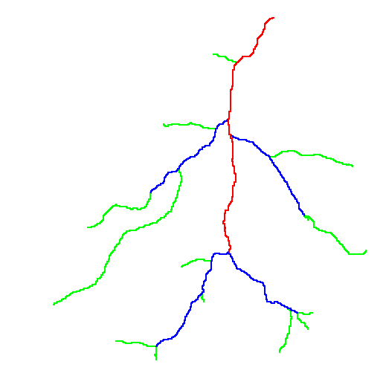
Hortons Laws: Strahler system for stream ordering
1
3
1
2
1
2
1
1
1
1
1
2
2
1
1
1
1
1
1

Slide 37
Constant Stream Drops Law
Broscoe, A. J., (1959), "Quantitative analysis of longitudinal stream profiles of small watersheds," Office of Naval Research, Project NR 389-042, Technical Report No. 18, Department of Geology, Columbia University, New York.

Slide 38

Stream Drop
Elevation difference between ends of stream
Nodes
Links
Single Stream
Note that a “Strahler stream” comprises a sequence of links (reaches or segments) of the same order

Slide 39
Suggestion: Map channel networks from the DEM at the finest resolution consistent with observed channel network geomorphology ‘laws’.
Look for statistically significant break in constant stream drop property as stream delineation threshold is reduced
Break in slope versus contributing area relationship
Physical basis in the form instability theory of Smith and Bretherton (1972), see Tarboton et al. 1992

Slide 40
Statistical Analysis of Stream Drops

Slide 41
T-Test for Difference in Mean Values
0
72
130
T-test checks whether difference in means is large (> 2)
when compared to the spread of the data around the mean values

Slide 42
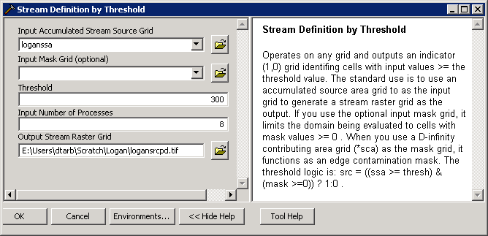
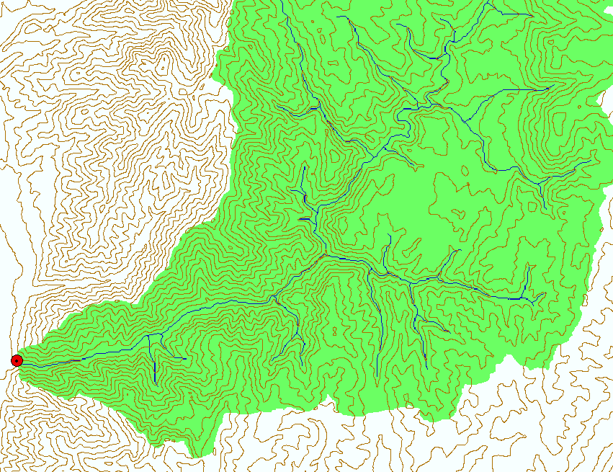
Stream Definition by Threshold

Slide 43
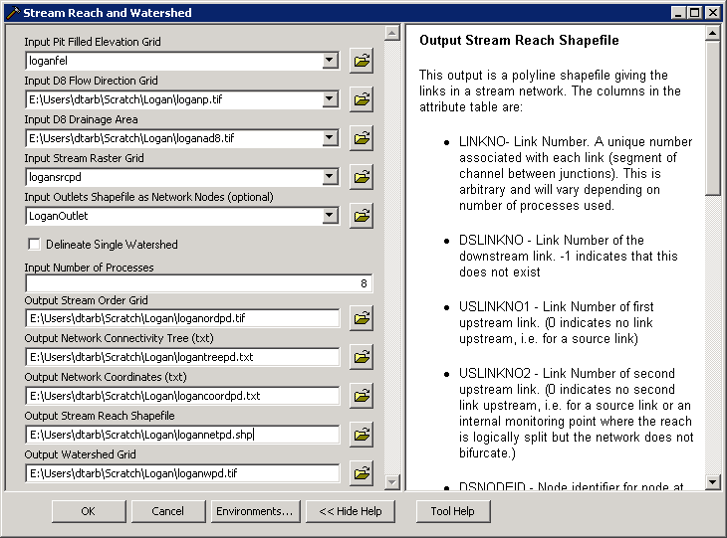
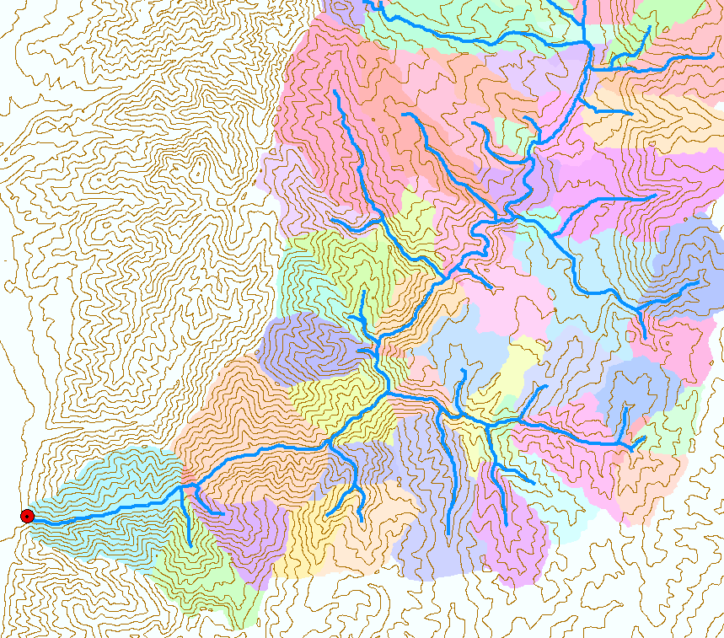
Stream Reach and Watershed

Slide 44
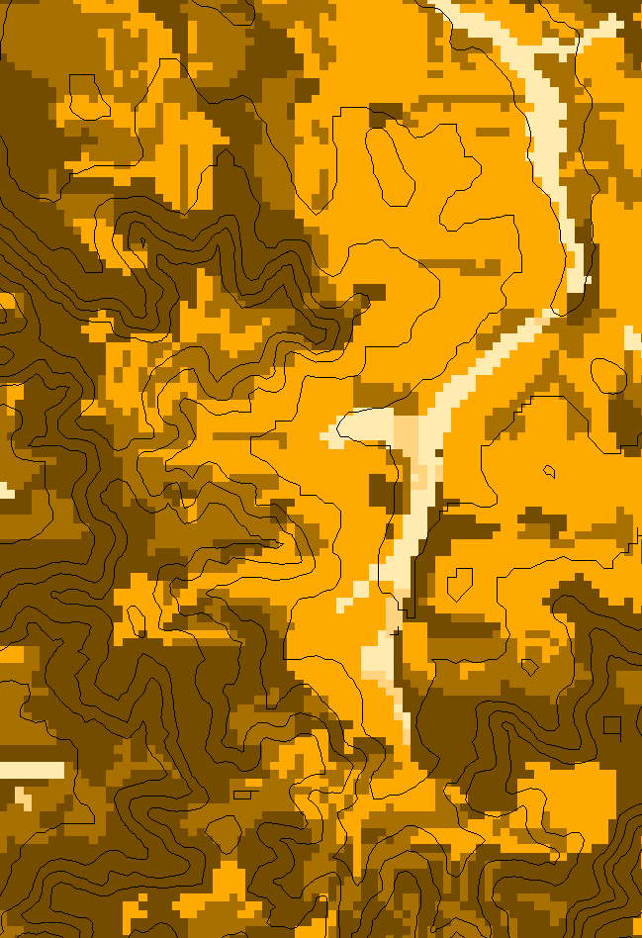
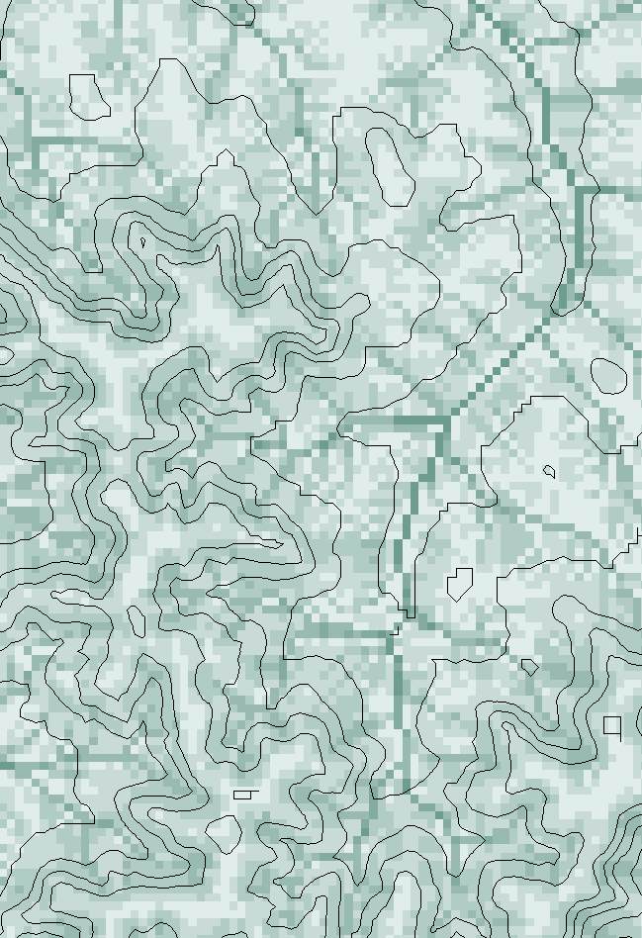
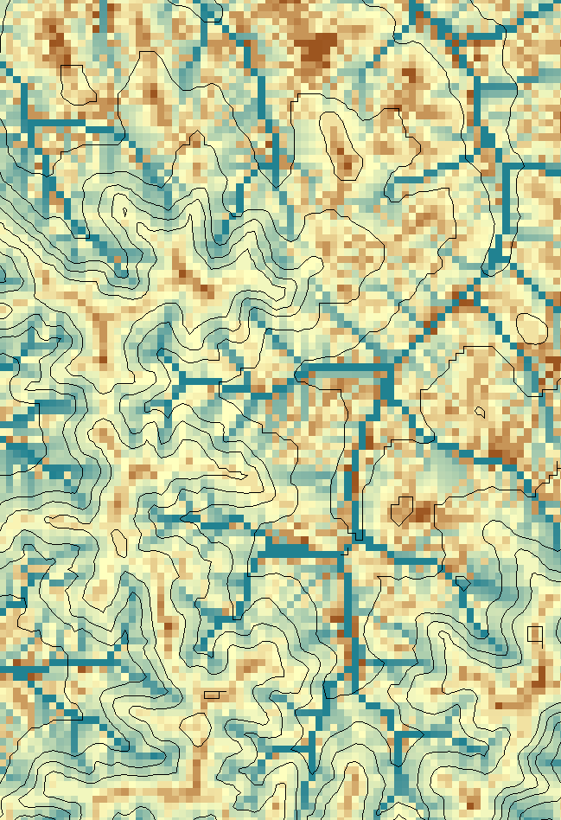
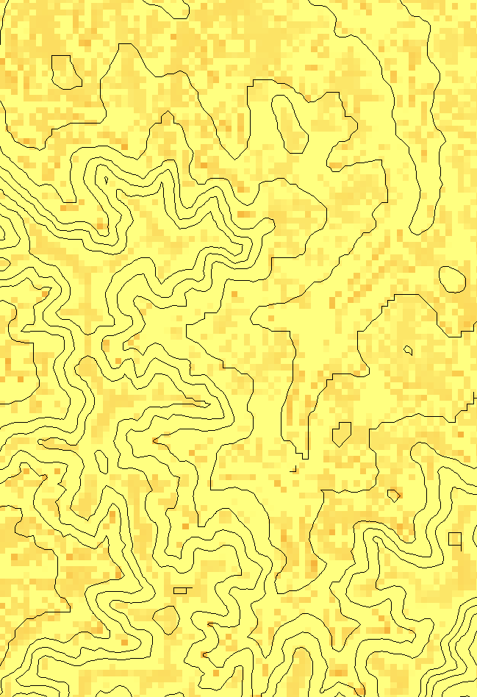
Illustration of some other functions
Transport limited accumulation
Supply
Capacity
Transport
Deposition
S
T
=
χa
2
tan(
b
)
2
T
=
min{
S
+
∑
T
,
T
}
D
=
S
+
∑
T
−
T
cap
out
in
cap
in
out
Useful for modeling erosion and sediment delivery, the spatial dependence of sediment delivery ratio and contaminant that adheres to sediment

Slide 45
Useful for a tracking contaminant or compound subject to decay or attenuation

Slide 46
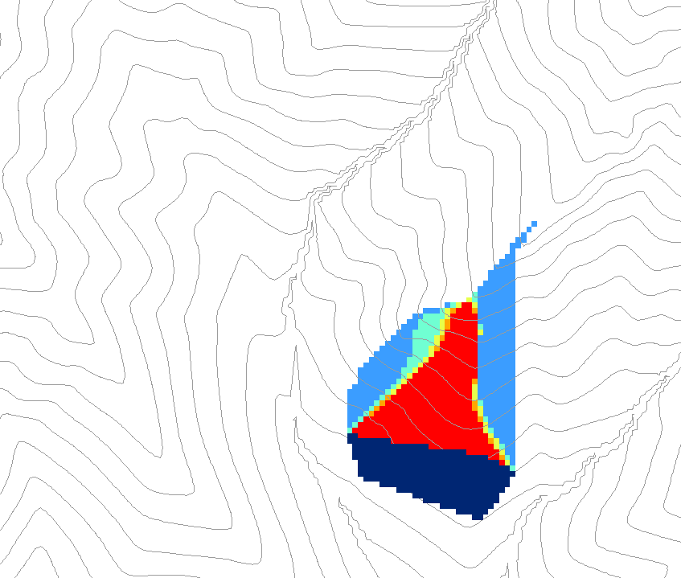
0.6
0
0
0.3
0.3
0
0
0.6
0
0
1
0
0
1
0
Grid cells y
Dependence function of grid cells y
Useful for example to track where a contaminant may come from

Slide 47
Distance Down and Distance Up
Ridge
Ridge
sr
sr
pr
pr
vr
Point of interest
vr
Point of interest
Stream
Stream
ps
ps
vs
ss
vs
ss
hr
hs
hr
hs
Types of distance measurements possible in distance down and distance up functions.

Slide 48
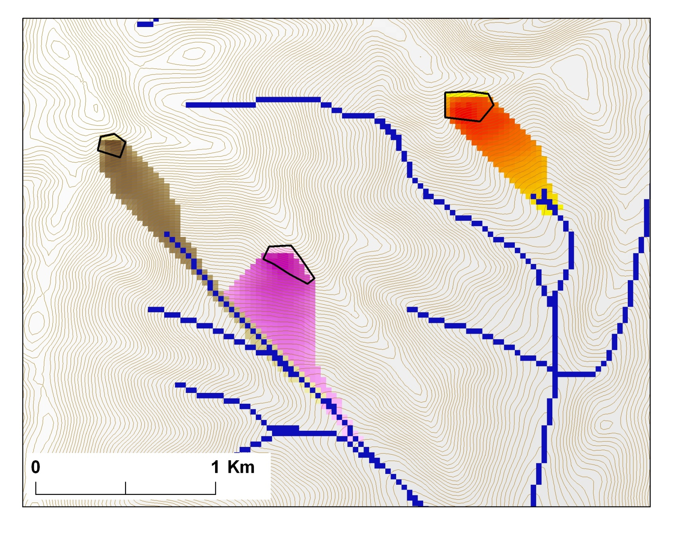
Avalanche Runout
α
Upslope recursion to determine elevation and distance to point in trigger zone that has the highest alpha angle

