Slide 1
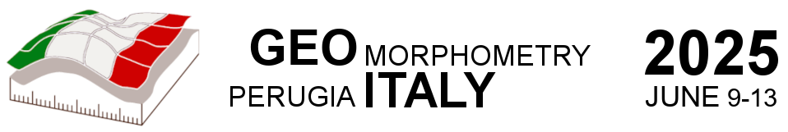
Reflections on Geomorphometry and Hydrology
David Tarboton
Utah State University
http://hydrology.usu.edu/taudem

Slide 2

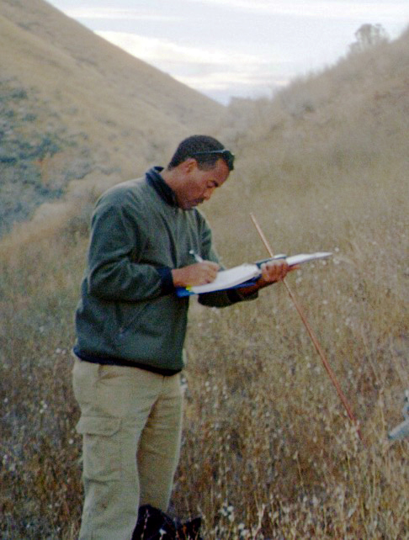










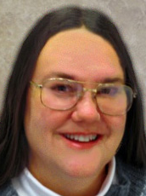


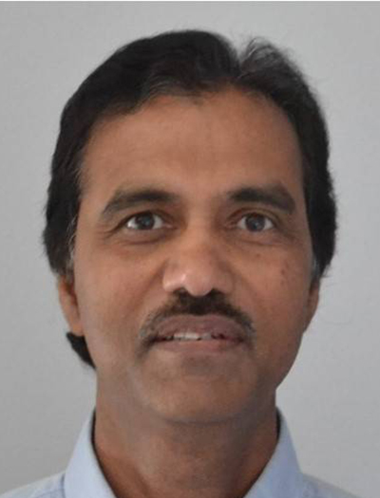

David Maidment
Teklu Tesfa
Irene
Garousi-Nejad
Shaowen Wang
Matt Baker
Xing Zheng
Bob Pack
Kiran Chinnayakanahalli
Paolo Tarolli
Rob
Wallace
Yan
Liu
Dan
Watson
Kim
Schreuders
Ahmet
Yildirim
Dan Ames
Pabitra Dash
Ajay Prasad

Slide 3
Outline
Watershed and channel network delineation and objective channelization threshold determination
D-infinity and multiple flow directions
Generalized terrain-based flow analysis (flow algebra)
Height above nearest drainage (HAND) and flood inundation mapping
TauDEM software and parallel programming (speeding it up)

Slide 4
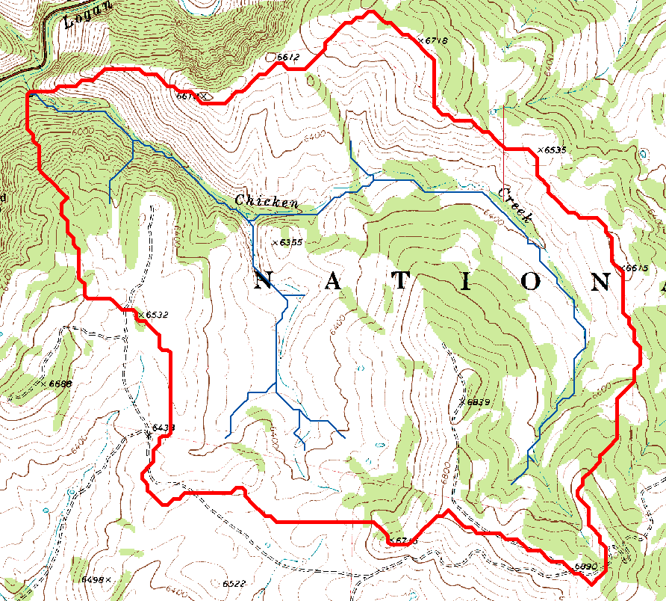
Topography and Hydrology
Watersheds are fundamentally the most basic hydrologic landscape elements
Topography dictates the flow of water across the landscape
Flowing water sculpts the landscape
This synergy is at the heart of much hydrologic modeling relating to questions of runoff generation important for flooding and water resources
Representing hydrologic processes at high resolution is important to help solve these problems

Slide 5
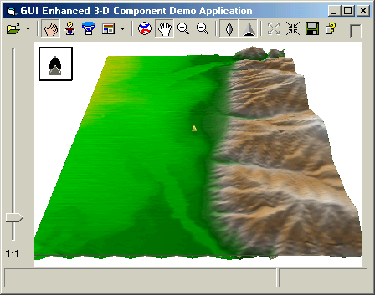

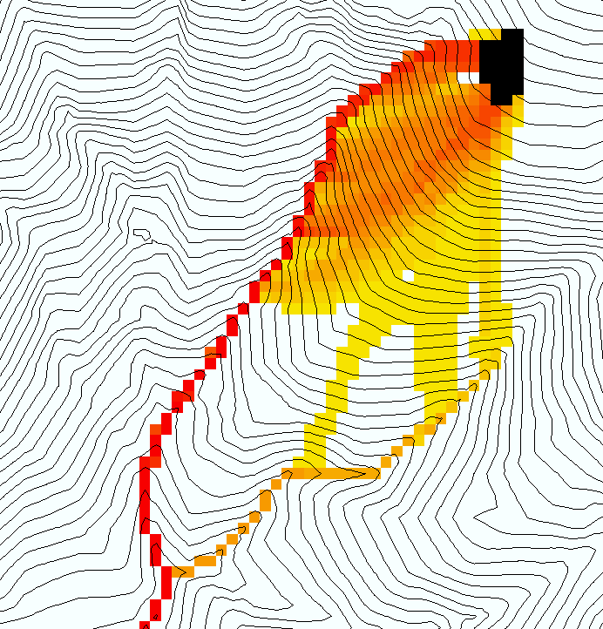
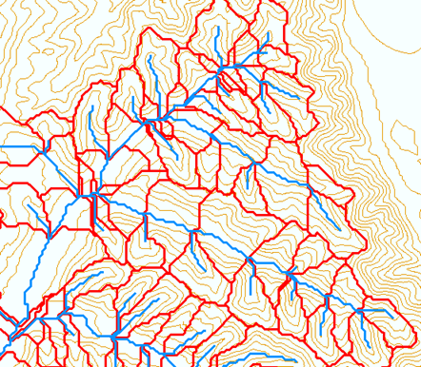
General Terrain Flow Model
Input Digital Elevation Model
Hydrologic Conditioning (Often Filling)
Flow Field
Flow Related Terrain Information
“In the most simple terms, geomorphometry is everything you can extract from DEMs”
www.geomorphometry.org
Notes:
This slide shows the general model for deriving flow field related derivative surfaces from digital elevation data. The input is a raw digital elevation model, generally elevation values on a grid. This is basic information used to derive further hydrology related spatial fields that enrich the information content of this basic data. The process is actually quite amazing. One starts with a very simple set of data, elevation values on a grid. At the end of it you have a rich set of information useful in hydrology for understanding the movement of water at and near the earth surface and multiple other related processes.
The first step is to remove sinks, either by filling, or carving. Then a flow field is defined. This enables the calculation of flow related terrain information. My focus has been on flow related information working within this framework. I try to leave other GIS functionality, like radiation exposure, line of sight analyses and visualization to others.

Slide 6
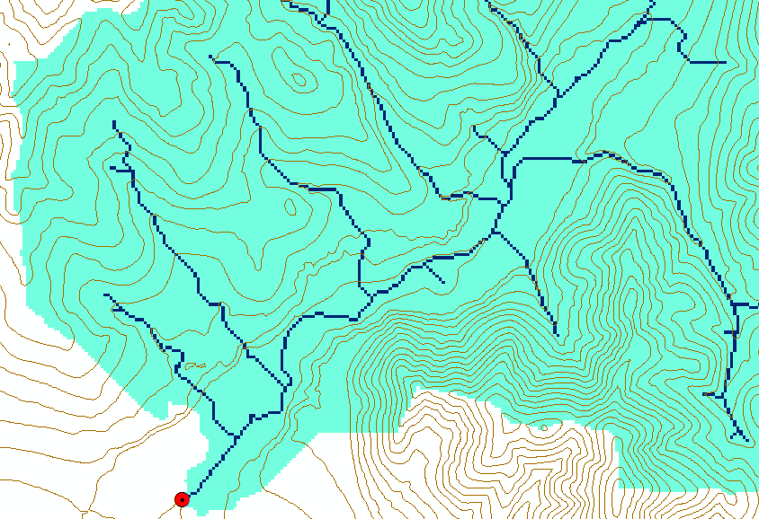
Basic Watershed and Channel Network Delineation
Pit Removal (Filling)
Flow direction calculation (D8)
Flow accumulation (may be weighted)
Channel (Stream) definition using a threshold
Channels and watersheds (catchments/basins)

Slide 7
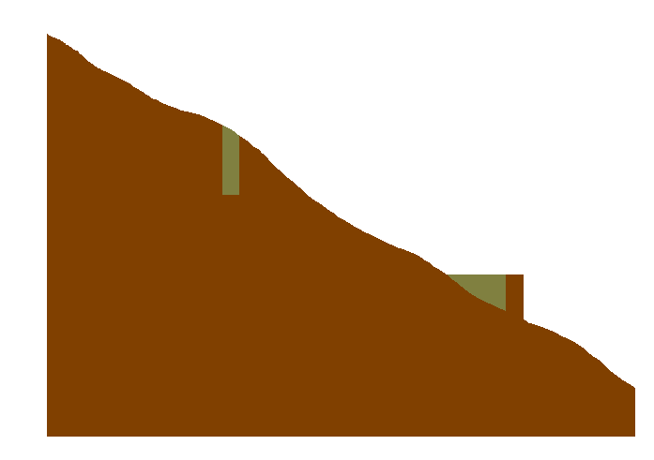
Conditioning the DEM - Pit Filling
Increase elevation until the pit drains to a neighbor and ultimately out of the domain
Original DEM
Pits Filled
Pits
Grid cells or zones completely surrounded by higher terrain

Slide 8

Conditioning the DEM - Carving
Lower elevation of neighbor along a predefined drainage path until the pit drains to the outlet point
Original DEM
Carved DEM
Pits
Carve outlets

Slide 9
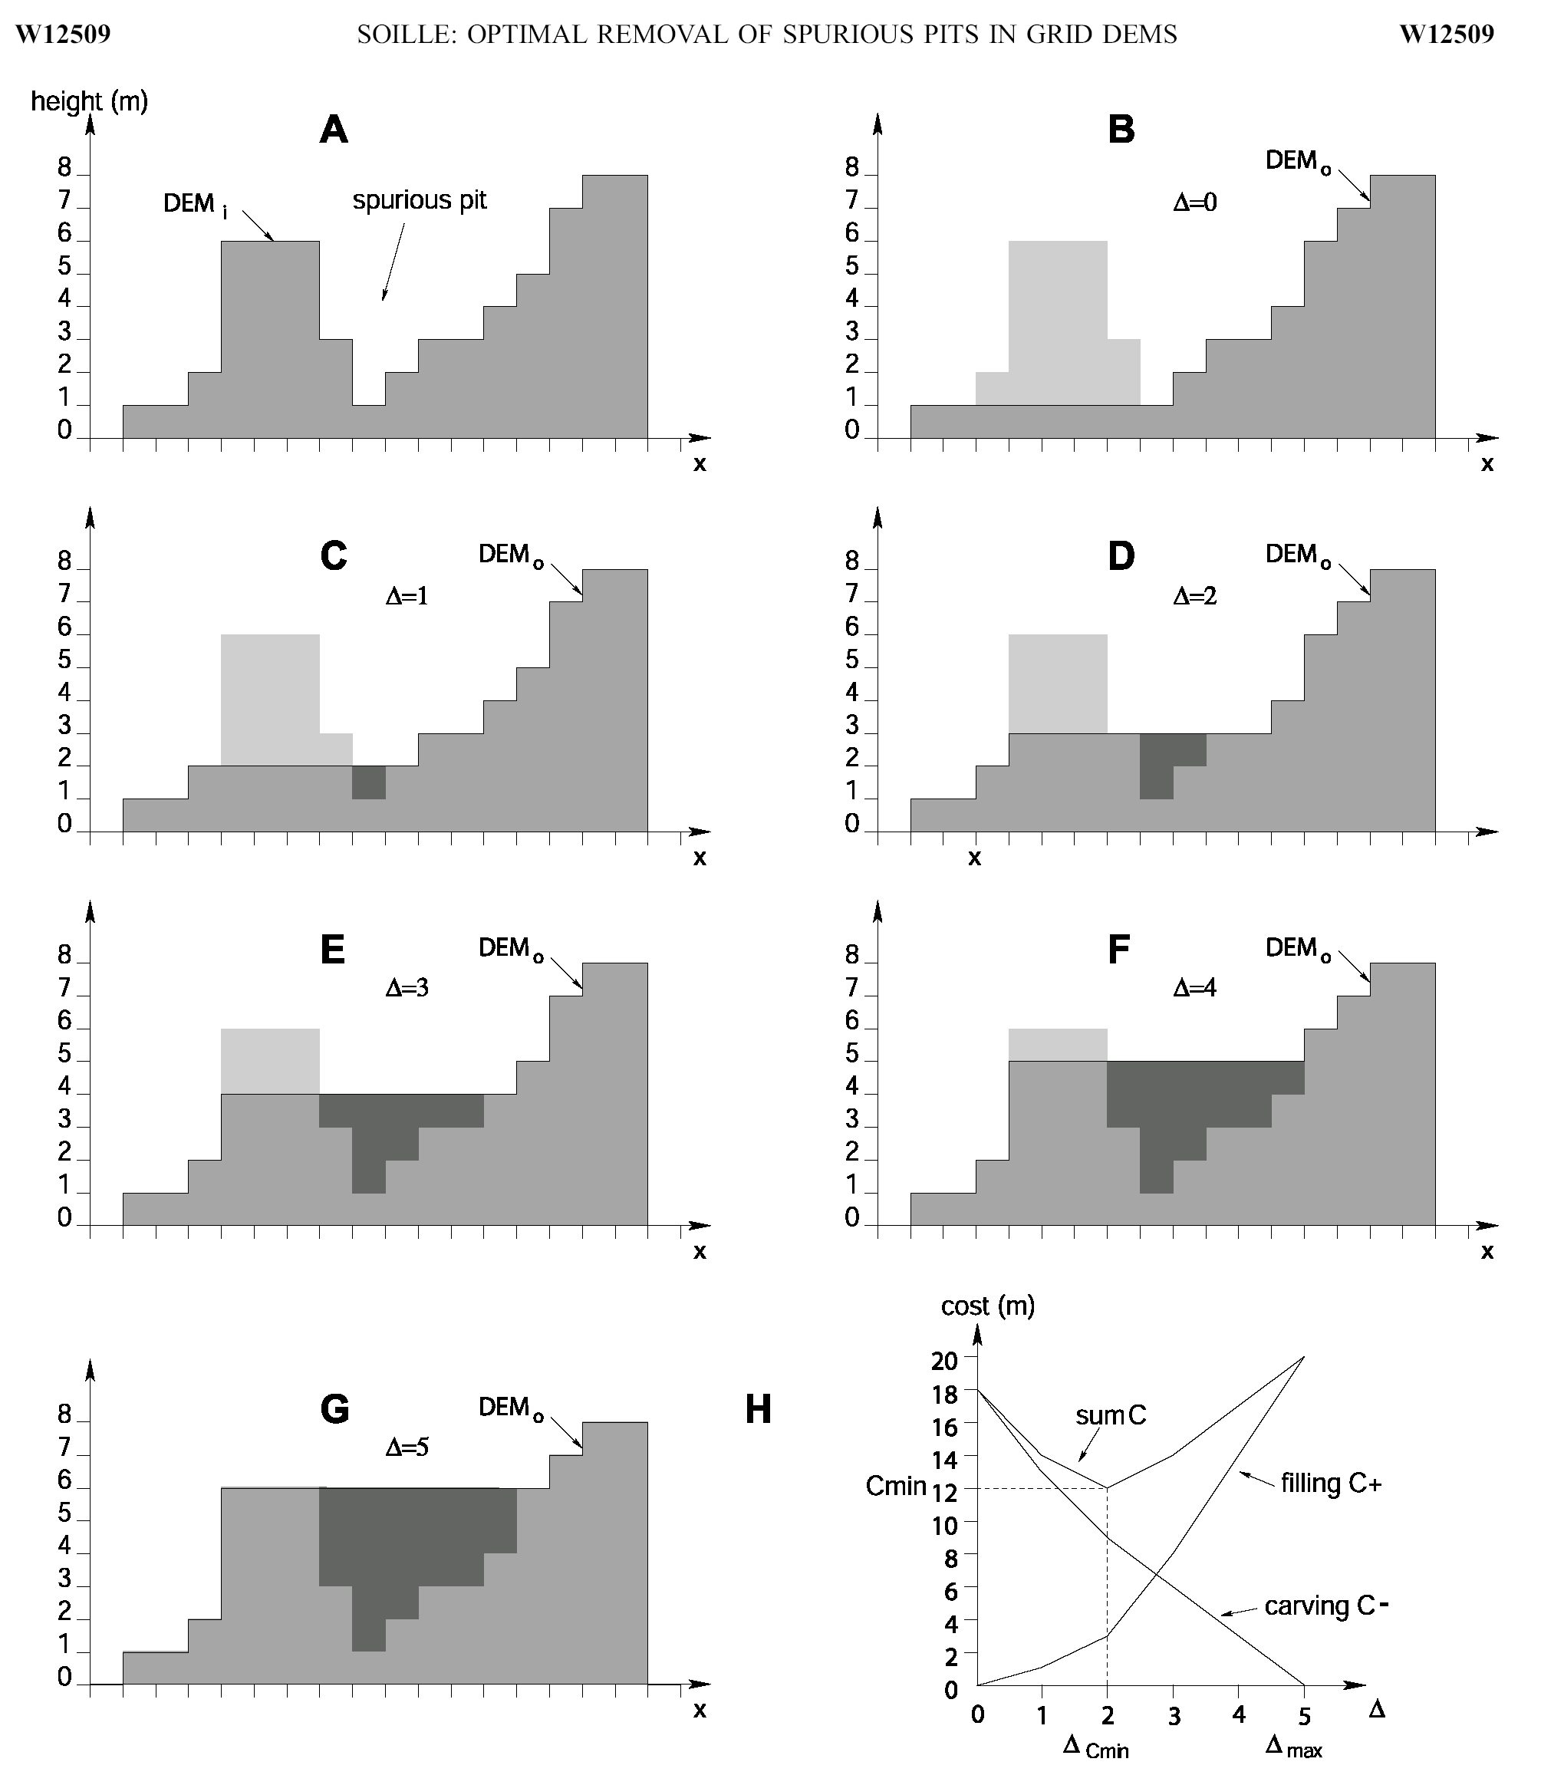
Optimal removal of spurious pits in grid digital elevation models
Pierre Soille, WRR 2004, http://doi.org/10.1029/2004WR003060
Filling
Carving
Minimizing Alterations

Slide 10
Conditioning the DEM – Optimally adjusted
Carved
Original DEM
Optimally adjusted
Pits
Filled

Slide 11
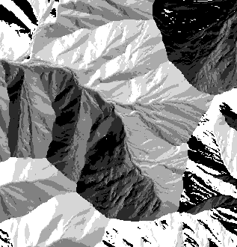

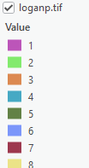

D8 Flow Direction Model
Direction of steepest descent
30
80
74
63
4
3
2
69
67
56
5
1
60
52
48
6
7
8
Slope = Drop/Distance
Steepest down slope direction
Note that this is different from the 3x3 or 5x5 slope that Peter Guth discussed Monday. It only looks down to where water may flow.
O'Callaghan, J. F. and D. M. Mark, (1984), https://doi.org/10.1016/S0734-189X(84)80011-0.

Slide 12
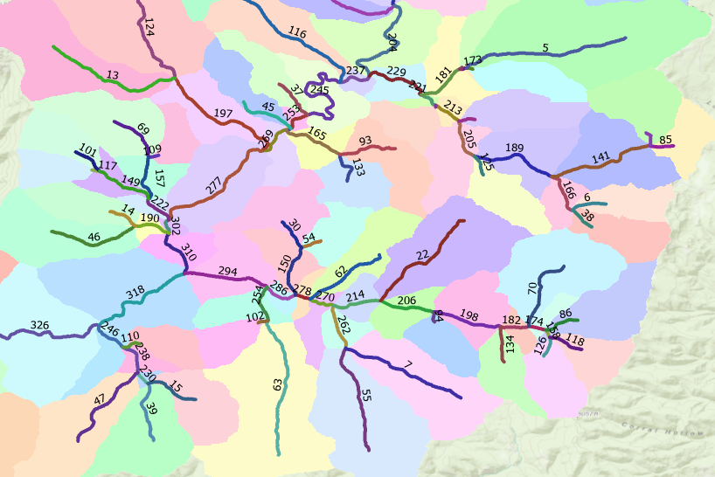
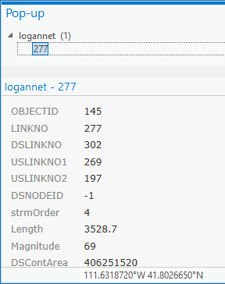
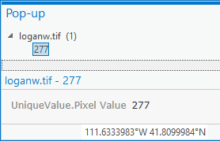
Grid Network, Flow Accumulation, Streams and Watersheds
Streams linked to associated catchments
1
1
1
1
1
1
3
3
3
1
1
1
1
2
11
2
1
1
1
15
1
5
2
2
The starting point for catchment based distributed hydrologic modeling
20

Slide 13
Where do Channels Begin?
AREA 2
3
AREA 1
12
How to decide on stream delineation threshold ?
Why is this important ?

Slide 14
Hydrologic processes are different on hillslopes and in channels. It is important to recognize this and account for this in the delineation of streams.
Drainage area can be concentrated or dispersed (specific catchment area) representing concentrated or dispersed flow.

Slide 15
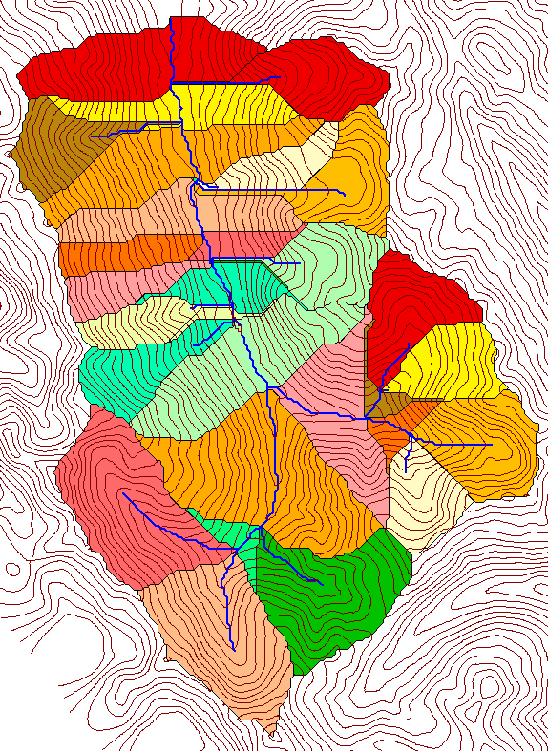
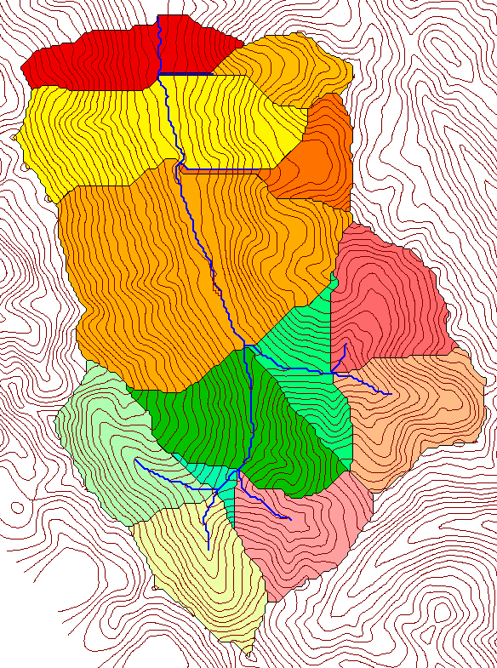
The scale of catchment model elements is sensitive to channelization support area threshold
500 cell theshold
1000 cell theshold

Slide 16
Alternative views
Although the river and hill-side waste do not resemble each other at first sight, they are only the extreme members of a continuous series, and when this generalization is appreciated, one may fairly extend the “river” all over its basin and up to its very divides. Ordinarily treated, the river is like the veins of a leaf; broadly viewed it is like the entire leaf.
landscape dissection into distinct valleys is limited by a threshold of channelization that sets a finite scale to the landscape.
Davis, W. M., (1899), "The geographical cycle," Geogr. J., 14: 481-504 (reproduced in Geographical Essays, edited by W. M. Davis, Ginn, Boston, 1909).
Montgomery, D. R. and W. E. Dietrich, (1992), "Channel Initiation and the Problem of Landscape Scale," Science, 255: 826-830.

Slide 17
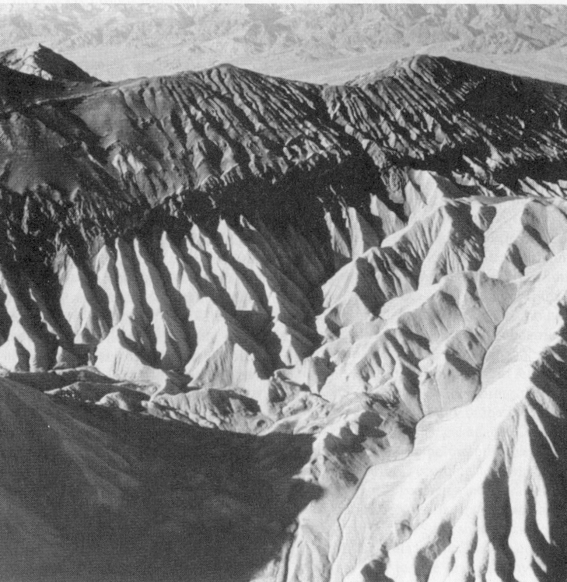
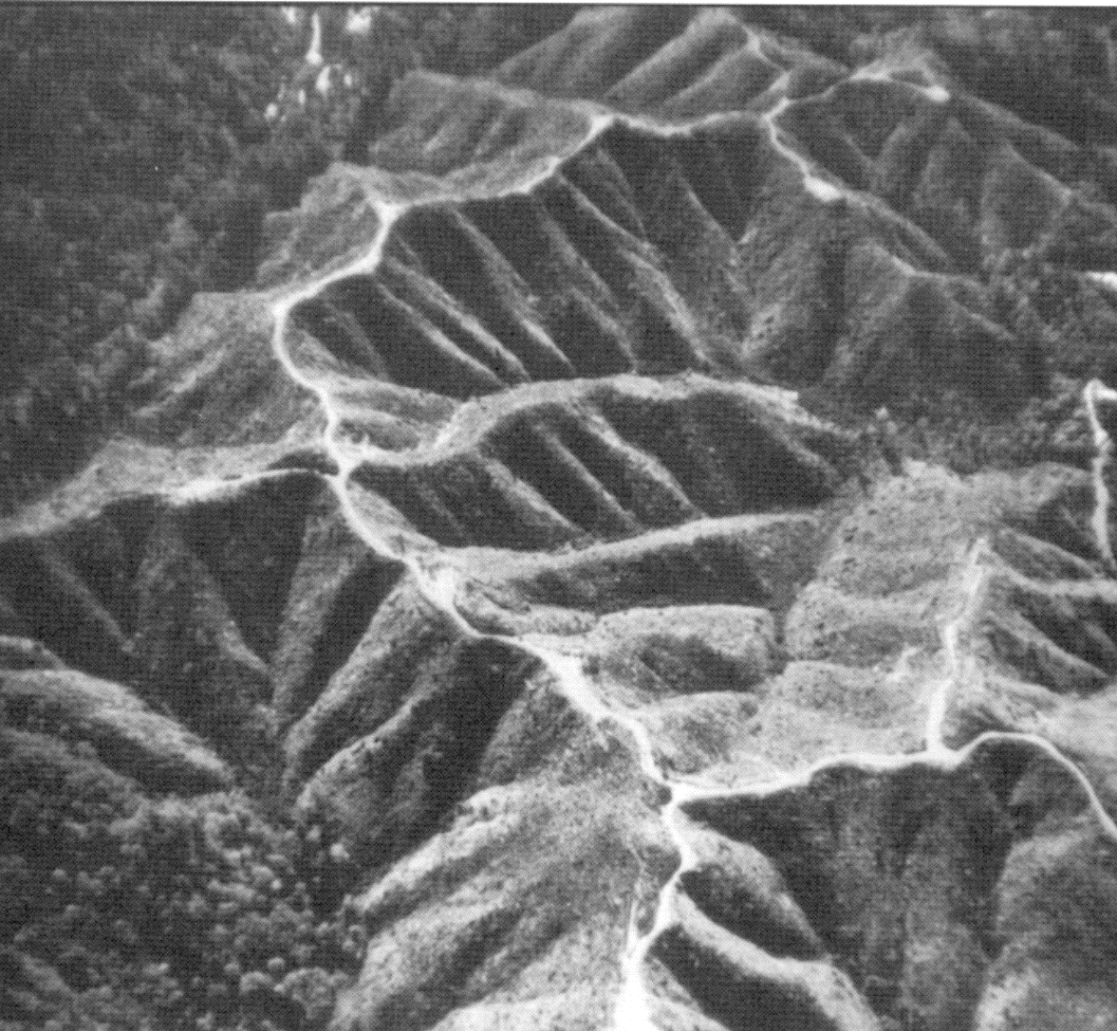
Examples of differently textured topography
Badlands in Death Valley.
from Easterbrook, 1993, p 140.
Coos Bay, Oregon Coast Range.
from W. E. Dietrich

Slide 18
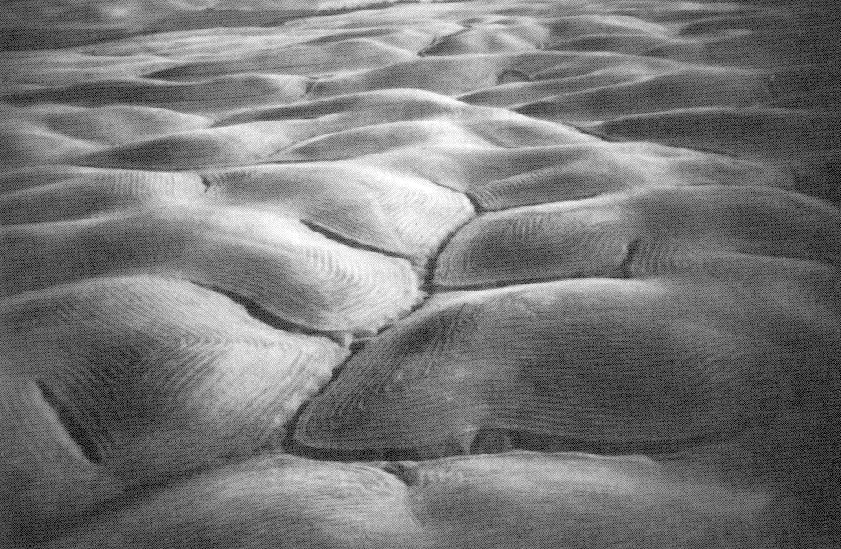
Gently Sloping Convex Landscape
From W. E. Dietrich

Slide 19
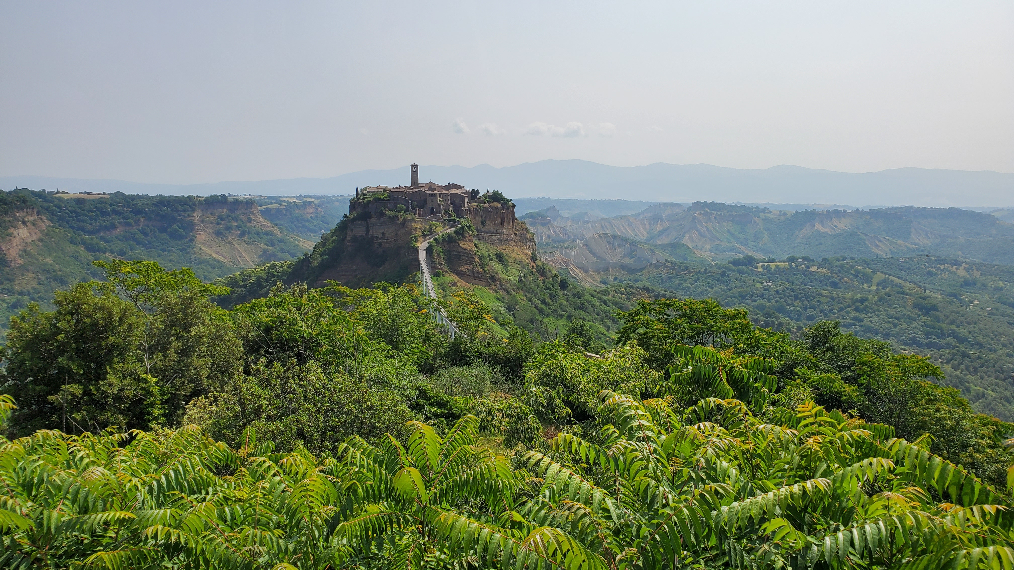

Slide 20
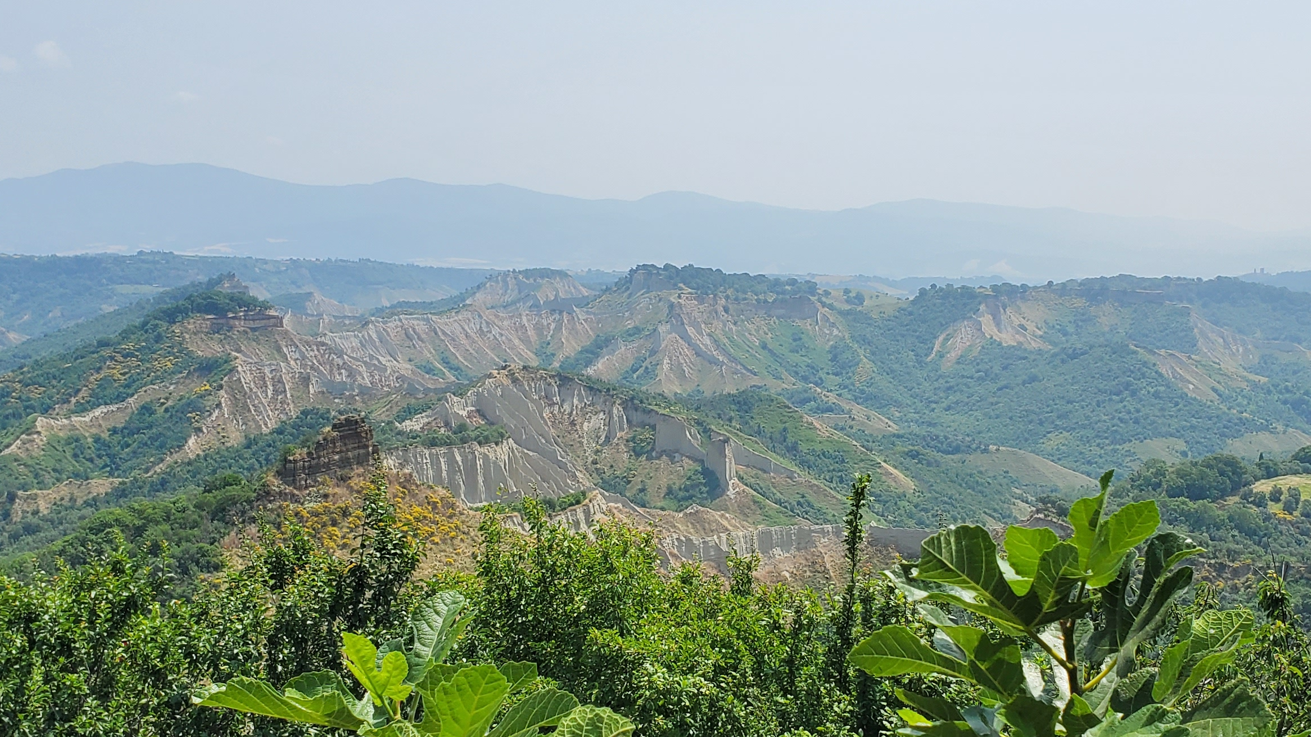

Slide 21
Contours indicate topographic texture
Driftwood, PA
Same scale, 20 m contour interval
Sunland, CA

Slide 22
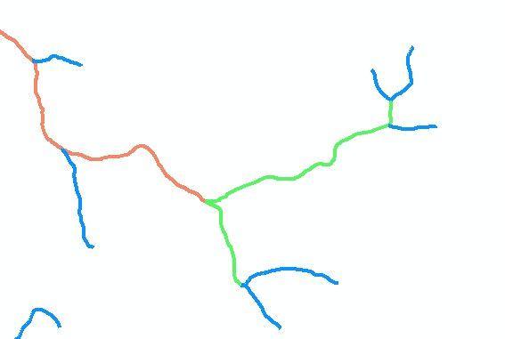
Topographic texture, drainage density and “laws” of geomorphology
Horton/Strahler stream ordering
Stream networks obey (approximately) the empirically established Hortons “laws”
Drainage density “measures” the scale of topographic texture
B
B
D_{d} = L/A
1
Hillslope length = B
A = 2B L
D_{d} = L/A = 1/(2B)
∴ B= 1/(2D_{d})
1
1
L
3
2
1
1
2
1
Hillslope length ≈ 1/(2D_{d})
1
Related concepts: Topographic grain, contour crenulations, ruggedness, topographic roughness

Slide 23
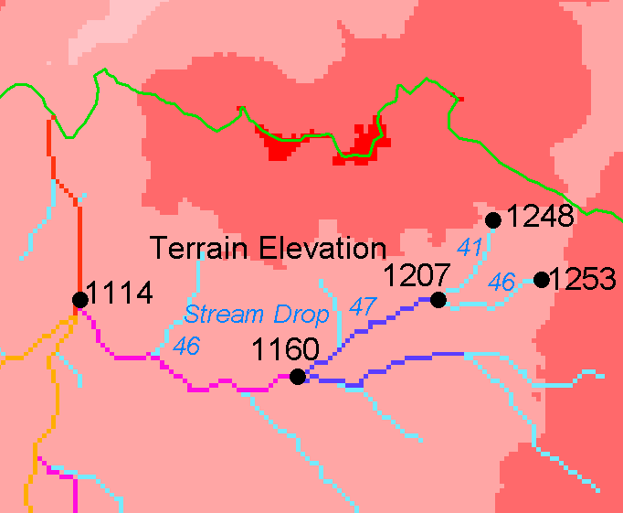
Constant Stream Drops Law
Broscoe, A. J., (1959), "Quantitative analysis of longitudinal stream profiles of small watersheds," Office of Naval Research, Project NR 389-042, Technical Report No. 18, Department of Geology, Columbia University, New York.
Nodes
Links
Single Stream

Slide 24
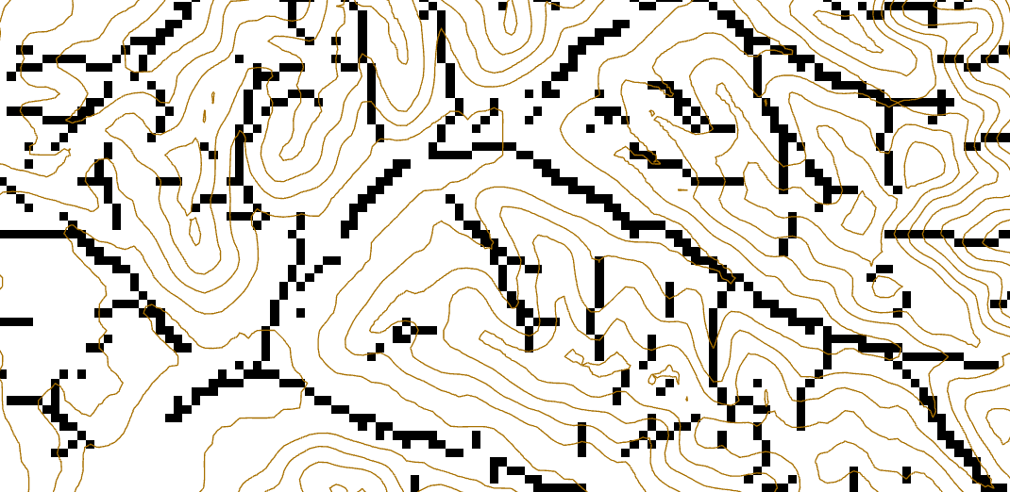
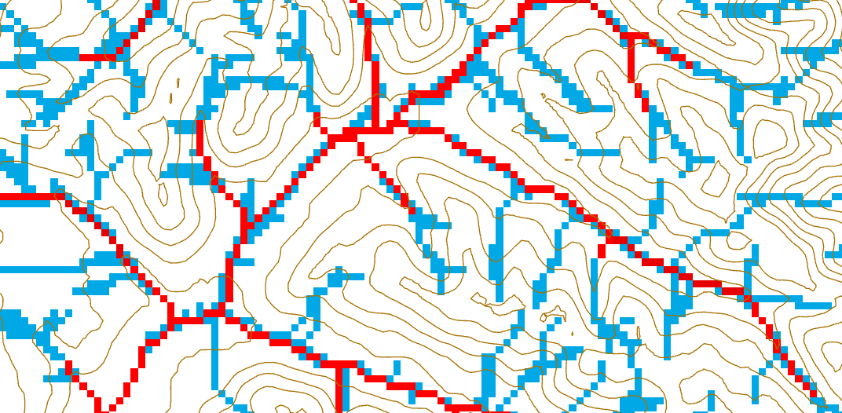
Approaching the objective mapping of channel networks
43
48
48
51
51
56
41
47
47
54
54
58
Adjust for spatially variable drainage density
Local valley grid cells (Peuker and Douglas, 1975, Comput. Graphics Image Proc. 4:375)
Connect by taking valley grid cells as weights for flow accumulation
Threshold the weighted flow accumulation grid
Notes:
Top Left 21.6348, 46.7631
Bot right 21.6658 46.7529

Slide 25
Select threshold to map channel networks at the finest resolution consistent with empirical constant drop “law”
Weighted Valley Cell Contributing Area Threshold
t-test for difference in mean between first and higher order stream drops
Strahler Steam Drop (m)
72
130
Strahler Order
0
Weighted valley grid cell threshold | 10 | 15 | 20 | 30
Drainage Density (km⁻¹) | 2.2 | 1.8 | 1.6 | 1.4
T for diff of first and higher order drop means | -4.1 | -2.2 | -1.3 | -1.2
Use smallest threshold for which |t| < 2 (p=0.05) to map channels

Slide 26
Channels mapped using contributing area and optimal threshold
Channels mapped using valley grid cells as weight and optimal threshold

Slide 27
Summary so far
A simple grid DEM is the starting point for watershed delineation that produces structured information on watersheds and connected stream networks useful for hydrologic modeling
Knowledge from geomorphology offers an approach towards objective selection of channel network delineation threshold
Curvature and valley cell identification adapt for spatially variable drainage density and topographic texture
Watershed delineation based on D8
Results are limited by being scale dependent and objective approach to finding a channelization threshold does not always work well
Opportunities to extend using other valley classification approaches (some seen at this conference)

Slide 28
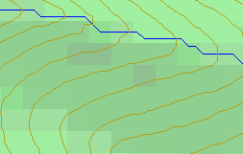
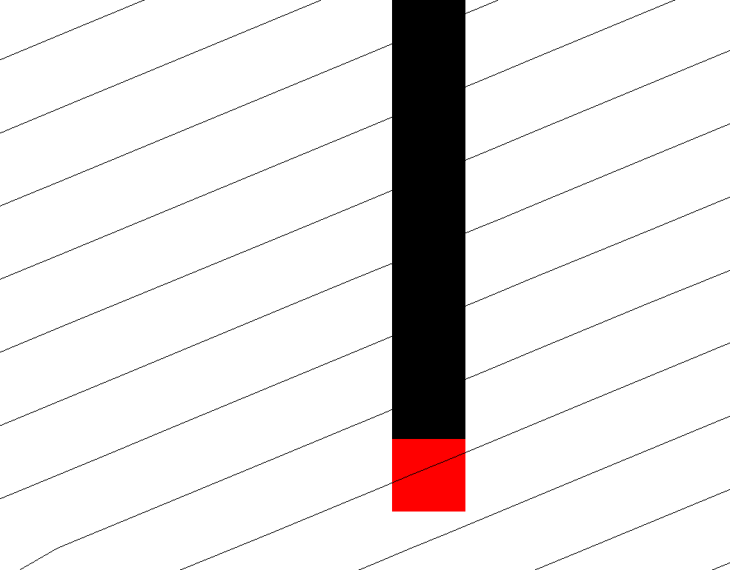
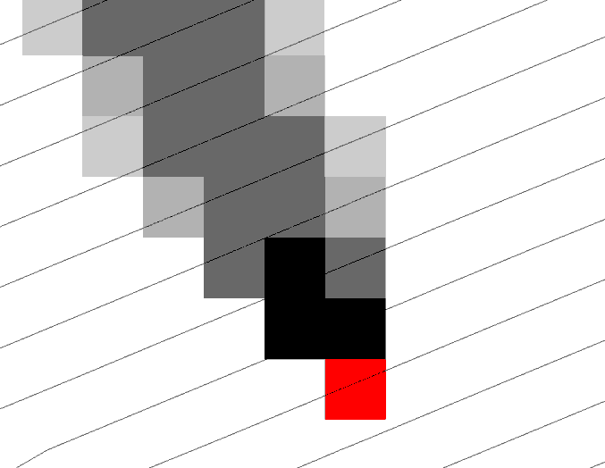
Representation of Flow Field
Steepest single direction
48
52
56
67
D8
D∞
Tarboton, D. G., (1997), "A New Method for the Determination of Flow Directions and Contributing Areas in Grid Digital Elevation Models," Water Resources Research, 33(2): 309-319, http://doi.org/10.1029/96WR03137.
Notes:
This slide shows how the terrain flow field is represented. Early DEM work used a single flow direction model, D8. In 1997 I published the Dinfinity method that proportions flow from each grid cell among downslope neighbors. This, at the expense of some dispersion, allows a better approximation of flow across surfaces.

Slide 29
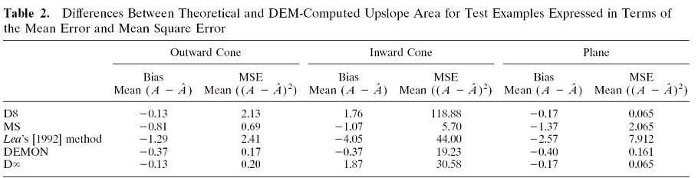
Contributing Area
D∞
D8
<1 ha
1-4 ha
4-8 ha
>8 ha

Slide 30
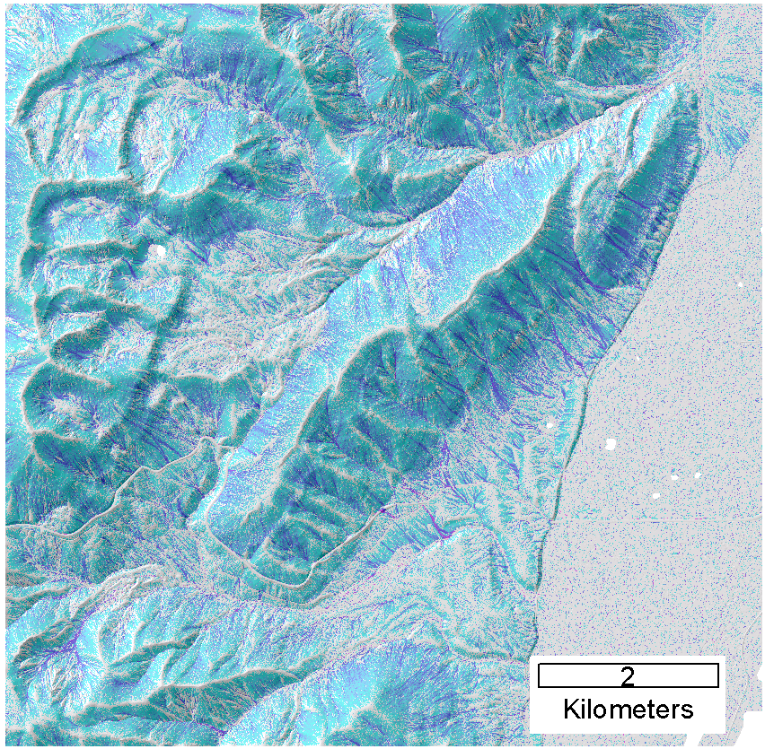
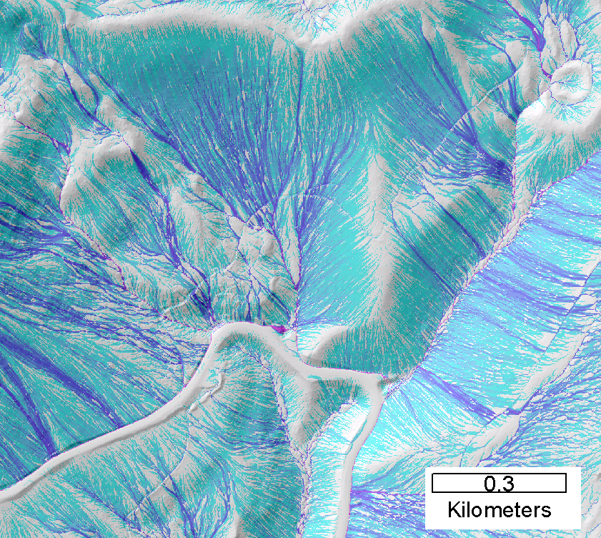
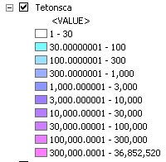
Contributing area from D-Infinity
Notes:
Note the detail in the representation of flow paths at features such as roads

Slide 31
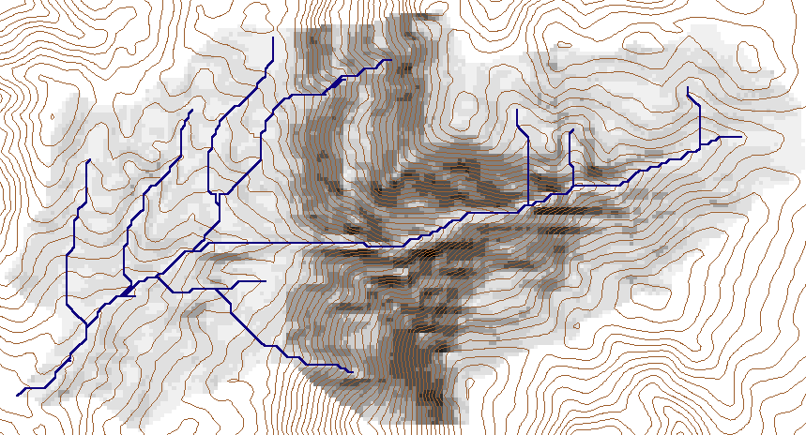
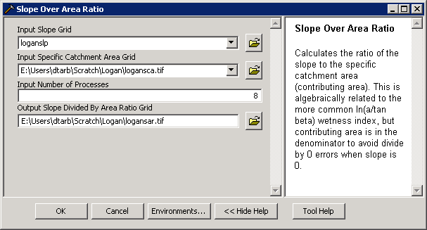
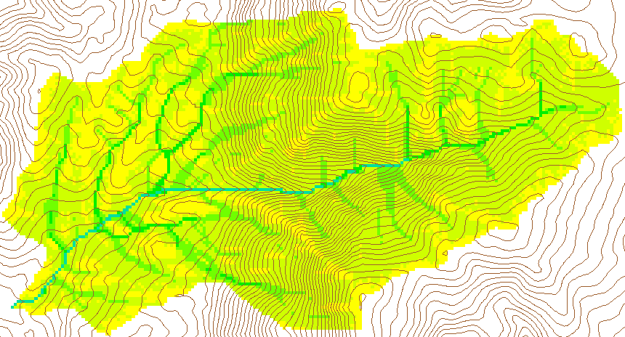
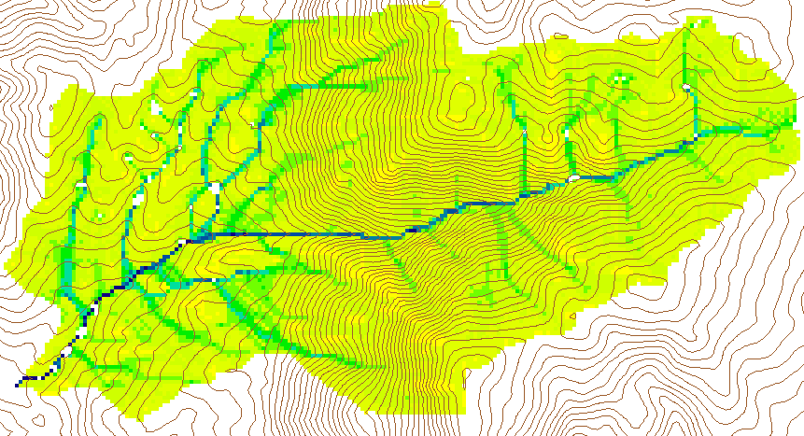
Wetness Index
Slope (S)
Specific Catchment Area (a)
Wetness Index ln(a/S)

Slide 32
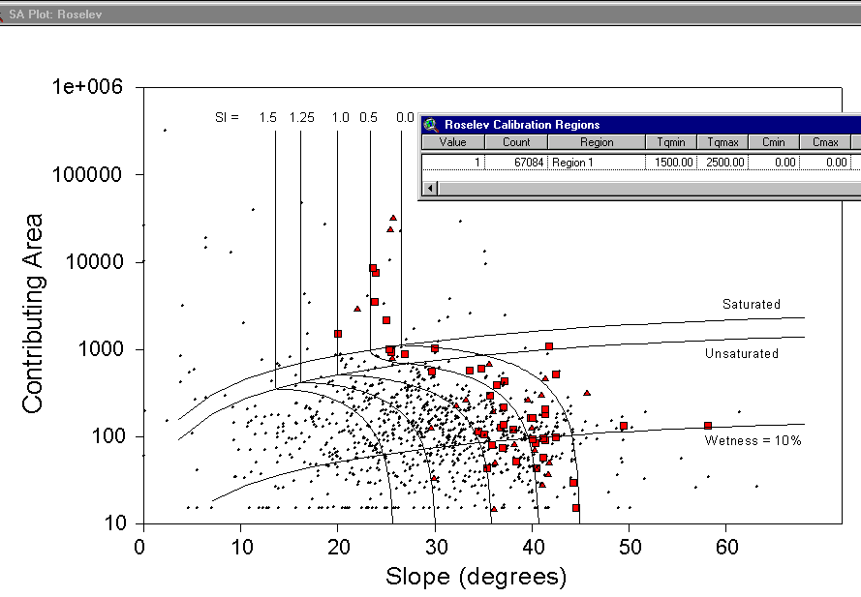
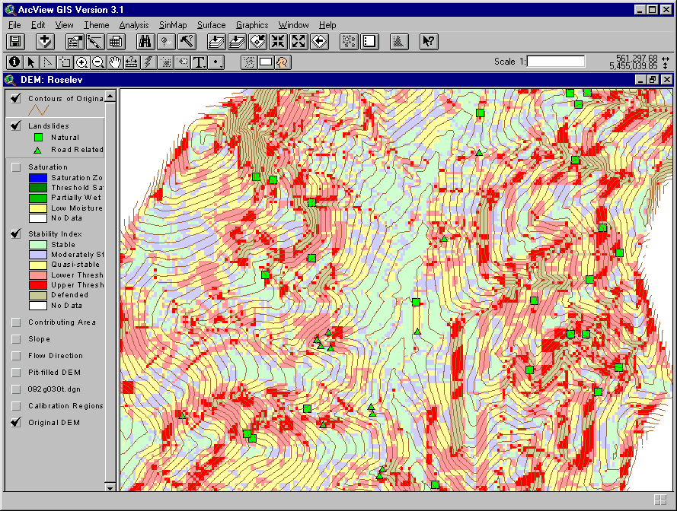
Terrain Stability Mapping
SINMAP: https://hydrology.usu.edu/sinmap2/

Slide 33
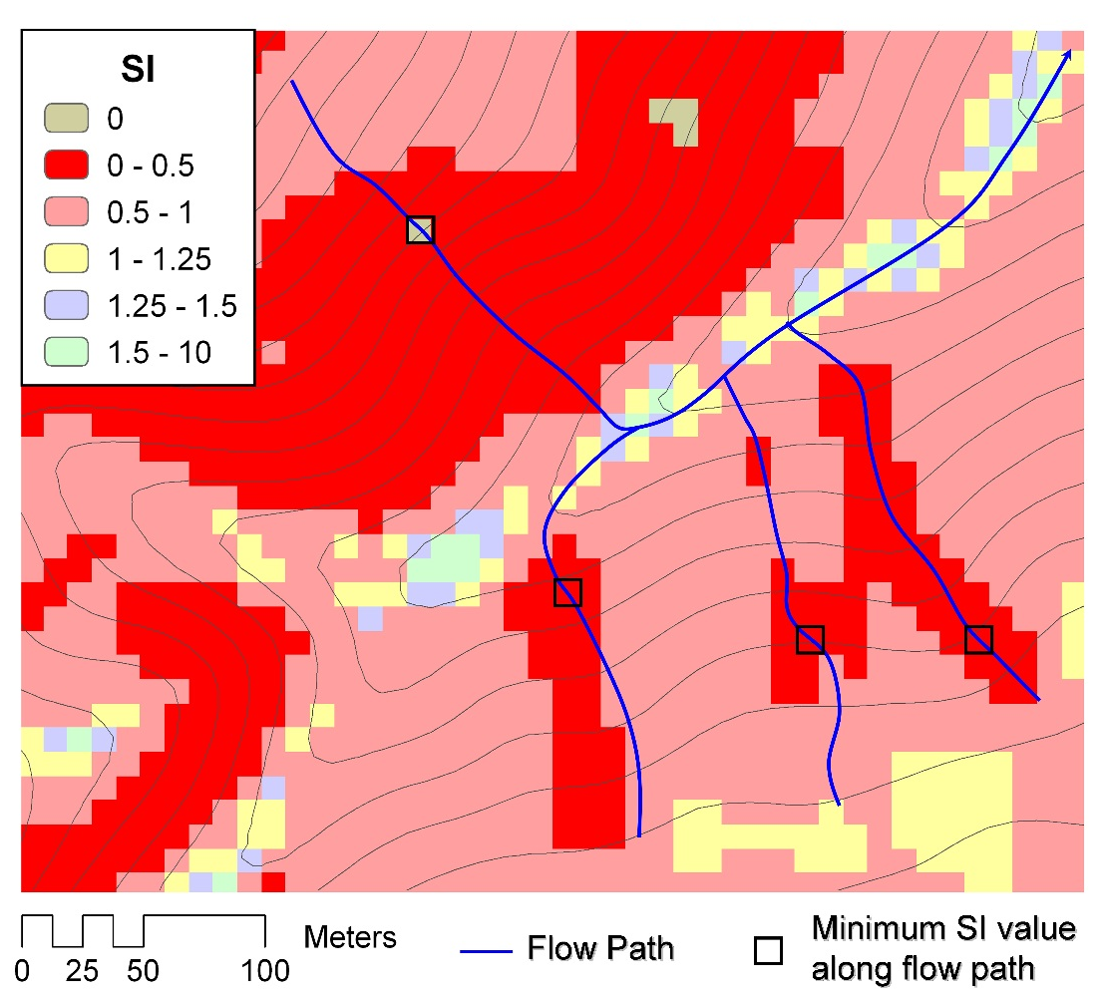
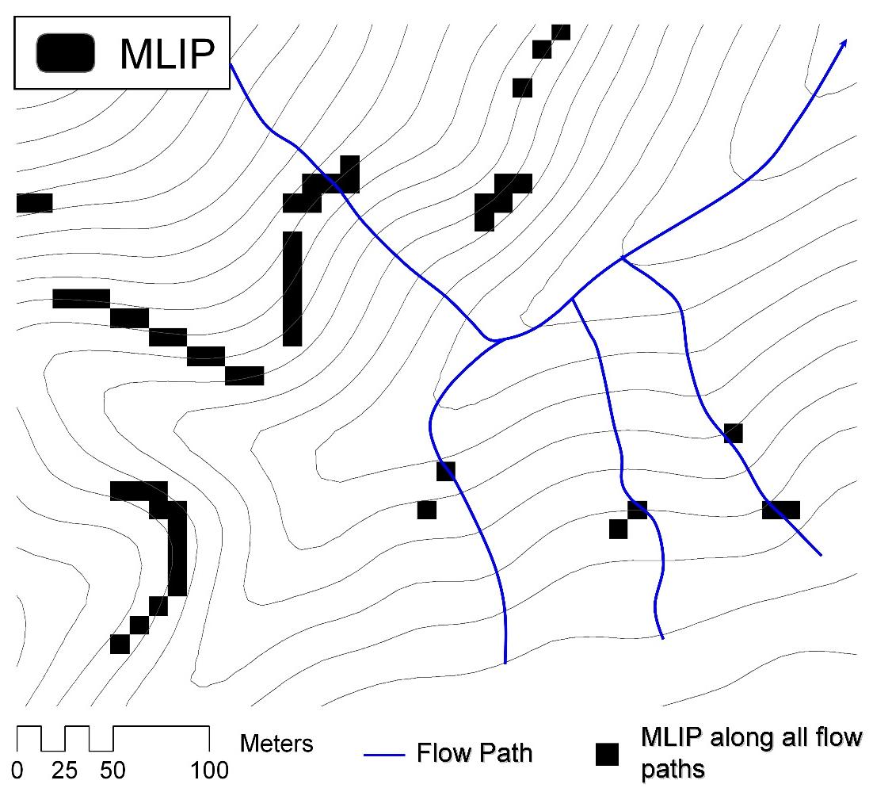
Most Likely Landslide Initiation Points
The location of the lowest SI value along a flow path
Tarolli, P. and D. G. Tarboton, (2006), HESS https://doi.org/10.5194/hess-10-663-2006

Slide 34
Other contributions, considerations and outstanding questions
Seibert and McGlynn, 2007, MD∞, http://dx.doi.org/10.1029/2006WR005128
Gallant and Hutchinson, 2011, differential equation approach, http://doi.org/10.1029/2009wr008540
Gruber, S. and S. Peckham, 2009, https://doi.org/10.1016/S0166-2481(08)00007-X (Mass flux method)
Lindsay (this conference) Minimal Dispersion Flow Algorithm
Quinn et al., 1991; Fairfield and Leymarie, 1991
Reduce angle/direction dispersion dependency
Flow width. What cell dimension to use for specific catchment area calculation?
Test cases beyond specific catchment area are needed

Slide 35
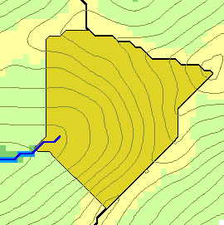
Flow accumulation calculation can be generalized to compute a broad class of terrain flow related quantities
w(x)
x

Slide 36
Generalization to Flow Algebra
Replace
P_{ki}
P_{ki}
P_{ki}
i
by general function
Flow direction proportions
Input Results from upslope
θ_{i} = F(γ_{i}, P_{ki}, θ_{k}, γ_{k})
Output Result,
Quantity being calculated
Other inputs at cell and upslope
Tarboton, D. G. and M. E. Baker, (2008), "Towards an Algebra for Terrain-Based Flow Analysis," in Representing, Modeling and Visualizing the Natural Environment: Innovations in GIS 12, Edited by N. J. Mount, G. L. Harvey, P. Aplin and G. Priestnall, CRC Press, Florida, p.496, http://dx.doi.org/10.1201/9781420055504.ch12.

Slide 37
General Pseudocode Upstream Flow Algebra Evaluation
Global P, γ, θ FlowAlgebra(i) for all k neighbors of i if P_{ki}>0 FlowAlgebra(k) next k θ_{i} = FA(γ_{i}, P_{ki}, θ_{k}, γ_{k}) return
P_{ki}
P_{ki}
P_{ki}
i

Slide 38
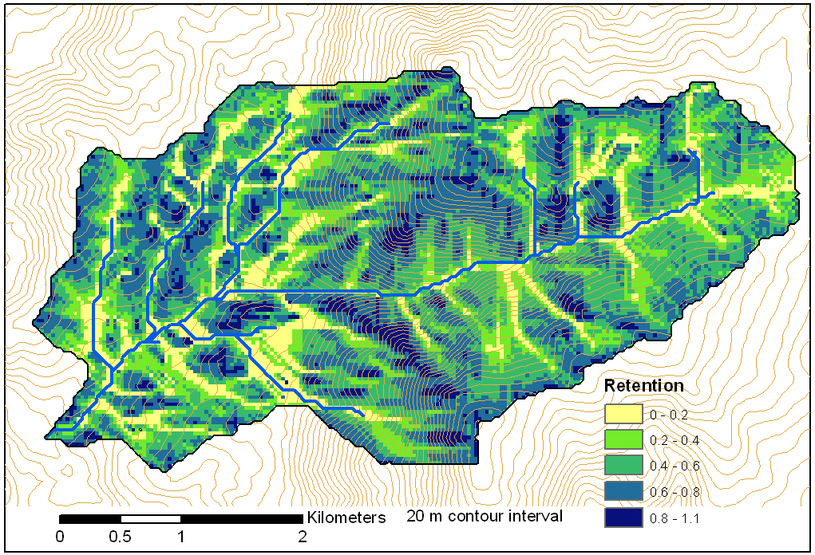
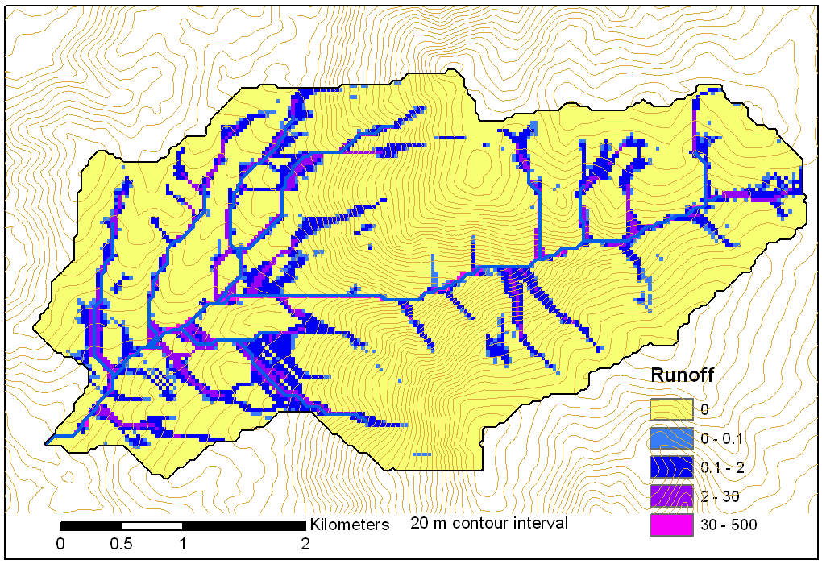
Example: Retention limited runoff generation with run-on
q_{k}
r
Global P, (r,c), q FlowAlgebra(i) for all k neighbors of i if P_{ki}>0 FlowAlgebra(k) next k return
q_{i}
c

Slide 39
Decaying Accumulation
Useful for a tracking contaminant or compound subject to decay or attenuation

Slide 40
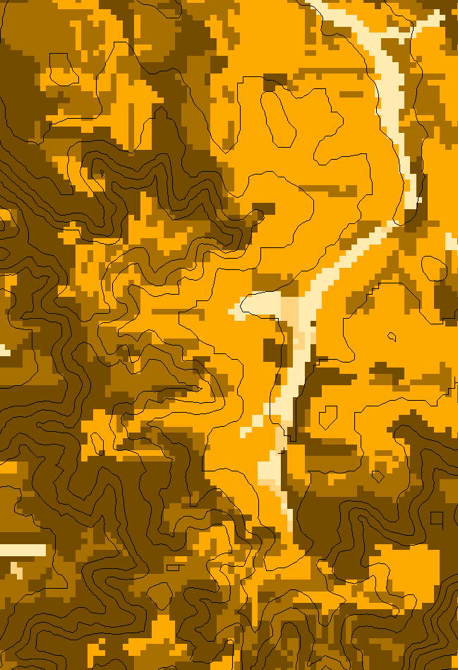
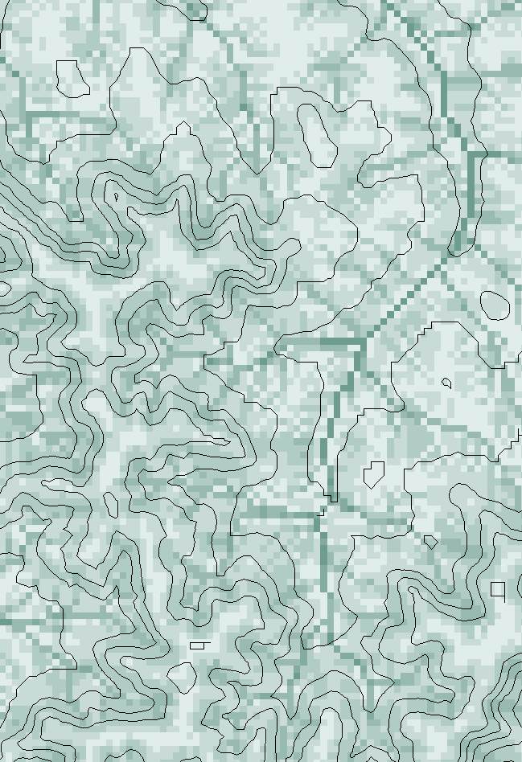
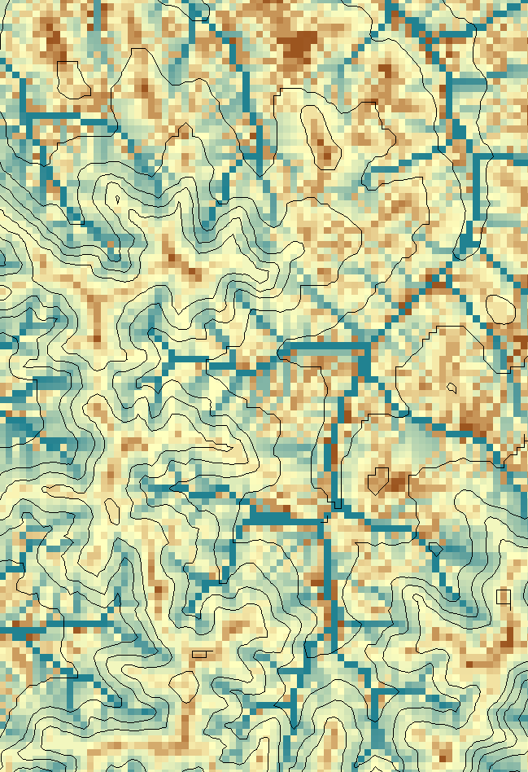
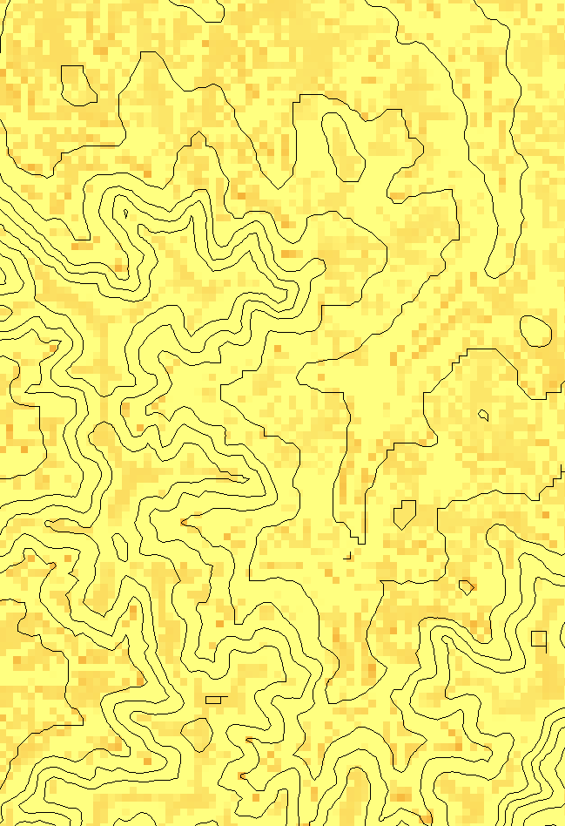
Transport limited accumulation
Supply
Capacity
Transport
Deposition
S
T
=
χa
2
tan(
b
)
2
T
=
min{
S
+
∑
T
,
T
}
D
=
S
+
∑
T
−
T
cap
out
in
cap
in
out
Useful for modeling erosion and sediment delivery, the spatial dependence of sediment delivery ratio and contaminant that adheres to sediment

Slide 41
General Pseudocode Downstream Flow Algebra Evaluation
Global P, γ, θ FlowAlgebra(i) for all k neighbors of i if P_{ik}>0 FlowAlgebra(k) next k θ_{i} = FA(γ_{i}, P_{ik}, θ_{k}, γ_{k}) return
i
P_{ik}

Slide 42
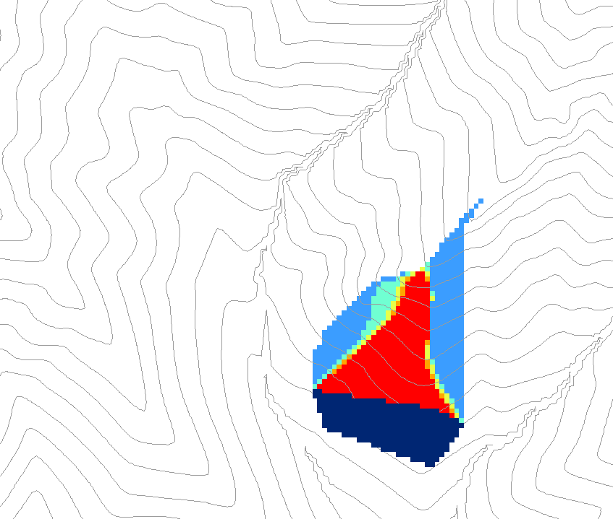
Dependence function. Quantifies the amount a point x contributes to the point or zone y.
0.6
0
0
0.3
0.3
0
0
0.6
0
0
1
0
0
1
0
Grid cells y
Dependence function of grid cells y
Useful for example to track where a contaminant may come from

Slide 43

General Proximity Functions as weighted distance to a target set along Dinfinity Flow Directions
Ridge
sr
sr
pr
pr
vr
Point of interest
Stream
ps
ps
ss
vs
ss
D∞
hr
hs
hr
hs
Tesfa, T. K., D. G. Tarboton, D. W. Watson, K. A. T. Schreuders, M. E. Baker and R. M. Wallace, (2011), "Extraction of hydrological proximity measures from DEMs using parallel processing," Environmental Modelling & Software, 26(12): 1696-1709, http://dx.doi.org/10.1016/j.envsoft.2011.07.018.

Slide 44
Flooding occurs when Water Depth is greater than Height Above Nearest Drainage (HAND)
Address Point
Height Above
Nearest Drainage
(HAND)
Flood Depth
Normal Depth
Stream Bed
Slide from David Maidment
May be used to determine flood risk

Slide 45
Literature on HAND
Rodda, H. J. E., (2005), "The Development and Application of a Flood Risk Model for the Czech Republic," Natural Hazards, 36(1): 207-220, http://dx.doi.org/10.1007/s11069-004-4549-4.
Rennó, C. D., A. D. Nobre, L. A. Cuartas, J. V. Soares, M. G. Hodnett, J. Tomasella and M. J. Waterloo, (2008), "HAND, a new terrain descriptor using SRTM-DEM: Mapping terra-firme rainforest environments in Amazonia," Remote Sensing of Environment, 112(9): 3469-3481, http://doi.org/10.1016/j.rse.2008.03.018.
Nobre, A. D., L. A. Cuartas, M. Hodnett, C. D. Rennó, G. Rodrigues, A. Silveira, M. Waterloo and S. Saleska, (2011), "Height Above the Nearest Drainage – a hydrologically relevant new terrain model," Journal of Hydrology, 404(1–2): 13-29, http://dx.doi.org/10.1016/j.jhydrol.2011.03.051.
Nobre, A. D., L. A. Cuartas, M. R. Momo, D. L. Severo, A. Pinheiro and C. A. Nobre, (2016), "HAND contour: a new proxy predictor of inundation extent," Hydrological Processes, 30(2): 320-333, http://dx.doi.org/10.1002/hyp.10581.

Slide 46
Height above Nearest Drainage (HAND) evaluated using TauDEM Dinfinity vertical distance down function
D∞
A special case of a general hydrological proximity measure
Ridge
sr
sr
pr
pr
vr
Point of interest
Stream
ps
ps
ss
vs
D∞
ss
hr
hs
hr
hs
Vertical distance to stream evaluated as weighted average over multiple flow paths. This results in a “smooth” height above nearest drainage layer

Slide 47

HAND from TauDEM for Onion Creek near Austin Texas
1/3 arc second NED DEM

Slide 48




Flood Inundation Mapping from National Water Model Discharges
Take discharge forecast from the National Water Model
Discharge
Transform discharge to depth by rating curve or hydraulic model
Depth
Create flood inundation map from water depth
Inundation
Assess impact on people and property
Impact
Slide from David Maidment

Slide 49




Implementation
Height above drainage
(relative elevation of land surface cell above cell in stream to which it flows)
Each stream reach has a discharge
Each stream reach has a water depth calculated from discharge, h_{w}
Each stream reach has a unique ID
Each catchment has a unique ID for the reach to which it drains
Each grid cell has the ID of the catchment it is in (reach it drains to) and height above the nearest drainage, h_{d}
Evaluate inundation using
    if(h_{w}(id) > h_{d}(id))
      Inundation depth = h_{w}(id) - h_{d}(id)
    else
      Inundation depth = 0
Streams
Reach Scale Flood Depth
Comid | Depth (ft)
5781365 | 8
5781381 | 9
5781405 | 10
5781401 | 15
5781399 | 14
5781383 | 12
5781933 | 11
Catchments
Inundation map

Slide 50






Using HAND to determine reach average hydraulic properties
For each Catchment
For each height h
Identify cells where HAND h_{d} < h
Comid | H | A | R | P | T | V | Ab | As
5781175 | 3
5781175 | 4
A table with reach hydraulic parameters keyed to hydrography
Single Cell Plan Area $A_{c}$ =dx * dy
A_{s}
Surface Area
Surface area $A_{s}=\sum{A_{c}}$
Bed Area $A_{b}=\sum{A_{c}\sqrt{1+slp^{2}}}$
Approximates each cell as sloping plane
Wetted Bed Area
Volume $V$ = $\sum{A_{c}\left(h−h_{d}\right)}$
A_{b}
L
$$A=\frac{V}{L}$$
Cross Section Area
T
V
Volume
P$=\frac{Ab}{L}$
Wetted Perimeter
T$=\frac{As}{L}$
Top Width
Depth
h
A
P
Zheng, et al., 2018, http://doi.org/10.1111/1752-1688.12661.
R$=\frac{A}{P}$
Hydraulic Radius
Notes:
HAND based derivation of “reach scale” hydraulic properties. Note that DEM topography should represent riverbed elevations. Zheng et al., 2018
Zheng, X., D. G. Tarboton, D. R. Maidment, Y. Y. Liu and P. Passalacqua, (2018), "River Channel Geometry and Rating Curve Estimation Using Height above the Nearest Drainage," JAWRA Journal of the American Water Resources Association, 54(4): 785-806, http://doi.org/10.1111/1752-1688.12661.

Slide 51
Terrain Approximated Reach Average Hydraulic Properties
Hydraulic Radius
Wetted Perimeter
Cross-sectional Area
Top Width
Used for input to reach scale hydraulic model

Slide 52

Combined with roughness estimate to determine rating curve and depth from discharge
Flood Depth, y (ft)
$$Q=\frac{1.49}{n}AR^{2/3}S_{o}^{1/2}$$
Forecast Discharge, Q, from National Water Model
Slide from David Maidment

Slide 53




The challenge of increasing Digital Elevation Model (DEM) resolution demands a parallelization approach
e.g. 50,000 km²
Watershed
1980’s DMA 90 m
10² cells/km²
27 MB
1990’s USGS DEM 30 m
10³ cells/km²
240 MB
2000’s NED 10 m
10⁴ cells/km²
2 GB
2010’s LIDAR ~1 m
10⁶ cells/km²
200 GB
A factor 10,000 increase in 30 years

Slide 54

TauDEM Parallel Programming Approach
MPI, distributed memory paradigm
Row oriented slices
Each process includes one buffer row on either side
Each process does not change buffer row
Improved runtime efficiency
Capability to run larger problems

Slide 55
Parallel Pit Filling based on Planchon and Darboux approach
Initialization
Communicate
1st Pass
Initialize( Z,F) Do for all grid cells i if Z(i) > n F(i) ← Z(i) Else F(i) ← n i on stack for next pass endfor Send( topRow, rank-1 ) Send( bottomRow, rank+1 ) Recv( rowBelow, rank+1 ) Recv( rowAbove, rank-1 ) Until F is not modified
Z denotes the original elevation.
F denotes the pit filled elevation.
n denotes lowest neighboring elevation
i denotes the cell being evaluated
Iterate only over stack of changeable cells
2nd Pass
Planchon, O. and F. Darboux, (2001), http://dx.doi.org/10.1016/S0341-8162(01)00164-3.

Slide 56



Continental-Scale HAND layer evaluated on ROGER supercomputer at NCSA using TauDEM
Catchments and Flowlines
Height Above Nearest
Drainage (HAND)
(relative elevation of land
surface cell above cell in
stream to which it flows)
Digital Elevation Model
Slide from David Maidment

Slide 57

TauDEM
Dinfinity and D8 flow direction models
Includes multiple hydrological proximity measures such as distance to stream which measured vertically gives height above the nearest drainage (HAND)
Uses parallel algorithms for processing large datasets
Includes Toolbox for ArcGIS
Open source platform independent C++ command line executables for each function
Deployed as an ArcGIS Toolbox with python scripts that drive command line executables
http://hydrology.usu.edu/taudem/

Slide 58
TauDEM Programming
C++ Command Line Executables that use MPI
Use GDAL/OGR library to read and write datasets in open standard formats for exchange with other programs
ArcGIS Python Script Tools
Python validation code to provide file name defaults
Shared as ArcGIS Toolbox
Any computer
Requires ArcGIS

Slide 59

Conclusions
Starting from a simple grid DEM, a rich set of data structures and information useful for hydrologic analysis can be derived
Empirical geomorphology “laws” offer approaches objective selection of channel network delineation threshold
Terrain surface derivatives enhanced by use of D∞ model.
Flow algebra a general “recipe” for terrain flow related modeling.
The height above nearest drainage approach provides a way to rapidly approximate real time flood inundation and approximate reach scale hydraulic properties
Future challenges and opportunities remain as to how to leverage increasingly high resolution DEMs and emerging cloud and high-performance computing capabilities

Slide 60
Questions
Some References
Tarboton, D. G., (1997), "A New Method for the Determination of Flow Directions and Contributing Areas in Grid Digital Elevation Models," Water Resources Research, 33(2): 309-319, http://doi.org/10.1029/96WR03137.
Tarboton, D. G. and D. P. Ames, (2001), "Advances in the mapping of flow networks from digital elevation data," World Water and Environmental Resources Congress, Orlando, Florida, May 20-24, ASCE, http://dx.doi.org/10.1061/40569(2001)166.
Tesfa, T. K., D. G. Tarboton, D. W. Watson, K. A. T. Schreuders, M. E. Baker and R. M. Wallace, (2011), "Extraction of hydrological proximity measures from DEMs using parallel processing," Environmental Modelling & Software, 26(12): 1696-1709, http://dx.doi.org/10.1016/j.envsoft.2011.07.018.
Zheng, X., D. G. Tarboton, D. R. Maidment, Y. Y. Liu and P. Passalacqua, (2018), "River Channel Geometry and Rating Curve Estimation Using Height above the Nearest Drainage," JAWRA Journal of the American Water Resources Association, 54(4): 785-806, http://doi.org/10.1111/1752-1688.12661
AREA 2
3
AREA 1
12
Others at: https://hydrology.usu.edu/dtarb/tarpubs.htm
Thank You !

