Slide 1


HydroShare: Advancing Hydrology through Collaborative Data and Model Sharing
David Tarboton, Ray Idaszak, Jeffery Horsburgh, Dan Ames, Jon Goodall, Larry Band, Venkatesh Merwade, Alva Couch, Jennifer Arrigo, Rick Hooper, David Valentine, David Maidment, Jeff Heard, Pabitra Dash, Tian Gan, Tony Castronova, Stephen Jackson, Cuyler Frisby, Stephanie Mills, Brian Miles
USU, RENCI, BYU, UNC, UVA, CUAHSI, Tufts, Texas, Purdue, SDSC
http://www.hydroshare.org
OCI-1148453
OCI-1148090
2012-2017

Slide 2
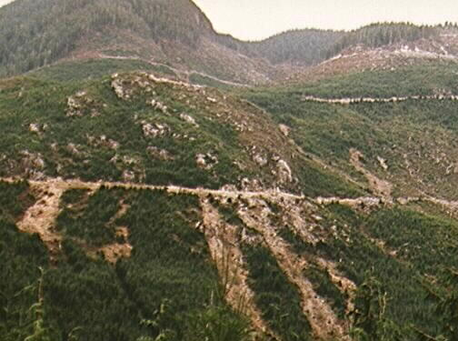
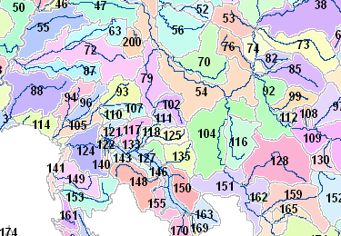
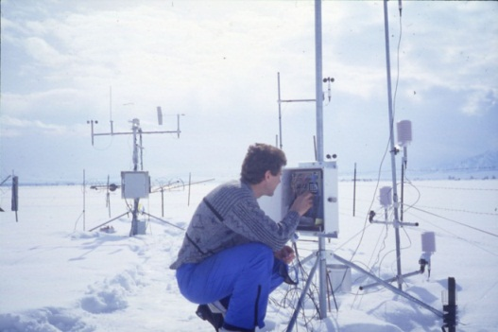
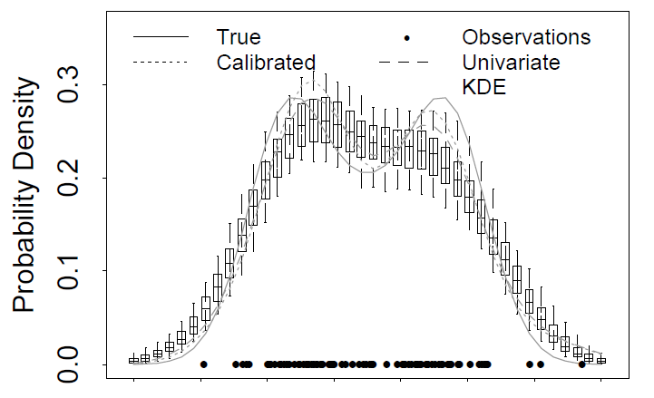
Research Areas
Hydrologic Information Systems
Digital Elevation Model Terrain Analysis
Hydrology and Geomorphology
Distributed Hydrologic Modeling
Snow and glacier melt
Non parametric stochastic hydrology
Streamflow regimes for stream ecology
The Great Salt Lake
Discovery
Catalog
Metadata
ODM, WaterML
Search
Server
Data
Desktop
Production
Consumption

Slide 3

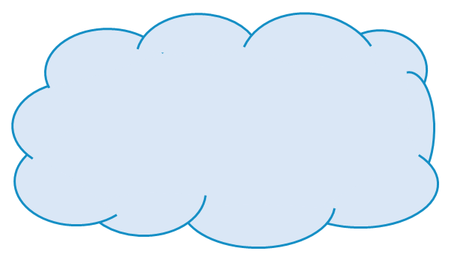
Outline
Data and computational challenges
CUAHSI HIS
HydroShare
  Goals
  Use cases
  Resource data model
  Architecture
Web based data, modeling and analysis services
Summary
Analysis
Data
Models

Slide 4




The challenge of increasing Digital Elevation Model (DEM) resolution
e.g. 50,000 km²
Watershed
1980’s DMA 90 m
10² cells/km²
27 MB
1990’s USGS DEM 30 m
10³ cells/km²
240 MB
2000’s NED 10 m
10⁴ cells/km²
2 GB
2010’s LIDAR ~1 m
10⁶ cells/km²
200 GB

Slide 5
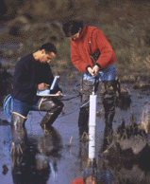


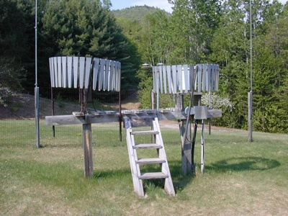
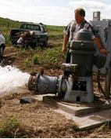
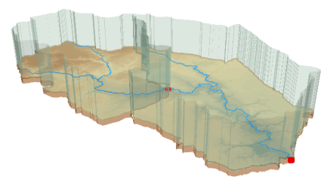
Data Heterogeneity
Water quality
Water quantity
From dispersed federal agencies
From investigators collected for different purposes
Different formats
  Points
  Lines
  Polygons
  Fields
  Time Series
Rainfall and Meteorology
Soil water
Groundwater
The way that data is stored can enhance or inhibit the analysis that can be done
We need ways to organize the data we work with
Data models
GIS

Slide 6
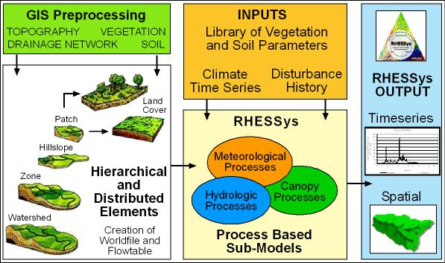
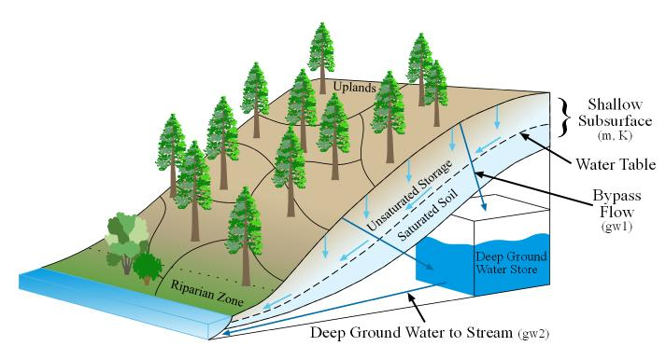
Data intensive models to understand and examine consequences, impacts and effects
From Larry Band
Notes:
Strata can be redefined any time

Slide 7

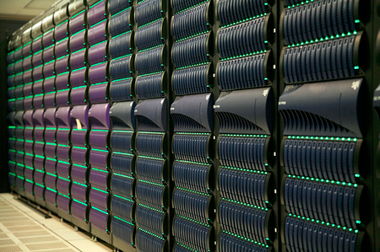
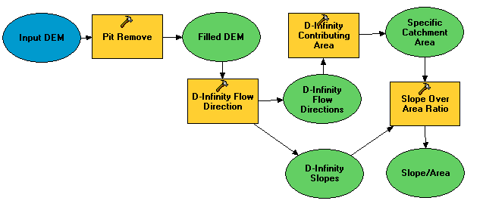
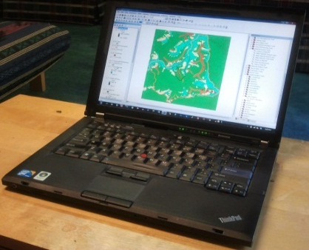
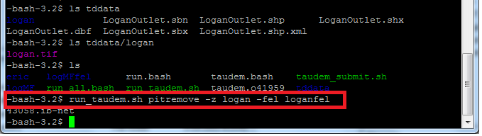
A Digital Divide
Hydrologic Experimentation and Modeling
Data Intensive High Performance Computing
#!/bin/bash
vi
chmod
#PBS -l nodes=4:ppn=8
grep
awk
mpiexec
Do you have the access or know how to take advantage of advanced computing capability?
Gateways, Web Interfaces, Software services

Slide 8

HydroShare Goals
Enable more rapid advances in hydrologic understanding through collaborative data sharing, analysis and modeling
To become a foundational cyberinfrastructure platform for hydrologic research that blends
  Software as a service
  Data as a service
  Models as a service
  Visualization and analysis services
To solve problems of size and scope not otherwise solvable using desktop computing
Address community needs

Slide 9
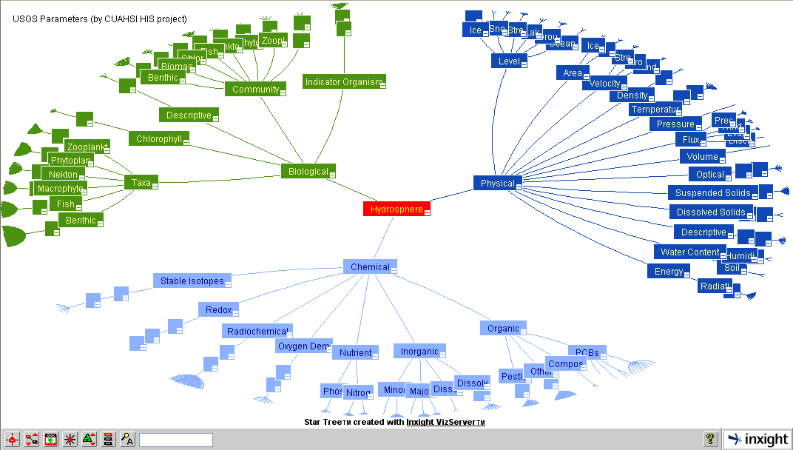
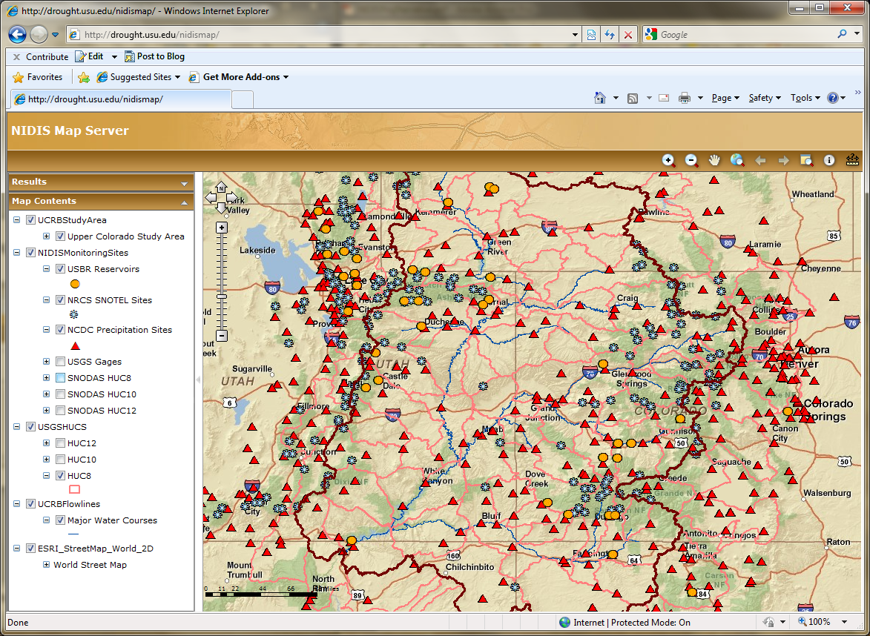
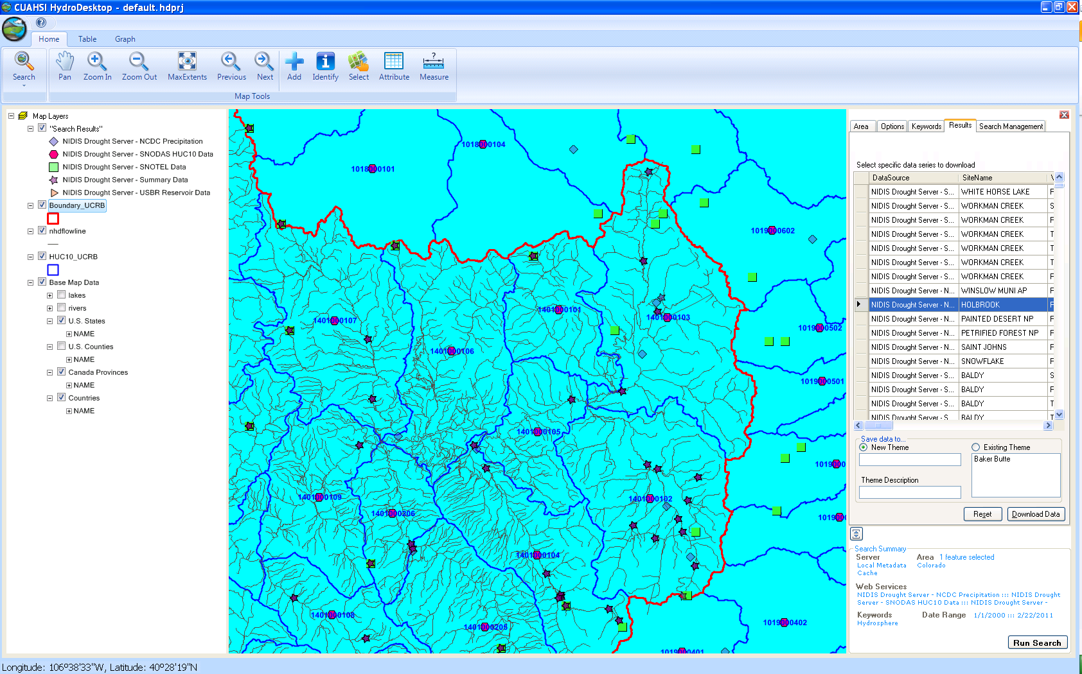
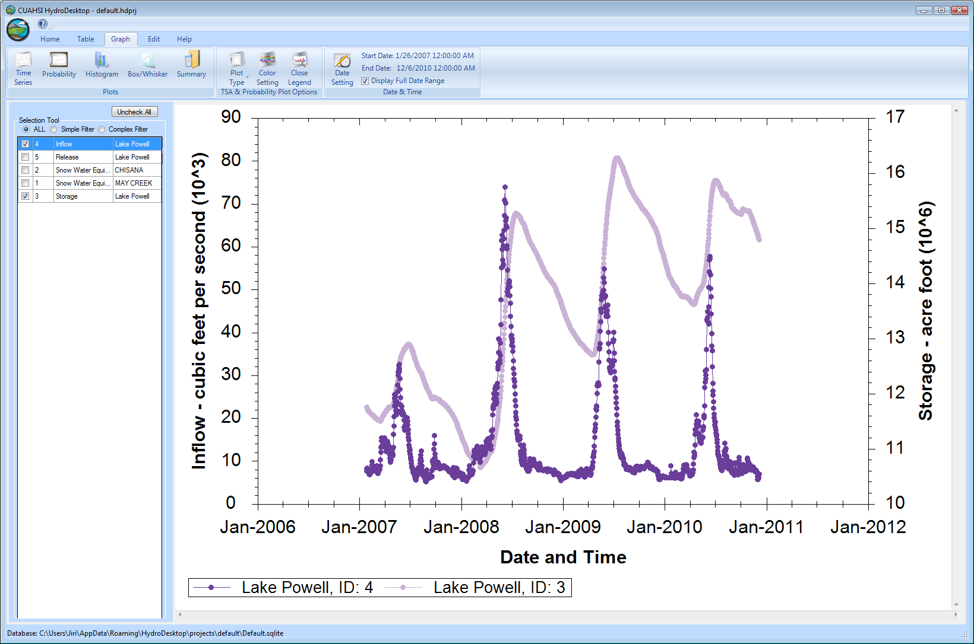
CUAHSI HIS
The CUAHSI Hydrologic Information System (HIS) is an internet based system to support the sharing of hydrologic data. It is comprised of hydrologic databases and servers connected through web services as well as software for data publication, discovery and access.
HydroServer – Data Publication
HydroCatalog
Data Discovery
Lake Powell Inflow and Storage
HydroDesktop – Data Access and Analysis
HydroDesktop – Combining multiple data sources

Slide 10
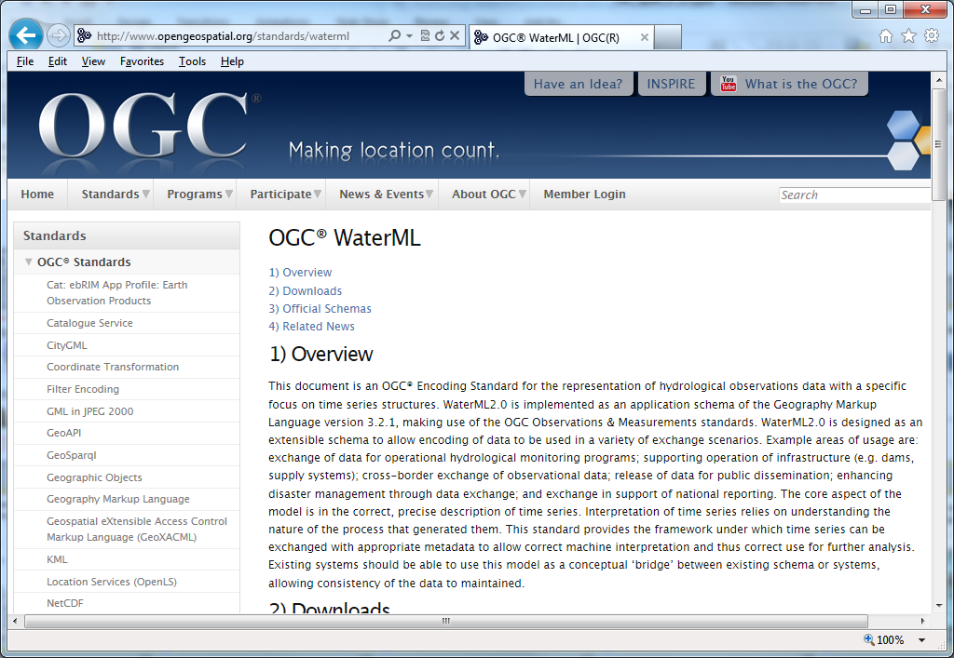
Open Geospatial Consortium Web Service Standards
http://www.opengeospatial.org/standards/waterml
This document is an OGC® Encoding Standard for the representation of hydrological observations data with a specific focus on time series structures.
These standards have been developed over the past 10 years …. by 400 companies and agencies ....

Slide 11
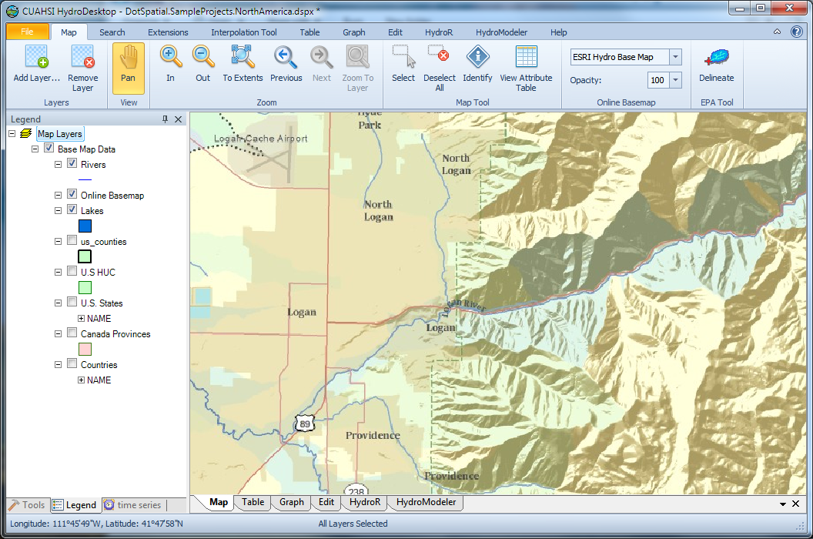
HydroDesktop
An open source
dotSpatial GIS based desktop client that supports discovery and analysis of hydrologic observations data
Uses EPA WATERS Web, Mapping, and Database Services at http://www.epa.gov/waters/geoservices/index.html to delineate Watersheds
Notes:
The service URLs that the HD tool uses are seen in http://hydrodesktop.codeplex.com/SourceControl/changeset/view/475b15a84bf4#Source%2fEPADelineation%2fCallWebService.cs The HD tool uses the Point Indexing Service to find the nearest NHD reach to where the user clicked. This returns a location on that reach. This point location is then used as input to the Navigation Delineation Service to get the watershed, and the Upstream/Downstream Service to get the river lines. The delineation service has two limitations: * It only works up to a certain distance upstream. I think we have it set to 100km. So for large watersheds (those with more than 100km of stream length upstream of where the user clicked), we don't get the most upstream portions of the watershed. * It doesn't delineate exactly to where the user clicked. It delineates to the endpoint of the NHD reach. (Can't remember if it is the clicked reach or the upstream reach -- try it and see.)

Slide 12
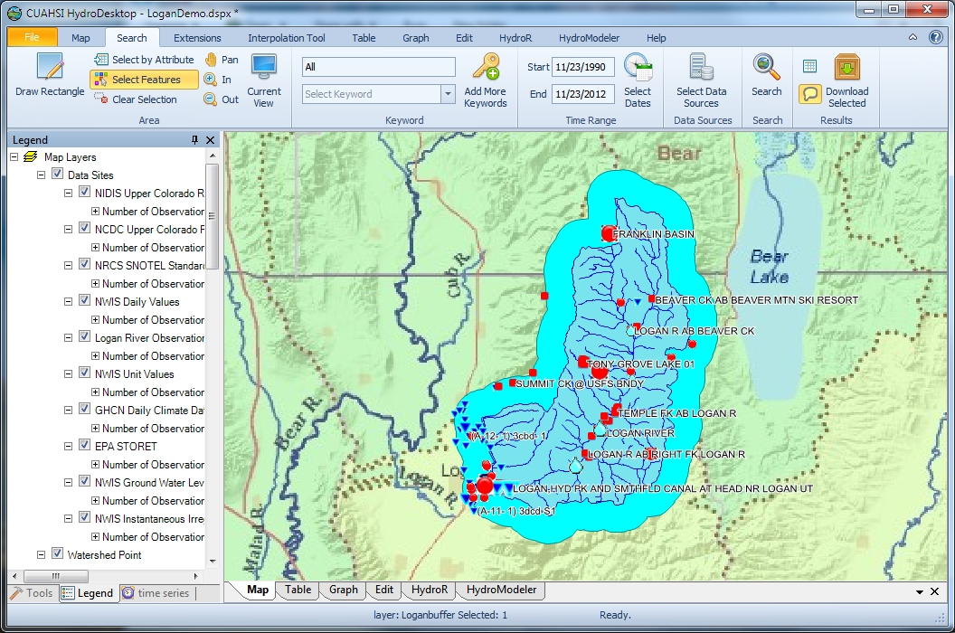
Search last 22 years for all data in buffer around watershed

Slide 13
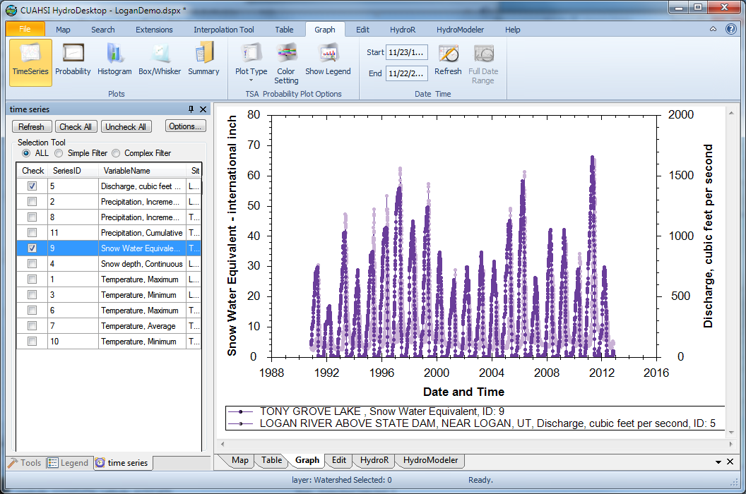
Download and Plot the Data
Combining information from multiple sources

Slide 14
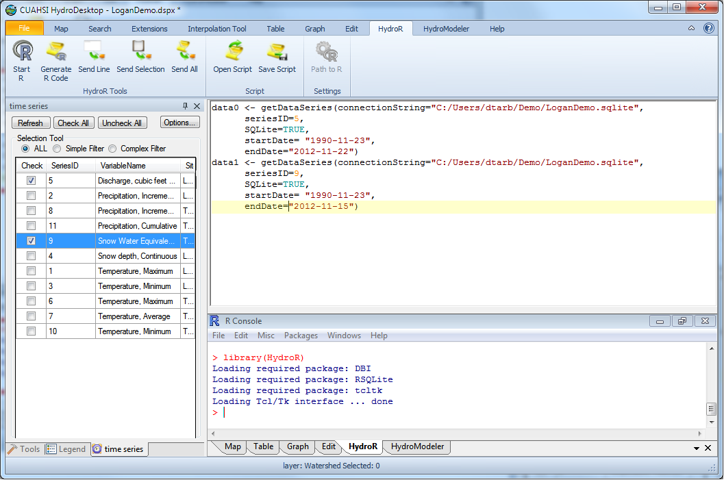
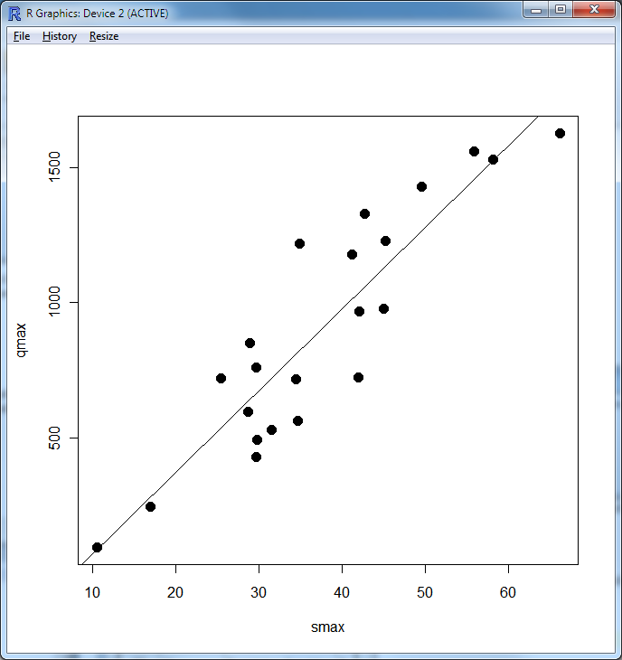
Perform an analysis using R
At your fingertips
the full analysis capability of R
data from multiple sources
accessed from distributed (cloud) resources.
importance of interoperability

Slide 15

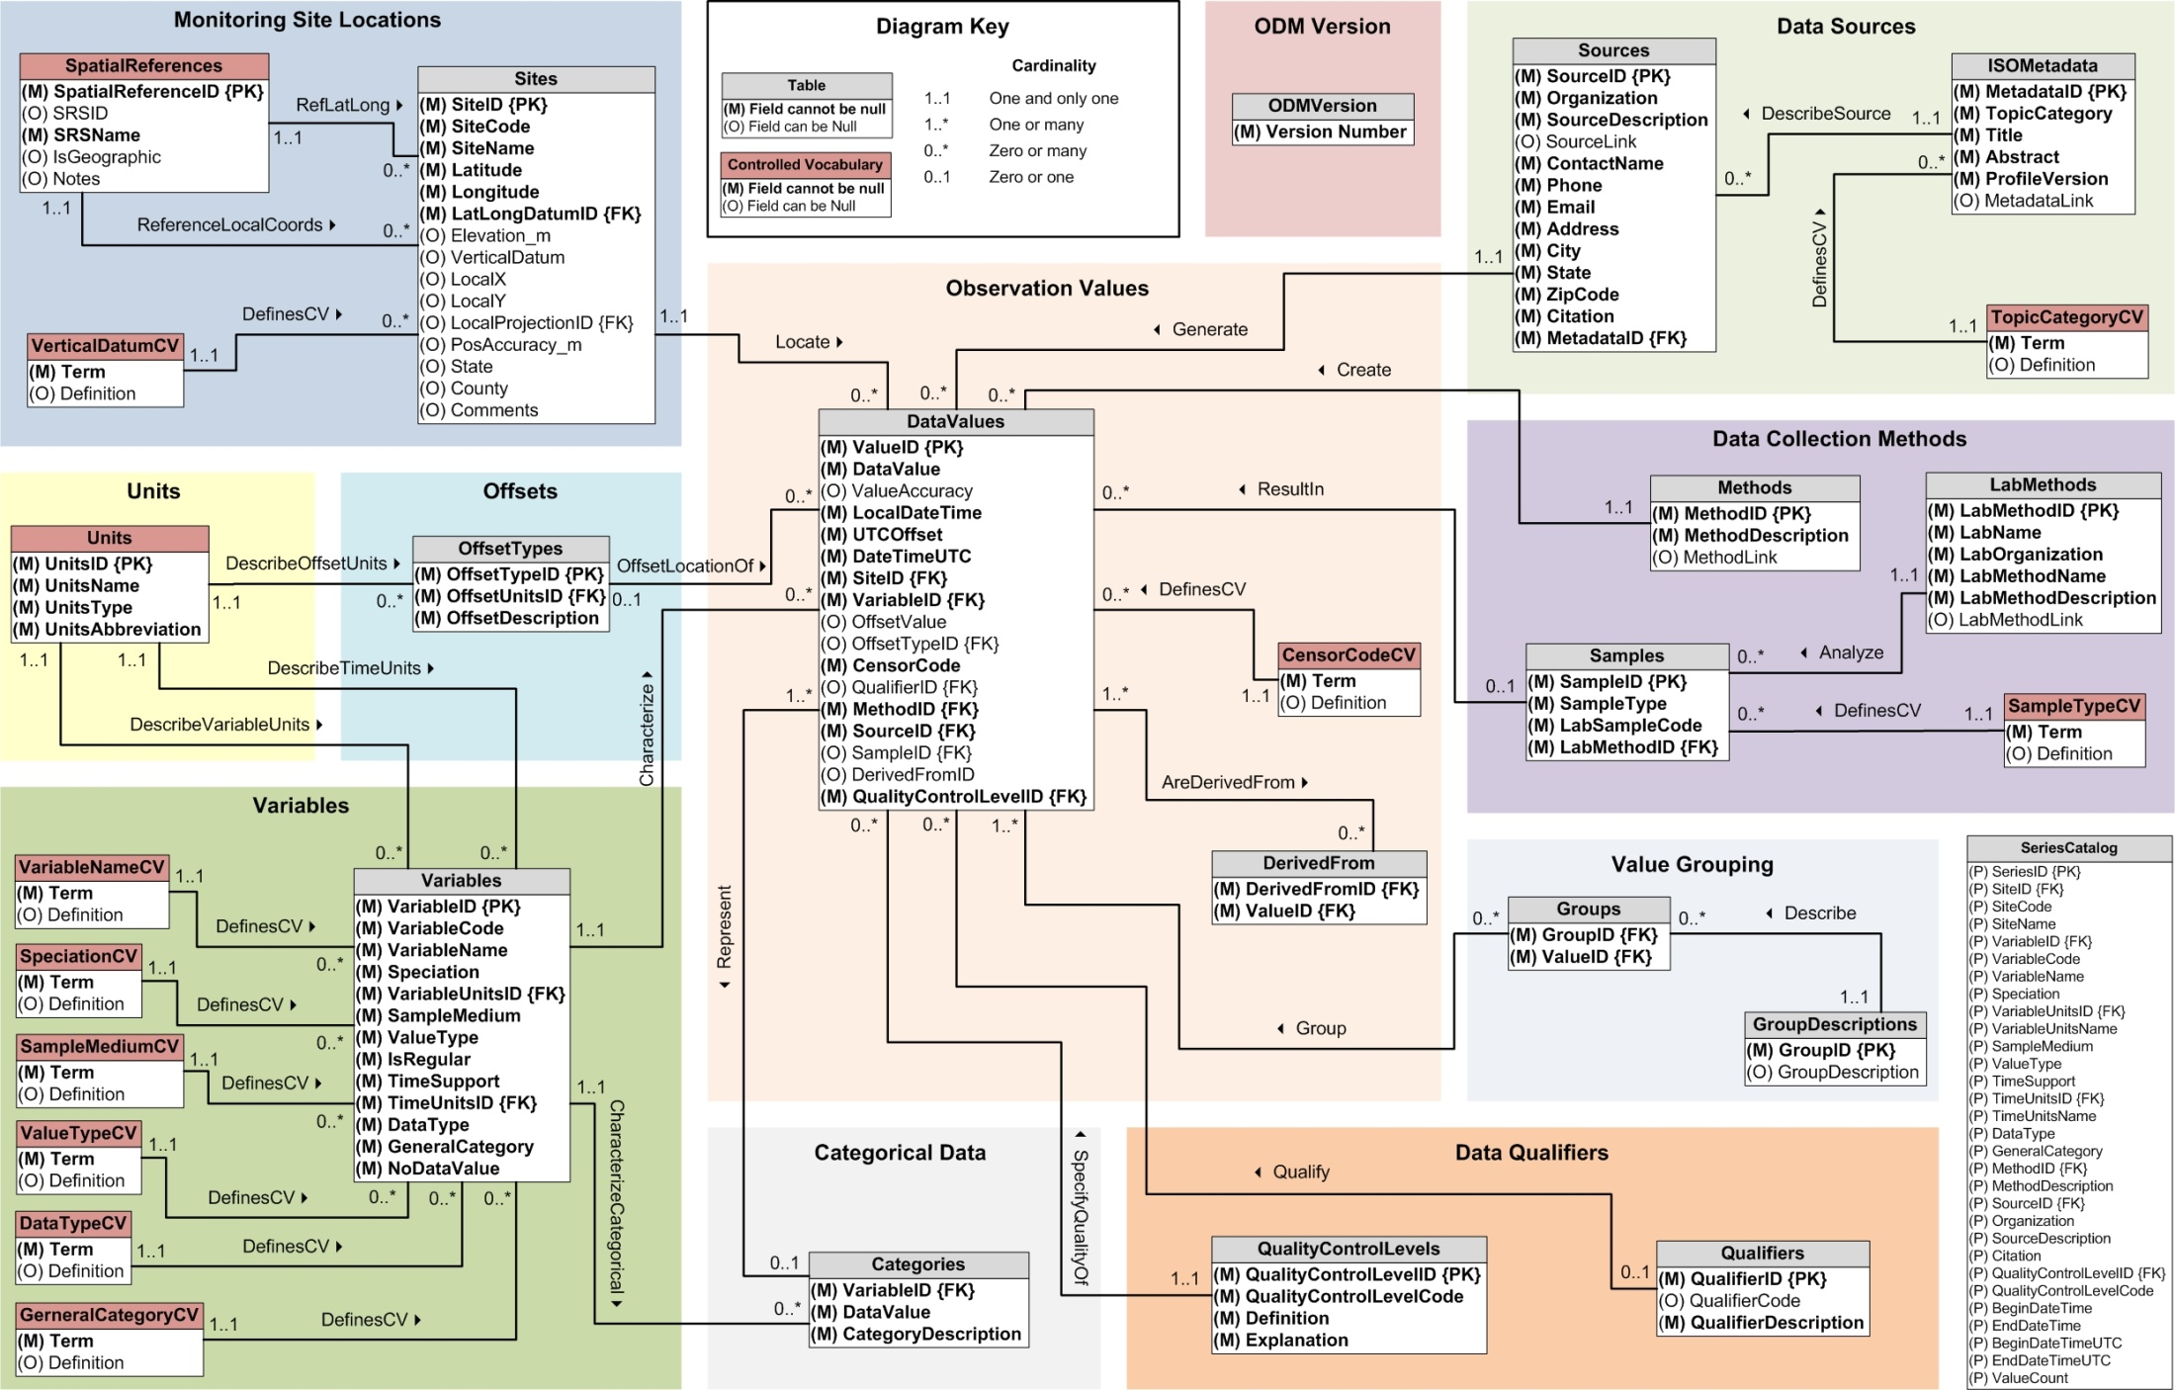
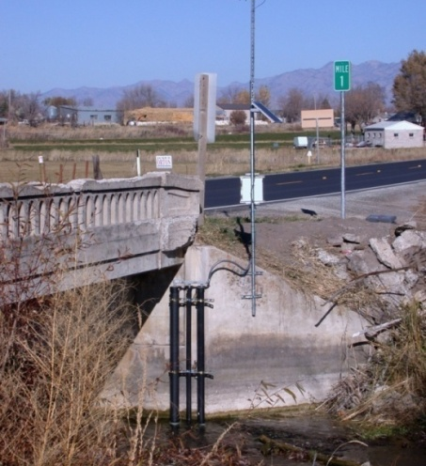
But
Publishing data using CUAHSI HIS requires access to or setting up a HydroServer
Accessing data requires HydroDesktop
Generally limited to time series at a point
Desktop
Catalog
Server

Slide 16
HydroShare is a collaborative environment (being developed) for data sharing, analysis and modeling
Users
Web based data and software services to overcome
Simplify working with large datasets and HPC
Overcome platform dependency limitations
Avoid software installation limitations
Browser
Client
Web Pages
Web Services (REST API)
Django web framework
iRODS “Network File System”
Resource Files
User accounts
Access control
Our goal is to make sharing of hydrologic data and models as easy as sharing videos on YouTube or shopping on Amazon.

Slide 17


Collaborative data analysis and publication use case
Collaboration
5
3
4
Analysis
6
7
Observers and instruments
Data
Models
Digital Library
1
2
Publication, Archival, Curation
Observe
Store
Discover and access
Analyze
Model
Collaborate
Publish (DOI)

Slide 18

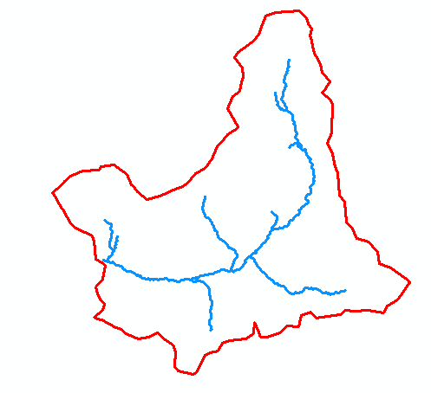
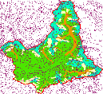
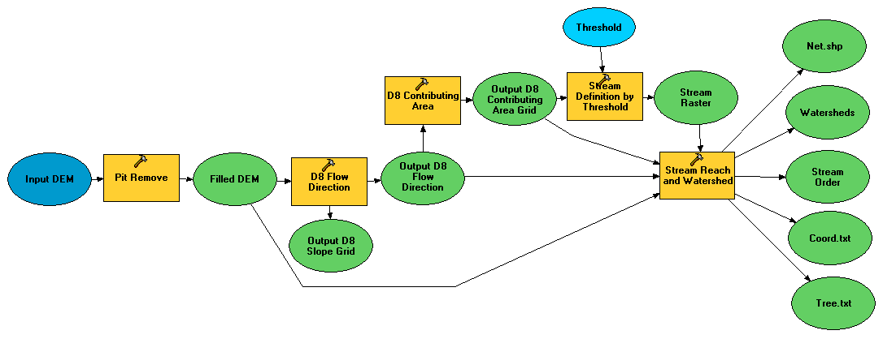
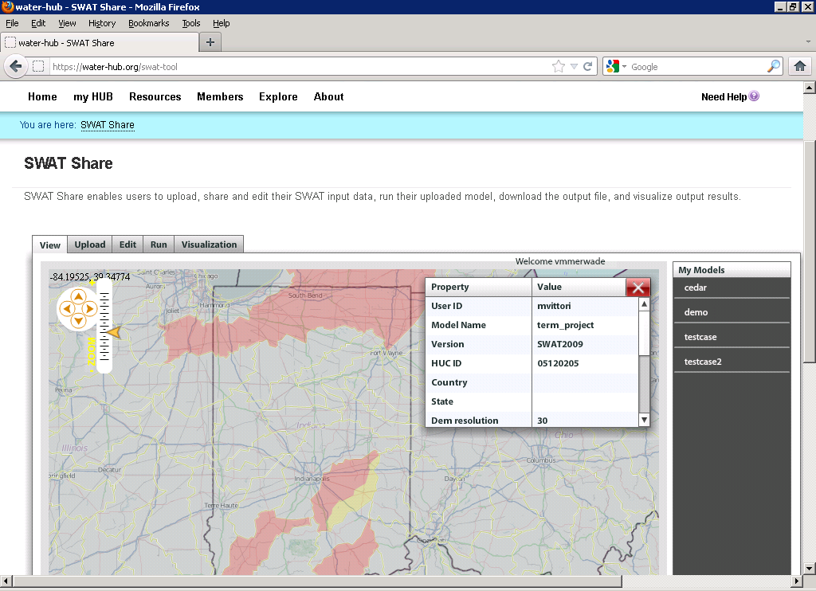
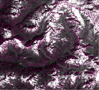
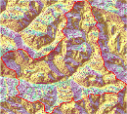
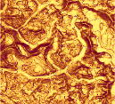
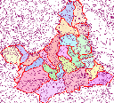

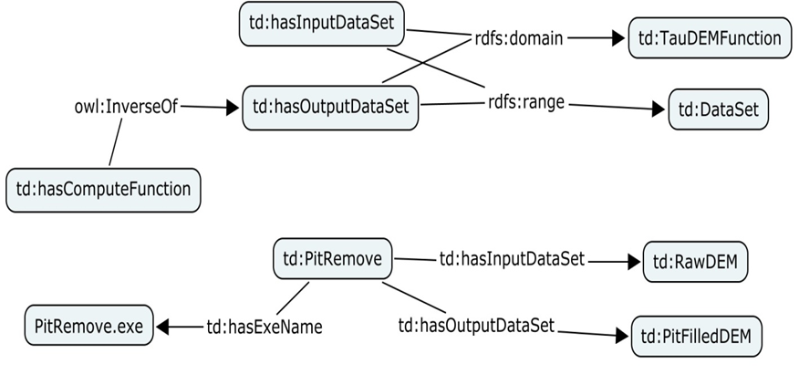
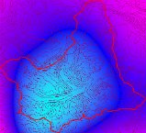

Collaborative Integrated Modeling
Flow
Time
P
Flow
Time
t
Time
Pre-processing and model linking
y
x
Modeling Services (e.g. SWATShare)
Data: Links to national and global data sets of essential terrestrial variables (e.g. NASA NEX, HydroTerre)
Tools to preprocess and configure inputs (EcoHydroLib, TauDEM, CyberGIS)
Preconfigured models and modeling systems as services (SWATShare)
Standards for information exchange for interoperability (OpenMI, CSDMS BMI)
Tools for visualization and analysis
Notes:
Data: Links to national and global data sets of essential terrestrial variables (e.g. NASA NEX, HydroTerre)
Tools to preprocess and configure inputs
Preconfigured models and modeling systems as services
Standards for information exchange for interoperability (OpenMI, CSDMS BMI)
Tools for Visualization and Analysis
Automated reasoning to couple models based on purpose, context, data and resources

Slide 19
At its heart, HydroShare is a system for sharing Resources and Collaborating
Files and sets of files structured to represent a hydrologic process, model, or element in the hydrologic environment
Standard data models enhance interoperability and support functionality “hydro value added”
Tools that act on resources to visualize, modify and create new resources
  Encode standard/best practices
Access control and sharing model

Slide 20
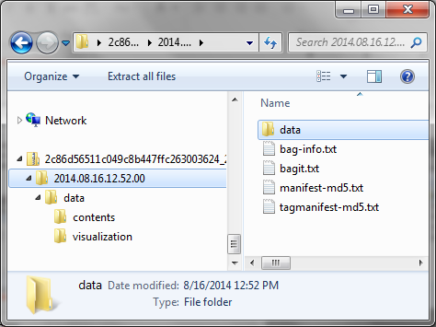
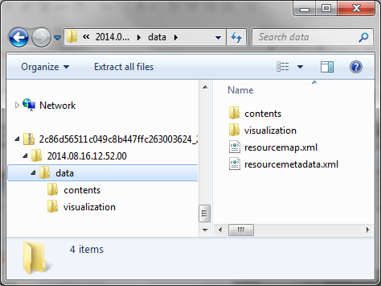
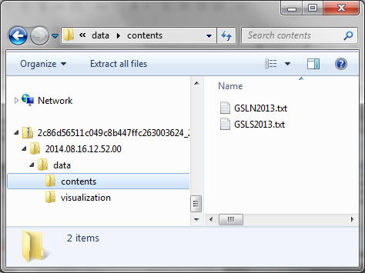
Resource Data Model
Open Archives Initiative – Object Reuse and Exchange (OAI-ORE) - standards for the description and exchange of aggregations of Web resources
BagIt – hierarchical file packaging format designed to support disk-based or network-based storage and transfer of generalized digital content
Compatible with DataOne

Slide 21
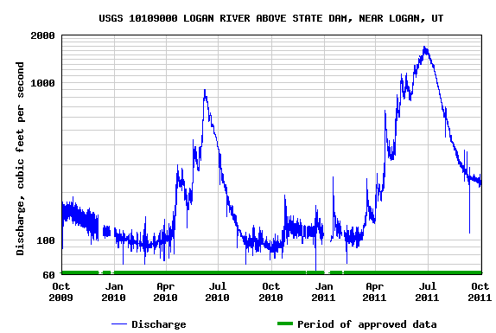
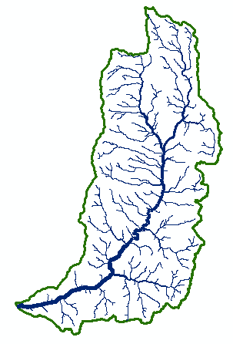
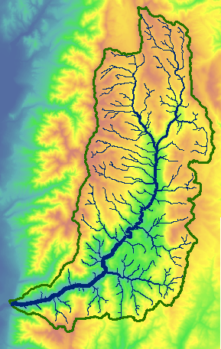

Types of data to support as resources
Resource Types
Generic ✓
Geographic Raster ✓
Referenced Time Series (CUAHSI HIS web service link) ✓
Geographic Feature set
Multidimensional Space Time dataset
River Geometry
Sample based observations (ODM2 and CZO)
HydroDesktop Project package
Scripts
Model program
Model component
Model instance
Composite resources
t
y
x

Slide 22
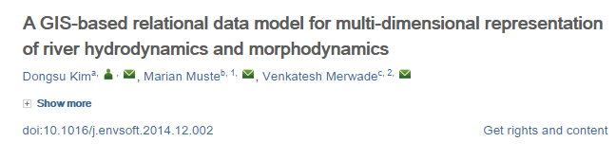
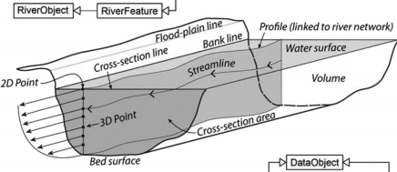
River Channel
http://dx.doi.org/10.1016/j.envsoft.2014.12.002

Slide 23
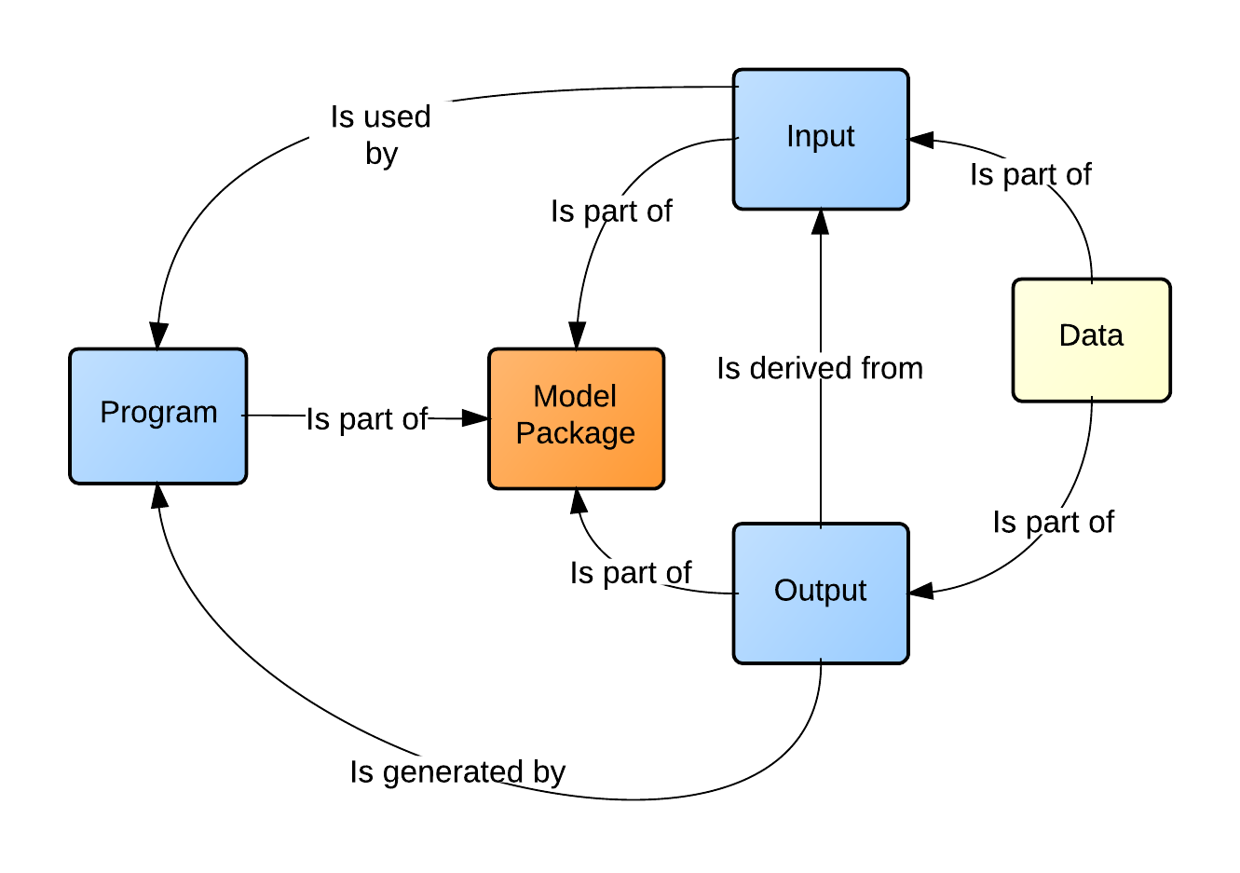
Models
Model package
  Bundled components
  references existing resources
Model program
  executable entity
  may consist of submodules and other complex relationships
Model input
  input required by a program
  files, parameters, etc...
Model output
  outputs produced by a program
  files, plots, etc...

Slide 24
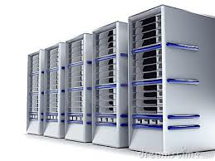
Model Execution in HydroShare
Input and output Hydroshare resources
Link input, output, and program resources to create model packages
Execution of model package within the HydroShare environment to create "new" resources
Output
CREATE OUTPUT
CREATE PACKAGE
Package
EXECUTE
Program
Input
Package
Program
Input
Output

Slide 25
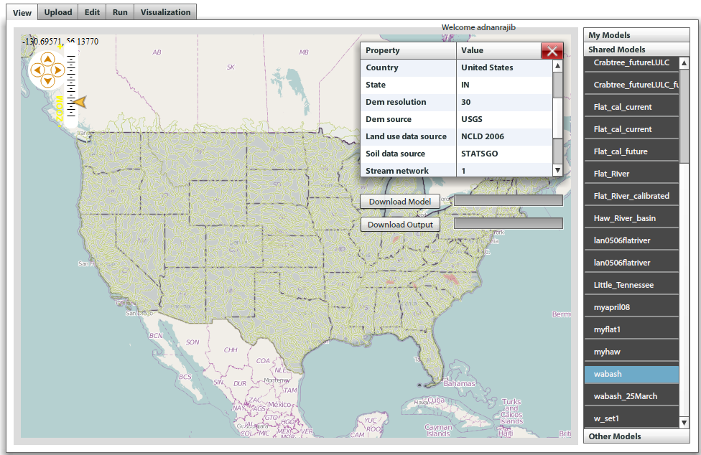
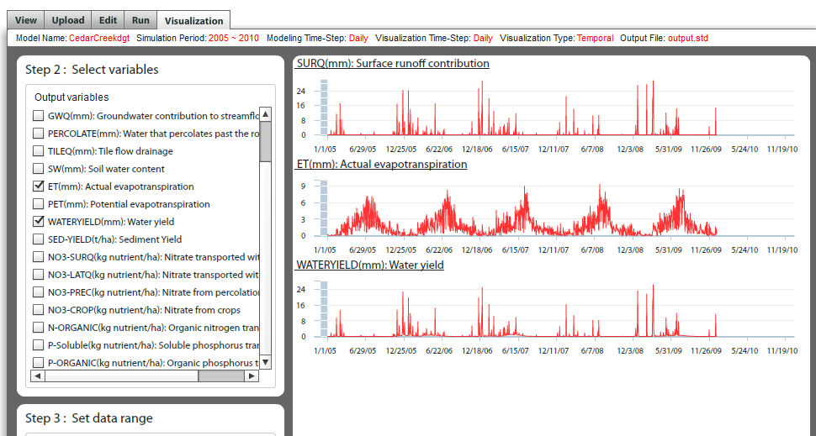
SWATShare
SWAT Models (.zip file)
Metadata
Model and Output (.zip, .xls or .txt file)
Location

Slide 26
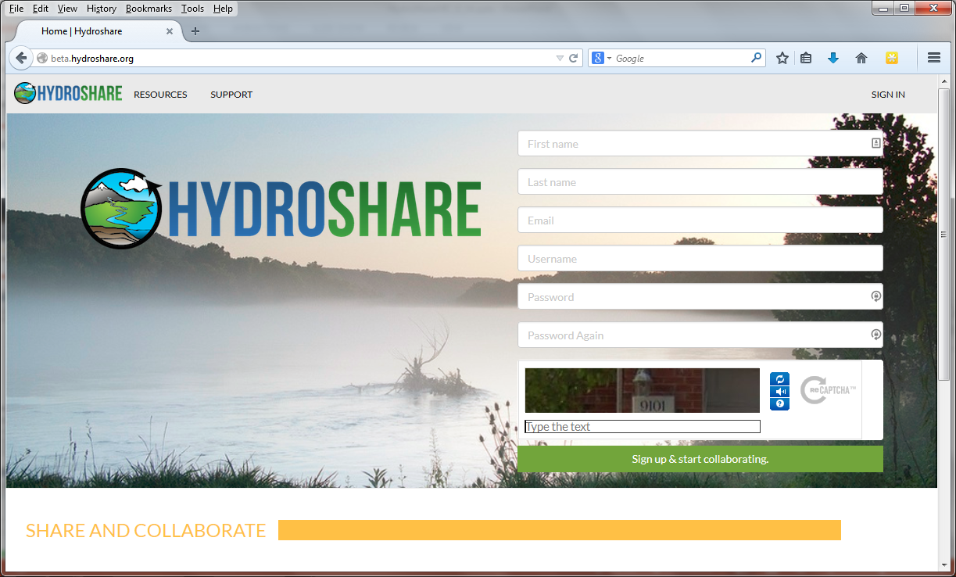


Demo

Slide 27

Collaborative functionality

Slide 28












Clearing your desk. The trend towards network (cloud) computing.
Can we deliver Hydrologic Analysis functionality as a service over the web?
Data Sources
Server
Functions and Tools
Software as a Service
Users
Based on slide from Norm Jones

Slide 29




Terrain Analysis
Raw DEM
Pit Removal
Flow Field
Flow Related Terrain Information
Watersheds are the most basic hydrologic landscape elements
Notes:
This slide shows the general model for deriving flow field related derivative surfaces from digital elevation data. The input is a raw digital elevation model, generally elevation values on a grid. This is basic information used to derive further hydrology related spatial fields that enrich the information content of this basic data. The first step is to remove sinks, either by filling, or carving. Then a flow field is defined. This enables the calculation of flow related terrain information.

Slide 30




TauDEM
Stream and watershed delineation
Multiple flow direction flow field
Calculation of flow based derivative surfaces
MPI Parallel Implementation for speed up and large problems
Open source platform independent C++ command line executables for each function
Deployed as an ArcGIS Toolbox with python scripts that drive command line executables
CSDMS Cluster Implementation
Open Topography and XSEDE implementation
http://hydrology.usu.edu/taudem/

Slide 31

Using TauDEM today requires
Expertise in Hydrologic DEM analysis
The software
  ArcGIS licenses (for ArcGIS plugin)
  The ability to install software
  TauDEM command functions with MPI installation
  Compilation for other platforms
Sufficient Hardware (RAM and Disk)
The data (uncompressed GeoTIFF, projected, consistent grid size and spatial reference)

Slide 32




Moving TauDEM to the cloud
CyberGIS
http://gateway.cigi.illinois.edu/
Open Topography
www.opentopography.org

Slide 33

Parallel TauDEM Functions
MPI, distributed memory paradigm
Row oriented slices
Each process includes one buffer row on either side
Each process does not change buffer row
Improved runtime efficiency
Capability to run larger problems

Slide 34

XSEDE Extended Collaboration Support Services (ECSS) improvements
Reconfiguration of multiple file header reads to be broadcast from single node
Reconfiguration of output files to avoid spanning processors
Execution time of the three most costly TauDEM functions on a 36GB DEM dataset.
I/O Time Comparison (before / after; in seconds) for 2 GB DEM
StreamNet
DinfFlowdir
D8Flowdir
#cores | Compute | Header Read | Data Read | Data Write
32 | 42.7 / 42.8 | 193.5 / 3.8 | 0.4 / 0.4 | 153.5 / 3.5
64 | 35.3 / 34.8 | 605.5 / 3.9 | 1.5 / 1.1 | 160.2 / 2.3
128 | 33.7 / 33.0 | 615.2 / 2.6 | 0.9 / 1.0 | 173.2 / 2.3
256 | 37.5 / 38.0 | 831.7 / 2.3 | 0.5 / 0.9 | 391.3 / 1.6

Slide 35


TauDEM Wetness index from Open Topography
Eel River ln(a/S)
a in meters

Slide 36


TauDEM in CyberGIS
http://gateway.cigi.illinois.edu/

Slide 37

Select the products you want
The wizard configures the sequence of functions to run to get the result

Slide 38

Results displayed in browser

Slide 39



Computation via Python Client calling API
Input
Python session on desktop but data and analysis on server
Result
Assumptions
Research hydrologic modelers should be comfortable using a scientific programming language like Python or R.
Hydrologic modelers are not expert in HPC systems and learning this is a barrier to the use of HPC.
Hydrologic modeling is data intensive (large datasets from a range of sources)

Slide 40
Architecture
www.hydroshare.org
tools.hydroshare.org
Web Pages
Clients (3rd party), interoperable systems and web tools
Web Services (REST API)
Django web application framework (Python)
HydroDesktop
Tethys
BiG CZ SSI
CI-WATER
SEAD
CyberGIS
SESYNC GI Venture
iRODS Native REST API
iRODS “Network File System”
iCAT Zone
User Accounts
Authentication and Authorization Infrastructure (AAI) for Access Control
Distributed Resource Servers
Files
Science Metadata
Discovery (using e.g. ElasticSearch via MSVC plugin)
RENCI
Utah
Others

Slide 41
Summary
A new, web-based system for advancing model and data sharing
Sharing features to HydroDesktop
Access multiple types of hydrologic data using standards compliant data formats and interfaces
Flexible discovery functionality
Model sharing and execution
Facilitate and ease access to use of high performance computing
Social media and collaboration functionality
Links to other data and modeling systems

Slide 42

Thanks to the HydroShare team!
  USU
  RENCI/UNC
  CUAHSI
  BYU
  Tufts
  UVA
  Texas
  Purdue
  SDSC
http://hydroshare.cuahsi.org
OCI-1148453
OCI-1148090
2012-2017
Notes:
The HydroShare project is part of a broad effort in CUAHSI in the area of Hydrologic Information Systems. We have a team of developers and domain scientists from eight universities working on HydroShare. This is part of the even broader focus in NSF on data management, Cyberinfrastructure and sustainable software.

