Slide 1
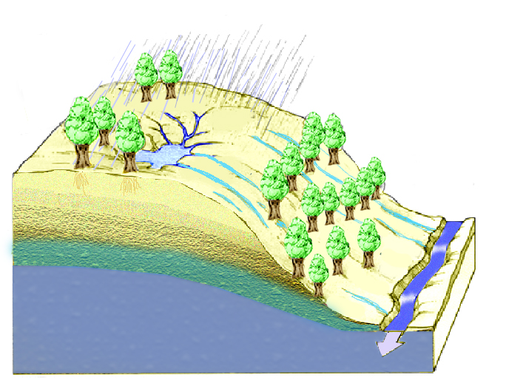

Physical Factors Affecting Runoff

Slide 2
Water Balance Equation
P
∆S=P-Q-E
E
P=Q+E
Q=P-E
∆S
Q

Slide 3
P=Q+E
E=P
E
Q
E=Ep
E
P

Slide 4
P=Q+E
E=P
E
Q
E=Ep
W=Q/P 1
E
P
W=Q/P 0

Slide 5
Seasonal or storm period fluctuations
(Slide courtesy of Mike Kirkby, University of Leeds, presented at AGU Chapman Conference on Hillslope Hydrology, 2001)
Notes:
Figure 15. Generalised dependence of Runoff Coefficient and Style of Overland Flow on Arid-Humid scale and on Storm Rainfall Intensities (From Mike Kirkby, University of Leeds, AGU Chapman Conference on Hillslope Hydrology, October 2001)

Slide 6
100
Reynolds Ck, ID
Coshocton, OH
10
ID
Mean annual Runoff (inches)
IA
PA
OH
Reisel, TX
MO
VA
1
San Pedro, AZ
AZ
OK
TX
MS
GA
Walnut Gulch, AZ
FL
0.1
0.001
0.1
10
1000
Area (sq. miles)
Scale dependence of mean annual runoff for different geographic locations in the U.S. (Courtesy of David Goodrich, USDA-ARS).

Slide 7
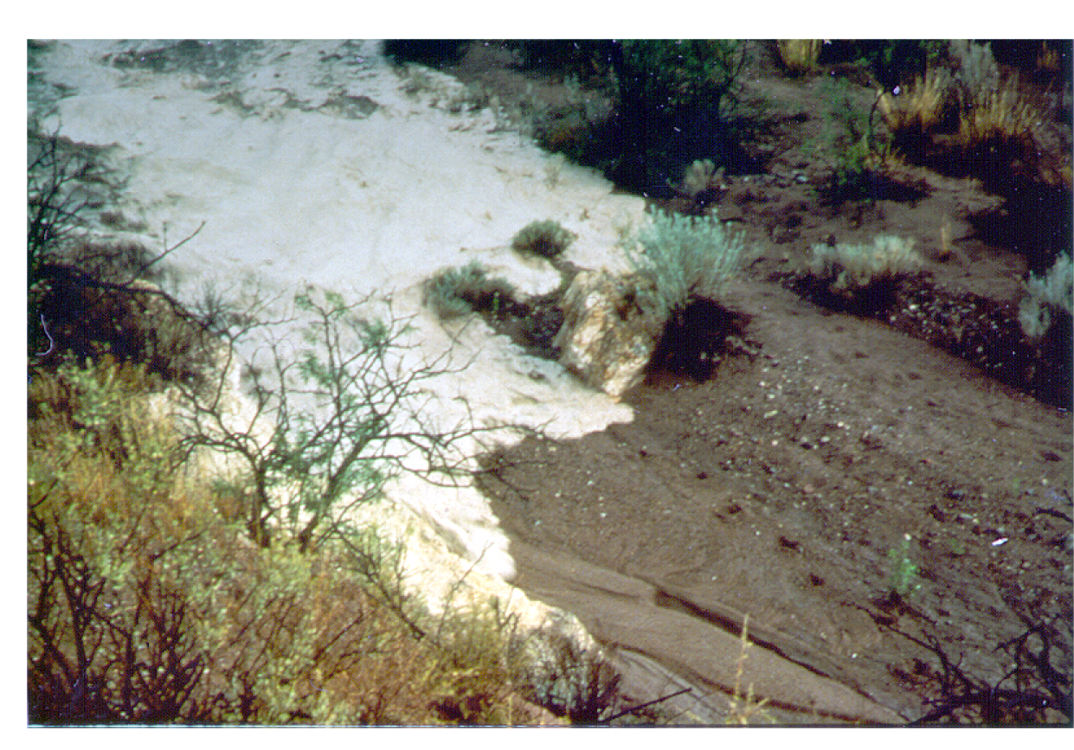
Flood wave advancing over a dry stream bed in Walnut Gulch experimental watershed where channel transmission losses are considerable. (Courtesy of David Goodrich, USDA-ARS)

Slide 8
Direct precipitation and return flow dominate hydrograph; subsurface stormflow less important
Thin soils; gentle concave footslopes; wide valley bottoms; soils of high to low permeability
Horton overland flow dominates hydrograph; contributions from subsurface stormflow are less important
Variable source concept
Subsurface stormflow dominates hydrograph volumetrically; peaks produced by return flow and direct precipitation
Topography and soils
Steep, straight hillslopes; deep,very permeable soils; narrow valley bottoms
Arid to sub-humid climate; thin vegetation or disturbed by humans
Humid climate; dense vegetation
Climate, vegetation and land use
Runoff processes in relation to their major controls.
(From Dunne and Leopold, 1978)

Slide 9
Topographic definition of contributing area, concentrated at a point or dispersed (specific catchment area) on a hillslope.

Slide 10
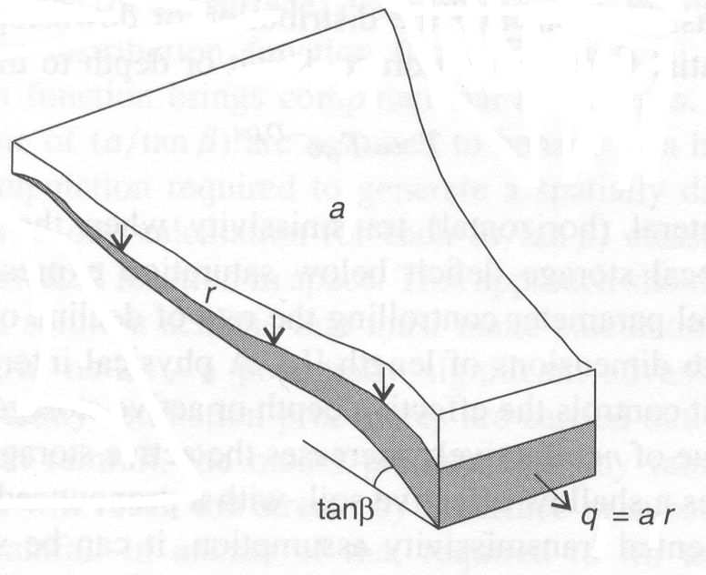
Definition of the upslope area draining through a point within a catchment
S
q = a r
q_{cap} = T S
Saturation occurs when

Slide 11
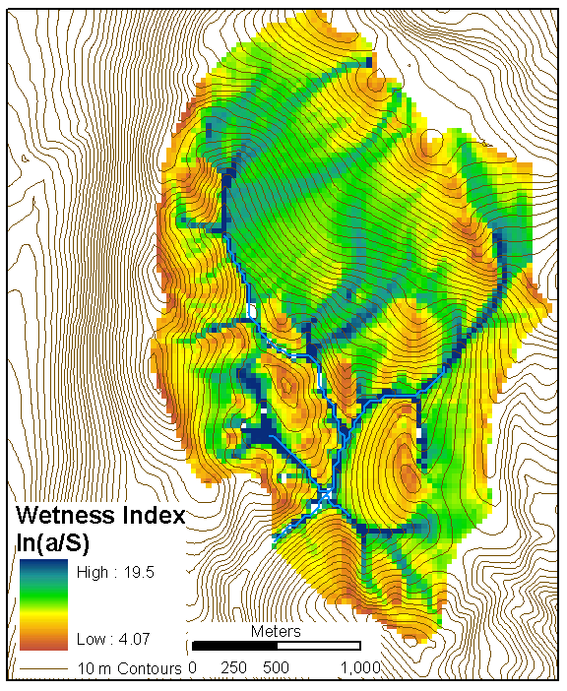
ln(a/S) wetness index for a small watershed evaluated from a 30 m Digital Elevation Model.

Slide 12
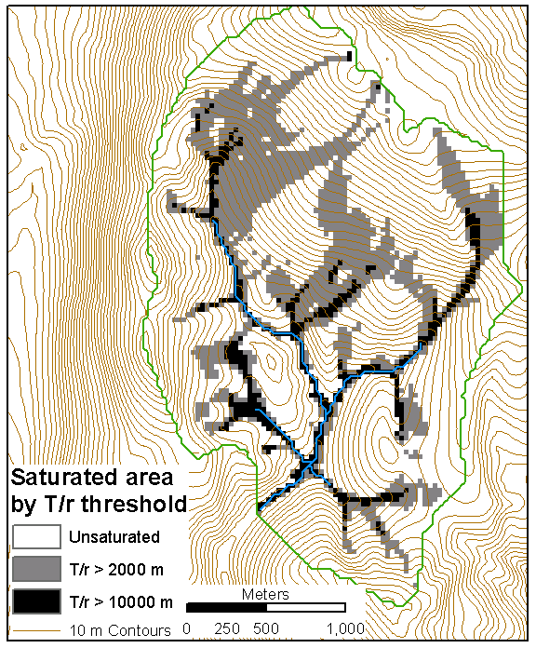
Saturated area based on wetness index for two different T/r thresholds.

