Slide 1
Using Digital Elevation Model Derived Height Above the Nearest Drainage for flood inundation mapping and determining river hydraulic geometry
David Tarboton¹, Xing Zheng², David Maidment², Yan Liu³, Shaowen Wang³
1. Utah State University, dtarb@usu.edu
2. University of Texas at Austin, 3. University of Illinois

Slide 2
Outline
Overview
Calculating height above the nearest drainage (HAND) from a Digital Elevation Model
Using HAND to map flood inundation for stream reach catchments
Using HAND to determine stream reach hydraulic properties
Further considerations

Slide 3
Flooding occurs when Water Depth is greater than Height Above Nearest Drainage (HAND)
Address Point
Height Above
Nearest Drainage
(HAND)
Flood Depth
Normal Depth
Stream Bed
May be used to determine flood risk
Slide from David Maidment

Slide 4
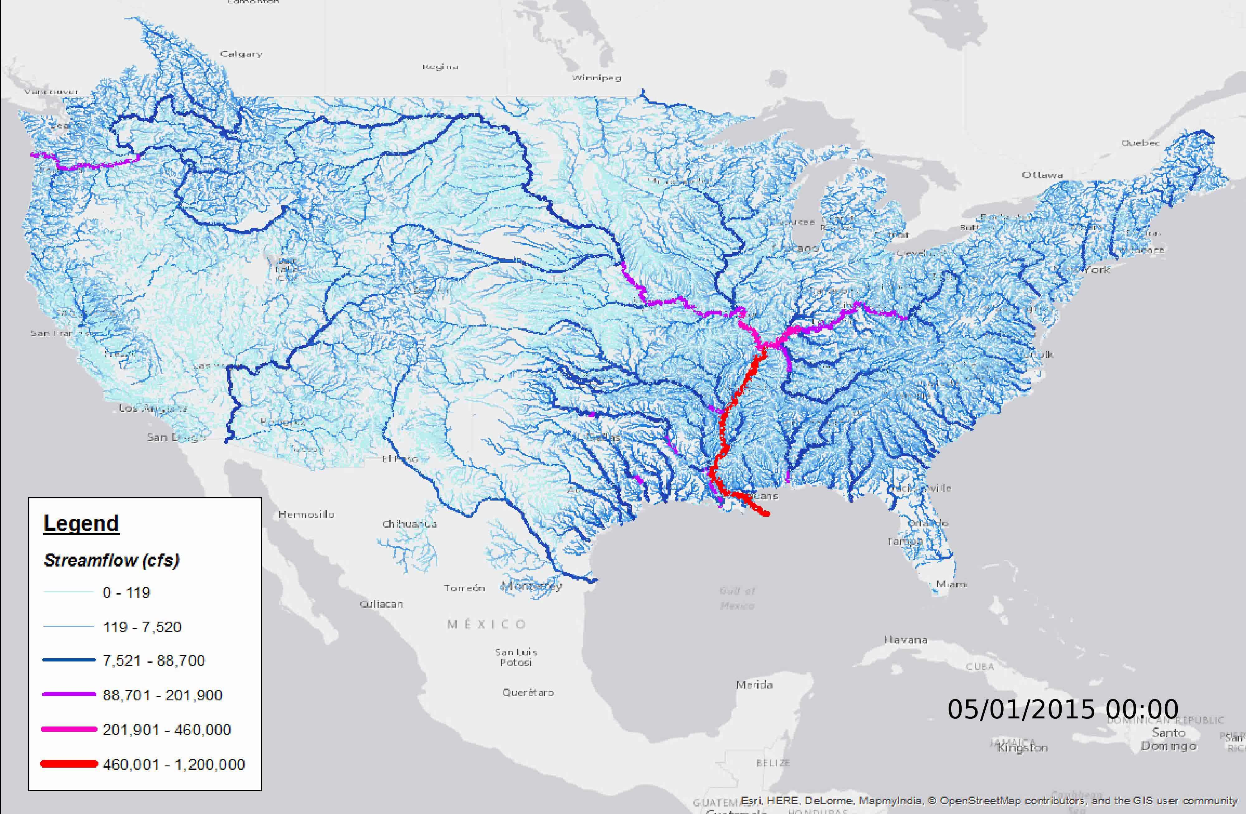
National Water Model Discharge Forecast Across the Continental US
(Operational by National Weather Service in August 2016)
Slide from David Maidment

Slide 5
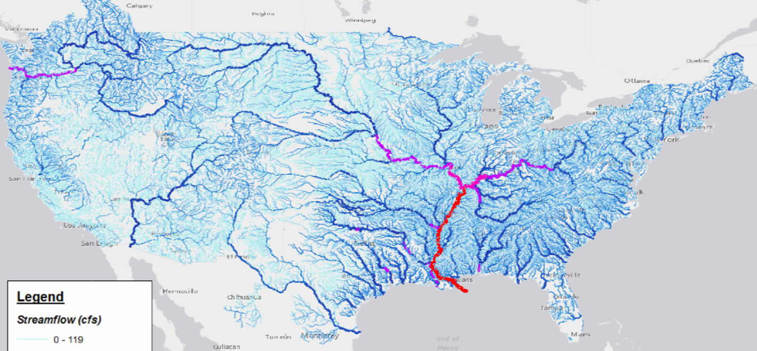
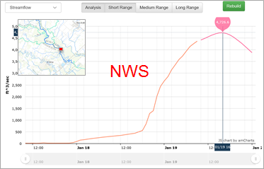
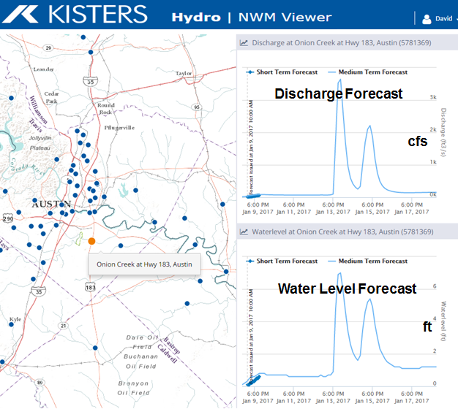
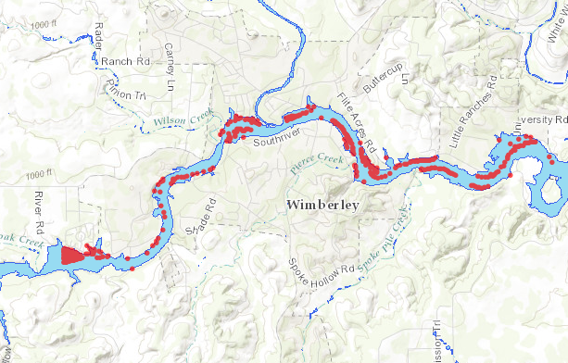
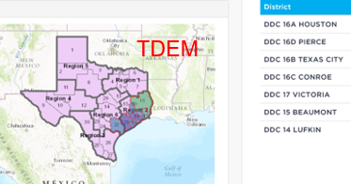
Flood Inundation Mapping
Take discharge forecast from the National Water Model
Discharge
Transform discharge to depth by rating curve or hydraulic model
Depth
Create flood inundation map from water depth
Inundation
Assess impact on people and property
Impact
Flood emergency response depends on assessment of impact
Slide from David Maidment

Slide 6
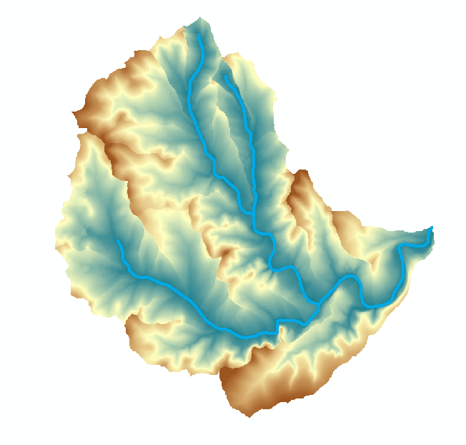
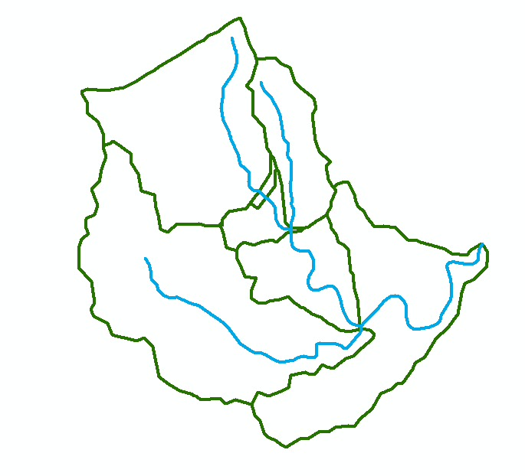
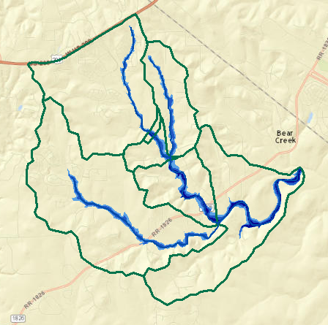
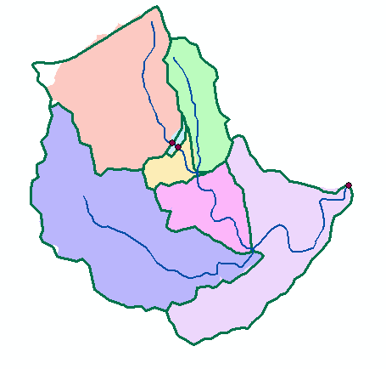
Implementation in GIS
Height above drainage
(relative elevation of land surface cell above cell in stream to which it flows)
Each stream reach has a discharge
Each stream reach has a water depth calculated from discharge, h_{w}
Each stream reach has a unique ID
Each catchment has a unique ID for the reach to which it drains
Each grid cell has the ID of the catchment it is in (reach it drains to) and height above the nearest drainage, h_{d}
Evaluate inundation using
    if(h_{w}(id) > h_{d}(id))
      Inundation depth = h_{w}(id) - h_{d}(id)
    else
      Inundation depth = 0
Streams
Reach Scale Flood Depth
Comid | Depth (ft)
5781365 | 8
5781381 | 9
5781405 | 10
5781401 | 15
5781399 | 14
5781383 | 12
5781933 | 11
Catchments
Inundation map

Slide 7
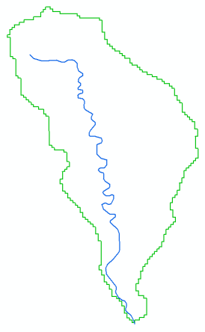
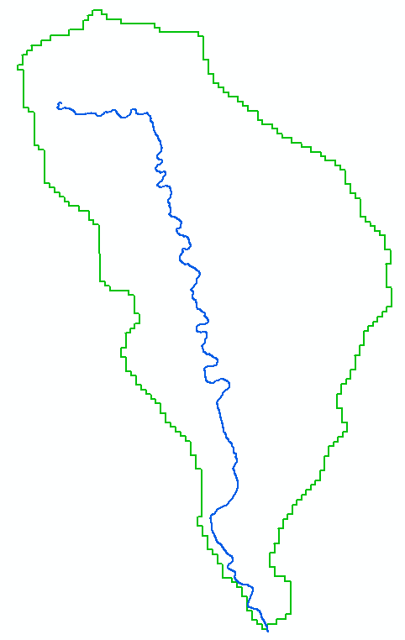
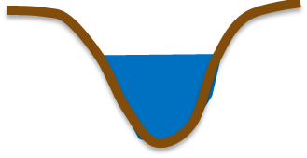
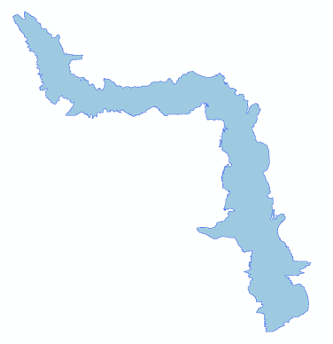
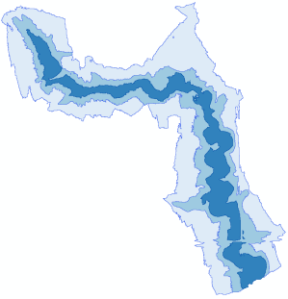
Information Model for Flood Mapping
NWM Forecast
River Segment with unique ID
Q
River Geometry
t
H
NHDPlus Flowline and Catchment
Rating Curve
Q
Flood Map Library
Real-time
Inundation Extent
HEC-RAS
NED-HAND
Lidar-HAND (GeoFlood)
Slide from Xing Zheng

Slide 8
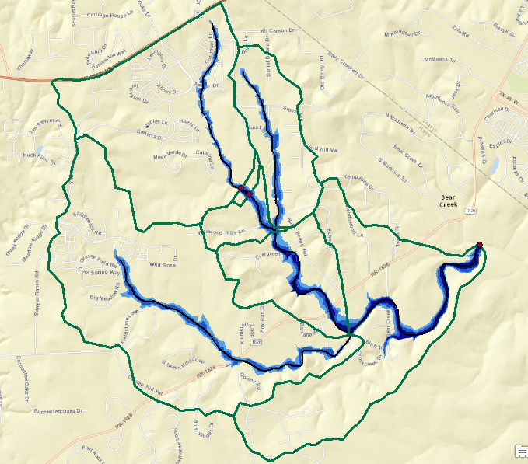
Reach based height above nearest drainage flood map example
This is approximate because it neglects many details of the river hydraulics and flow over flood plains. But more detailed approaches often demand hard to obtain and uncertain inputs so this may be a helpful approach to get screening level and real time flood maps
Premised on good elevation model and consistent stream raster
h_{w}=8 ft
h_{w}=9 ft
h_{w}=11 ft
h_{w}=12 ft
h_{w}=14 ft
h_{w}=10 ft
h_{w}=15 ft

Slide 9
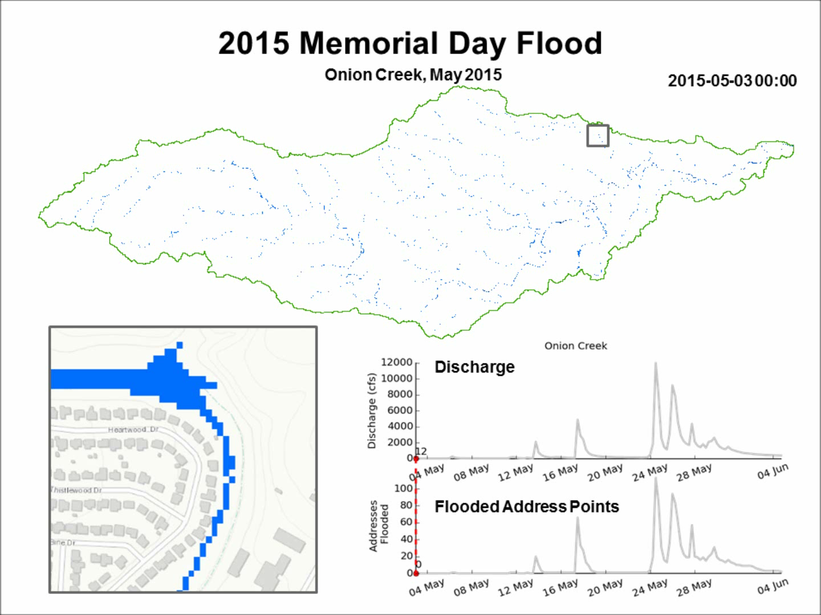
Video from Xing Zheng

Slide 10
Outline
Overview
Calculating height above the nearest drainage (HAND) from a Digital Elevation Model
Using HAND to map flood inundation for stream reach catchments
Using HAND to determine stream reach hydraulic properties
Further considerations

Slide 11
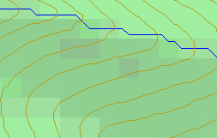
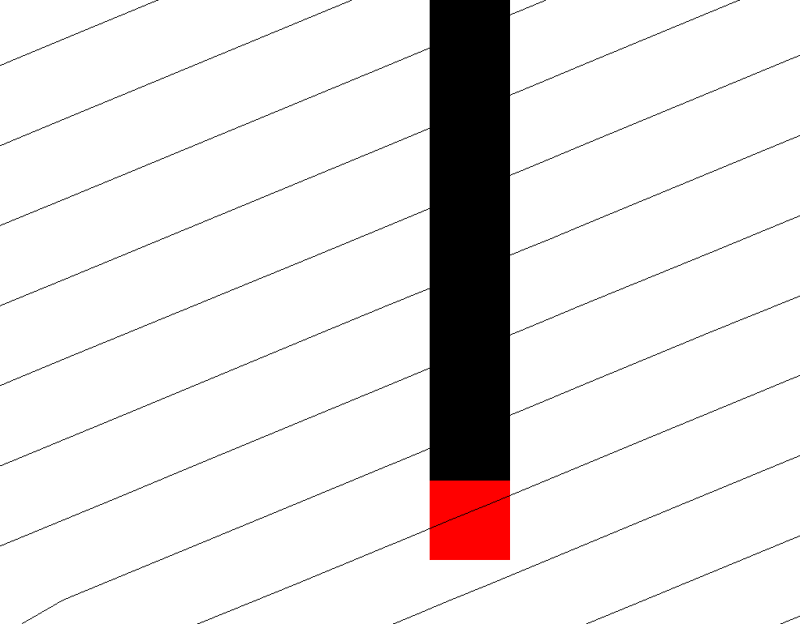
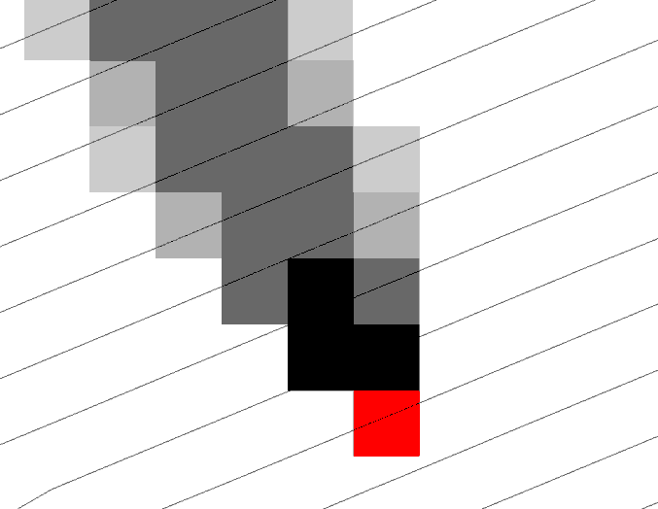
Calculation of HAND from a Digital Elevation Model (DEM)
Steepest single direction
48
52
D8
D∞
56
67
D8
D∞
Tarboton, D. G., (1997), "A New Method for the Determination of Flow Directions and Contributing Areas in Grid Digital Elevation Models," Water Resources Research, 33(2): 309-319.
Notes:
This slide shows how the terrain flow field is represented. Early DEM work used a single flow direction model, D8. In 1997 I published the Dinfinity method that proportions flow from each grid cell among downslope neighbors. This, at the expense of some dispersion, allows a better approximation of flow across surfaces.

Slide 12
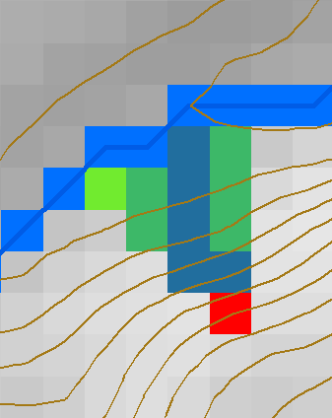
HAND evaluated using TauDEM Dinfinity Vertical Distance Down function
D∞
TauDEM Vertical Distance Down a special case of a general hydrological proximity measure
Ridge
sr
sr
pr
pr
vr
Point of interest
Stream
ps
ps
ss
vs
ss
D∞
hr
hs
hr
hs
Vertical distance to stream evaluated as weighted average over multiple flow paths. This results in a “smooth” height above nearest drainage layer
Tesfa, T. K., D. G. Tarboton, D. W. Watson, K. A. T. Schreuders, M. E. Baker and R. M. Wallace, (2011), "Extraction of hydrological proximity measures from DEMs using parallel processing," Environmental Modelling & Software, 26(12): 1696-1709, http://dx.doi.org/10.1016/j.envsoft.2011.07.018.

Slide 13

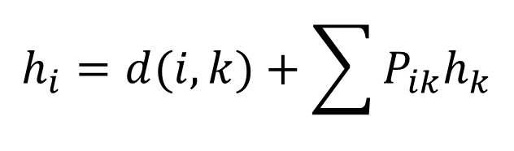
TauDEM model for vertical drop to stream (aka HAND)
$$h_{i}=0 for i on stream raster$$
$$h_{i}=d(i,k)+\sum{P_{ik}h_{k}}$$
i
P_{ik}
P_{ik}
$$d\left(i,k\right)=z_{i}−z_{k} for vertical drop$$

Slide 14
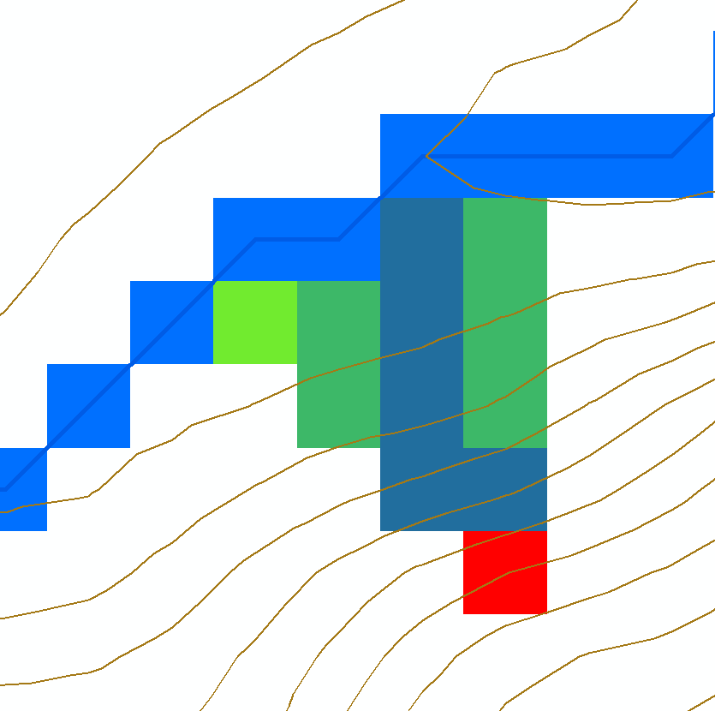
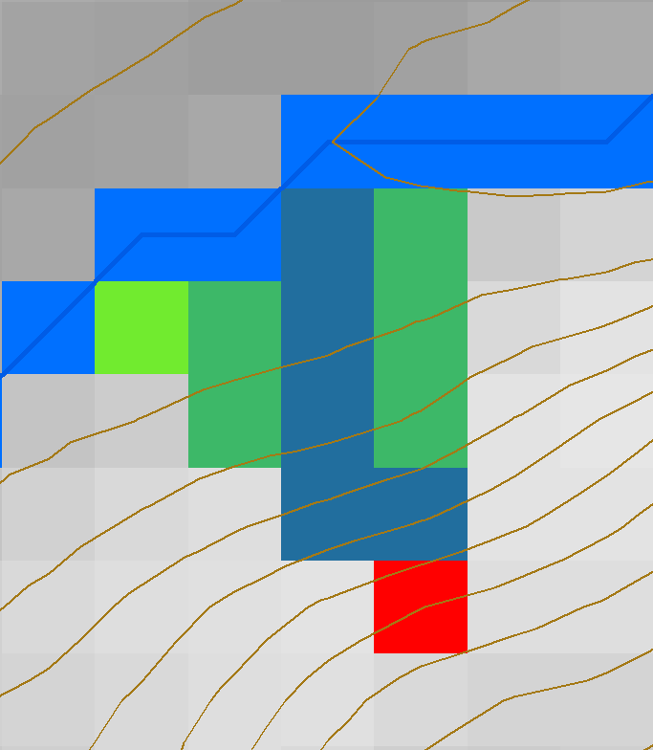





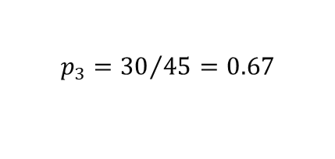
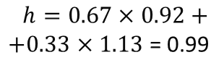

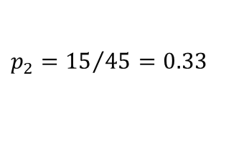
HAND Algorithm
Set h=0 along streams (target input set)
Mark remaining grid cells as “ready” if all down results are available and “not ready” if down results not yet computed
For a “ready” cell find its flow direction and elevation differences to down cells
Calculate h using weighted average
0
0
0
0
0
0
0.99
0
$$z=435.56$$
$$z=435.35$$
$$p_{3}={30}/{45}=0.67$$
$∆_{3}$=$\left(436.48−435.56\right)$=0.92
$p_{2}={15}/{45}=0.33$
$∆_{2}$=$\left(436.48−435.35\right)$=1.13
$$α=1.308 rad= 75°$$
$$z=436.48$$
$$h=0.67×0.92+$$
$+0.33×1.13$ = 0.99

Slide 15






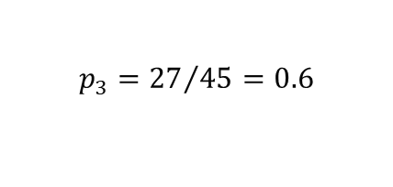

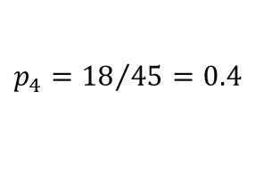

HAND Algorithm Continued
Evaluate up cells when they become “ready”
0
0
0
0
0
0
0.95
0.99
$$z=438.13$$
$$z=437.49$$
$$h=1.88$$
$$h=2.64$$
0
1.88
2.64
$p_{4}={18}/{45}=0.4$
$$p_{3}={27}/{45}=0.6$$
4.88
$$α=1.902 rad= 108°$$
$$z=440.23$$
$∆_{3}$=$\left(440.23−438.13\right)$=2.1
$∆_{4}$=$\left(440.23−437.49\right)$=2.74
$h=0.4×(2.74+1.88)+0.6×(2.1+2.64)$ = 4.88

Slide 16
Result
Elevation z (m)
HAND h (m)
436.01
435.56
0
0
436.44
436.47
436.48
0
0.92
0.99
437.15
437.49
438.13
0.71
1.88
2.64
438.65
439.20
440.22
2.20
3.31
4.68

Slide 17
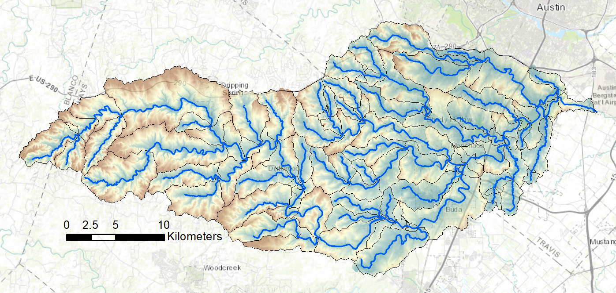
HAND from TauDEM for Onion Creek near Austin Texas
1/3 arc second NED DEM

Slide 18
Outline
Overview
Calculating height above the nearest drainage (HAND) from a Digital Elevation Model
Using HAND to map flood inundation for stream reach catchments
Using HAND to determine stream reach hydraulic properties
Further considerations

Slide 19
Mapping Flood Inundation with Height above the Nearest Drainage (HAND)
Each stream reach has a water depth h_{w} (from a hydraulic model)
Each stream reach has an ID
Each grid cell has the ID of the reach it connects to and the height above the nearest stream (drainage) h_{d}
Evaluate inundation using h_{w}-h_{d}
    If(h_{w}(id) > h_{d}(id))
      Inundation depth = h_{w}(id) - h_{d}(id)
    Else
      Inundation depth = 0

Slide 20
Mapping from height above nearest drainage to flood extent
Reach and Watershed id
Height above nearest drainage raster h_{HAND}
h_{w}(1) = 3.5
h_{w}(2) = 2.5
h_{w}(3) = 1.5
Notes:
Elevations are filled to that of the pools pour point

Slide 21
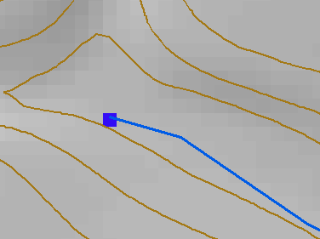
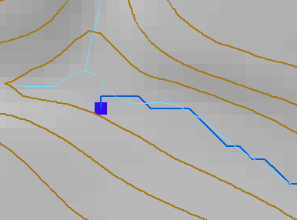
Deriving Terrain Aligned Flow Network
Grids from the NHD Plus channel head cell to the outlet cell are defined as Stream Cells
D8 Flow direction from each grid cell set in the steepest downslope direction to one of eight adjacent neighbors
Routing across flats away from high terrain and towards low terrain (Garbrecht and Martz, 1997)
Channel Head
NHD Plus channel head and flowline
NHD Plus Flowline
48
52
DEM derived stream
NHD HR Stream
56
67

Slide 22
DEM derived stream network is consistent with the DEM but at the scale (drainage density) of NHD Plus.

Slide 23
Height Above Nearest Drainage (HAND) evaluated from 1/3 arc sec NED DEM relative to stream raster derived from NHDPlus medium resolution stream network source grid cells. 2 m contour interval.

Slide 24
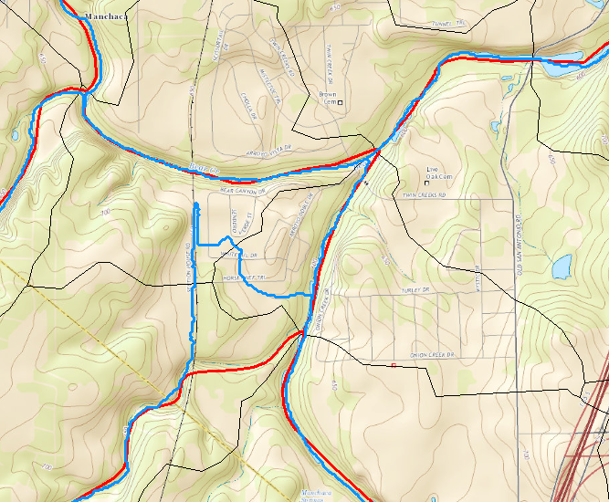
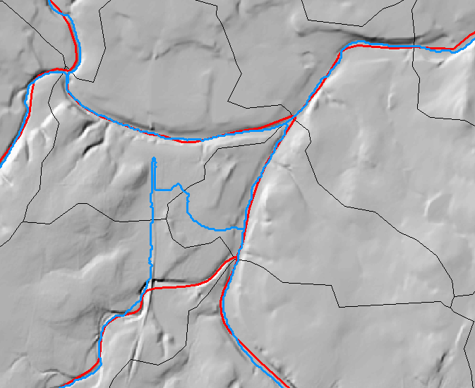

The problem of artificial DEM Barriers

Slide 25
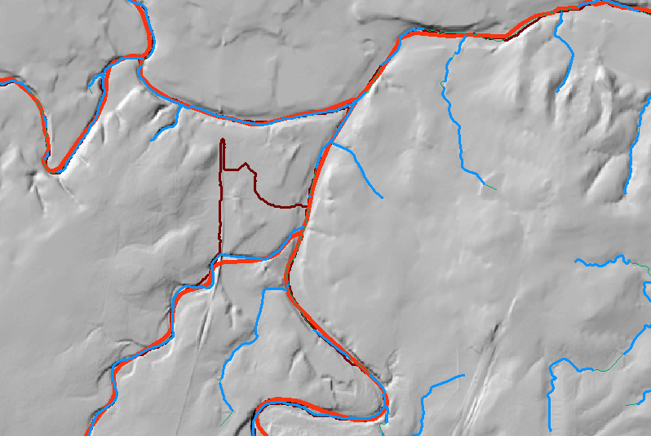
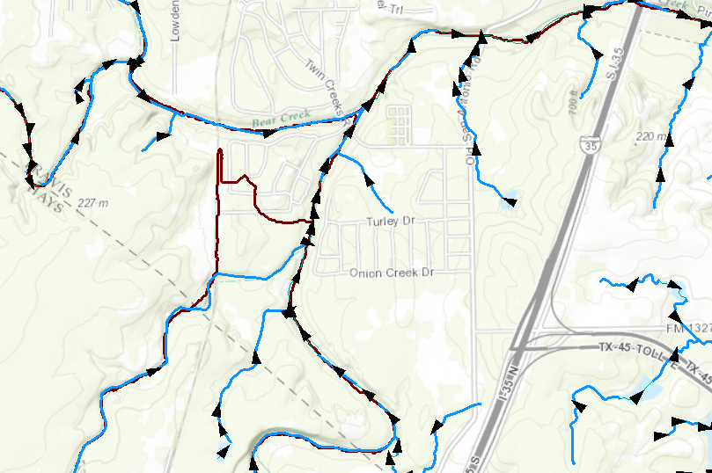
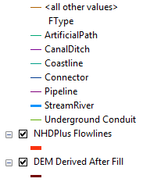
Etch (soft burn) in of NHDHR streams
NHDHR vectors are part of a network with direction.
Trace downslope enforcing DEM to not increase along the flow path
Railway Barrier that deflects filled DEM derived streams
From NHDHR

Slide 26
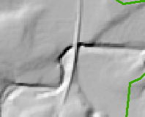
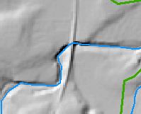
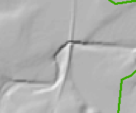
Conditioning the DEM by Obstacle Removal or “etching” using Vector Stream Information used to align and reconcile elevation and hydrography
Digital Elevation Model Conditioning
48 | 48 | 49 | 48 | 47
48 | 46 | 50 | 46 | 45
47 | 45 | 51 | 43 | 39
44 | 40 | 51 | 47 | 47
41 | 45 | 52 | 48 | 48
48 | 48 | 49 | 48 | 47
48 | 46 | 50 | 46 | 45
47 | 45 | 51 | 43 | 39
44 | 40 | 51 | 47 | 47
41 | 45 | 52 | 48 | 48
48 | 48 | 49 | 48 | 47
48 | 46 | 50 | 46 | 45
47 | 45 | 40 | 40 | 39
44 | 40 | 51 | 47 | 47
41 | 45 | 52 | 48 | 48
Obstacles, like this railroad that are present in DEM are removed tracing down NHD HR streams ensuring that elevation never increases along a stream.

Slide 27
Obstacle Removal “Etch in” Workflow
Rasterize NHDPlus HR flowline;
Lower the elevation of stream cells on DEM by 100m;
Remove pits on the burned DEM;
Derive D8 flow direction on the pit-removed DEM;
Keep D8 flow direction on stream cells only;
Call TauDEM:flowdircond to burn the original DEM
  Identify ‘top cells’ which are on NHDPlus HR streams, have D8 direction, and are not downstream cells. Put them in a queue;
  For each cell in the queue:
    If the elevation is higher than its neighbors, level the elevation with neighbors;
    If above step makes any of the neighboring cell a non-downstream cell, add the neighboring cell to the queue. This step propagates the burn-in until the upstream connects to the downstream.
Motivated development of new TauDEM function “flowdircond”

Slide 28
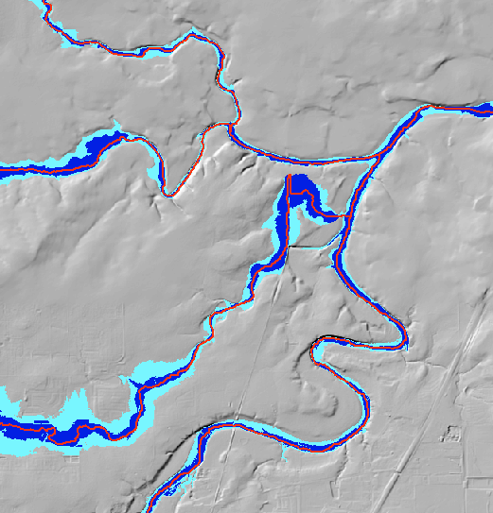
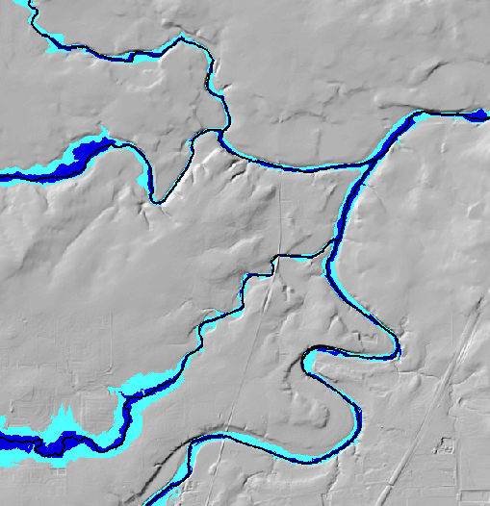
Effect of obstacle removal
Before
After
HAND inundation based on raw 10 m NED DEM
Hand inundation for 10 m NED DEM with obstacles removed using NHD HR

Slide 29
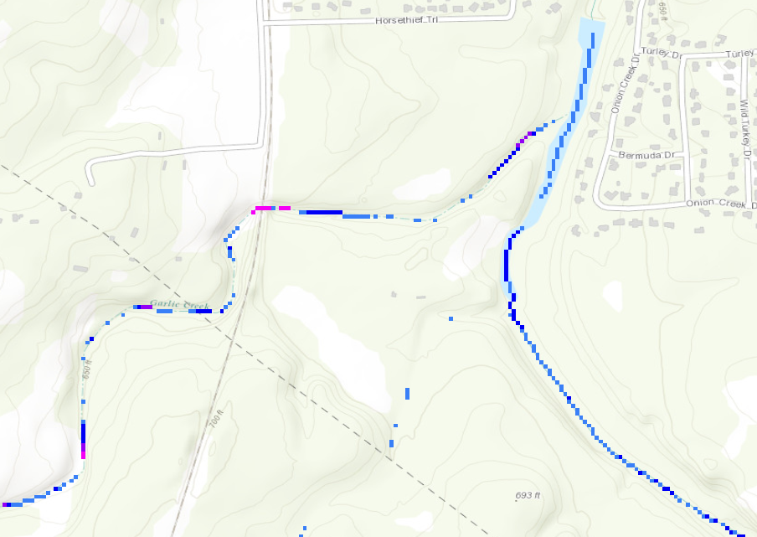
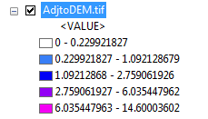
Adjustments at railroad crossing
Original DEM – Flow Direction Conditioned DEM

Slide 30
Outline
Overview
Calculating height above the nearest drainage (HAND) from a Digital Elevation Model
Using HAND to map flood inundation for stream reach catchments
Using HAND to determine stream reach hydraulic properties
Further considerations

Slide 31
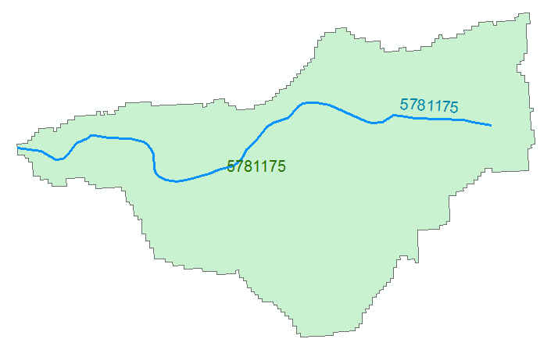

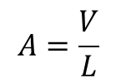



Evaluating River Hydraulic Properties
Comid | H | A | R | P | T | V | Ab | As
5781175 | 3
5781175 | 4
A table with reach hydraulic parameters keyed to hydrography
A_{s}
Surface Area
Wetted Bed Area
L
V
Volume
A_{b}
T
$$A=\frac{V}{L}$$
Cross Section Area
Depth
h
A
P
P$=\frac{Ab}{L}$
Wetted Perimeter
T$=\frac{As}{L}$
Top Width
R$=\frac{A}{P}$
Hydraulic Radius

Slide 32

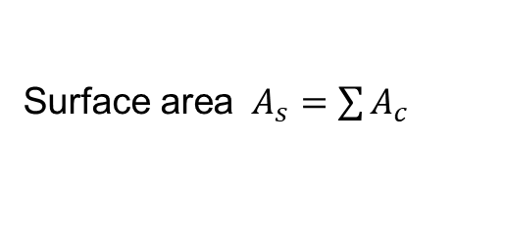

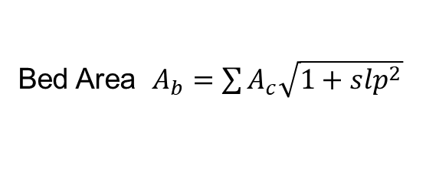
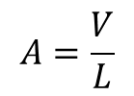
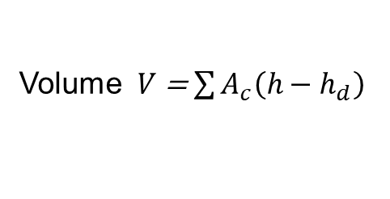


HAND based derivation of “reach scale” hydraulic properties
For each Catchment
For each height h
Identify cells where h_{d} < h
A_{s}
Surface Area
Single Cell Plan Area $A_{c}$ =dx * dy
Surface area $A_{s}=\sum{A_{c}}$
Bed Area $A_{b}=\sum{A_{c}\sqrt{1+slp^{2}}}$
Wetted Bed Area
L
A_{b}
Approximates each cell as sloping plane
V
Volume
Volume $V$ = $\sum{A_{c}\left(h−h_{d}\right)}$
T
$$A=\frac{V}{L}$$
Cross Section Area
A
P$=\frac{Ab}{L}$
Wetted Perimeter
P
T$=\frac{As}{L}$
Top Width
R$=\frac{A}{P}$
Hydraulic Radius
Note: DEM topography used for HAND should represent river bed elevations
Based on slide from David Maidment

Slide 33




Reach Hydraulic Properties Example
1 m inundation
3 m inundation
Height (m) | A_{s} (m²) | Vol (m³) | A_{b} | L (m) | A=V/L (m²) | P=A_{b}/L (m) | T=A_{s}/L (m) | R=A/P (m)
1 | 129878 | 79466 | 129948 | 2975 | 26.7 | 43.7 | 43.7 | 0.612
3 | 319877 | 530378 | 320414 | 2975 | 178.3 | 107.7 | 107.5 | 1.655

Slide 34
Terrain Approximated Reach Average Hydraulic Properties
Hydraulic Radius
Wetted Perimeter
Cross-sectional Area
Top Width
Used for input to reach scale hydraulic model

Slide 35

Example - Reach Catchment 5781289
Eanes Creek, Rollingwood, Texas
Drainage area = 3.13 mi²
Reach Length = 4.3 miles
Slide from David Maidment

Slide 36




Example Discharge Computation for Reach Catchment 5781289 Eanes Creek, Rollingwood, Texas
Cross section Area, A
Hydraulic Radius, R
Flood Discharge, Q (cfs)
$$Q=\frac{1.49}{n}AR^{2/3}S_{o}^{1/2}$$
n = 0.035 Manning roughness of channel
S_{o} = 0.0163 Bed slope
Assumes uniform flow
Slide from David Maidment

Slide 37

Rating Curve for Eanes Creek
Flood Depth, y (ft)
$$Q=\frac{1.49}{n}AR^{2/3}S_{o}^{1/2}$$
Forecast Discharge, Q, from National Water Model
Slide from David Maidment

Slide 38
Outline
Overview
Calculating height above the nearest drainage (HAND) from a Digital Elevation Model
Using HAND to map flood inundation for stream reach catchments
Using HAND to determine stream reach hydraulic properties
Further considerations

Slide 39




Automated workflow prototyped for Texas Flood Response System by David Maidment and Colleagues
National Water Model discharge forecasts
Conversion of discharge to depth using rating curves
Summary of Impacts for Disaster Districts
Inundation mapping and local impact assessment
ESRI
Slide from David Maidment

Slide 40


HAND Workflow implemented on ROGER supercomputer at NCSA for Continental US-Scale HAND layer evaluated
USGS 3DEP 10m DEM
NHD HR Flowline
1:24000
NHDPlus Flowline
1:100000
Obstacle Removal
Pit Removal
Channel Head Extraction
D∞ Flow Direction
D8 Flow Direction
Rasterization
D8 Flow Accumulation
Channel Head Weight Grid
Stream Definition by Threshold
D∞ Flow Direction
Raster
D∞ Distance Down
(Vertical Average)
Stream Raster
HAND Raster
Catchment Features
Flood Inundation Mapping
Results at https://web.corral.tacc.utexas.edu/nfiedata/

Slide 41




Decompose computation by catchments or River Corridor
Parallel computation
High resolution in some areas
Incremental refinement of DEM
Incremental improvement
Can exploit high resolution (e.g. LIDAR) data in areas where accuracy is critical

Slide 42






Increased Use of Lidar
30m USGS DEM
D-8 Flowline
River Direction
10m USGS DEM
NHDMR Flowline
0.5m Lidar DEM
Target Flowline
Slide from Xing Zheng

Slide 43
Integration of topography and bathymetry
A_{s}
Surface Area
Wetted Bed Area
L
A_{b}
V
Volume
Reach scale hydraulic property calculations assume the DEM represents channel bed elevations
Image from Xing Zheng

Slide 44




Improve NWM Routing using Reach Hydraulic Properties
Weather model and forecasts (HRRR)
Probabilistic flood forecasts
Catchment-level forecasts
Weather
Precipitation
Streamflow
Routing here may be improved using HAND derived channel hydraulic properties
Runoff
Land-Atmosphere Model (NOAH-MP)
RAPID flow routing (for continental US)
Based on slide from David Maidment

Slide 45

Improve Stream Reach Segmentation
The segmentation of the NHD Plus network was not designed with HAND hydraulic property calculation and routing in mind. A more uniform segmentation may be better
Illustration from Xing Zheng

Slide 46
Conclusions and Further Considerations
HAND is a special case of TauDEM distance down DEM proximity measure
The HAND approach suggested as way to rapidly approximate real time flood inundation
Serves to support flood inundation mapping where the data to support hydraulic calculations is limited
Neglects details of the river hydraulics and flow over flood plains, but more detailed approaches demand hard to obtain and uncertain inputs so this may be a helpful approach to get screening level and real time flood maps
Includes an approach to approximate reach scale hydraulic properties
Consider best reach length
Premised on good elevation model and consistent stream raster
  DEM topography should represent river bed elevations to maximal extent possible
  Research ways to align and reconcile elevation and hydrography (present obstacle removal approach not ideal)
Has been calculated across continental US using 10 m resolution DEM and NHDPlus streams for use in US National Water Model flood inundation mapping
Can exploit high resolution (e.g. LIDAR) data in areas where accuracy is critical

Slide 47
Reading
Prior Work
Rodda, H. J. E., (2005), "The Development and Application of a Flood Risk Model for the Czech Republic," Natural Hazards, 36(1): 207-220, http://dx.doi.org/10.1007/s11069-004-4549-4.
Rennó, C. D., A. D. Nobre, L. A. Cuartas, J. V. Soares, M. G. Hodnett, J. Tomasella and M. J. Waterloo, (2008), "HAND, a new terrain descriptor using SRTM-DEM: Mapping terra-firme rainforest environments in Amazonia," Remote Sensing of Environment, 112(9): 3469-3481, http://doi.org/10.1016/j.rse.2008.03.018.
Nobre, A. D., L. A. Cuartas, M. Hodnett, C. D. Rennó, G. Rodrigues, A. Silveira, M. Waterloo and S. Saleska, (2011), "Height Above the Nearest Drainage – a hydrologically relevant new terrain model," Journal of Hydrology, 404(1–2): 13-29, http://dx.doi.org/10.1016/j.jhydrol.2011.03.051.
Tesfa, T. K., D. G. Tarboton, D. W. Watson, K. A. T. Schreuders, M. E. Baker and R. M. Wallace, (2011), "Extraction of hydrological proximity measures from DEMs using parallel processing," Environmental Modelling & Software, 26(12): 1696-1709, http://dx.doi.org/10.1016/j.envsoft.2011.07.018.
Nobre, A. D., L. A. Cuartas, M. R. Momo, D. L. Severo, A. Pinheiro and C. A. Nobre, (2016), "HAND contour: a new proxy predictor of inundation extent," Hydrological Processes, 30(2): 320-333, http://dx.doi.org/10.1002/hyp.10581.

Slide 48
Reading
Papers just out
Zheng, X., D. G. Tarboton, D. R. Maidment, Y. Y. Liu and P. Passalacqua, (2018), "River Channel Geometry and Rating Curve Estimation Using Height above the Nearest Drainage," JAWRA Journal of the American Water Resources Association, 54(4): 785-806, http://doi.org/10.1111/1752-1688.12661.
Liu, Y. Y., D. R. Maidment, D. G. Tarboton, X. Zheng and S. Wang, (2018), "A CyberGIS Integration and Computation Framework for High-Resolution Continental-Scale Flood Inundation Mapping," JAWRA Journal of the American Water Resources Association, 54(4): 770-784, https://doi.org/10.1111/1752-1688.12660.

Slide 49
Are there any questions?
HAND 10m for CONUS

