Slide 1
TOPMODEL and the role of topography and variable contributing areas in runoff production
Learning objectives
Be able to define and compute the topographic wetness index and describe its role and use in TOPMODEL runoff calculations
Be able to use TOPMODEL principles to calculate the spatial distribution of soil moisture deficit and use this information in the calculation of runoff using appropriate GIS tools

Slide 2
TOPMODEL
Beven, K., R. Lamb, P. Quinn, R. Romanowicz and J. Freer, (1995), "TOPMODEL," Chapter 18 in Computer Models of Watershed Hydrology, Edited by V. P. Singh, Water Resources Publications, Highlands Ranch, Colorado, p.627-668.
“TOPMODEL is not a hydrological modeling package. It is rather a set of conceptual tools that can be used to reproduce the hydrological behaviour of catchments in a distributed or semi-distributed way, in particular the dynamics of surface or subsurface contributing areas.”

Slide 3
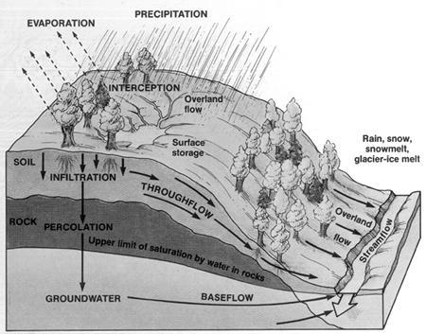
Hydrological processes within a catchment are complex, involving:
Macropores
Heterogeneity
Fingering flow
Local pockets of saturation
However:
The general tendency of water to flow downhill is however subject to macroscale conceptualization
Hydraulic conductivity tends to decrease with depth

Slide 4
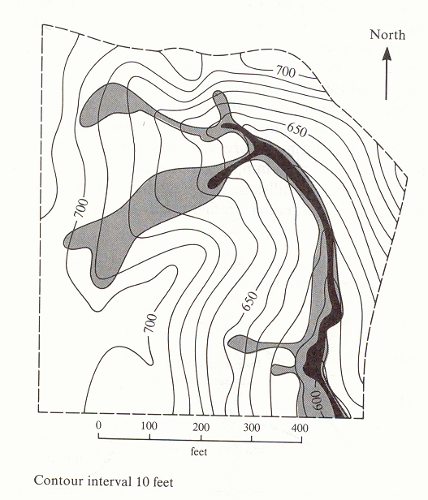
TOPMODEL Key Ideas
Surface saturation and soil moisture deficits based on topography
  Slope
  Specific Catchment Area
  Topographic Convergence
Partial contributing area concept
Saturation from below (Dunne) runoff generation mechanism
Map of saturated areas showing expansion during a single rainstorm. The solid black shows the saturated area at the beginning of the rain; the lightly shaded area is saturated by the end of the storm and is the area over which the water table had risen to the ground surface. [from Dunne and Leopold, 1978]

Slide 5
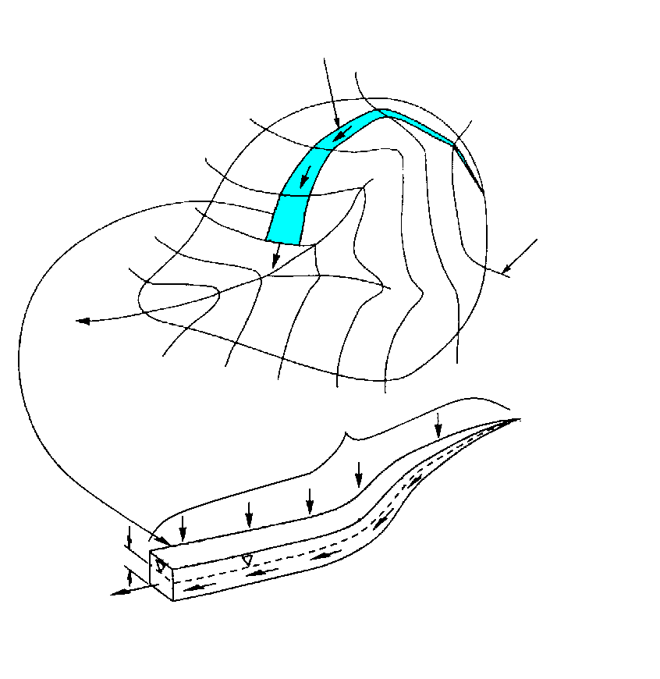
Specific catchment area a is the upslope area per unit contour length [m²/m ⇒ m]
Topographic Definition
Stream line
Contour line
Upslope contributing area a

Slide 6
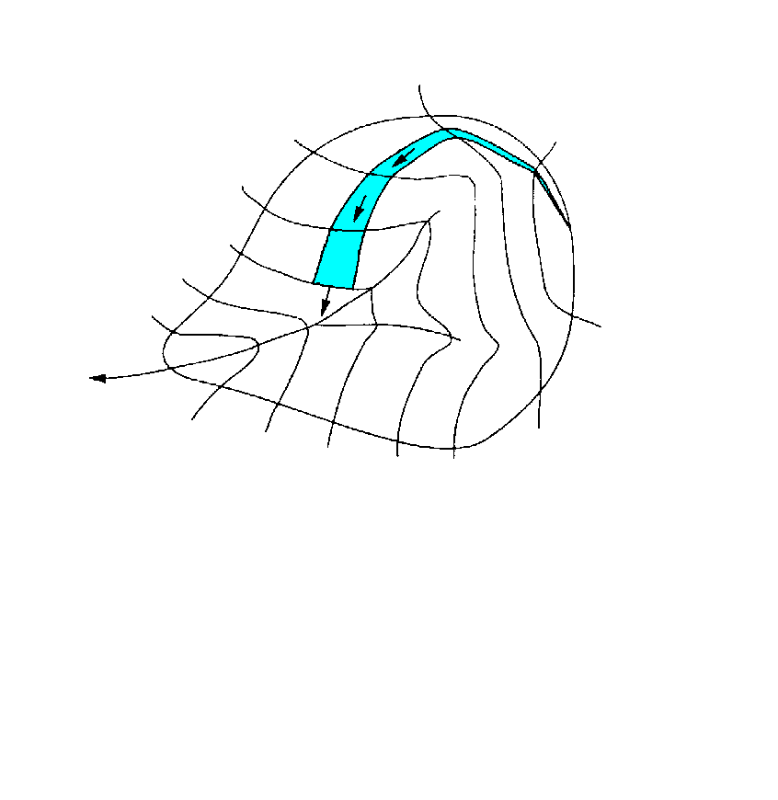

Topmodel - Assumptions
The soil profile at each point has a finite capacity to transport water laterally downslope.
Hydraulic conductivity decreases exponentially (as a rough macroscale approximation)
Hydraulic gradient approximated by topographic slope
K
z_{w}
S
z
Units
z m T m²/hr f m⁻¹
K m/hr S dimensionless q m²/hr = m³/hr/m

Slide 7
Topmodel - Assumptions
Specific catchment area a [m²/m ⇒ m]
(per unit contour length)
Drainage of saturated zone supports baseflow
Dynamics of saturated zone approximated by successive steady state representations
Recharge rate spatially homogeneous
The actual lateral discharge is proportional to specific catchment area.
R
z_{w}
R is proportionality constant that may be interpreted as “steady state” recharge rate, or “steady state” per unit area contribution to baseflow.
a
S
q

Slide 8

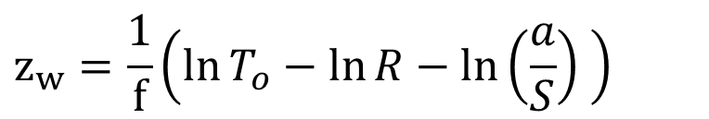

Topmodel – Local depth to water table
Specific catchment area a [m²/m ⇒ m]
(per unit coutour length)
Soil moisture deficit at a point and depth to water table is determined by equating topographic and profile q and solving for z_{w}
$$q=Ra=T\left(z_{w}\right)S=T_{o}{Se}^{−f z_{w}}$$
$$z_{w}=\frac{1}{f}\left(\ln{T_{o}}−\ln{R}−\ln\left(\frac{a}{S}\right) \right)$$
z_{w}
Saturation when z_{w}<0.
i.e.
S
q
$$\ln\left(a/S\right)>ln\left(T_{o}/R\right)$$

Slide 9
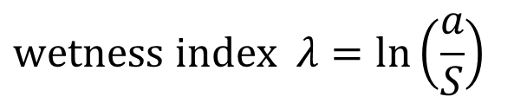
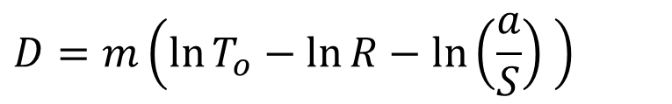
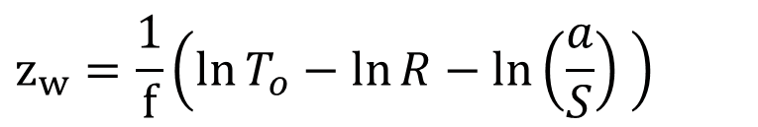
Topmodel – Local soil moisture deficit
Specific catchment area a [m²/m ⇒ m]
(per unit coutour length)
D=θ_{e}z_{w} m= θ_{e}/f
$$z_{w}=\frac{1}{f}\left(\ln{T_{o}}−\ln{R}−\ln\left(\frac{a}{S}\right) \right)$$
$$D=m\left(\ln{T_{o}}−\ln{R}−\ln\left(\frac{a}{S}\right) \right)$$
Define
$$wetness index λ=ln\left(\frac{a}{S}\right)$$
D= θ_{e}z_{w}
z_{w}
Points with equivalent topographic wetness index respond similarly in terms of runoff generation
S
q

Slide 10
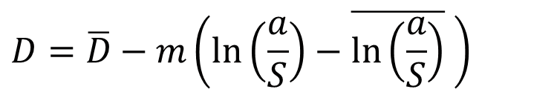
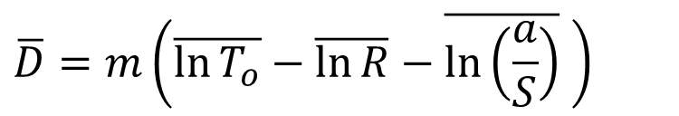
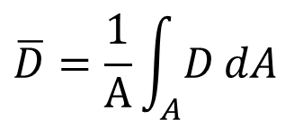
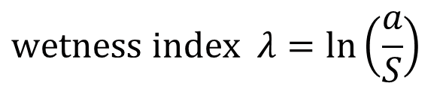
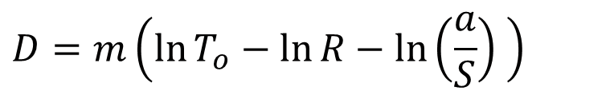

Topmodel – Spatial Averages
Specific catchment area a [m²/m ⇒ m]
(per unit coutour length)
$$D=m\left(\ln{T_{o}}−\ln{R}−\ln\left(\frac{a}{S}\right) \right)$$
$$\overline{D}=\frac{1}{A}\int_{A}^{ }{D}dA$$
$$\overline{D}=m\left(\overline{\ln{T_{o}}}−\overline{\ln{R}}−\overline{\ln\left(\frac{a}{S}\right)} \right)$$
$$D=\overline{D}−m\left(\ln\left(\frac{a}{S}\right)−\overline{\ln\left(\frac{a}{S}\right)} \right)$$
$$D=\overline{D}−m\left(λ−\overline{λ} \right)$$
D= θ_{e}z_{w}
z_{w}
$$wetness index λ=ln\left(\frac{a}{S}\right)$$
S
q

Slide 11


Topmodel - Summary
Specific catchment area a [m²/m ⇒ m]
(per unit coutour length)
Local soil moisture deficit a function of average soil moisture deficit and topographic wetness index
Average soil moisture deficit a function of streamflow (baseflow) and watershed drainage parameters
Enables spatial modeling of runoff generation from topography and aggregate watershed properties
$$D=\overline{D}−m\left(\ln\left(\frac{a}{S}\right)−\overline{λ}\right)$$
$$\overline{D}=m\left(\overline{\ln{T_{o}}}−\overline{\ln{R}}−\overline{λ} \right)$$
D= θ_{e}z_{w}
z_{w}
S
q

Slide 12

Topmodel – Wetness Index Histogram
Specific catchment area a [m²/m ⇒ m]
(per unit coutour length)
Topographic variability for runoff generation summarized by distribution of wetness index expressed as a histogram
Increasing D
saturated
Recharge
Drainage
D= θ_{e}z_{w}
z_{w}
S
q
$$\ln\left(a/S\right)$$

Slide 13
TOPMODEL and GIS
Surface saturation and soil moisture deficits based on topography
  Slope
  Specific Catchment Area
  Topographic Convergence

Slide 14
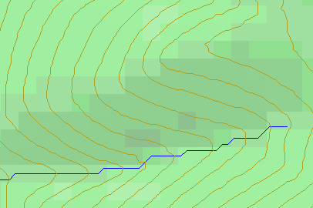
Topographic Slope
?
Topographic Definition Drop/Distance
Limitation imposed by 8 grid directions.

Slide 15
Specific catchment area a is the upslope area per unit contour length [m²/m ⇒ m]
Numerical Evaluation with the D∞ Algorithm
Stream line
Contour line
Upslope contributing area a
Tarboton, D. G., (1997), "A New Method for the Determination of Flow Directions and Contributing Areas in Grid Digital Elevation Models," Water Resources Research, 33(2): 309-319.) (http://www.engineering.usu.edu/cee/faculty/dtarb/dinf.pdf)

Slide 16
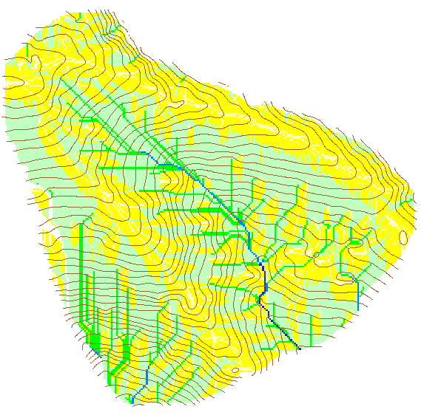

Contributing Area using D∞
Contributing Area using D8

Slide 17
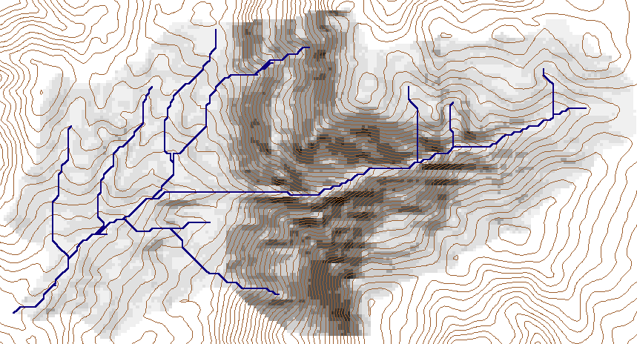
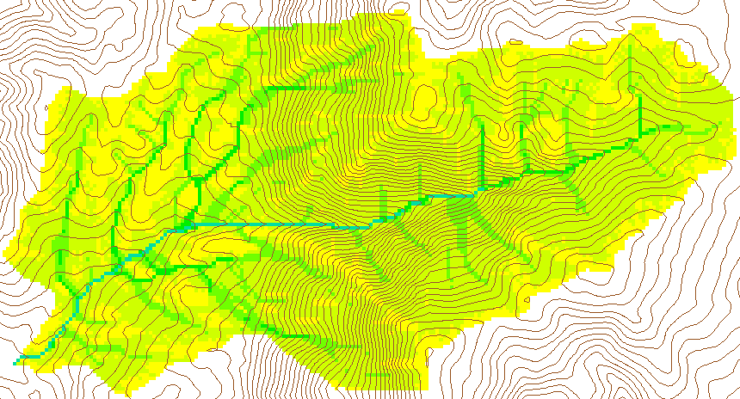
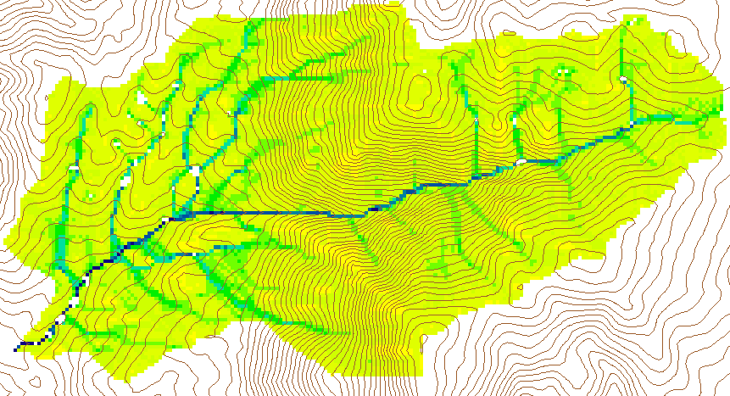
Slope
Specific Catchment Area
Wetness Index ln(a/S)
from Map Calculator.
Average, λ = 6.9

Slide 18
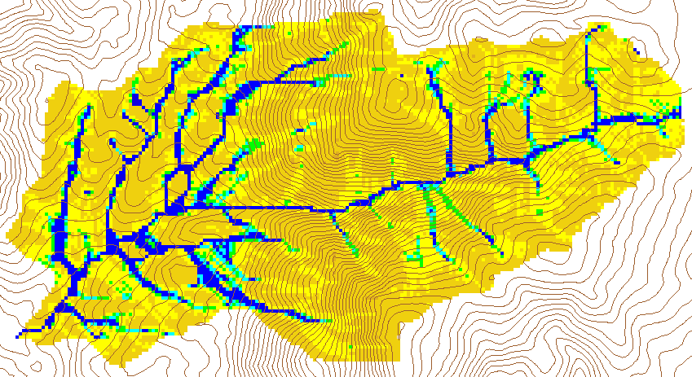
Numerical Example
Given
K_{o}=10 m/hr
f=5 m⁻¹
Q_{b} = 0.8 m³/s
A (from GIS)
n_{e} = 0.2
Compute
R=0.0002 m/h
λ=6.9
T=2 m²/hr
Raster calculator -( [ln(sca/S)] - 6.9)/5+0.46

Slide 19
Calculating Runoff from 25 mm Rainstorm
Flat area’s and z <= 0
  Area fraction (81 + 1246)/15893=8.3%
  All rainfall ( 25 mm) is runoff
0 < z ≤ rainfall/effective porosity = 0.025/0.2 = 0.125 m
  Area fraction 546/15893 = 3.4%
  Runoff is P-z*0.2
  (1 / [Sat_during_rain ]) * (0.025 - (0.2 * [z]))
  Mean runoff 0.0113 m =11.3 mm
z > 0.125 m
  Area fraction 14020/15893 = 88.2 %
  All rainfall infiltrates
Area Average runoff
  11.3 * 0.025 + 25 * 0.083 = 2.47 mm
  Volume = 0.00247 * 15893 * 30 * 30 = 35410 m³

