Slide 1
Terrain Analysis Using Digital Elevation Models (TauDEM)
Learning Objectives
To be able to delineate watersheds as the basic hydrologic model elements from Digital Elevation Models using Geographic Information Systems tools and to use this information in Hydrologic Analyses
  TauDEM
  Raster Calculation

Slide 2
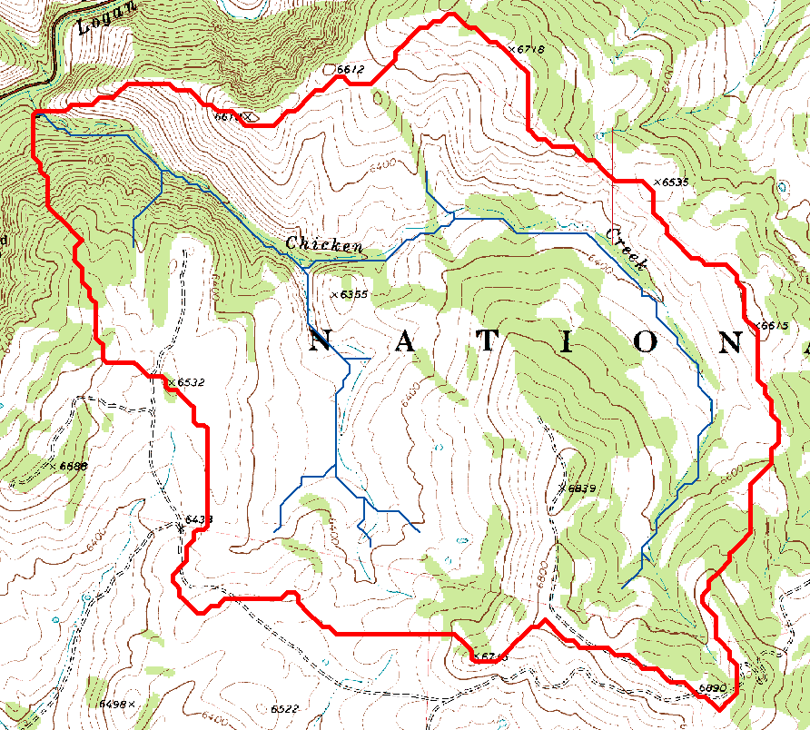
Topography defines watersheds which are fundamentally the most basic hydrologic landscape elements.

Slide 3
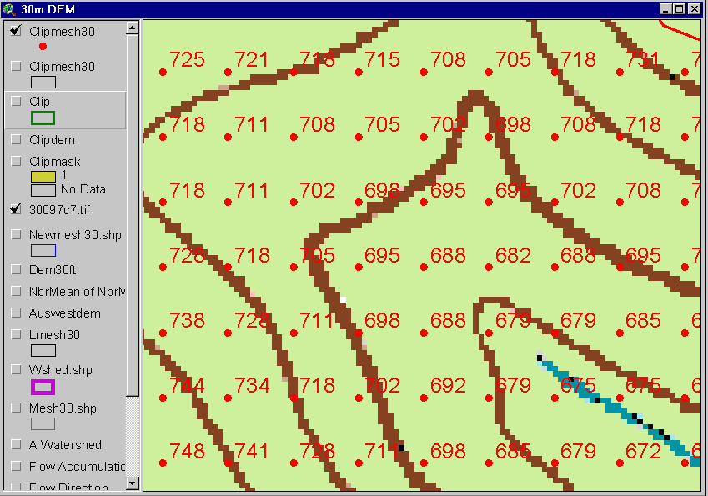
The starting point: a grid digital elevation model (DEM)
720
720
Contours
740
720
700
680
740
720
700
680

Slide 4




Deriving hydrologically useful information from Digital Elevation Models
Raw DEM
Pit Removal (Filling)
Flow Field
Flow Related Terrain Information
Notes:
This slide shows the general model for deriving flow field related derivative surfaces from digital elevation data. The input is a raw digital elevation model, generally elevation values on a grid. This is basic information used to derive further hydrology related spatial fields that enrich the information content of this basic data. The first step is to remove sinks, either by filling, or carving. Then a flow field is defined. This enables the calculation of flow related terrain information. My focus has been on flow related information working within this framework. I try to leave other GIS functionality, like radiation exposure, line of sight analyses and visualization to others. I have distributed my software in ways that it easily plugs in to mainstream systems, such as ArcGIS to enhance ease of use.

Slide 5
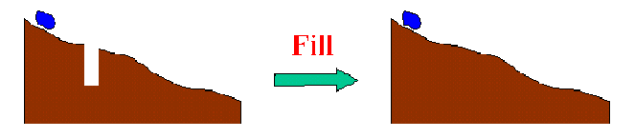
The Pit Removal Problem
DEM creation results in artificial pits in the landscape
A pit is a set of one or more cells which has no downstream cells around it
Unless these pits are removed they become sinks and isolate portions of the watershed
Pit removal is first thing done with a DEM

Slide 6


Pit Filling
Increase elevation to the pour point elevation until the pit drains to a neighbor

Slide 7
Pit Filling
Original DEM
Pits Filled
Pits
Pour Points
Notes:
Elevations are filled to that of the pools pour point

Slide 8
D8 Flow Direction Model
- Direction of steepest descent
30
80
74
63
4
3
2
69
67
56
5
1
60
52
48
6
7
8
Slope = Drop/Distance
Steepest down slope direction

Slide 9
Grid Network

Slide 10
Contributing Area (Flow Accumulation)
1
1
1
1
1
1
1
1
1
1
1
3
3
3
1
1
3
3
3
1
1
1
11
1
2
1
1
1
2
11
2
1
1
15
1
2
1
1
1
15
1
5
2
20
2
1
5
2
2
20
The area draining each grid cell includes the grid cell itself.

Slide 11
Stream Definition
Flow Accumulation
> 10 Cell Threshold
Stream Network for 10 cell Threshold Drainage Area
1
1
1
1
1
1
1
1
1
1
1
3
3
3
1
1
3
3
3
1
1
1
11
1
2
1
1
2
1
11
2
1
1
15
1
2
1
1
1
15
1
5
2
20
2
1
5
2
2
20

Slide 12
Watershed Draining to Outlet

Slide 13
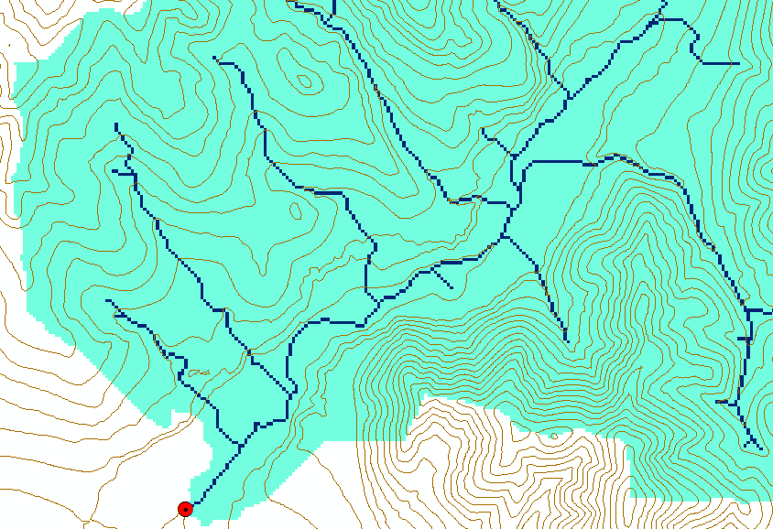
Watershed and Stream Grids

Slide 14
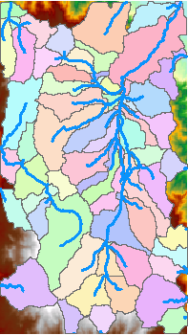
DEM Delineated Catchments and Stream Networks
For every stream segment, there is a corresponding catchment
Catchments are a tessellation of the landscape
Based on the D8 flow direction model

Slide 15
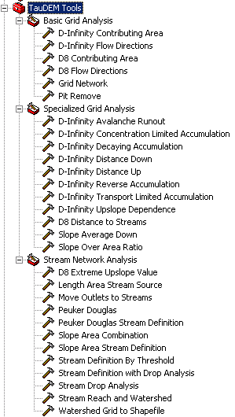

TauDEM Channel Network and Watershed Delineation Software
Stream and watershed delineation
Multiple flow direction flow field
Calculation of flow based derivative surfaces
Deployed as an ArcGIS Toolbox with tools that drive accompanying command line executables, available from http://hydrology.usu.edu/taudem/

Slide 16
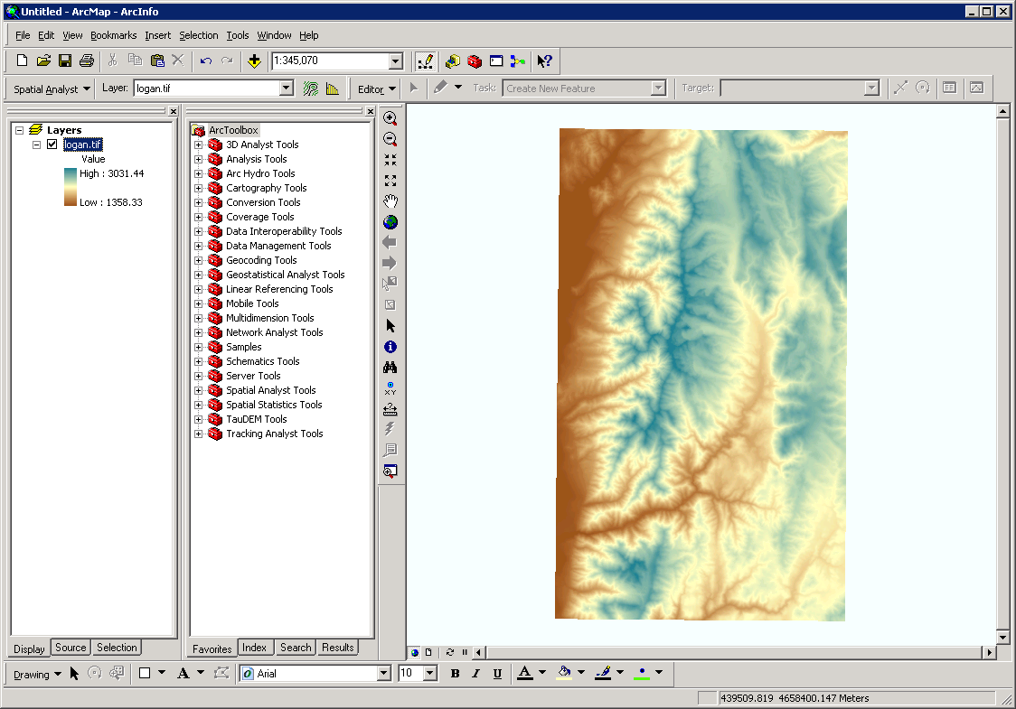
ArcMap

Slide 17
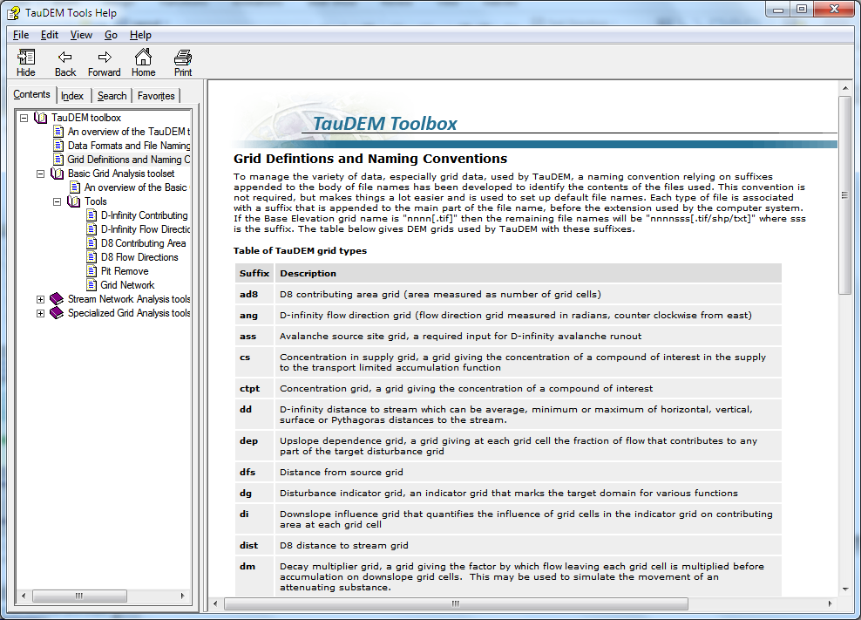
Default file name suffixes
For complete list see: http://hydrology.usu.edu/taudem/taudem5.0/TauDEM_Tools.chm

Slide 18
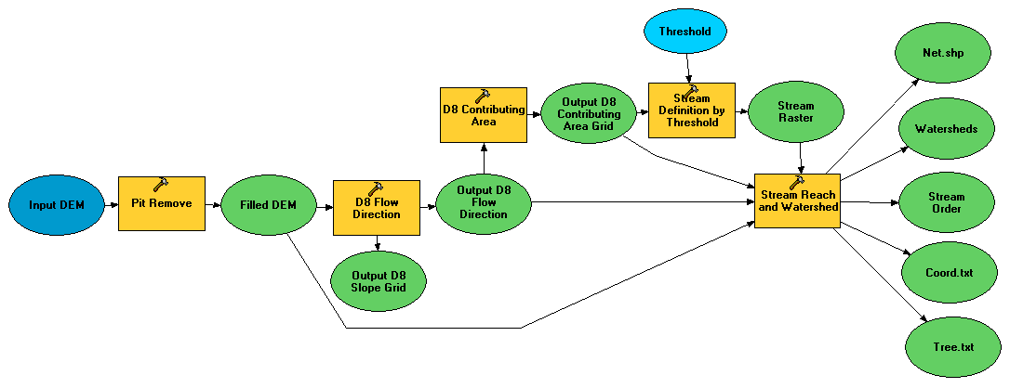
Illustrative Use Case: Delineation of channels and watersheds using a constant support area threshold
Steps
Pit Remove
D8 Flow Directions
D8 Contributing Area
Stream Definition by Threshold
Stream Reach and Watershed

Slide 19
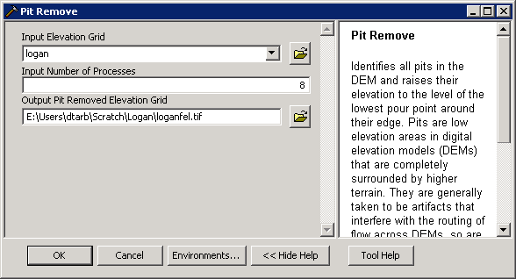
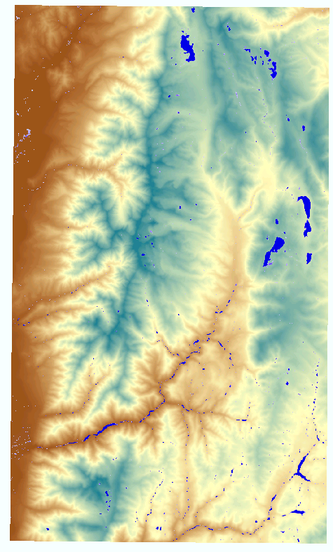
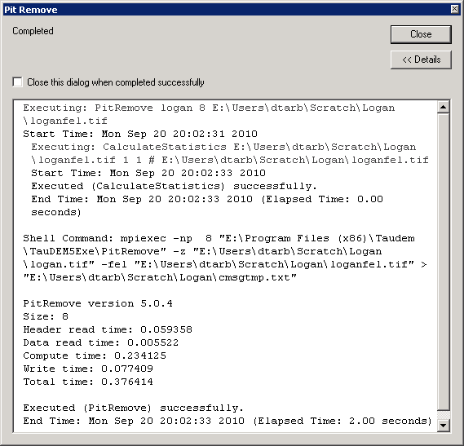
Pit Remove

Slide 20
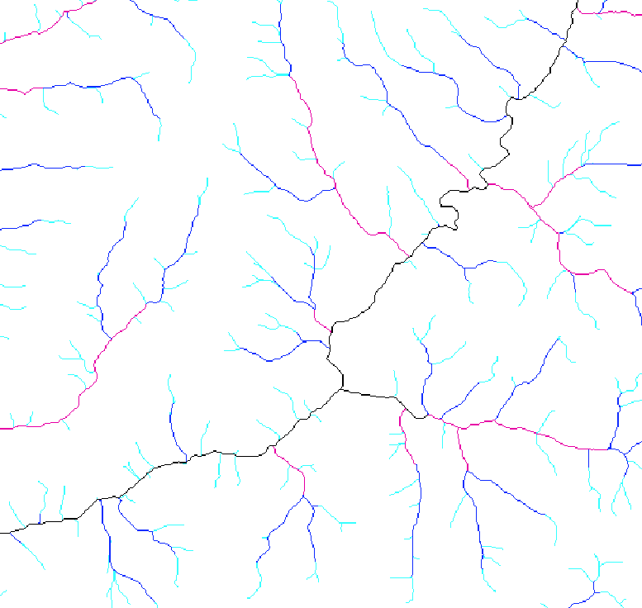
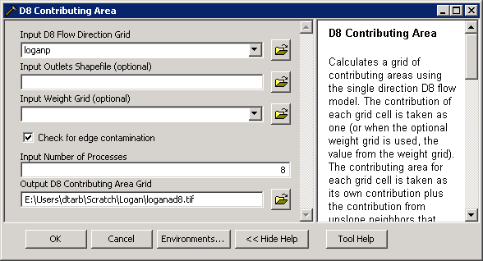
D8 Contributing Area

Slide 21

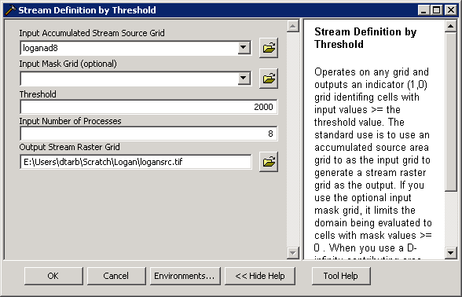
Stream Definition by Threshold

Slide 22
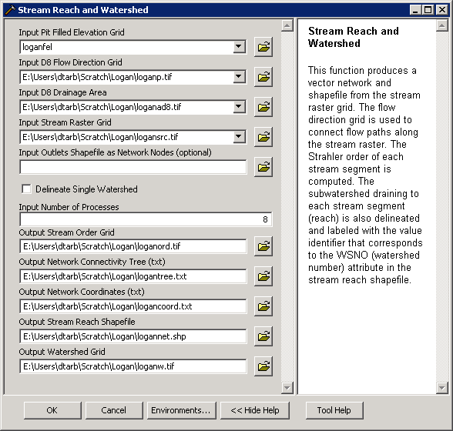
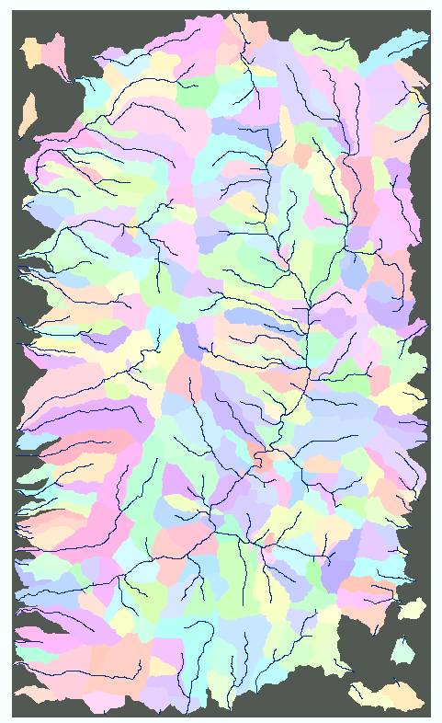
Stream Reach and Watershed

Slide 23
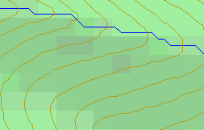
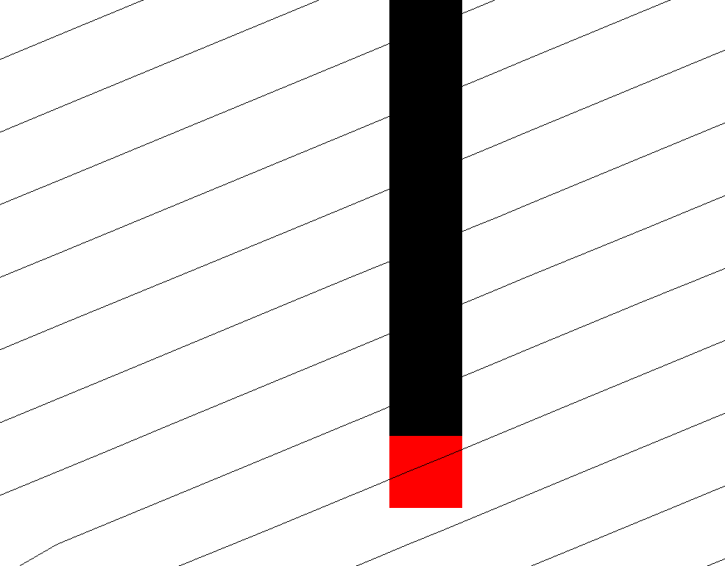
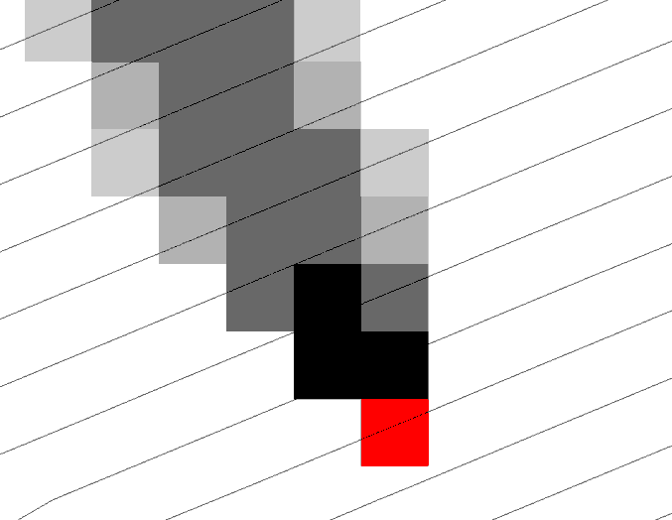
D-Infinity multiple flow direction model for representation of flow field in a DEM
Steepest single direction
48
52
56
67
D8
D∞
Tarboton, D. G., (1997), "A New Method for the Determination of Flow Directions and Contributing Areas in Grid Digital Elevation Models," Water Resources Research, 33(2): 309-319.)
Notes:
This slide shows how the terrain flow field is represented. Early DEM work used a single flow direction model, D8. In 1997 I published the Dinfinity method that proportions flow from each grid cell among downslope neighbors. This, at the expense of some dispersion, allows a better approximation of flow across surfaces.

Slide 24
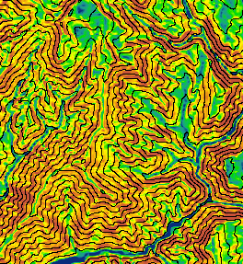
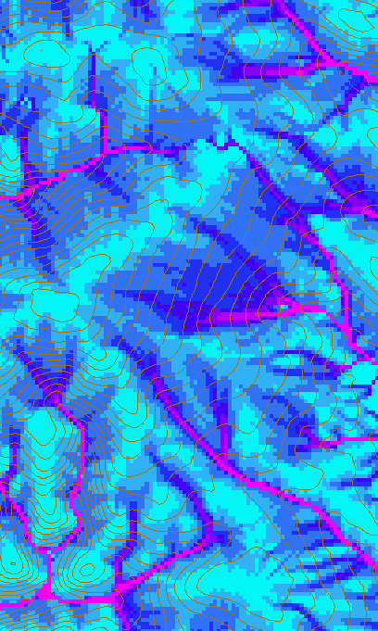
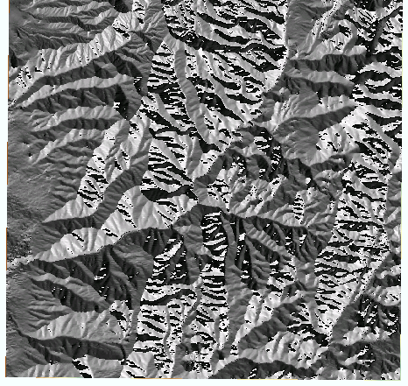

D-Infinity Slope, Flow Direction and Contributing Area

Slide 25
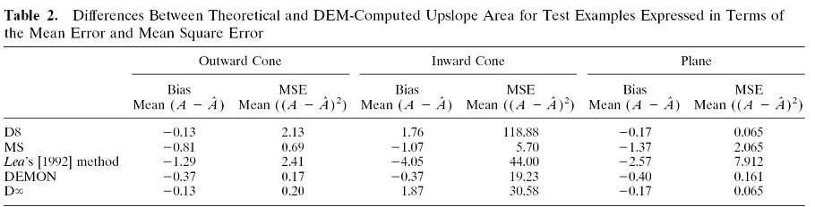
Contributing Area
D∞
D8
<1 ha
1-4 ha
4-8 ha
>8 ha

Slide 26
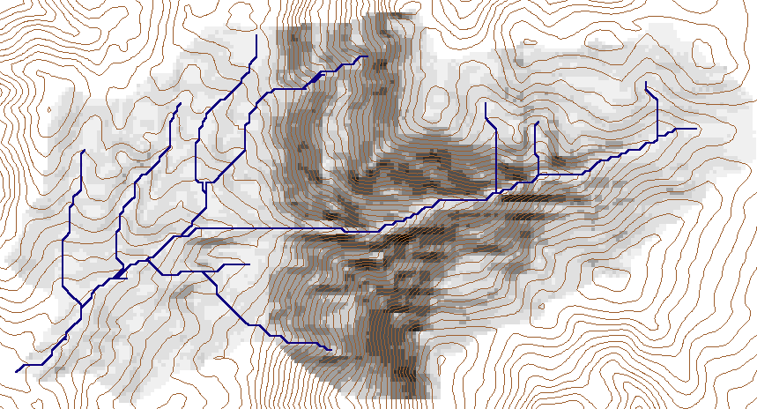
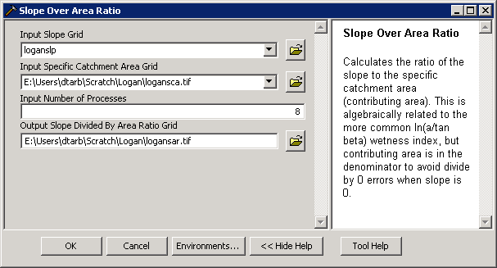
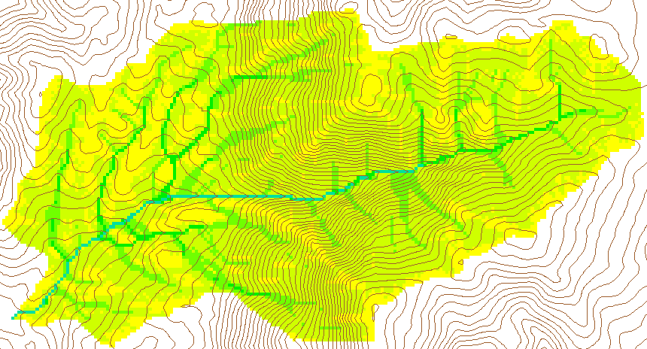
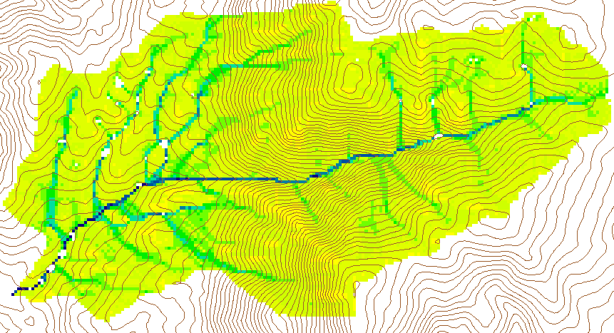
Wetness Index
Slope (S)
Specific Catchment Area (a)
Wetness Index ln(a/S)

Slide 27
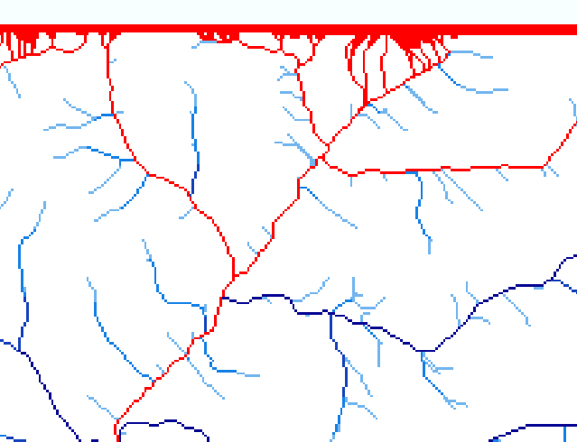
Edge contamination
Edge contamination arises due to the possibility that a contributing area value may be underestimated due to grid cells outside of the domain not being counted. This occurs when drainage is inwards from the boundaries or areas with no data values. The algorithm recognizes this and reports "no data" resulting in streaks of "no data" values extending inwards from boundaries along flow paths that enter the domain at a boundary.

Slide 28
Summary Concepts
The GIS grid based terrain flow data model enables the representation of flow processes at and near the earth surface and derivation of a wide variety of information useful for the study of hydrologic processes.
  Slope
  Flow direction
  Drainage area
  Catchments, watersheds and channel networks
  Multiple other flow related quantities
Edge contamination checking important to ensure that results are not impacted by area outside the domain of the DEM analyzed

Slide 29
Terrain Analysis Using Digital Elevation Models (TauDEM)
Readings
Tarboton, D. G., R. L. Bras and I. Rodriguez-Iturbe, (1991), "On the Extraction of Channel Networks from Digital Elevation Data," Hydrologic Processes, 5(1): 81-100. http://www.neng.usu.edu/cee/faculty/dtarb/hp91.pdf
Tarboton, D. G., (1997), "A New Method for the Determination of Flow Directions and Contributing Areas in Grid Digital Elevation Models," Water Resources Research, 33(2): 309-319. http://www.neng.usu.edu/cee/faculty/dtarb/96wr03137.pdf
Tarboton, D. G., K. A. T. Schreuders, D. W. Watson and M. E. Baker, (2009), "Generalized terrain-based flow analysis of digital elevation models," 18th World IMACS Congress and MODSIM09 International Congress on Modelling and Simulation, ed. R. S. Anderssen, R. D. Braddock and L. T. H. Newham, Modelling and Simulation Society of Australia and New Zealand and International Association for Mathematics and Computers in Simulation, July 2009, p.2000-2006, http://www.mssanz.org.au/modsim09/F4/tarboton_F4.pdf.

