Slide 1
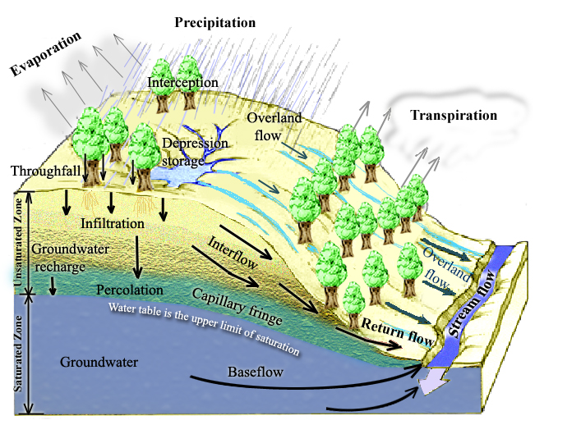
Processes involved in Runoff Generation
Notes:
Figure 1. Physical Processes involved in Runoff Generation.

Slide 2
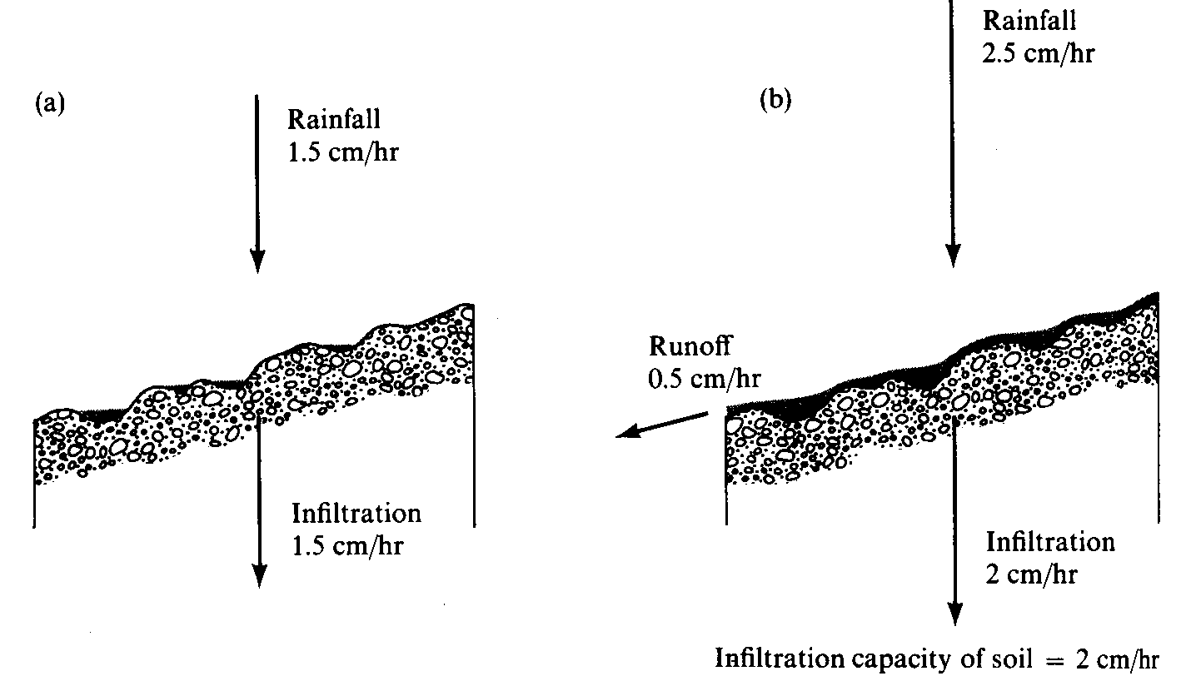
Surface Runoff occurs when surface water input exceeds infiltration capacity. (a) Infiltration rate = rainfall rate which is less than infiltration capacity. (b) Runoff rate = Rainfall intensity – Infiltration capacity. (from Dunne and Leopold, 1978)

Slide 3
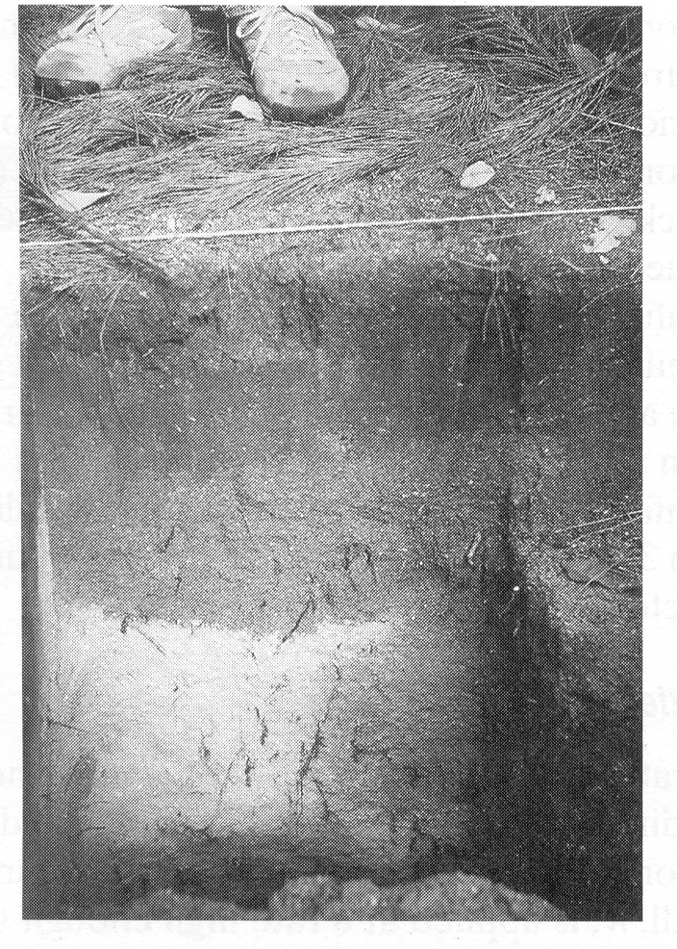
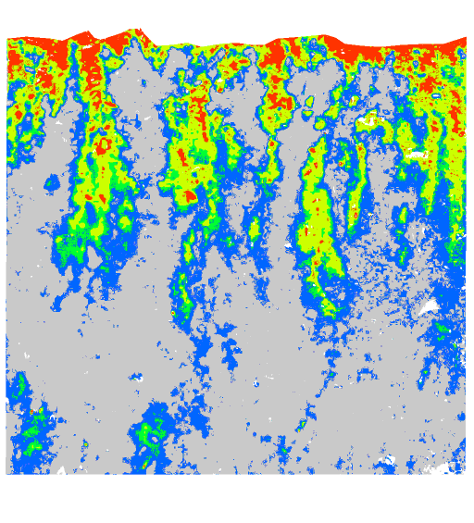
Wetting front in a sandy soil exposed after intense rain (from Dingman, 1994).
Preferential pathway infiltration (Markus Weiler, ETH Zurich)

Slide 4
Continuity equation in an unsaturated porous medium.
Δθ Δx Δy Δz =
(q Δx Δy – (q+Δq) Δx Δy) Δt

Slide 5
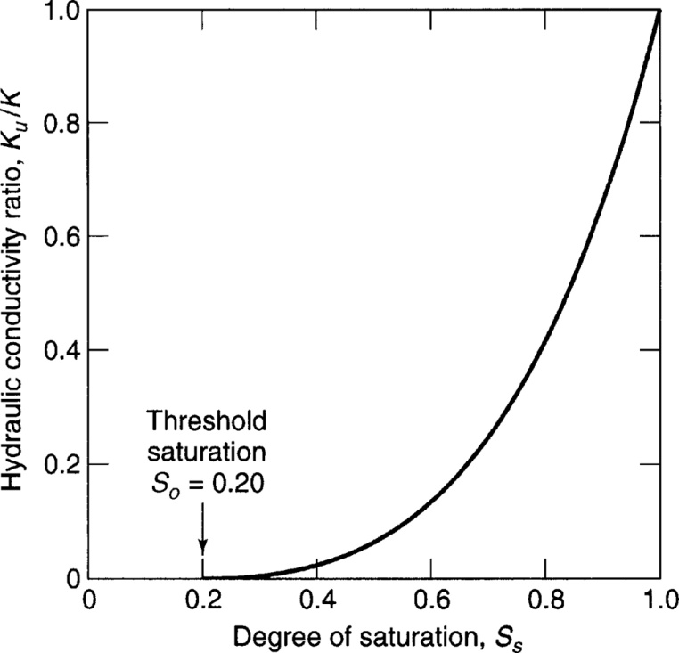
Flow in Unsaturated Soil
Hydraulic conductivity depends on moisture content
$$q=−K_{u}\left(θ\right)\frac{∂h}{∂z}$$
$$\frac{K_{u}}{K}={\left(\frac{S_{s}−S_{o}}{1−S_{o}}\right)}^{3}$$
$S_{s}$= $θ/α$
From Mays, 2011, Ground and Surface Water Hydrology

