Slide 1
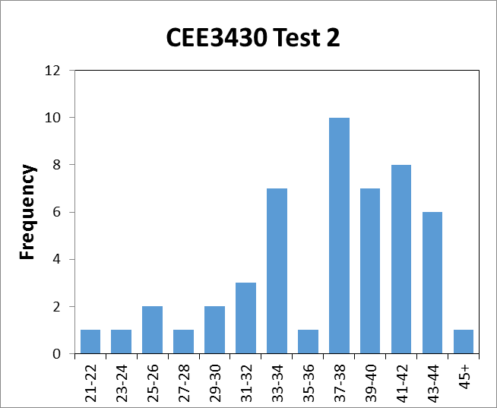
Average: 36.8
Low: 21
High: 47

Slide 2
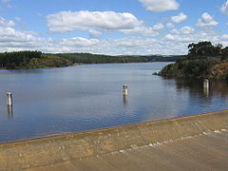
Reservoir and Streamflow Routing
How do reservoirs, stream reaches, and distributed elements alter the runoff hydrograph?
Determine the time and magnitude of flow at a point on a watercourse from known or assumed hydrographs at points upstream
Hydrologic (lumped)
Storage equation
Hydraulic (distributed)
St Venant Equations
$$\frac{dS}{dt}=I(t)−Q(t)$$

Slide 3
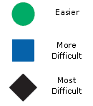
Reservoir Routing Learning objectives
Identify reservoir system components
Describe the storage continuity equation
Use the level pool method to derive reservoir output (Puls method)
Specify outlet characteristics
Route inflow through the reservoir
and outlet
Evaluate if the basin/outlet are
properly sized

Slide 4
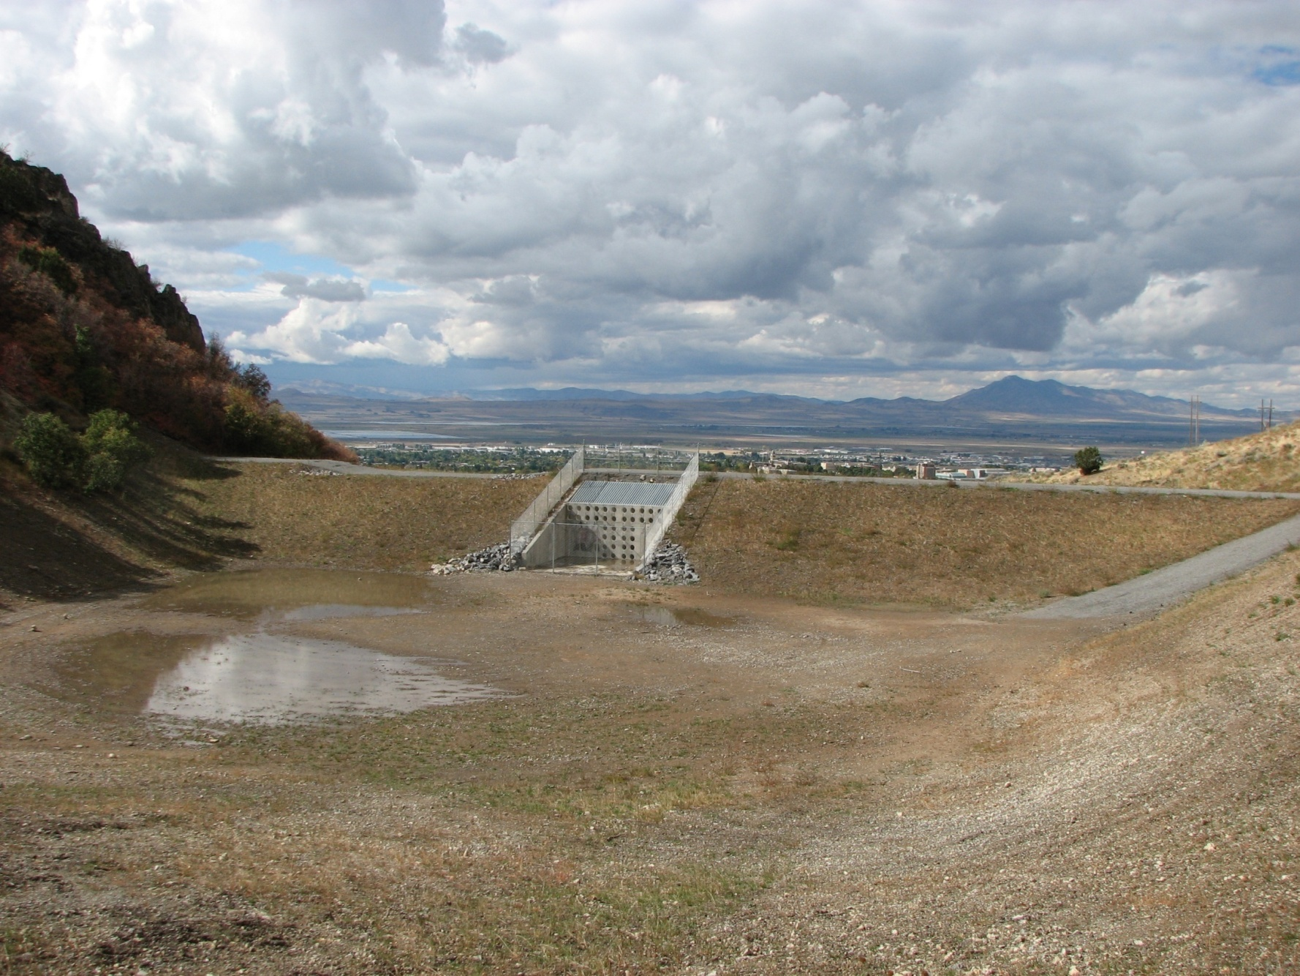
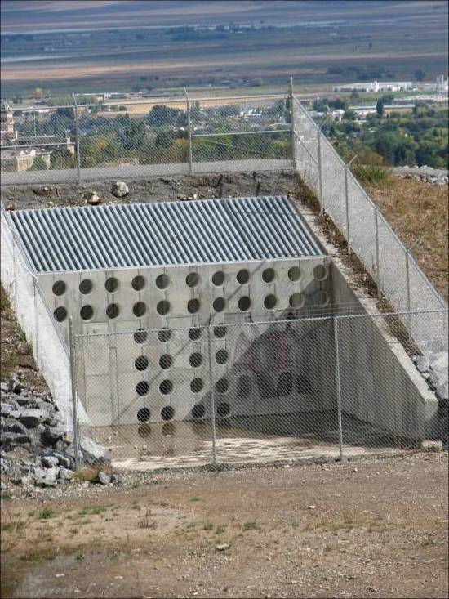
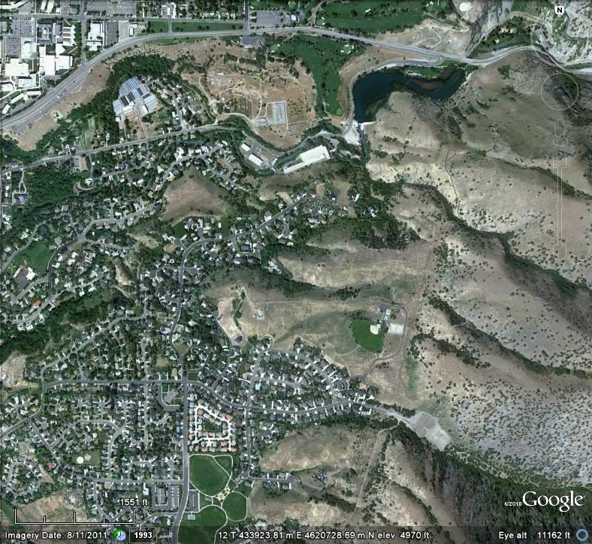
Dry Canyon, Logan Detention Basin above Cliffside Terrace

Slide 5
Outlet specification
Unmanned
Both give a stage (h) vs discharge (Q_{out}) relationship
Weir | Outlet pipe (orifice)
b = weir crest length [L] | A = cross-sectional area of orifice [L²]
C_{d} = discharge coefficient [fraction] g = gravitation constant [L/T²] h = water height above crest [L]

Slide 6
Level-Pool Routing Steps
Estimate inflow hydrograph, I(t)
Establish outlet stage-discharge relationship (h vs Q)
Establish basin stage-storage relationship (h vs S)
Establish discharge-storage relationship (Q vs S) and Q vs (2S/Δt + Q)
Start at time step 1: S₁, I₁, Q₁, I₂, Δt known
Proceed with iterative calculations

Slide 7
Conclusions
Inflows, storage characteristics, and outlet properties influence reservoir output
Combine reservoir and outlet stage-storage-output relationship and continuity equation to iteratively solve for output
Check that reservoir is properly sized!
Reservoirs can alter the magnitude and timing of the hydrograph

